Slide 1
A Formalization of
Typed Lua
DLS 2015
André Murbach Maidl (PUCPR)
Fabio Mascarenhas (UFRJ)
Roberto Ierusalimschy (PUC-Rio)

Slide 2
Typed Lua
It is an optional type system for Lua
Preserves several Lua idioms
Aims to be sound
It is a structural type system
Uses subtyping to order types
Uses consistent-subtyping to handle dynamic typing
  any <: any, but T ~ any and any ~ T

Slide 3
Typing Lua is challenging
Lua is a small scripting language
  First-class functions, extensive use of associative arrays, dynamic overloading, etc
The primary use of Lua is as an embedded PL
  DIY module systems
  DIY object models

Slide 4
We needed guidance on the design
We surveyed 2598 files from 262 different projects that are in the LuaRocks repository
  Table initialization, indexing, and iteration
  Function declarations
  Dynamic overloading
  Object-Oriented programming
  Module definitions
Novel type system features

Slide 5
Table refinement
1 function new_point (x, y)
2 local point = {}
3 point.x = x
4 point.y = y
5 point.move = function (self, dx, dy)
6 self.x = self.x + dx
7 self.y = self.y + dy
8 end
9 return point
10 end

Slide 6
Overloading on the return type
1 local function idiv (x, y)
2 if y == 0 then
3 return nil, “division by zero”
4 else
5 return x // y, x % y
6 end
7 end
8
9 local q, r = idiv(a, b)
10 if q then
11 print(a == b * q + r)
12 else
13 print(“ERROR: “ .. r)
14 end

Slide 7
Ways for refining tables
Table types
  unique, open, fixed, and closed
There are two ways to change the type of unique and open tables
  Assignment to a non-existing field
  Coercion expression

Slide 8
Assignment to a non-existing field
1 local point:{}_{unique} = {} in
2 point[“x”] <number> = x;
3 point[“y”] <number> = y
point:{}_{unique}
point:{“x”:number}_{unique}
point:{“x”:number,
“y”:number}_{unique}

Slide 9
Aliasing tables
1 local a:{}_{unique} = {} in
2 local b:{}_{closed} = a in
3 a[“x”] <string> = “foo”;
4 b[“x”] <integer> = 1
a:{}_{unique}
a:{}_{open}
b:{}_{closed}
a:{“x”:string}_{open}
b:{}_{closed}

Slide 10
Unique versus Open
1 local a:{“x”:integer}_{unique} = { x = 1 } in
2 local b:{“x”:integer}_{closed} = a in
3 local c:{“x”:integer ∪ nil}_{closed} = a in
4 c[“x”] = nil
a:{“x”:integer}_{unique}
a:{“x”:integer}_{open}
b:{“x”:integer}_{closed}
c:{“x”:integer ∪ nil}_{closed}
{“x”:integer}_{closed} <: {“x”:integer ∪ nil}_{closed}

Slide 11
Coercion expression
1 local a:{}_{unique} = {} in
2 a[“x”] <string> = “foo”;
3 a[“y”] <string> = “bar”;
4 local b:{“x”:string, “y”:string ∪ nil}_{closed} =
5 <{“x”:string, “y”:string ∪ nil}_{closed}> a in
6 a[“z”] <integer> = 1
a:{}_{unique}
a:{“x”:string, “y”:string}_{unique}
a:{“x”:string, “y”:string ∪ nil}_{open}
b:{“x”:string, “y”:string ∪ nil}_{closed}
a:{“x”:string, “y”:string ∪ nil, “z”:integer}_{open}

Slide 12
Classes and Objects
1 local point:{}_{unique} = {} in
2 point[“x”] <number> = x;
3 point[“y”] <number> = y;
4 fun point:move (self:self,
5 dx:number, dy:number):nil*
6 self[“x”] = self[“x”] + dx;
7 self[“y”] = self[“y”] + dy;
8 return;
9 return point
point:{}_{unique}
point:{“x”:number, “y”:number}_{unique}
point:{“x”:number, “y”:number
“move”:(self ⋅ number ⋅ number ⋅ nil*) → (nil*)}_{unique}
point:{ “x”:number, “y”:number
“move”:(self ⋅ number ⋅ number ⋅ nil*) → (nil*) }_{fixed}

Slide 13
Projection types
1 local q, r = idiv(a, b)in
2 if q then print(a == b * q + r)
3 else print(“ERROR: “ .. r)
idiv : (integer ⋅ integer ⋅ nil*) →
(integer ⋅ integer ⋅ nil*) ∐
(nil ⋅ string ⋅ nil*)
x:
(integer ⋅ integer ⋅ nil*) ∐
(nil ⋅ string ⋅ nil*)
q : π(x,1) ≈ integer ∪ nil
r : π(x,2) ≈ integer ∪ string
x:
(integer ⋅ integer ⋅ nil*)
q : π(x,1) ≈ integer
r : π(x,2) ≈ integer
x:
(nil ⋅ string ⋅ nil*)
q : π(x,1) ≈ nil
r : π(x,2) ≈ string

Slide 14
Assignment to projection types
1 local q, r = idiv(a, b)in
2 r = “foo”;
3 if q then print(a == b * q + r)
4 else print(“ERROR: “ .. r)
q : π(x,1) ≈ integer ∪ nil
r : π(x,2) ≈ integer ∪ string
q : π(x,1) ≈ integer
r : π(x,2) ≈ integer
q : π(x,1) ≈ nil
r : π(x,2) ≈ string

Slide 15
Conclusions
Novel type system features to type Lua idioms
  type refinement and projections
Usability
  We could type 83% of 449 members from 29 modules
Limitations and future work
  overloaded functions, generic functions, generic tables, and operator overloading
  soundness proof

Slide 16
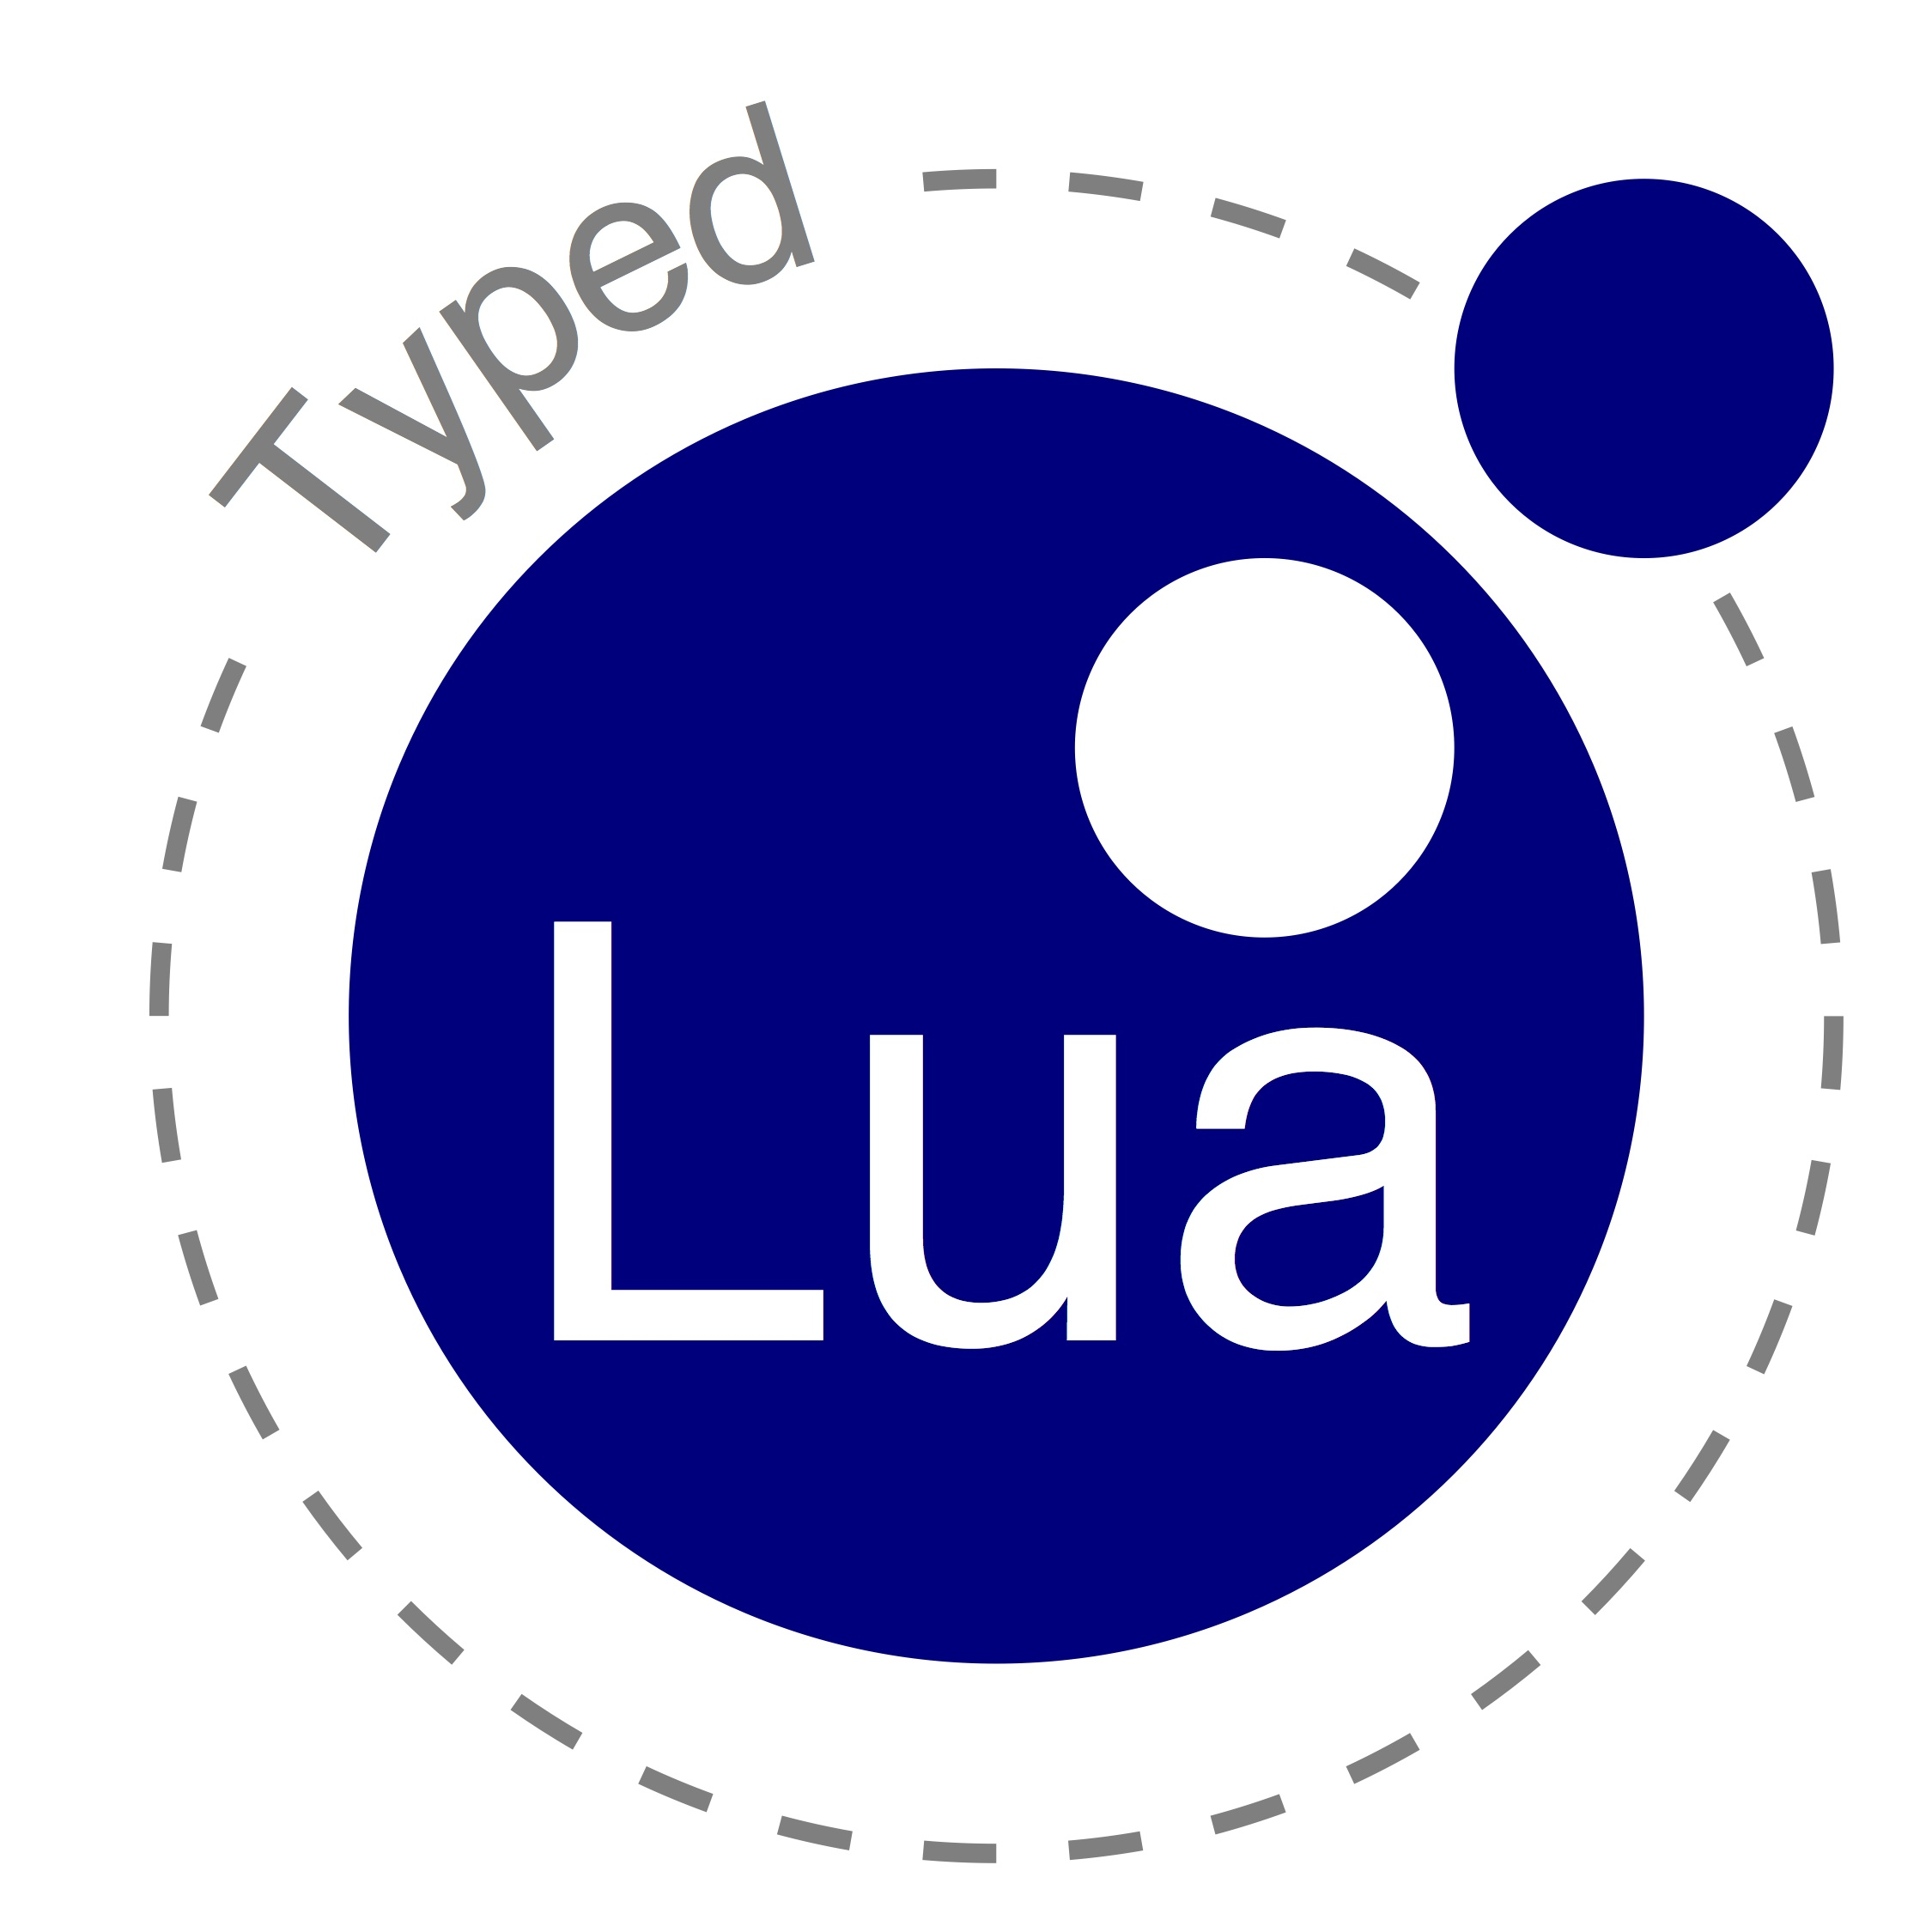
Thank you!
Typed Lua is available online:
  https://github.com/andremm/typedlua

