Slide 1

Multiple sequence Alignment Carillo-Lipman
Andrea Munarin, Davide Pizzolato, Simone Jovon
19/12/2023
Notes:
Presentations and good afternoon everyone

Slide 2
Introduction

Slide 3
Paper
The multiple sequence alignment problem in biology
Carrillo, Lipman (1988)
A tool for multiple sequence alignment
Lipman et al. (1989)
Notes:
examples and show the performance

Slide 4
Problem definition
Alignment of two sequence
Alignment of n sequence
Given a score system and a set of n sequence we are required to find the optimal alignment by inserting gaps in each string.

Slide 5


Authors
Humberto Carrillo
David J. Lipman
Universidad Nacional Autónoma de México
US National Center for Biotechnology Information (until 2017)
Author of FASTA and BLAST papers

Slide 6
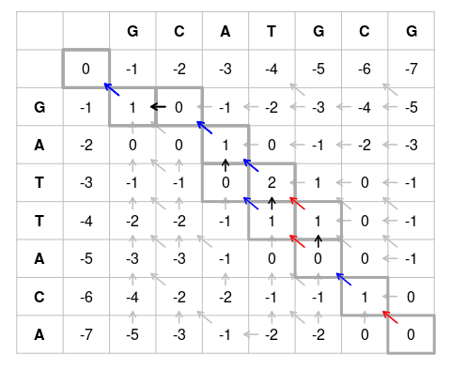
Issue with classical techniques
The pairwise alignment problem could be represented with a 2D grid.
Needleman-Wunsch dynamic programming algorithm can solve it in O(|S|²).

Slide 7
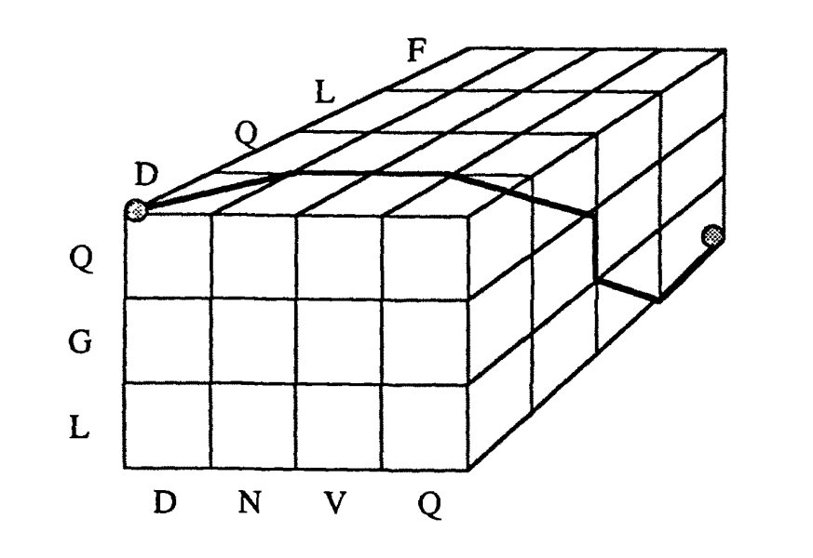
Issue with classical techniques
In a multiple sequence alignment we must build an n-dimensional hypercube using the cartesian product of the strings, and using dynamic programming the
complexity become O(2^{k} * |S|^{k})

Slide 8
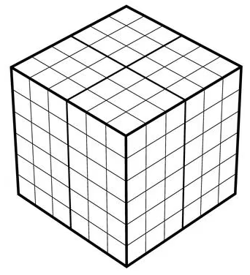
Scope of the research
The purpose of this research is to prove that it is possible to reduce the area to be analyzed without affecting too much the correctness of the algorithm.
This reduction implies fewer computations and less memory space needed.

Slide 9
Alignment, Path and Optimal Path

Slide 10
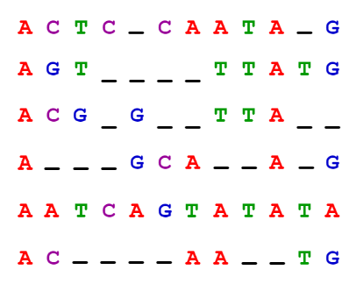
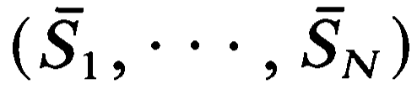
Alignment
Given a set of sequences (S₁, …, S_{N}) of the form S_{i} = (n^{i}₁, n^{i}₂, …, n^{i}_{ki},) an alignment is a new set of sequences
where every S_{i} is created by inserting gaps in S_{i}
It is also required that for each j there is at least one value of i for which n^{i}_{j} is not blank

Slide 11
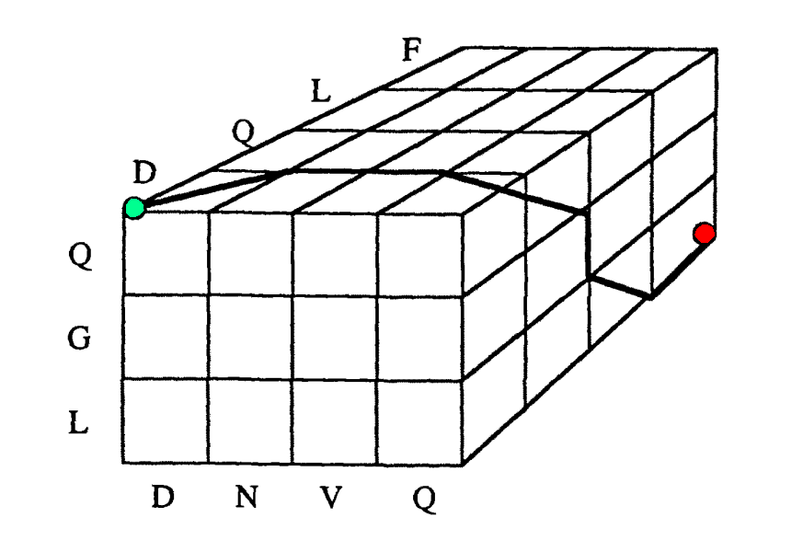
Path: Corners
Original corner: the begin of all strings
End corner: the end of all strings
In a subset L’ of L:
the original corner of L’ is the corner closest to the original corner of L
the end corner of L’ is the corner closest to the end corner of L

Slide 12
Path
A path 𝛾(S₁, S₂, …, S_{n}) between the sequences S₁ and S_{n} is a connected broken line joining the original corner to the end corner.
Every step of the path should get closer to the end point.
A path 𝛾 describe a unique alignment of the sequences and an alignment of the sequences determines a unique path.

Slide 13
Optimal Path
Choose a score system that depends only on the transformation applied.
Then assign to every path 𝛾 a measure M(𝛾) that denotes the similarity among the sequences.
In every cube L there is at least one path 𝛾* such that:
M(𝛾*) <= M(𝛾) for every 𝛾 in L

Slide 14
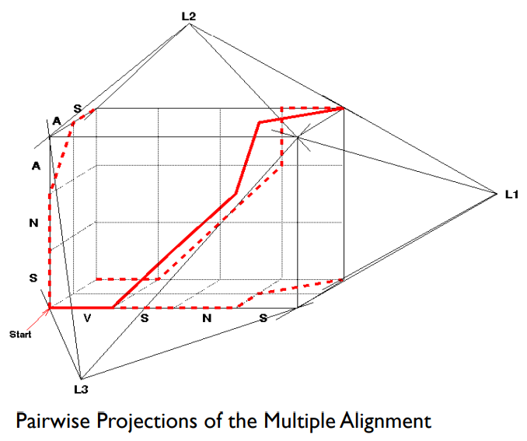
Projection of path
Two sequences in the hypercube forms a plane.
Every path in the hypercube can be projected in this plane, and creates a pairwise alignment.

Slide 15
Reduce the space of the search

Slide 16
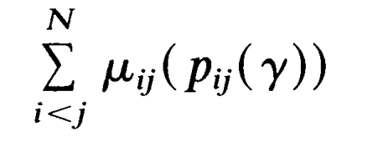
Measure of N-dimensional path
Given that the similarity between sequence S_{i} and S_{j} is expressed by the measure 𝜇_{ij} of a two-dimensional path, we have that the measure M of an N-dimensional path 𝛾 is a non-decreasing function of
where p_{ij} is the projection of 𝛾 on the plane determined by S_{i} and S_{j} .

Slide 17

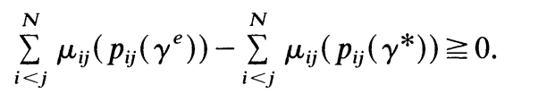
Estimated path
Given any N-dimensional path 𝛾^{e}, called 𝛾-estimated, we have that
and then

Slide 18

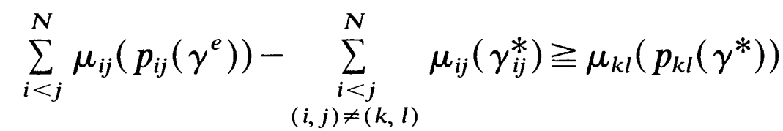
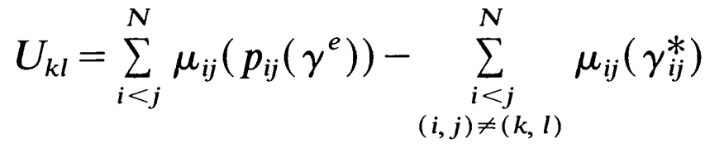
Upper bound
Let 𝛾*_{ij} denote the two-dimensional optimal path for the measure 𝜇_{ij}.
Since , we have that
So we can say that
is and upper bound for the measure of the projection, on the plane determined by S_{i} and S_{j} , of any N-dimensional optimal path.

Slide 19

Upper bound
So when we are looking for 𝛾* we can just consider those path 𝛾 that satisfy
thus we are searching 𝛾* in some subregion Y of the lattice L(S₁, … , S_{N} ).

Slide 20
Subregion Y
Y_{ij} is the set of squares of L(S_{i} ,S_{j}) that are traversed by a some path of measure
smaller or equal to U_{ij}.
Thus, the subregion Y is the set of points of the lattice L(S₁, … , S_{N} ) whose projections p_{ij} belong to Y_{ij}, for every i and j.

Slide 21
Find the estimated path

Slide 22
Importance of estimated path
The smaller the region Y, the smaller the amount of computation to find an optimal path.
To obtain a small region Y we would need to produce an estimated path 𝛾^{e} with measure close to the measure of an optimal path. This because the minimum upper bound U_{ij} occur when M(𝛾^{e}) equals the measure of an optimal path.

Slide 23
1st approach — Main idea
The first approach is based on the following observation:
If there is a path 𝛾 such that p_{ij}(𝛾) = 𝛾*_{ij} for all i, j, where 𝛾*_{ij} denotes an optimal path on the lattice L(S_{i}, S_{j}), then 𝛾 is an optimal path for the N-dimensional problem.
Therefore, the idea is to construct 𝛾^{e} in such a way that its projections p_{ij} (𝛾^{e}) are as close as possible to the optimal paths 𝛾*_{ij}.

Slide 24
1st approach — the process
As we discuss in class, we cannot build the multialignment given all the combination of optimal pair alignment:
A given set of two-dimensional optimal paths {𝛾*_{ij}} is the set of projections
of an N-dimensional path only when the paths 𝛾*_{ij} are properly compatible.
BUT, If N-1 two-dimensional paths are given, it can be guaranteed that there is at least one N-dimensional path of which they are all projections

Slide 25

1st approach — searching space
Because of the possible insertion of gaps, a set of N-1 paths 𝛾*_{ij}, chosen in a
compatible way do not necessarily determine a unique N-dimensional path that will project into them.
contains an m-dimensional region with 1 < m < N.
To determine a convenient path through this lower-dimensional subregion of L(S₁, …, S_{N}), another optimization problem must be solved.

Slide 26
1st approach — Iteration
Note that this problem can, in turn, be reduced in the same way that the original problem was to obtain a region of smaller dimension.
Repeating this procedure, the region where the optimization must be carried
out will eventually be two-dimensional.

Slide 27
1st approach — Conclusion
This method of producing an estimated path is heuristic, and there is no guarantee that the resulting path will always have a measure close to that of an optimal path.

Slide 28
2nd approach
Start with a guess of an estimated measure Me which, unlike M(𝛾^{e}), may not necessarily correspond to the measure of an actual 𝛾.
We may then determine all upper bounds using Me and proceed to compute an "optimal" path: 𝛾^{e*}.
Then:
if M(𝛾^{e*}) ≤ Me then 𝛾^{e*} is a true optimal path.
If M(𝛾^{e*}) > Me then M(𝛾^{e*}) can be used to determine the upper bounds required in the computation of 𝛾*.

Slide 29
Conclusions

Slide 30



Complexity
|Y_{ij}| = average number of hypercubes in Y_{ij}.
f_{ij} represents the size of Y_{ij} relative to the size of the entire lattice L(S_{i}, S_{j}).
|Y_{i}| is computed by considering the size of the Y_{ij} regions relative to a fixed string i and all possible j. This represents an upper bound of our region |Y| and therefore is considered by the authors the spatial and temporal complexity of the algorithm:

Slide 31
Available implementations
Has been produced an implementation written in the C programming language.
This has been tested on several machines using the UNIX system V operating system.
Even if the implementation is not public and currently available it is described in the paper that aligning five sequences, on a commonly available 32-bit personal computer, took <2 min of computation time and required <1.3 megabytes of memory.

Slide 32
References
Carrillo, Humberto, and David Lipman. "The multiple sequence alignment problem in biology." SIAM journal on applied mathematics 48.5 (1988): 1073-1082.
Lipman, David J., Stephen F. Altschul, and John D. Kececioglu. "A tool for multiple sequence alignment." Proceedings of the National Academy of Sciences 86.12 (1989): 4412-4415.

