Slide 1
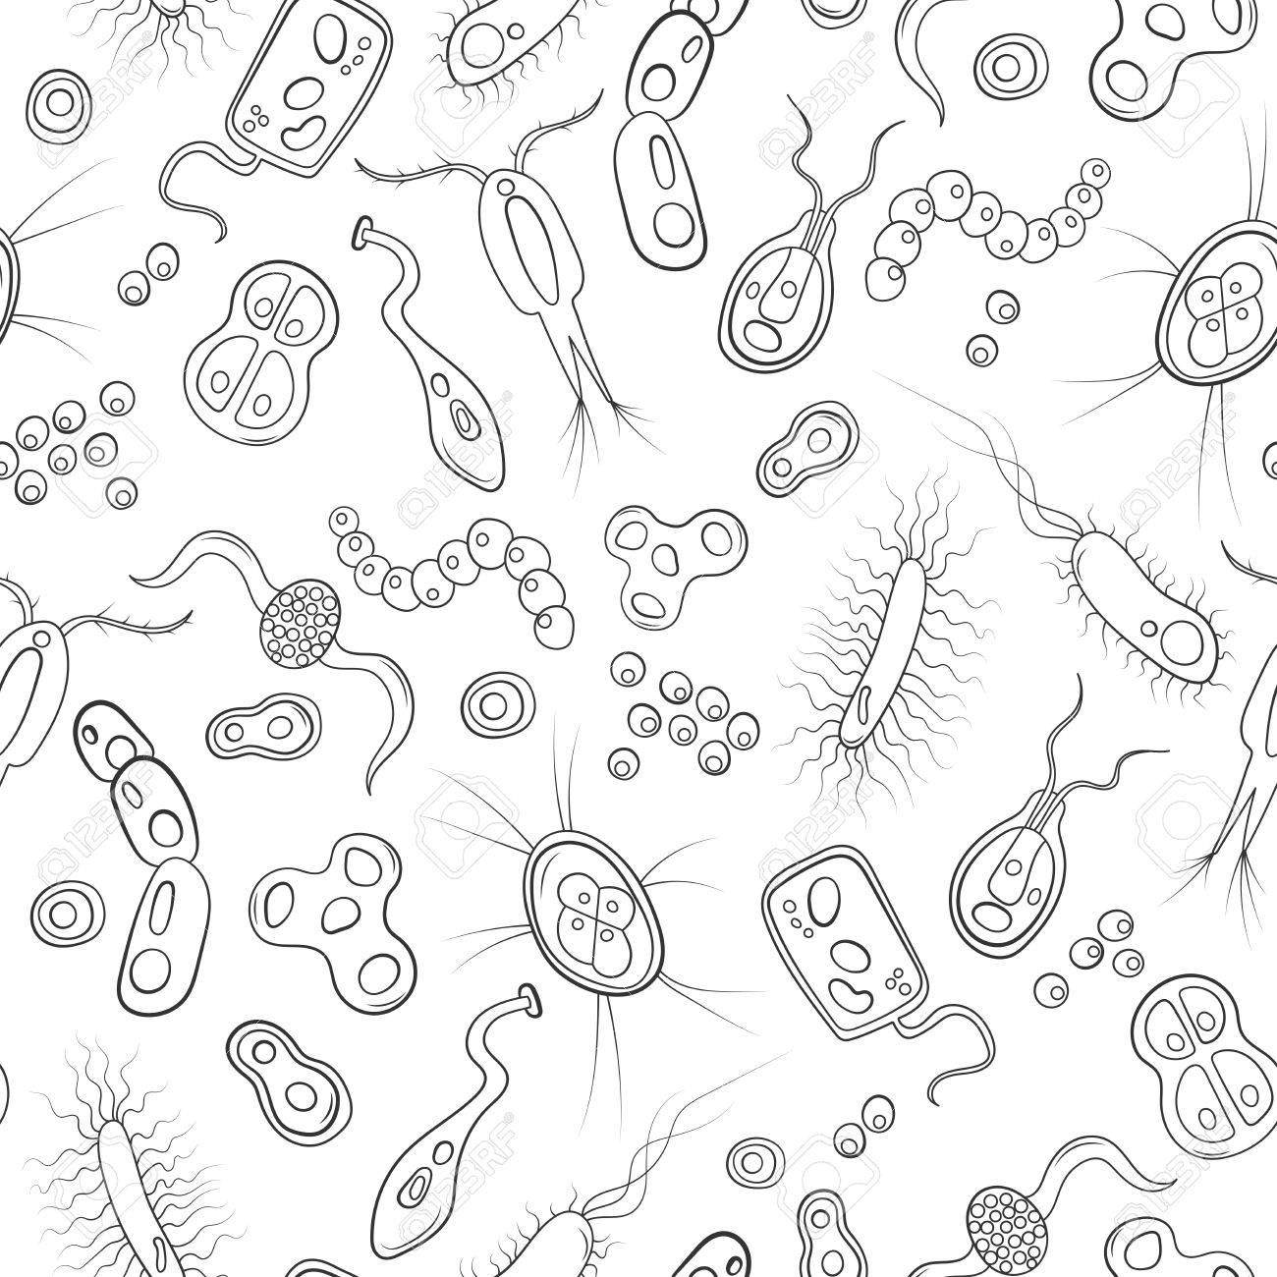
MATH.EN.JEANS
Berlin, 13/03/2018
PANDEMICS
I.S.I.S.S. ”MARCO CASAGRANDE”
Pieve di Soligo, Italy

Slide 2
The problem statement
A disease is spreading At every moment for each patient occurs that:
1) The patient could infect another entity with a certain probability
2) The patient could heal with a certain probability
3) The patient could die with a certain probability.
What could happen considering different probabilities? Is it better to vaccinate a part of the population or to isolate the population in small groups?

Slide 3
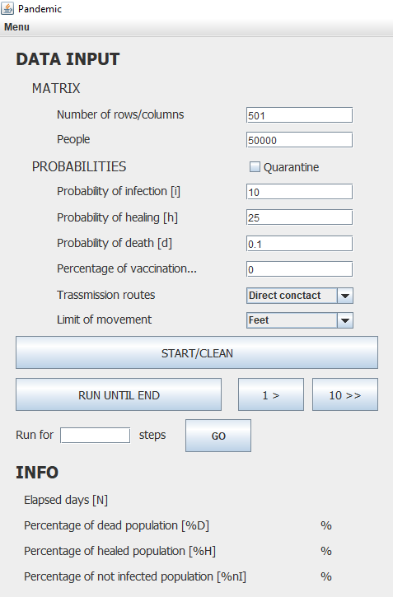
The static framework
Statistical approach with a Java numerical simulation
Contained infection on a square matrix
Setting of INPUT parameters
Transmissions routes
Limit of movement
Quarantine
These three new parameters were subsequently added and analysed
Extraction of OUTPUT parameters
Notes:
2 parole sull’input
2 colore molto velox
Mostrare programma statico!!!
Info box

Slide 4
The simulation
MAIN RULES:
The disease spreads from a single cell (zero patient)
The infection could spread the 8 adjacent cells
A cell can be infected by an adjacent infected cell
Healed cells are immune from the disease
Dead cells can not spread the disease
The development of the system occurs checking the condition of each cell.
ENDING CONDITION:
The system is left to evolve until there are no more infected entities in the matrix:
Stable matrix: n. of infected=0.

Slide 5
The colors’ logic
We have identified four different “conditions” of a single cell:
0
Healthy
White
1
Infected
Yellow
2
Healed
Green
3
Dead
Red
The state of each cell is updated every step according to the values of the parameters added in input

Slide 6
Infection spreading
1
1
0
Starting on a cell where the state is 0, we count the number n of the infected cells among the 8 adjacent.
0
0
0
The probability of infection I_{n} depends on i and n
0
0
1
3
2
1
n=
Notes:
La probabilità di infezione I_{n} dipende da i (parametro di input) e n

Slide 7


Evaluating a cumulative infection probability I_{n}
i
1-i
i(1-i)
(1-i)²
i(1-i)²
(1-i)³
This is the infection probability
$$I_{n}=1−{\left(1−i\right)}^{n}$$
$${\left(1−i\right)}^{n}$$
I.S.I.S.S. MARCO CASAGRANDE
Notes:
Probabillita di essere infettati che dipende dal num di ammalati adiacenti (<8)
N= numero degli infettati intorno
FORMA BINOMIALE
Come aumenta la porb?

Slide 8
Infection spreading and disease evolution
The infection is evaluated through the generation of a random number i’:
For a healing probability (h), created with a random generator the cell state can change in this way
If i’ ≤ I_{n} the cell state changes to 1 = infected
If cell = 1 (Infected)
If i’ > I_{n} the cell remains unaffected
= 1
= 2
= 3
Infected
healed
dead
I.S.I.S.S. MARCO CASAGRANDE
Notes:
Si calcola la prob di infezione della cella Pn in base al seguente schema, secondo una dipendenza diretta da questo N, DIPENDENDO anche dal parametro i fissato a priori.
Mediante la generazione di un num casuale viene simulato il processo di infezione
Per ogni cella viene controllata la condizione e in base a quella viene determinata l’evoluzione del sistema secondo l’alogitmo: .
Given p,N,Pn the
In base ad una prob h di guarigione (simulata con un generatore random) lo stato della cella può essere cambiato in 2 guarito o 3 morto.
lo stato rimane inalterato quando la cella 3

Slide 9
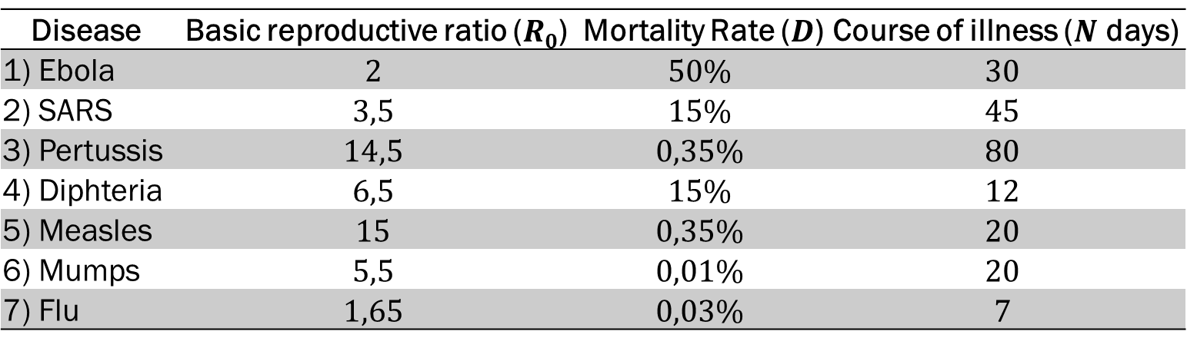
Some real diseases
Data from medical literature were used to make the simulation more realistic
→ 7 diseases have been chosen to analyse their characteristics:
The course of illness ($N$): the duration of a disease, that is the number of days after which the patient is definitely healed or dead
Disease | Basic reproductive ratio ($R0$) | Mortality Rate ($D$) | Course of illness ($N$ days)
1) Ebola | $$2$$ | $$50\%$$ | $$30$$
2) SARS | $$3,5$$ | $$15\%$$ | $$45$$
3) Pertussis | $$14,5$$ | $$0,35\%$$ | $$80$$
4) Diphteria | $$6,5$$ | $$15\%$$ | $$12$$
5) Measles | $$15$$ | $$0,35\%$$ | $$20$$
6) Mumps | $$5,5$$ | $$0,01\%$$ | $$20$$
7) Flu | $$1,65$$ | $$0,03\%$$ | $$7$$
The mortality rate ($D$): the percentage of deaths in a given area, assumed as the cumulative probability to be death after N days from the contagion
The basic reproductive ratio ($R0$): the average number of cases a single patient generates over the course of the infectious period (assumed as the whole duration of the disease)
Notes:
Sono stati utlizzati dei dati di percentuale reale

Slide 10
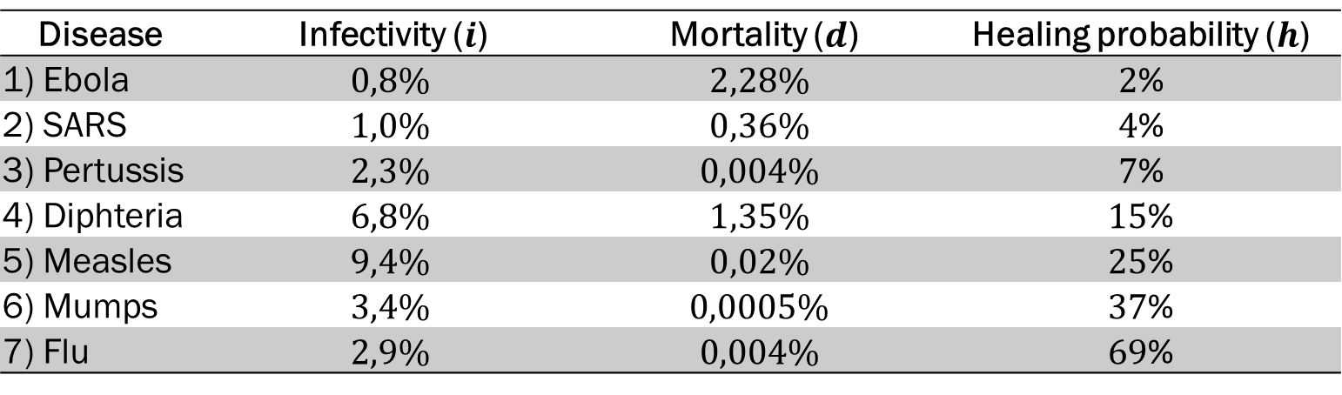
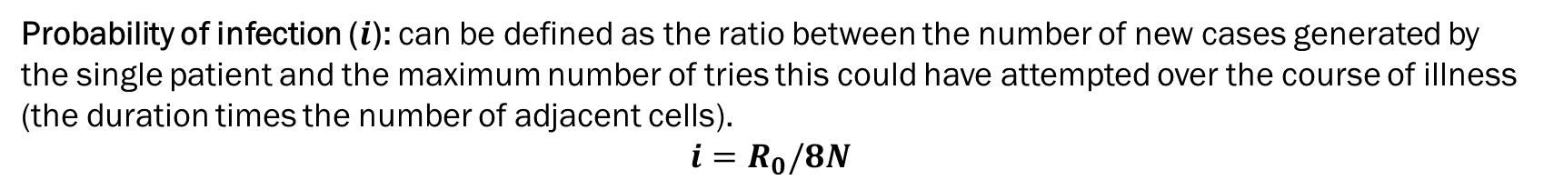
From diseases to probabilities
From these raw data we tried to derive formulas for the relevant probabilities with the following reasonings.
Probability of infection ($i$): can be defined as the ratio between the number of new cases generated by the single patient and the maximum number of tries this could have attempted over the course of illness (the duration times the number of adjacent cells).
$$i=R_{0}/8N$$
Disease | Infectivity ($i$) | Mortality ($d$) | Healing probability ($h$)
1) Ebola | $$0,8\%$$ | $$2,28\%$$ | $2$%
2) SARS | $$1,0\%$$ | $$0,36\%$$ | $4$%
3) Pertussis | $$2,3\%$$ | $$0,004\%$$ | $7$%
4) Diphteria | $$6,8\%$$ | $$1,35\%$$ | $15$%
5) Measles | $$9,4\%$$ | $$0,02\%$$ | $25$%
6) Mumps | $$3,4\%$$ | $$0,0005\%$$ | $37$%
7) Flu | $$2,9\%$$ | $$0,004\%$$ | $69$%
Probability of death ($d$): by reversing the reasoning shown before for the cumulative infectivity $I_{n}$ by $n$ nearby infectious patients, this probability can be derived as follows.
$$D=1−{\left(1−d\right)}^{N}→d=1−\sqrt[N]{1−D}$$
Probability of healing ($h$): can be defined in the same way, just assuming the cumulative healing rate to be complementary to the mortality one.
$H=1−D→h=1−\sqrt[N]{1−H}=1−\sqrt[N]{D}$
Notes:
Dati in rete riguardo alle malattie. Poi calcolo delle nostre probabilità

Slide 11
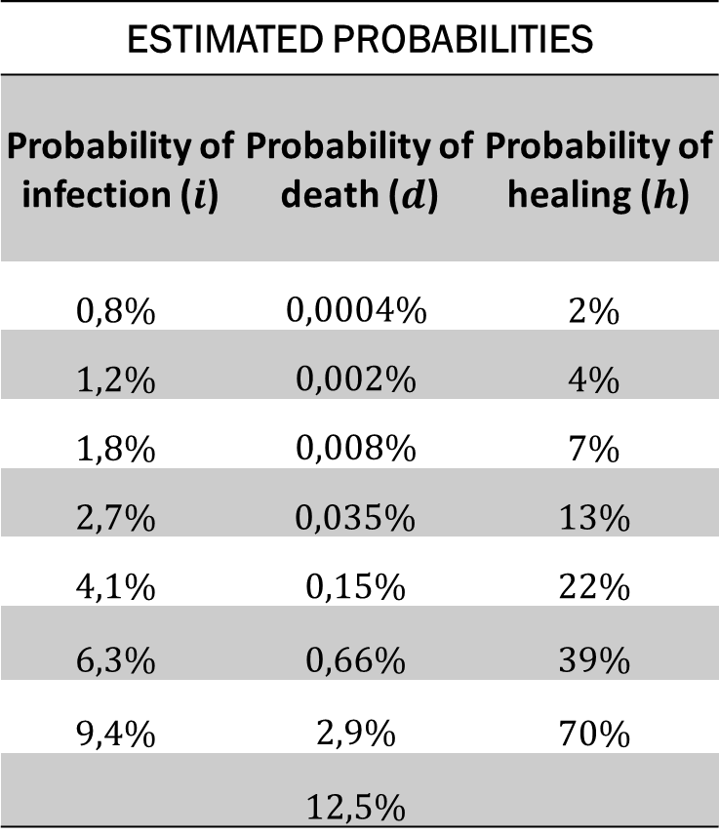
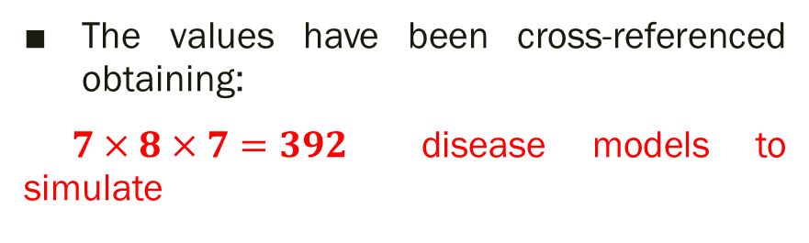
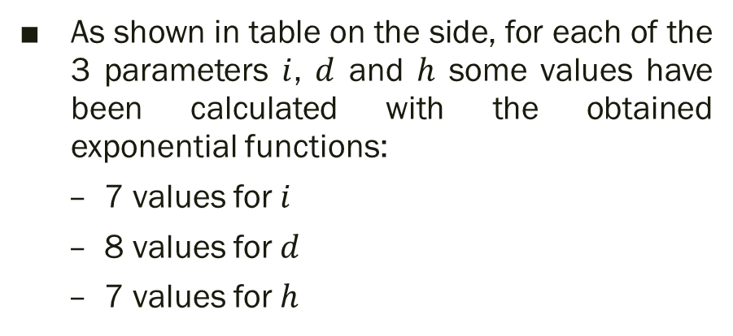
The estimated probabilities
As shown in table on the side, for each of the 3 parameters $i$, $d$ and $h$ some values have been calculated with the obtained exponential functions:
7 values for $i$
8 values for $d$
7 values for $h$
ESTIMATED PROBABILITIES
Probability of infection ($i$) | Probability of death ($d$) | Probability of healing ($h$)
$$0,8\%$$ | $$0,0004\%$$ | $$2\%$$
$$1,2\%$$ | $$0,002\%$$ | $$4\%$$
$$1,8\%$$ | $$0,008\%$$ | $$7\%$$
$$2,7\%$$ | $$0,035\%$$ | $$13\%$$
$$4,1\%$$ | $$0,15\%$$ | $$22\%$$
$$6,3\%$$ | $$0,66\%$$ | $$39\%$$
$$9,4\%$$ | $$2,9\%$$ | $$70\%$$
 | $$12,5\%$$
Despite these values are arbitrary they cover with greater density the «low value» zones of the parameter space, where most real diseases are expected to be found
The values have been cross-referenced obtaining:
$7×8×7=392$ disease models to simulate

Slide 12


The data collection
Given the random nature of the phenomenon, in order to get a significative statistics with fairly stable behaviours, the simulation has been ran $100$ times over a $501×501$ cells matrix, for each disease model. After each run, the following $4$ data have been extracted:
The percentage of not-infected patients ($NI$)
The percentage of dead patients ($D$)
The percentage of healed patients ($H$)
The number of days spent (cycles ran) before stability ($N$)
For each simulated model the $100$ values obtained for each of the aforesaid parameters have been used to calculate an average value and the corresponding standard deviation $σ$
Given the great number of parameters involved, in order to compare the data output with the input probabilities, the resulting data have been analysed using pivot tables.
Notes:
Scarto quadratico medio, deciazione standard

Slide 13
The course of the pandemic
i (%)

Slide 14
The mortality rate
i (%)

Slide 15

Some simple results
Firstly…
If $i$ is high enough to infect approximately all the population, the relation between H and D stands as:
$$\frac{H}{D}≃\frac{h}{d}$$
Decreasing $i$ this stable behaviour is quickly lost with variable results

Slide 16


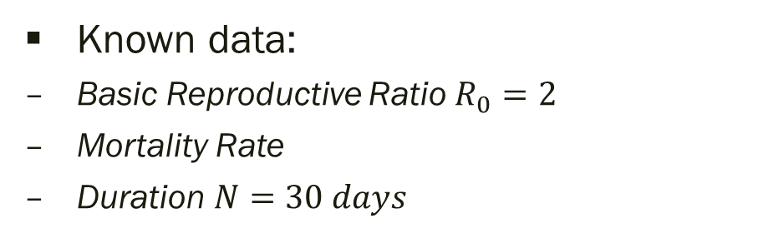

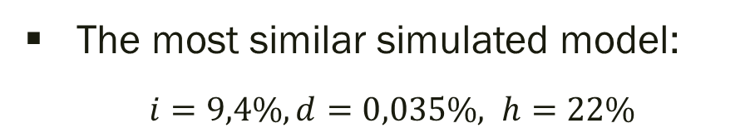

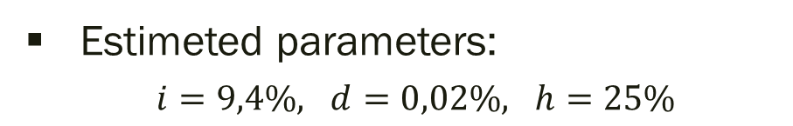

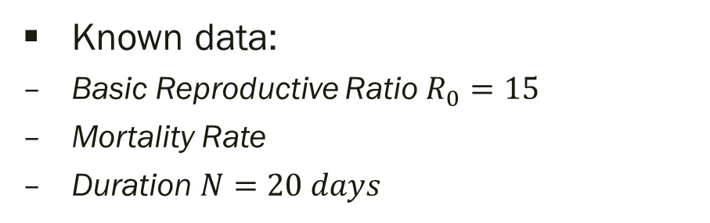
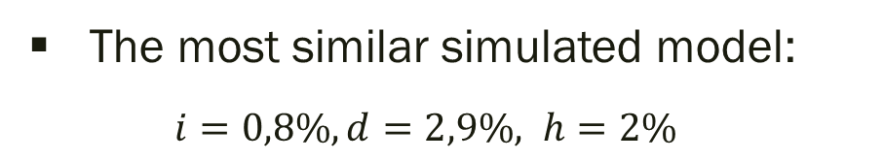
A check with some real diseases
Measles
Ebola
Known data:
Basic Reproductive Ratio $R_{0}=15$
Mortality Rate
Duration $N=20 days$
Known data:
Basic Reproductive Ratio $R_{0}=2$
Mortality Rate
Duration $N=30 days$
$$D=0,035\%$$
$$D=50\%$$
Estimeted parameters:
$i=9,4\%, d=0,02\%, h=25\%$
Estimeted parameters:
$i=0,8\%, d=2,28\%, h=2\%$
The most similar simulated model:
$i=9,4\%, d=0,035\%, h=22\%$
The most similar simulated model:
$i=0,8\%, d=2,9\%, h=2\%$
→ Estimated mortality rate
→ Estimated mortality rate
$$D= 0,157\%$$
$$D=67,5\%$$

Slide 17
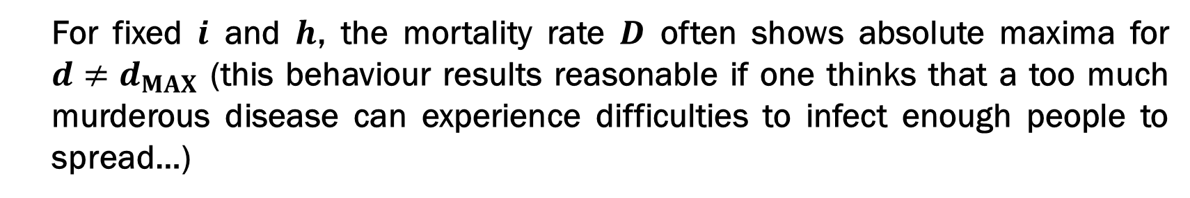
Some simple results
The mortality rate graphs have been analysed fixing 2 of the 3 input probabilities each time, and studying the obtained data as a function of the third one.
Two different kind of results have been obtained.
For fixed $i$ and $d$, the mortality rate $D$ decreases monotonically with increasing $h$
For fixed $i$ and $h$, the mortality rate $D$ often shows absolute maxima for $d≠d_{MAX}$ (this behaviour results reasonable if one thinks that a too much murderous disease can experience difficulties to infect enough people to spread…)

Slide 18
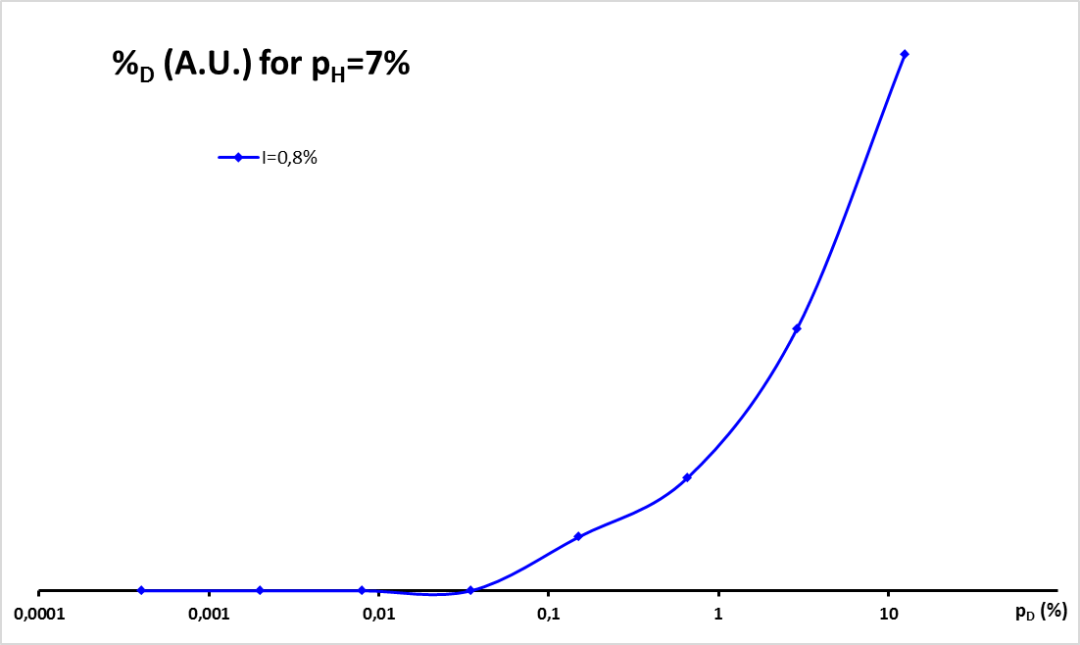
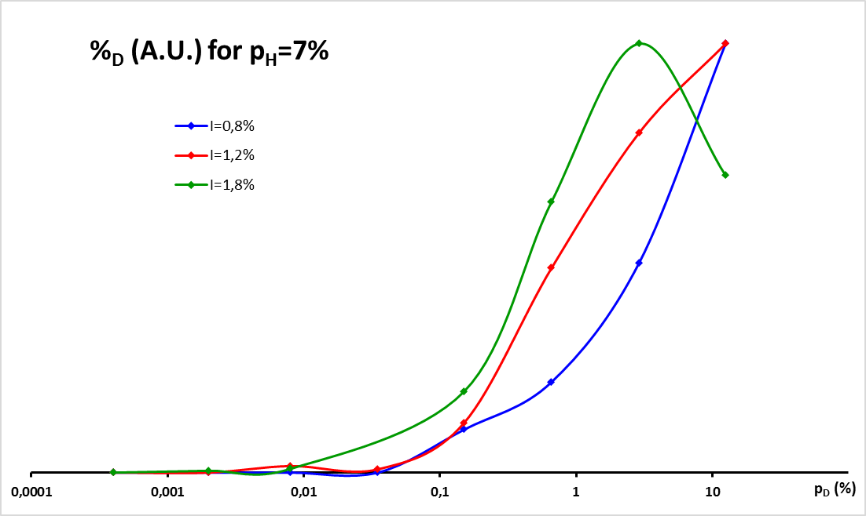
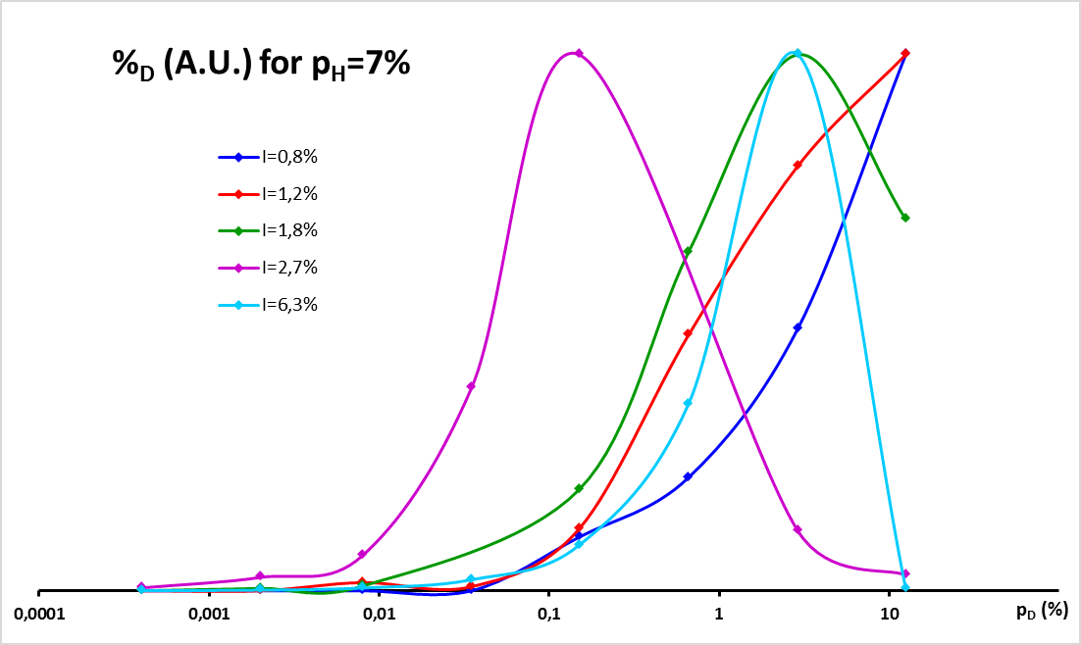
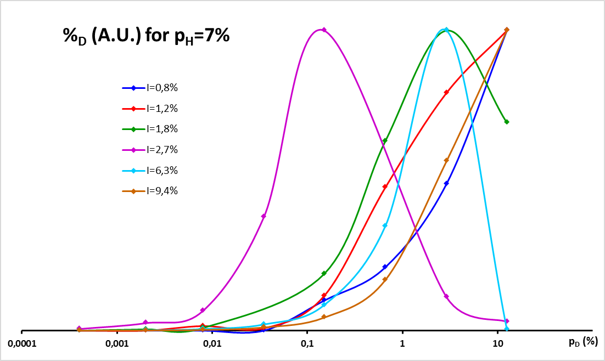
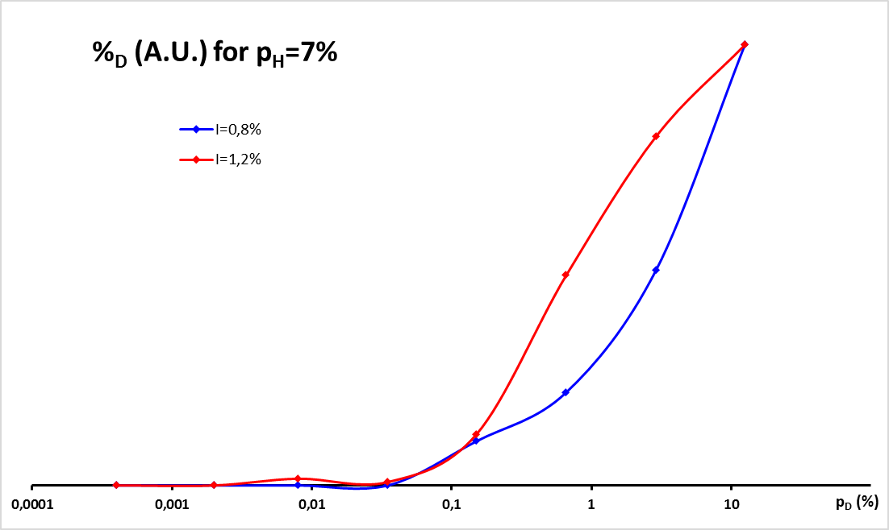
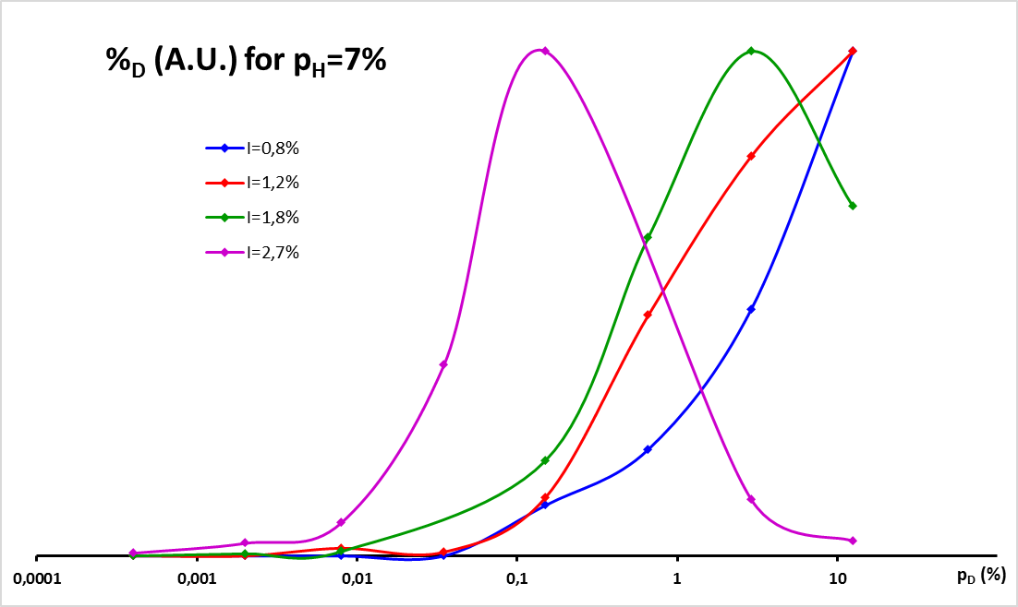

$D$ vs $d$ for fixed $h$ and various $i$

Slide 19
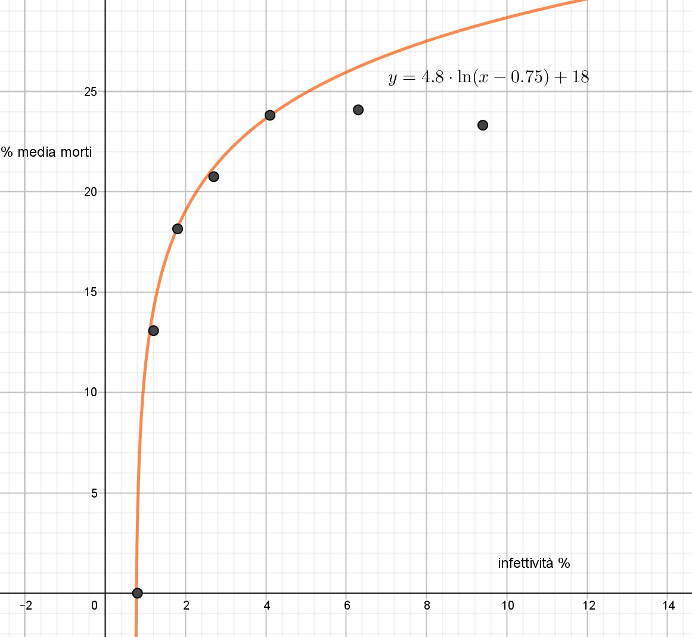
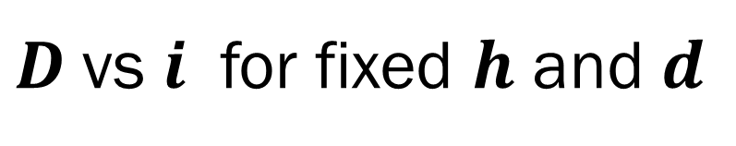


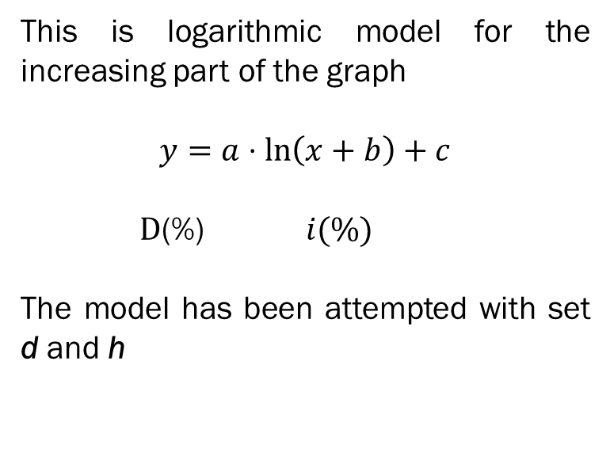
Some interesting fits I
$$D$$
$D$vs $i$ for fixed $h$ and $d$
This is logarithmic model for the increasing part of the graph
$$y=a⋅\ln\left(x+b\right)+c$$
$\text{D}\text{(\%)} i(\%)$
The model has been attempted with set d and h
$$i$$

Slide 20
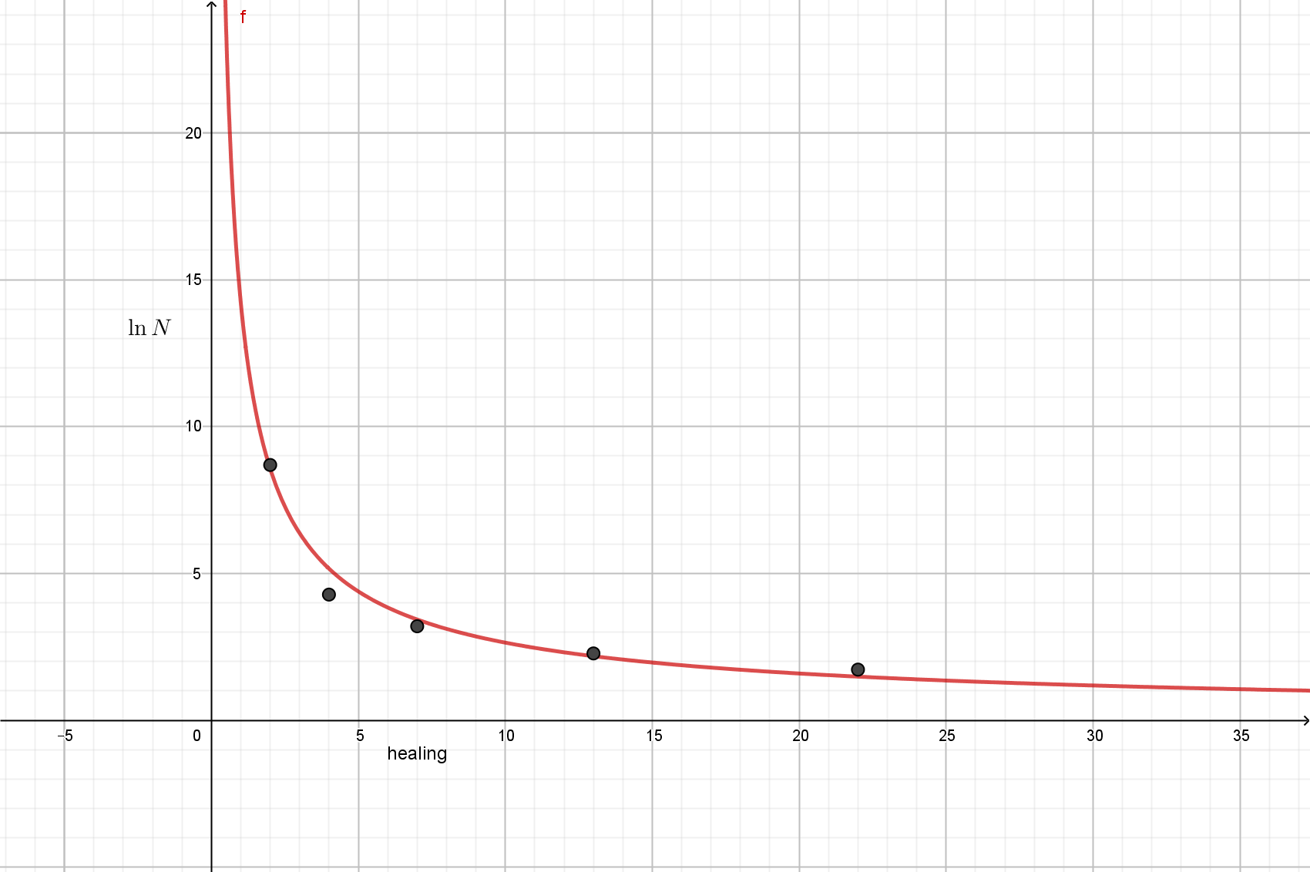
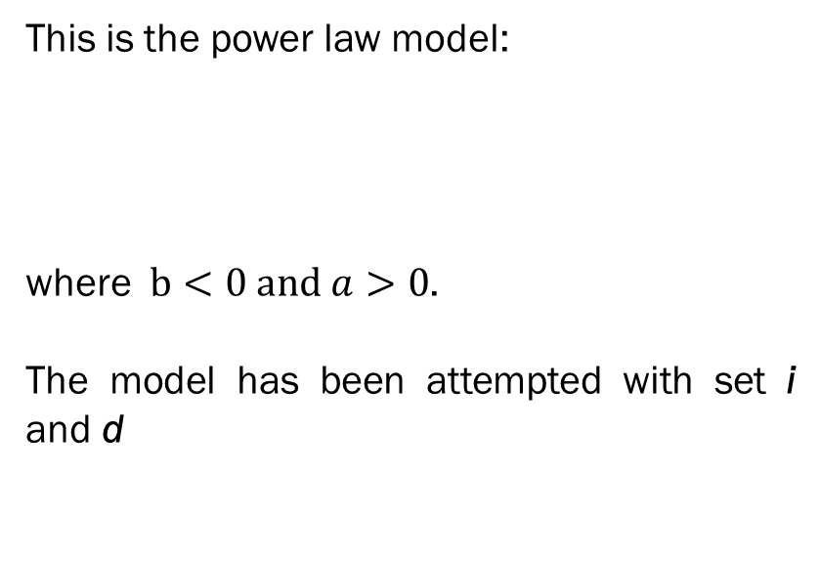

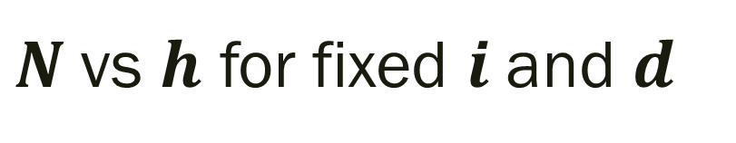


$N$vs $h$ for fixed $i$and $d$
Some interesting fits II
$$N$$
This is the power law model:
where $b<0 and a>0$.
The model has been attempted with set i and d
$$\ln{N=a∙h^{b}}$$
$$h$$

Slide 21
Vaccination
For simulating the effect of a vaccination we can choose a %V (vaccination percentage) which describe the density of vaccinated people inside the matrix allocated with a random distribution
0
Healthy
White
1
Infected
Yellow
2
Healed
Green
3
Dead
Red
4
Immunized
Blue
We simulated a «measles-like» disease (i=10%, d=0,1% e h=25%) with increasing percentages of immunized people (0 to 99%) each run 100 times
Notes:
Mostrare programma statico +vacc!!!

Slide 22
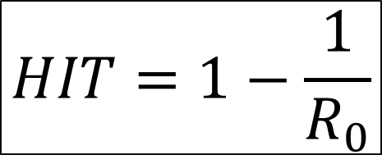
Herd Immunity Threshold (HIT)
HIT = percentage of population that must be immunized in order to stop the spreading of the disease:
$$HIT=1−\frac{1}{R_{0}}$$
This value must be compared with the one obtained from the simulation

Slide 23

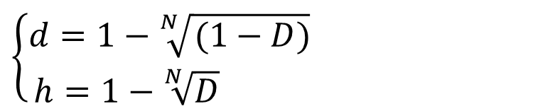
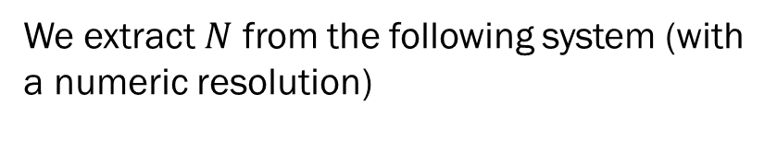
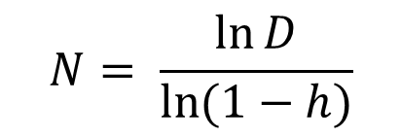
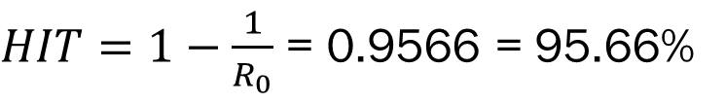
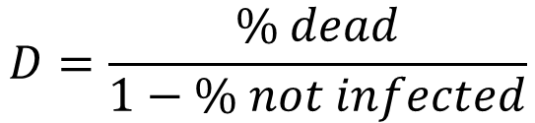


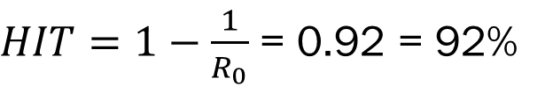
Estimation of HIT for a measles-like disease
Theoretical estimation
Data estimation
We extract $N$ from the following system (with a numeric resolution)
With the 0%v file’s data we calculate
$$D=\frac{\% dead}{1−\% not infected}$$
$$\left\{\begin{aligned}d=1−\sqrt[N]{(1−D)} \\ h=1−\sqrt[N]{D} \end{aligned}\right.$$
Thus
Then we find $R_{0}$
$$N= \frac{\ln{D}}{\ln{(1−h)}}$$
$i= \frac{R_{0} }{8N} \overset{⇒}{ }$ $R_{0}=8Ni$
And so
And as shown before we find $R_{0}$ and so
$HIT=1−\frac{1}{R_{0}}$ = 0.92 = 92%
$HIT=1−\frac{1}{R_{0}}$ = 0.9566 = 95.66%
Notes:
-Rinfrescata sulle variabili utili in questa slide
-ricorda che per hit serve r0

Slide 24
Movement
In order to simulate a more realistic behaviour, the algorithm has been modified to include the movement of people and different kinds of transmission modes
-1
Empty Cell
Black
0
Healthy
White
1
Infected
Yellow
2
Healed
Green
3
Dead
Red
4
Immunized
Blue
At the beginning of every step, before considering the evolution of the disease, the movement of people to empty cells of the matrix is computed with a random generator
Notes:
Mostrare programma statico mov+vacc!!!

Slide 25
Movement and ways of trasmission
WAYS OF MOVEMENT
Static
Walking (max 100 per axis)
Bike (max 200 per axis)
Car (max 400 per axis)
WAYS OF TRANSMISSION
Direct infection (r = 1 cell)
Droplet (r=5 cells)
Air (r=10 cells)
Vector (animals) (r = 20 cells)

Slide 26
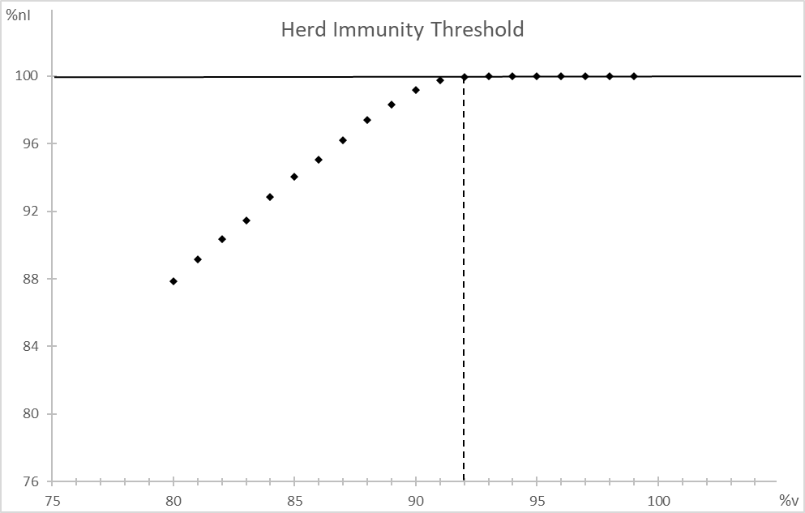
HIT in a more realistic model
«Measles-like» disease
(i=10%, d=0,1% e h=25%) with:
vaccination (80-99%),
movement (Car, 400 cells)
infection radius (Animals, 20 cells)
HIT= 92%
It is found that HIT in the static model is quite similar to the one evaluated in this model

Slide 27

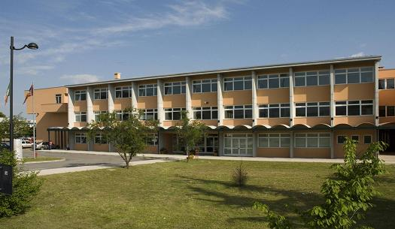

Thanks for your attention
The Pandemic Group
Teachers
Fabio Breda
Francesco Maria Cardano
Francesco Zampieri
Students
Simone Boscaratto
Leonardo Breda
Anna De Biasi
Francesco Luigi De Faveri
Bianca Della Libera
Beatrice Gatti
Yui Man Kwan
Marco Micheletto
Andrea Munarin
Erica Piccin
Camilla Viviani

