Slide 1
1542 BINDSHELL METASPLOITABLE ROOT SHELL
Wasawas, Andre Nikko
Betia, Norien

Slide 2
1524-BINDSHELL
Bind shell is a type of shell in which the target machine opens up a communication port or a listener on the victim machine and waits for an incoming connection. The attacker then connects to the victim machine’s listener which then leads to code or command execution on the server.

Slide 3
STEPS
Connect to a Network.
Open VirtualBox and run Metasploitable also Kali.
Find the Ip addresses for Metasploble and Kali by using ifconfig command.
Then ping those Ip address to make sure that it’s reachable.
Open Zenmap to scan the target Ip address .

Slide 4
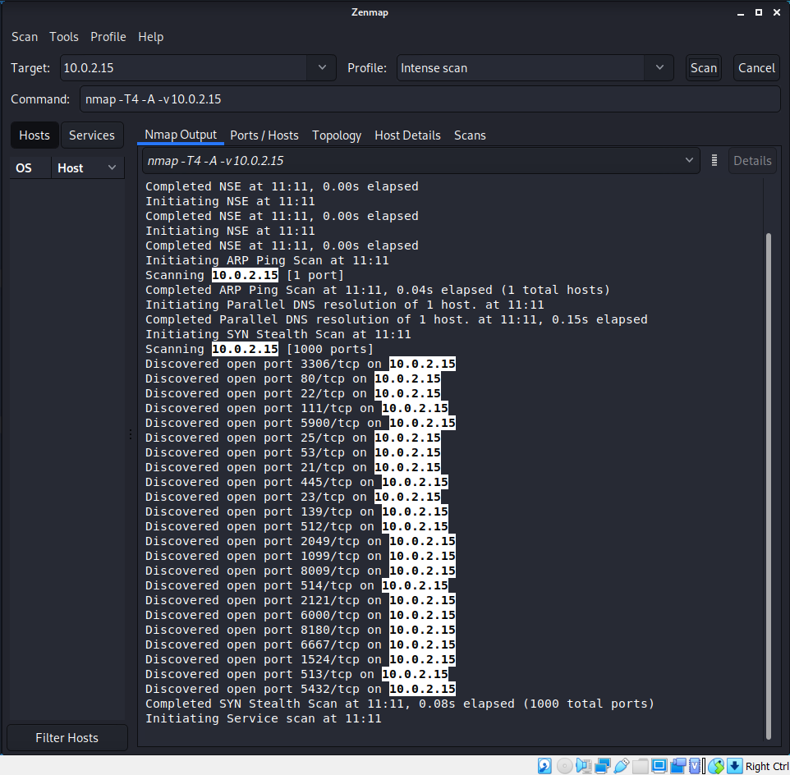
SCAN TARGET IP ADDRESS

Slide 5
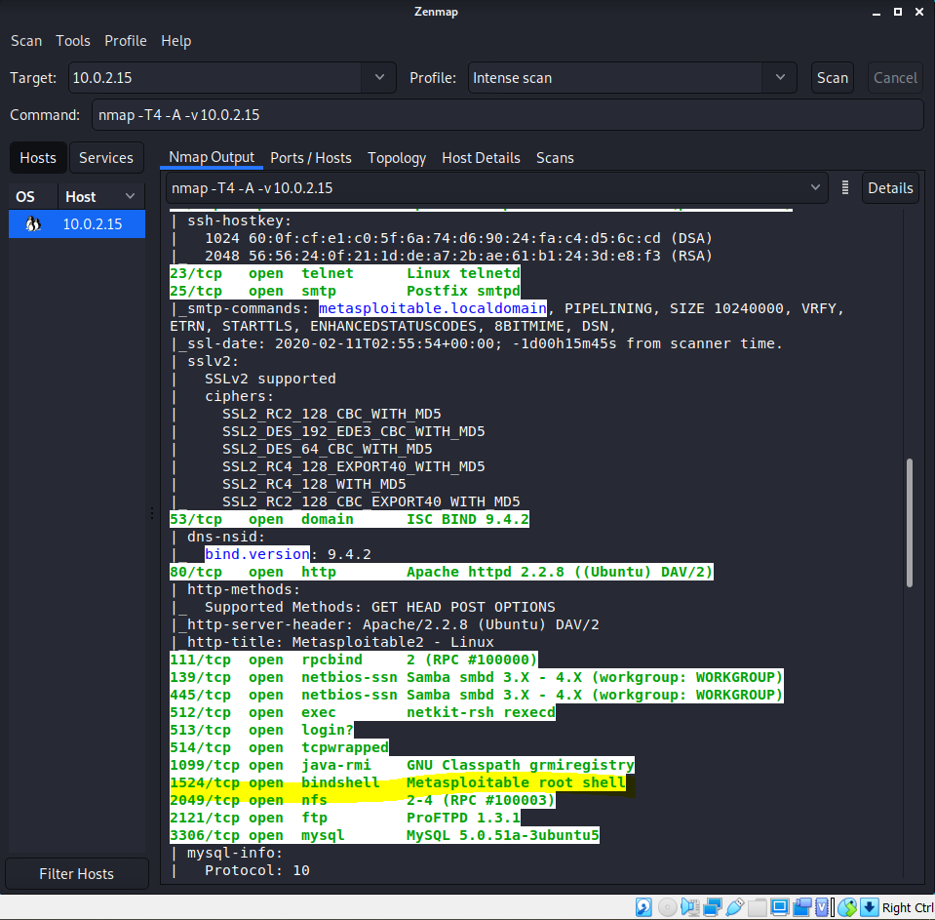

Slide 6
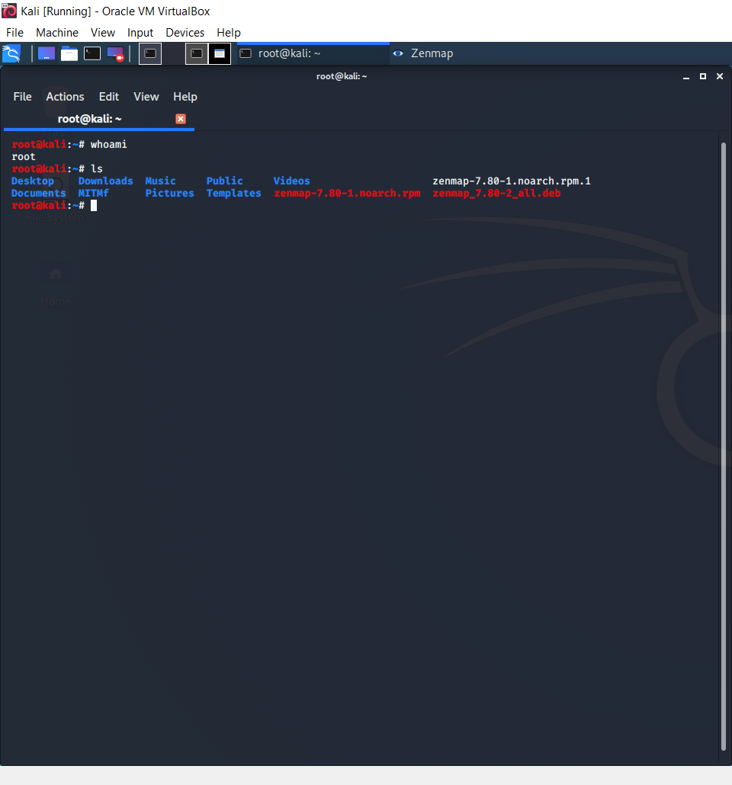
Check your root

Slide 7
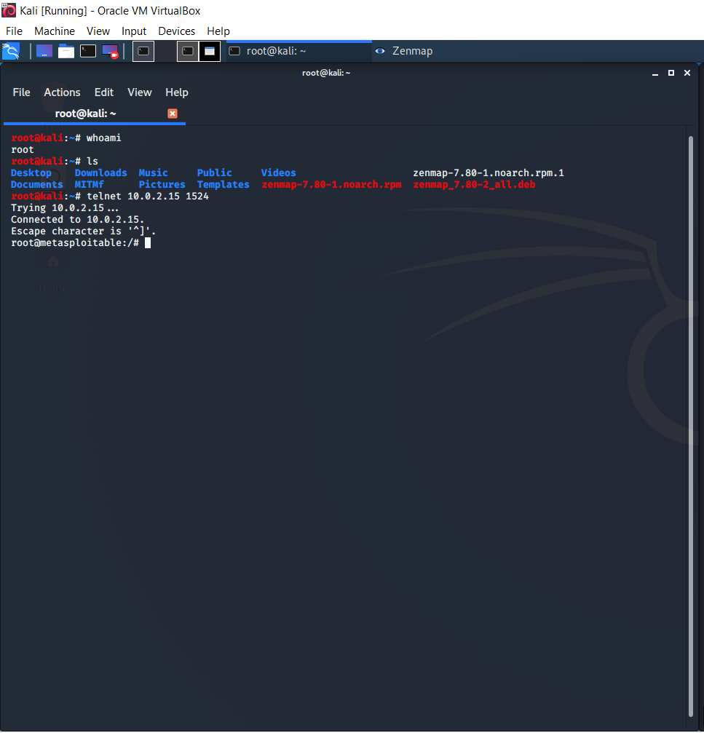
Start Metasploitable Root Shell Exploit

Slide 8
Exploitation
It is a root shell so we can connect through netcat service or telnet.
nc <target ip address> 1524 or
telnet <target ip address> 1524

Slide 9
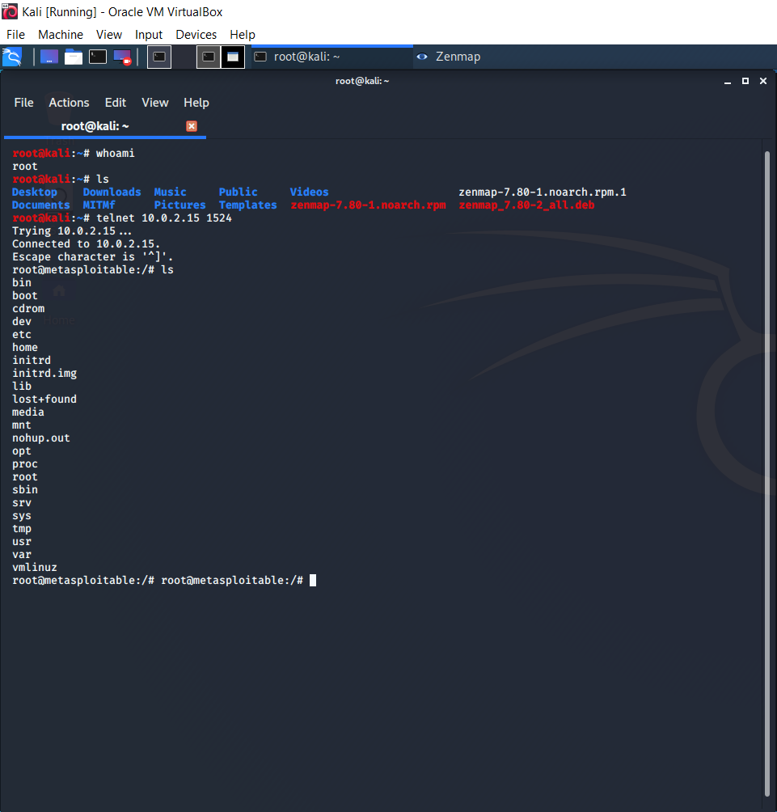
YOU ARE A METASPLOITABLE USER NOW.

