Slide 1


Slide 2
InsurXRP
Konstantinos Andreou
Stelios Symeonides
A Smart Contract on XRP EVM Sidechain, which aims to prevents loosing funds, from miss-typed wallet address.
Chainanalysis estimates more than $3.8 billion of crypto was lost last year alone.

Slide 3

Relief from Stress – Use InsurXRP dApp
Most people say that they feel stress when sending big amounts throught crypto. Since if any error or misstyped address, can lead to lost of funds. What if there is a dApp to relief from this Stress? Get back your crypto if the receiver doesn’t claim it!

Slide 4
InsurXRP Transaction Security Features
Integration with XRP EVM SideChain:
Enhancing Transaction Security: By seamlessly integrating with the XRP EVM SideChain, InsurXRP elevates transaction security through the implementation of intelligent smart contracts.
Advanced Authentication Layer:
Precision in Fund Access: InsurXRP establishes an advanced layer of authentication, ensuring that only the designated recipient possesses the authorization to claim and access the transferred funds.
Sender Empowerment for Flexible Fund Retrieval:
Dynamic Fund Control: InsurXRP empowers senders with the flexibility to reclaim funds at any point in time if the recipient has not initiated the claiming process. This feature exemplifies the platform's commitment to maintaining control and security throughout the entire transaction lifecycle.
Recipient Interaction for Fund Claiming:
User-Initiated Verification: To facilitate fund claiming, recipients actively engage with our smart contract by inputting the sender-defined secret number and their respective wallet address. This interactive process enhances precision and reinforces user verification.

Slide 5
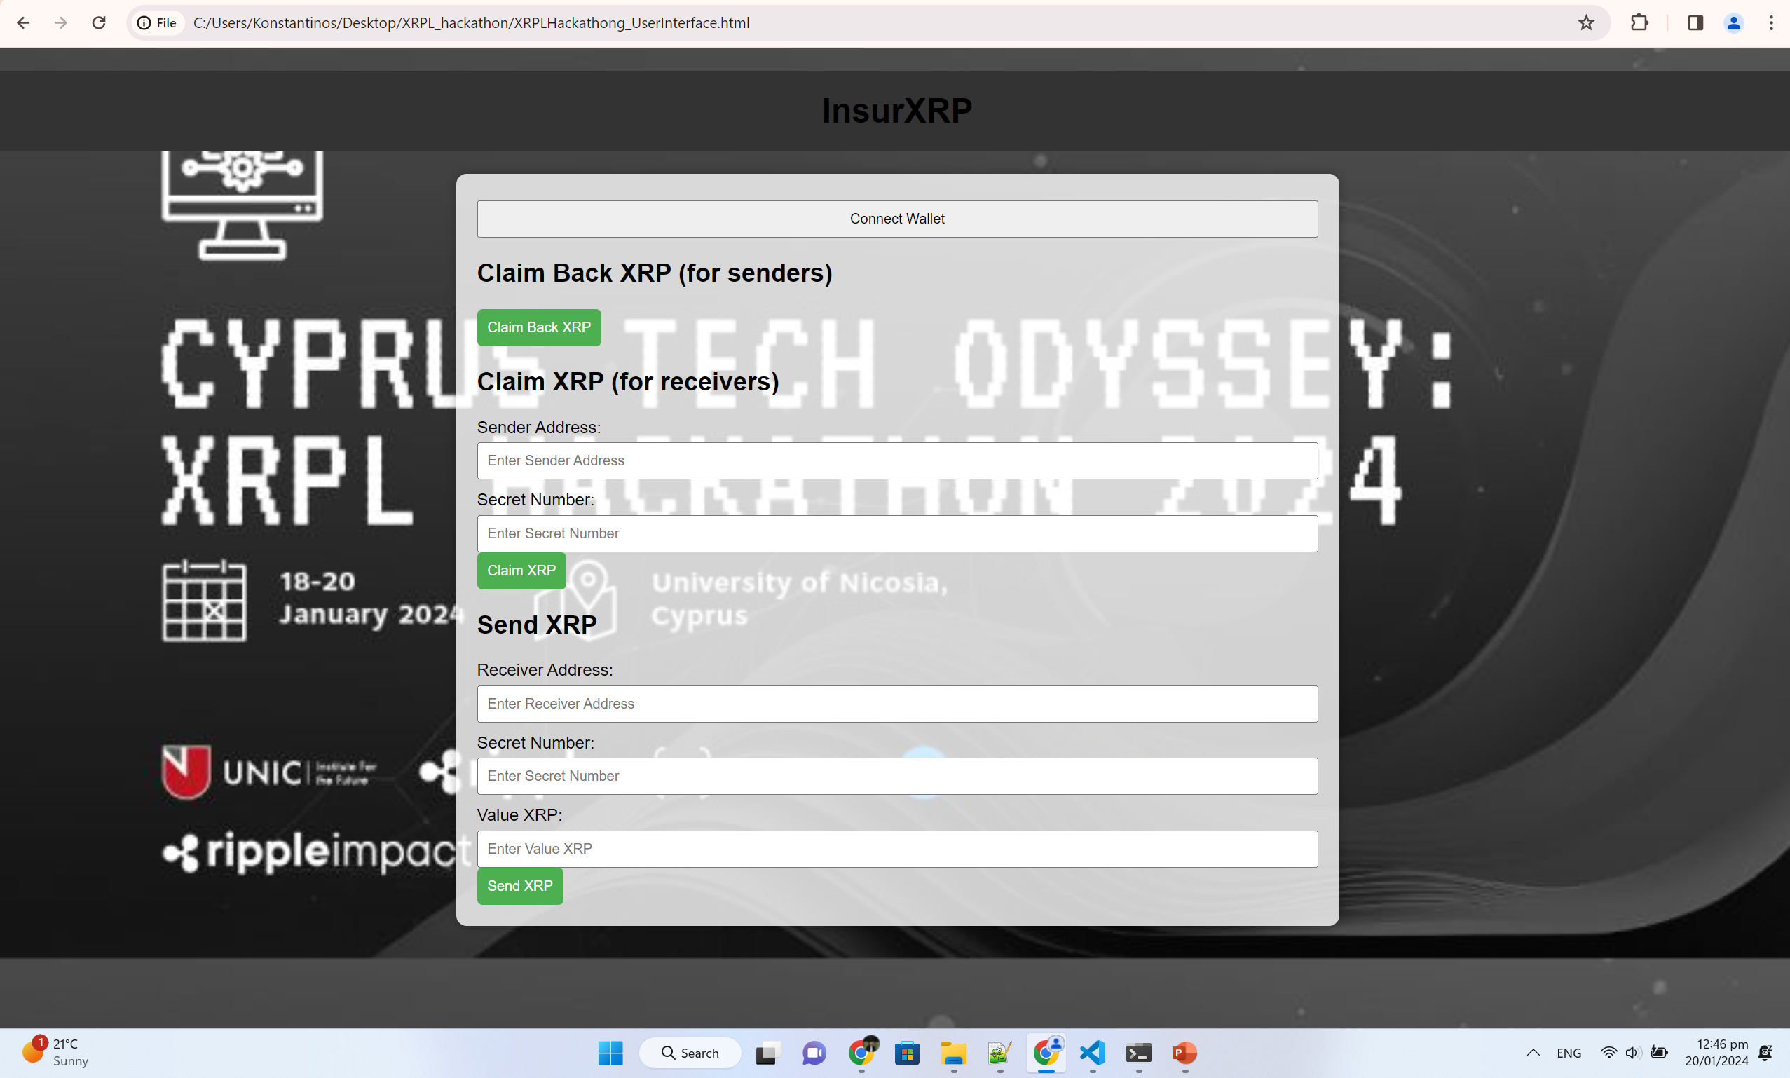

Slide 6

Thanks for your attention
Questions?

