Slide 1
Species distribution modeling

Slide 2
Why do species occur where they do?

Slide 3
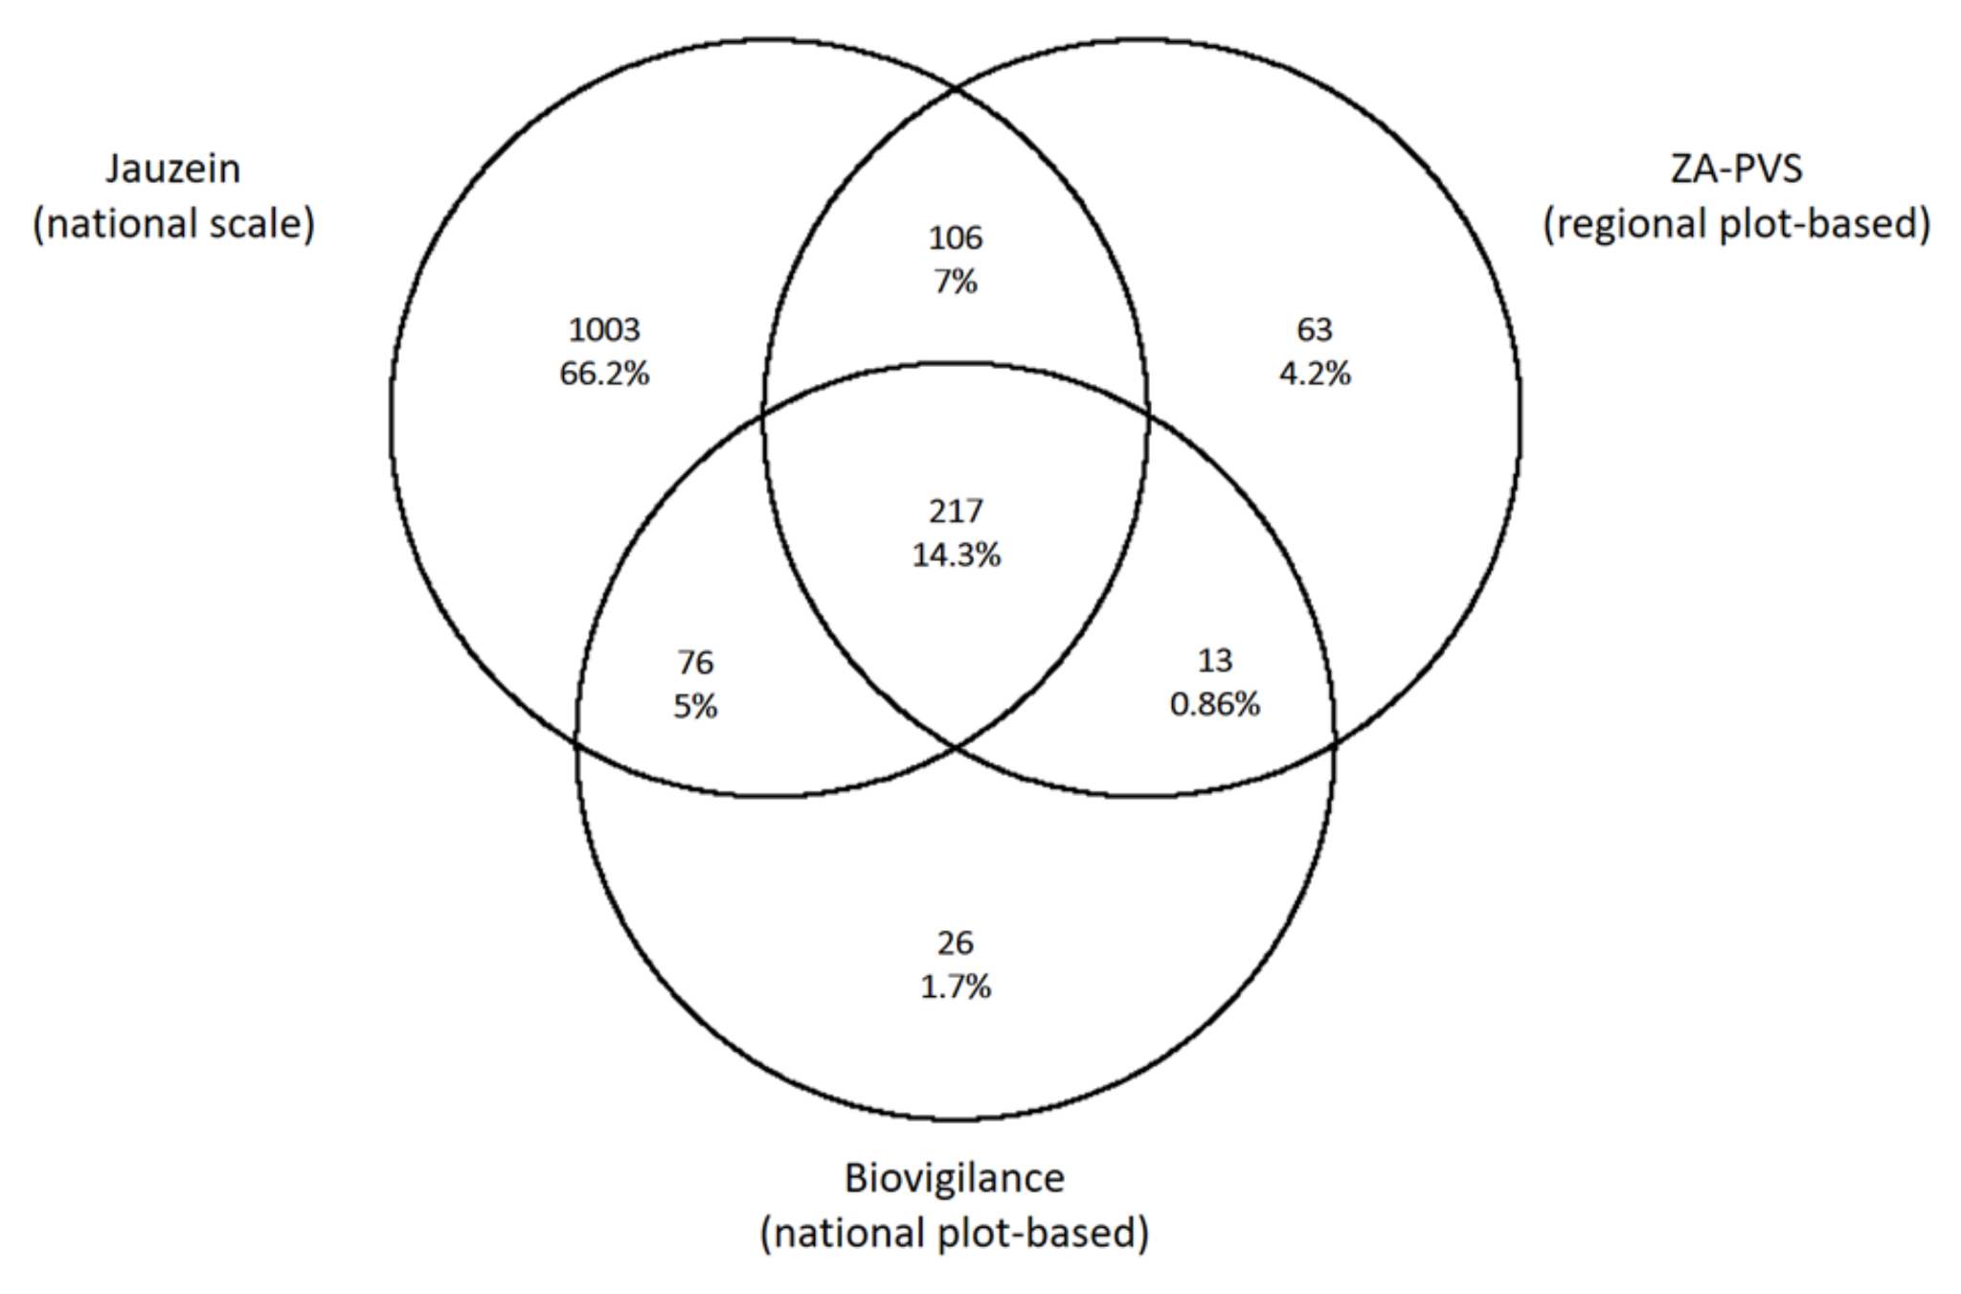
Habitat

Slide 4
Habitat
Dispersal

Slide 5
Habitat
Interactions
Dispersal

Slide 6
Habitat
Interactions
SDM
Realized Niche
Dispersal
What we would like to know

Slide 7
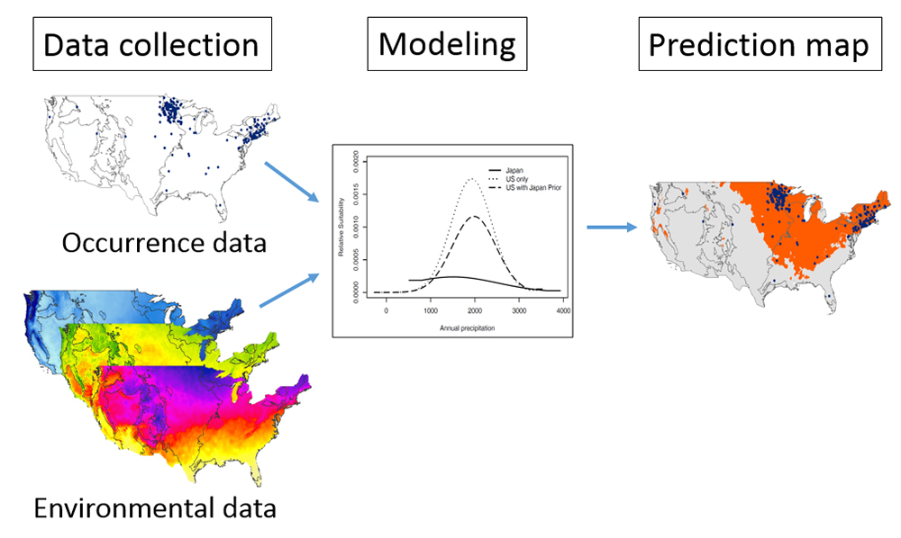

Slide 8
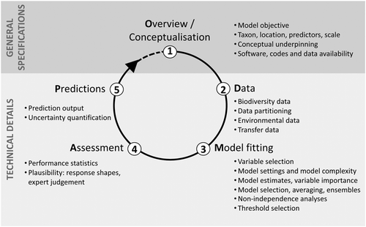
ODMAP protocol

Slide 9
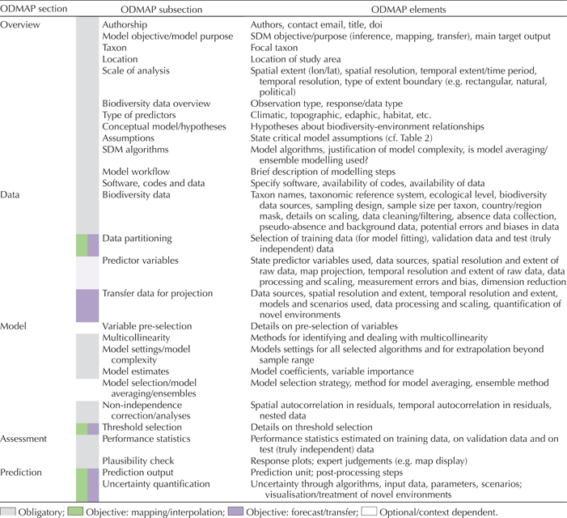
ODMAP list

Slide 10
Where to download species occurrence data?
GBIF - https://www.gbif.org/
BIEN - https://bien.nceas.ucsb.edu/bien/biendata/
but a lot more see some suggestions below (including trait data)
https://earthdata.nasa.gov/learn/pathfinders/biodiversity/species-distribution

Slide 11
Where to download environmental data?
worldclim - https://www.worldclim.org/
chelsa - https://chelsa-climate.org/downloads/
(worldclim vs chelsa https://www.nature.com/articles/sdata2017122)
land use harmonization - https://luh.umd.edu/
corine land cover - https://land.copernicus.eu/pan-european/corine-land-cover
MODIS land cover - https://search.earthdata.nasa.gov/search?q=MCD12Q2

Slide 12
What variables should I use?
Ecological meaning
Previous knowledge/expert opinion/related taxa
Uncorrelated
or use all and try reduction of dimensionality (e.g. PCA) but interpretation difficult…
also have in mind the number of occurrences you have (1/10 rule of thumb)

Slide 13
What models should I use?
it’s a mess - talk to a statistician before designing your project but there are some guidelines
Philosophies - machine learning (e.g. Maxent) - inferring parameters vs statistical (e.g. GLM) - prediction of response variable
Maxent usually does well with low amount of occurrence data
GLMs - if you have absence data can do well
Occupancy models - good data and repeated measures

Slide 14
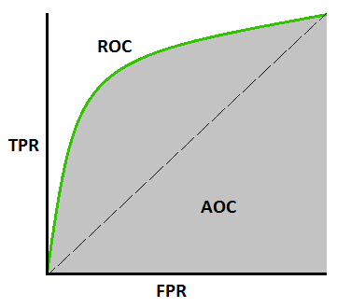
How do I know if my model makes sense?
TPR = sensitivity
FNR = specificity
FPR = 1 - specificity
TSS = sensitivity + specificity – 1 (threshold dependent)
AUC (threshold independent)

Slide 15
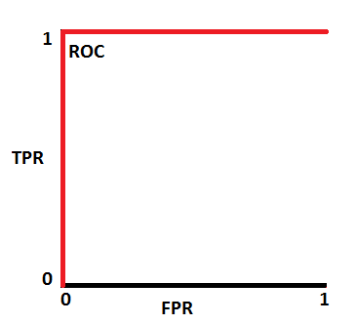
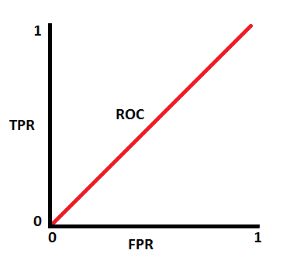
How do I know if my model makes sense?
TPR = sensitivity
FNR = specificity
FPR = 1 - specificity
TSS = sensitivity + specificity – 1
AUC = 1
AUC = 0.5

Slide 16
What software should I use?
R packages (e.g. biomod, SDM, dismo, unmarked)
Apps (e.g. wallace - https://wallaceecomod.github.io/)
stand alone software (e.g. maxent)

Slide 17
Let’s try it out!

