Slide 1

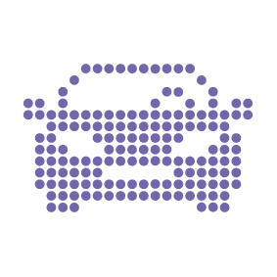
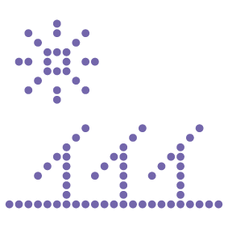



Business Case
By André Raiça Silva
29.09.2020

Slide 2

Making a Scalable System
Scooter Rental – Business Case

Slide 3
Topics
1
4
About Myself
A litlle bit about my career and my experience
Scalability strategy
A deeper explanation what about is involved on it
2
5
The Challenge
Business Scenario
Business Statements
Proof of Concepts
The code base solution to check the proposal viability
3
6
The Challenge
Technical Scenario
Technical Statements
Appreciation
Special Thanks

Slide 4
1.
About Myself

Slide 5

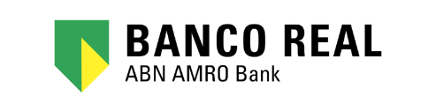



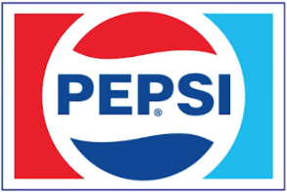





My career & technologies
More than seventeen years working as a web developer and architecting .NET solutions, always making sure that SOLID principles are applied using C#, Entity Framework, Web API, SQL Server, JavaScript and others cutting-edge technologies. Considering quality and performance, I am used to apply DDD, Tests and being an Agile enthusiast.
Companies Sumary
FENABRAVE / FIESP → Brazilian Industry and Automotive Federations
HOSPITAL ALBERT EINSTEIN → Internacional Hospital
BANCO REAL / CAIXA ECONOMICA → Big Banks
PEPSI Corp. / SKY → Internacional company
AZUL AIRLINES → Airline company
SERASA EXPERIAN → Credit analitics
MARISA → Brazilian fashion e-commerce
AVON → Cosmetic
FARFETCH → Portugal fashion e-commerce – UNICORN
About myself

Slide 6


Career Timeline
2001
Trainee
2003
Junior
2008
Mid
2013
Senior
2020
Architect
2025
MVP & Team Leader
2000
Telecom Technician
2001
Starts
University
TFS
MVC
ASP.NET
VB.NET
C++
C#
JS
SQL
LINUX
ANDROID
XAMARIM
REST
TFS
MVC
ASP.NET
.NETCORE
WCF
C#
JS
SQL
INFORMIX
REST
DEVOPS
AZURE
ASP
ASP.NET
VB6
VB.NET
C#
JS
SQL
ASP
VB6
JS
SQL
HTML
JAVA
VB4
GIT
.NETCORE
C#
JS
SQL
DDD
TDD
SCRUM
REST API
DEVOPS
AZURE
DOCKER
KUBERNETS
VB3
VBA

Slide 7
2.
The Challenge
Business Scenario

Slide 8
Business Scenario
There is a legacy scooter rental system that needs to support the business growth.
Current Problems Definition:
It is expensive to the company to apply new features.
The company realizes that is too expensive to contract infrastructure specialists to scale the current Windows Server Host schema.
The database is going down and self-degrading performance for each day.
There are a lot of user calls that don’t know how to use the system.
They realized that the most required and slower functionality is about monitoring scooter

Slide 9
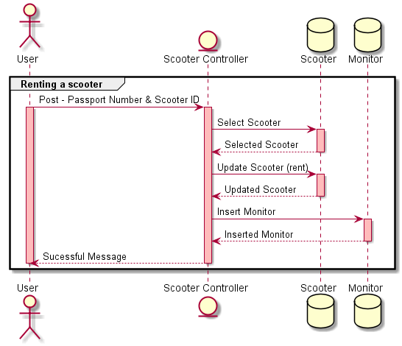
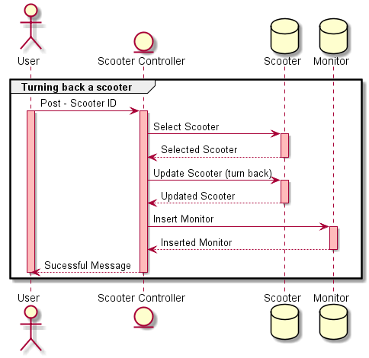
Renting a Scooter
Use Cases
Turning back a Scooter

Slide 10
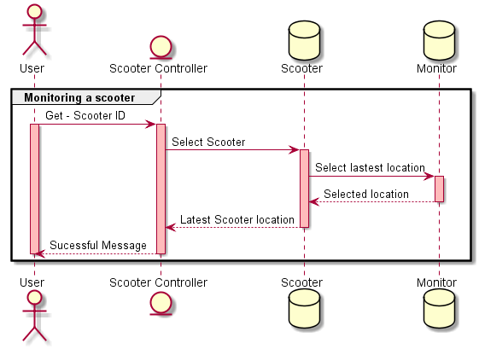
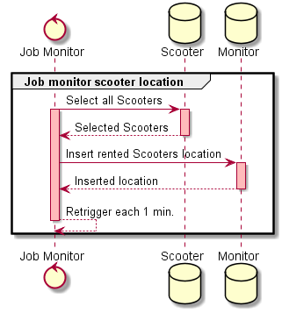
Monitoring a Scooter
Use Cases
Job Monitoring Scooters

Slide 11
3.
The Challenge
Technical Scenario

Slide 12
Technical Scenario
There is a legacy scooter rental system that needs to be scalable and easier to maintain.
The Architecture Challenge Statements:
Implement micro-services architecture
Guarantee that all communication between the services be resilient
Use container
Must be scalable to support the business network initiatives

Slide 13
Technical Statements
Current Problems Definition:
Hard to maintain the code and to develop new features.
Too much effort and expensive costs to create & scale to Windows Virtual Machine (VM)
The database is not supporting the data volume without lost performance
Bad user experience
Monolith does not allow scale the system per resource
High dependency of all components

Slide 14
Technical Proposal Solution
The proposal includes the migration of the current technology to:
LEGACY | NEW
.net Framework 4.6.1 | Microsoft .Net Core 3.1
Monolith MVC on IIS | Micro-services using Docker & Kubertes
Razor | Angular 2+
SQLite | Microsoft SQLServer Azure with Dapper
Virtual Machine Host | Windows Azure
Directly Controller Call | WebAPI & Service BUS Azure

Slide 15
Technical Proposal Solution
Angular
It is a modern UI, attending the performance needs
Uses TypeScript, a typed JavaScript easy to maintain the code
Microsoft SQL Server Azure
There are many options as Oracle, MySQL, CosmosDB, etc
SQLServer is a Microsoft database on azure and it attends the performance needs
Windows Azure
There are many cloud platforms to choose like AWS, Google Cloud, etc.
The cloud environment allows us to manage our resource easy, paying just when it is in use.
Microsoft Service BUS Azure
It is a choice of queue to communicate between the domains
There is an excellent management panel and full control of “dead letters“
Maintain each domain isolated
It Guarantees that if one microservices is down, it will maintain the information to be processed later
Why use these technologies?
Microsoft .Net Core
Provides a better Performance and it is easy to scale
Cross-Platform – Able to run easily in cloud containers
Open Source community support
Support built-in Dependency Injection
Dapper
It is a micro ORM, making the performance higher
Docker
Enables more efficient use of system resources.
Faster software delivery cycles.
Enables application portability.
Docker is great for microservices architecture.
Kubernetes
It is a portable, extensible, open-source platform for managing containerized workloads and services.
It has a large, rapidly growing ecosystem, turning the application widely available.

Slide 16
Technical Proposal Solution
Way to be followed in architecture:
Domain Driven Design (DDD)
It is a concept that the structure and language of software code should match the business domain
Being close for business language, it turns easier to separate some appointments in specific domains, making it possible to identify boundaries and micro-services
Domain Events
Some domain actions will start a chain of reaction asynchronously to do something related from it
Test Driven Development (TDD)
It Guarantees the application test coverage before and during a developing of a new feature
Azure Service Bus as queue
In case of unavailable service, the queue will guarantee the communication between the services, keeping each micro-services working independently
The Azure Service Bus has a great “dead letter” retry schema in case of application exception or instability
Azure Functions as Job
Using it the job cans be constantly executed using CRON expression on cloud

Slide 17
Technical Proposal Solution
What is the benefits of this approach:
Easy to scale the application to support elevate web traffic and data
Easier to increase new features and fix bugs on code
Multiplatform and scalable system
Increase of web performance and user experience
Lower and controlled costs using the pay-per-use on cloud
Easy to identify and build isolated services

Slide 18
Technical Proposal Solution
Initial approach:
Each domain will work independently inside containers
The relationship between the domains is the queue, working asynchronously when it is invoked
Identified Domains:
These identified domains will become microservices, making it possible to be scaled on the cloud
Scooter
Tracking

Slide 19
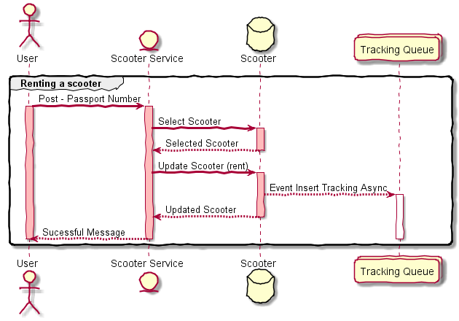
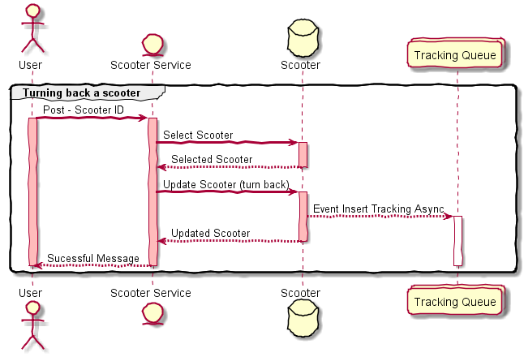
Renting a Scooter
Use Cases
Scooter Service
Turning back a Scooter

Slide 20
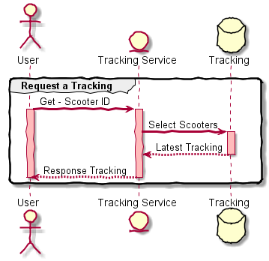
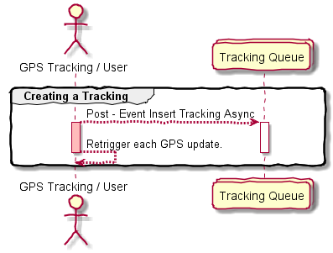
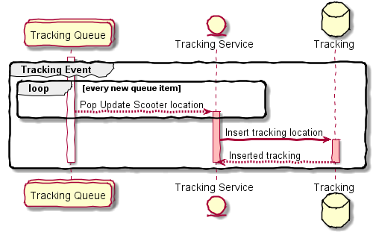
Looking for a Scooter
Use Cases
Tracking Service
Tracking Scooters
Tracking Event Processor
Queue Trigger Azure Function

Slide 21
4.
Scalability strategy

Slide 22
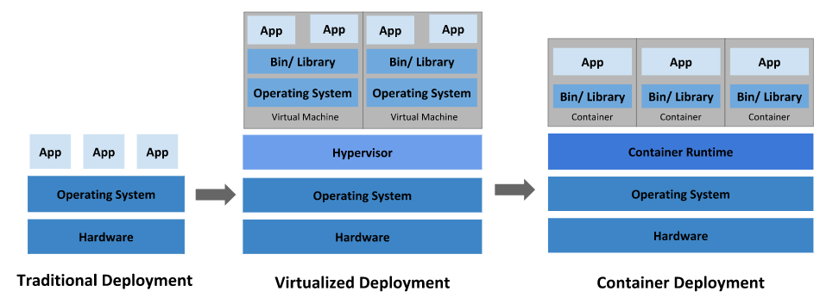
Container Structure History
https://kubernetes.io/docs/concepts/overview/what-is-kubernetes/

Slide 23
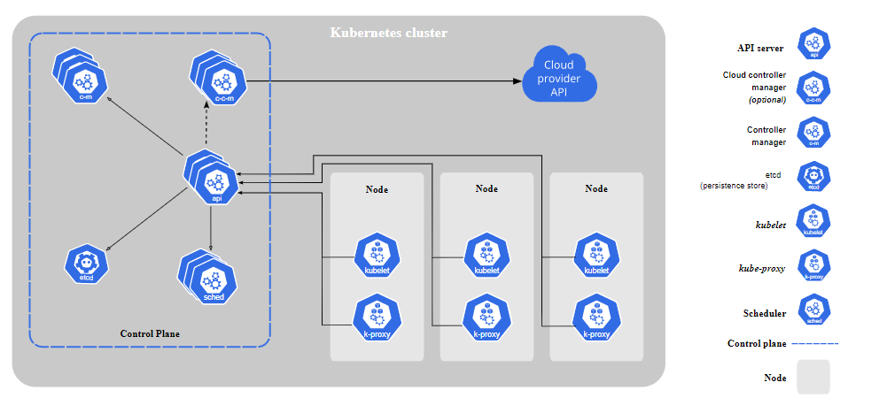
Kubernetes Cluster
https://kubernetes.io/docs/concepts/overview/what-is-kubernetes/

Slide 24
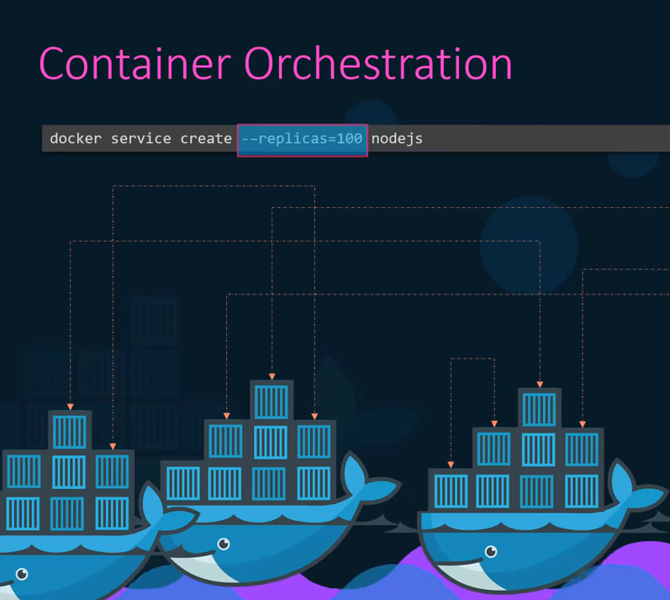
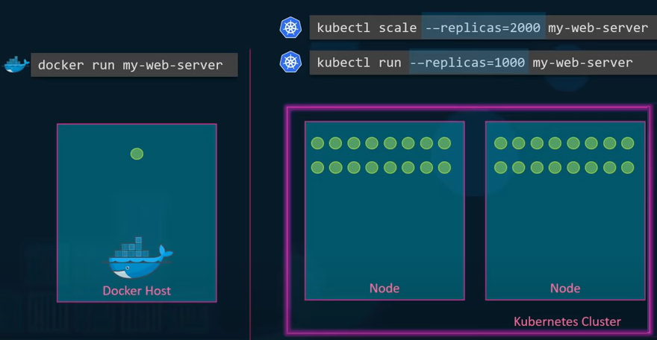
How to Run and Scale it?
KodeKloud

Slide 25
5.
Proof of Concepts

Slide 26

Proof of Concepts
Community Source code and documentation:
Proposal
https://github.com/andreraica/ScooterRental
Legacy
https://github.com/andreraica/ScooterRental/tree/master/legacy

Slide 27
6.
Appreciation

Slide 28
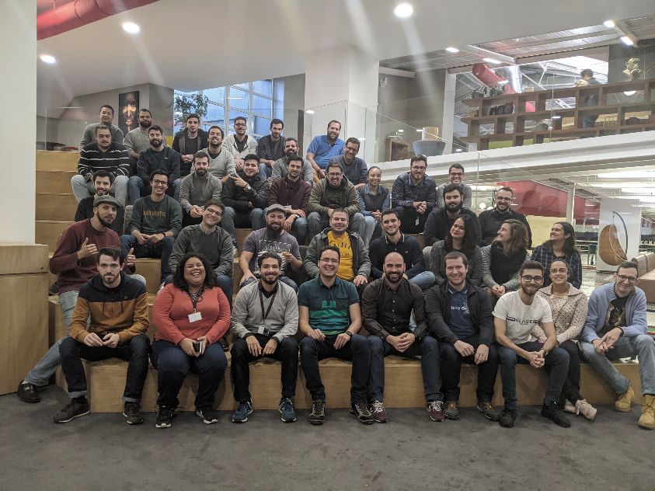
Appreciation
Thank you for the patient and the support from all Altran team
Special Thanks
Luis Rocha
Henrique Miraldo
Carlos Valente
Altran Team…

