Slide 1


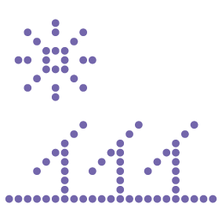



Business Case
By André Raiça Silva
29.09.2020

Slide 2

Turnning a Scable System
Scooter Rental Case

Slide 3
Topics
1
4
About Myself
A litlle bit about my career and my experience
Proof of Concepts
The codebase solution to check the proposal viability
2
5
The Challenge
Business Scenario
Business Statements
Appreciation
Special Thanks
3
The Challenge
Technical Scenario
Technical Statements

Slide 4
1.
About Myself

Slide 5





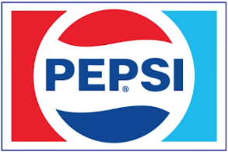





My career & technologies
More than seventeen years working as a web developer and architecting .NET solutions, always making sure that SOLID principles are applied using C#, Entity Framework, Web API, SQL Server, JavaScript and others cutting-edge technologies. Considering quality and performance, I am used to apply DDD, Tests and being an Agile enthusiast.
Companies Sumary
FENABRAVE / FIESP → Brazilian Industry and Automotive Federations
HOSPITAL ALBERT EINSTEIN → Internacional Hospital
BANCO REAL / CAIXA ECONOMICA → Big Banks
PEPSI Corp. / SKY → Internacional company
AZUL AIRLINES → Airline company
SERASA EXPERIAN → Credit analitics
MARISA → Brazilian fashion e-commerce
AVON → Cosmetic
FARFETCH → Portugal fashion e-commerce – UNICORN

Slide 6


Career Timeline
2001
Trainee
2003
Junior
2008
Mid
2013
Senior
2020
Architect
2025
MVP
2001
Starts
University
TFS
MVC
ASP.NET
VB.NET
C++
C#
JS
SQL
LINUX
ANDROID
XAMARIM
REST
TFS
MVC
ASP.NET
.NETCORE
WCF
C#
JS
SQL
INFORMIX
REST
DEVOPS
AZURE
ASP
ASP.NET
VB
VB.NET
C#
JS
SQL
HTML
JAVA
GIT
.NETCORE
C#
JS
SQL
DDD
TDD
SCRUM
REST API
DEVOPS
AZURE
DOCKER
KUBERNETS
ASP
VB
JS
SQL

Slide 7
2.
The Challenge
Business Scenario

Slide 8
Business Scenario
There is a legacy scooter rental system that needs to support the business growth.
Current Problems Definition:
It is expensive to the company apply new features.
The company realize that is too expensive and needs a specialist to scale the current Virtual Machine schema.
The database is going down and degrading performance for each day.
There are a lot of user calls that don’t know how to use the system.
They realized that the most required and slower functionality is about monitoring scooter

Slide 9
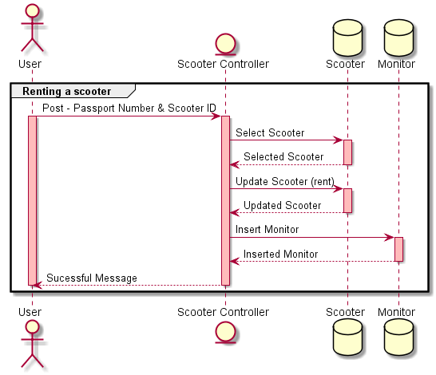
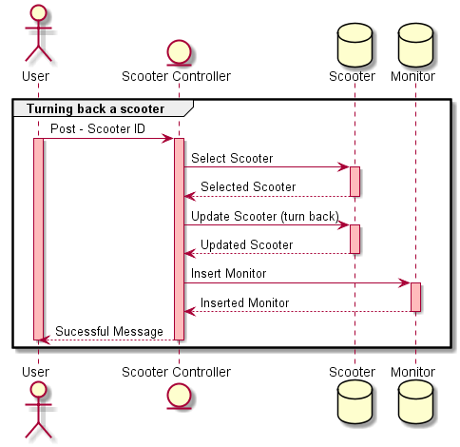
Renting a Scooter
Use Cases
Turning back a Scooter

Slide 10
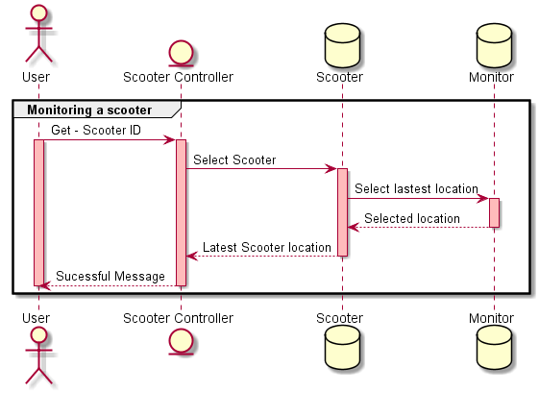
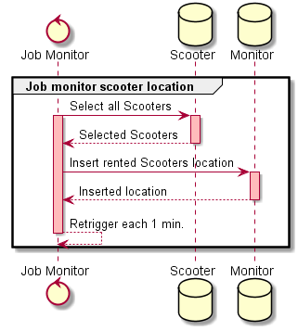
Monitoring a Scooter
Use Cases
Job Monitoring Scooters

Slide 11
3.
The Challenge
Technical Scenario

Slide 12
Technical Scenario
There is a legacy scooter rental system that needs to be scalable and easier to maintain.
The Challenge Architectural Statements:
Implement micro-services architecture
Guarantee that all communication between the services be resilient
Use container
Must be scalable to support the business network initiatives

Slide 13
Technical Statements
Main Problems Definition:
Hard to maintain the code and to develop new features.
Too much effort and expensive costs to create & scale Windows Virtual Machine (VM)
The database is not supporting the data volume without lost performance
Bad user experience
Monolith does not allow scale the system per resource

Slide 14
Technical Proposal Solution
The proposal includes to migrate the currently technology for:
LEGACY | NEW
.net Framework 4.6.1 | Microsoft .net Core 3.1
Monolith MVC on IIS | Micro-services using Docker & Kubertes
Razor | Angular 2+
SQLite | Microsoft SQLServer Azure with Dapper
Virtual Machine Host | Windows Azure
Directly Controller Call | WebAPI & Service BUS Azure

Slide 15
Technical Proposal Solution
Why use these technologies?
Angular
It is a modern UI, attends the performance needs
Uses Type Script, a typed JavaScript easy to maintain the code
Microsoft SQL Server Azure
There are many options as Oracle, MySQL, etc
SQLServer is a Microsoft database on azure and it attends the performance needs
Windows Azure
There are many cloud platforms to choose as AWS, Google Cloud, etc.
The cloud environment allows us to manage our resource easy, paying just when It is in use.
Service BUS Azure
There is an excellent management of dead letters and panel
It is a queue to communicate between the domains
Maintain each domain isolated
Guarantee that the micro-services down, it will wait to process the information later
Microsoft .net Core
Improved Performance
Cross Platform – Able to run easy in cloud environments
Open Source community support
Support built in Dependency Injection
Dapper
It is a micro ORM that makes the performance higher
Docker
Docker enables more efficient use of system resources.
Docker enables faster software delivery cycles. ...
Docker enables application portability. ...
Docker shines for micro-services architecture.
Kubernetes
is a portable, extensible, open-source platform for managing containerized workloads and services. It has a large, rapidly growing ecosystem, turning the application widely available.

Slide 16
Technical Proposal Solution
Way to be followed in architecture:
Domain Driven Design (DDD)
It is a group of techniques to make your code near from the business language, broken it in specific domains, making possible to identify boundaries and micro-services
Domain Events
Some action will have a reaction to do something related from it
Test Driven Development (TDD)
Guarantee the application test coverage before developing a new feature
Azure Service Bus as queue
In case of unavailable service, the queue will guarantee the communication, keeping the micro-services working independently
The Azure Service Bus has a dead letter and retry schemas in case of exception on service before Pop.
Azure Functions as Job
In this case will be executed in time to time using CRON expression

Slide 17
Technical Proposal Solution
What is the main benefits of this approach:
Easy to scale to support an elevate web traffic and data
Easier to increase new features on code
Multiplatform and scalable system
Increase of web performance and user experience
Lower cost using the pay-per-use on cloud
Easy to identify and build isolated services

Slide 18
Technical Proposal Solution
Initial approach:
Each domain will work independently
The relation between the domains will be the queue, working asynchronous as well its invokes
Identified Domains:
These identified domain will become micro-services making possible to scale it on the cloud
Scooter
Tracking

Slide 19
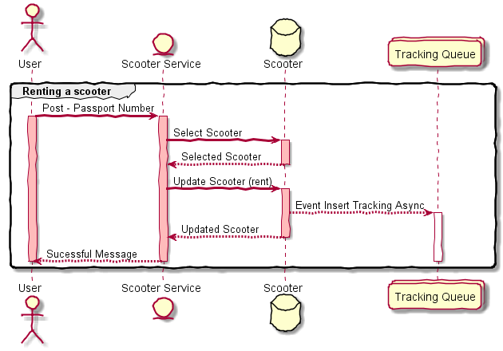
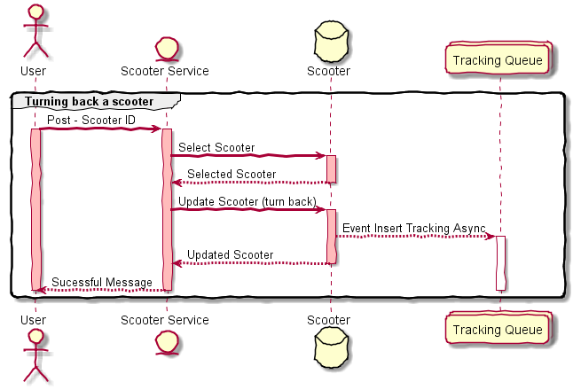
Renting a Scooter
Use Cases
Turning back a Scooter

Slide 20
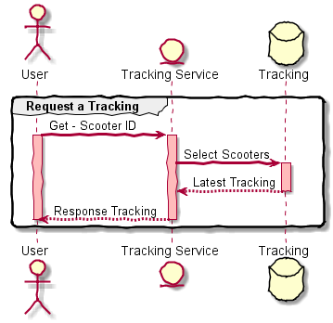
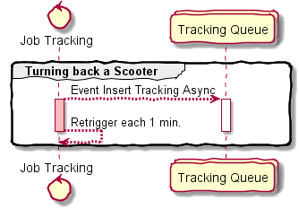
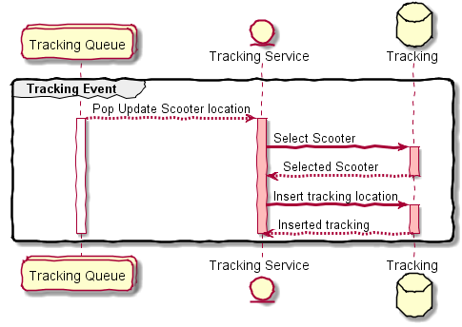
Tracking a Scooter
Use Cases
Tracking Job Scooters
Tracking Event Processor

Slide 21
4.
Proof of Concepts

Slide 22

Proof of Concepts
Source code and documentation:
Proposal
https://github.com/andreraica/ScooterRental
Legacy
https://github.com/andreraica/ScooterRental/tree/master/legacy

Slide 23
5.
Appreciation

Slide 24
Appreciation
Thank you for the pacient and the support from all Altran team
Special Thanks
Luis Rocha
Henrique Miraldo
Carlos Valente

