Slide 1
Development plan

Slide 2
Technologies front-end
Angular/React
Quicksight

Slide 3
Technologies Back-end/Databases
Python/Node.js
AWS
Redshift(analysis)
PostgreSQL(OLTP)

Slide 4
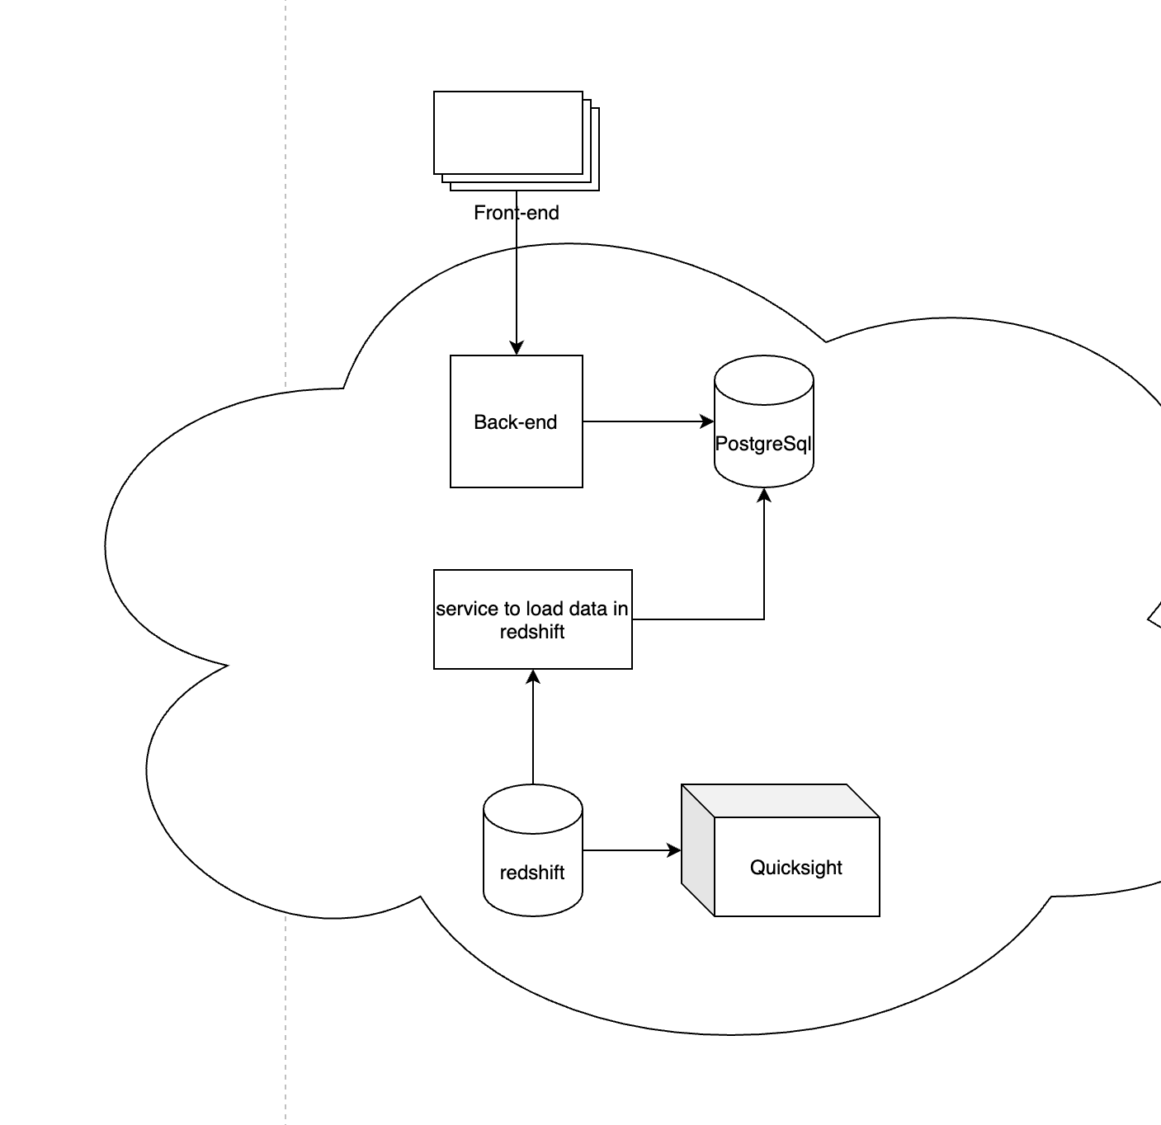
How would it look like
ETA with all the testing, and bulding it with good practices. I would estimate 6 to 8 weeks

