Slide 1

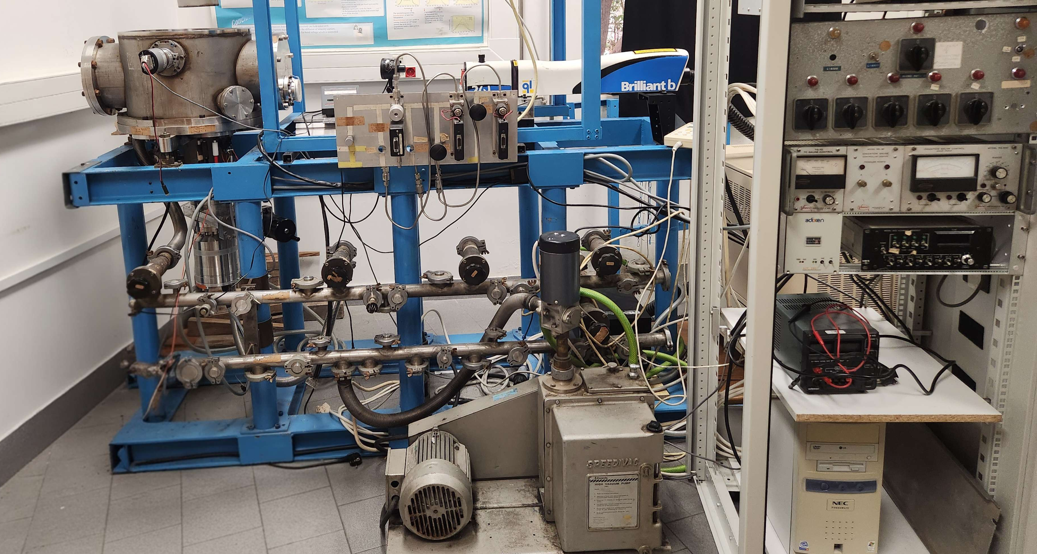
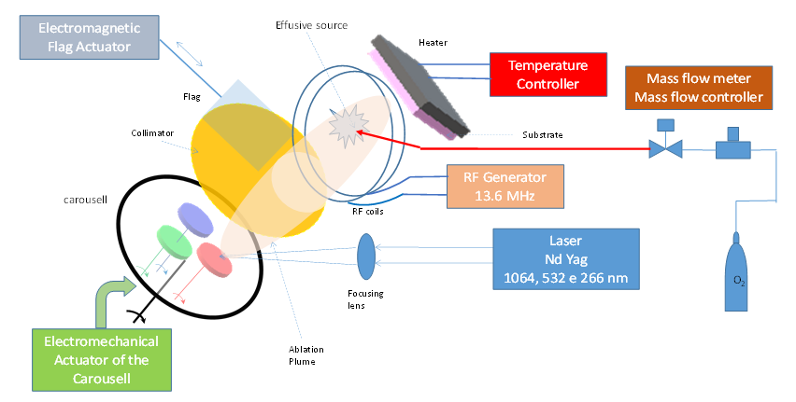
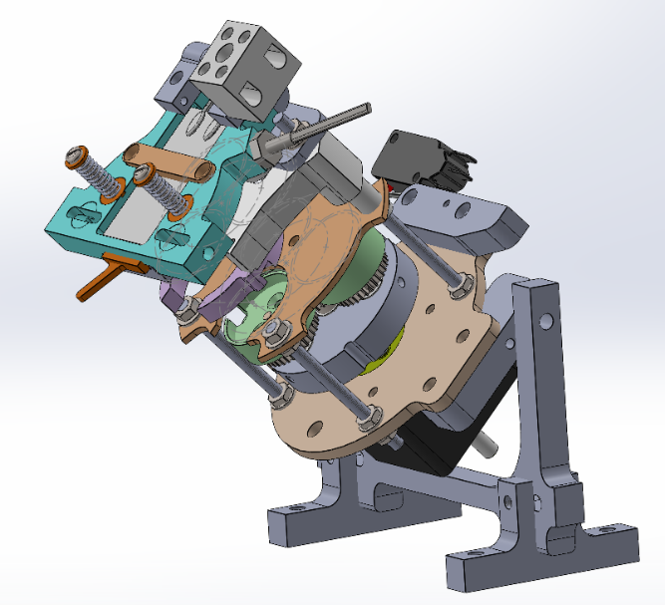
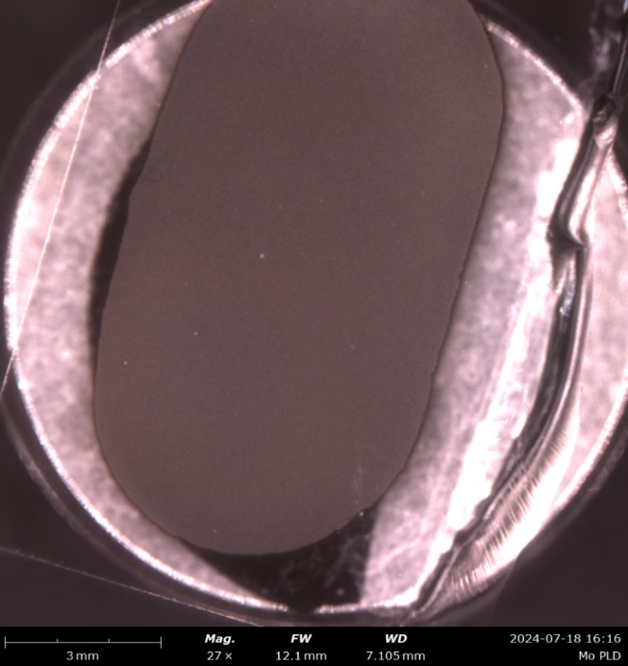
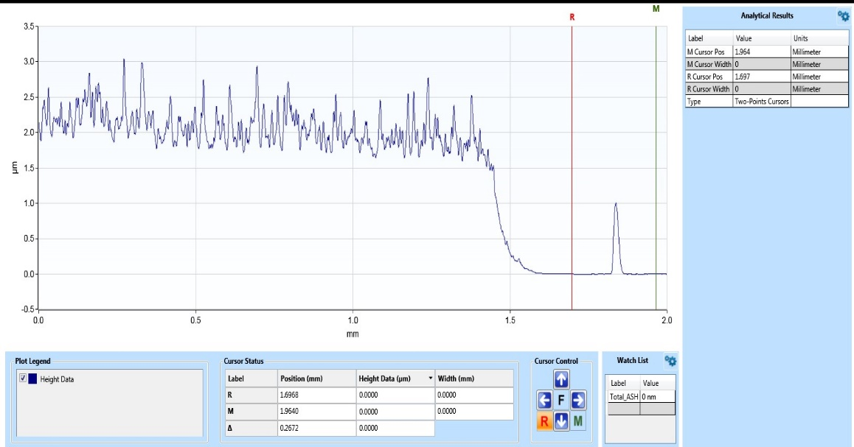


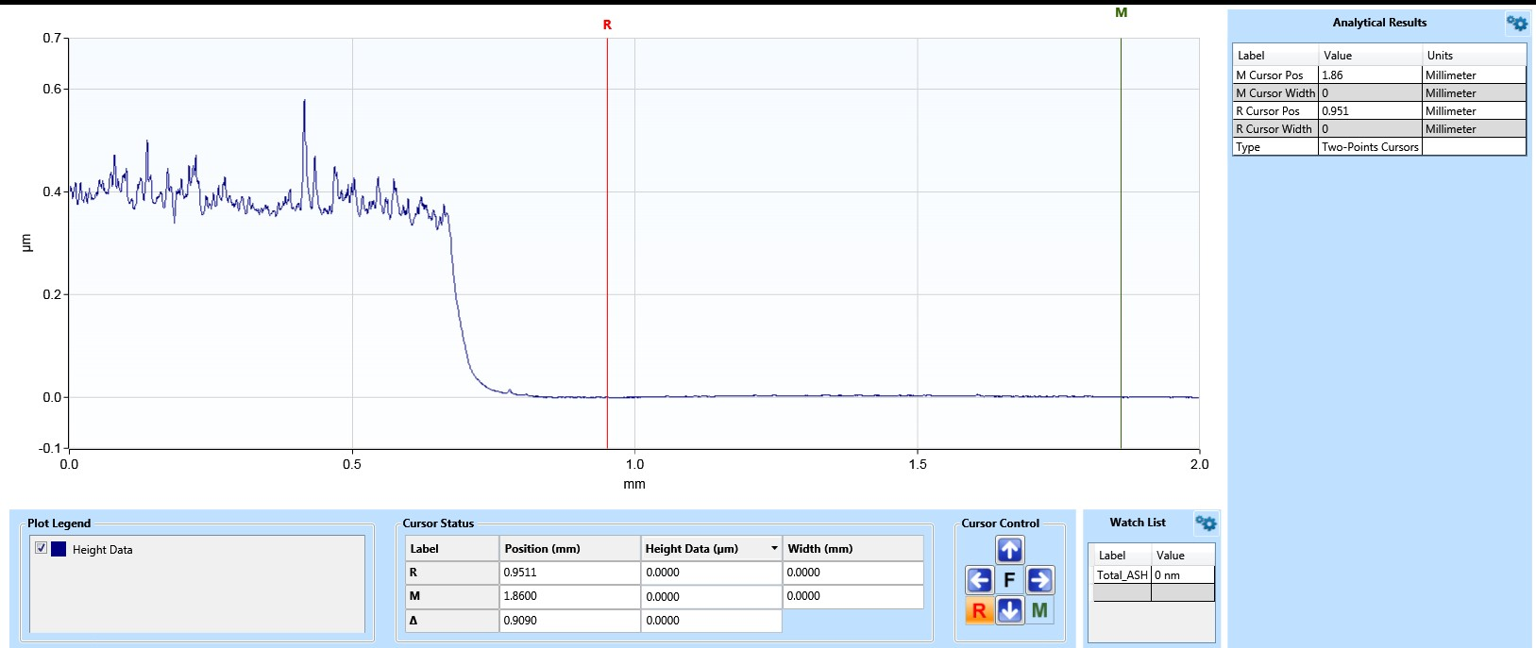



7th International Conference on Applications of Optics and Photonics
Lisbon, Portugal,
July 7 - 10, 2026
Poster Number 261
Nd:YAG Pulsed Laser Deposition Platform for Thin-Film and Nanostructured Material Fabrication for Photonic Applications
André Moreira^{1,} *, Miguel Fernandes^{1,2}, Jorge Fidalgo¹ , João Frazão¹
^{1.}Departamento de Engenharia Electrónica e Telecomunicações e de Computadores, Instituto Superior de Engenharia de Lisboa, Rua Conselheiro Emídio Navarro 1, 1959-007 Lisboa, Portugal | ^{2.}Center of Technology and Systems (CTS) and Associated Lab of Intelligent Systems (LASI), 2829-516 Caparica, Portugal
PLD SYSTEM OVERVIEW
PLD SYSTEM OVERVIEW
Development of a flexible PLD platform based on a Q-switched Nd:YAG laser (1064/532/266 nm) for controlled fabrication of thin films and nanostructured materials for photonic applications.
Deposition of Mo, Al, Cr and NiO thin films on glass substrates, studying the influence of laser fluence, wavelength, chamber pressure, substrate temperature and target–substrate distance.
Optimization of deposition conditions through analysis of film uniformity, surface coverage and morphology.
METHODS
SYSTEM FEATURES
Q-switched ND:YAG laser 20Hz, 6ns, up to 800MJ
Wavelengths: 1064, 532 and 266nm
High vacuum: $5×{10}^{−5}$ mbar
Rotating target carousel (up to 3 targets)
Substrate heating (up to 300 °C)
Adjustable flag to avoid target contaminations
Fig1. Experimental Setup
Fig2. Target carrousel
RESULTS
DEPOSITION PARAMETERS
Laser wavelength
(1064 / 532/ 266 nm)
Substrate temperature
Laser fluence on target
Target-substrate distance
Chamber pressure
Deposition time
(number of pulses)
(a)
(b)
(c)
Fig 3. Characterization of the aluminium thin film deposited by PLD: (a) macroscopic view of the Al deposition on glass substrate; (b) SEM micrograph revealing the surface morphology of the deposited layer; (c) Dektak profilometric measurement showing the film thickness profile.
CONCLUSIONS
A flexible Nd:YAG PLD platform was successfully developed for controlled thin-film and nanostructure fabrication.
Deposition parameters were optimized, demonstrating their influence on film uniformity, coverage and morphology.
The developed system enables advanced material fabrication for photonic and electronic applications
All mechanical design, development and implementation where successfully achieved in-house.
(a)
(b)
Fig 3. Characterization of the Nio thin film deposited by PLD: (a) SEM micrograph revealing the surface morphology of the deposited layer; (b) Dektak profilometric measurement showing the film thickness profile.

