Slide 1
Docker and small scale production ready applications
Tuesday May 14, 2019

Slide 2
Securing your application starts on the server
Your application will be attacked, constantly
What are your resources worth to an attacker?
Machine as a basis for further attack?
Personal data that can be resold?
Etc?
Make it harder for the attacker than what the resources are worth
Reduce the surface area
If you can keep it simple

Slide 3
Application deployment objectives
One codebase tracked in revision control, many deploys
Explicitly declare and isolate dependencies
Store config in the environment
Treat backing services as attached resources
Strictly separate build and run stages
Execute the app as one or more stateless processes
Export services via port binding
Scale out via the process model
Maximize robustness with fast startup and graceful shutdown
Keep development, staging, and production as similar as possible
https://12factor.net/

Slide 4
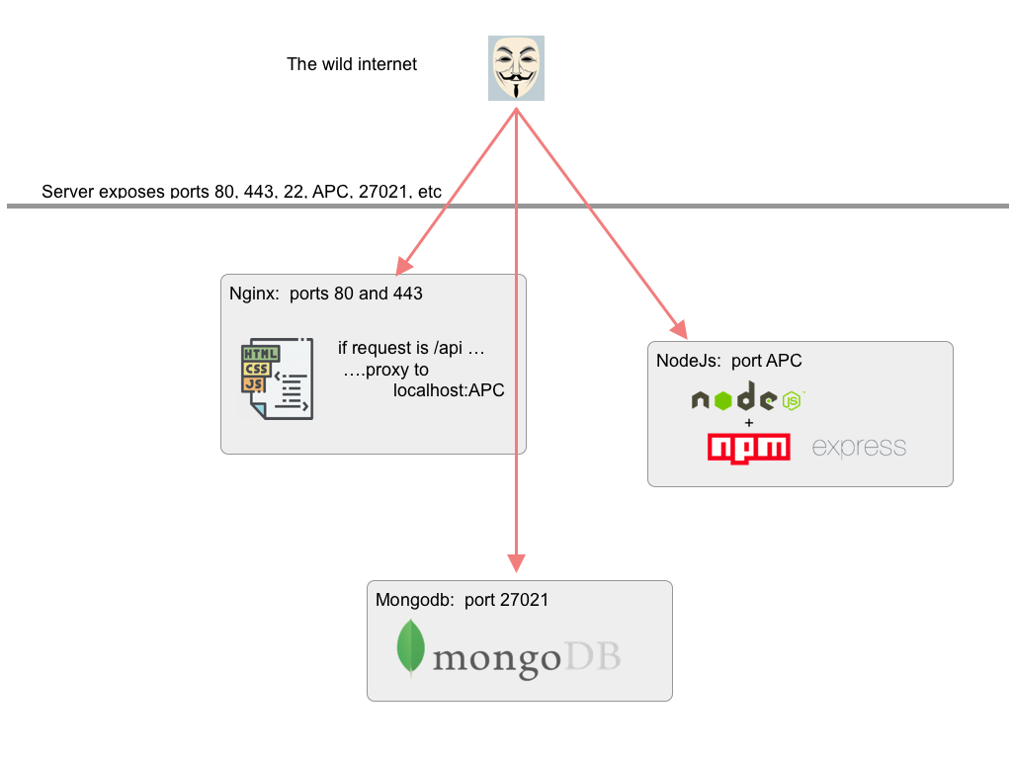
Your Application

Slide 5
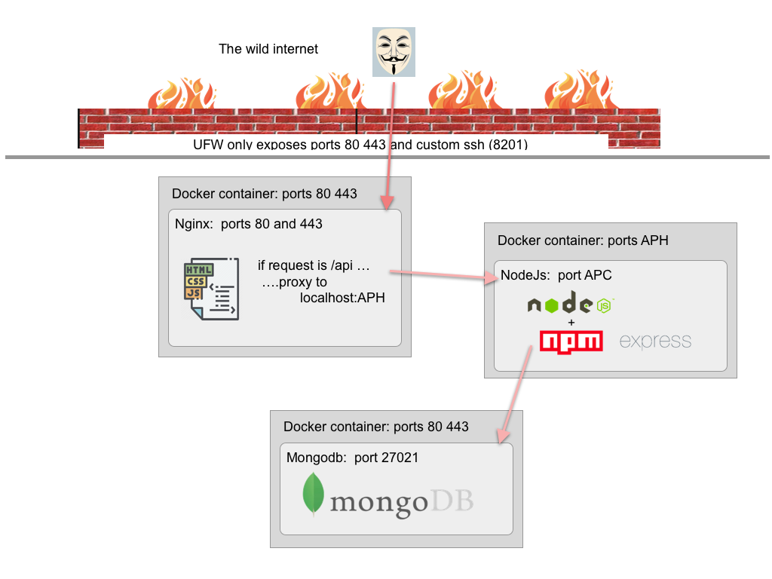
More secure

Slide 6
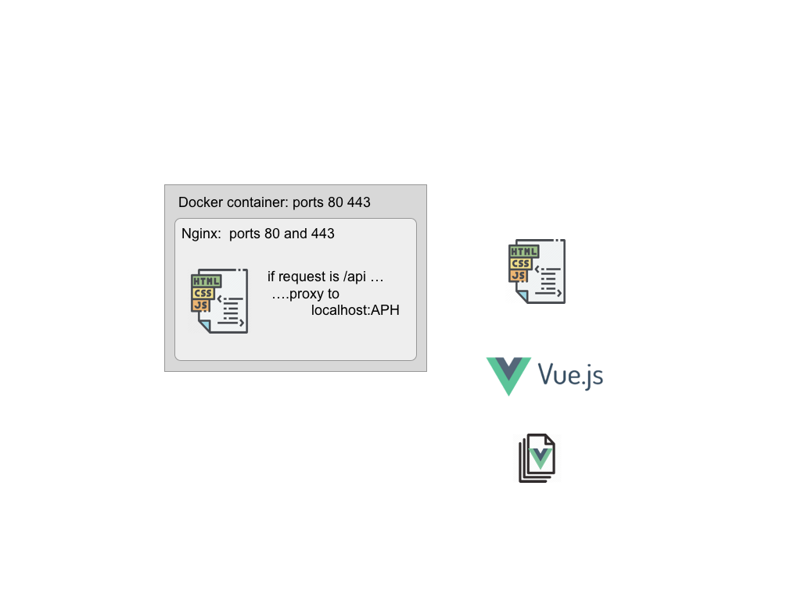
Brief intro to vue js
How does Vue produce the static web site and
How the files get into the web server container?

Slide 7
Stage 1 – secure the server
Take a freshly built Debian server
No access with passwords. Private public key ssh only.
Block all external root access
Create a user with sudo access
Add a firewall
Obscure the ssh port

Slide 8
Stage 2 – prepare the server
Install Docker
Install Node js and npm
Create a sample web site (your application web pages)
Serve your site via nginx in a docker container
Nginx is
Production quality web server
Responsive
Ideal for micro-services
In a docker container you can run nginx anywhere

Slide 9
Stage 3a – add API server
Add a node js, express based API server
Docker-ize the API server
Nginx proxy requests for http://domain/api to our
Stage 4 – mongo db
API server uses mongo db for data storage
Docker-ize the mongo db

Slide 10
More secure

