Slide 2
Securing your application
Text

Slide 3
Deploying your application
Text

Slide 4
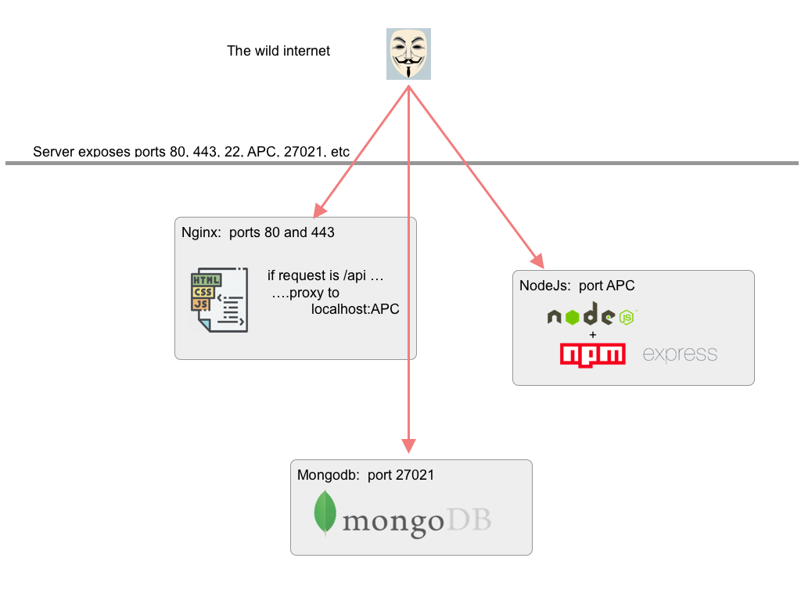
Your Application

Slide 5
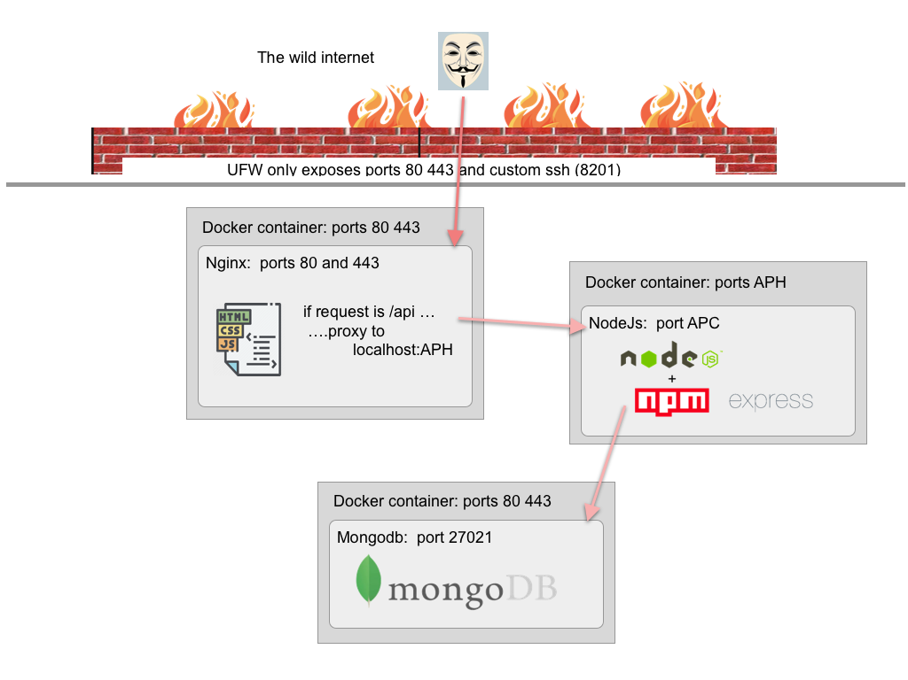
Docker and Firewall

