Slide 1
Differences in usage between annual members and casual riders
Presented by: Andres Gonzalez
Last update: Feb/05/2023

Slide 2
Today’s program
Defining Objective
Data used
Insights
Conclusions
Next steps

Slide 3
Objective
Define and analyze bike usage differences between annual members and casual riders to develop a better targeted marketing campaign.

Slide 4
Data used for analysis
All data imported from Divvy’s website: Index of bucket "divvy-tripdata“
Monthly data from January 2022 to December 2022.
Data cleaned using BigQuery and Excel
Notes:
Data was found in zip files separated by month and the terms and conditions for the data set use are found on Divvys website too. Data was for whole year 2022 and was cleaned mostly using queries on Bigquery and splitting, adding and spectating the files on excel. After cleaning, about 4,300,000 trips were remain for analysis

Slide 5
Insights Summary
Trips behavior by month, day of the week and hour of the day.
Most used stations.
Ride length behaviors.
Notes:
We’ll check both users behavior, how long their rides are, which ones are longer, how many trips they take during the months, weeks, and hours of the day, top stations and compare it between users to get relevant insights and differences and look for some new areas to explore and collect new data

Slide 6


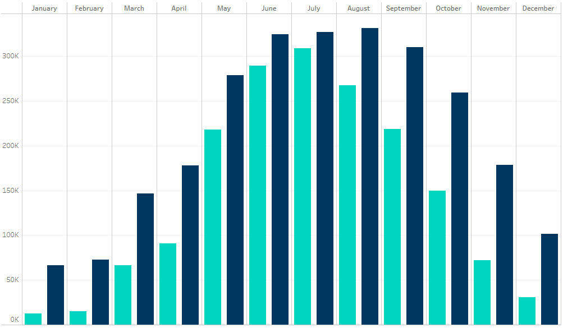
2022 rides by month
No differences in overall monthly behavior.
However, average ride length for casuals is 2 times longer than members ride length.
Notes:
Relevant insights here are trips length compared between members and casuals and that monthly behavior doesn’t tells us much.

Slide 7
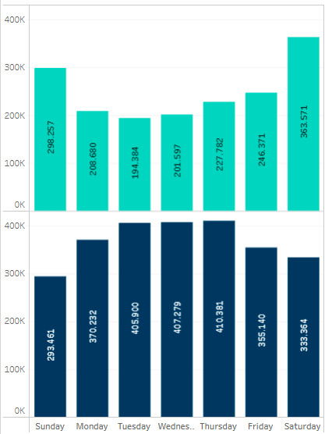
2022 rides by day of week
Casual riders use Cyclistic the most on weekends.
Annual members use Cyclistic the most on weekdays.
Notes:
Relevant insights here are that casuals use Cyclistic more on weekends and annual members on weekdays which might tell casuals use Cyclistic for fun and annual members to commute to work.

Slide 8
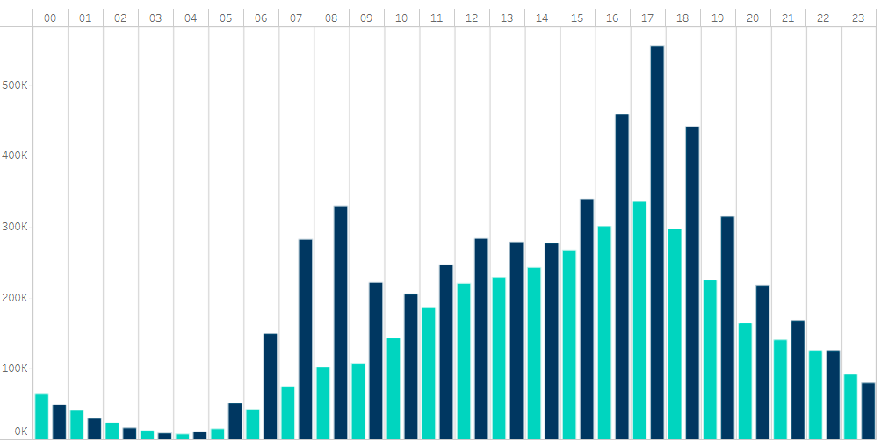
2022 rides by hour of the day
Both users Cyclistic usage peaks at 5 PM, however, annual members usage also has a smaller peak at 8 AM.
This might tell annual members use Cyclistic to commute to work more than casual users.*
*further analysis required
Notes:
Relevant insights: both of them peak at 5PM but annual members also peak at 8 AM which might reinforce that they use Cyclistic to commute to work

Slide 9
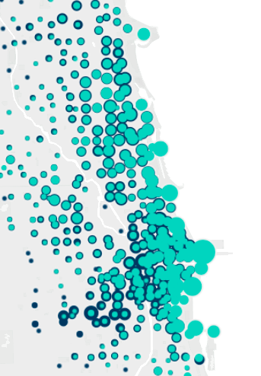
Start stations popularity
Casual users start more trips at the coastal zone.
Annual members start more trips downtown and at city outskirts.
This might reinforce that casual users use Cyclistic more for leisure and annual members use it more to commute to work.
Notes:
Explain graph and then relevant insights: Casuals use cyyclistic more at coastal zones and annual members use it more on downtown and at city outskirts which may reinforce the hypothesis of cyclistic’s usage

Slide 10
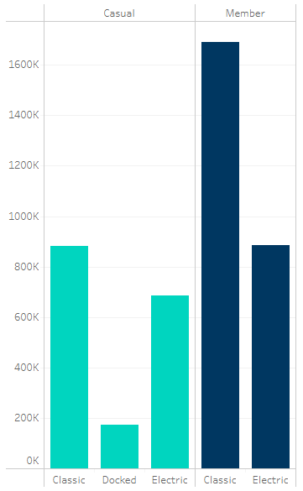



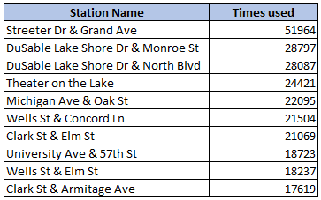
Other key findings
Only casual users used docked bikes in 2022.
Casual users are more likely to take longer rides than annual members.
Most used stations.
Notes:
Relevant insights: only casual users used docked bikes, the longer the trip, the bigger the disparity between casuals and annual members, casual riders then, tend to take longer rides with Cyclistic. Also tell about how the most used stations can help target the physical ads for more exposure to casual users.

Slide 11
Conclusions Summary of differences between casual and annual members:
Average ride length for casual users is 2 times longer than members ride length.
Casual riders use Cyclistic the most on weekends and annual members use Cyclistic the most on weekdays.
Casual users start more trips at the coastal zone.
Casual users are more likely to take longer rides than annual members.
Casual users might use Cyclistic more for leisure and annual members use it more to commute to work, but further analysis is required
Notes:
-casuals take longer trips in average
-casual riders use cyclistic the most on weekends while annual members use it the most on weekdays
-Casual users ride more at coastal zones
-Casuals take longer trips in total length, (+12 hrs)
-Need more data to further explain differences in usage between member type, specially to prove the hypothesis stated.

Slide 12
Next steps
1
2
3
Further research on how is Cyclistic used by its users.
Surveys on what they use Cyclistic for
Target ad campaigns on the coastal zones.
Target physical ads on this areas to get more exposure to casual members
Make Cyclistic memberships more attractive to new members.
Modifying free ride limit, cheaper all day passes if you are an annual member
Notes:
Related to the need of more data to make a deeper analysis and reach deeper conclusions
Using the popular stations data, the physical ads of the marketing campaign (if existing) can be placed in strategic points for more exposure to casual users
Casual users take longer rides, which means they usually buy the all day pass, maybe modifying the 45 minute mark of free rides for members or getting discounts on all day passes if you are an annual member would result on more casual riders becoming annual members.

Slide 13
Any Questions?

