Slide 1

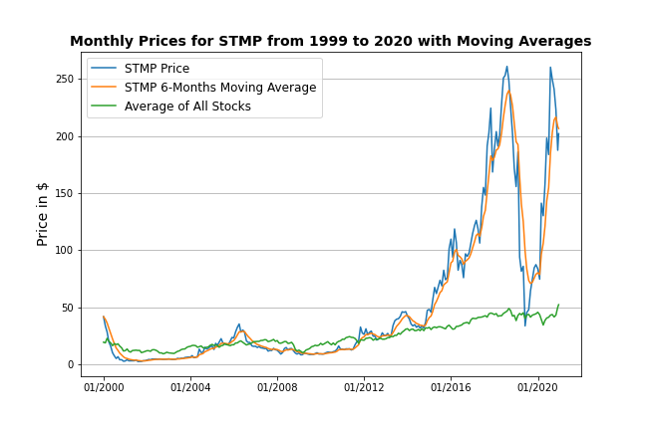
STMP (Stamps.com) is a provider of mailing and shipping solutions in the United States and Europe.
Two divisions:
Stamps.com is US based and focused on personal and small business
MetaPack is the enterprise grade platform focused on e-commerce brands
Benefited greatly from ecommerce growth due to COVID.
Crash at the end of 2019 due to discontinuation of partnership with the Postal Service.

