Slide 1

Winners in a PANDEMIC
David Grimmett - Jon Smart
Andrés Solano - Brittney Hopkins
Mercan Aslan

Slide 2





A Massive Challenge or a Massive Benefit?
The global COVID-19 pandemic has forced risks and challenges to many industries
Unfortunately, many businesses have been impacted badly –some, forever gone
However, there are some industries/sectors that have benefited tremendously. Our goal is to take a closer looks at a few companies
COVID 19
??
E-commerce
TOURISM
Technology
FINANCE
Restaurant
industry
??
??
WORKFORCE

Slide 3
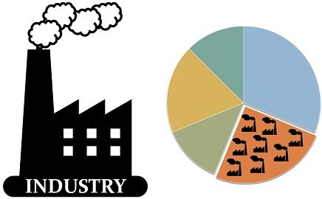
Industries vs. Sectors
Industry refers to a much more specific group of companies or businesses
Sector describes a large segment of the economy
The terms industry and sector are often used interchangeably to describe a group of companies that operate in the same segment of the economy or share a similar business type

Slide 4

Gathering Data – AlphaVantage API
Installing Package
from alpha_vantage.timeseries import TimeSeries
from alpha_vantage.sectorperformance import SectorPerformances
from config import akey
Gathering Stock Prices
ts = TimeSeries(key=akey, output_format='pandas', indexing_type='integer')
data, meta_data = ts.get_monthly('AAN')
data['Ticker'] = 'AAN'
data.to_csv('api-data/stock_prices.csv')
for stock in stocks:
try:
data, meta_data = ts.get_monthly(stock)
data['Ticker'] = stock
data.to_csv('api- data/stock_prices.csv', mode='a', header=False)
time.sleep(2.5)
print(f'{stock} data found. Appending to CSV')
except:
print(f'{stock} not available. No data added.')
pass
print(f'Data Done')
Notes:
Jon

Slide 5
Gathering Data – AlphaVantage API
Installing Package
from alpha_vantage.timeseries import TimeSeries
from alpha_vantage.sectorperformance import SectorPerformances
from config import akey
Gathering Company Information
query_url = f'https://www.alphavantage.co/query?function=OVERVIEW&apikey={akey}&symbol='
#looping through stock ticker list
for stock in stocks:
#error handling for stock tickers not present in API
try:
#get json response
response = requests.get(query_url + stock).json()
co_information = pd.json_normalize(response)[["Symbol",
"Sector","Industry","FullTimeEmployees"]]
#save data to CSV
co_information.to_csv('api- data/company_info.csv', mode='a',header=False)
print(f'Retrieving data for {stock}')
except:
print(f'Cannot find information for {stock}')
pass
print(f'Data retrieval done')
Notes:
Jon

Slide 6
How to clean the code and calculate the sector performance?
#adding company information to stock prices file
all_info= stock_prices.merge(company, on='Ticker', how='left')
all_info.set_index('Date', inplace=True)
all_info.sort_index(ascending=True, inplace=True)
all_info['Year'] = pd.DatetimeIndex(all_info.index).year
all_info['Month'] = pd.DatetimeIndex(all_info.index).month
#drop remaining unneeded columns
all_info.drop(columns=['Open','High','Low','Daily Volume'], inplace=True)
all_info.to_csv('api-data/all_info.csv')
all_info.head()
#analyzing 2020 data to find interesting sectors
file='api-data/yearly_summary/prices_for_2020.csv'
stocks2020 = pd.read_csv(file)
#lamba function takes each stock ticker in the CSV, finds the first date and the last date and then calculates % chg
sect_perf = stocks2020.groupby(['Ticker','Sector','Industry'],sort=False).apply(lambda x: (x['Close'].values[-1] - x['Close'].values[0]) / x['Close'].values[-1] * 100)\
.reset_index(name='pct change')
sect_perf.head()
 | Ticker | Sector | Industry | pct change
0 | TRST | Financial Services | Banks-Regional | -21.068702
1 | LNTH | Healthcare | Diagnostics & Research | -22.791024
2 | EPRT | Real Estate | REIT-Diversified | -30.174446
3 | MDC | Consumer Cyclical | Residential Construction | 14.384397
4 | VRA | Consumer Cyclical | Footwear & Accessories | -22.978177
Notes:
Jon

Slide 7
Visualizing Sector Performance
w=.95
indchg = ticker2020.groupby('Sector')['pct change'].mean()
industry = indchg.to_frame(name='Pct Chg')
industry.reset_index(inplace=True)
x_labels = industry['Sector'].to_list()
x = np.arange(len(x_labels))
y = industry['Pct Chg']
plt.figure(figsize=(8,5))
ax = y.plot(kind='bar', width=w, color=(y > 0).map({True: 'blue', False:'orange'}))
ax.set_title('Sector Performance 2020', fontsize=16, fontweight='bold')
#ax.set_xlabel('Sector', fontsize=16)
ax.set_ylabel('Percentage Change 2020 YTD', fontsize=13)
ax.set_ylim(-40,20)
ax.set_xticks(x)
ax.set_xticklabels(x_labels, rotation=45, fontsize=12, ha='right')
#Calling function defined above to add labels
add_value_labels(ax)
plt.tight_layout()
plt.savefig('images/industry_performance_w_labels.png')
Sector | pct change
Technology | 13.548758
Basic Materials | 12.188316
Consumer Defensive | 9.328190
Industrials | 7.555920
Healthcare | 7.233188
Consumer Cyclical | 6.285675
Financial Services | -7.277631
Communication Services | -9.482677
Utilities | -16.221258
Energy | -20.833857
Real Estate | -33.506755
Notes:
Jon

Slide 8
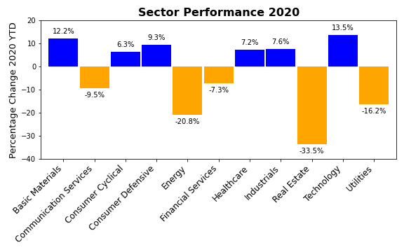
Monthly Sector Performance for 2020
Notes:
Jon

Slide 9
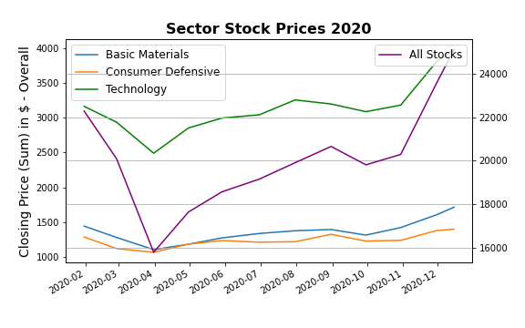
Chosen Sectors vs. SPDR Index 2020
Notes:
Jon

Slide 10
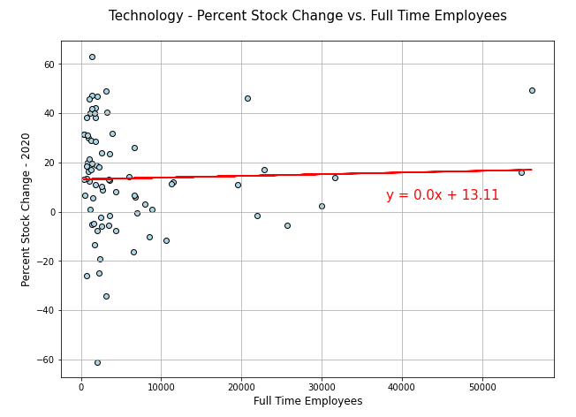
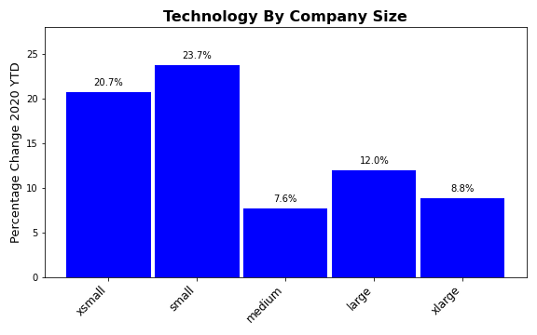

Technology
Electronic Components
Computer Hardware
Software (Applications & Infrastructure).
Consumer Electronics
Semiconductors and Semiconductor Equipment
Communications Equipment
Scientific & Technical Instruments

Slide 11
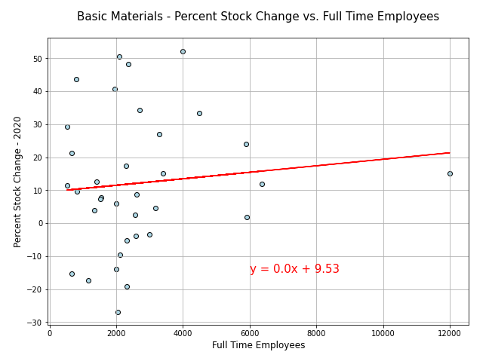
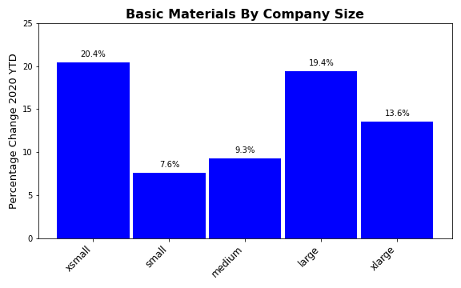

Basic Materials
Agricultural Inputs
Coking Coal, Building Material, Lumber
& Wood Production
Paper & Paper Products
Specialty Chemicals
Steel
Industrial Metals & Mining

Slide 12
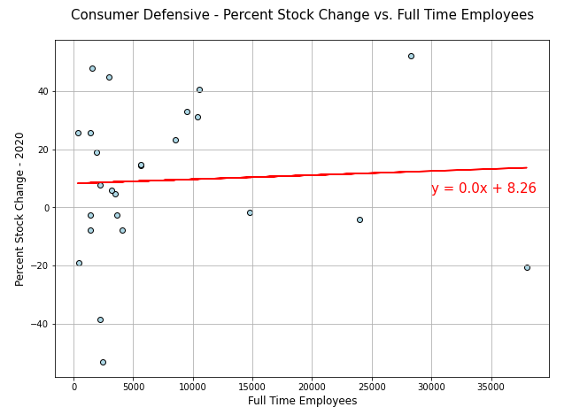
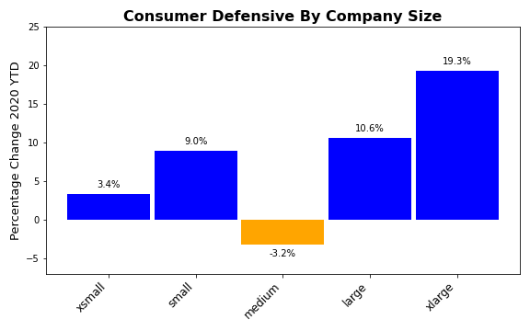

Consumer Defense
Packaged Foods
Education & Training Services
Farm Products
Beverages (Non-Alcohol)
Food Distribution
Tobacco
Household & Personal

Slide 13

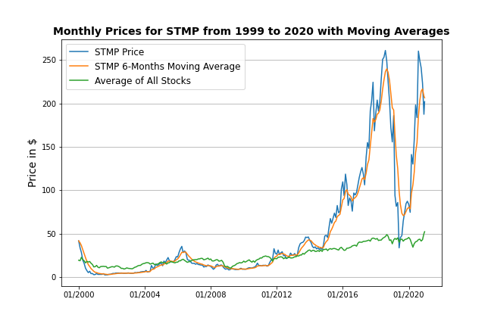
A provider of mailing and shipping solutions in the United States and Europe
Benefited greatly from e-commerce growth due to COVID
“TOO COLD TO GO TO THE POST OFFICE?”
Print official stamps and shipping labels from your own computer
Crash at the end of 2019 due to
discontinuation of partnership
with the Postal Service!

Slide 14

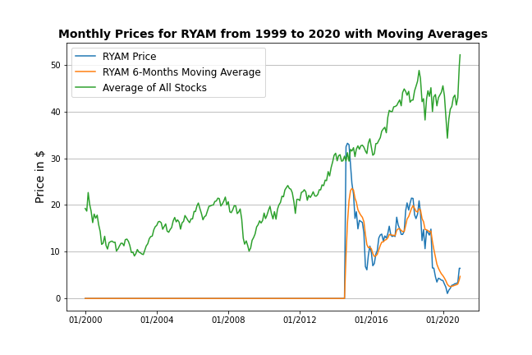
High-Purity Cellulose
Lumber
High Yield Pulp
Newsprint
Paperboard
American chemical company specializing in cellulose-based products
Produces more than 25 grades of high-purity performance fibers for products ranging from food, cosmetics, and pharmaceuticals to paints, filters, impact-resistant plastics, and digital display screens

Slide 15

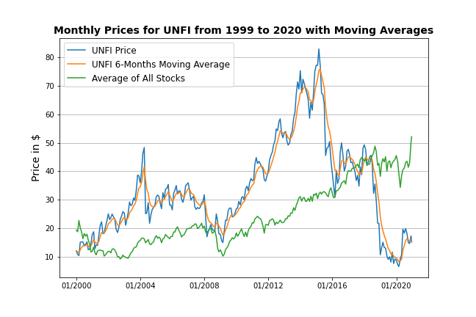
A North American food wholesaler
Works with suppliers to deliver the most-needed products to customers
Hiring additional warehouse workers and drivers during covid to maximize capacity of distribution

Slide 16
Conclusions
While sector performance was negative for 5 of 11 sectors (highlighted by Real estate and Energy- down 33.5% and 20.8% respectively) sector performance is UP for 6 of 11 sectors.
In addition, overall stock closing prices are up 56% from April 2020 to December 2020
Thus, our data displays balanced performance among sectors and recovery for the 600 stocks analyzed.
These facts indicate that while the pandemic has undoubtedly impacted the economy- the effects of these changes have brought about some winners, along with economic recovery.
“The greatest danger in times of turbulence is not the turbulence – it is to act with yesterday’s logic.” – Peter Drucker
Notes:
Andres can add in the Implications from project requirements

Slide 17
References
Ohio.gov
Census Business Formation Data
https://www.ssga.com/us/en/institutional/etfs/funds/spdr-sp-600-small-cap-etf-sly
https://www.ers.usda.gov/data-products/#!topicid=14832&subtopicid=14878
https://www.forbes.com/sites/rohitarora/2020/06/30/which-companies-did-well-during-the-coronavirus-pandemic/?sh=2509aec87409
https://www.naics.com/search/
https://abcnews.go.com/Business/winners-pandemic-economy-big-tech-lockdown-essentials-soar/story?id=72495436
https://www.alphavantage.co/
https://www.thebalance.com/what-are-the-sectors-and-industries-of-the-sandp-500-3957507
https://www.thebalance.com/what-are-the-sectors-and-industries-of-the-sandp-500-3957507
Rayonier Advanced Materials – Wikipedia
Wholesale Bulk Food & Products | Wholesale Food Distributors | UNFI

Slide 18

Thanks!
This guy named Mark that work at Home Depot..
A couple rented their apartment in Santiago, traveled the worl…

