Slide 1
CyberTrace
Clustering and Analysis of Suspicious Network Traffic
Victor Andrade and Ben Miller

Slide 2
Problem Statement
How can suspicious network artifacts be compared without relying only on signatures?
Can unsupervised clustering reveal meaningful groups of benign and malicious behavior?
Can the workflow stay interpretable and useful for cybersecurity investigation?

Slide 3
Motivation
Analysts cannot rely only on exact signature matches.
Suspicious traffic often needs comparison by observable behavior.
Clustering helps group similar artifacts for investigation.

Slide 4
Contributions
Built a Python repo and CLI for cybersecurity clustering analysis.
Prepared a real NSL-KDD dataset into a reusable feature table.
Generated clustering results, figures, tests, report, slides, and zip packaging.

Slide 5
Dataset
Real dataset: small NSL-KDD training CSV sample.
Records: 1011 total, 516 benign, 495 malicious.
Safe benchmark: no live malware and no sensitive production traffic.

Slide 6
Pipeline
Raw dataset stored in data/raw/.
prepare-nsl-kdd converts rows into a CyberTrace feature table.
KMeans clusters the standardized numeric feature matrix.
Labels are used after clustering for interpretation only.

Slide 7
Methodology
Store raw safe data in data/raw/.
Prepare NSL-KDD into numeric and encoded features.
Standardize the feature matrix and apply KMeans.
Interpret clusters by comparing labels and attack types after fitting.

Slide 8
Implementation
Main package: src/cybertrace/
CLI commands: prepare-nsl-kdd and cluster
Outputs: prepared CSV, cluster assignments, notebooks, figures, report
Validation: Ruff checks and Pytest

Slide 9
Findings
Cluster 0: 493 benign, 95 malicious
Cluster 1: 23 benign, 109 malicious
Cluster 2: 0 benign, 291 malicious

Slide 10
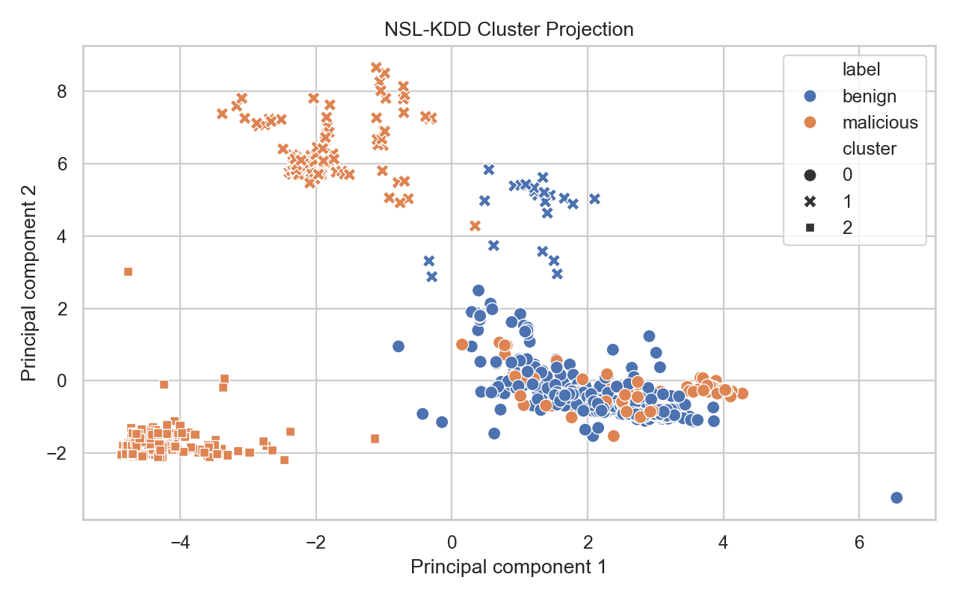
Results Visualization
PCA projection of the clustered NSL-KDD records.

Slide 11
Interpretation
Cluster 0 is the most normal-like group.
Cluster 1 is mixed but malicious-heavy, showing overlapping suspicious behavior.
Cluster 2 is fully malicious in this baseline run and dominated by neptune.

Slide 12
Implications
Clustering can help prioritize analyst review even without using labels to fit the model.
Mixed clusters are still valuable because they highlight ambiguity worth investigating.
The workflow is reproducible and can be extended to additional safe datasets.

Slide 13
Group Members
Victor Andrade and Ben Miller worked on the project together from start to finish.
The work was divided evenly across planning, implementation, analysis, reporting, and presentation.

Slide 14
Future Work
Evaluate newer datasets and richer flow-based artifacts.
Compare KMeans with hierarchical clustering and DBSCAN.
Add deeper per-cluster feature summaries and reporting.

Slide 15
Conclusion
CyberTrace shows that clustering can meaningfully support cybersecurity investigation.
The project now delivers a report, presentation, code, data, and a submission zip.
It is a strong foundation for deeper threat-analysis work.

