Slide 1
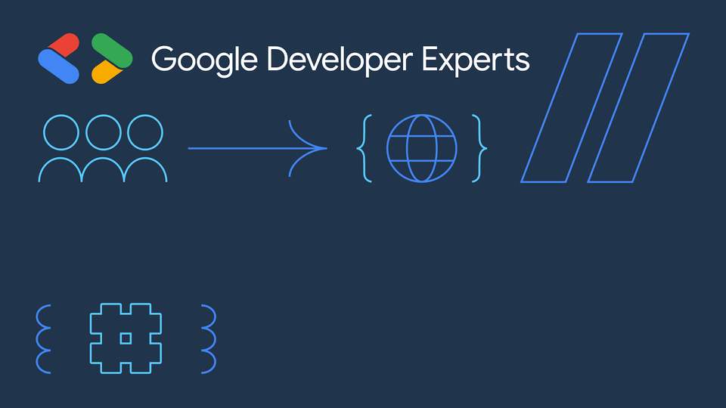
< > Google Developer Experts // { 01 // 2026 GDE BRAND IDENTITY & GRAPHICS } { # } // o o o -> { 🌐 }
01 // 2026 GDE BRAND IDENTITY & GRAPHICS
Google Developer Experts: 2026 Brand Identity & Graphic Motifs
Authentic #20344B Navy Canvas, Brighter Halftones (#FF7DAF, #5CDB6D, #57CAFF, #FFD427) & Signature { # } // Graphics
HALFTONE GREEN // STAT PILL
#5CDB6D
2026 Brighter Halftones
Halftone Green (#5CDB6D), Pink (#FF7DAF), Blue (#57CAFF) & Yellow (#FFD427)
Paired directly against Grounding Navy (#20344B) for high-contrast stage legibility
Replaces flat 4-color bars with expressive rounded pill cards
SIGNATURE GDE GRAPHICS
{ 2026 }
Brackets { # } & Slashes //
Curly hash brackets { # } and double-slash // framing technical callouts
Community-to-globe diagram (o o o -> { globe }) from Slide 1 of the 2026 Guide
Horizontal < > Google Developer Experts bracket lockup on #20344B Navy
TYPOGRAPHY & FOOTPRINT
Distilled
Google Sans + PT Mono
Google Sans SemiBold headlines paired with PT Mono technical tags
Distilled from 83 MB (38 slides) into a fast, token-efficient brand template
Preserves actual GDE graphic artwork, color tone, and slide chrome
SLIDE 23 // NAVY BG
#
Navy BG
Used with no text, to provide contrast and ensure 16:9 or 4:3 graphics are not skewed in a 1:1 format
Authentic 2026 GDE slides pair #20344B Navy and #FF7DAF Halftone Pink headlines with { # }, //, and overlapping stat pill cards.
Google Developer Experts // 2026 Official Brand System | Google Developer Expert (Cloud & AI GDE) | Slide 1 of 2

Slide 2
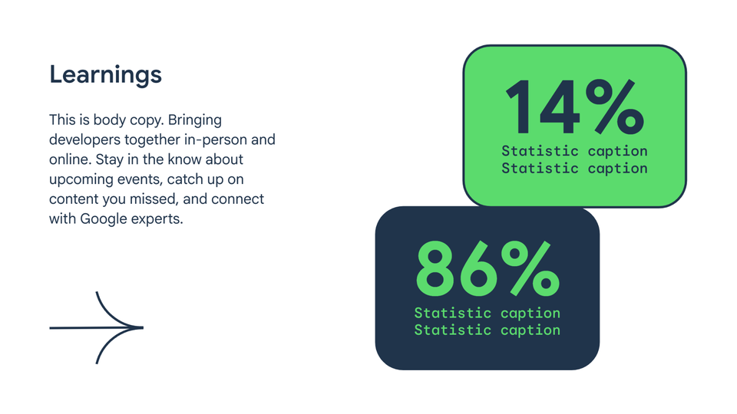
< > Google Developer Experts // { 02 // SLIDE 23 TEMPLATE: OVERLAPPING STAT PILLS } { # } // o o o -> { 🌐 }
02 // SLIDE 23 TEMPLATE: OVERLAPPING STAT PILLS
2026 GDE Slide Template: Overlapping Stat Pills & Editorial Hierarchy
Modeled directly on Slide 23 (Slide Template) of the 2026 Google Developer Experts Brand Guide
SLIDE 23 // GREEN STAT PILL
14%
Primary Halftone Metric
Rounded #5CDB6D Halftone Green pill card with #20344B Navy typography
Oversized Google Sans SemiBold numerals for instant audience scan
Curved directional arrow (->) connecting headline to data proof
SLIDE 23 // NAVY STAT PILL
86%
Grounding Navy Contrast
Overlapping #20344B Navy pill card with #5CDB6D Halftone Green numerals
Creates visual depth and breaks away from rigid rectangular grids
Framed by #FF7DAF pink circular ring accents (O O O)
SLIDE 23 // YELLOW CALLOUT
#FFD427
Halftone Yellow Caption Pill
#FFD427 Halftone Yellow callout card with 2pt #20344B Navy border
Highlights key architectural takeaways and benchmark caveats
Ready for one-click export to .PPTX or Google Workspace Slides
SLIDE 23 // WHITE BG
#FFFFFF
White BG
Used with no text, to provide highlight and ensure 16:9 or 4:3 graphics are not skewed in a 1:1 format
Slide 23 of the 2026 GDE Brand Guide replaces generic bullet boxes with overlapping #5CDB6D, #20344B, and #FFD427 rounded stat pills.
Google Developer Experts // 2026 Official Brand System | Google Developer Expert (Cloud & AI GDE) | Slide 2 of 2

