Slide 1

Wiring Method for DWIN Products and STM32 Development Board
2024.6.27

Slide 2
Catalogue
1. Pin description for SMT32 development board
2. Wiring 10pin&1.0mm pitch connector
3. Wiring 8pin&2.0mm pitch connector
4. Wiring 8pin&3.81mm pitch connector
5. Wiring 6pin&2.54mm vertical socket
6. Wiring COF structure display
7. Wiring development board

Slide 3
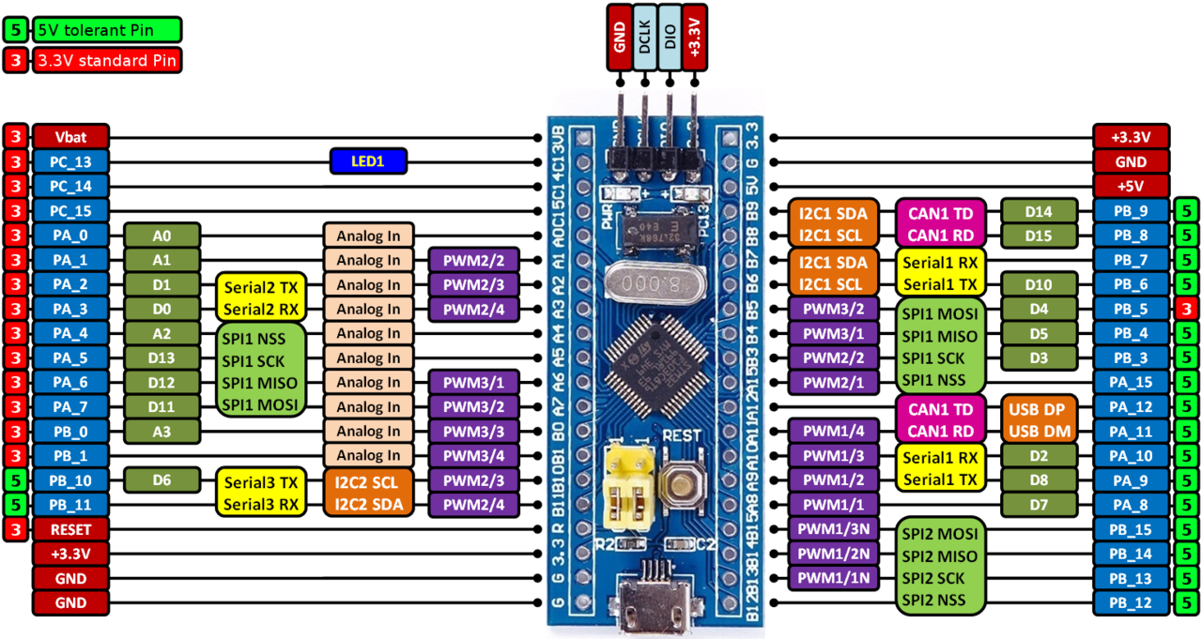
1. Pin description for STM32 F103C8T6
This ESP32 C3 development board have 3 UARTs. The 3 UARTs are TTL level and we will use UART2 to communicate with DWIN displays. And we need to power the board independently.
POWER
UART 2&3
UART 1

Slide 4
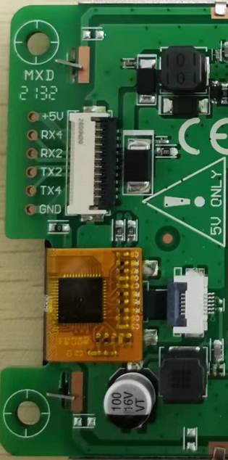
2. Wiring 10pin&1.0mm pitch connector
This kind of display are all TTL level, please wiring them as below.
+5V
GND
+5V GND

Slide 5
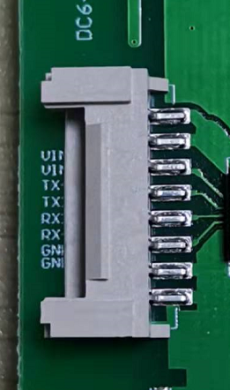
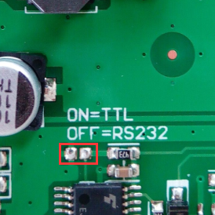
3. Wiring 8pin&2.0mm pitch connector
This kind of displays may use RS232&TTL switchable port. First switch the level to TTL. If the display cannot switch the level, you will need a conversion board.
A. Without conversion board：
+5V
GND
RS232/TTL switcher
+12V GND

Slide 6
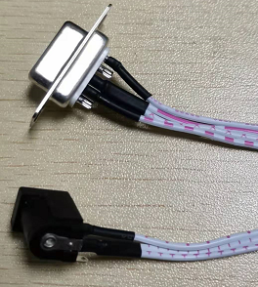

3. Wiring 8pin&2.0mm pitch connector
B. With conversion board:
RS232 to TTL
conversion board
5V
TX
DB9
RX
GND
HDL65011
12V DC power
+5V
GND
5V GND

Slide 7
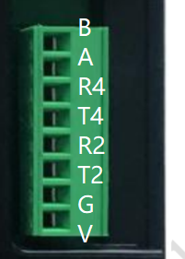
4. Wiring 8pin&3.81mm pitch connector
This kind of displays will use RS232 level, so we must use a conversion board. For your convenience to wiring, you can take off the socket of HDL65011.
RS232 to TTL
conversion board
5V
TX
DB9
RX
GND
HDL65011
HDL65011 socket
Color for linear sequence:
blue=2
orange=3
grey=5
black=GND
red=VCC
12V DC power
+5V
GND
5V GND

Slide 8
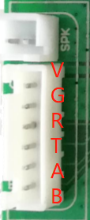
5. Wiring 6pin&2.54mm pitch vertical socket
Non-TTL level display of vertical socket will need conversion board. This socket will use special plug to wiring. You can also take off the socket of HDL65011, use the wires to plug in.
RS232 to TTL
conversion board
5V
TX
DB9
RX
GND
HDL65011
Color for linear sequence:
blue=2
orange=3
grey=5
black=GND
red=VCC
5/12V DC power
+5V
GND
5V GND

Slide 9
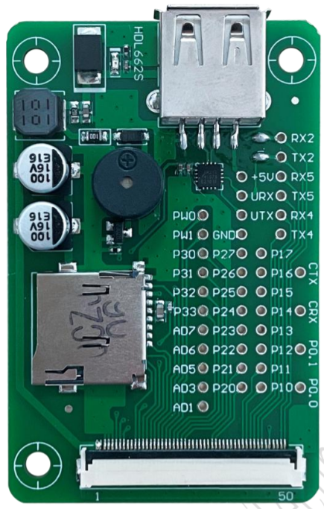
6. Wiring COF structure display
COF display has a official adaptor, this adaptor could use to communicate with PC. Because the via holes are connect to T5L kernel, so all UARTs are both TTL level. We can plug in as below.
5V DC power
+5V
GND

Slide 10
7. Wiring development board
A development board is a special DWIN serial port display. They have a independent DC power, and almost all hardware resources have been leaded out. You can plug in the via holes as below to communicate.
RX2
TX2
Use the silk marks to find these via holes.
GND
+5V
GND
5V/12V DC power

