Slide 1

Computational investigation of collisional broadening and shifting for Ar lines in helium: methods and problems of calculation
Andrey A. Pershin,
PhD Student
Master of Applied Physics and Mathematics
Samara, 2020

Slide 2

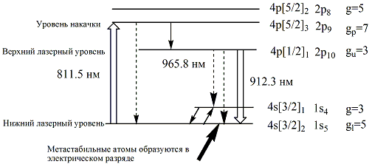
Laser with Optical Pump on Rare Gases (LOPRG)
[Han J., Heaven M.C., Opt. Lett., Vol. 39, No. 22, 2014. pp. 6541-6544.] [Demyanov A.V. et al., J Phys D: Appl Phys, Vol. 46, No. 375202, 2013.] [Han J. et al., Opt. Lett., Vol. 38, No. 24, 2013. pp. 5458-5461.]
2

Slide 3
To-Do-List
Calculate potential energy curves by methods of quantum chemistry +
Calculate cross sections and Einstein’s coefficients for transitions between substates ±
Calculate spectrum of transitions in different conditions (temperature+concentration) –
Approximate spectrum and find coefficients for transition between states (full) –
3

Slide 4
Step 1. Quantum chemistry
Basis sets: aug-cc-PV5Z + even-tempered diffuse s and p orbitals (Ar); aug-cc-PCV5Z(He)
Methods: CASSCF -> MRCI -> MRCI+HLSMAT
Active space (6, 7)
48 excited states (Ground state has been excluded)
Software: MOLPRO 2015 (molpro.net)
Hardware: Supercomputer “Sergey Korolev”, Samara University (http://hpc.ssau.ru/), Emerson Center, Emory University (http://www.emerson.emory.edu/)
4

Slide 5
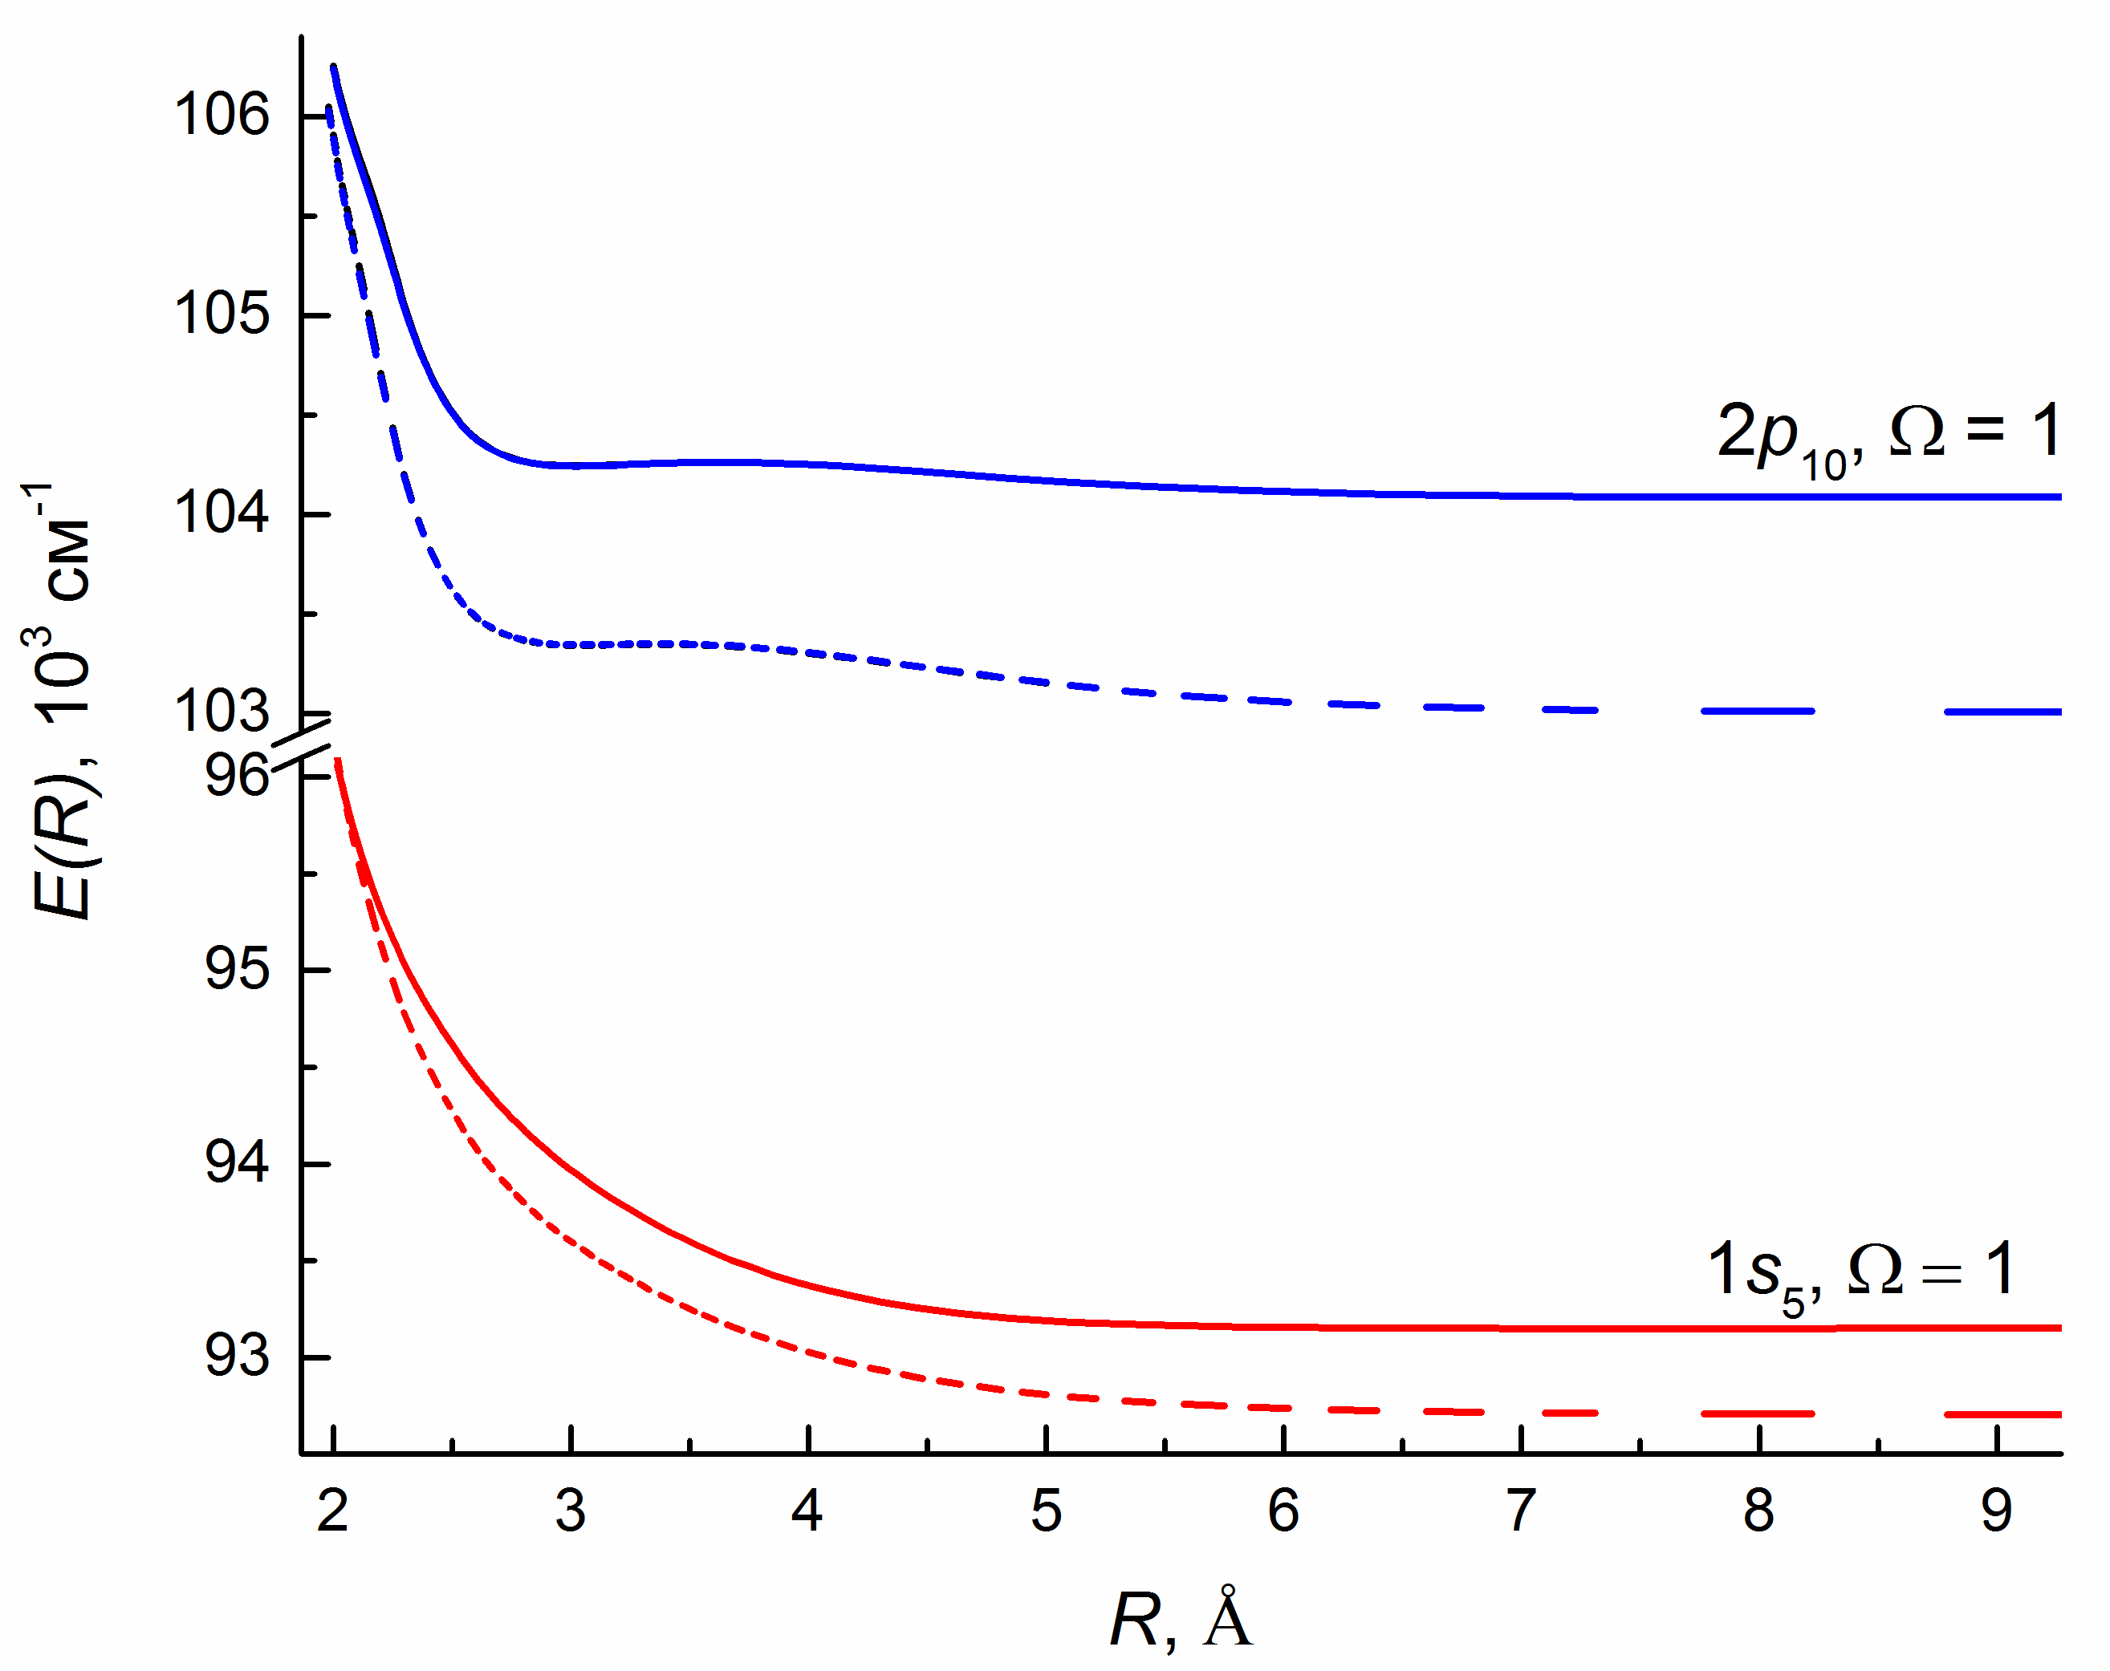
Step 1. Quantum chemistry
Pershin A.A. et al. CALCULATION OF POTENTIAL ENERGY CURVES FOR Ar*-He COLLISIONAL COMPLEX. Bull. Lebedev Phys. Inst. 2020 (In print)
5

Slide 6
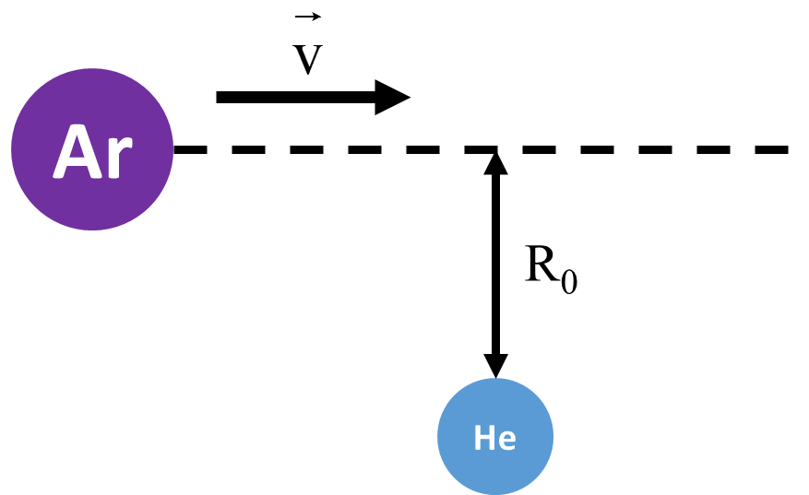
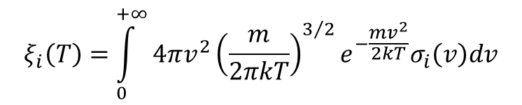
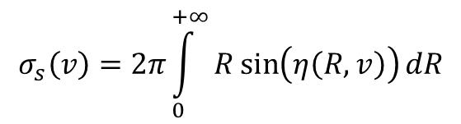
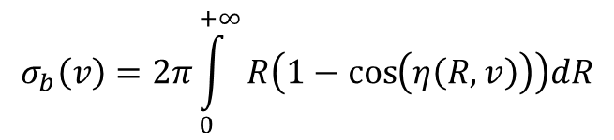
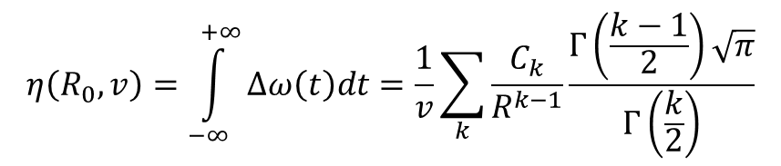
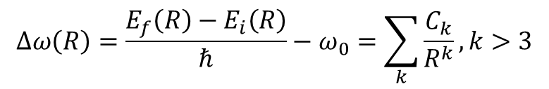
Step 2. Calculation of cross sections
$$∆ω\left(R\right)=\frac{E_{f}\left(R\right)−E_{i}\left(R\right)}{ℏ}−ω_{0}=\sum_{k}{\frac{C_{k}}{R^{k}}}, k>3$$
$$η\left(R_{0},v\right)=\int_{−∞}^{+∞}{∆ω\left(t\right)dt}=\frac{1}{v}\sum_{k}{\frac{C_{k}}{R^{k−1}}\frac{Γ\left(\frac{k−1}{2}\right)\sqrt{π}}{Γ\left(\frac{k}{2}\right)}}$$
$$σ_{b}\left(v\right)=2π\int_{0}^{+∞}{R\left(1−\cos\left(η\left(R,v\right)\right)\right)dR}$$
$$σ_{s}\left(v\right)=2π\int_{0}^{+∞}{R\sin\left(η\left(R,v\right)\right)dR}$$
$$ξ_{i}\left(T\right)=\int_{0}^{+∞}{4πv^{2}{\left(\frac{m}{2πkT}\right)}^{3/2}e^{−\frac{mv^{2}}{2kT}}σ_{i}\left(v\right)dv}$$
[Demtroder W. Laser spectroscopy. 2008.]
6

Slide 7
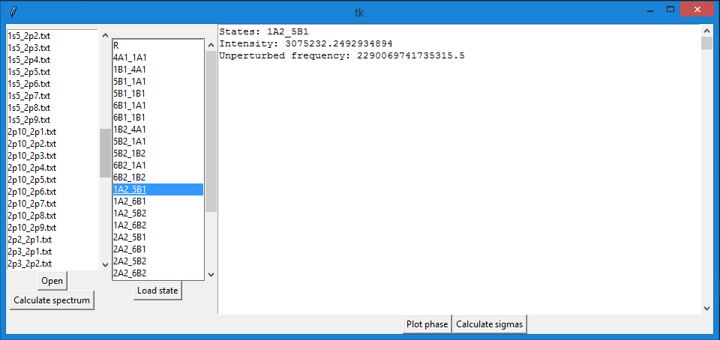
Step 2. Calculation of cross sections. Software.
https://github.com/andrescorp93/ArHeSpectrum_GUIversion
Made on Python 3.6 with SciPy, numPy, matplotlib etc.
7

Slide 8
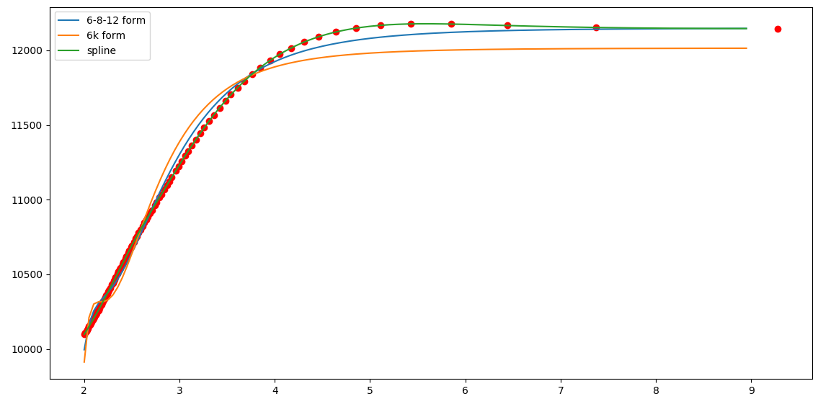
Step 2. Calculation of cross sections. Fitting
8

Slide 9
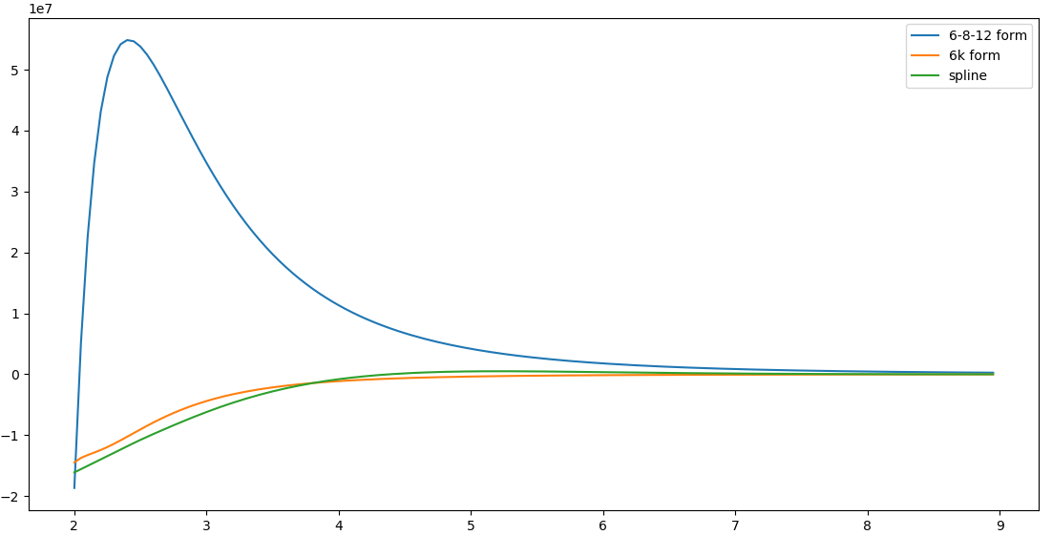
Step 2. Calculation of cross sections. Phase integral
9

Slide 10
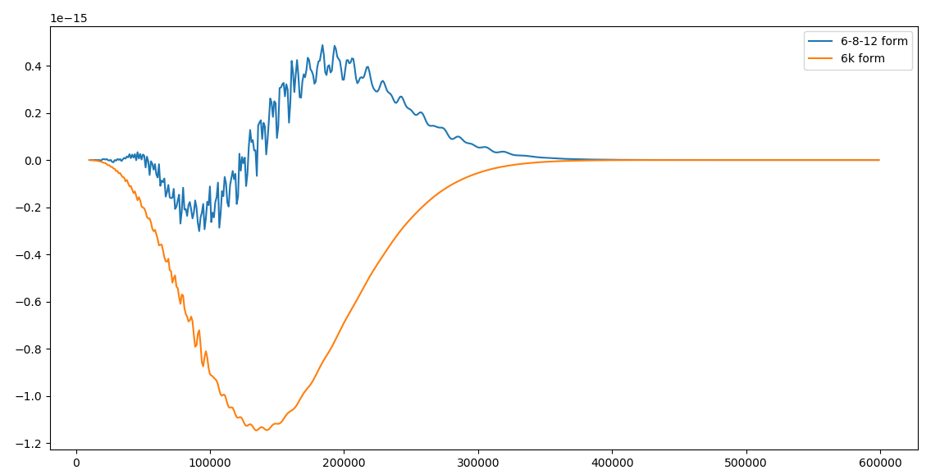
Step 2. Calculation of cross sections. vσ_{s}(v)f_{Maxwell}(v)
10

Slide 11
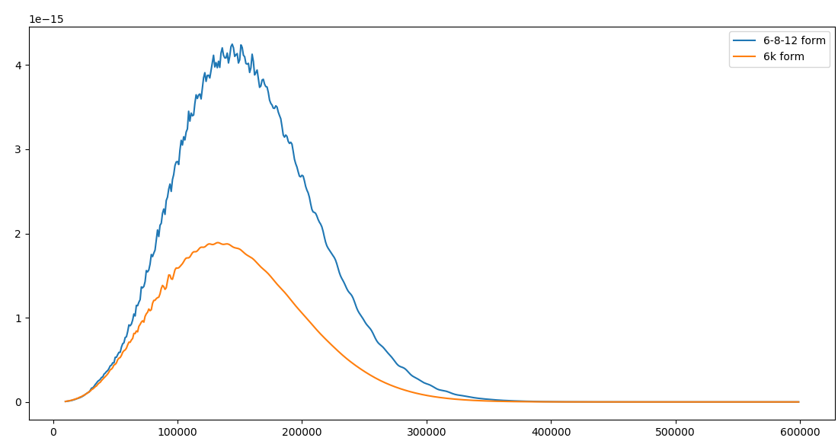
Step 2. Calculation of cross sections. vσ_{b}(v)f_{Maxwell}(v)
11

Slide 12
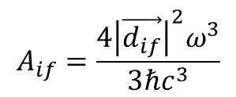
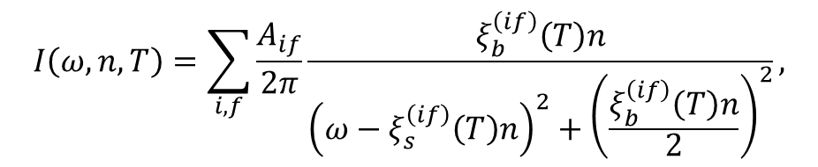
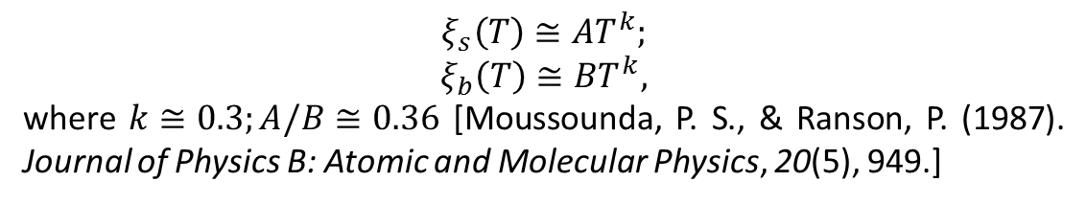


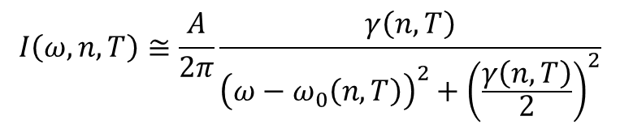
Step 3. Calculation and analysis of spectrum
$$A_{if}=\frac{4{{\left|\vec{d_{if}}\right|}^{2}ω}^{3}}{3ℏc^{3}}$$
$$I\left(ω, n,T\right)=\sum_{i,f}{\frac{A_{if}}{2π}\frac{ξ_{b}^{\left(if\right)}\left(T\right)n}{{\left(ω−ξ_{s}^{\left(if\right)}\left(T\right)n\right)}^{2}+{\left(\frac{ξ_{b}^{\left(if\right)}\left(T\right)n}{2}\right)}^{2}},}$$
$$I\left(ω, n,T\right)≅\frac{A}{2π}\frac{γ\left(n,T\right)}{{\left(ω−ω_{0}\left(n,T\right)\right)}^{2}+{\left(\frac{γ\left(n,T\right)}{2}\right)}^{2}}$$
$$γ\left(n,T\right)≅ξ_{b}\left(T\right)n$$
$$ω_{0}\left(n,T\right)≅ξ_{s}\left(T\right)n$$
$$ξ_{s}\left(T\right)≅AT^{k};$$
$$ξ_{b}\left(T\right)≅BT^{k},$$
where $k≅0.3;A/B≅0.36$ [Moussounda, P. S., & Ranson, P. (1987). Journal of Physics B: Atomic and Molecular Physics, 20(5), 949.]
12

Slide 13
Step 3. Calculation and analysis of spectrum. Einstein coefficients
Transition | λ, Å | A_{ki} (calculated), s⁻¹ | A_{ki} (NIST), s⁻¹
2p2-1s5 | 6965.431 | 1.36E+06 | 6.70E+06
2p3-1s5 | 7067.218 | 808566.1 | 3.95E+06
2p1-1s2 | 7503.869 | 7.87E+06 | 4.72E+07
2p6-1s5 | 7635.106 | 5.01E+06 | 2.74E+07
2p4-1s3 | 7948.176 | 3.63E+06 | 1.96E+07
2p6-1s4 | 8006.157 | 817388.2 | 4.90E+06
2p8-1s5 | 8014.786 | 1.68E+06 | 9.28E+06
2p7-1s4 | 8103.693 | 4.76E+06 | 2.50E+07
2p9-1s5 | 8115.311 | 6.45E+06 | 3.31E+07
2p10-1s5 | 9122.967 | 3.33E+06 | 1.89E+07
2p10-1s4 | 9657.786 | 922946.9 | 5.43E+06
All calculated coefficients are 5.5 times less than values in NIST spectroscopic database!
13

Slide 14
AND AS ALWAYS…
THANKS FOR WATCHING
Phone: +79991716397
E-mail: anchizh93@gmail.com
GitHub: https://github.com/andrescorp93

