Slide 1

Distinct Counts with Noisy Identity Functions
Dr. Andrés Corrada-Emmanuel, Data Engines

Slide 2
Introduction
Data Engines develops and licenses ground truth inference algorithms.
Leader in AI errors since 2008. Now Auto-ML and AI Accountability have raised the profile of the work.
We have two Instant POCs online at dataengines.com/groundseer
GroundSeer Regressors
GroundSeer Classifiers (soon!)
Non-parametric estimators don’t get enough attention
Good-Turing smoothing: How many species have I not seen yet?
Distinct Counters: How many uniques have I seen?
Algebraic Ground Truth Inference: How many errors have these AI algorithms made?
For Researchers – hardly mined out.

Slide 3

The Distinct Count Statistic
Along with volume, one of the most important ad-tech statistics
Affects planning, optimization, and reporting.
Privacy and monopolistic concerns are making it harder to obtain.

Slide 4
Data Streaming Algorithms for Distinct Counting
Estimate some statistic of a data stream with a very small footprint.
Millions can be counted with about 1K of memory.
My slant on it
Algorithms that refuse to remember the Ground Truth.
Privacy-preserving

Slide 5


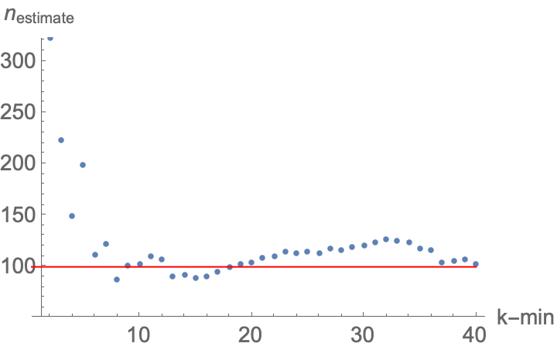
The Basic Idea behind Distinct Counters
Given Identity function for data stream objects.
Hash Identity output to (0,1) interval
n ~ 1/x_min
All the details are about making this have a small variance.
Great resources
datasketches.apache.org
Swoop’s Spark Alchemy library
Sim Simeonov, Swoop CTO, talk on Advanced Analytics with HyperLogLog

Slide 6
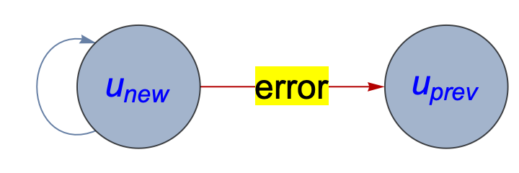
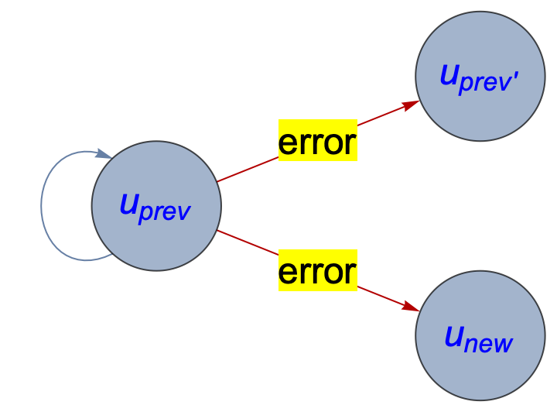
The Ad-Tech Reality: Noisy Identifiers
IP address
Cookies
Vendor ID Services
User logins

Slide 7
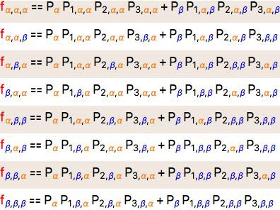
Errors in Binary Classification: What?
Majority of data unlabeled for ultimate business purpose. Otherwise, why us?
How do we know how good our production classifiers are? Pedestrian detectors in self-driving cars?
2010 – Algebraic Ground Truth Inference
Uses beautiful mathematics of Algebraic Geometry.
Really about ensemble failures:
Marriages
Super-Max
Learned societies / Democracies

Slide 8
Theoretical importance of non-parametric estimators
They avoid the thorny representation problem in Science.
Examples:
Good-Turing smoothing estimates unseen species count with no Biology or NLP inside it.
HyperLogLog or KMV estimates unique count without any Queueing Theory inside it.
Algebraic GTI estimates AI errors without any Machine Learning inside of it.
Error-correcting codes detect and fix memory errors without understanding manufacturing errors or cosmic rays.
In this application, since no family of functions is used, independence of two distributions is a looser requirement.

Slide 9
Mapping the ID task to Binary Classification
We do not want detailed knowledge of the errors.
Re-label each ID system’s output into new and previous users.
We lose ability to tell correct from incorrect previous user assignments.
But we can still estimate prevalence of new users – the distinct count.

Slide 10
An Algorithm for Distinct Counting with Noisy Identity functions
Given (id_a, id_b, id_c)
Construct (label_a, label_b, label_c) event using Bloom filters set-membership queries.
Solve for true prevalence of new users in the data stream.

Slide 11
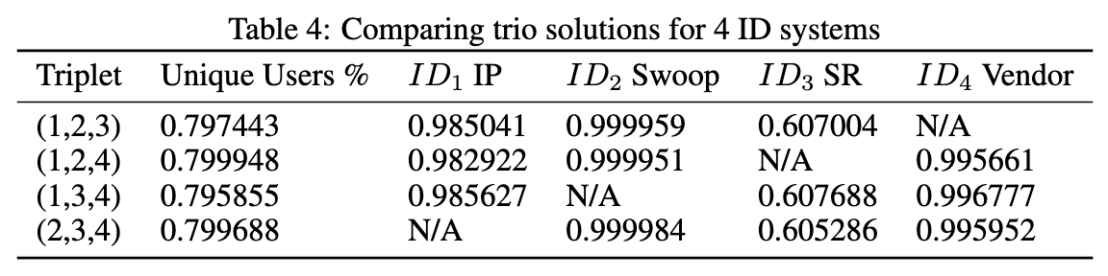
A Swoop online experiment
We had access to four noisy Identifiers
IP address
Site cookie
NPI service
LiveRampXY id
How do we know these systems are independent? We don’t
Do Algebraic GTI on all possible trios. Do they agree?
5 parts in a thousand!
IP really good in this context because we have mostly singletons.
Diversity most important, not quality, for self-assessment.
Self-reported ID vendor not fulfilling SLA.
LiveRampXY looks good, comparison with site cookie.
No causes or explanations inherent in the results.

Slide 12
Concluding Remarks
Advantages
Precise
Private
Useful for
SLA verification
Error mapping of domains/times
Want to thank my colleagues at Swoop again:
Ed Pantridge
Eddie Zahrebelski
Aditya Chaganti
Sim Simeonov
Pointers
Algebraic Ground Truth Inference NeurIPS 2020 submission
ICML 2008 paper for Regressors Ground Truth Inference, not patented
Github.com/andrescorrada/ground-truth-problems-in-business
Dataengines.com/groundseer

