Slide 1

Time In Ad-Tech Data Flows

Slide 2

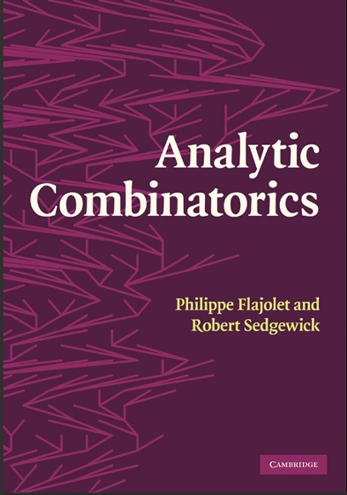
Taming uncertainty in Ad-Tech Flows
Street-fighting mathematics, back-of-the-envelope calculations
Focus on the combinatorics of the data

Slide 3
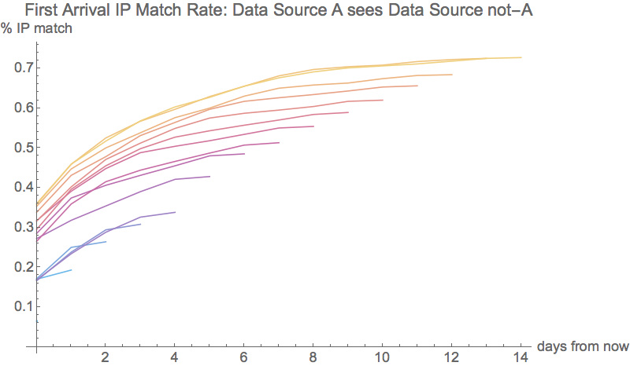
A match rate misunderstanding
Notes:
Forgetting that match rate is dynamic.
Not sure why this belief is so common.
Possible causes
It’s hard to calculate match rates in big data systems.
It is easier to reason with less numbers.

Slide 4
Time is Easy to Understand
“A cookie lasts 100 hours, the BC ID on desktops lasts 100 days”
“This lightbulb lasts 100 hours, an LED 22.5 years.”
“This table has information about new things in that other table in less than one day.”
“This table has no more information about things in that other table if you go back three months.”

Slide 5
Uniqueness gives you Time

Slide 6
Time => exponential increase in data

Slide 7
Time = linear increase in information

Slide 8
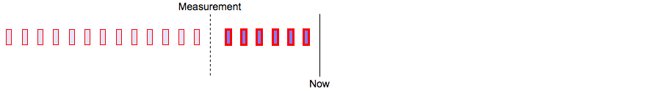
Time of First Appearance
When does new data that I see in source A show up in source B?
Notes:
Ad-tech systems use different data sources to learn how to run future campaigns.
Your ability to learn depends on tying together data from different sources.
You cannot learn about something that does not show up.
Time of first appearance is the quickest you could do it.
We already see a computational problem here – we will have to do n^2 calculations where n is the number of time units.

Slide 9
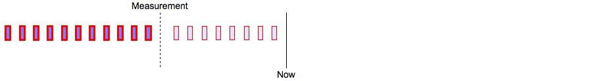
Time of Last Appearance
When does new data that I see in source A stop showing up in source B?

Slide 10
Counting Distinct Values is Hard
Number of days: D
Number of pair comparisons: D²
Number of incremental comparisons: D³
Notes:
Calculations of these times is prohibitive if we want exact counts.
In the spirit of street-fighting advertising mathematics, we are happy with estimates that show overall trends.

Slide 11
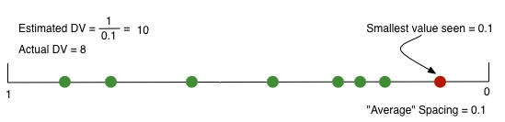
A Solution: HyperLogLog
From the excellent blogs of Neustar Research:

Slide 12
Ad-Tech Science Rules of Thumb
On short enough time-scales, IPs are correlated with true entities.
IPs are easier to consider than complicated algorithms.

Slide 13
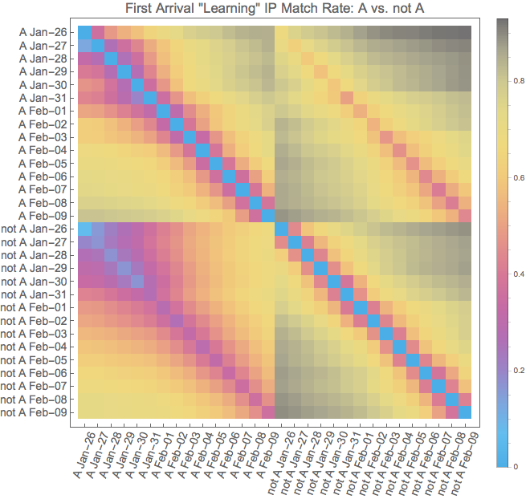
Data Source A vs Not-A

Slide 14
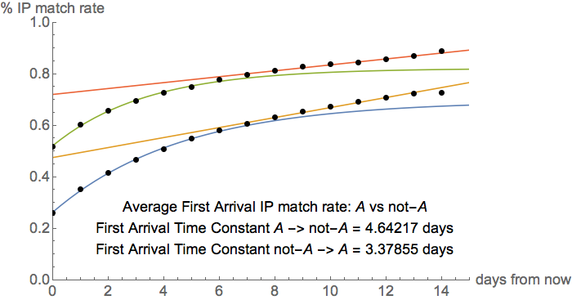
First Arrival Time Constant

Slide 15
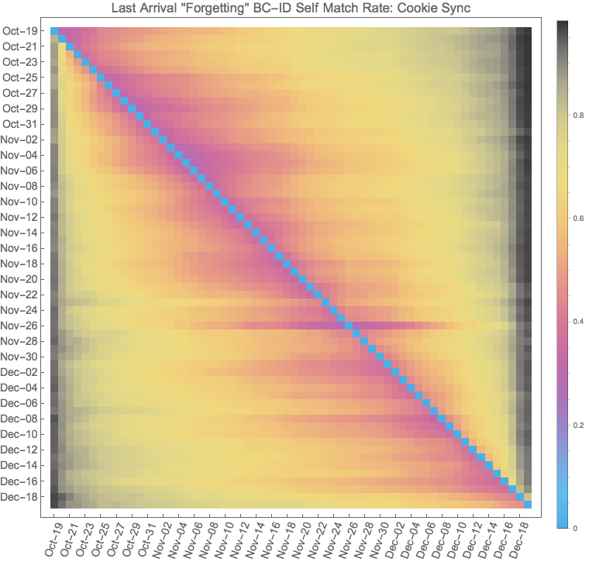
The Lifetime of the BC ID

Slide 16
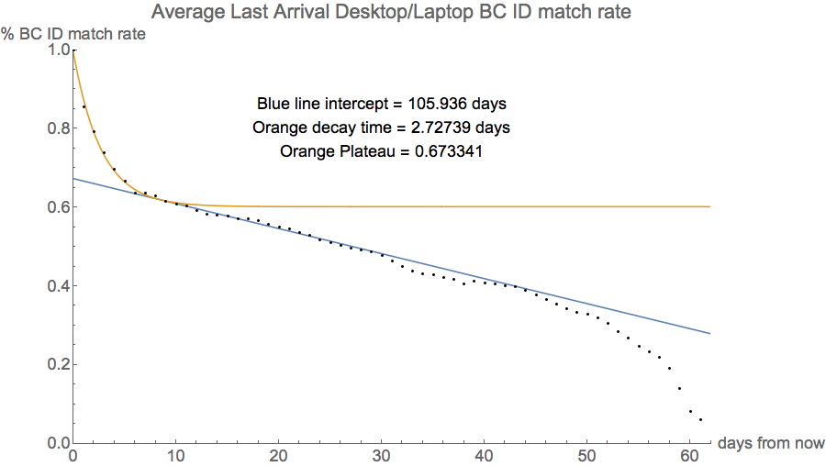
The Lifetime of the BC ID

Slide 17
Conclusions
Time is
Easy to measure with HyperLogLog
Meaningful
Has many uses
Understanding information flow between data sources
SLA metric

