Slide 1
Algebraic ground truth inference and counterfactual assumptions

Slide 2
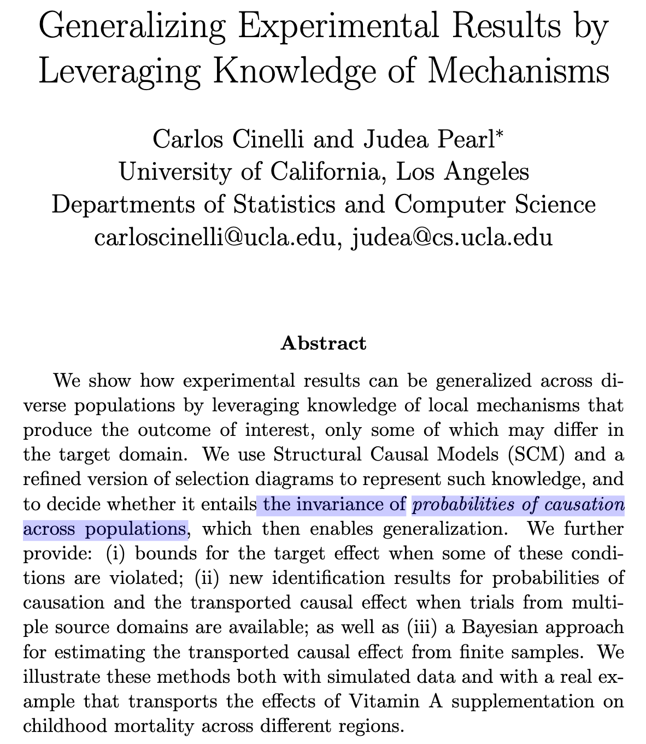
Extending RCTs across domains, Vitamin A
How do we test instruments and theory
Without ground truth?
Without more theory?

Slide 3
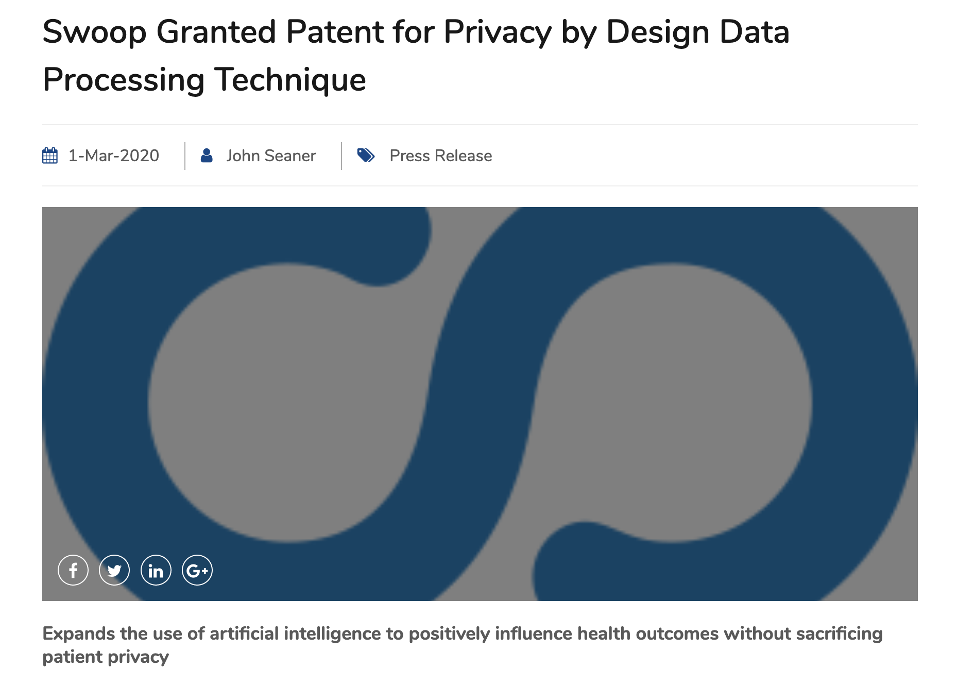

Who are we?
As we know, there are known knowns; there are things we know we know. We also know there are known unknowns; that is to say we know there are some things we do not know. But there are also unknown unknowns—the ones we don’t know we don’t know.
Donald Rumsfeld, US Secretary of Defense
Aditya Chaganti
Ed Pantridge
Eddie Zahrebelski
Simeon Simeonov
Measurement without ground truth
Privacy
Unavailable
Unknown
Notes:
IPM.ai is a US medical AI start-up.
We use de-identified US claims data to help pharmaceuticals model patient populations fo planning research goals, recruit patients for clinical trials, and plan their marketing efforts.
By law (HIPPA) and temperament, we have built privacy into the foundation of our all our analytic and data science work.
This makes us acutely aware of the challenges of evaluation and quality assurance when there is no ground truth for the evaluation.
Like the infamous Rumsfeld quote, we worry about the know unknowns, and the unknown unknowns.

Slide 4
The pervasive role of evaluation
How do we evaluate without ground truth?
Grade student’s final exam,
without the answer key?
Allow others to compute any web site traffic overlap metric, without IDs? Use HyperLogLog
Measure the errors of ID vendors, on any data we want, without true IDs? Use algebraic GTI
Notes:
Evaluation is pervasive in all aspects of science and society but gets a disproportional small share of focus by theoreticians and scientists.
For us, it is crucial. Quality assurance and compliance requires that we understand how well our outputs are helping patients and our clients.
What we want to do all the time is conceptually equivalent to grading final exams without the answer key.
This talk will focus on how we can “grade” the counterfactual assumptions by Cinelli and Pearl in a recent paper that studied how to use data from multiple domains to compute counterfactual quantities – the probabilities of sufficiency.
Examples of how we have done this sort evaluation without ground truth before are:
Our use of HyperLogLog to allow clients to carry out arbitrary traffic analysis of unique counts while revealing no ID of the users involved.
Using multiple noisy ID vendors to understand how well they are working.
Algebraic ground truth inference refers to this purely algebraic, purely data driven approach that eschews parametric modeling in favor of sample evaluation.
We want to know how we are doing right now, recognizing that we cannot predict future performance with this approach.

Slide 5
Extending RCTs across domains, Vitamin A
Aceh
How do we test instruments and theory
Without ground truth?
Without more theory?
WJava

Slide 6
Basic idea in Cinelli/Pearl and Huitfeldt et al
How do we test instruments and theory
Without ground truth?
Without more theory?
Probability Vitamin A treatment is sufficient to kill someone
that would survive if not treated
Probability Vitamin A treatment is sufficient to save someone
that would die if not treated

Slide 7
Using Data to Extend RCTs
Aceh
Sarlahi
Predicted 0.9893
Actual 0.9895
WJava

Slide 8
Using data to test counterfactual invariance
Aceh
WJava
Sarlahi

Slide 9
Invariance test equations

Slide 10
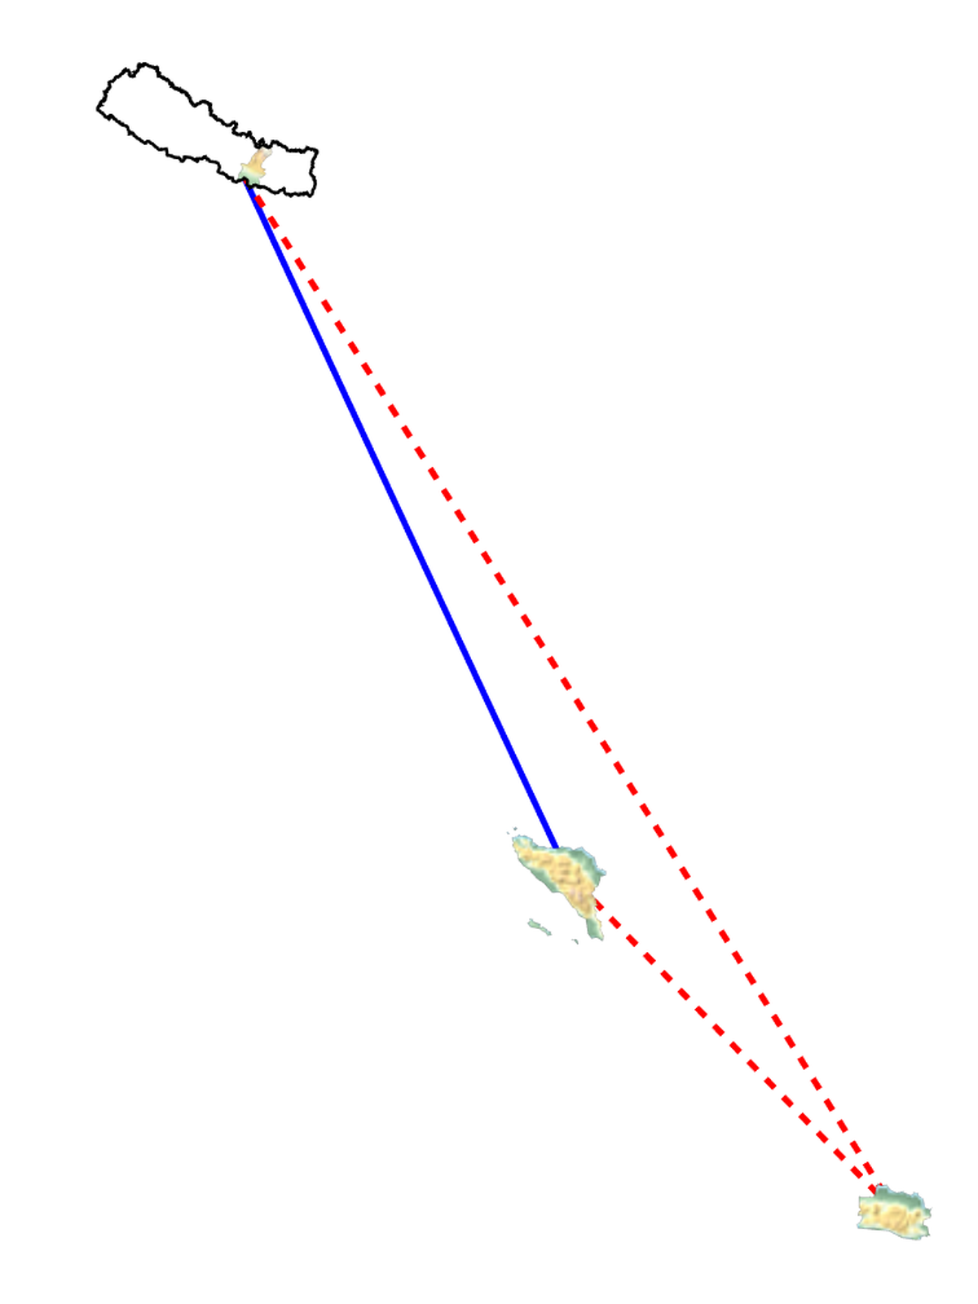
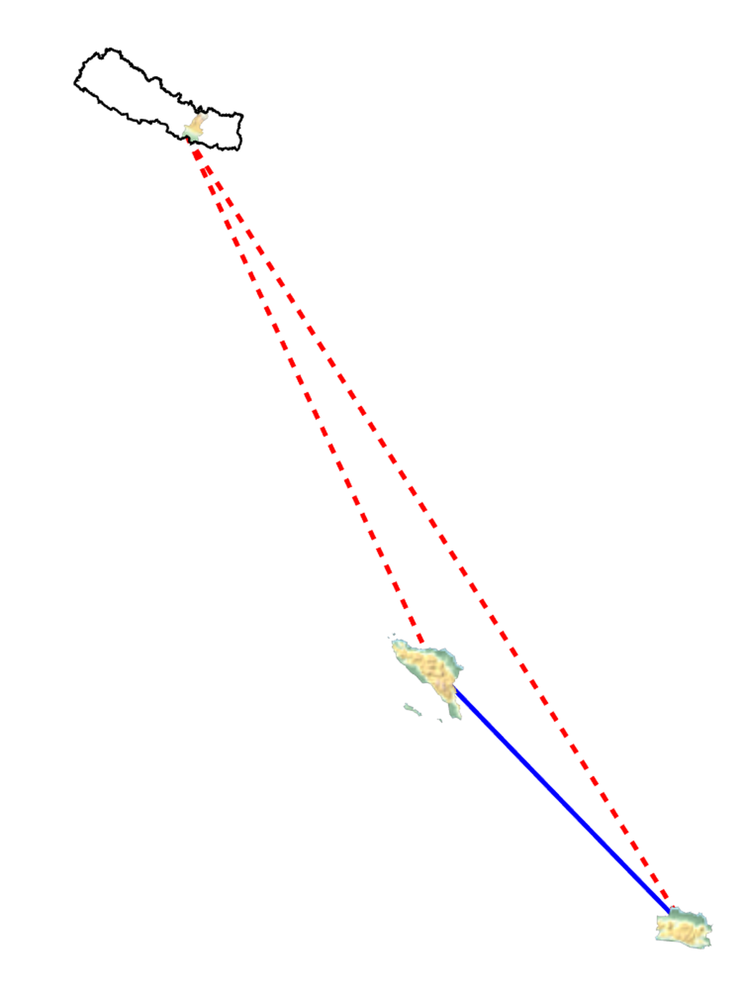
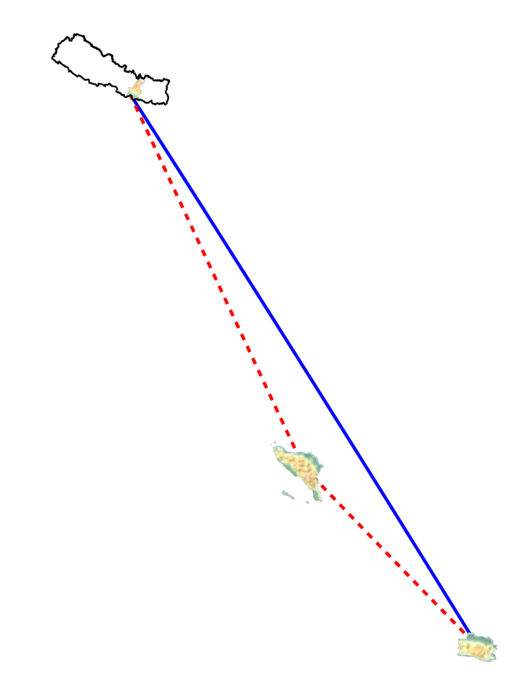
Counterfactual assumptions deltas, PS01
0.00013
0.000053
0.000088

Slide 11
Counterfactual assumptions deltas, PS10
0.0027
0.0021
0.0082

Slide 12
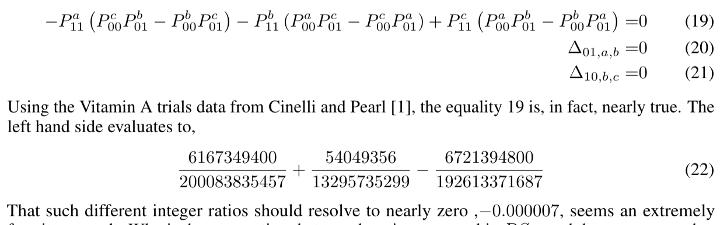
Mixing equality assumptions is tight

Slide 13
Final Thoughts
This becomes interesting for n>3
In general half + 1 of the assumption deltas need to be set to zero.
Possibility of using this to detect anomalies
Errors in experiments
Errors in invariance
Limitations of this approach
No generalization – what grade are you going to get on the next test?
No explanation – why do you have a high fever?
Work in progress – we want to evaluate this further and look forward to implementing causal inference in our products.
Criticisms welcome.

Slide 14
Pointers
github.com/andrescorrada/ground-truth-problems-in-business/presentations/CDSM2020
Privacy Patent
Great Models with Great Privacy: Optimizing ML and AI Under GDPR
HyperLogLog to enable arbitrary unique count analytics while protecting user privacy
High-Performance Advanced Analytics with Spark-Alchemy
GitHub repository: Spark HyperLogLog Functions
Counting with and evaluating noisy Identity functions without ground truth
ArXiv paper: Algebraic Ground Truth Inference: Non-parametric Estimation of Sample Errors by AI Algorithms
Testing independence of model errors without ground truth:
ArXiv paper: Independence Tests Without Ground Truth for Noisy Learners

Slide 15
IPM.ai (www.ipm.ai) is an Insights as a Service (IaaS) company that empowers the world’s leading life sciences brands to better understand and improve the lives of patients through the research, development and commercialization of new therapies and modalities of care for specialty and rare disease. IPM’s HIPAA-certified system of insight streamlines patient discovery, treatment journey mapping, referral network intelligence, key opinion leader identification, market segmentation and adherence modeling by utilizing granular-level longitudinal analytics, artificial intelligence and machine learning in conjunction with a real world evidence and outcomes research pool of over 300 million de-identified patients.
THANK YOU
Andrés Corrada-Emmanuel, Director of Optimization
andres@swoop.com

