Slide 1
Design-First
AI Collaboration
Practical implementation of Rahul Garg's patterns
martinfowler.com · February–April 2026
github.com/andresdiegolanda/design-first-ai
MIT License · v1.5.0
Andrés Landa · 26 years Java/Spring · Merged contribution in Spring AI · Applied Generative AI Certification

Slide 2
The Origin
Five patterns to reduce friction in AI-assisted development — moving from correcting a tool to collaborating with a capable partner.
The five patterns
Martin Fowler
Reference author in software engineering.
Knowledge
Priming
Design-First
Collaboration
Encoding Team
Standards
Chief Scientist at Thoughtworks since 2000.
His site martinfowler.com is the most influential
technical publication in the industry.
Load context
before every session
Design before
coding
Senior's judgment
in versioned files
Rahul Garg
Context
Anchoring
Feedback
Flywheel
Principal Engineer @ Thoughtworks — global software consultancy,
reference in engineering practices.
Published five patterns on martinfowler.com
Documents that
persist across sessions
Continuous retrospective
improves the other four
(Feb–Apr 2026) on how to use AI in teams.
This framework is the practical implementation of those five patterns

Slide 3
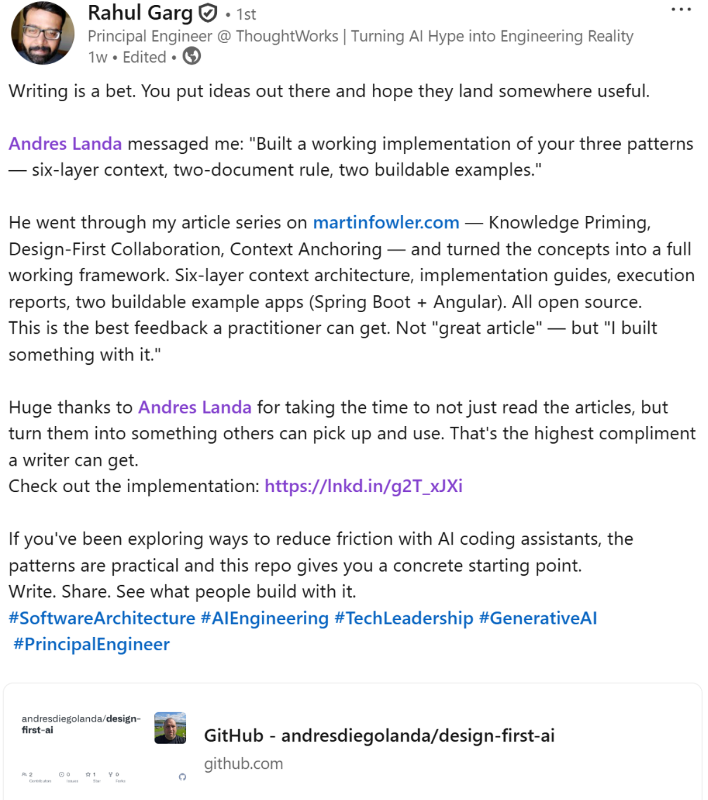
Author Validation
"the greatest compliment
a writer
can receive"
Rahul Garg
Principal Engineer @ Thoughtworks
Author of the patterns
martinfowler.com
Starred the repo · Public endorsement on LinkedIn

Slide 4
⚠ The Problem
Without context, AI decides for you
"You describe a feature,
you receive 400 lines of code,
and you discover that the AI made
a dozen decisions
they never asked you about."
• Picks generic patterns from training data
• Invents unnecessary abstractions
• Ignores project conventions
• Makes architectural decisions without consulting you
• Produces code that "works" but doesn't fit
— The Implementation Trap
Rahul Garg · martinfowler.com

Slide 5
🗂 The Solution — Context in Layers
L0
L1–2
L3
L4
L5
Generation
Auto-loaded
Skills
Templates
Story Docs
Produces layers 1–4
from your codebase
Identity, stack,
conventions
Error handling,
testing, logging...
Prompts for
recurring tasks
impl-guide +
execution-report
layer-0-
generation-prompt.md
.github/copilot-
instructions.md
context/skills/
{name}/SKILL.md
layer-4-prompt-
templates.md
docs/[STORY]-
*.md
Once,
manual
Automatic
every session
#file: or by
name in agent
#file: or by
name in agent
By path in
agent or #file:
Same tool · Same model · Same prompt · The only difference is context

Slide 6
⚠ Without Context — What Copilot Generates
Prompt: "Add a search endpoint that filters products by name and category, with pagination"
Copilot generates:
Decisions nobody asked for
@Autowired
• @Autowired on field
private ProductRepository repository;
Project uses constructor injection
@GetMapping("/search")
• ProductRepository invented
public Page<Product> search(
Project has no repository layer
@RequestParam String name,
Pageable pageable) {
• Spring Data Pageable
return repository
Project does not use Spring Data
.findByNameContaining(
• Long implied for IDs
name, pageable);
Project defines UUID
}

Slide 7
✅ With Context — Same Prompt, Different Output
Same prompt — now with .github/copilot-instructions.md loaded
Copilot generates:
What the context enforced
private final ProductService productService;
• Constructor injection
@GetMapping("/search")
private final — no @Autowired
public ResponseEntity<ProductPage> search(
• No repository layer
@RequestParam(required = false)
Delegates directly to ProductService
String name,
• Manual pagination
@RequestParam(required = false)
Own ProductPage, no Spring Data
String category,
@RequestParam(defaultValue="0")
• UUID for IDs
int page,
Respects the project constraint
@RequestParam(defaultValue="20")
• Javadoc on public method
int size) {
Non-negotiable of the project

Slide 8
⚙ The File That Makes the Difference
.github/copilot-instructions.md — auto-loaded in every Copilot session
## Non-Negotiables
## Anti-Patterns — Never Propose
- No business logic in controllers
- Do not add @Autowired on fields
- Constructor injection only — no @Autowired
- Do not use Long or int for IDs
- All public service methods have Javadoc
- Do not put logic in controllers
- Named domain exceptions only
- Do not throw RuntimeException directly
- UUID for all product identifiers — never Long
- Do not add Spring Data or JPA
- Do not add pagination or filtering
## What This Project Is NOT
## Architecture
- Not database-backed — in-memory only
ProductController → ProductService
- Not authenticated
→ ConcurrentHashMap
- Not paginated
- Not using Spring Data
No repository layer.
Service owns the store directly.
These rules live in a markdown file inside the repo. Copilot reads them automatically.

Slide 9
📄 The Two-Document Rule
Document 1 — Implementation Guide
Document 2 — Execution Report
BEFORE the code
AFTER the code
• Scope — what is built, what is NOT
• What was implemented and where
• Components — blocks and responsibility
• Deviations from the guide and why
• Interactions — data flow + error paths
→
• How to run the app
• Contracts — signatures, types, DTOs
• How to run the tests
• No code — design only
• Commit message

Slide 10
✅ Design Corrections — Before the Code
Correction 1 — @Autowired on field
Cost if not corrected:
all controllers +
all wiring tests
The AI used @Autowired on field — the generic Java default.
But the project defines constructor injection only. Corrected in the document.
Correction 2 — UUID instead of Long
Cost if not corrected:
all signatures, tests, URLs
The AI used Long for IDs — the typical Java default. But the project defines UUID.
Corrected in the implementation guide, not in code.
Both corrections: 1 document iteration. 0 lines of code touched.

Slide 11
🚀 How to Start
1
2
3
Layer 0 — 15 minutes
First story
Continuous improvement
One prompt analyzes your existing codebase
and generates context layers 1–4.
No code changes needed.
Pick a small feature.
Write the impl-guide before the code.
The difference is visible in the first session.
"What context were you missing
that would have changed your approach?"
Each answer improves the context files.

Slide 12
Next Step
This ran against a generic CRUD app.
The real value is when it runs against your code.
If you're interested, next time we do it
against one of your features.
github.com/andresdiegolanda/design-first-ai
MIT License · Open · Free

