Slide 1

Kubernetes and Helm
101

Slide 2
Contents
The new standards for deploying apps
So…what did we use before?
Why is docker not enough?
Kubernetes deployment architecture
And why is k8s not enough?
Running K8s and Helm from your home PC
Minikube
Demo 1
Creating a Helm chart
Demo 2
Training resources

Slide 3
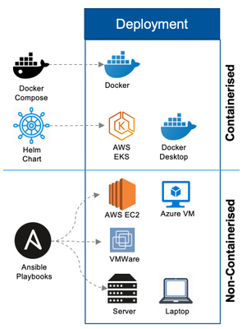
The new standards for deploying apps

Slide 4
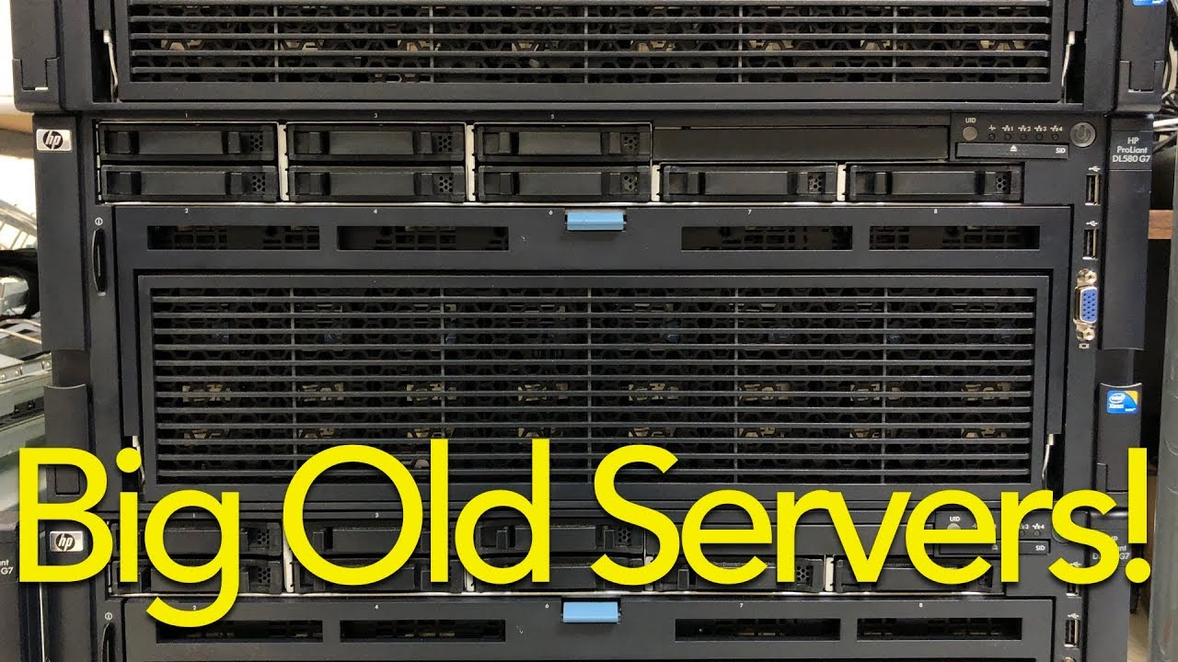
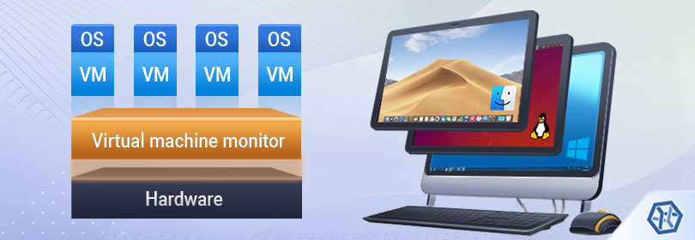
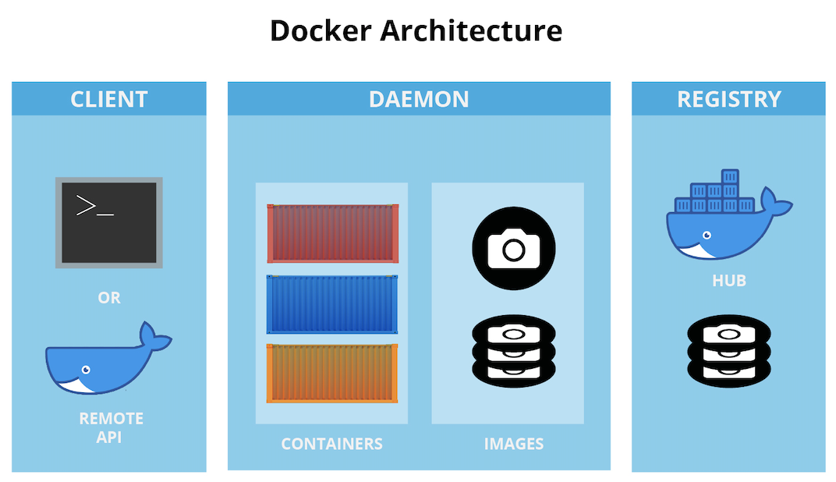
So…what did we use before?

Slide 5
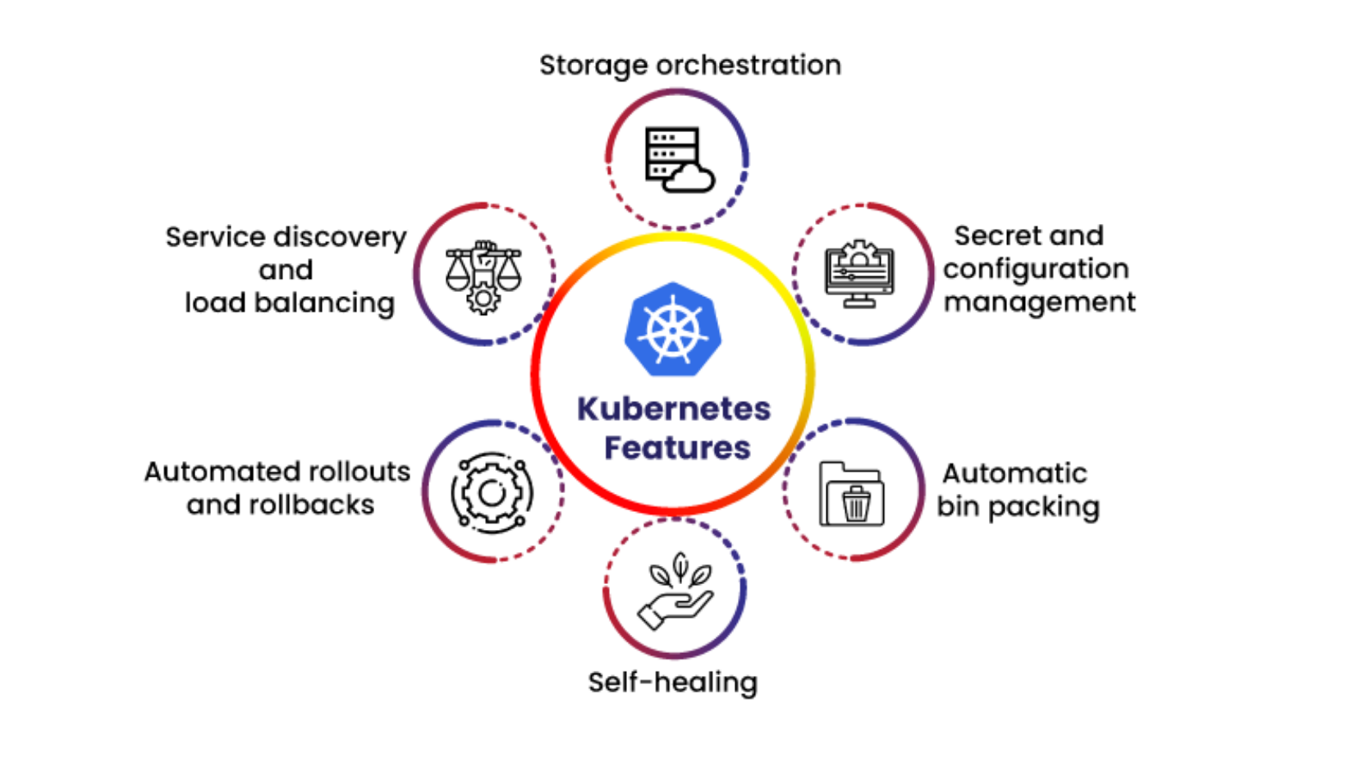
Why is docker not enough?
Notes:
https://cloudstackgroup.com/4-major-benefits-of-using-kubernetes/

Slide 6
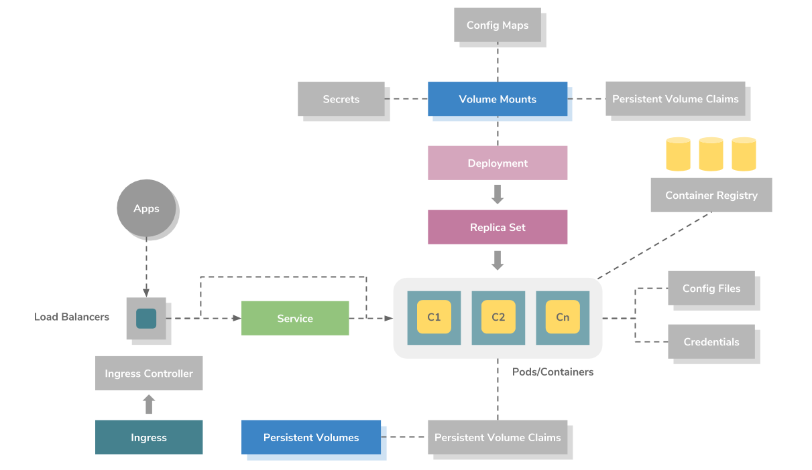
Kubernetes deployment architecture
Notes:
https://devops.digit.org/devops-general/the-rise-of-kubernetes/kubernetes

Slide 7
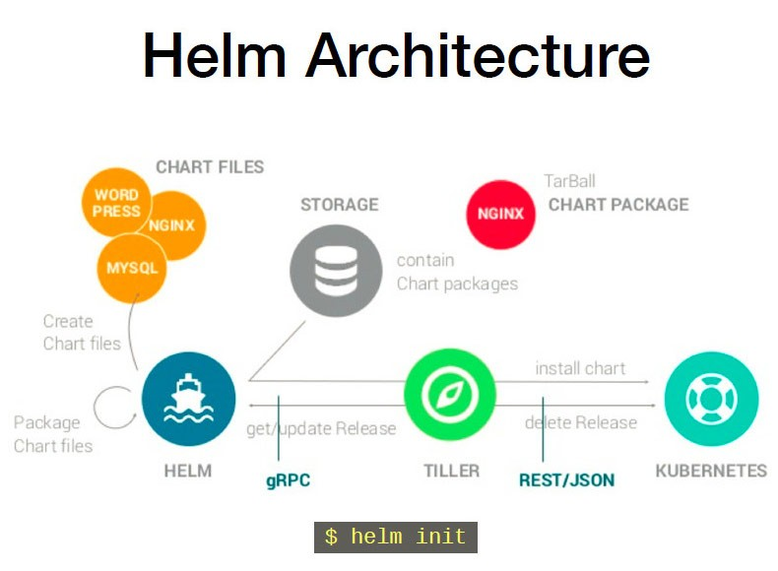
And why is k8s not enough?
Notes:
https://programmer.help/blogs/helm-for-k8s-quick-download-yaml-file-template.html

Slide 8
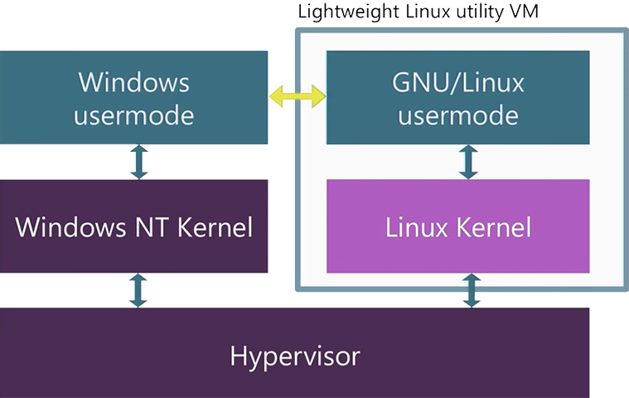
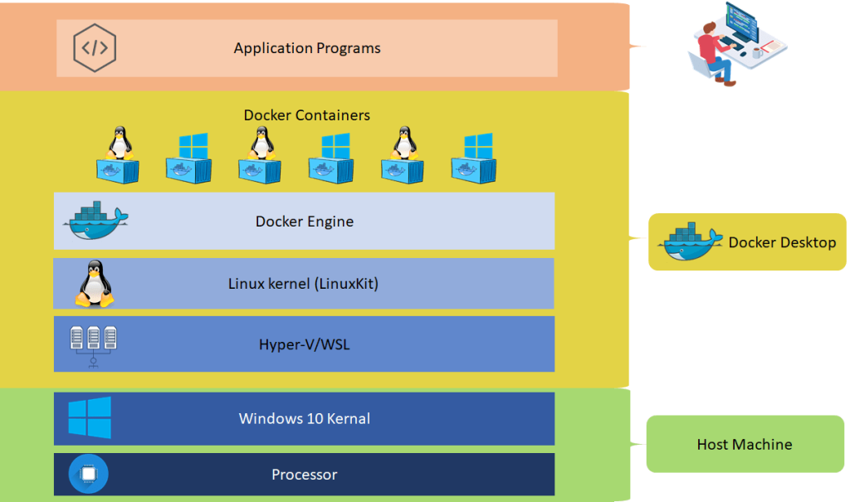
Running K8s and Helm from your home PC
Notes:
https://docs.docker.com/desktop/install/windows-install/
https://learn.microsoft.com/en-us/windows/wsl/install

Slide 9
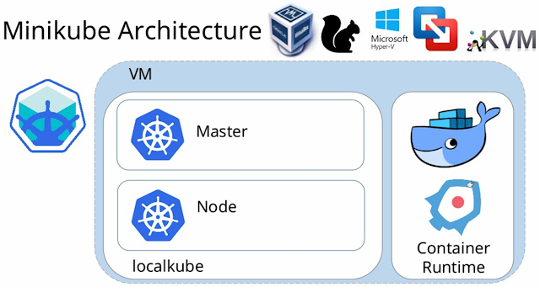
Minikube

Slide 10
Demo 1
curl -LO https://storage.googleapis.com/minikube/releases/latest/minikube-linux-amd64
sudo install minikube-linux-amd64 /usr/local/bin/minikube
minikube start
curl -LO https://get.helm.sh/helm-v3.10.0-linux-386.tar.gz
tar -zxvf helm-v3.10.0-linux-386.tar.gz
sudo mv linux-386/helm /usr/local/bin/helm
helm repo add stable https://charts.helm.sh/stable
kubectl get all
helm install demy-mysql stable/mysql
kubectl get all
helm uninstall demy-mysql
kubectl get all
Notes:
https://git.app.uib.no/caleno/helm-charts/tree/63f3f1a5783e7642da392d7b284517eb222e94af/stable/mysql

Slide 11
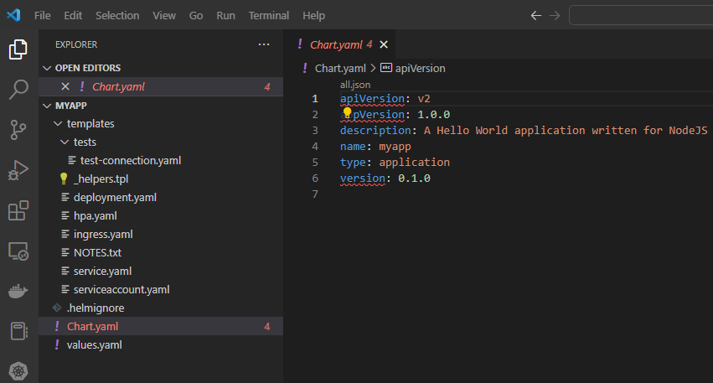
Creating a Helm chart

Slide 12
Demo 2
sudo docker run -d -p 8080:80 afakharany/hellonodejs:1.0.0
curl localhost:8080
docker ps
docker stop 9b
docker ps
myapp helm list
helm list
ls
cd myapp/
helm install myapp01 .
kubectl get pods
kubectl port-forward myapp01-5f79fb647b-dhw27 8080:80
helm uninstall myapp01
helm list
history
Notes:
https://git.app.uib.no/caleno/helm-charts/tree/63f3f1a5783e7642da392d7b284517eb222e94af/stable/mysql

Slide 13
Training resources
Kubernetes:
  https://www.udemy.com/course/learn-kubernetes/
  https://www.udemy.com/course/certified-kubernetes-application-developer/
Helm:
  https://app.pluralsight.com/library/courses/kubernetes-packaging-applications-helm/table-of-contents
  https://www.udemy.com/course/helm-the-kubernetes-package-manager-hands-on-course/learn/lecture/28191768?start=180#overview

Slide 14
Thank you!

