Slide 1


Prediction of the Pro ICFES project

Slide 2
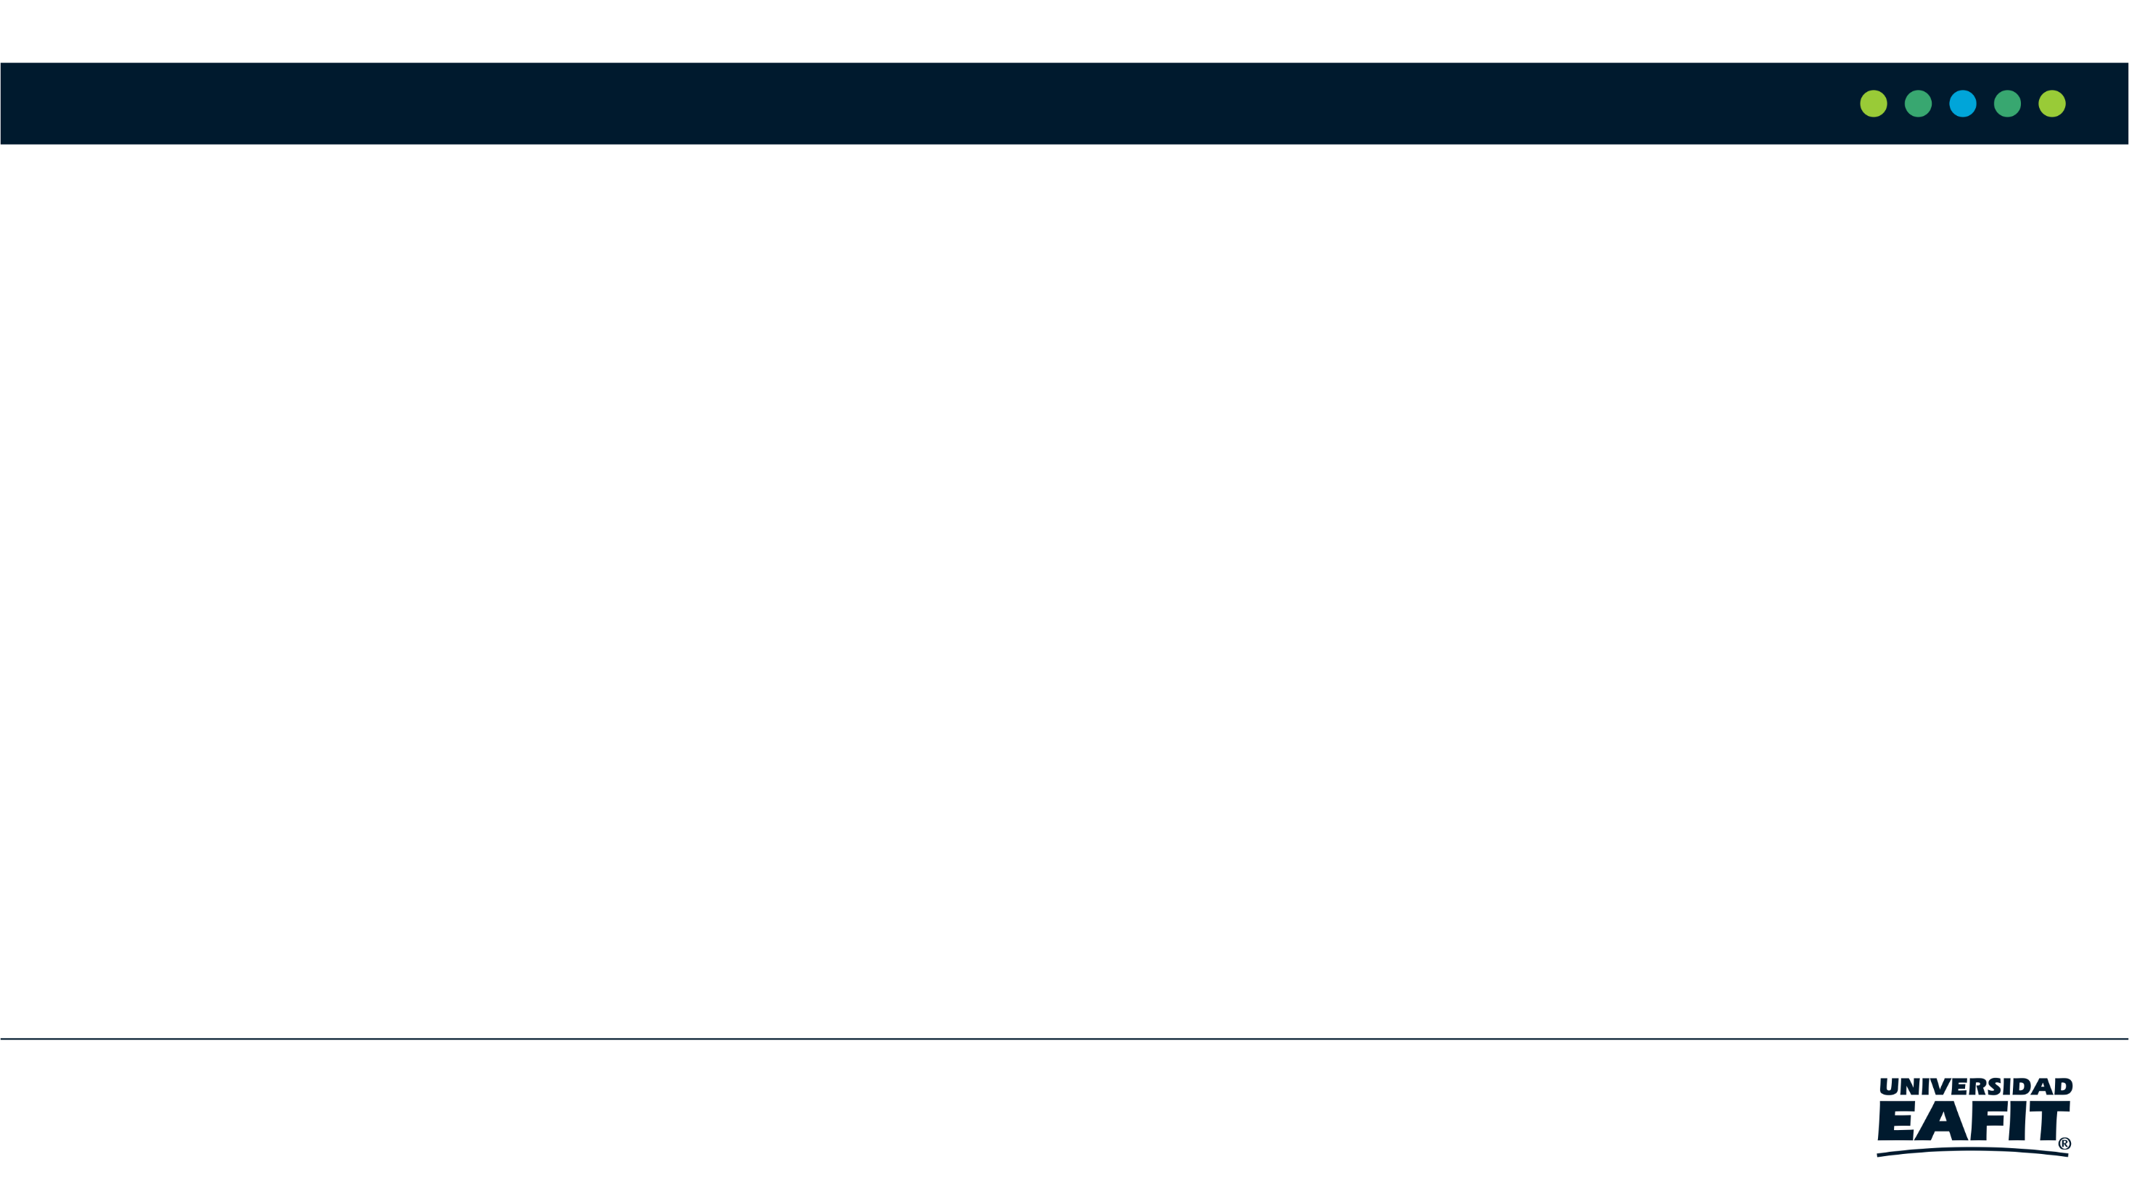
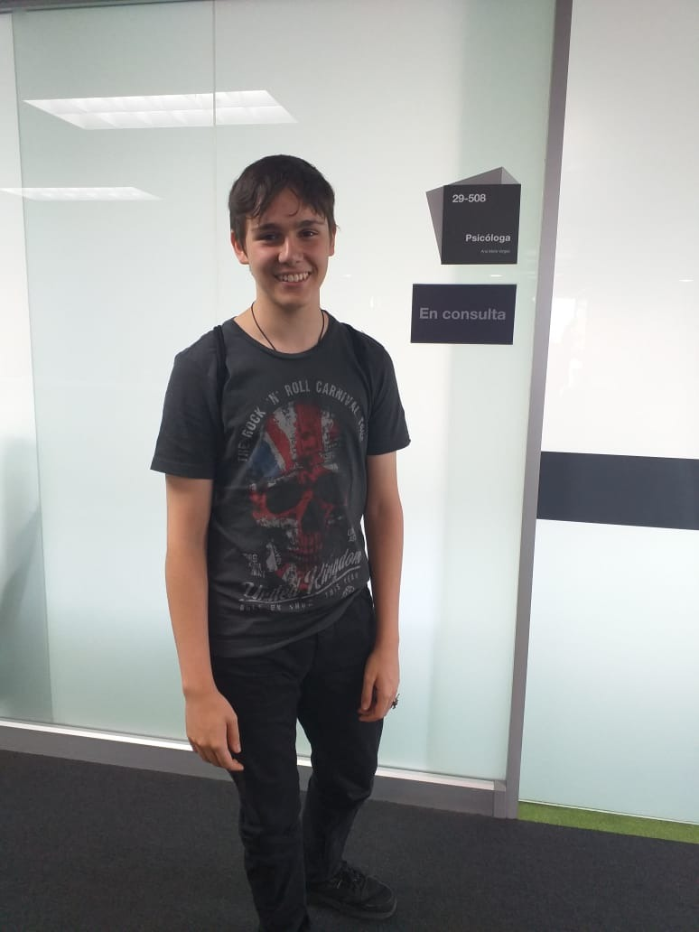
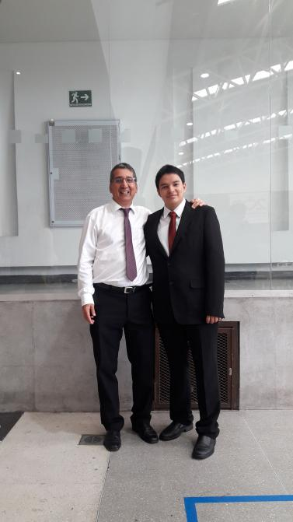
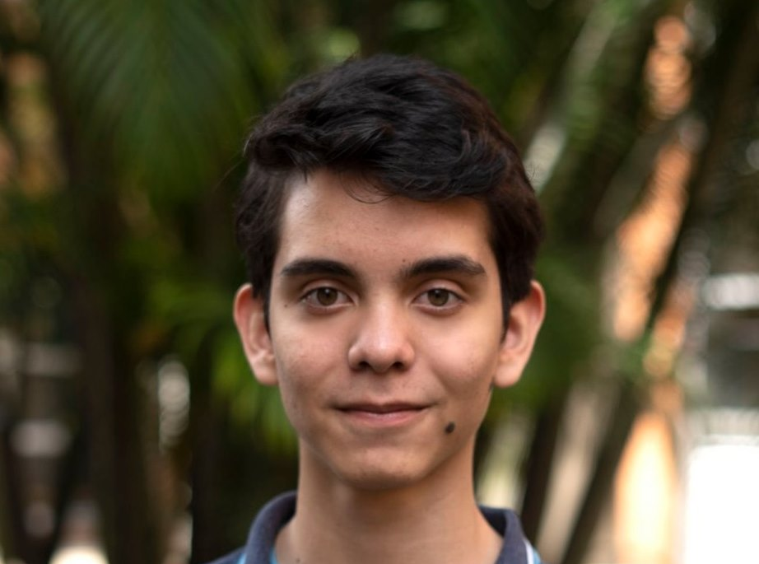
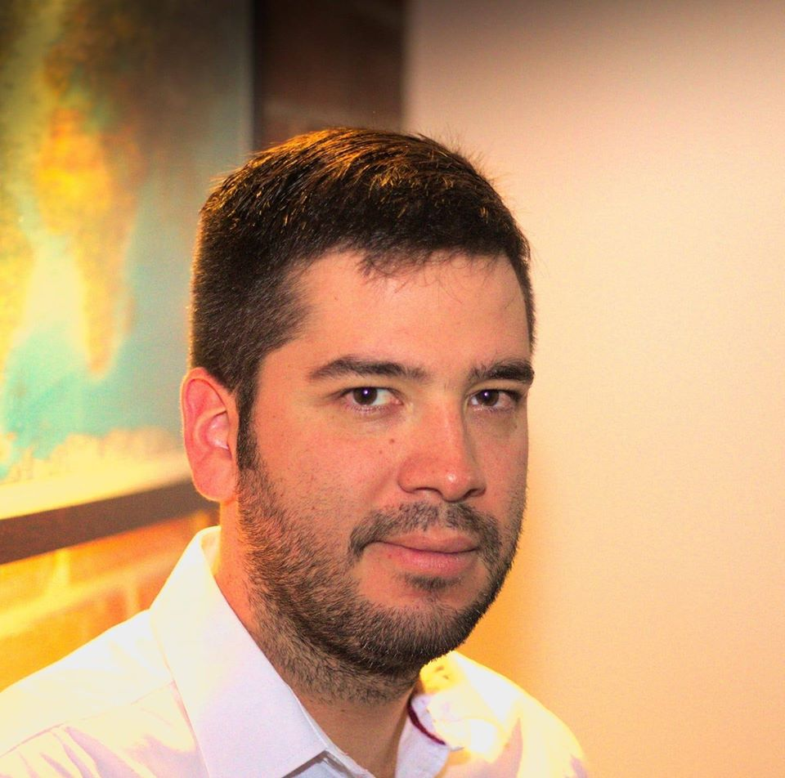
Team Presentation
Andrés Echeverri Jaramillo
Juan Sebastián Jácome Burbano
Miguel Correa
Mauricio
Toro

Slide 3
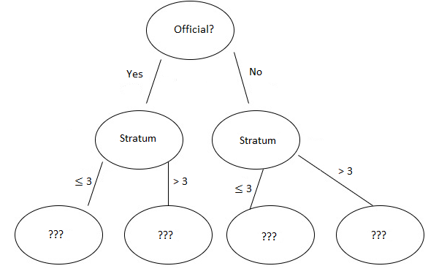

Algorithm Design
Students
No
Yes
Students that didn’t comply the condition
Students that comply the condition
Students that didn’t comply the condition
Students that didn’t comply the condition
Students that didn’t comply the condition
Students that didn’t comply the condition
Our model is going to decide who have the highest chance to get a better score in the pro Icfes, and is based if the come from an official or non-official school, their stratum, and the grades they got in the icfes

Slide 4


Algorithm Complexity
 | Time Complexity | Memory Complexity
Training the model | O(n^2*2m) | O(n^2+m)
Testing the Model | O(2n^2+2^(1-m)) | O(n*m+4^(1-n))
where n is the number of students which stores the matrix and m the number of nodes in which divide the tree

Slide 5
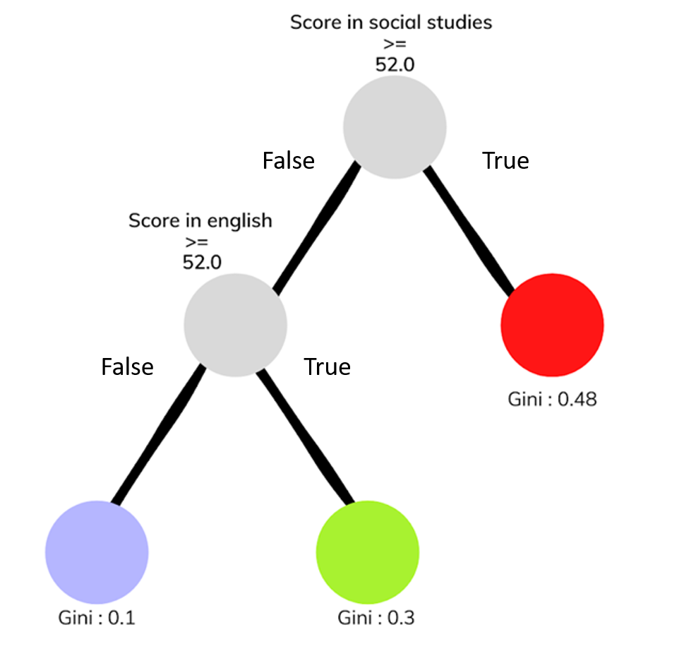

Decision-Tree Model
Most Relevant Features
The Grades
A binary decision tree to predict Saber Pro scores based on the results of Saber 11. Violet nodes represent those with a high probability of success, green medium probability and red a low probability of success.

Slide 6

Evaluation Metrics
 | Dataset 1 | Dataset 2 | Dataset 3 | Dataset 4
Accuracy | 0.61 | 0.62 | 0.66 | 0.57
Evaluation metrics using 4 training dataset of 45.00, 75,000,105,000 and 135,000 students and 4 test dataset of 15.000, 25.000, 35.000 and 45.000 students.

Slide 7


Complete this slide
For the third deliverable
Time and Memory Consumption
Keep this title
Create the plots in Excel. Do not copy pixelated screenshots from the technical report please!
Time Consumption
Memory Consumption

Slide 8
THANK YOU!

