Slide 1


Prediction of the Pro ICFES project

Slide 2

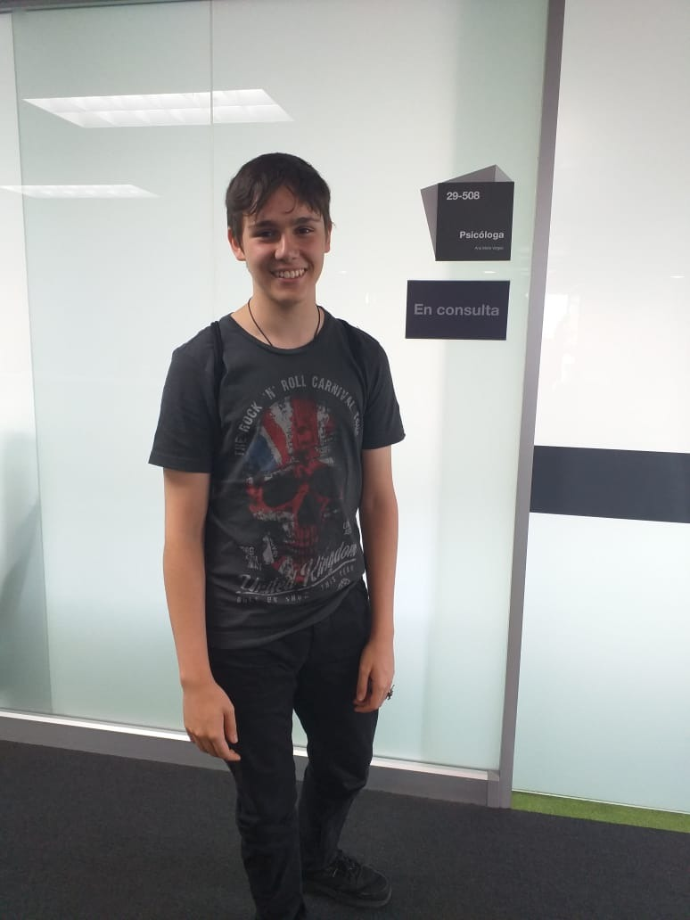
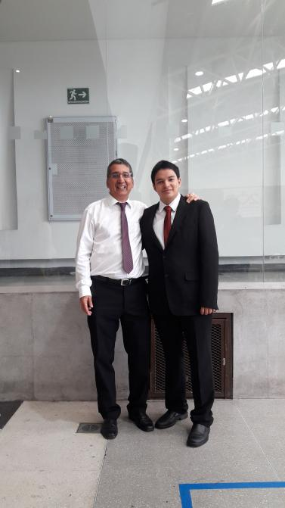
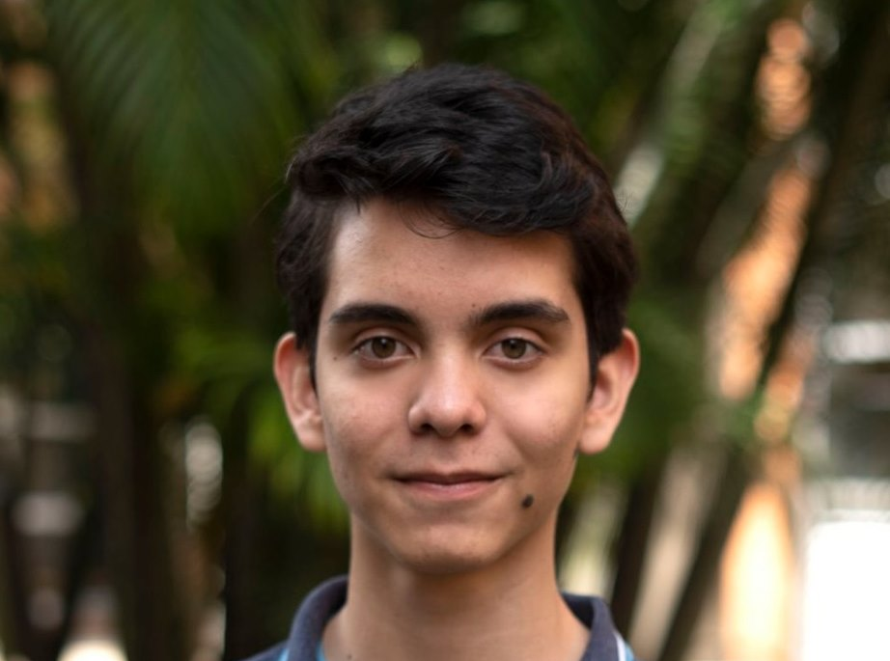
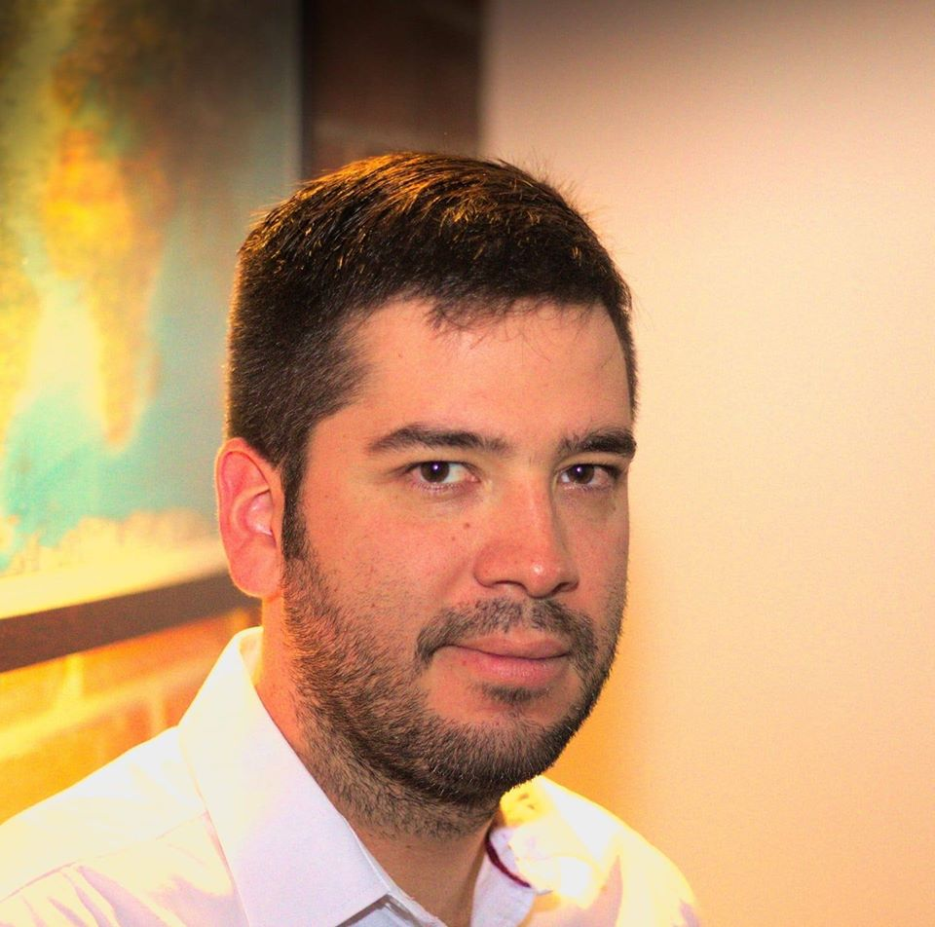
Team Presentation
Andrés Echeverri Jaramillo
Juan Sebastián Jácome Burbano
Miguel Correa
Mauricio
Toro

Slide 3
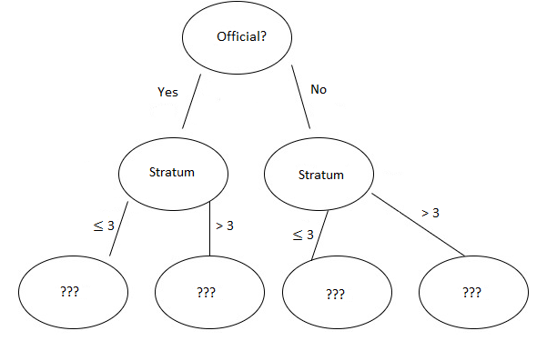
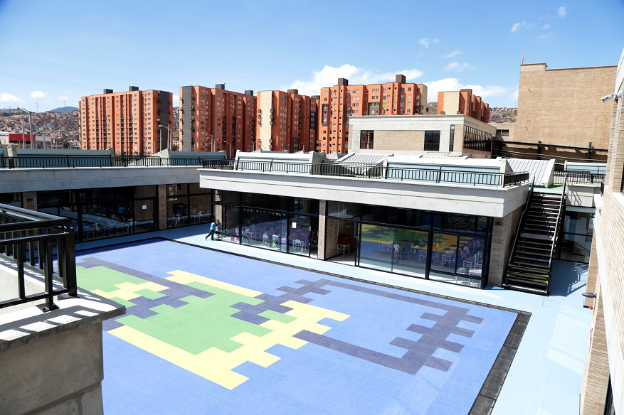
Algorithm Design
Our model is going to decide who have the highest chance to get a better score in the pro Icfes, and is based if the come from an official or non-official school and in their stratum. (At this moment we still don't know which ones are going to have better chances, and for that reason the last ones are still an incognita)

Slide 4
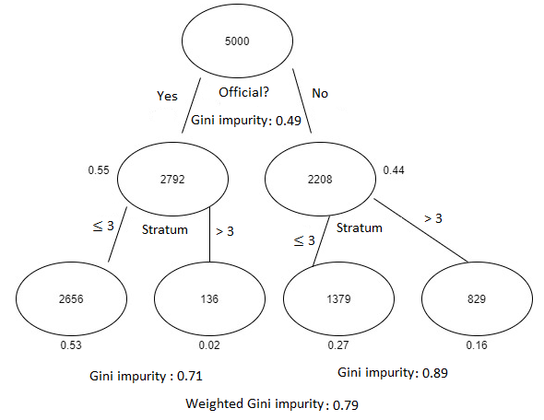
Node Splitting
The firs condition is "Official == true" that ends with a Gini impurity of 0.55 at the left, and 0.44 at the Right. The second split is based on "Stratum >= 3" For the ones from officials schools the left Gini impurity is 0.53 and the one from the right is 0.02, and for the ones from non-official schools have a Gini impurity of 0.27 at the left and 0.16 at the right, and all ended with a weighted Gini impurity of 0.79

Slide 5

Complete this slide
For the third deliverable
Algorithm Complexity
Keep this title
Create the table in Powerpoint. Do not copy pixelated screenshots from the technical report please!
 | Time Complexity | Memory Complexity
Training the model | O(N²*M*2^{M}) | O(N*M*2^{M})
Testing the Model | O(N*M) | O(1)
Time and memory complexity of the (In this semester, one could be CART, ID3, C4.5… please choose) algorithm. (Please explain what do N and M mean in this problem. PLEASE DO IT!
Explain the tables in your
own words
Include another HD picture related to the example that you modeled in the decision tree

Slide 6
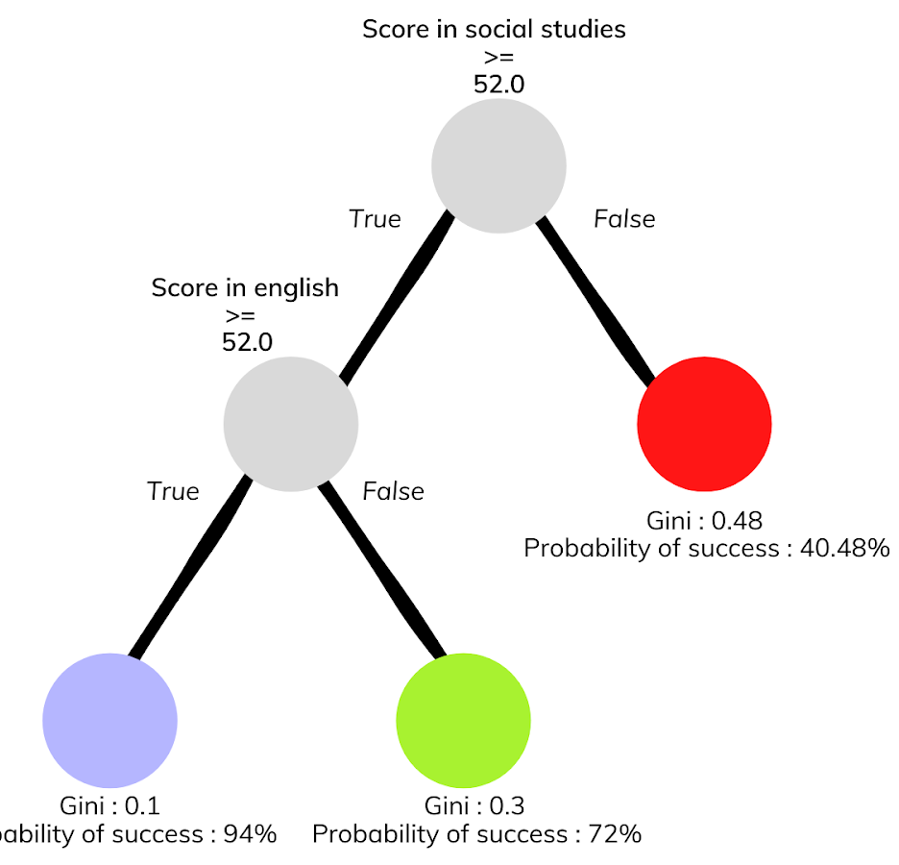



Complete this slide
For the third deliverable
Decision-Tree Model
Keep this title
Create the Figure in Powerpoint. Do not copy pixelated screenshots from the technical report please!
Most Relevant Features
Social Studies
English
Gender
A binary decision tree to predict Saber Pro scores based on the results of Saber 11. Violet nodes represent those with a high probability of success, green medium probability and red a low probability of success.
Use an icon for each feature!
Is it ethical to make a model that predicts academic success based on gender?
Explain the Figures in your
own words

Slide 7
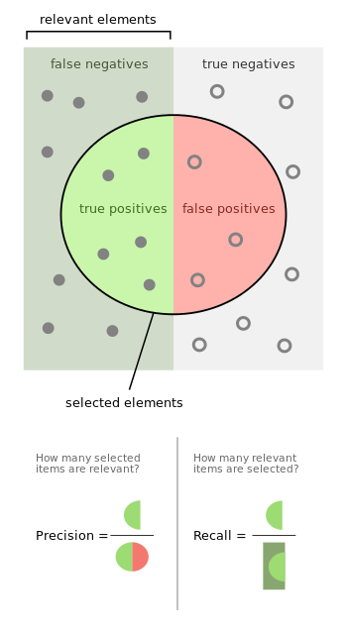
Complete this slide
For the third deliverable
Evaluation Metrics
Keep this title
Use vectorized figures to
explain the algorithm the evaluation metrics, so they are not pixeled like mines
Use these
Colors for
Your figures
Explain Accuracy too…
In the same manner
If possible, avoid equations for simple concepts that can be
explained through diagrams

Slide 8
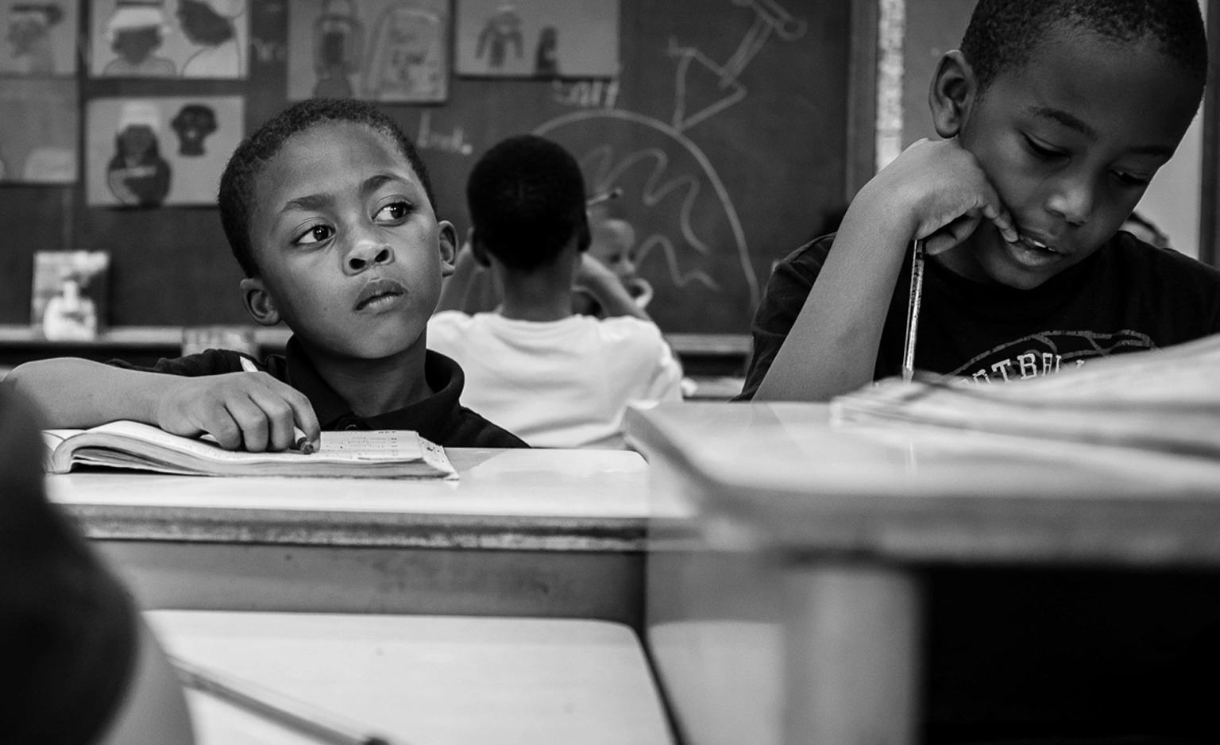
Complete this slide
For the third deliverable
Evaluation Metrics
Keep this title
Create the table in Powerpoint. Do not copy pixelated screenshots from the technical report please!
 | Training data set | Testing data set
Accuracy | 0.8 | 0.62
Precision | 0.6 | 0.55
Recall | 0.76 | 0.61
Evaluation metrics using a training dataset of 135,000 students and test dataset of 45,000 students.
Include another HD picture related to the example that you modeled in the decision tree
Explain the tables in your
own words

Slide 9


Complete this slide
For the third deliverable
Time and Memory Consumption
Keep this title
Create the plots in Excel. Do not copy pixelated screenshots from the technical report please!
Time Consumption
Memory Consumption

Slide 10
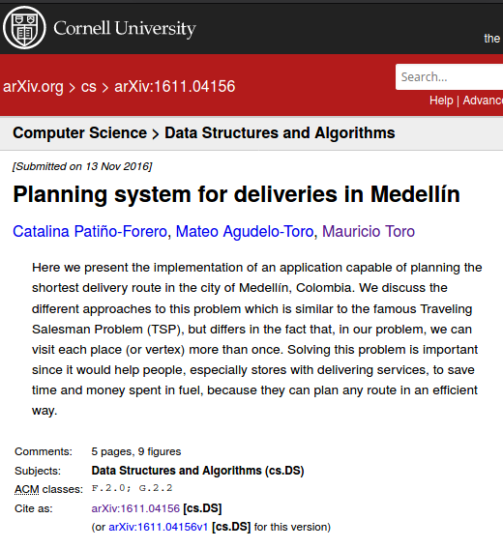
Complete this slide
For the third deliverable
Report Accepted on arXiv
Keep this title
Include the citation of the report in arXiv and link
C. Patiño-Forero, M. Agudelo-Toro, and M. Toro. Planning system for deliveries in Medellín. ArXiv e-prints, Nov. 2016. Available at: https://arxiv.org/abs/1611.04156
Include a screenshot

Slide 11
Complete this slide
For the third deliverable
Say thank you for listening!
THANK YOU!

