Slide 1
Macintosh
Pearce & Hall
S1 S2 S3
S1 S2 S3
100% 50% random
100% 50% random
One reward
R1 R2 R3
S1 will be learned S2 will induce strongest response
→ Association strength → prediction error
I am still confused about the difference of associative strength vs attention and what I care about: what stimulus is actually learned?
- What is learned should have had the strongest associative strength
- In my view, associative strength cannot be measured with attention
- Attention is indeed linked to uncertainty (lack of associative strength); the animal tries to understand better

Slide 2
Macintosh
Pearce & Hall
S1 S2 S3
S1 S2 S3
I would accept Pearce & Hall if S2 is learned in the left scenario, but no evidence so far…
100% 50% random
100% 50% random
One reward
R1 R2 R3
S1 will be learned S2 will induce strongest response
→ Association strength → prediction error
I am still confused about the difference of associative strength vs attention and what I care about: what stimulus is actually learned?
- What is learned should have had the strongest associative strength
- In my view, associative strength cannot be measured with attention
- Attention is indeed linked to uncertainty (lack of associative strength); the animal tries to understand better

Slide 3
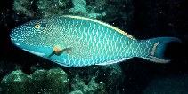
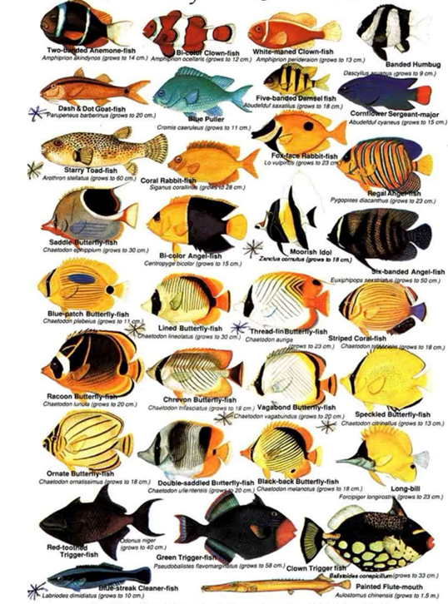
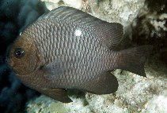
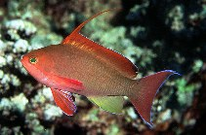
We are now interested in complex stimuli like client fish that have many features: size, shape, colour, eye size, mouth features
For any single combination of 2 client fish, all differing features would be informative
Some feature have a more generalised predictive power across client species regarding food patch quality
We are not yet interested in the market problem

Slide 4

We are now interested in complex stimuli like client fish that have many features: size, shape, colour, eye size, mouth features
For any single combination of 2 client fish, all differing features would be informative
Length
Body height
Parrot Damsel
Parrot Damsel
Greenish black
Medium Large
eye size
Beak Terminal
mouth
If the parrotfish consistently yields more food than the damselfish, any of the five criteria can be learned alone and will yield perfect discrimination

Slide 5
We are now interested in complex stimuli like client fish that have many features: size, shape, colour, eye size, mouth features
For any single combination of 2 client fish, all differing features would be informative
Some feature have a more generalised predictive power across ALL client species regarding food patch quality
Reward
Reward
Reward
Reward
Length
Body depth
Gr Blu Bla Re Wh
main colour
Te Th Be Ba
mouth features
- In this example, length is clearly the best general predictor of reward
- 2 mouth features are also highly predictive: beak and barbels
- All other features have high variance because species from different families can have similar body depths and/or similar colours

Slide 6
We are now interested in complex stimuli like client fish that have many features: size, shape, colour, eye size, mouth features
For any single combination of 2 client fish, all differing features would be informative
Some feature have a more generalised predictive power across ALL client species regarding food patch quality
I think our first model should
define parameter spaces for the different features
combine them with some constraints (based on biology)
Implement Macintosh and P&H and analyse what features will be used
I assume the 2 concepts make different predictions
We can compare model predictions with data from the recent master project

Slide 7
We are now interested in complex stimuli like client fish that have many features: size, shape, colour, eye size, mouth features
For any single combination of 2 client fish, all differing features would be informative
Some feature have a more generalised predictive power across ALL client species regarding food patch quality
I think our first model should
define parameter spaces for the different features
combine them with some constraints (based on biology)
Implement Macintosh and P&H and analyse what features will be used
I assume the 2 concepts make different predictions
We can compare model predictions with data from the recent master project
Once we have this model up and running, we can reintroduce simultaneous choices in a biological market

