Slide 1
Commercial
Review
Full Year Results
February 2026
Kingspan Middle Americas
October 2026 · Board of Directors

Slide 2
COMMERCIAL OVERVIEW
October 2026 · IMP volume (m²) · YoY vs October-25 · MoM vs Sep-26 · YTD Jan–Oct
SALES
OCTOBER 2026
YTD 2026
MOM VS SEP
141,2k m²
1.199,5k m²
+12%
▲ +43% YoY
▲ +18,0% YoY
ORDER INTAKE
OCTOBER 2026
YTD 2026
MOM VS SEP
160,54k m²
1.400,9k m²
+10%
▲ +21,0% YoY
▲ +25,0
% YoY
▼ vs 146,4k m²
TOP ORDERS OF THE MONTH
Client | Project | Channel | USD (mm)*
Haceb | Recambio de cubiertas planta hacer | Industrial | $675
Minutocorp S.A | Hiper la Joya | Industrial | $ 491
Cubic 33 | PE002 | Industrial | $ 303
KEY INSIGHT
Order intake 25% over sales YTD; order Intake YoY 2026 Vs 2025, 18%.
* Unit as reported in source deck – to be validated. OI by region: Data Engine › 19_OI_Regiones (estimated split of Other Geographies until ERP data is loaded).
2
Notes:
KEY MESSAGES
- Sales Sep 125,9k m² (+7% YoY); YTD 1.058,3k m² (+15% YoY); MoM −7% vs Aug.
- Order Intake Sep 146.446 m² (+27,8% YoY vs 114.611); YTD 1.239.541 m² (+25,4% vs 988.103); MoM −3,4% vs 151.623.
- Book-to-bill YTD 1,17x: demand > billing → backlog build-up.
DATA NOTES
- Source deck labelled OI as 'August' and YTD as 1.293,5K m²; corrected to Sep / 1.239.541 per the OI table.
- Sales PY and Aug absolute values are not in the source (only %); Data Engine sheet 01 holds derived values to be replaced.
- Update: Data Engine › 01_Overview.

Slide 3
ORDER INTAKE – OCTOBER 2026
IMP · Current month (CM) vs prior year (PY) and YTD · Revenue in COP MM · bar labels = OI volume (k m²)
OI YTD 2026
OI YTD 2025
REVENUE OCT IMP (COP MM)
GROSS MARGIN OCT (STD)
1.400,08 m²
1.120,8 m²
$ 14.484
27,1%
▲ +25% vs1.120.88
▲ +14% YTD $ 144.66 VS 108.228
▲ +3,0 pp YTD 25% vs 24%
Product / metric | Oct-26 | Oct-25 | YoY | YTD-26 | YTD-25 | YoY
Kingcore – Volume (m²) | 20.793 | 10.126 | +105,34% | 229.903 | 88.736 | +159,09%
Single Skin – Volume (m²) | 16.271 | 13.384 | +21,57% | 122.613 | 52.300 | +134,44%
Benchmark – Volume (m²) | 3.402 | 175 | +1.844,00% | 5.817 | 563 | +933,21%
KEY INSIGHT
3
Margin OI increased 3pp vs October 2025.
Notes:
KEY MESSAGES
- OI Sep 146.446 m² (+27,8%); YTD 1.239.541 m² (+25,4%).
- Revenue Sep COP 13.741 MM (+28,7%); YTD COP 130.176 MM (+36,3%).
- Gross margin STD Sep 27% vs 24% PY (+3 pp); YTD 25% vs 24%.
- May peak (COP 27.094 MM) at the lowest margin of the year (20,9%) – large-project pricing.
DATA NOTES
- Margin cards in the source said 'August 2026'; relabelled September.
- Monthly CY revenue: Apr uses 12.270 and Jul 11.719 so that the series reconciles with YTD 130.176 (source chart showed Apr 13.170).
- Update: Data Engine › 02_OI (chart: right-click › Edit Data).

Slide 4
ORDER INTAKE BY CHANNEL – IMP
Oct-26 CM vs PY, YoY and gross margin by channel and segment · YTD volume, sales and Board budget compliance (m²)
BY CHANNEL
Channel | OI CM | OI PY | YoY | GM CM | GM PY | Var GM | OI YTD | Mix YTD | Sales YTD | Budget YTD | % Budget
Industrial | 99.466 | 56.348 | +76,5% | 26,7% | 23,6% | +3,2 pp | 866.197 | 62% | 677.298 | 710.343 | 95%
Distribution | 55.432 | 73.769 | −24,9% | 26,7% | 22,3% | +4,4 pp | 475.480 | 34% | 452.776 | 397.695 | 114%
Alternative Sales | 5.649 | 2.669 | +111,7% | 41,5% | 37,0% | +4,5 pp | 58.411 | 4% | 69.430 | 41.822 | 166%
Total | 160.547 | 132.786 | +20,9% | 27,3% | 23,2% | +4,1 pp | 1.400.088 | 100% | 1.199.504 | 1.149.860 | 104%
BY SEGMENT
Segment | OI CM | OI PY | YoY | GM CM | GM PY | Var GM | OI YTD | Mix YTD | Sales YTD | Budget YTD | % Budget
Construction | 112.383 | 92.950 | +20,9% | — | — | — | 980.062 | 70% | 839.653 | 804.902 | 104%
Refrigeration | 48.164 | 39.836 | +20,9% | — | — | — | 420.026 | 30% | 359.851 | 344.958 | 104%
Total | 160.547 | 132.786 | +20,9% | 27,3% | 23,2% | +4,1 pp | 1.400.088 | 100% | 1.199.504 | 1.149.860 | 104%
KEY INSIGHTS
OI October 160.547 m² (+20,9% vs Oct-25); YTD 1.400.088 m² (+24,9% YoY).
YTD mix: Industrial 62% · Distribution 34% · Alternative Sales 4%; Construction 70% · Refrigeration 30%.
Weighted OI margin 27,3% vs 23,2% PY (+4,1 pp); Alternative Sales leads at 41,5%.
Sales YTD at 104% of the Board budget (1.199.504 vs 1.149.860 m²): Industrial 95% · Distribution 114% · Alternative Sales 166%.
Channels: Alternative Sales = current channel; Industrial + Distribution = IMP total excl. Alternative Sales, prorated by the current Industrial/Distribution mix (64% / 36% OI CM). Segments: Construction 70% / Refrigeration 30% (assigned). Budget = Board budget (Jan–Oct).
4
Notes:
KEY MESSAGES
- OI October 160.547 m² (+20,9% vs Oct-25); YTD 1.400.088 m² (+24,9% YoY).
- YTD mix: Industrial 62% · Distribution 34% · Alternative Sales 4%; Construction 70% · Refrigeration 30%.
- Weighted OI margin 27,3% vs 23,2% PY (+4,1 pp); Alternative Sales leads at 41,5%.
- Sales YTD at 104% of the Board budget (1.199.504 vs 1.149.860 m²): Industrial 95% · Distribution 114% · Alternative Sales 166%.
- Channels: Alternative Sales = current channel; Industrial + Distribution = IMP total excl. Alternative Sales, prorated by the current Industrial/Distribution mix (64% / 36% OI CM). Segments: Construction 70% / Refrigeration 30% (assigned).
UPDATE
- Data Engine › 22_Canales_Segmentos (tablas filas 42–63) · 21_Ppto_Junta

Slide 5
BACKLOG – OCTOBER 2026
IMP · Current month vs prior year and vs 1 January · Value in COP MM · bar labels = backlog volume (k m²)
BACKLOG October 2026
VS 1 JANUARY 2026
BACKLOG VALUE (COP MM)
MARGIN STD
525.529m²
+36,8%
$ 49.836
27,3%
▲ +46% vs PY 360.246
▲ +133.957 m² from 364.496
▲ +41% vs PY $ 35.225
▲ +2,3 pp w/o Canpack 27,7%
Product / metric | Oct-26 | Oct-25 | Var vs PY | 1-Jan-26 | Var vs Jan
Kingcore – Volume (m²) | 78.432 | 38.588 | +103,25 | 22.362 | +250,74%
Single Skin – Volume (m²) | 57.196 | 21.370 | +167,65% | 21.486 | +116,20%
Benchmark – Volume (m²) | 12.167 | 0 | n.a. | 349 | +3.386,47%
KEY INSIGHT
5
Backlog is +43% in m² and +51% in value vs PY, with margin up to 27,3% (best month of 2026).
Notes:
KEY MESSAGES
- Backlog IMP 498.453 m² (+43,3% vs 347.834 PY; +36,8% vs 364.496 on 1-Jan).
- Kingcore 78.182 m² (+84%), Single Skin 40.157 m² (3,8x PY).
- Value COP 50.189 MM (+51% vs 33.248 PY). Margin STD 27,3% (+2,3 pp); 27,7% excluding Canpack.
DATA NOTES
- Source table showed PY revenue 10.617 (duplicate of Single Skin PY); corrected to COP 33.248 MM from the progression chart (Sep-25).
- Margin card said 'August'; relabelled September.
- Update: Data Engine › 04_Backlog.

Slide 6
BACKLOG BY CHANNEL – IMP
Oct-26 backlog vs PY, YoY and gross margin by channel and segment (m²)
BY CHANNEL
Channel | Backlog CM | Backlog PY | YoY | GM CM | GM PY | Δ GM | Mix %
Industrial | 412.516 | 274.539 | +50,3% | 27,1% | 22,3% | +4,8 pp | 78%
Distribution | 107.224 | 81.397 | +31,7% | 25,2% | 21,2% | +4,0 pp | 20%
Alternative Sales | 5.789 | 4.310 | +34,3% | 45,3% | 37,0% | +8,3 pp | 1%
Total | 525.529 | 360.246 | +45,9% | 26,9% | 22,2% | +4,7 pp | 100%
BY SEGMENT
Segment | Backlog CM | Backlog PY | YoY | GM CM | GM PY | Δ GM | Mix %
Construction | 367.870 | 252.172 | +45,9% | — | — | — | 70%
Refrigeration | 157.659 | 108.074 | +45,9% | — | — | — | 30%
Total | 525.529 | 360.246 | +45,9% | 26,9% | 22,2% | +4,7 pp | 100%
KEY INSIGHTS
Backlog IMP 525.529 m² (+45,9% vs 360.246 m² PY); Industrial holds 78% (+50,3%).
Distribution 107.224 m² (+31,7%) · Alternative Sales 5.789 m² (+34,3%).
Weighted backlog margin 26,9% vs 22,2% PY (+4,7 pp).
Segments: Construction 367.870 m² · Refrigeration 157.659 m² (assigned split 70% / 30%).
Channels: Alternative Sales = current channel; Industrial + Distribution = IMP total excl. Alternative Sales, prorated by the current Industrial/Distribution mix (79% / 21% backlog CM). Segments: Construction 70% / Refrigeration 30% (assigned).
6
Notes:
KEY MESSAGES
- Backlog IMP 525.529 m² (+45,9% vs 360.246 m² PY); Industrial holds 78% (+50,3%).
- Distribution 107.224 m² (+31,7%) · Alternative Sales 5.789 m² (+34,3%).
- Weighted backlog margin 26,9% vs 22,2% PY (+4,7 pp).
- Segments: Construction 367.870 m² · Refrigeration 157.659 m² (assigned split 70% / 30%).
- Channels: Alternative Sales = current channel; Industrial + Distribution = IMP total excl. Alternative Sales, prorated by the current Industrial/Distribution mix (64% / 36% OI CM). Segments: Construction 70% / Refrigeration 30% (assigned).
UPDATE
- Data Engine › 22_Canales_Segmentos (tablas filas 42–63) · 21_Ppto_Junta

Slide 7
PERFORMED / FORECAST – ORDER INTAKE 2026
Actual Jan–Sep + forecast Oct–Dec · IMP volume (m²) and revenue (COP MM) vs 2025
ACTUAL YTD SEPT
FORECAST Q4 (OCT–DEC)
FY 2026 FORECAST
FY REVENUE FCST (COP MM)
1.228.503 m²
400.000 m²
1.628.503 m²
$ 171.821
75% of FY YoY +24,3%
▲ +7,6% vs Q4-25 371.738
▲ +19,8% vs 2025 1.359.841
▲ +31,0% vs 2025 $ 131.136
IMP | 2026 m² | 2025 m² | YoY m² | YoY COP | GM 26 / 25
Sept (CM) | 146.446 | 114.611 | +27,8% | +28,7% | 27% / 24%
YTD Jan–Sep | 1.228.503 | 988.103 | +24,3% | +34,6% | 25% / 24%
Q4 forecast | 400.000 | 371.738 | +7,6% | +21,5% | —
FY 2026 (A+F) | 1.628.503 | 1.359.841 | +19,8% | +31,0% | —
Revenue (COP MM): YTD $ 128.546 · Q4 fcst $ 43.275 · FY $ 171.821 vs $ 131.136 in 2025.
KEY INSIGHT
75% of the FY is already booked. The updated Q4 forecast (400.000 m², +7,6% vs Q4-25) takes FY 2026 to 1.628.503 m² (+20%) and COP 171.821 MM (+31%); Nov (140.000 m²) is the peak month to secure.
7
Notes:
KEY MESSAGES
- Actual YTD Sep 1.228.503 m² (+24,3% vs 988.103); revenue COP 128.546 MM (+34,6%).
- Updated Q4 forecast: Oct 138.000, Nov 140.000, Dec 122.000 = 400.000 m² (+7,6% vs Q4-25 371.738); COP 43.275 MM (+21,5%).
- FY 2026: 1.628.503 m² (+19,8% vs 1.359.841); COP 171.821 MM (+31,0% vs 131.136).
DATA NOTES
- June actual updated in the Data Engine to 124.406 m² / COP 12.023 MM; the OI table (slides 2–3) still shows YTD 1.239.541 m² – reconcile.
- Update: Data Engine › 06_Perf_Forecast.

Slide 8
KEY PROJECTS – INDUSTRIAL & DISTRIBUTION
Top 5 projects per segment by volume (m²), all statuses · October pipeline
ACTIVE PROJECTS
PIPELINE VALUE
PIPELINE VOLUME
CLOSED WON
41
USD 23,9 M
749.389m²
USD 2,8 M
32 Industrial · 9 Distribution
Ind. USD 21,6 M · Dist. USD 2,3 M
Ind. 672,5k · Dist. 76,6k m²
10 projects
INDUSTRIAL – TOP 5 BY m²
DISTRIBUTION – TOP 5 BY m²
Customer · Project | Country | m² | % seg. | USD | Status
Construplan · Walmart | Guatemala | 100.000 | 15% | $ 2.787.794 | Specification
Haceb · Recambio | Colombia | 61.000 | 13% | 1.700.505 | Pending
Conmetal · Bodegas AMT | Guatemala | 50.000 | 8% | $ 1.200.000 | Pending
Haceb · Recambio | Dominicana | 24.000 | 8% | $669.120 | Closed won
Prosein | Venezuela | 22.000 | 7% | $ 891.749 | Pending
Top 5 total |  | 330.000 | 50% | $ 8.799.533
Customer · Project | Country | m² | % seg. | USD | Status
Colcover · Proyecto | Colombia | 21.528 | 27% | $ 411.565 | Pending
Galvaceros · Colegios Sucre | Colombia | 14.000 | 18% | $ 333.529 | Pending
RFS · Cold Storage | Costa Rica | 12.500 | 16% | $ 312.500 | Closed Won
CIA Caribe Mar · Antártica | Venezuela | 12.000 | 15% | $ 360.000 | Specification
Galvaceros · Panandina Data Center | Colombia | 4.106 | 5% | $ 494.712 | Pending
Top 5 total |  | 64.134 | 81% | $ 1.912.306
41 active projects worth USD 23,5 M and 749,3k m². Volume is concentrated: the top 5 Industrial projects are half of the segment's m², led by Construplan–Walmart (100k m²) and Haceb (61k m²).
SOPORTE
8
Notes:
KEY MESSAGES
- Industrial: 38 projects (26 itemised + 'Others' group), 662.771 m², USD 21.038.017. Closed won: Mecalfab, Metalmecánica–Indulogix, Fluitec, Inversiones Cold (USD 1.287.000).
- Distribution: 10 projects, 79.254 m², USD 2.459.507. Closed won: RFS, Agropecuaria SantaCruz, Técnica Industrial Duarte (USD 491.937).
- Total: 48 projects, USD 23,5 M, 742.025 m².
DATA NOTES
- Sum of Industrial rows = 662.771 m² vs 658.771 total reported in the source table (USD reconciles). Validate one row.
- Update: Data Engine › Pipeline and 08_Key_Projects.

Slide 9
LOST BUSINESS – OCTOBER 2026
Opportunities lost in the month · volume (m²), value (USD), competitor, reason and corrective action · source: Data Engine › 20_Lost_Business
M² LOST
VALUE LOST (USD)
MAIN REASON
MAIN COMPETITOR
LARGEST LOSS
10.576 m²
US$ 419,7k
Price
Termopainel
EC BUILDING
7 opportunities
Avg ticket US$ 60,0k
56% of lost value
56% of lost value
US$ 158,1k · Price
Customer · Project | Product | m² | USD | Competitor | Reason | Corrective action
EC BUILDING · Bodega Mz 100, Zona Franca Zofia | Kingroof / Kingwall | 5.000 | 158.110 | Termopainel | Price | Build CEO-level relationship
Industrias Refridcol · Proyecto Frigorífico Yumbo | Kingfrigo 125 mm | 2.127 | 131.199 | Metecno | Plant capability | Assess special-length capability
Interfrigo | Kingfrigo 80 | 2.000 | 75.893 | Termopainel | Price | Earlier follow-up and feedback
Centurión · Mezzanine y Oficinas C5 | Kingfrigo 60 | 658,8 | 20.456 | Not specified | Customer budget | Align budget, offer alternatives
Andexco Colombia · Cubierta Finca Lorica | Kingroof PIR30 | 372 | 17.439 | UPVC sheets | Alternative tech | Distributor value training
Bold · Cubierta Color Madera James | Kingroof PIR30 | 264 | 10.149 | UPVC sheets | Alternative tech | Distributor value training
Andexco Colombia · Finca Ganadera Piñón Magdalena | Kingfrigo PIR50 | 154,7 | 6.480 | Metecno | Lead time | Confirm date & stock upfront
Total |  | 10.576 | 419.726
KEY INSIGHT
Price explains 56% of the US$ 419,7k lost (Termopainel the main competitor); plant capability adds US$ 131,2k (31%). 10.576 m² lost across 7 opportunities.
9
Notes:
KEY MESSAGES
- Price explains 56% of the US$ 419,7k lost (Termopainel the main competitor); plant capability adds US$ 131,2k (31%). 10.576 m² lost across 7 opportunities.
UPDATE
- Data Engine › 20_Lost_Business (tabla con filtros y consulta interactiva por competidor/motivo)

Slide 10
KEY PROJECTS – lost
Full September pipeline · volume (m²) per project, all statuses · source: Pipeline de proyectos Industrial & Distribución
INDUSTRIAL – 38 projects · 662.771 m² · USD 21,0 M
Segment | Projects | m² | USD | Avg m²/proj.
Industrial | 38 | 662.771 | $ 21.038.017 | 17.441
Distribution | 10 | 79.254 | $ 2.459.507 | 7.925
Total | 48 | 742.025 | $ 23.497.524 | 15.459
Pending
Specification
Closed won
Industrial carries 89% of pipeline m²: 8 projects ≥30k m² and the top 5 = 50%. Distribution is concentrated: top 4 = 76% of its m².
10
Notes:
PURPOSE
- Full project base behind the Key Projects summary (top 5 per segment on the previous slide). Volume only – no close probability or close month.
- Industrial: 38 projects (26 itemised + 'Others' group), 662.771 m², USD 21.038.017. Largest: Construplan–Walmart 100.000 m², Haceb 85.000, Conmetal 50.000, Imbert Dominguez 50.000, Magnetron 45.000.
- Distribution: 10 projects, 79.254 m², USD 2.459.507. Largest: Colcover 21.528 m², Galvaceros–Colegios Sucre 14.000, RFS 12.500, CIA Caribe Mar 12.000.
- Bar colour = status (Pending / Specification / Closed won).
DATA NOTE
- Sum of Industrial rows = 662.771 m² vs 658.771 total printed in the source table (USD reconciles at 21.038.017).

Slide 11
RSM PERFORMANCE BY GROUPS (YTD)
RSM groups · order intake, sales, Board budget compliance and backlog · thousands of m² (k m²), Jan–Oct 2026
ORDER INTAKE YTD
SALES YTD
BOARD BUDGET YTD
BUDGET COMPLIANCE
BACKLOG · MARGIN
1.269k m²
1.058k m²
1.150k m²
92%
526k m²
Book-to-bill 1,2x
Gap −92k m²
Board budget · 6 groups
2 of 6 groups ≥100%
Margin 27%
Group | OI YTD | Sales YTD | Board budget YTD | Gap vs budget | % Budget | Backlog | Backlog margin | Mix backlog
Industrial | 431 | 340 | 409 | −70 | 83% | 240 | 33% | 46%
Distribution | 236 | 227 | 229 | −2 | 99% | 62 | 30% | 12%
Other Geographies | 367 | 306 | 358 | −52 | 86% | 166 | 15% | 32%
Cold Storage | 36 | 9 | 9 | 0 | 100% | 29 | 28% | 5%
Site Cali | 140 | 107 | 103 | 4 | 104% | 22 | 37% | 4%
Alternative Sales | 58 | 69 | 42 | 28 | 166% | 6 | 45% | 1%
Total | 1.269 | 1.058 | 1.150 | −92 | 92% | 526 | 27% | 100%
Board budget YTD = Board total (Presupuesto Junta) allocated with each group's share of the prior budget · backlog and margin per ERP channel report.
0–60%
61–84%
85–100%
>100%
KEY INSIGHT
Groups at 92% of the Board YTD budget (gap −92k m²). Largest gaps: Industrial (−70k m², 83%) and Other Geographies (−52k m², 86%); above budget: Site Cali, Alternative Sales. Backlog 526k m² at 27% margin.
11
Notes:
KEY MESSAGES
- Groups at 92% of the Board YTD budget (gap −92k m²). Largest gaps: Industrial (−70k m², 83%) and Other Geographies (−52k m², 86%); above budget: Site Cali, Alternative Sales. Backlog 526k m² at 27% margin.
- Board budget = Presupuesto Junta YTD × participación de cada grupo en el presupuesto anterior (selector en 21_Ppto_Junta B5).
UPDATE
- Data Engine › RSM_Resumen_Canales (columnas T:W) · 21_Ppto_Junta

Slide 12
RSM PERFORMANCE – CHANNELS & SEGMENTS (YTD)
Summary of the RSM groups in the new structure · 3 channels and 2 segments · k m², Jan–Oct 2026 · Board budget
BY CHANNEL
Channel | OI YTD | Sales YTD | Board budget | Gap | % Budget | Backlog | Bkl margin
Industrial | 782 | 592 | 710 | −118 | 83% | 413 | 27%
Distribution | 429 | 396 | 398 | −2 | 100% | 107 | 25%
Alternative Sales | 58 | 69 | 42 | 28 | 166% | 6 | 45%
Total | 1.269 | 1.058 | 1.150 | −92 | 92% | 526 | 27%
BY SEGMENT
Segment | OI YTD | Sales YTD | Board budget | Gap | % Budget | Backlog | Bkl margin
Construction | 888 | 741 | 805 | −64 | 92% | 368 | —
Refrigeration | 381 | 317 | 345 | −28 | 92% | 158 | —
Total | 1.269 | 1.058 | 1.150 | −92 | 92% | 526 | 27%
RSM totals regrouped: Alternative Sales = current channel; Industrial/Distribution prorated 60%/40% (sales); segments 70%/30% (assigned).
0–60%
61–84%
85–100%
>100%
KEY INSIGHT
Channels at 92% of the Board budget: Industrial 83%, Distribution 100%, Alternative Sales 166%. Backlog 526k m² – Industrial 78% of it; Construction 368k / Refrigeration 158k m².
12

Slide 13
RSM PERFORMANCE & MARGIN EVOLUTION BY GROUP
Sales YTD vs Board budget YTD (k m², bars) · backlog gross margin Oct-25 → Oct-26 (lines) · Jan–Oct 2026
Group | % Budget | GM Oct-25 | GM Oct-26 | Δ pp
Industrial | 83% | 28,7% | 33,1% | +4,4 pp
Distribution | 99% | 27,0% | 30,0% | +3,0 pp
Other Geographies | 86% | 10,4% | 14,6% | +4,2 pp
Cold Storage | 100% | 38,7% | 28,1% | −10,6 pp
Site Cali | 104% | n.a. | 36,8% | n.a.
Alternative Sales | 166% | 37,0% | 45,3% | +8,3 pp
Total | 92% | 22,2% | 26,9% | +4,7 pp
Margin = backlog gross margin (STD) by channel, ERP channel report. Total = volume-weighted. Site Cali has no PY base.
KEY INSIGHT
Margin improves in 4 of 5 groups with PY base (total 22,2% → 26,9%, +4,7 pp), while sales are at 92% of the Board budget.
13
Notes:
KEY MESSAGES
- Bars: sales YTD vs budget YTD by channel (k m²). Lines: backlog gross margin Sep-25 (dashed) vs Sep-26 (solid).
- Industrial: sales 340k vs budget 444k (77%), margin 28,7% → 33,1%; Distribution: sales 227k vs budget 249k (91%), margin 27,0% → 30,0%; Other Geographies: sales 306k vs budget 388k (79%), margin 10,4% → 14,6%; Cold Storage: sales 9k vs budget 10k (92%), margin 38,7% → 28,1%; Site Cali: sales 107k vs budget 111k (96%), margin n.a. → 36,8%; Alternative Sales: sales 69k vs budget 45k (153%), margin 37,0% → 45,3%.
- Total margin 22,2% → 27,9%.
NOTE
- Monthly sales/budget/margin by channel is not in the Data Engine yet; with monthly inputs this chart can show the month-by-month trend.
- Update: Data Engine › RSM_Resumen_Canales.

Slide 14
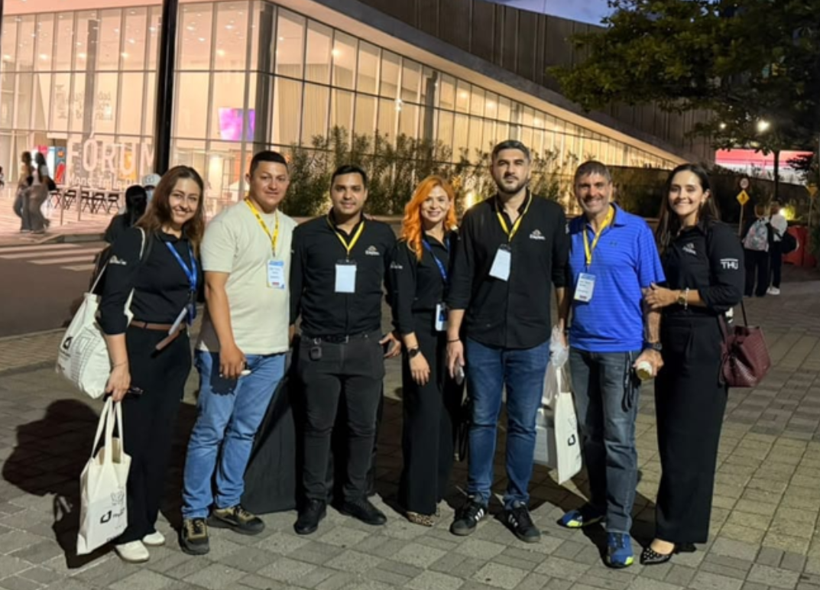
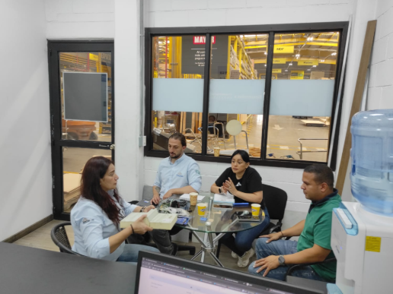
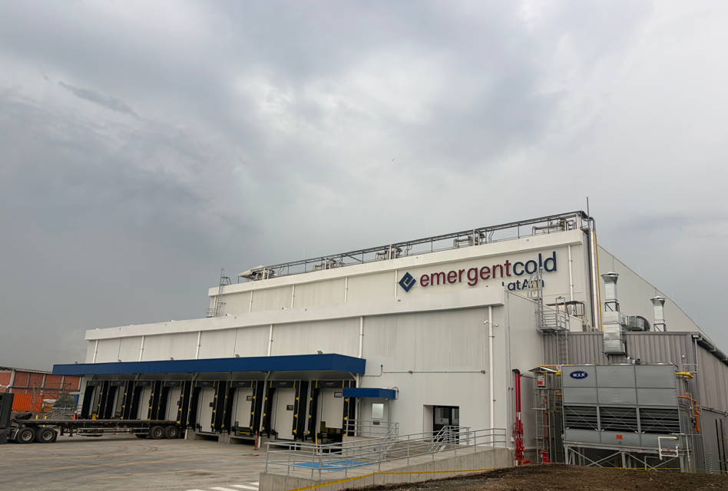

HIGHLIGHTS October – COMMERCIAL
Commercial activity, market development and milestones of the month
CUSTOMER VISITS
NEW CLIENTS
IMP M" Lost with competition
Quotes IMP
M² SPECIFIED
258
52
45K (26K OC, 21K Colo)
357|37,592M
122.241M2
field coverage
18.1 m² · USD 551.907
+ 10.998 m² architectural
MARKET DEVELOPMENT
CUSTOMER TRAINING
FEATURED PROJECTS
FEATURED PROJECT
Envolum Summit 2026 – Medellín
Portfolio
Emergent Cold Cali – Cubic 33 | +8,000 m²
Colombina – 3.000 m² | Valle del Cauca
We participated in Envolum Summit 2026 in Medellín to identify new business opportunities, attract potential customers, strengthen strategic relationships, and continue enhancing our brand positioning in the market.
Training for clients and on the general / cold storage portfolio (146people).
Strengthening and diversifying our customer portfolio, generating new business opportunities and expanding our market presence
Supply and installation of over 8,000 m² of Kingfrigo panels for a cold storage facility, with building heights of 16 and 18 meters, including on-site supervision and installation.
Supply and installation of 3,000 m² of Kingfrigo panels for temperature-controlled rooms at the CLIP Industrial Center, in partnership with Construandes.
Strengthening our relationship with Emergent Cold, creating new business opportunities as the company expands across the region.
Impact: Use of smooth-finish Kingfrigo panels to enhance hygiene and food safety standards. Customer testimonials collected to document the success story
14
Notes:
KEY MESSAGES
- Activity: 218 customer visits; 26 new clients (7,4k m², USD 197.235 → ~USD 7,6k per new client); 122 people trained; 2 trade shows.
- Specification: 163.801 m² in panels + 49.626 m² in the architectural line (213.427 m² total).
- Milestones: Binational Event Cúcuta (Colombia–Venezuela business round); cold storage training for Grupo Nutresa; Smartfit façade 599 m²; Dollarcity Mamatoco roof.
UPDATE
- Data Engine › 15_Highlights.

Slide 15

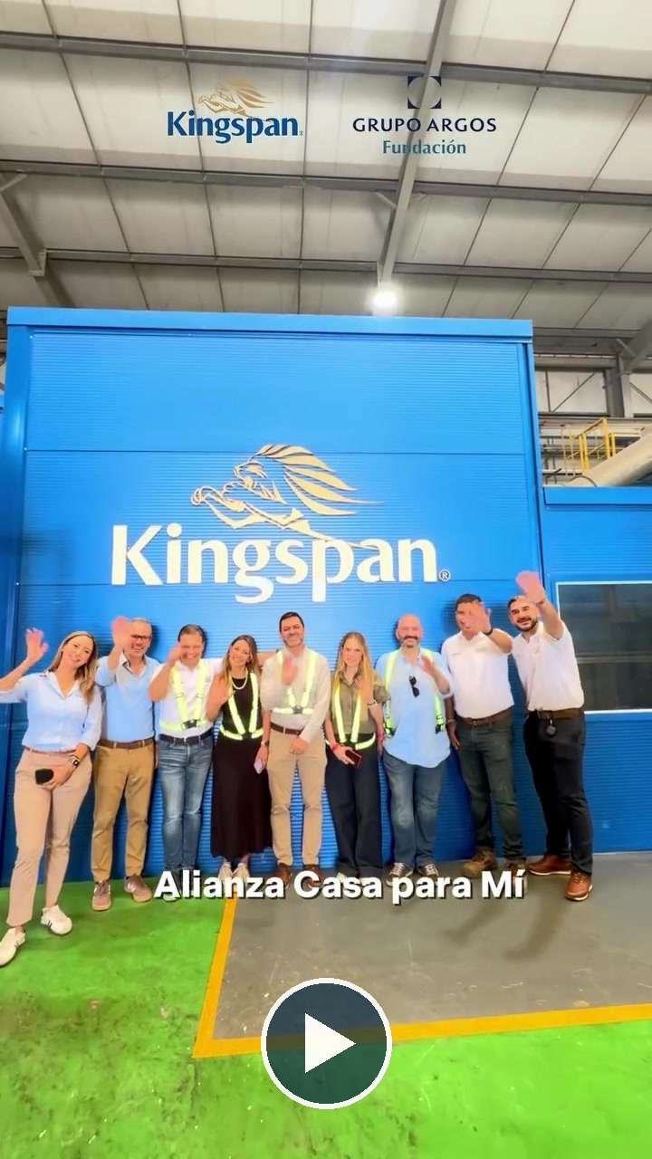
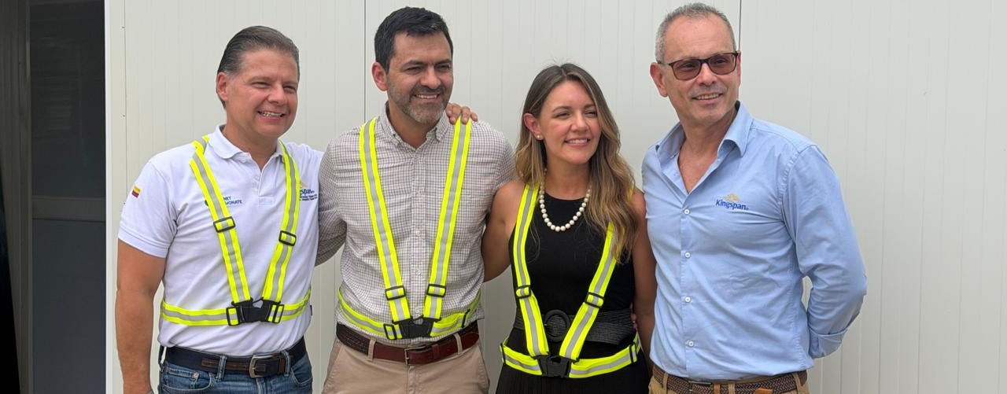
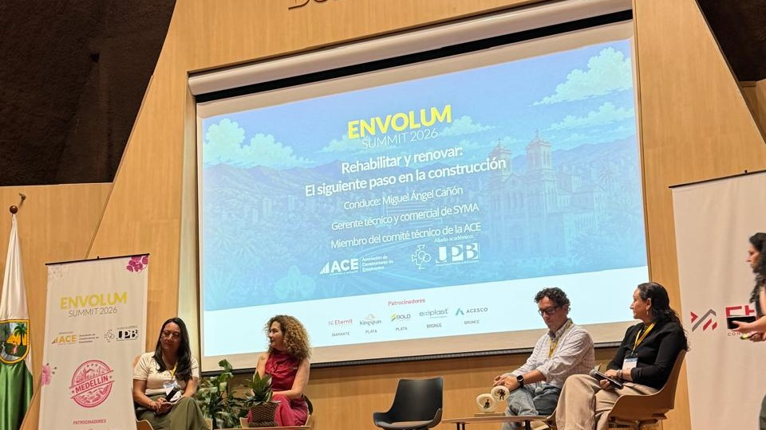

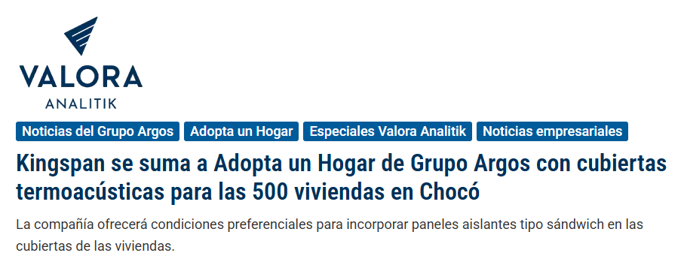
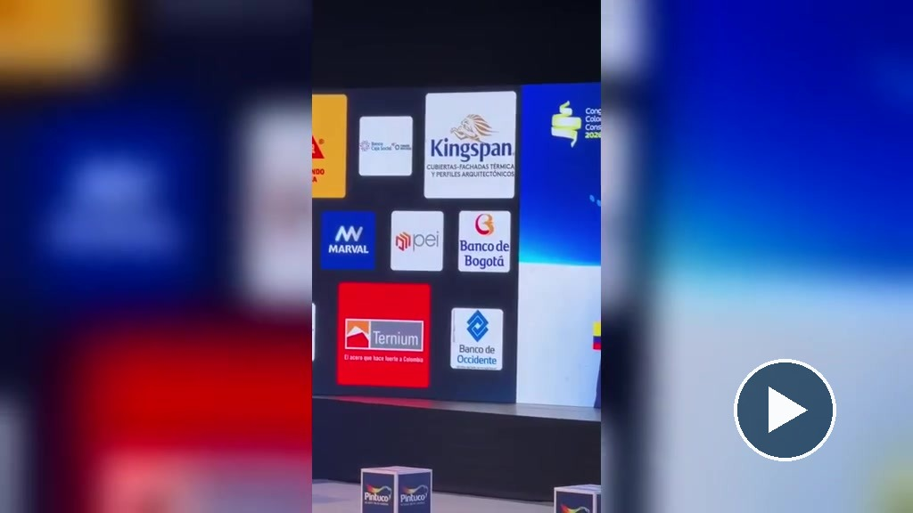
MARKETING & COMMUNICATIONS · OCTOBER 2026
Brand visibility: social impact, industry events and digital growth
SOCIAL RESPONSIBILITY · PARTNERSHIP WITH GRUPO ARGOS
INDUSTRY EVENT SPONSORSHIPS
FACTORY TOUR
Envolum Summit 2026
ACE · UPB Medellín | Silver Sponsor
Valora Analitik · October 23, 2026
Homes rebuilt after the August 10 earthquake. Program's national commitment: 1,000 homes.
7k
180
Factory Tour with ProColombia
Collaborative reel: a tour of our plant
organic video views
organic reactions
Congreso Colombiano de la Construcción 2026
Camacol | Sponsor
DIGITAL SUMMARY
Last 30 days
+200k
views in 30 days
+12k
followers on our main Instagram account

Slide 16
Pipeline mapped and first contacts under way
KINGSPAN DATA SOLUTIONS · MIDDLE AMERICAS · STATUS UPDATE
Identified data centers
Key operators and designers
Market snapshot
29 projects in 11 countries · priority projects shown
Who builds, specifies and buys
Publicly disclosed capacity
Project | Country | Size | Status
ODATA BG03 · Tenjo | CO | 120 MW | Construction
ODATA BG02 · Mosquera | CO | 24 MW | Construction
Telconet · Barranquilla | CO | n/d | Construction
Telconet · Panama City | PA | n/d | Construction
Cirion LIM2 · Lurín | PE | 20 MW | Operational
Telconet AI hub · Quito | EC | 10 → 100 MW | Announced
BioNube · Santa Marta | CO | 3 DCs · 30 MW | Announced
Aurum AI campus | GT | 50 MW | Announced
IFX · 5 countries | C. Am. | US$155 M | Announced
GTD · Lurín phase 2 | PE | US$10–13 M | Announced
AI campus · Limón | CR | Up to 200 MW | Feasibility
Hummingbird AI and EY | TT | 450 MW | Feasibility
PRIORITY OPERATORS
Green = contacted
~1,000 MW
InterNexa
ODATA / Aligned
Telconet
IFX
announced across the region
KIO
GTD
Cirion
164 MW · 16%
DESIGNERS AND ENGINEERING
Construction or operational
Gensler
Contacted
192 MW · 19%
Announced by operators
Deerns
Contacted
650 MW · 65%
Turner & Townsend
Next
Feasibility or MoU
Data Center Consultores
Next
Two-thirds of the MW are not firm yet: we focus on what is being built.
DONE
Regional pipeline mapped · Gensler, Deerns and InterNexa contacted · Envelope already supplied on several DC projects
NEXT
Meeting with the KDS / Tate LATAM sales lead · Joint envelope + white-space offer · Visits to priority operators
Sources: DCD, BNamericas, Gestión, Bloomberg Línea, Infobae, Intelligent CIO, Rio Times (2025–2026). n/d = not disclosed.
Notes:
Status update for the Data Solutions plan in Middle Americas. 29 projects identified across Colombia, Ecuador, Peru, Central America, the Caribbean, Puerto Rico and Venezuela. Gensler, Deerns and InterNexa have been contacted. Next step: meeting with the Kingspan Data Solutions / Tate sales lead for Latin America to agree on an integration plan for projects where Kingspan Colombia currently supplies only the envelope.

Slide 17
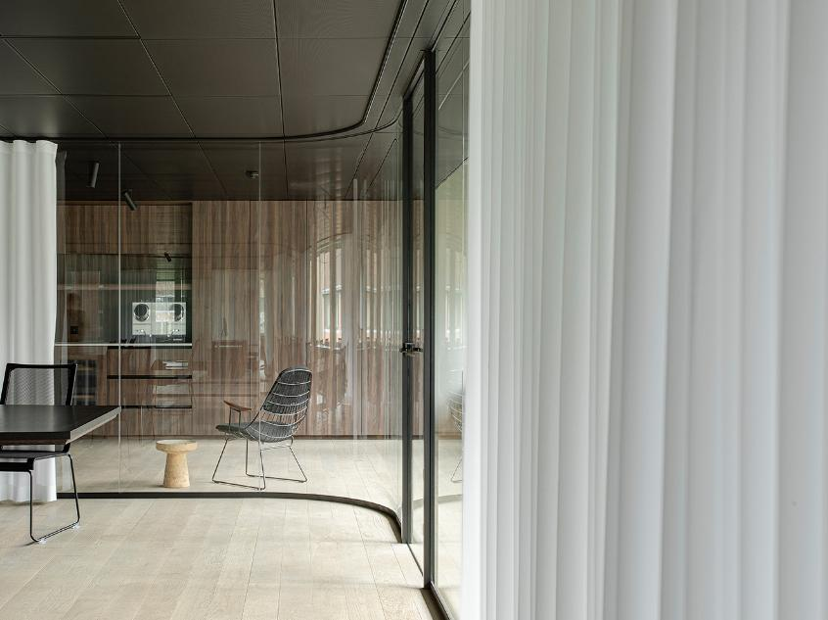
Dublin Road
Kingscourt, Co Cavan
Ireland, A82 XY31
Tel: +353 42 969 8000
Email: admin@kingspan.com
  www.kingspan.com

