Slide 1
Introduction
Significance of API Testing
APIs form the backbone of modern applications, allowing seamless communication between different components. In the context of our Pet Store, the API is the lifeline, enabling actions such as adding pets, retrieving information, and managing inventory. The effectiveness of our API directly correlates with the reliability of our application.
Automation Impact
Through automation, I aimed to address key challenges in the testing process, such as efficiency, repeatability, and the ability to catch potential issues early in the development lifecycle. By implementing automated tests for our API, we are not only ensuring the quality of our software but also accelerating the pace of our development cycles.

Slide 2





Framework-stack
Programming Language and Build Management:
Implemented in Java for its versatility and community support.
Maven serves as the build tool, managing dependencies and simplifying the build process.
Version Control:
GitHub repository for version control, facilitating collaboration and version tracking.
Testing Frameworks and Libraries:
RestAssured for API testing, providing a straightforward way to interact with the Pet Store API.
Cucumber and Gherkin for BDD, enabling collaboration and creating human-readable test scenarios.
Page Object Model (POM):
Page Object Model design pattern adopted for modularity and maintainability.
Enhances code readability by separating page objects representing different components of the Pet Store API.
Test Data Management:
Strategies for data-driven testing implemented, allowing tests to be executed with different data sets.
Test data may be managed within the automation code.
Reporting and Logging:
Cucumber generates detailed reports, offering insights into test execution and scenario outcomes.
Logging mechanisms in place to capture relevant information during test execution.

Slide 3
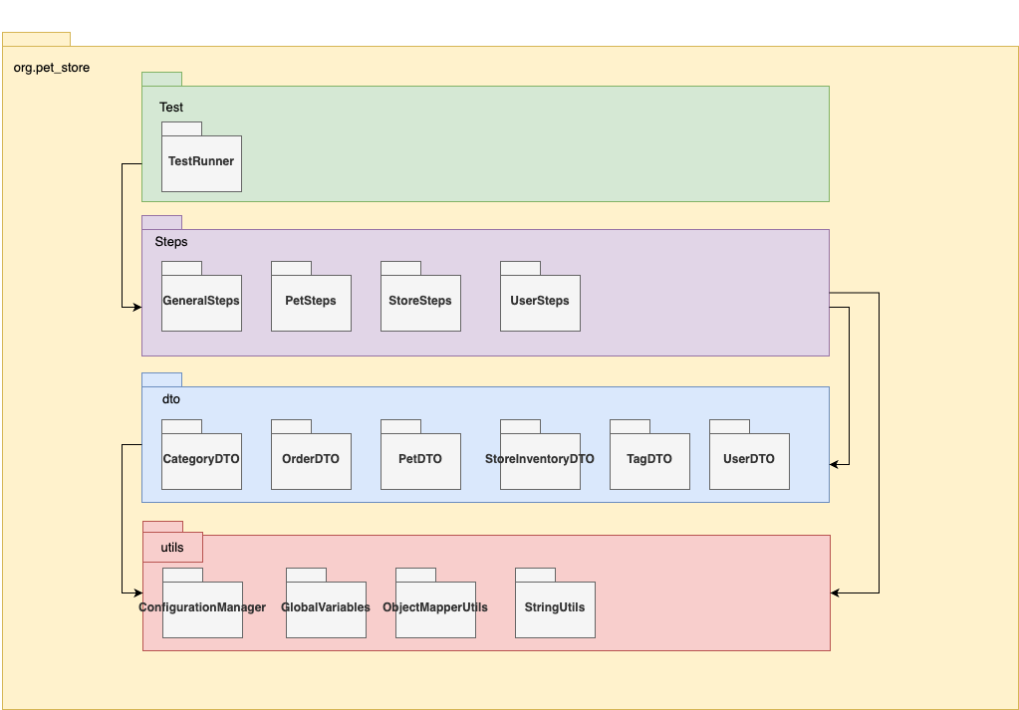

Slide 4
This framework utilizes a layered architecture for building robust and maintainable automated tests for the pet store API. Here's a breakdown of the key components:
Test Layer:
Test Runner: This class acts as the entry point, initiating the execution of all test scenarios.
Steps Layer:
This layer comprises step definition classes that define reusable steps for interacting with the API. These classes are typically annotated with @Given, @When, and @Then annotations from Cucumber.
GeneralSteps: This class likely contains common steps applicable to all API interactions, such as setting up the base URL or handling authentication.
SpecificSteps (e.g., PetSteps, StoreSteps, UserSteps): These classes encapsulate steps specific to different API functionalities, like managing pets, orders, or users.

Slide 5
DTO (Data Transfer Objects) Layer:
This layer houses classes representing the data models used in API requests and responses. These classes map directly to the data structures of the pet store API.
CategoryDTO
OrderDTO
PetDTO
StoreInventoryDTO
TagDTO
UserDTO

Slide 6
Utils Layer:
This contains utility classes with helper methods for common tasks:
ConfigurationManager: This class could handle loading configuration variables from a file or environment.
GlobalVariables: Stores global variables accessible throughout the tests.
ObjectMapperUtils: Provides methods for working with JSON data using a library like Jackson ObjectMapper.
StringUtils: Contains helper methods for string manipulation.

Slide 7
Benefits of this Layered Approach:
Improved Readability and Maintainability: Separation of concerns makes the codebase easier to navigate and understand.
Enhanced Reusability: Reusable step definitions in the Steps Layer promote code efficiency.
Modular Design: Simplifies adding new functionalities or modifying existing ones.
Clear Separation of Logic: Divides testing logic from data models and utility functions.

Slide 8
Effectiveness of the Automation Solution
1. Test Execution Speed:
The automation solution demonstrates exceptional speed, with a regression suite of 9 scenarios completing in just 1.1 seconds.
Quick execution allows for swift feedback during development and minimizes delays in the testing process.
2. Test Coverage:
While the exact percentage of API functionality covered by automated tests is not available, the focus on the 9 most critical scenarios highlights a targeted and impactful approach.

Slide 9
3. Defect Detection:
During the development of the critical scenarios, automation identified 3 bugs, showcasing its effectiveness in early defect detection.
Automation contributes to reducing the likelihood of critical issues reaching later stages of development.
4. Resource Utilization:
Although specific resource utilization metrics are not provided, the quick and efficient nature of automation suggests potential resource savings.
Consider any observations or feedback regarding changes in manual testing efforts.

Slide 10
5. Regression Testing: The automation solution significantly enhances the efficiency of regression testing, enabling the quick validation of critical scenarios with each iteration. Rapid regression testing ensures that new changes do not introduce unexpected issues.
6. Test Maintenance: Test maintenance details are not available, but the quick execution time suggests a streamlined and well-maintained test suite. Future insights into test maintenance efforts can provide a more comprehensive view.

Slide 11
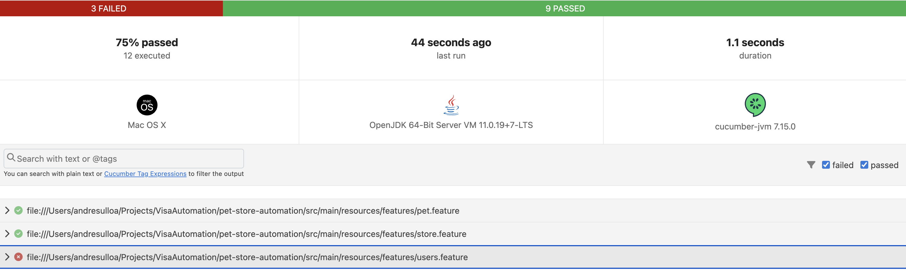

Slide 12
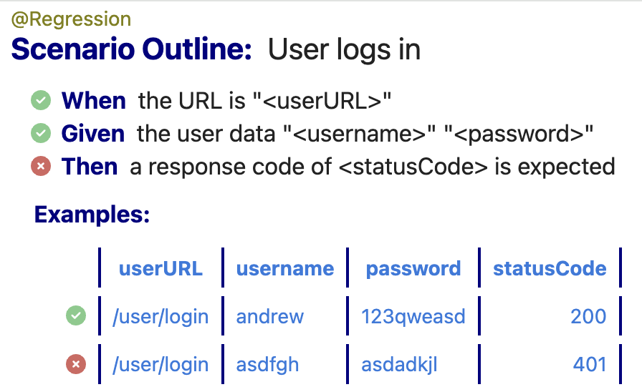
Bug Explanation: Absence of Error Message for Invalid Credentials in API Response During Pet Store API testing, a critical issue arose in the authentication mechanism when invalid credentials are used, leading to a lack of clear error messages in the response. This affects client integration and developer troubleshooting, making it challenging to manage authentication failures. To address this, it's crucial to ensure the API response includes an appropriate HTTP status code for authentication failures and a descriptive error message. This resolution aims to enhance usability, providing vital feedback for clients and developers during authentication attempts and improving overall system reliability.

Slide 13
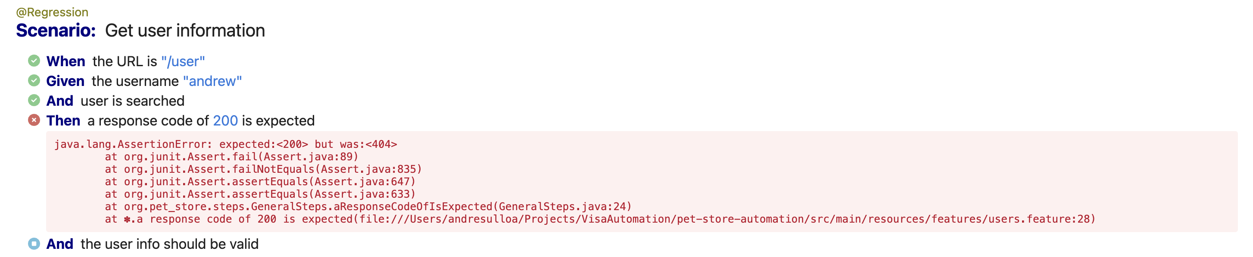
Bug Explanation: Consistent 404 Status Code for User Search in API
The API testing for the Pet Store application revealed a critical bug in the user search functionality, consistently returning a status code 404 (Not Found) irrespective of the accuracy of provided user details. This deviation from the expected behavior poses reliability concerns and confusion for developers and clients. The persistent 404 status undermines the intended functionality of the endpoint, potentially leading to misinterpretation of API responses. To address this issue, it is crucial to investigate and rectify the user search functionality, ensuring that valid user details yield an appropriate success status. Resolving this bug is essential for enhancing the accuracy and reliability of API responses, providing users with a consistent and expected experience when interacting with this endpoint.

Slide 14
Potential Improvements
Continuous Integration Optimization:
Fine-tune the integration of your automation suite with CI/CD pipelines. Ensure that the execution is seamless, and leverage parallel execution to optimize test suite run times.
Dynamic Test Data Generation:
Explore solutions for dynamic test data generation to reduce dependency on static datasets. This can enhance test scenarios and make the automation suite more adaptable to changing requirements.
Automated Environment Configuration:
Investigate solutions for automating environment configuration to reduce manual intervention and potential configuration errors.
Security Testing Integration:
Integrate security testing tools or libraries to perform static and dynamic security analysis on your API requests. Identify potential vulnerabilities and strengthen security measures.

