Slide 1


ROOT Tutorial
Andrés Delgado
Practical session for bachelor project
April 21th 2022

Slide 2
Contents
1st part
  Create a TGraph
  Create a TH1D
  Write simple code
  Pointers
  Writting a TTree
  Reading a TTree
2nd part
  Read simulation files
  Write a function
  Fitting of data
Nomenclature:
- Blue: you type it
- Red: indicate in what enviroment you are
Macros and slides are here https://github.com/andresgd17/Bachelor_project.git

Slide 3

Google: ROOT CERN

Slide 4
ROOT in a nutshell
ROOT is a large Object-Oriented data handling and analysis framework
  C++ interpreter
  Efficient object store scaling from kB’s to PB’s
Extensive set of multi-dimensional histograming, data fitting, modeling and analysis methods.
Ref: Tutorial from Luca Fiorini

Slide 5
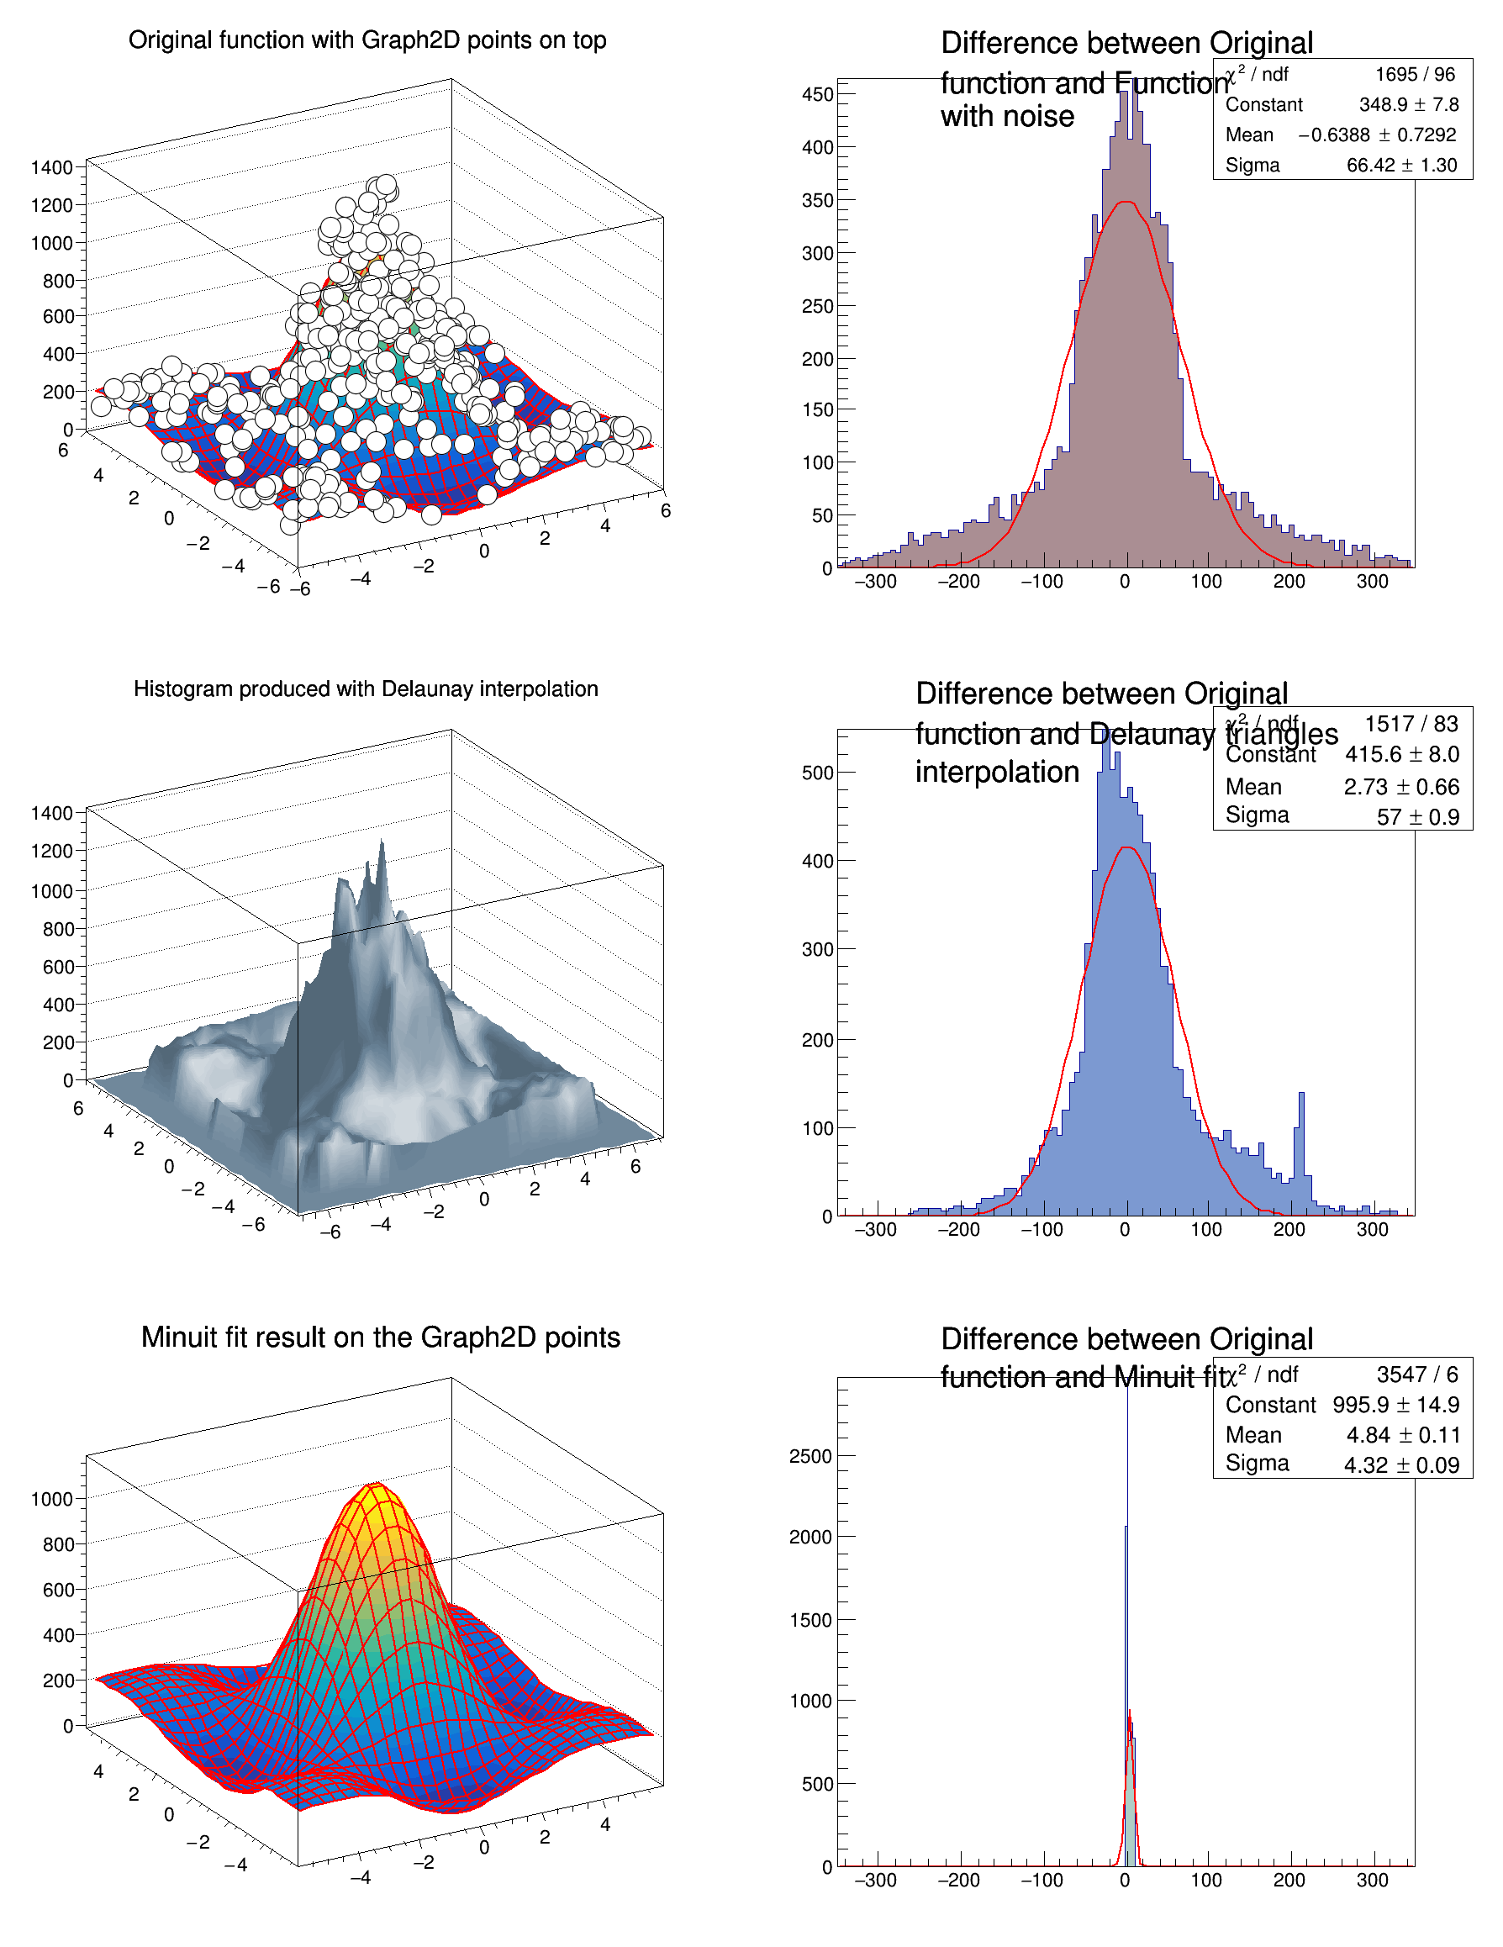
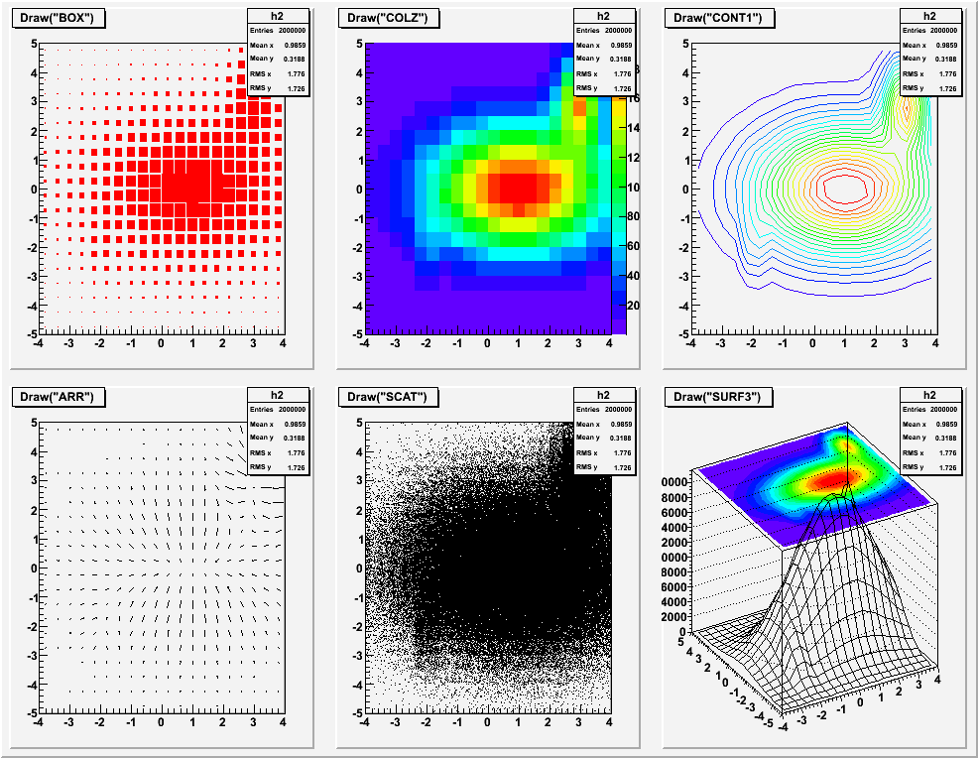
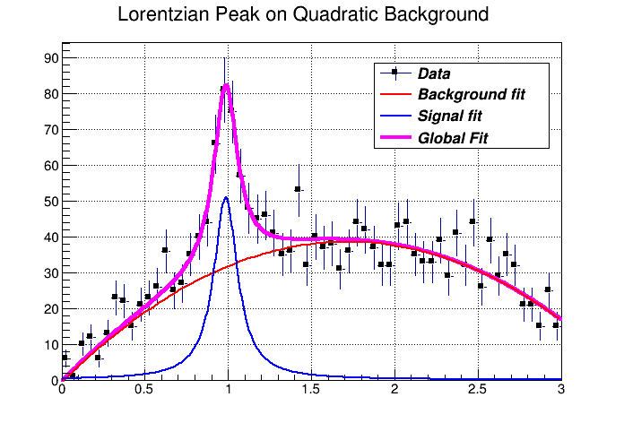
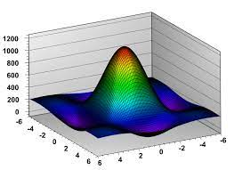
ROOT: Graphics

Slide 6
ROOT in a nutshell
The user can interact with ROOT using:
  graphical user interface, (probably don’t work in rug cluster)
  the command line, or
  scripts.
The command and scripting language is C++

Slide 7
ROOT in the RUG cluster
Connect to cluster:
  ssh <snumber>@peregrine.hpc.rug.nl
  https://wiki.hpc.rug.nl/_media/peregrine/additional_information/peregrine_course.pdf
Load ROOT module in the cluster
  $ module spider ROOT
  $ module load ROOT

Slide 8
ROOT prompt
Starting ROOT
  $ root
In the ROOT prompt you can type:
  root [ ] 5+4 root [ ] int i = 3
  root [ ] TMath::Pi() root [ ] cout << i << endl;
  root [ ] float x[5] = {1, 2, 3, 4, 5}
  root [ ] float y[ ] = {1, 4, 9, 16, 25}

Slide 9
TGraph
Creating a Graph with TGraph in the ROOT prompt:
  root [ ] TGraph gr(5,x,y)
  root [ ] gr.Draw("alp")
  root [ ] TGraph gr2
  root [ ] gr2.SetPoint(0,1,1)
  root [ ] gr2.SetPoint(1,2,4)
  root [ ] gr2.Draw("alp")

Slide 10
TH1D
Creating a histogram of 1 dimension:
  root [ ] TH1D histo("name", "title", 10, 0, 100)
  root [ ] histo.Fill(2)
  root [ ] histo.Draw()
  root [ ] histo.Fill(50, 4)
  root [ ] histo.Draw("histo")

Slide 11
Creating a macro.C
macro.C is the script containts your code
To execute your script macro.C:
  System prompt: $ root macro.C
  ROOT prompt : root [ ] .x macro.C
Useful options (root --help or root.help):
  System prompt: $ root -b -q macro.C
  ROOT prompt : root [ ] .L macro.C

Slide 12
Pointers
A pointer is a variable that stores address of another variable, .i.e., point to the address of the memory location.
A pointer declaration use * and has the form: data_type * name;
  Variable declaration: int i = 8;
  Pointer declaration: int * i = new int(8);
Allocate memory with operator new just for pointers:
We access to members of pointers using: ->
You can get the address of variable using: &
( To print the value type: *i )

Slide 13
Pointers
Create macro_pointers.C by modifying:
  TGraph gr(5,x,y)→ TGraph *gr = new TGraph(5,x,y)
  gr.Draw("alp") → gr->Draw("alp")

Slide 14
Break
Everything is ok?
Any questions?

Slide 15
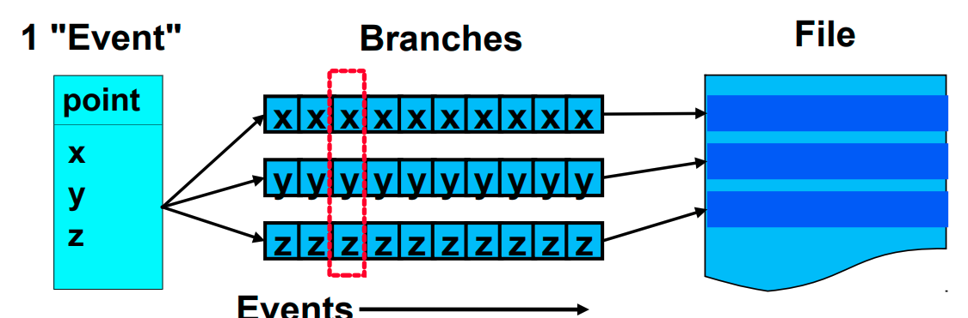
TTree
Trees have been designed to support very large collections of objects.
Trees allow direct and random access to any entry
Trees can be browsed via TBrowser
The class TTree is the main container for data storage
  It can store any class and basic types (e.g. Float_t)
  When reading a tree, certain branches can be switched off → speed up of analysis when not all data is needed

Slide 16
Ttree - writing
Root files have extension <filename>.root
  root [ ] TFile *file = new TFile("myRootFile.root", "recreate")
  root [ ] TTree *tree = new TTree("tree_name", "tree_title")
  root [ ] float energy
  root [ ] tree->Branch("Energy", &energy)
  root [ ] tree->Print()
  root [ ] energy = 50
  root [ ] tree->Fill()
  ...

Slide 17
Ttree - writing
  ...
  root [ ] tree->Print()
  root [ ] tree->Scan("Energy")
  root [ ] energy = 100
  root [ ] tree->Fill()
  root [ ] tree->Print()
  root [ ] tree->Scan("Energy")
  root [ ] file->Write()
  root [ ] file->Close()
Don’t forget to write all objects in the file!!

Slide 18
Ttree - reading
Reading myRootFile.root:
  root [ ] TFile *file = new TFile("myRootFile.root", "read")
  root [ ] .ls
  root [ ] tree_name->Print()
  root [ ] tree_name->Scan("Energy")
  root [ ] tree_name→Draw("Energy")
Check readtree.C: Script to read a tree
  $ root readtree.C

Slide 19
Small assignment
Try to type by yourself all the codes again to familiarize with them.
Create a script called writetree.C to create a Ttree:
  You can use the same code from Ttree – writing section :)
  Try to create another branches: i.e. velocity, momentum, etc, and fill them with random numbers :)

Slide 20
2nd part of tutorial
Read simulations files:
  conex_qgsjetII04_040390428_5600.root
  12 files in total:
    4 files for each kind of primary particle: gamma, proton and iron
      Each of the 4 files for each energy: 10 TeV, 50 TeV, 100 TeV, 300 TeV
ID of primary particle:
Gamma: 0
Proton: 100
Iron: 5600
Seed number

Slide 21
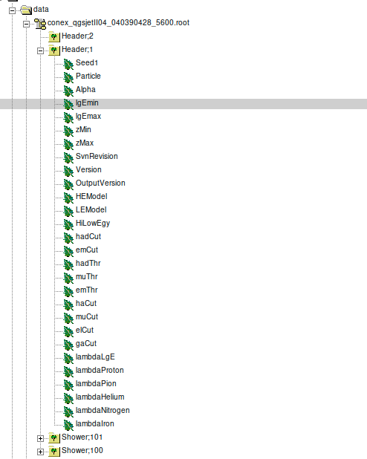
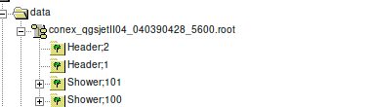
  Data files

Slide 22
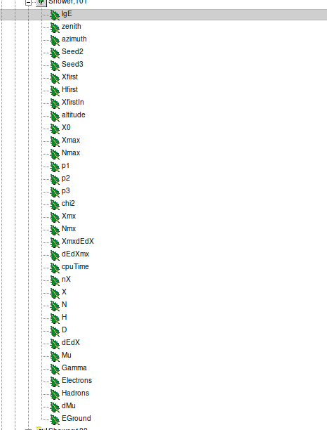
  Data files

Slide 23
Important information
Tree: Shower;101
  Branches:
    LgE: log10( Energy /eV) e.g: lgE = 14 → Energy=10¹⁴ eV
    nX: number of points of "X", "N",
    X: slant depth array (g/cm²)
    N: array of number of charged particles
For more information check README file in data folder

Slide 24
Plot profiles
Use plotProfile.C script to plot TGraph of charged particles profiles with legend.
Let’s plot one profile:
  ROOT prompt:
    $ root
    root [ ] .x plotProfile.C("../data/conex_qgsjetII04_040390428_5600.root",4)
  System prompt:
    $ root "plotProfile.C(\"../data/conex_qgsjetII04_040390428_5600.root\",4)"

Slide 25
TChain
A chain is a collection of files containing TTree objects.
  TChain Shower("Shower");
  Shower.Add("../data/conex_xxx_.root");
  Shower.Add("../path/conex_xxx_.root")
Check chain.C

Slide 26
Assignment
Open the conex_xxx_.root files and explore the contents.
Plot the profile of charged particles, electrons, hadrons and muons (in the same TGraph) for each particle of some energy: 3 plots in total for each profile.
Fix the Y-axis title in the profile plot (search how to do on root fórum, google, ...)

Slide 27
Write a function
Check plotFitFunction.C
  Define second-order polynomial function
  Fit profile around the maximum
Assignment:
  Get the Xmax from the second-order polynomial fitting for each kind of air shower: 3 plots in total.
  Plot the distribution of the Xmax in a histogram TH1D

Slide 28
Backup

Slide 29
Tree
Branches
  root[ ] Shower->Print()
  root[ ] Shower->Show(5)
  root[ ] Shower->Scan(X)
  root[ ] Shower->Scan(N)
  root[ ] Shower→Draw("N:X","X < 500", "*", 1, 5)
condition
First shower to consider
# of showers
Variables you want to draw

Slide 30
Useful
You can open files when starting ROOT by:
  $ root file.root
Suppose a macro myscript.C with a function myscript(string file, int i, float x)
  $ root "plot.C(\"filename.root\",1,1)"
Type .? to see meta commands in the ROOT prompt

Slide 31
Need help?
ROOT fórum (https://root-forum.cern.ch/)
Youtube: search for root cern <something> (could work)
Send me an e-mail! :)

