Slide 1
Asynchronous Job + Worker + HTTP 202
CMPS4191 Advanced Web Technologies Quiz 2
Andres Hung (2018118240)
August 30, 2026

Slide 2
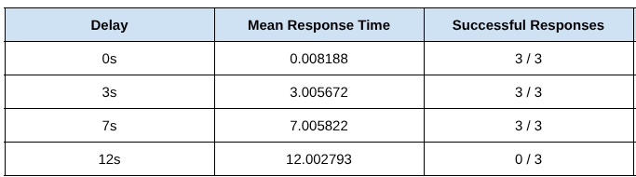
A) The Problem & Requirement
In Laboratory 1, synchronous report generation time was shown to increase as report generation delay increased. When it was too long, a timeout occurred.
The client should NOT be waiting so long, unable to do anything else…
Failure with 12s delay
New Requirements - Acknowledge without waiting for report completion. - Allow work to continue after POST ends. - Expose current job state. - Exposes completed result or failure.

Slide 3
B) The HTTP Contract
The clients sends the initial HTTP POST request to the server for report generation.
Instead of having the POST handler process the report generation, create a job and delegate processing to a background worker.
A response with a HTTP status code of 202 Accepted, containing the job identifier and job status endpoint, can be returned to the client.
202 Accepted does NOT guarantee the job (report generation) will be successful. It may fail.
The client needs a job identifier and a job status endpoint so it knows how to query the status of the job it submitted.

Slide 4
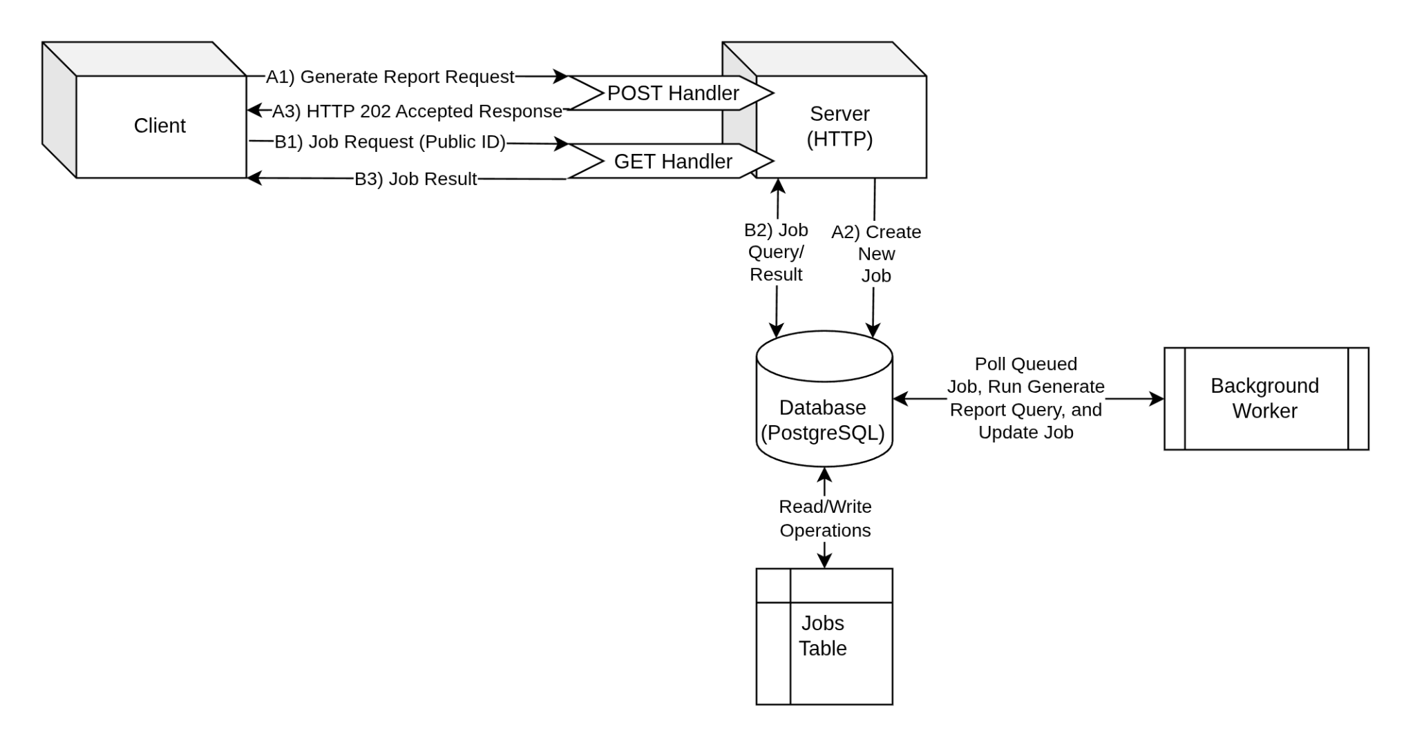
C) Architecture
The background worker periodically polls for queued jobs to process.
The background worker is a separate process or thread from the server e.g., goroutine, Python program.
Numbered arrows prefixed with A and B show synchronous sequences of the client’s initial POST request and the client’s polling GET request, respectively.
The client periodically polls the job status.

Slide 5
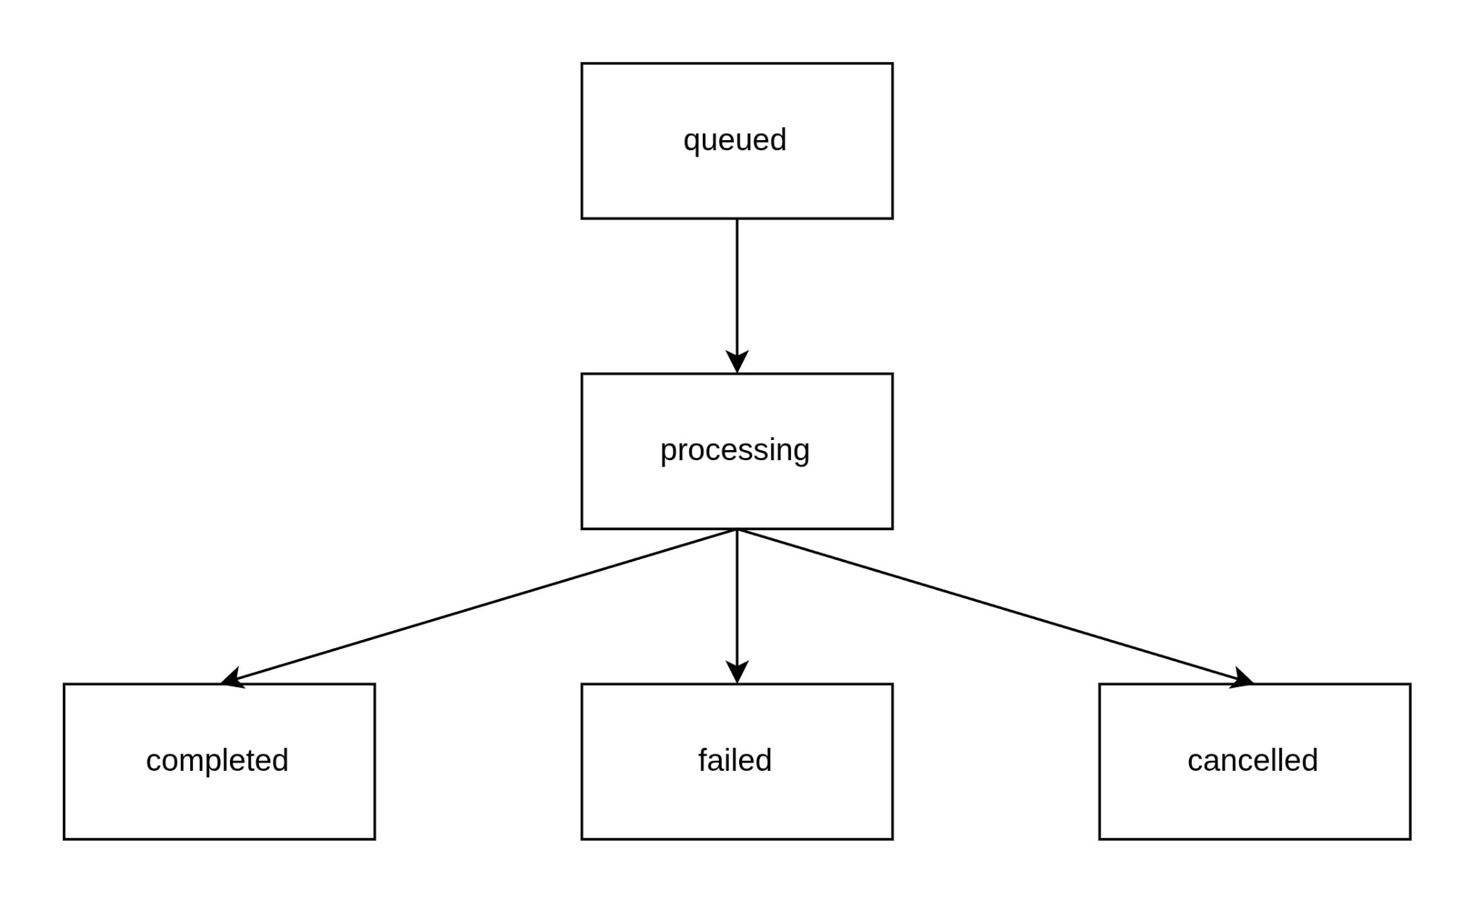
D) Job Lifecycle
Functions responsible for each job status is listed. Multiple functions may participate, and are listed from highest to lowest abstraction.
The cancelled status currently does not have an associated function.
createReportHandler (h_reports.go)
JobModel.Insert (m_jobs.go)
startReportWorker (worker.go)
processNextJobReport (worker.go)
JobModel.ClaimNext (m_jobs.go)
JobModel.MarkCompleted (m_jobs.go)
JobModel.MarkFailed (m_jobs.go)
N/A

Slide 6
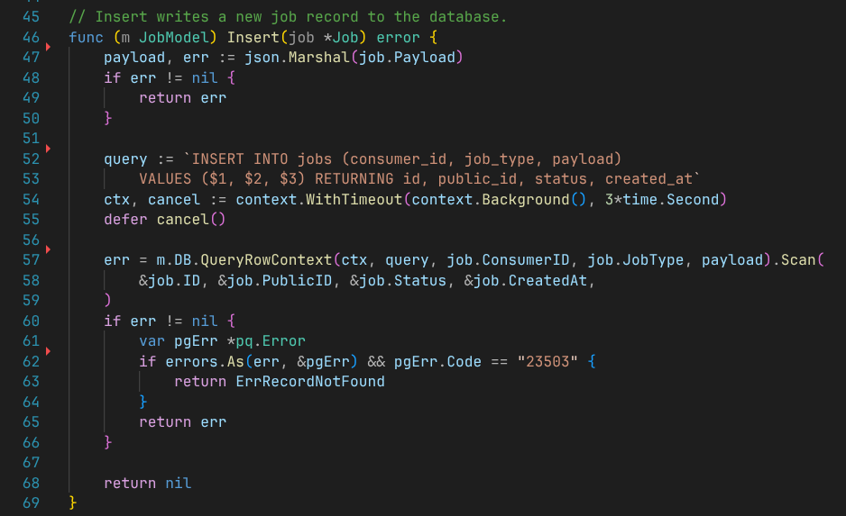
E-1) Job Creation
Payload serialization to JSON is needed since Payload is a Go struct (ReportPayload) and the job payload column in the database is JSONB and expects JSON type.
When INSERTing the job into the database, the RETURNING clause is used to make the newly populated columns available to the Go program, which populates the rest of the fields of the the Job Go struct.
m_jobs.go

Slide 7
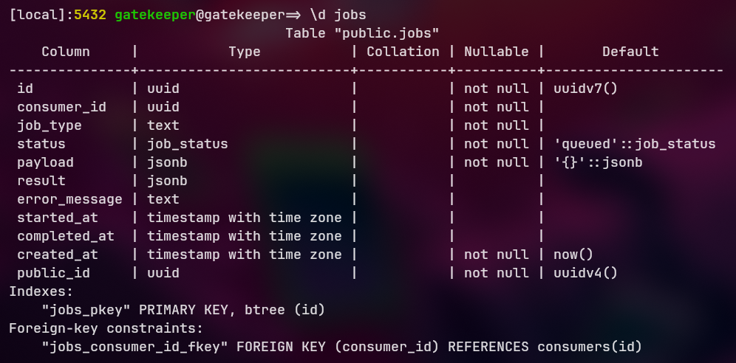
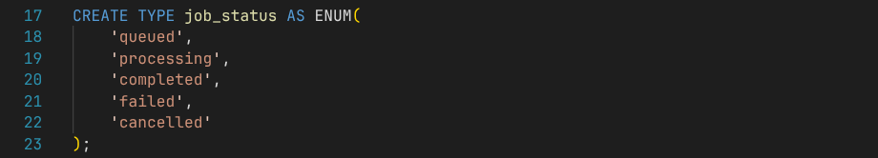
E-2) Job Persistence
gatekeeper database
In the database, the jobs table persists job records. A job has two IDs: a non-public id of UUIDv7 which has a timestamp component useful for quick indexing, and a public_id of UUIDv4, which does not have a timestamp component, and reduces exposing the job rate business performance metric.
The status column stores the job state, and defaults to the queued status.
000001_create_init_extensions_and_types.up.sql

Slide 8
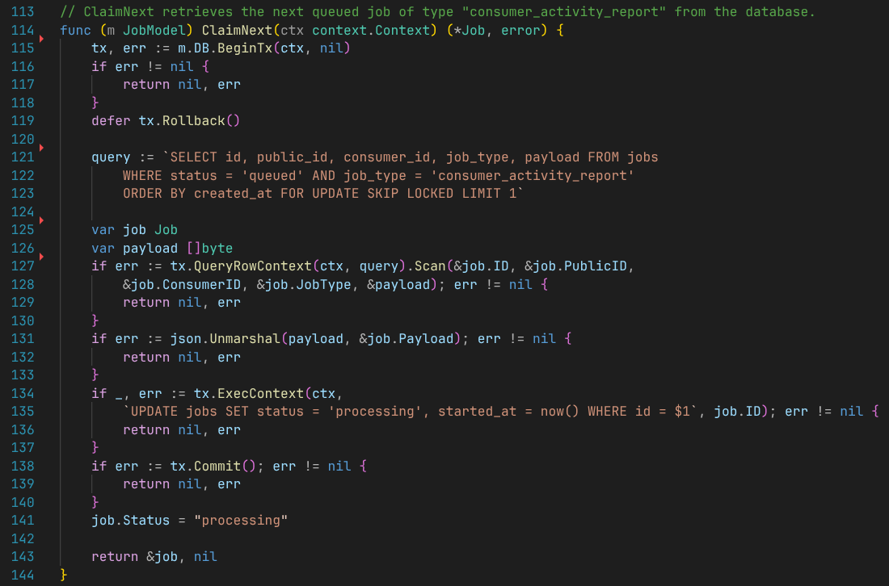
F) Claiming Jobs Safely
With multiple workers, it makes sense to use a transaction to ensure two workers don’t claim the same job. Also, if there are any errors with committing, any changes are rolled back.
The FOR UPDATE SKIP LOCKED clause locks the row during the transaction. If another worker happens to query the same job, it is skipped for next queued job.
After the job status is set to processing in the database, the transaction is committed. The job struct’s status is also updated.
m_jobs.go

Slide 9
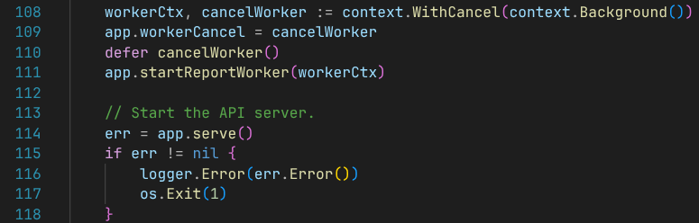
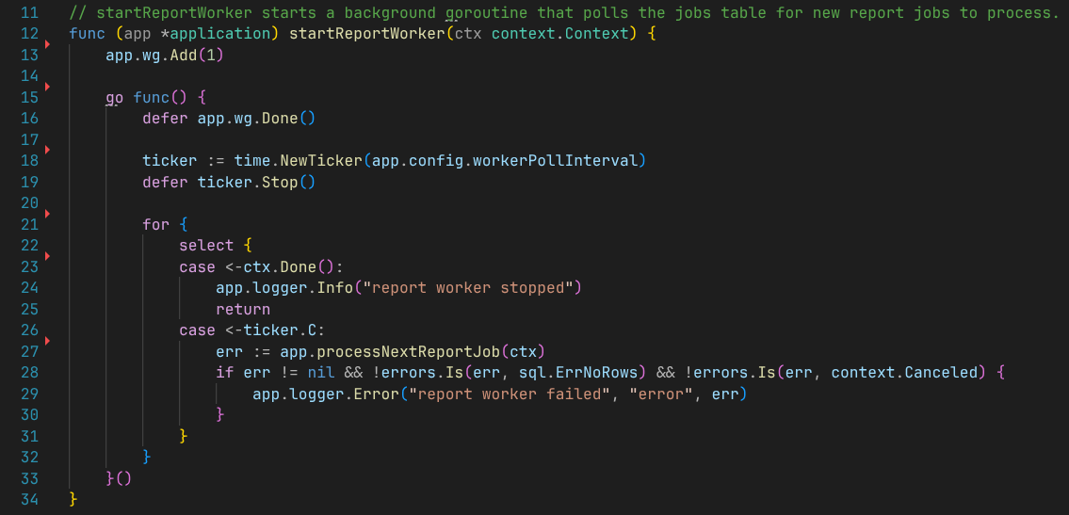
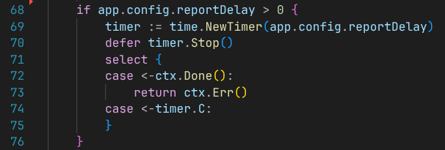
G) Worker Behavior
A worker goroutine starts right before the server starts.
The app struct in main.go holds the wg WaitGroup property, accessible to the worker. It is incremented when the worker starts, and ultimately decremented once the worker is stopped by the ctx.Done() channel being closed by cancellation.
The ticker implements the worker poll interval. The time is sent to the ticker.C channel, where once read, the worker processes the next report job (processNextReportJob).
The artificial delay for report generation is implemented in the processNextReportJob function. It’s only applied when the reportDelay is greater than 0.
main.go
processNextReportJob
worker.go

Slide 10
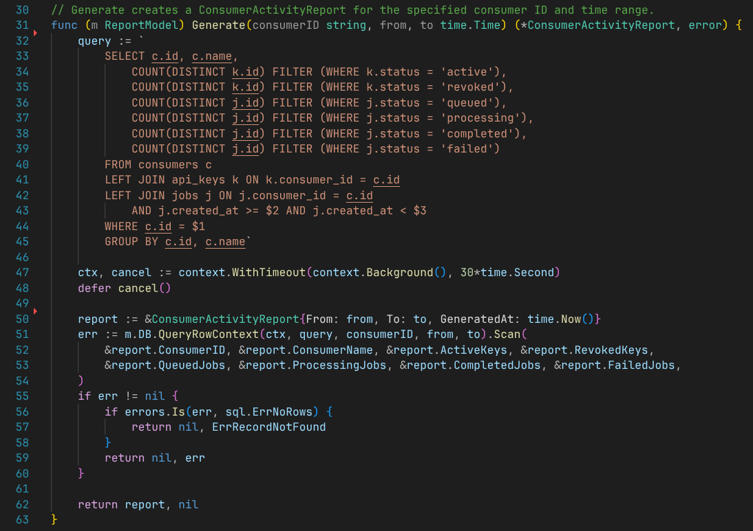
H) Report SQL & Outcomes
LEFT (OUTER) JOINs are used successively on the api_keys and jobs tables with the consumers table being on the left. The leftmost table always includes all records of that table.
In order to properly use COUNT aggregation, DISTINCT was applied on IDs and FILTER was applied on the statuses, which would be duplicated by the 2 LEFT JOINs.
The completed result is then scanned into the ConsumerActivityReport Go struct, which is later returned to the client as JSON.
sql.ErrNoRows is one of the specific recorded failures. This particular error occurs when the consumer ID provided does not exist in the database.
m_reports.go

Slide 11
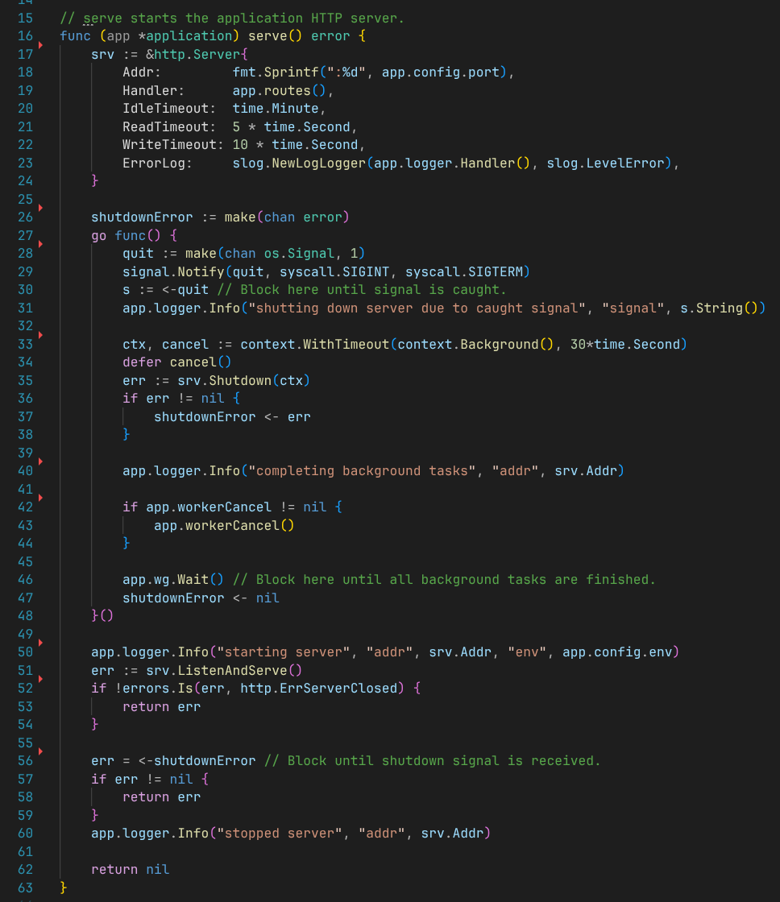
I) Graceful Shutdown
The server’s shutdown signal monitoring is handled by another goroutine. The single buffered os.Signal channel is configured to listen for SIGINT (Ctrl + C) or SIGTERM (pkill -15). The goroutine blocks until one of those signals is received. Then, background tasks are completed.
Worker cancellation occurs as part of background task completion. app.workerCancel calls the workerCtx in main.go that was passed to the worker. This is what ultimately causes the worker goroutine to return.
The app.wg.Wait() call blocks until the worker, who initially incremented the counter, decrements it, signalling that the worker has gracefully shutdown. After, the goroutine here completes and serve() proceeds to shut down the HTTP server.
server.go

Slide 12
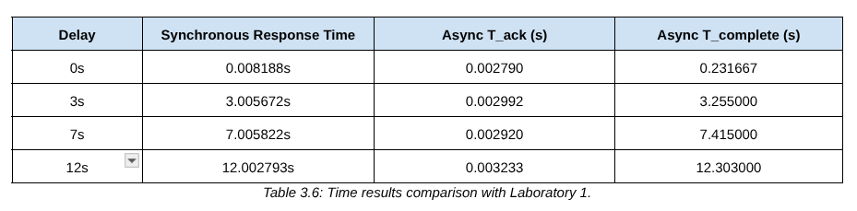
J) Measurements & Interpretation
In this implementation, acknowledgment time (T_ack) represented the point after which the 202 Accepted response was sent for the initial POST request.
The completion time (T_complete) represented the point in the implementation after which the worker completed report generation and the client polled the last GET request with the result.
Based on the measurements and controlled experimental condition, the current contract is satisfied, the acknowledgment time was independent of the delay, and the acknowledgment time stayed consistently low compared to the synchronous implementation in Laboratory 1.

Slide 13
Starter Code Differences
Small differences made to the starter code are documented below. The difference in implementation does not change the architecture and the changes were made for convenience or usage in previous projects.
The PostgreSQL citext extension creation was moved to the first migration (000001_create_init_extensions_and_types.up.sql) instead of manually creating it.
The github.com/julienschmidt/httprouter package was used instead of the provided mux := http.NewServeMux(). This package was used in previous projects, and functionally works the same for configuring routes and serving the endpoints.

