Slide 1
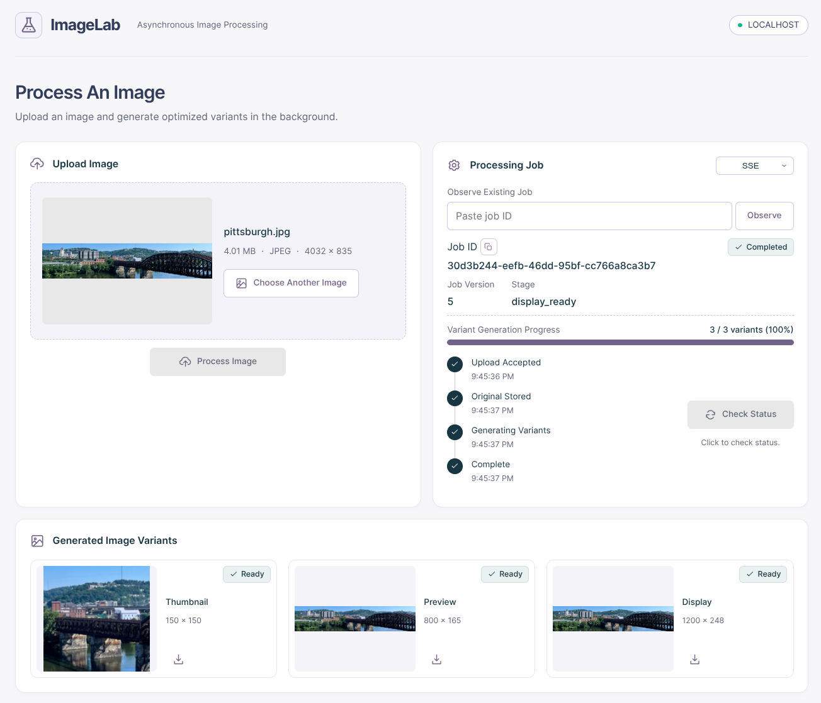
ImageLab v3
CMPS4191 Advanced Web Technologies
Andres Hung & Jennessa Sierra
November 18, 2026
CMPS4191 Advanced Web Technologies

Slide 2
SERVER-SENT EVENTS (SSE)
GOAL: Extend functionality to include SSE ssynchronous API.
SSE MODE
SSE ENDPOINT
SSE EVENTS
In addition to short polling and long polling, the UI dropdown also includes an SSE option.
The backend exposes the /v1/jobs/:id/events endpoint, where an SSE handler subscribes to a job.
The worker notifies subscribing SSE handlers of job updates, and handler sends job-update named events. If there are no updates in 20s, a heartbeat (: keep-alive) is sent. Flush is called to immediately send updates to the client.
EVENTSOURCE OBJECT
MULTIPLE OBSERVATION
The frontend utilizes JS EventSource object to implement an SSE stream.
Observe the same job in two browser tabs using the UI.
CMPS4191 Advanced Web Technologies

Slide 3
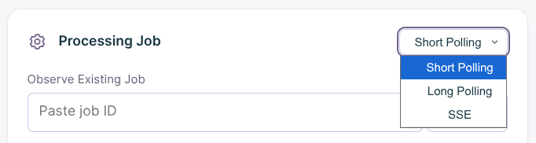
Summary of v3 Changes
NO NEW DATABASE MIGRATIONS
Reusing job version, simulated version, and variants completed.
ADDITIONAL ENDPOINT + HANDLER
A different endpoint route and job handler function were implemented to use SSE logic.
3 weeks
Channel-based notification system. In contrast, Long Polling implementation is ticker-based.
LONG POLLING + SSE COMPARISONS
Measurements compare Long Polling and SSE, primarily in regards to GET counts and completion-detection delay.
FRONTEND CHANGES
Implemented SSE mode and same-job observation controls.
CMPS4191 Advanced Web Technologies

Slide 4
MEASUREMENT EXPERIMENTS
CHARTS
Observation GET (LP) / Stream GET (SSE) Count (Required)
Observation GET (LP) / Job Events (SSE) Count (Extra)
Completion-Detection Delay (Required)
Observation Database Reads Count (Extra)
Condition | Summary
A | 30s delay before processing.
B | No artificial delays.
C (C2 in Version 2) | 10s simulated phase, simulated updates every 200ms.
CMPS4191 Advanced Web Technologies

Slide 5
LIVE DEMO
1) Long Polling + SSE Request/Event Lifecycle
2) SSE Manual Cancellation (AbortController)
3) SSE Network Reconnection (Server-Side Disconnection)
4) Condition A Demonstration
5) Condition C Demonstration
6) SSE Observing Same Job in 2 Browser Tabs

Slide 6
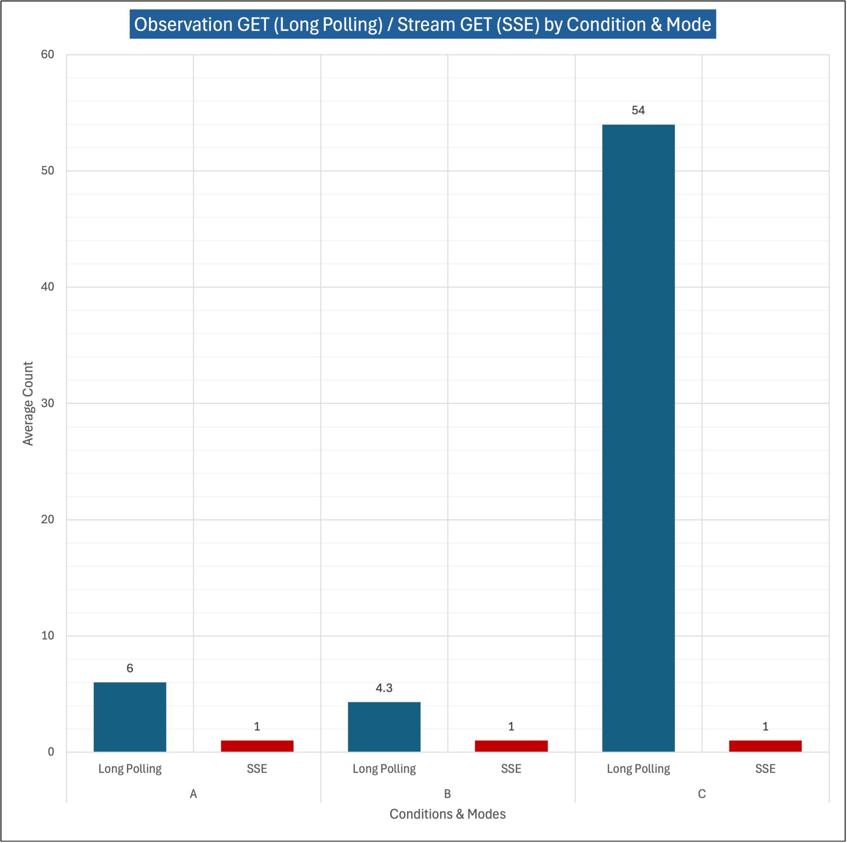
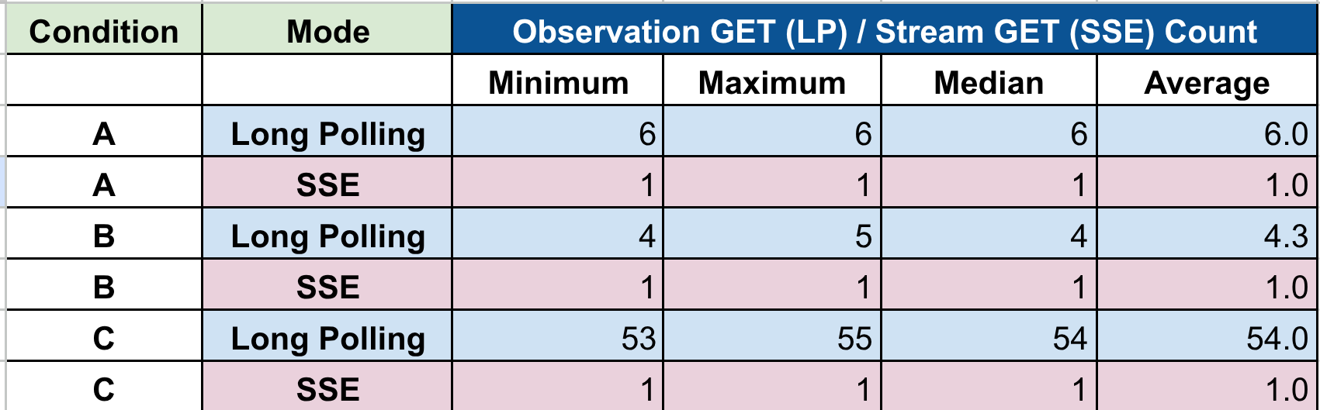
Observation GET (LP) & Stream GET (SSE)
By Condition & Mode
KEY POINTS
SSE sent 1 request across all conditions.
Long Polling sent a request for each update.
SSE more performant in this regard compared to Long Polling.
Does NOT mean that SSE skipped sending updates.

Slide 7
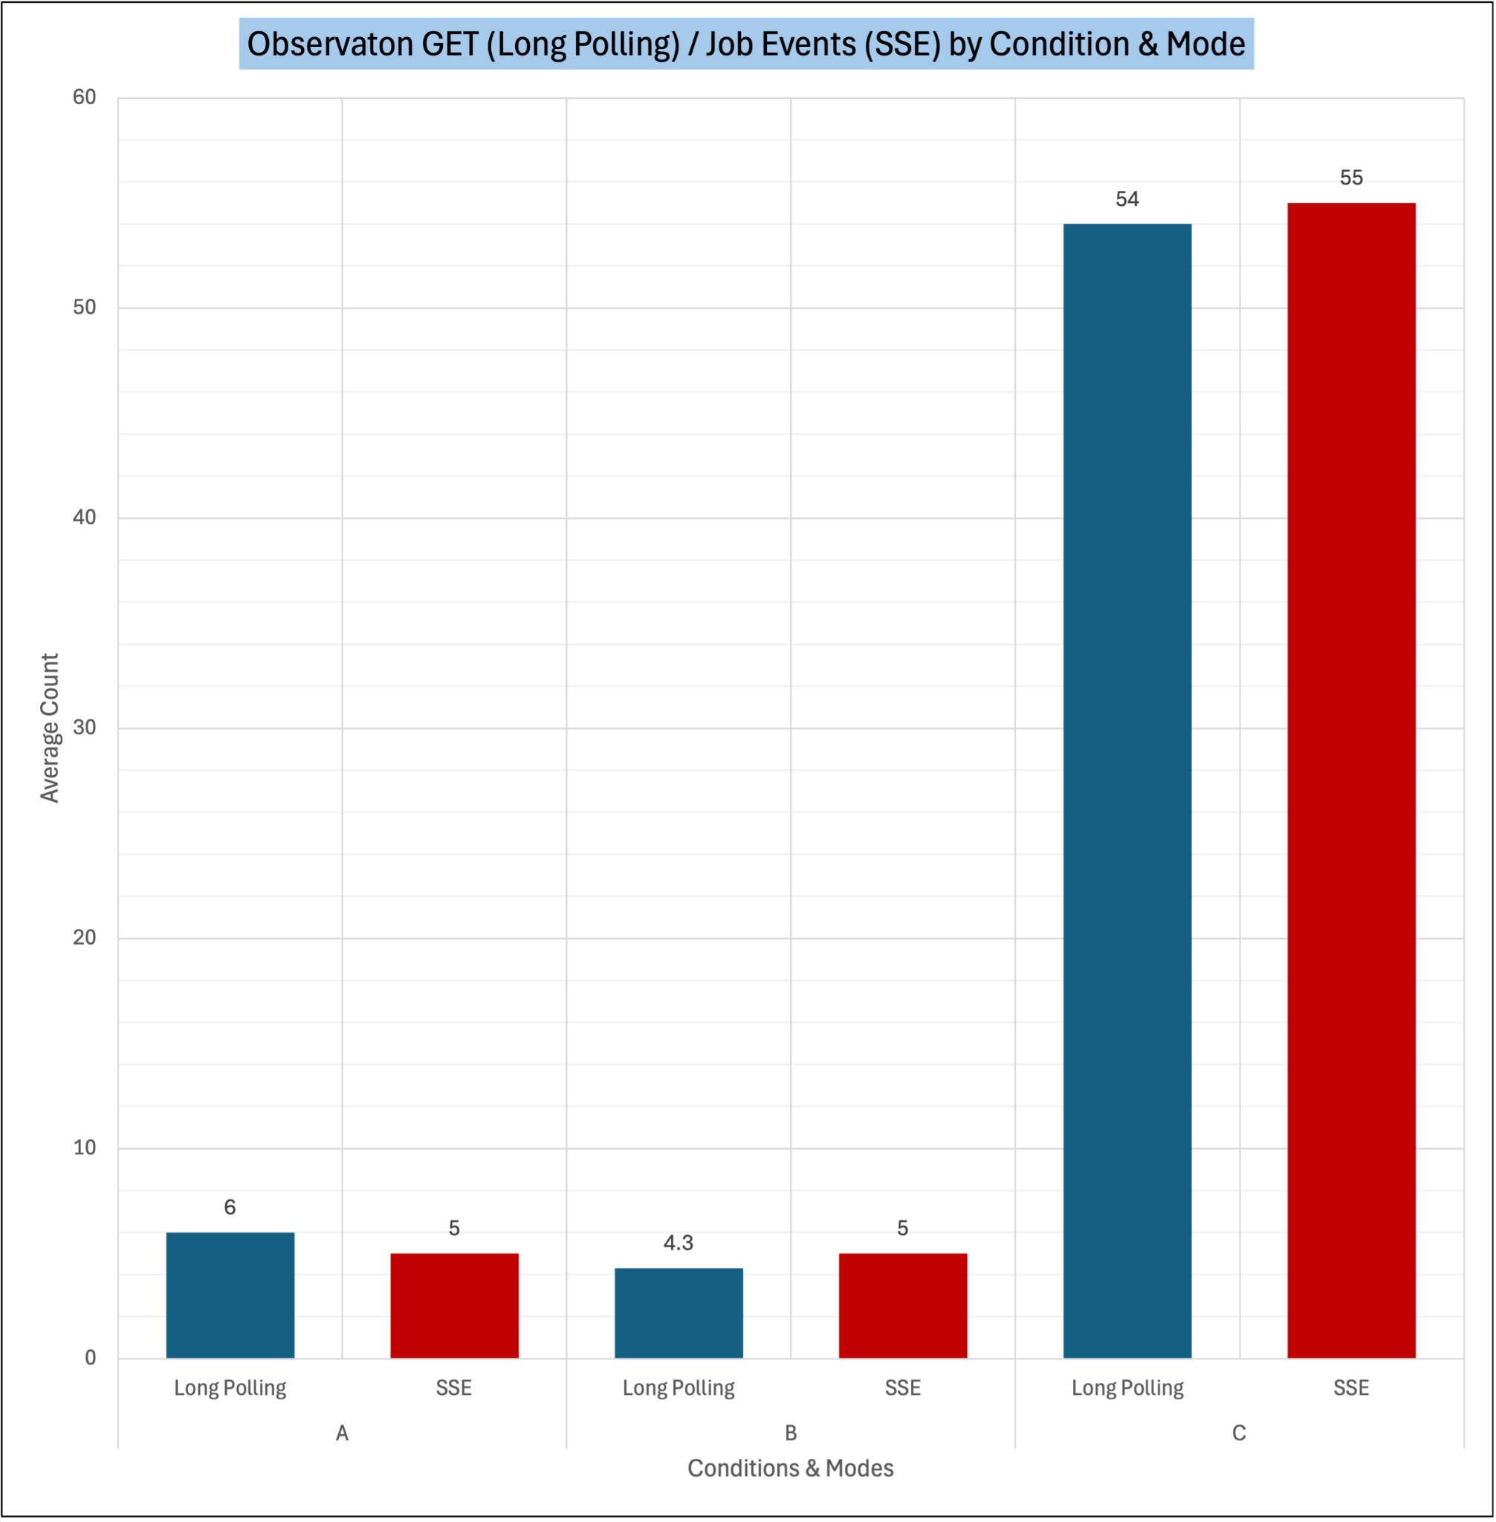
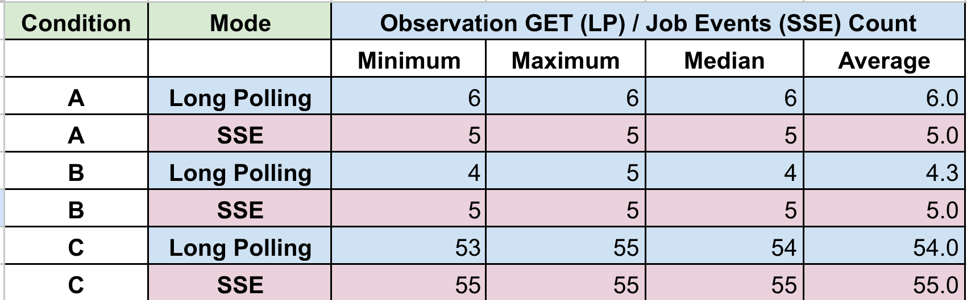
Observation GET (LP) & Job Events (SSE)
By Condition & Mode
KEY POINTS
SSE matched Long Polling across all conditions for the number of job updates sent back to the client.
The way each mode does this is the difference.
Long Polling may skip intermediate versions due to timing variance. This is not seen in SSE.

Slide 8
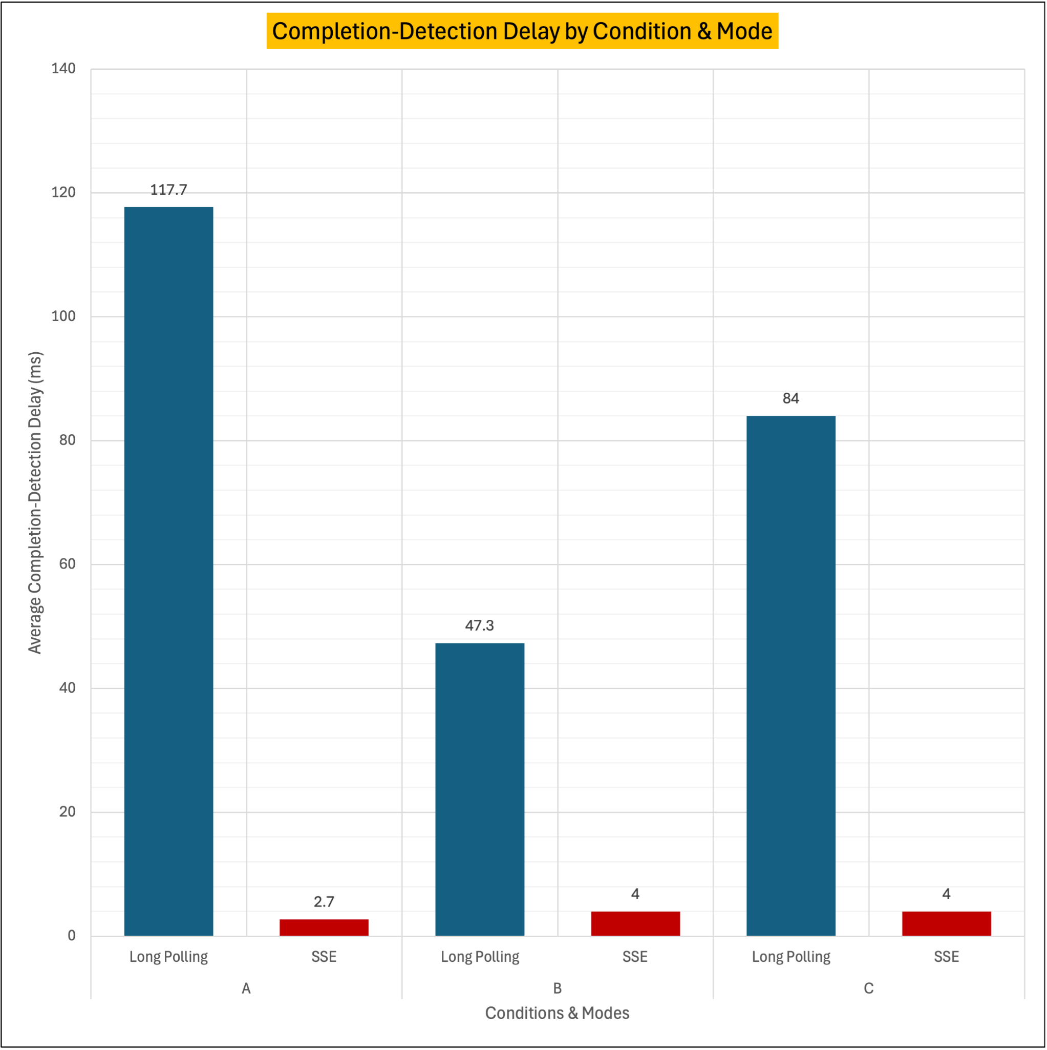
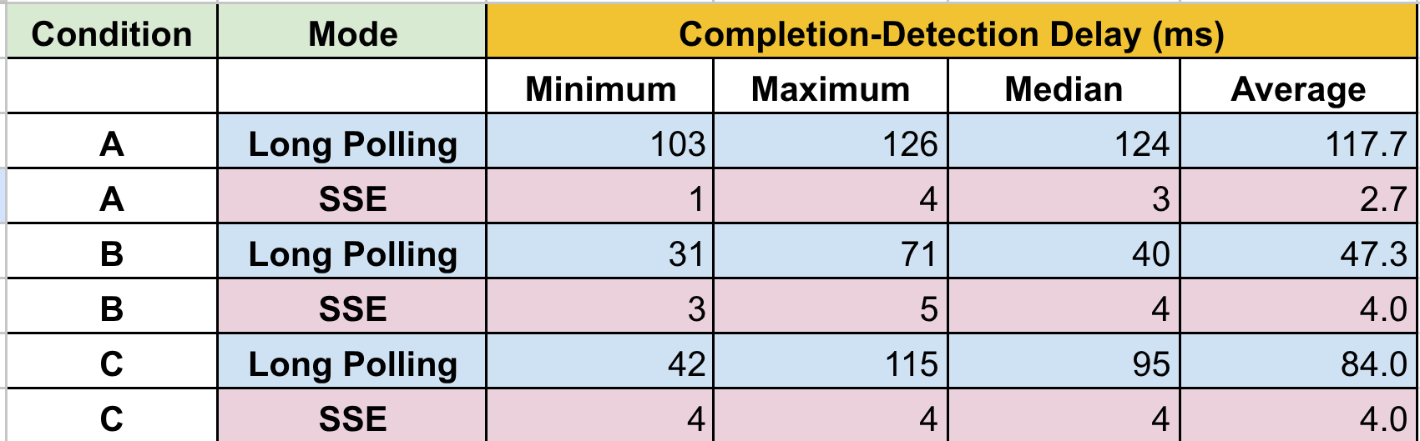
Completion-Detection Delay
By Condition & Mode
KEY POINTS
SSE was much faster than Long Polling when realizing the the terminal commit in the browser.
Long Polling variance is due to backend ticker, bounded by the 200ms set.
Channel-based implementation in SSE is more performant.

Slide 9
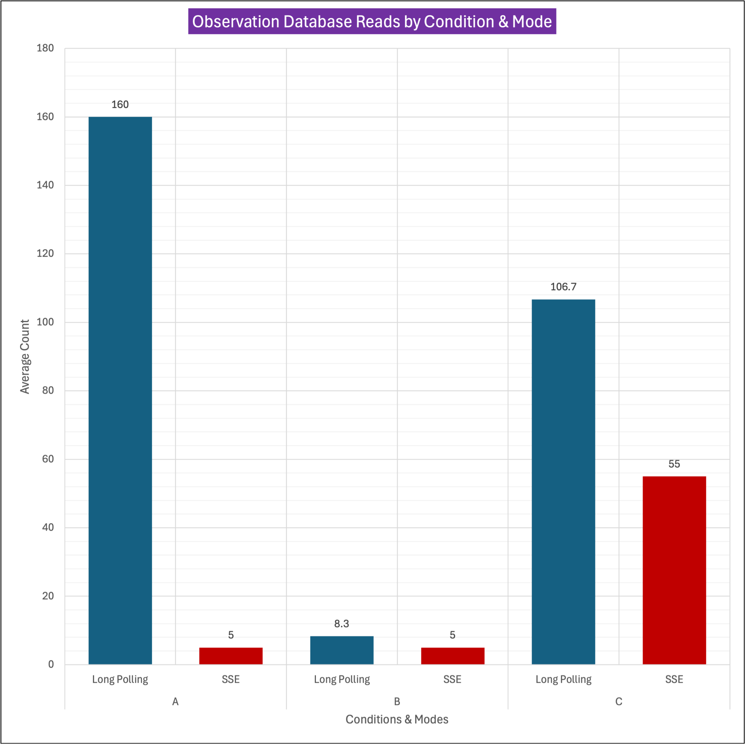
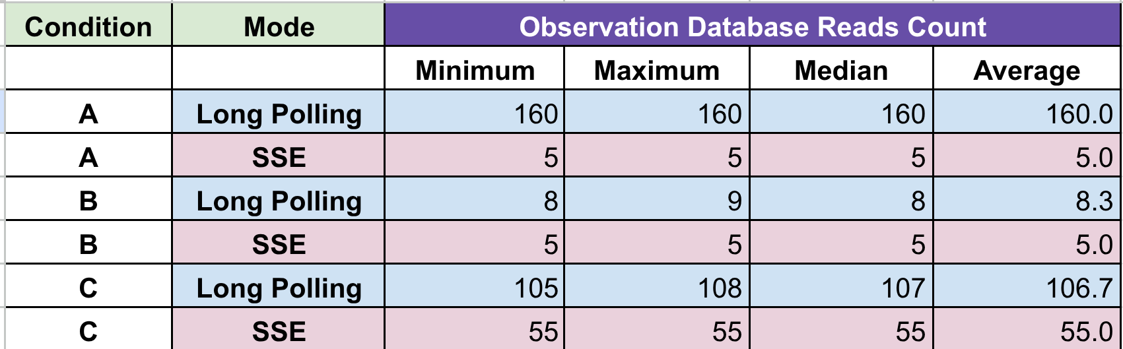
Observation Database Reads
By Condition & Mode
KEY POINTS
SSE read the database less frequently than Long Polling across all conditions.
The number of reads matches the job version updates exactly.
The differences between the ticker-based implementation in Long Polling and the channel-based implementation in SSE explain the results.

Slide 10
OTHER NOTABLE RESULTS
SSE STREAM DURATION
SSE PEAK STREAMS
SSE NO VERSION GAPS
SSE HEARTBEATS
SSE streaming added about 100ms to the processing duration time.
In all measurements, the peak SSE streams was 1. A higher peak is seen when a job is observed by multiple browser tabs.
SSE didn’t have the same timing variance issues as Long Polling.
Only seen in Condition A runs, as it is configured at 20s. Since Condition A has a 30s quiet delay, it is seen once.

Slide 11
Do fewer HTTP requests by SSE prove lower resource use?
Not necessarily.
SSE has less browser overhead of tearing down and recreating HTTP connections.
Same CPU resources are still used for image processing and server-side processes for maintaining connections.

Slide 12
IMAGELAB v3 CONCLUSIONS
Choice of chosen asynchronous API is still situational, despite SSE being more performant.
Long Polling
Server-Sent Events (SSE)
Semi-duplex communication between client and server
Stateless
Easier to load-balance
Could match SSE with channel-based implementation.
Preferred for applications with large batch submissions from the client
Fewer requests and faster completion-detection time than Long Polling
Unidirectional communication from server to client
Stateful (socket)
Preferred when the client only needs to receive updates from server
ImageLab benefits from SSE async API
Limitations: No network latency tests, single worker; Recommendations: Explore WebSockets, multiple workers

