Slide 1

ImageLab
CMPS4191 Advanced Web Technologies Test 1
Andres Hung & Jennessa Sierra
September 30,2026
CMPS4191 Advanced Web Technologies Test 1

Slide 2
REQUIREMENTS
GOAL: Build an application that processes uploaded images asynchronously while keeping the browser responsive.
WORK ACCEPTANCE
BACKGROUND PROCESSING
PROGRESS TRACKING
Store the original image and create a PostgreSQL job before returning 202 Accepted.
Use one worker to generate thumbnail, preview, and display variants.
Poll job status approximately every second, show results after completion, and stop polling at completion or failure.
UPLOAD VALIDATION
ERROR HANDLING
Accept JPEG and PNG images up to 10 MB, with a local preview before submission.
Distinguish processing failures from status-retrieval errors and allow observation of the same job to resume.
CMPS4191 Advanced Web Technologies Test 1

Slide 3
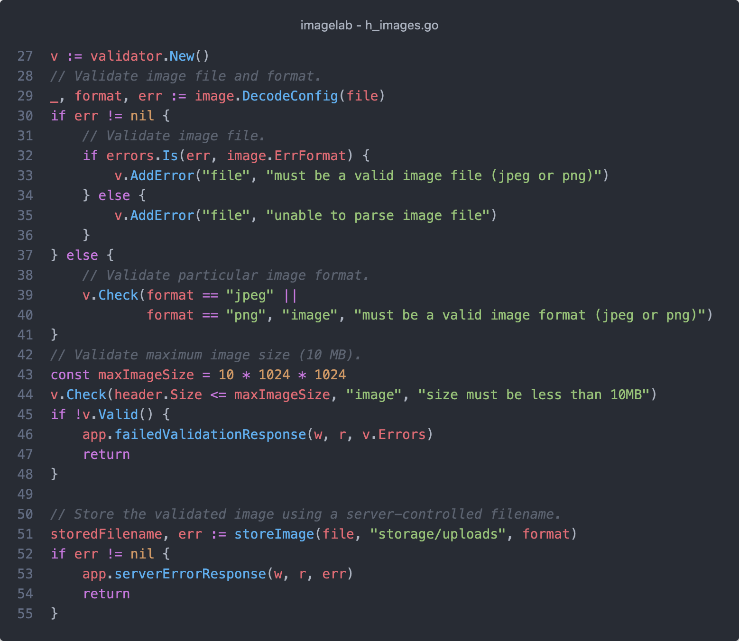
Week 1:
Foundation
PROJECT SETUP
Adapted the starter code and added database migrations, image models, and API routes.
FRONTEND STATES
Built the initial upload interface, client-side validation, and event-driven UI updates.
UPLOAD VALIDATION
Implemented image size and format validation, local file storage, and an initial 202 Accepted response with placeholder job values.
SUBMISSION PROTECTION
Used isSubmitting and a disabled Process Image button to prevent overlapping uploads.
CMPS4191 Advanced Web Technologies Test 1

Slide 4
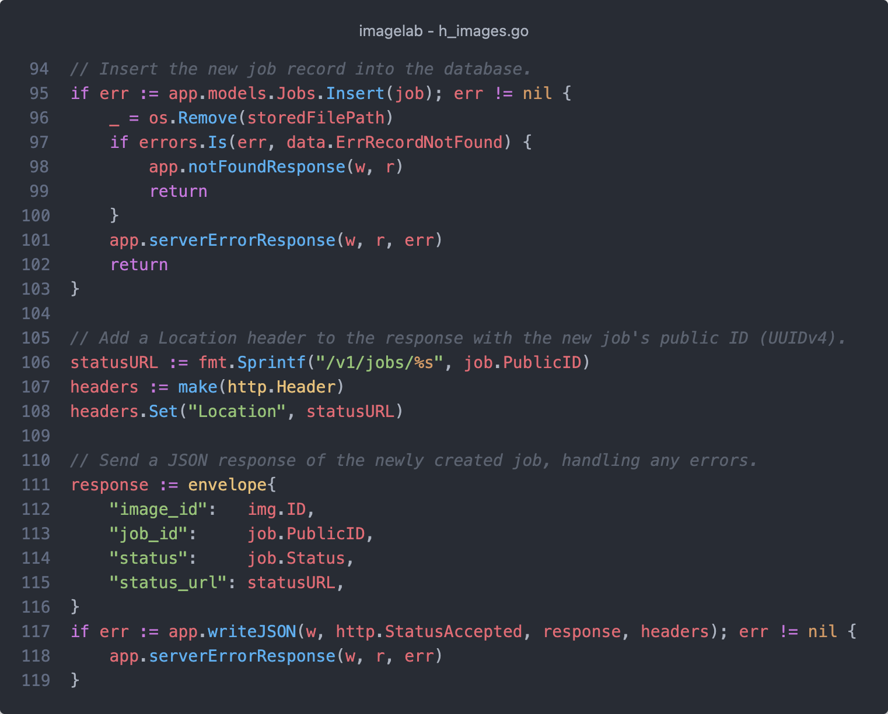
Week 2:
Job Processing
DURABLE ACCEPTANCE
Created image metadata and job records after saving the original, replacing placeholder values in the 202 Accepted response.
INDEPENDENT WORKER
Implemented background image processing and verified that exactly one worker was running.
PROCESS OUTPUTS
Generated thumbnail, preview, and display variants, storing their files and metadata.
JOB OUTCOMES
Verified completion and simulated worker failure, and prepared the job-status endpoint for polling.
CMPS4191 Advanced Web Technologies Test 1

Slide 5
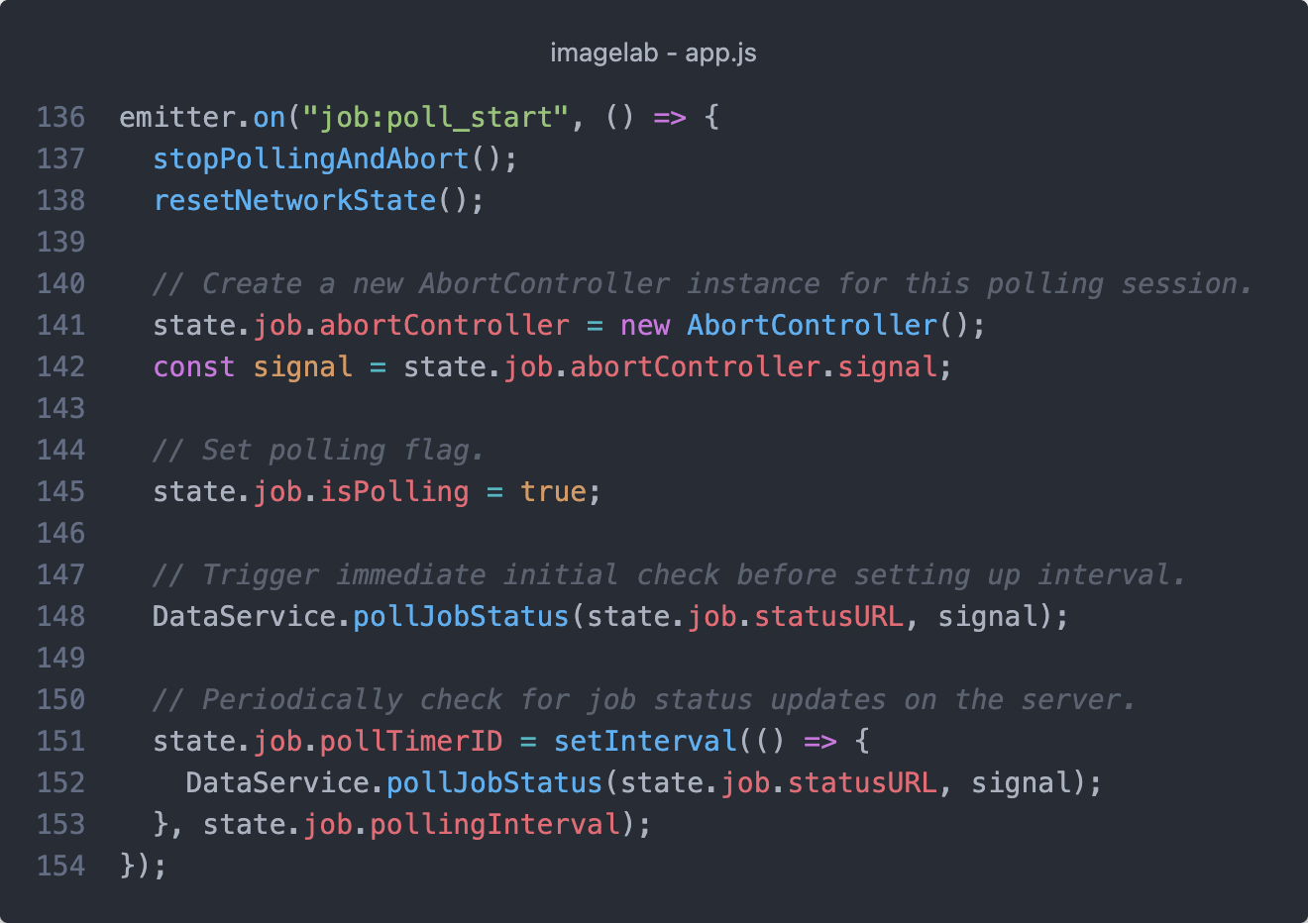
Week 3:
Short Polling
AUTOMATIC OBSERVATION
Verified one-second status requests after upload acceptance and UI updates as the job progresses.
TERMINAL STATES
Verified polling stops when processing completes or fails, with corresponding results or error messages.
POLLING CANCELLATION
Added AbortController to cancel active requests when stopping observation or leaving the page.
OBSERVATION RECOVERY
Refined retrieval-error handling and the “Check Status” button to resume observation of the existing job.
CMPS4191 Advanced Web Technologies Test 1

Slide 6
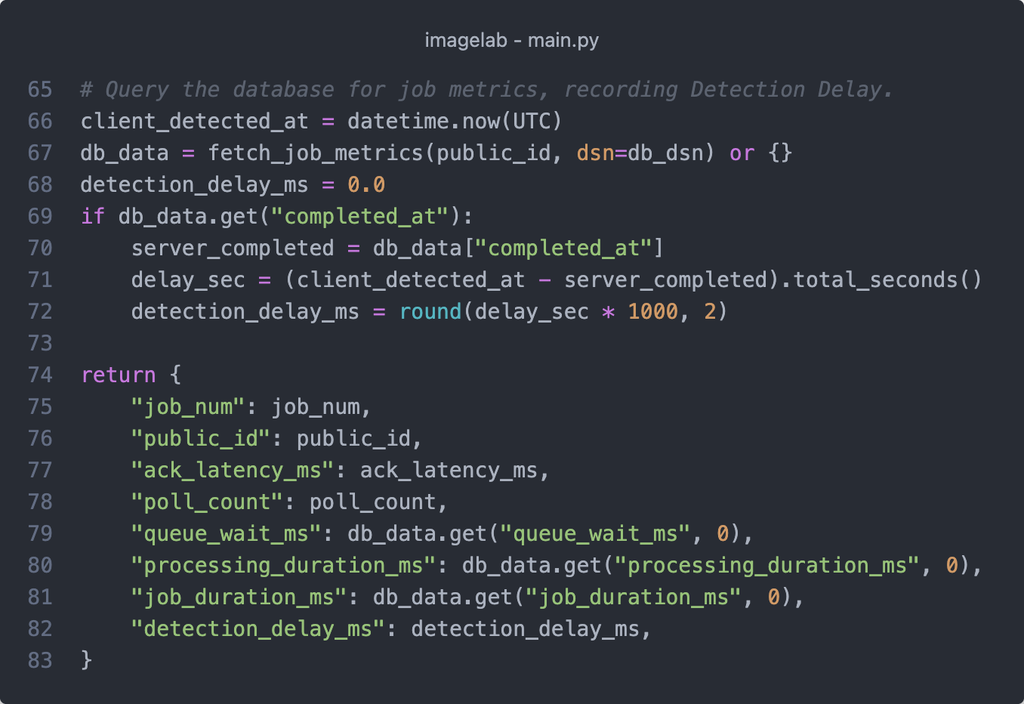
Week 4:
Performance
MEASUREMENT TOOLING
Created a database metrics view and Python program to collect all six required measurements.
PERFORMANCE TESTS
Tested one image and a five-image burst with a configured three-second processing delay.
FINAL REVIEW
Reviewed functional requirements, the acceptance checklist, and database constraints.
CMPS4191 Advanced Web Technologies Test 1

Slide 7
MEASUREMENTS
SINGLE IMAGE BASELINE
FIVE-IMAGE BURST
TEST CONDITIONS
Submit one image and observe the job until completion.
Submit five copies of the same image concurrently to observe queueing with one worker.
One Worker
~1s Polling
3s Delay
Measurement | How to determine it
Acknowledgement latency | Response received time minus POST start time
Queue wait | started_at minus queued_at
Processing duration | completed_at or failed_at minus started_at
Job duration | completed_at at minus queued_at
Polling count | Number of status GET requests for the job
Detection delay | Client observation of completion minus server completed_at
CMPS4191 Advanced Web Technologies Test 1

Slide 8
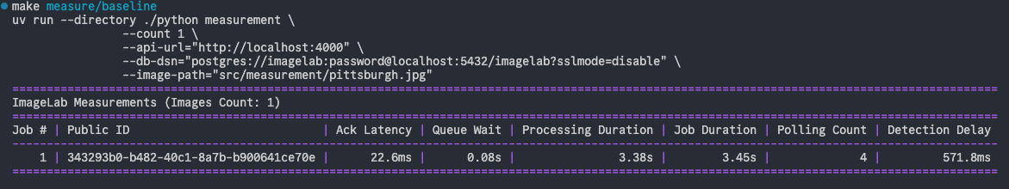
SINGLE-IMAGE RESULTS
EARLY ACKNOWLEDGEMENT
MINIMAL QUEUEING
DELAYED OBSERVATION
The API responded in 22.6ms while the job took 3.45s to complete.
The job waited only about 0.08s, so processing accounted for nearly all its duration.
Four polls detected completion 540.8ms after the server finished.
CMPS4191 Advanced Web Technologies Test 1

Slide 9
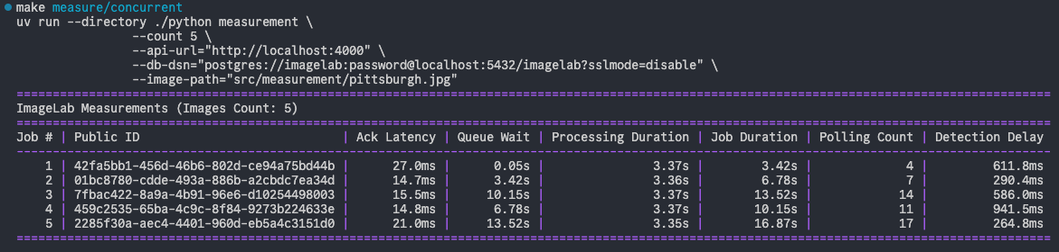
FIVE-IMAGE BURST RESULTS
QUICK ACKNOWLEDGEMENT
LONGER QUEUEING
INCREASED POLLING
All five uploads received responses within 27ms despite the processing backlog.
Processing stayed near 3.36s, while queue-wait ranged from 0.05s to 13.52s.
Longer waits required more polls, incrementing from 4 to 17 as job duration increased.
CMPS4191 Advanced Web Technologies Test 1

Slide 10
DEMO
LIVE

