Slide 1

ImageLab v2
CMPS4191 Advanced Web Technologies Test 2
Andres Hung & Jennessa Sierra
October 28, 2026
CMPS4191 Advanced Web Technologies Test 2

Slide 2
SHORT + LONG POLLING
GOAL: Extend functionality to include long polling.
SHORT/LONG POLLING MODES
LONG POLLING PARAMS
JOB VERSION TRACKING
Changeable modes from the UI. Long polling returns 204 No Content when the Wait query parameter expires.
Query parameters after and wait control for the GET /v1/jobs{id} route implement and configure long polling.
Job version field implements the Counter + Version approach. Simulated version exists for testing only.
PROGRESSIVE UPDATES
EXPERIMENTAL CONTROLS
Show each image variant as they become ready. Completed status is reserved when every variant is successfully generated.
Comparisons and analyses between short and long polling.
CMPS4191 Advanced Web Technologies Test 2

Slide 3
Summary of v2 Changes
ADDITIONAL DATABASE MIGRATIONS
Adding version and simulated version fields to the jobs table. Refactors to job model.
BACKEND REFACTORS
Individual image variant generation, long polling + short polling, worker logic and artificial delays.
70+ commits
36+ hours
3 weeks
Ticker-based notification long polling implementation over channel-based.
FRONTEND REFACTORS
Selectable polling modes, additional long polling and UI state, bug fixes. Additional state for simulated progress.
EXPERIMENTATION IMPLEMENTATION
Additional flags for configuring artificial delays and simulated updates. Custom browser network profiles for artificial latency.
CMPS4191 Advanced Web Technologies Test 2

Slide 4
LIVE DEMO
1) Short + Long Polling Demo
2) Short + Long Polling Job Failure Demo
3) Switch Observation Mode During Processing
4) Change Long Polling Wait During Processing
5) Cancellation During Processing (AbortController)
6) Retrieval Error Handling

Slide 5
EXPERIMENTS
SAME IMAGE
3 RUNS
CHARTS
The same image was used for each run, alternating short polling and long polling.
Three runs were conducted for each condition and each polling mode.
request count and completion-detection delay by condition.
Condition | Summary
A | 30s delay before processing.
B | No artificial delays.
C1 | 10s simulated phase, simulated updates every 2s.
C2 | 10 simulated phase, simulated updates every 200ms.
C3 | Same as C2 with 200ms latency.
C3-X (Extra) | Same as C2 with 400ms latency.
CMPS4191 Advanced Web Technologies Test 2

Slide 6
RESULTS
Condition | Mode | Minimum Requests | Maximum Requests | Average Requests | Average Completion-Detection Delay
A | Short Polling | 32.0 | 32.0 | 32.0 | 317.3
A | Long Polling | 6.0 | 6.0 | 6.0 | 95.7
B | Short Polling | 2.0 | 2.0 | 2.0 | 295.0
B | Long Polling | 4.0 | 5.0 | 4.3 | 65.3
C1 | Short Polling | 12.0 | 12.0 | 12.0 | 328.3
C1 | Long Polling | 9.0 | 10.0 | 9.7 | 92.7
C2 | Short Polling | 12.0 | 12.0 | 12.0 | 336.0
C2 | Long Polling | 53.0 | 54.0 | 53.7 | 108.7
C3 | Short Polling | 12.0 | 12.0 | 12.0 | 729.7
C3 | Long Polling | 53.0 | 54.0 | 53.7 | 304.0
C3-X | Short Polling | 12.0 | 12.0 | 12.0 | 1120.7
C3-X | Long Polling | 27.0 | 27.0 | 27.0 | 563.0
CMPS4191 Advanced Web Technologies Test 2

Slide 7
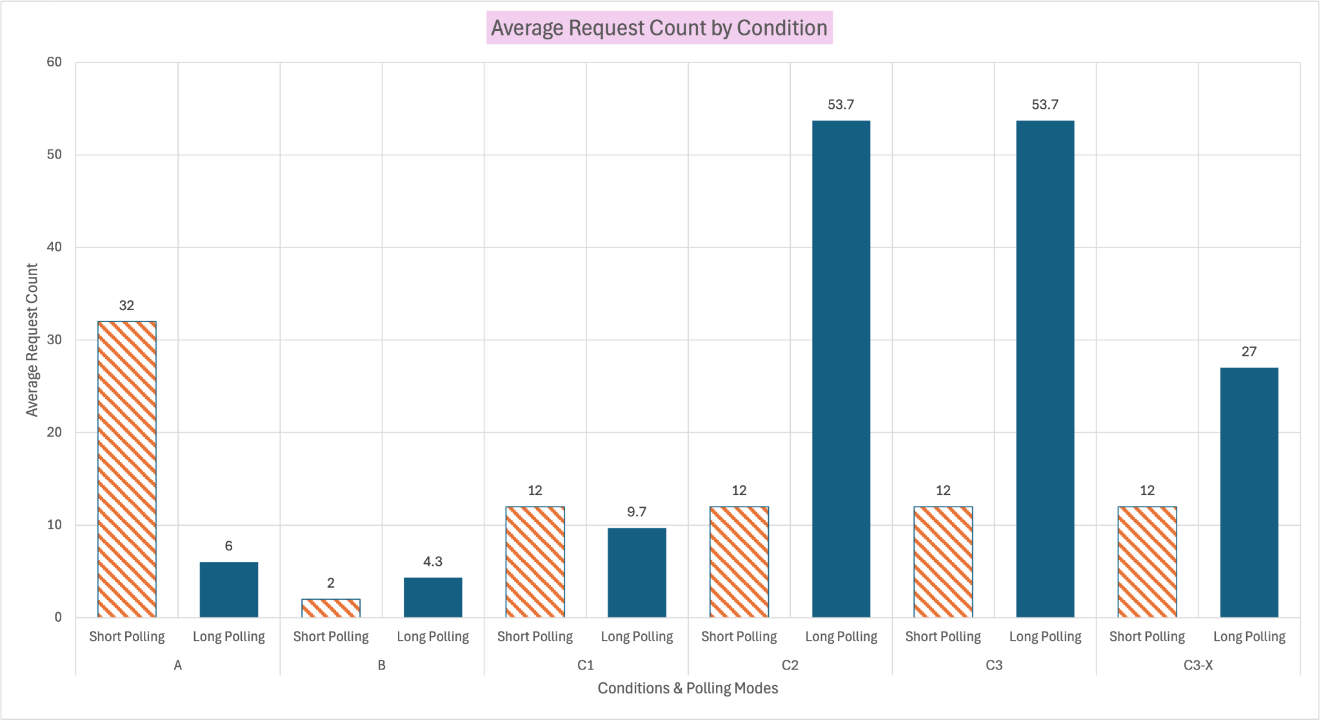
REQUEST COUNT
KEY POINTS
204 No Content response for long polling in A.
High long polling requests with simulated updates (C2, C3).
Short polling consistent across C1, C2, C3.
Same request count for long polling C2 and C3. 200ms aligns with 200ms ticker.
400 ms latency in C3-X halves long polling request count.
CMPS4191 Advanced Web Technologies Test 2

Slide 8
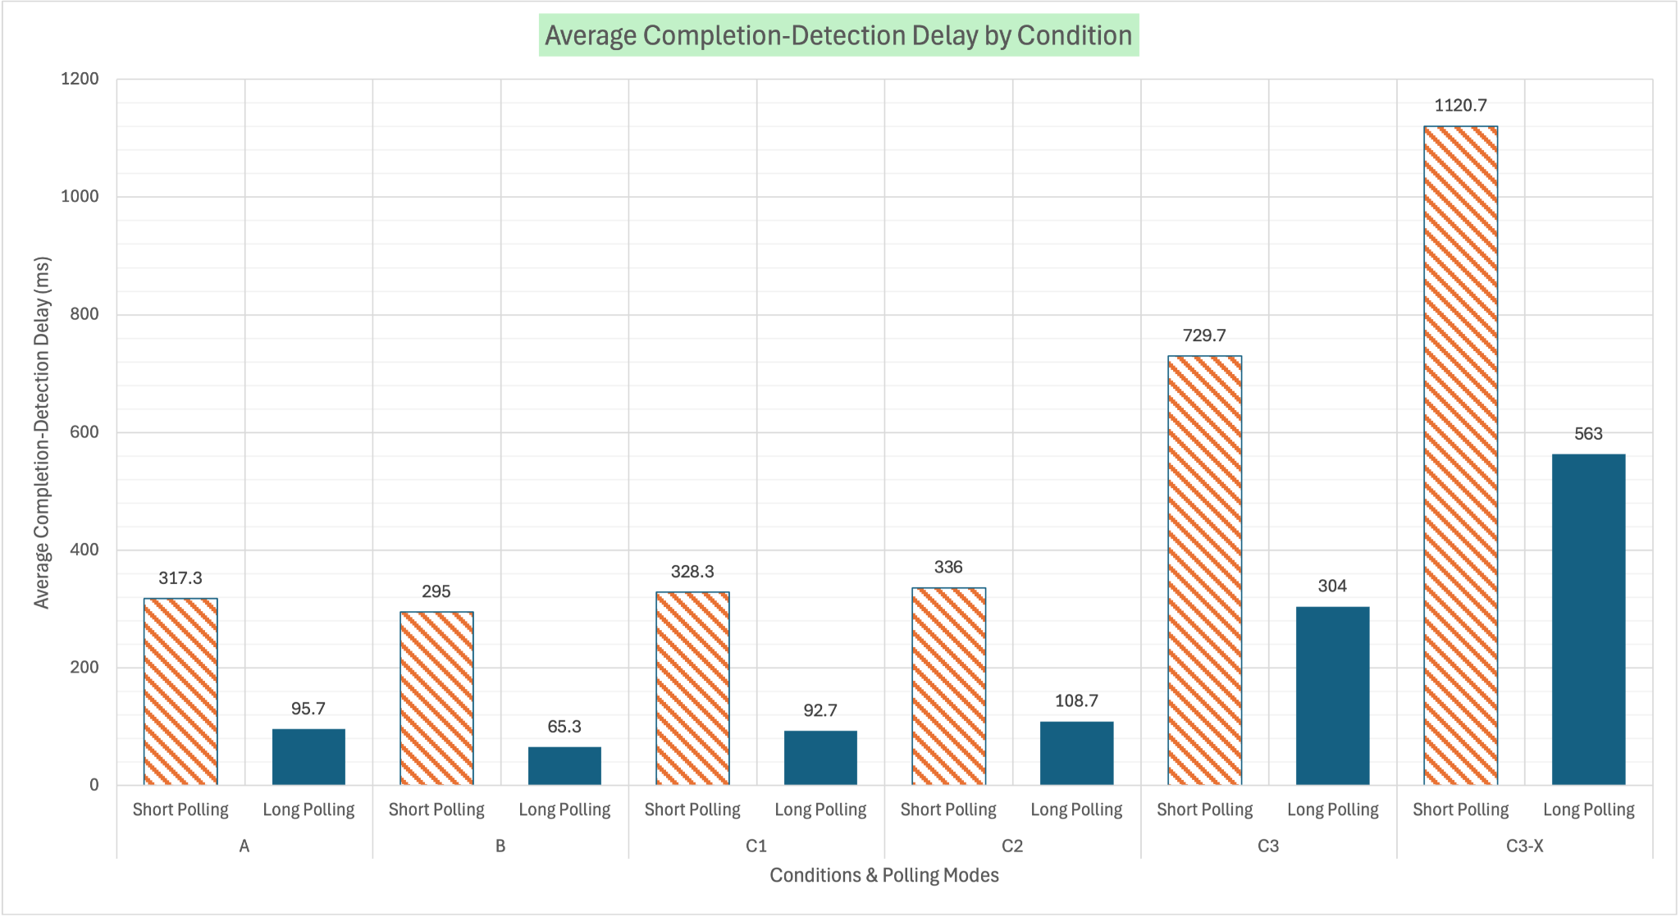
DETECTION DELAY
KEY POINTS
Completion-Detection Delay = Client detection time minus Terminal Commit time.
Long polling has lower delay across all conditions.
CMPS4191 Advanced Web Technologies Test 2

Slide 9
OTHER NOTABLE RESULTS
LONG POLLING
SHORT POLLING
BOTH
BOTH
Had higher observation database reads across all conditions. This is due to the the 200ms ticker in the backend implementation.
Didn’t result in any 204 No Content responses. This is expected as the job snapshot should be returned in short polling.
Run variations sometimes skipped an intermediate version. This is due to timing in short polling interval, long polling ticker, latency, and browser packet queuing.
Processing duration were consistent across both polling modes. Non-artificial duration has the real processing being around 500-600ms.

Slide 10
ImageLab v2 Conclusions
Long polling is better than short polling in some cases, but worse in others.
Long polling consistently had a lower detection delay compared to short polling.
Long polling works great when that lower detection delay is needed.
Long polling is more complex to implement than short polling.
Still using a single worker. Limitations pertaining performance under simultaneous loads and multiple workers.
Ticker can potentially be optimized or implemented using a channel-based notification approach.

