Slide 1
Python for
Data Science
Scott Little, Data Scientist

Slide 2
WHO AM I?
Data Scientist
PhD in Physics
Solar Energy Research – Silicon and Thin Film
Teach Physics and Astronomy
Used Matlab and Mathematica in research

Slide 3
WHO ARE YOU?
Turn to your neighbor on your left
Impersonate your Halloween costume
Now tell them who you really are
And what you’re doing here

Slide 4
INTRODUCTION
Ice-breaker: Halloween themed activities while students introduce themselves to each other
Specific group activities
Kaggle
Worksheets
IPNBs/screenshots from it
Define terms, especially @ beginning
Have jokes and cartoons!
Multiple choice
Jackbox.tv style questions?
Jupyterhub login?
Big section introducing Ipython and Jupyter
Flask app and making a predictor
Gamify with trick or treat candy
Make into a world’s shortest hackathon

Slide 5
KAGGLE COMPETITION
Turn to your neighbor on your left
Impersonate your Halloween costume
Now tell them who you really are
And what you’re doing here

Slide 6
IPython
In [48]: ?map
Docstring:
map(function, sequence[, sequence, ...]) -> list
Return a list of the results of applying the function to the items of
the argument sequence(s). If more than one sequence is given, the
function is called with an argument list consisting of the corresponding
item of each sequence, substituting None for missing values when not all
sequences have the same length. If the function is None, return a list of
the items of the sequence (or a list of tuples if more than one sequence).
Type: builtin_function_or_method
In [49]: map?
Docstring:
map(function, sequence[, sequence, ...]) -> list …

Slide 7
IPython - tab completion
In [8]: ma #Press tab...
%macro %magic %man %matplotlib map max

Slide 8
IPython / Python Review: An exercise
~ scott$ ipython
In [1]: import this
Using your IPython and Python skills, solve the puzzle

Slide 9
IPython Notebooks
● A feature-rich notebook for Python based on IPython
● Great for
○ prototyping
○ demonstration
○ exploratory data analysis (EDA)
● Terrible for
○ robustly engineered code
● Conclusion:
○ only use notebooks for simple exploratory tasks
○ use Sublime Text for actual development

Slide 10
IPython Notebook: Git, Pandas, Numpy, Matplotlib
[fork on github]
scott$ git clone https://github.com/scottlittle/python4ds
scott$ cd python4ds/
scott$ ipython notebook
[IPNB: http://localhost:8888/notebooks/Documents/python4ds/sandbox.ipynb]
scott$ git add .
scott$ git commit -m "first commit”
scott$ git push

Slide 11
Machine Learning
Supervised Learning : The label is the supervisor!
^{Supervised Learning}
– Linear, Logistic, Lasso, Ridge
– Decision Trees, Bagging, Random Forest, Boosting
^{– SVM}
^{– kNN}
^{Not supervised}
– K-means clustering is not supervised learning, nor is
^{hierarchical clustering}
– PCA is not supervised learning
⇒ Though both can be used in supervised learning!

Slide 12
Algorithms
Examples
Regression
Decision Trees
Logistic
Random Forests
K-Nearest neighbors
K-Means
Neural Networks

Slide 13
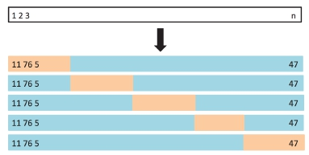
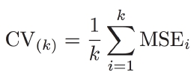
K-Fold Cross-Validation
Randomly divide data into K=5 folds.
Typically choose K=5 or 10.
1. Fit model on training set, using (K-1) folds
2. Use ﬁted model in 1. to predict responses for
validation set, 1 of the folds
3. Compute validation-­‐set error
-­‐ Quantitative Response: Typically MSE
-­‐ Qualitative Response: Typically Misclassiﬁcation Rate

Slide 14
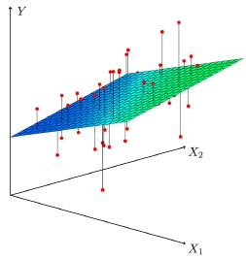

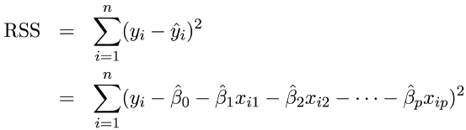

Multiple Linear Regression
Model
Fitted Value
Residual Sum of Squares
Coeﬃcient Estimmates

