Slide 1
PREDICTING THE SEVERITY OF ROAD CRASHES BASED ON ENVIRONMENTAL, ROAD AND OTHER CONDITIONS
by Musab Faiyazuddin

Slide 2
Introduction
Traffic accidents are a major cause of death globally.
More than 38K people die every year in crashes in US roads. The fatality rate is 12.4 deaths per 100,00 inhabitants.
If we can predict the traffic accidents or their intensities, it can potentially save many lives
Most of the accidents are influenced by many quantifiable factors like weather conditions, car types, driving speeds, road structures and many others.
The Aim is to find an amassed dataset with such quantifiable factors and perform Machine Learning modelling using that.

Slide 3
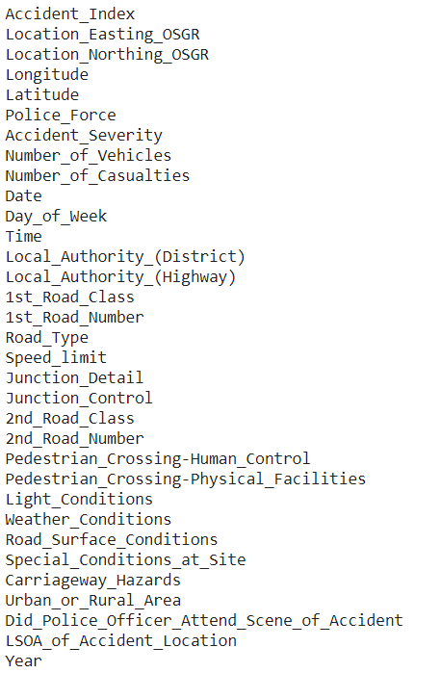
Data Description
Dataset of 1.5 Million accidents provided by UK Department of Transport on Kaggle is one such Dataset with many features included in it.
Recorded for the span of more than 6 Years.
Naming of features is quite self-explanatory

Slide 4
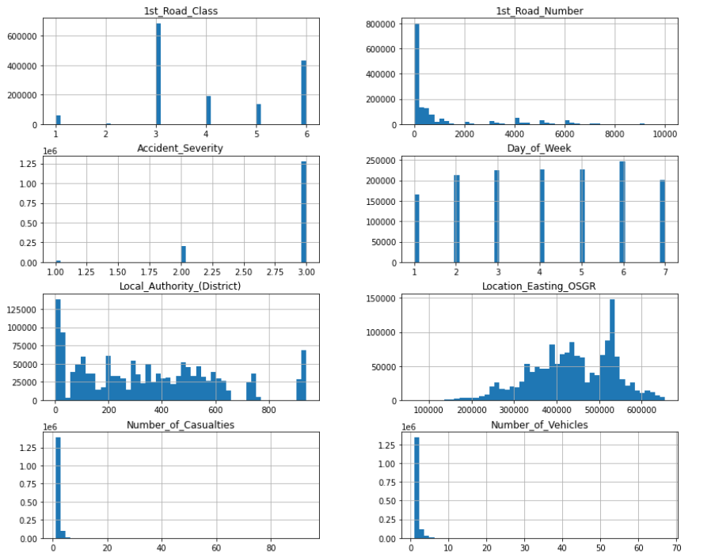
Distribution of data

Slide 5
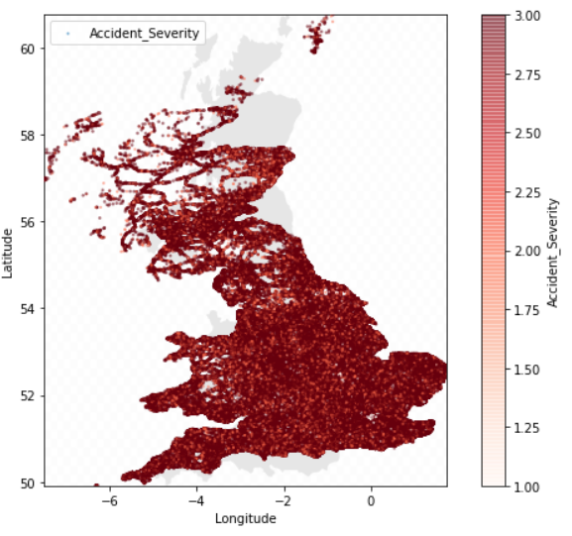
Accident Locations overlayed on UK map

Slide 6
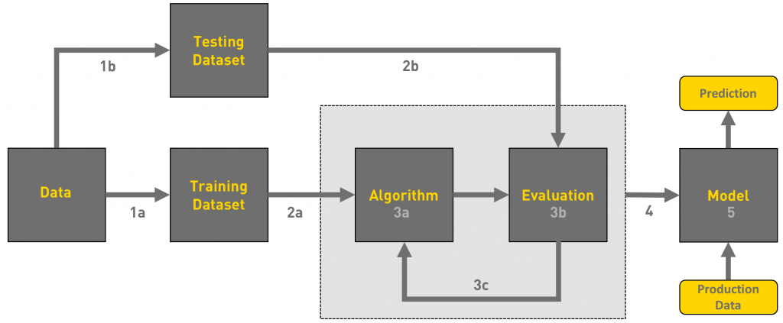
Methodology
Preprocessing : → Null / Unknown values treatment → Data type uniformity check → Correlation check with target → Identity / Duplicated feature removal → Uniform scaling of numeric data → Encoding Categorical Variables
Train / Test split: 70:30 split preferred
Evaluation: → Accuracy → Cross Val → Confusion Matrix
New Unknown data check
Via Towards Data Science

Slide 7
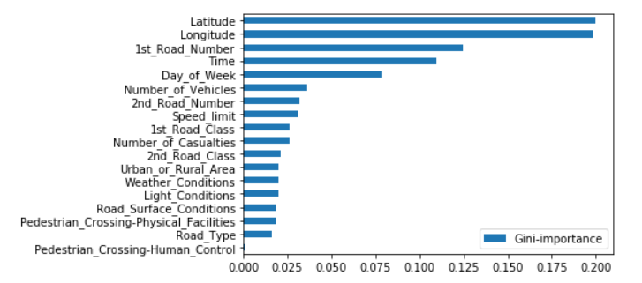
Result
XGB Classifier: → Accuracy = 83% → Evaluation revealed there is huge bias
Random Over sampling : To balance the class sets
Random Forest: → Accuracy = 85% → Evaluation revealed there had been improvement since the last time with less bias.
Generated feature importance to observe which features had more affect on the model

Slide 8
Conclusion
There has been continuous research work being done in the department of Transport as a result we have observed in the exploratory data analysis that there has been decline in the number of yearly fatalities in road accidents.
This modelling exercise helps understanding the factors involved in making accident fatal or less fatal.
Improved data engineering and collection can exponentially increase the way we are predicting the severity of an accident
Emergency Services can deploy such methodology to forecast severity of accident in an area and deploy support in close range to that saving time and lives.

Slide 9

Thank you

