Slide 1
Poverty and Mathematics in the Colombian Saber 11 Exams
Jorge Arias Martí & Andrés Mejía Rodríguez

Slide 2

Poverty and Education

Slide 3
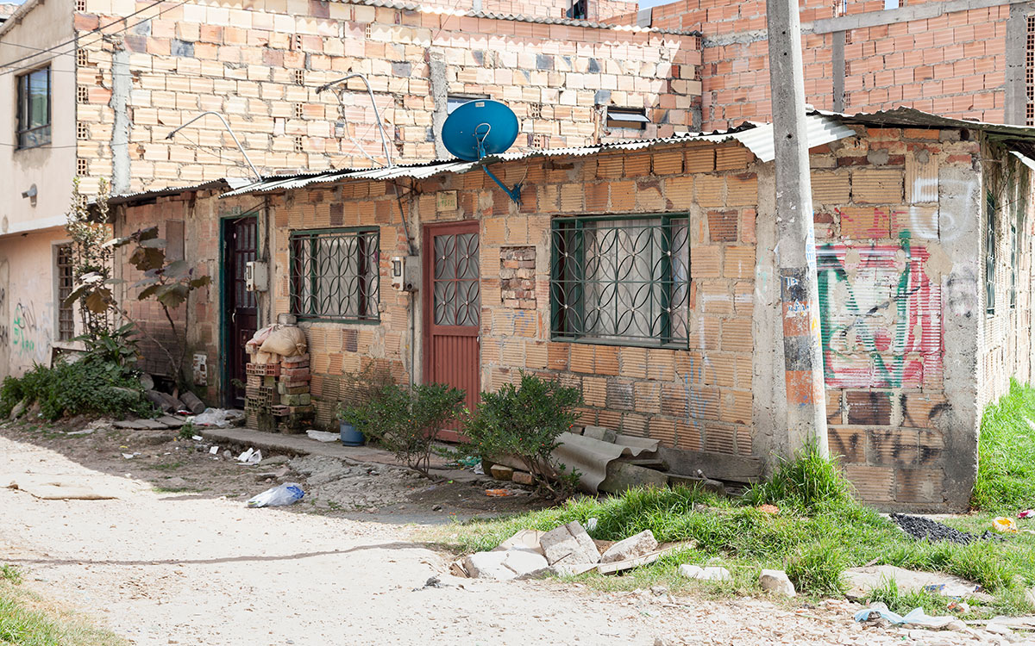
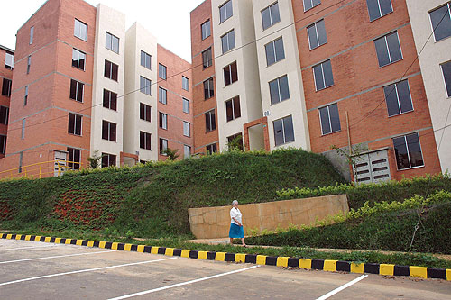
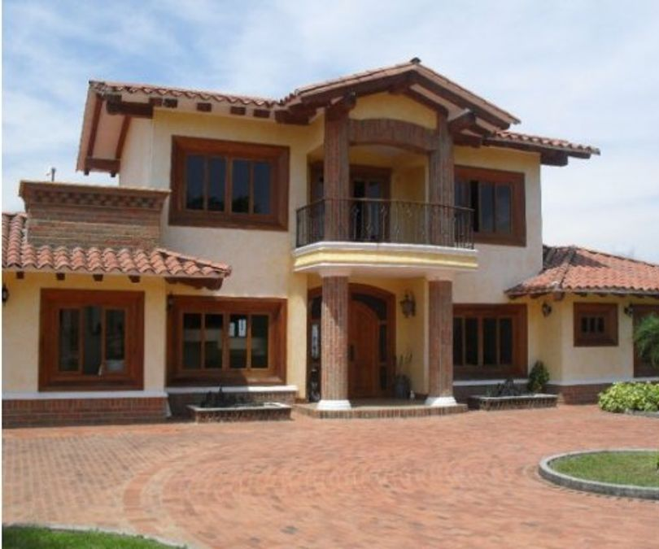
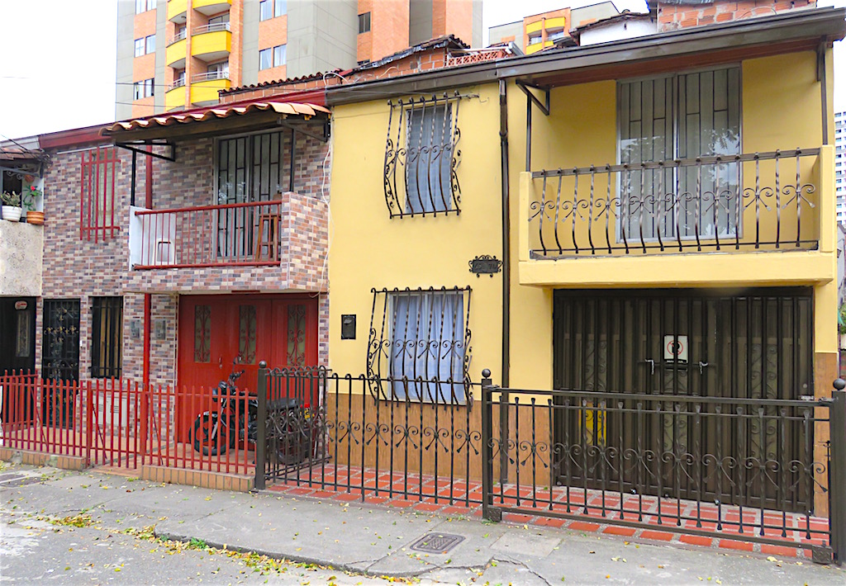
How is poverty measured?
1
1
4
6
3

Slide 4

How is education measured?
Education for
Citizenship
Mathematics
Science
English
Critical Reading

Slide 5
Dataset
Data provided by Instituto Colombiano de Fomento de la Educacion Superior-ICFES
Data from the 2020 2nd call
504872 students
Each module is scored 0-100 scale

Slide 6
Pressing Questions
Is there a gap in performance?
If there is a gap. Is it significant?
Does the number of top scoring students increase as stratum increases?
Is that difference significant?

Slide 7
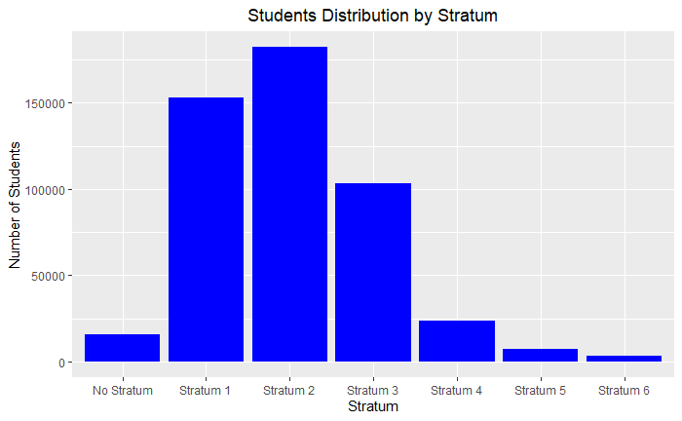
Strata in Saber 11

Slide 8
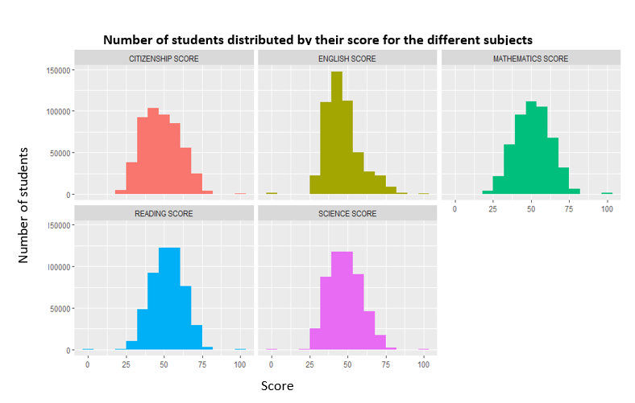
Model Selection

Slide 9
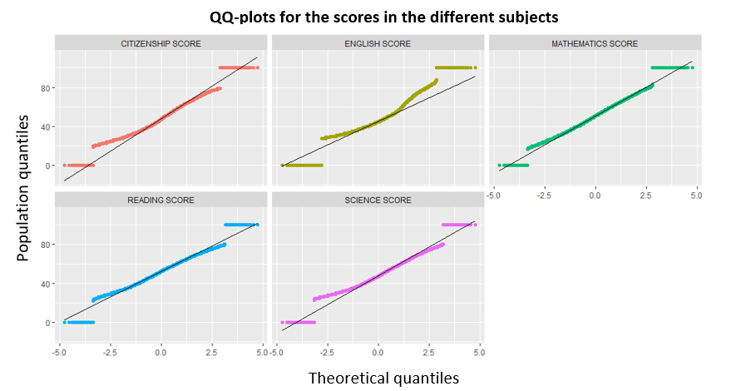
Model Selection

Slide 10
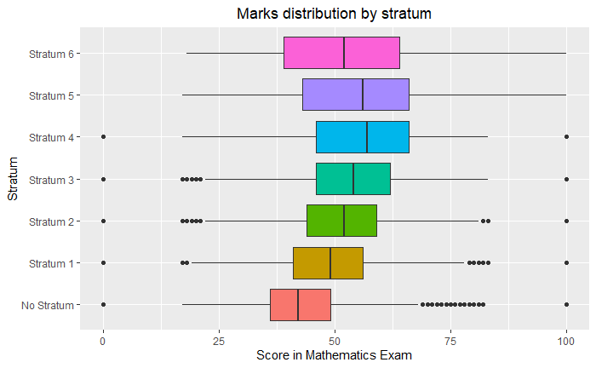
Math and Strata

Slide 11
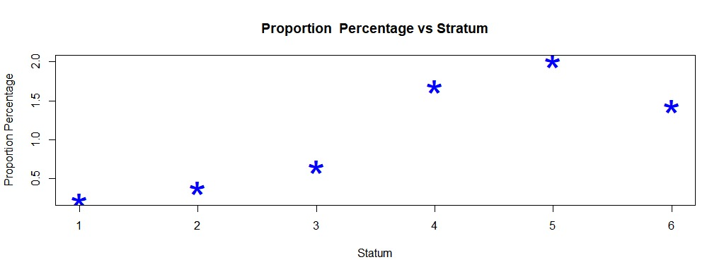
Proportion of top rated students

Slide 12
Hypothesis testing proportions: top rated students
Asymptoticaly Normal Distributed.
We reject the null hypotesis of equality of proportion (α=5%) in all cases.

Slide 13
Hypothesis Testing: Variance Comparison (Math Score)
Exact Snedecor’s F as the scores are assumed to be normal
We reject the null hypothesis of equality of variances (α=5%) pairwise between all groups.

Slide 14
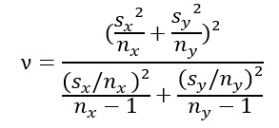
Hypothesis Testing: Math Mean Score
Test of difference of means with unknown and different variances
Distributed as t-student as the scores are assumed to be normal
The degrees of freedom ν are non integer.
All differences are significant (α=5%) except for strata 2 and 6!

Slide 15
Conclusions
Academic performance seems to increase with socioeconomic status.
This increase is reflected in both mean score and proportion of top scoring students.
However stratum 6 students perform worse than expected and can be compared with stratum 2 students.

Slide 16
Thank You

