Slide 1
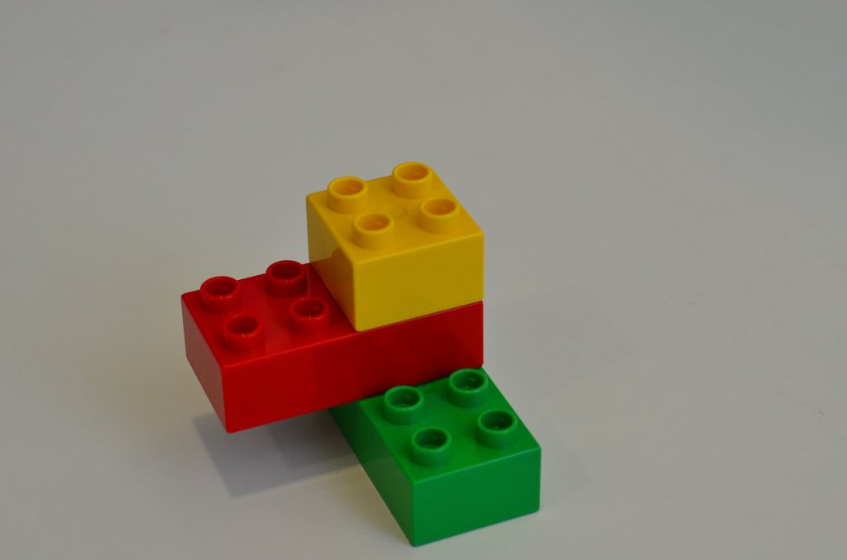
designing
for remixing
Supporting an Online Community of Amateur Creators
Andrés Monroy-Hernández
MIT Media Laboratory
(CC) BY SA
photo by sayamindu on Flickr

Slide 2
committee
Prof. Mitchel Resnick
MIT Media Lab
Prof. Yochai Benkler
Harvard Law School
Prof. Robert Miller
MIT CSAIL
photo by sayamindu on Flickr

Slide 3
acknowledgements
Amon Millner, Anant Seethalakshmi, Anupom Syam, Amos Blanton, Ashok Gond, Benjamin Mako Hill, Chris Garity, danah boyd, Cecilia Aragon, Dan Jared, Evelyn Eastmond, Eric Rosenbaum, Han Xu, Jay Silver, Jeff Nickerson, John Maloney, Karen Brennan , Kemie Guaida, Mark Goff, Natalie Rusk, Nick Bushak, Paul Medlock-Walton, Ricarose Roque, Rita Chen, Sayamindu Dasgupta, Stephanie Gayle, Tamara Stern, Ubong Ukoh, Vladimir Vuksan
Financial support from:
MIT Media Lab research consortia, NSF, Microsoft, Intel, MacArthur Foundation, Google, Bradesco, Samsung, Telmex, Iomega
photo by sayamindu on Flickr

Slide 4
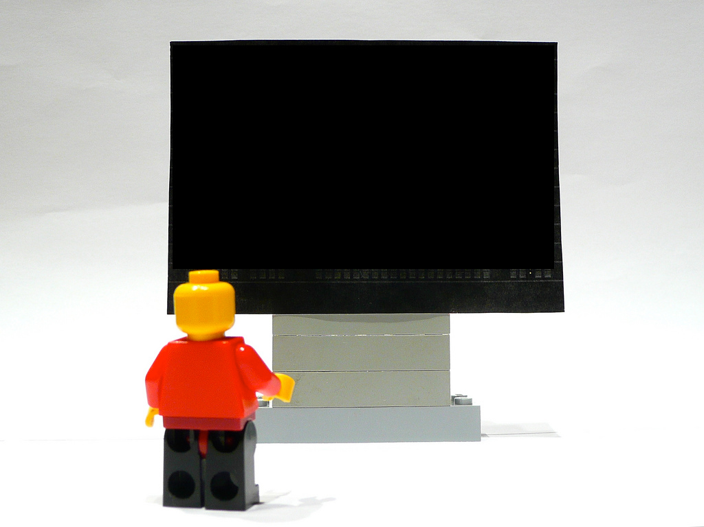
1. Background
2. Research Questions
3. Online Community
4. Previous Studies
5. Proposed Work
photo by ntr23 on Flickr

Slide 5
1. Background
2. Research Questions
3. Online Community
4. Previous Work
6. Proposed Work
photo by ntr23 on Flickr

Slide 6






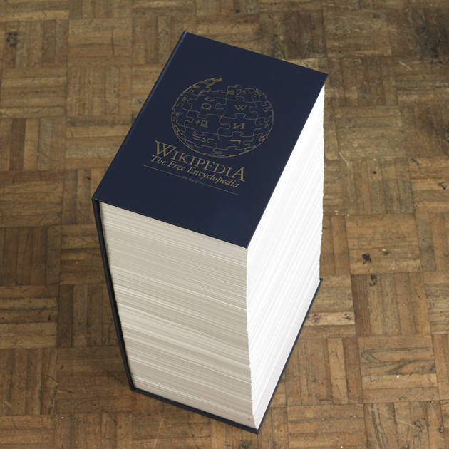
Rob Matthews
http://www.rob-matthews.com/index.php?/project/wikipedia/
Notes:
Online collaboration

Slide 7
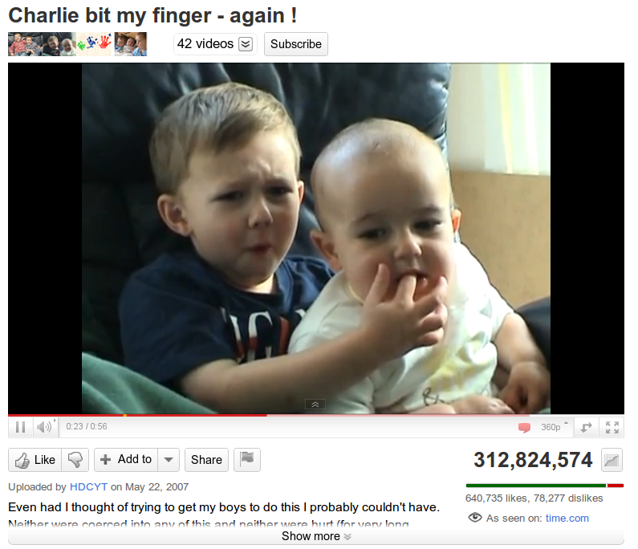

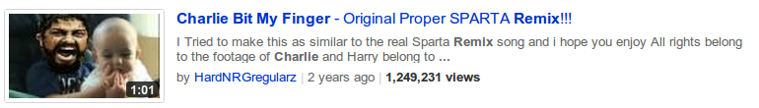
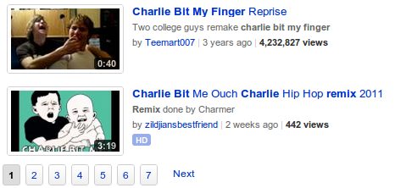

Slide 8
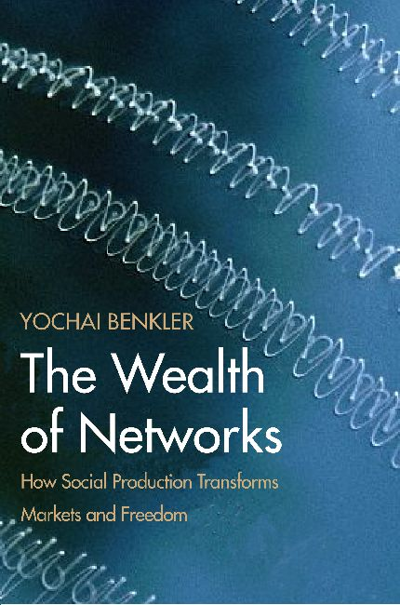
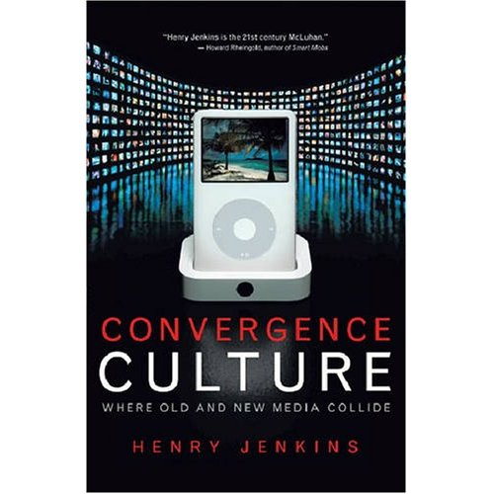
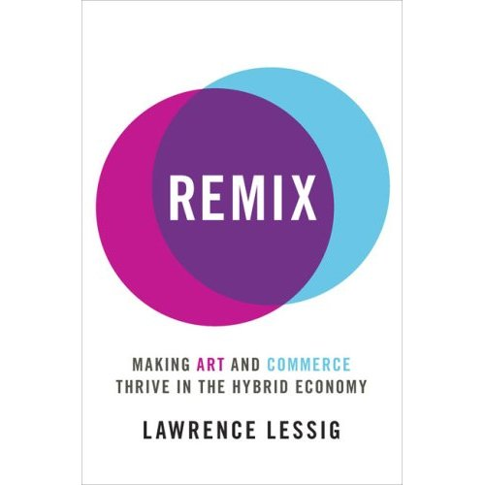
Commons-based Peer Production
Convergence
Culture
Remix
Culture
Benkler 2006
Jenkins 2006
Lessig 2008
Notes:
networked environment makes possible a new modality of organizing production: radically decentralized, collaborative, and nonproprietary; based on sharing resources and outputs among widely distributed, loosely connected individuals who cooperate with each other without relying on either market signals or managerial commands.

Slide 9
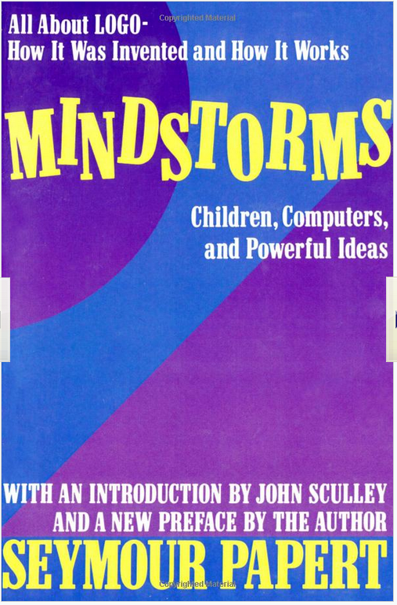
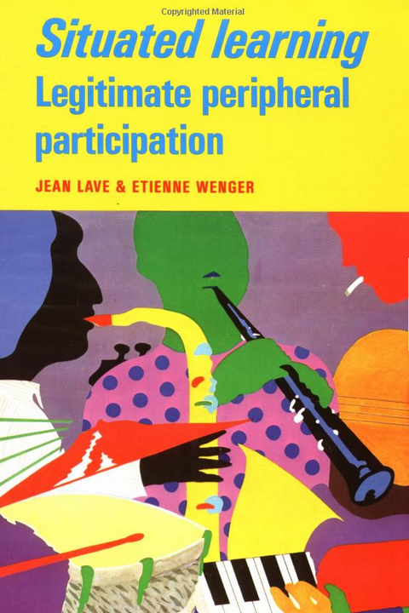
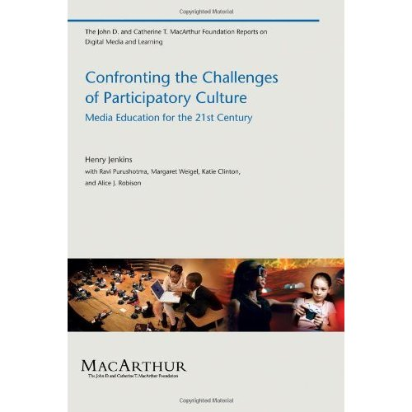
Constructionism
Communities of Practice
New Media Literacy Skills
Papert (1980)
Lave and & Wenger (1991)
Jenkins (2009)
Notes:
Social aspects
Bricolage – model of learning
“Appropriation. The ability to meaningfully sample and remix media content.”

Slide 10


Video
jumpcut interviews (Diakopolous et al. 2007)
System design (e.g. Shaw and Schmitz 2006)
Music
ccMixter network (Cheliotis and Yew 2009)
Text
Wikipedia territoriality (Thom-Santelli et al, 2009)
Web Mashups
(Bolin et al., 2005; Wong and Hong, 2007)

Slide 11
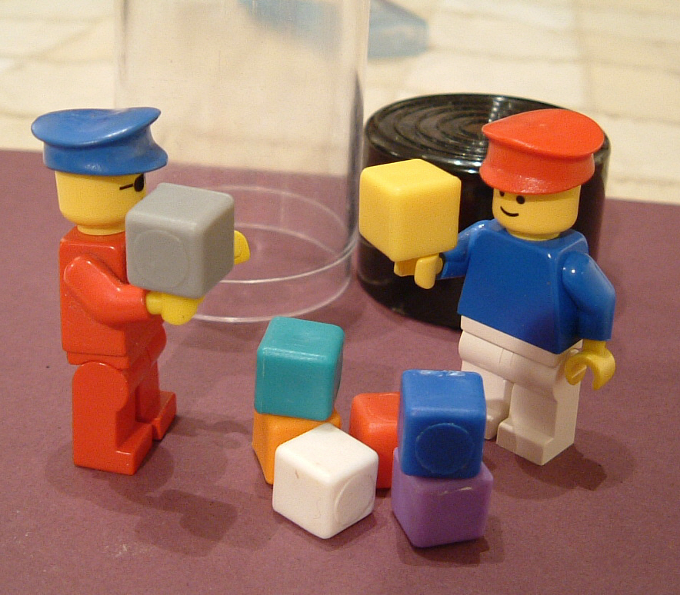
remix
(fork, mashup, appropriation, sample, bricolage, pastiche, collage)
Photo by Kaptain Kobold on Flickr
Notes:
Social
Creative

Slide 12
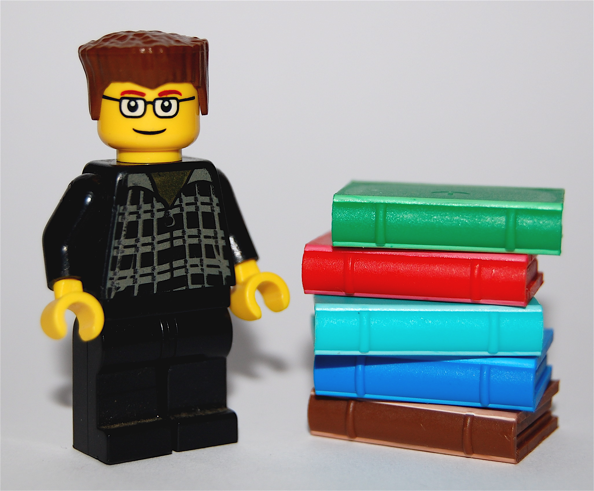
Perspectives:
- System Design
- Learning
- Social and Cultural
- Ethical
photo by minifig on Flickr
Notes:
INTERSECTION OF DESIGN and STUDY

Slide 13
1. Background
2. Research Questions
3. Online Community
3. Previous Work
4. Proposed Work
photo by ntr23 on Flickr

Slide 14
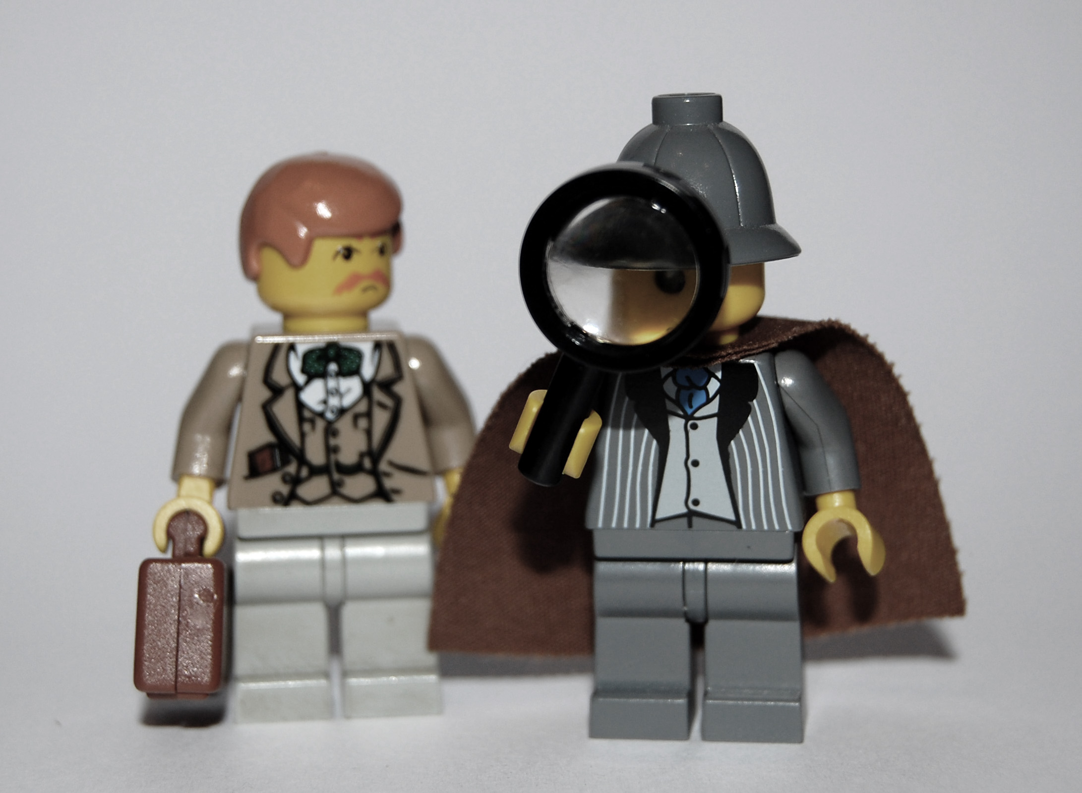
How to design
socio-technical systems that support remixing?
photo by minifig on Flickr

Slide 15
what are the structural properties of an online remixing community?
what is the functional role of remixing in cultural production and social learning?
what are amateur creators' attitudes towards remixing?
photo by minifig on Flickr

Slide 16
1. Background
2. Research Questions
3. Online Community
3. Previous Work
4. Proposed work
photo by ntr23 on Flickr

Slide 17
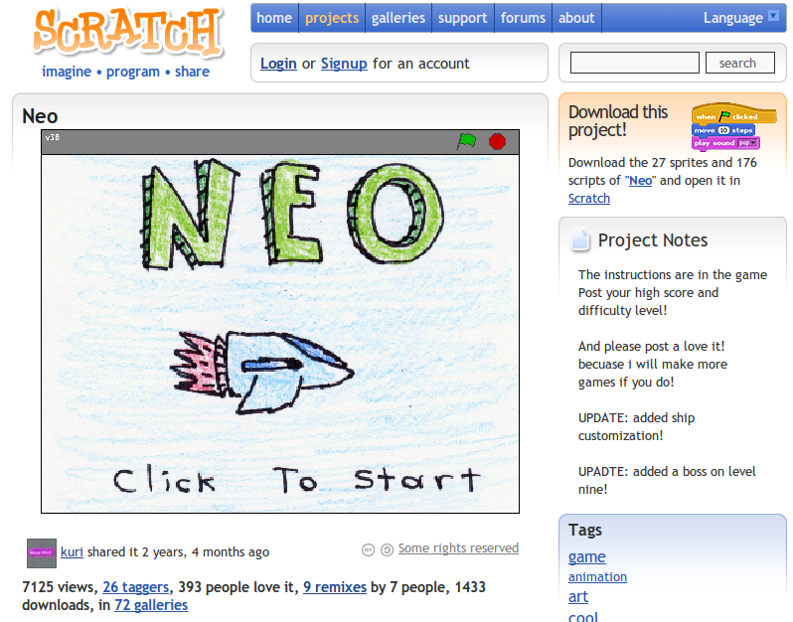

Slide 18
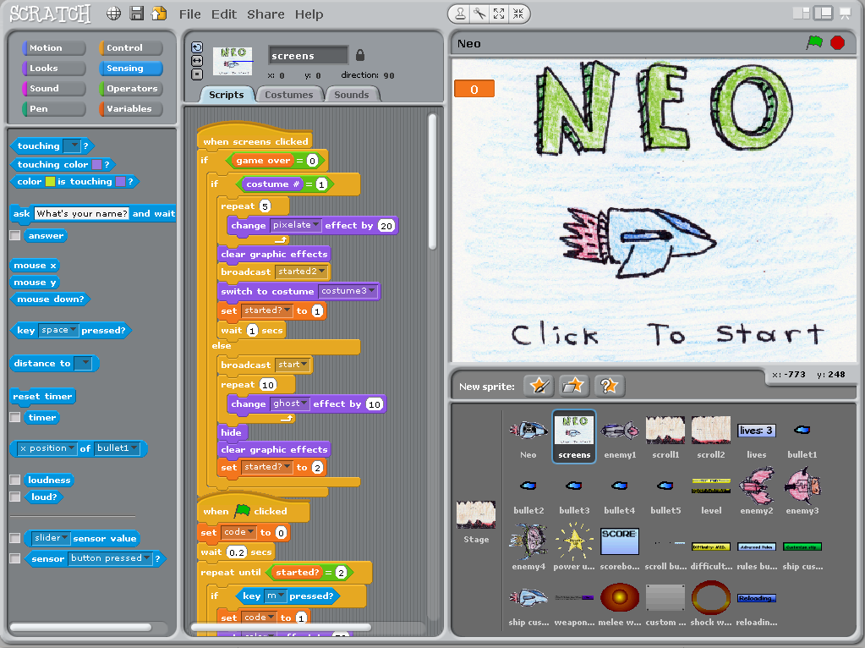
Scratch: programming for all (2009) Resnick, M. Maloney, J. Monroy-Hernández, A. et al. Communications.

Slide 19
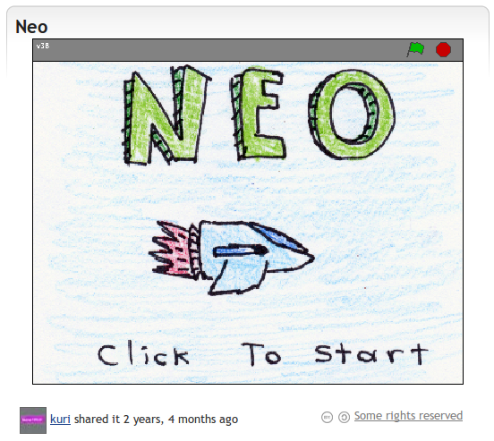
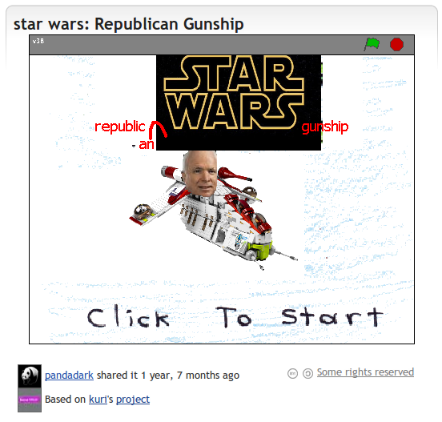
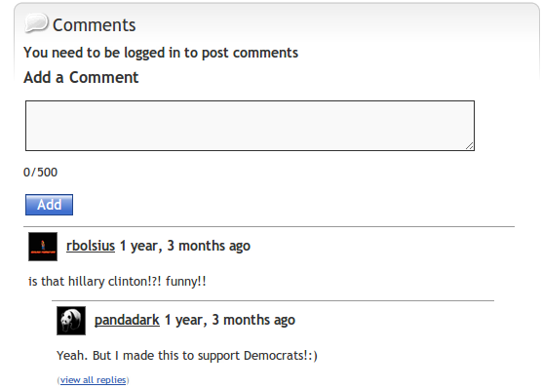

Slide 20
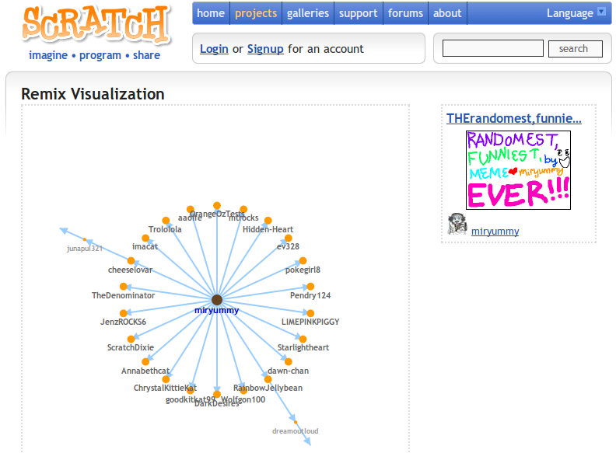

Slide 21
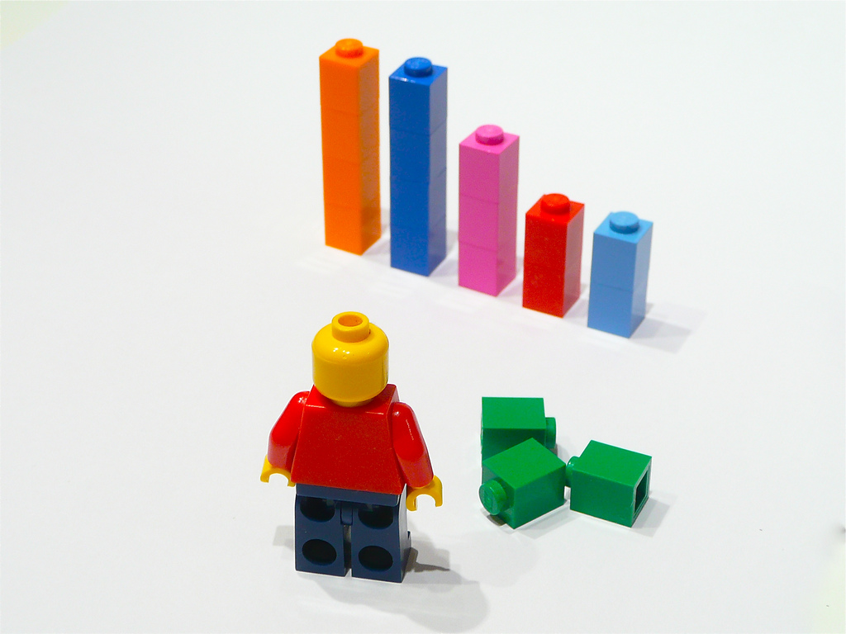
1.8 million projects
25%
remixes
800,000
accounts
200,000
creators
photo by ntr23 on Flickr

Slide 22
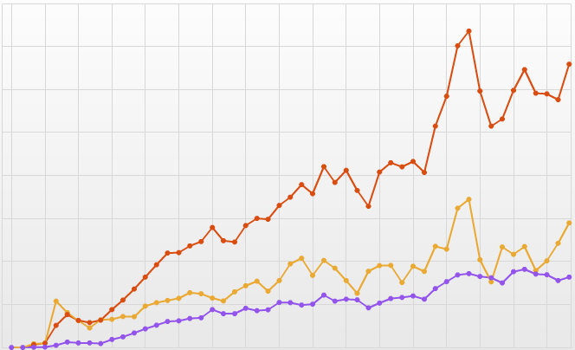
Monthly Activity
80K
65,000 new projects
40K
28,000 new users
0
16,000 new remixes
Mar 2007
Mar2011

Slide 23
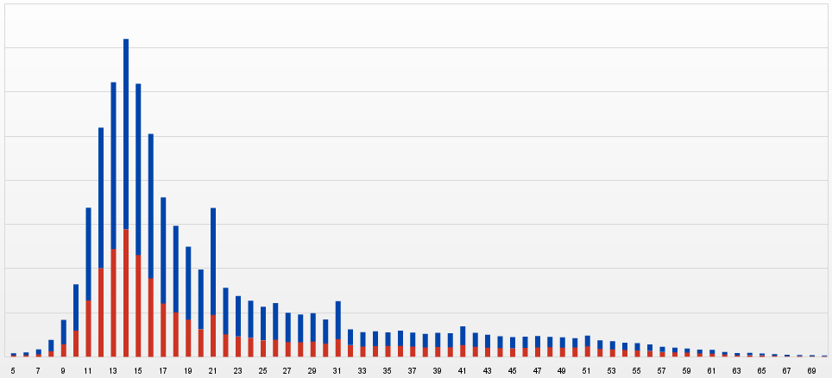
Age Distribution
14 years-old
70K
30K
0

Slide 24
1. Background
2. Research Questions
3. Online Community
4. Previous Work
5. Proposed Work
photo by ntr23 on Flickr
Notes:
To give an idea of the type of work I’ve been doing I’m going to present 3 studies.

Slide 25
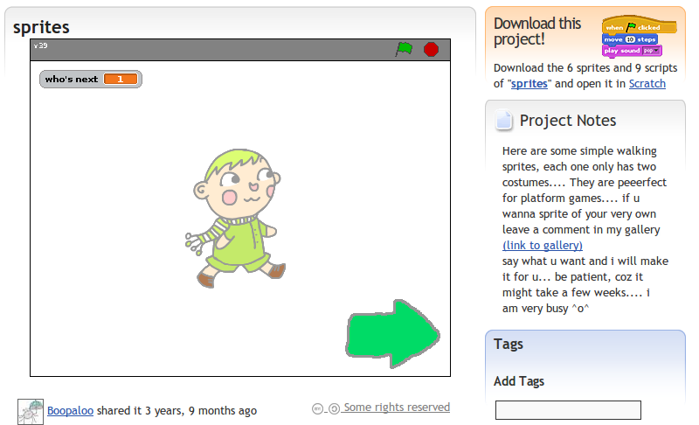

Slide 26
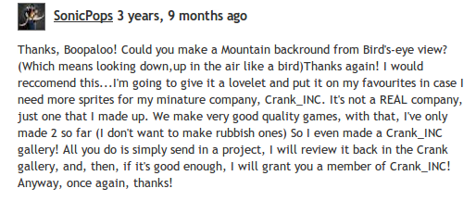

Slide 27
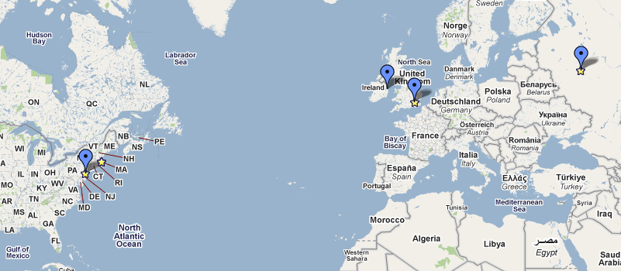
Co-co character deginer (sic) and Sound operator
Character and Background desigener (sic)
Proggramer (sic) and chairlady and game creator.
Co-character deigner and background scroller expert
Programmer and webpage designer

Slide 28
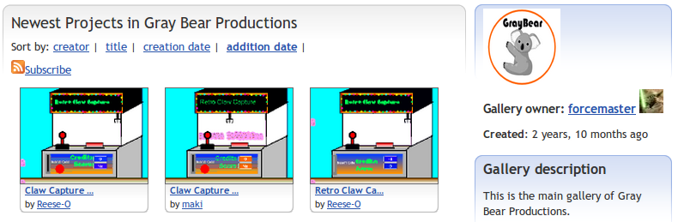
3 months, 6 games
17 remixes per project
A Tale of Two Online Communities: Fostering Collaboration and Creativity in Scientists and Children (2009) Aragon,C., Poon, S., Monroy-Hernández, A., Aragon, D. In Proc. Of Creativity and Cognition

Slide 29
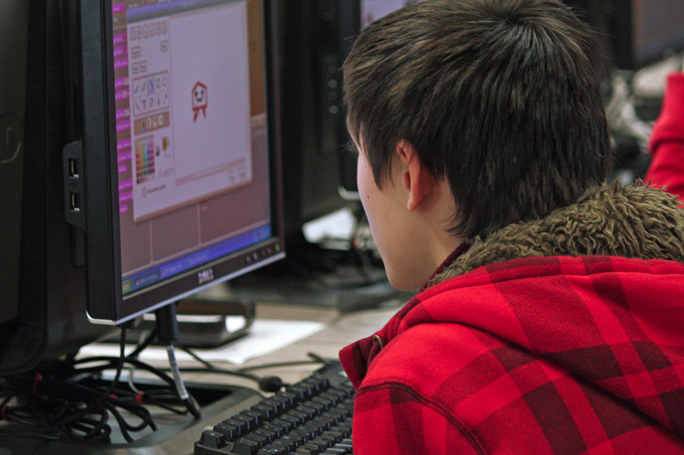
Hi i’m koolkid15 the original creator of luigi disco. jay-man41 copied me!! and didn’t even aknowladge (sic) me. he didn’t change anything I wrote or drew!! and jay-man...if your reading this think about other people!!!!
Skokie Public Library on Flickr

Slide 30
Negative
comments
(22%)
Positive
comments
(21%)
Responses to remixing on a social media sharing website (2010) Hill,B.M., Monroy-Hernández, A. Olson,K.R. ICWSM '10

Slide 31
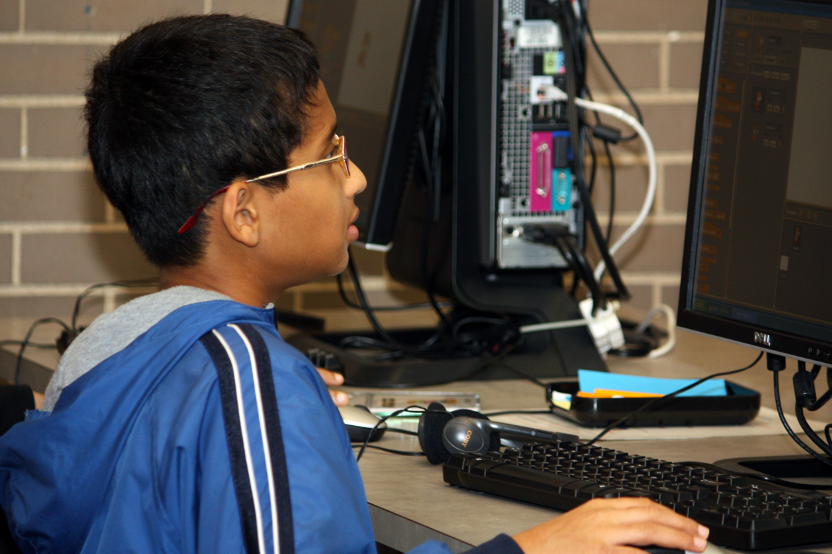
Make it so you can only download a view of how your
game/story/animation works.
Maybe downloaded Scratch files, after being uploadaed (sic), are
marked with the creators name at the bottom, and then any DIFFERENT people who edit it after are put on the list.
Skokie Public Library on Flickr

Slide 32
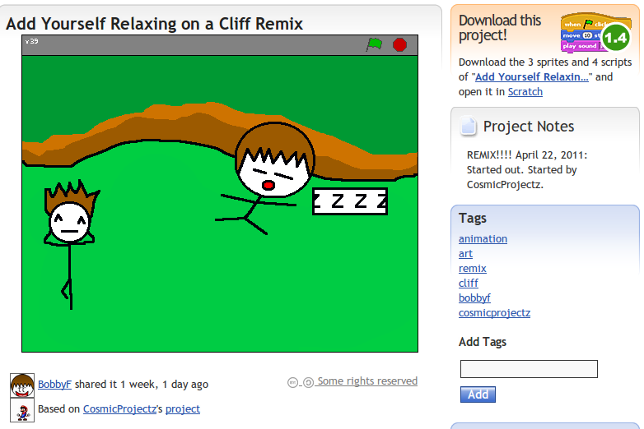

Computers Can't Give Credit: Automatic Attribution Falls Short in an Online Remixing Community (2011)
Monroy-Hernández, Hill, Gonzalez-Rivero, boyd. CHI '11

Slide 33
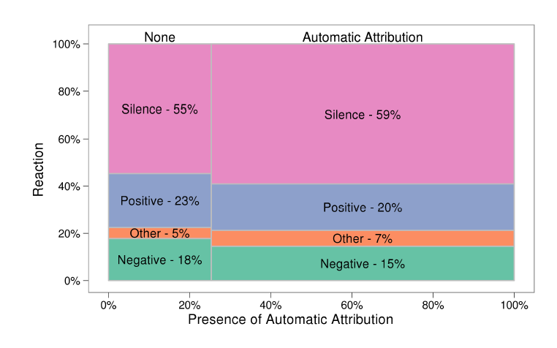
n = 932, χ2 = 3.94; df = 3; p = 0.27
Notes:
This not only looks similar. X2 suggest there is no statistically sig difference. Includes all originators who have VIEWED remixes of their projects.

Slide 34
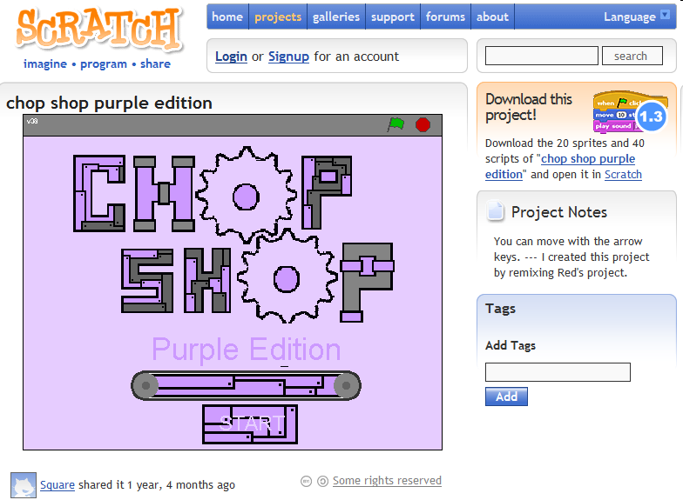

Slide 35
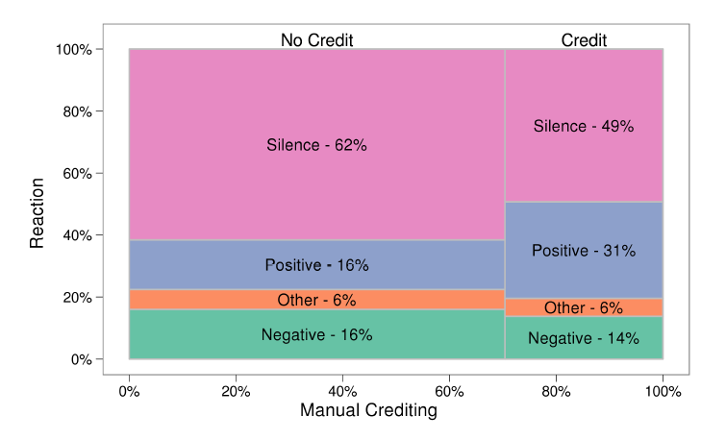
n =932, χ2 = 27.60; df = 3; p < 0.001
Notes:
^ more conservative test
If don't include silent people n = 388, only explicit reactions, we move
41% re-acted negatively when they were not given credit.
27% did so when they were credited.

Slide 36
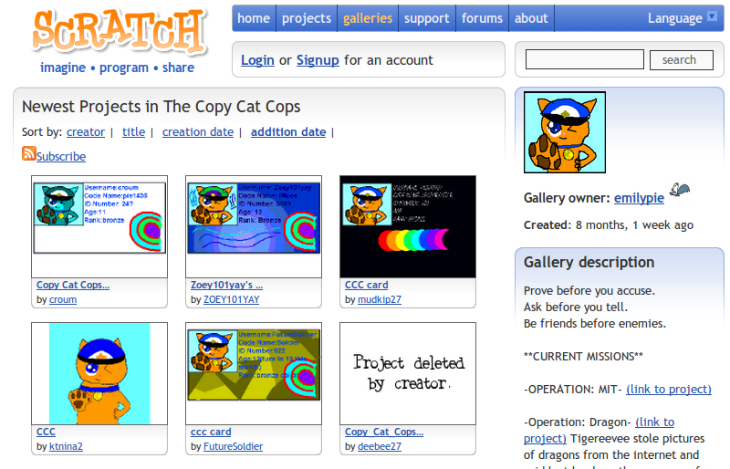

Slide 37
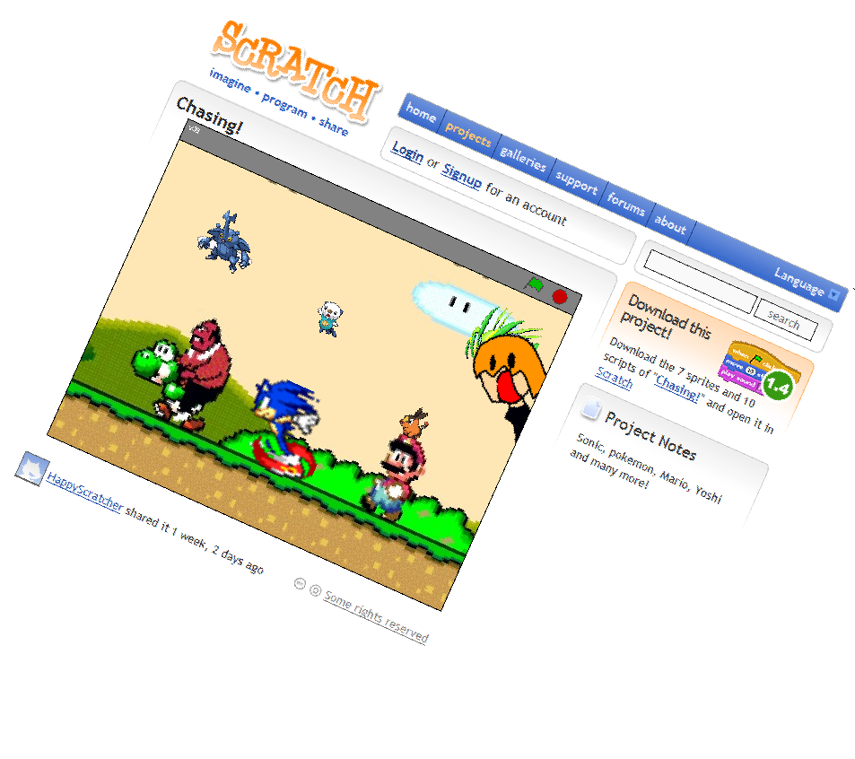
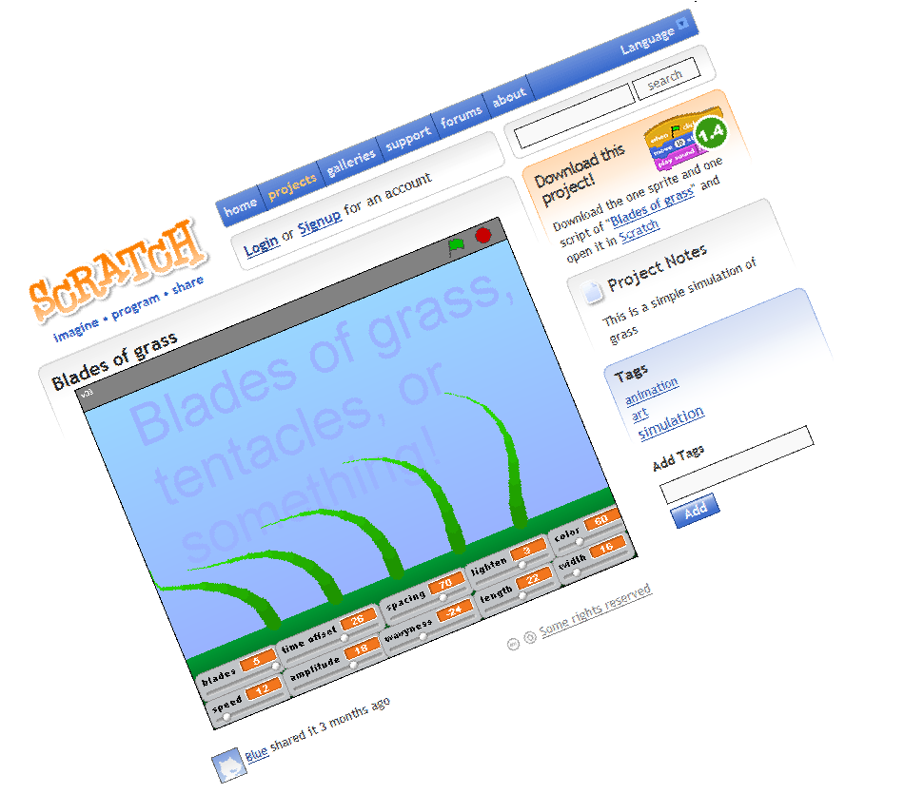
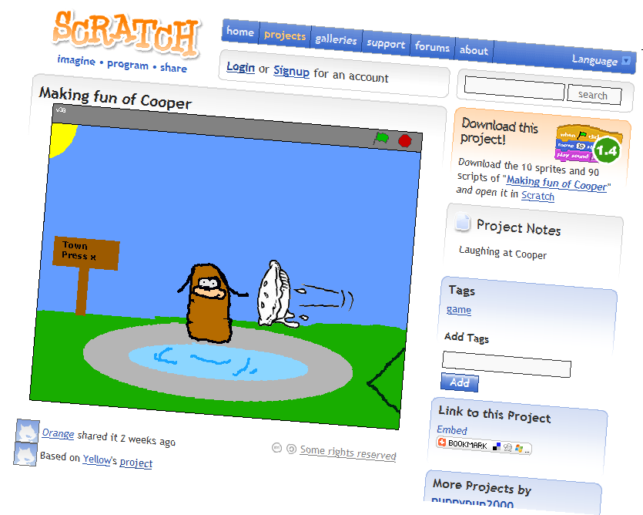
Interviews
11 kids
9 active Scratchers

Slide 38
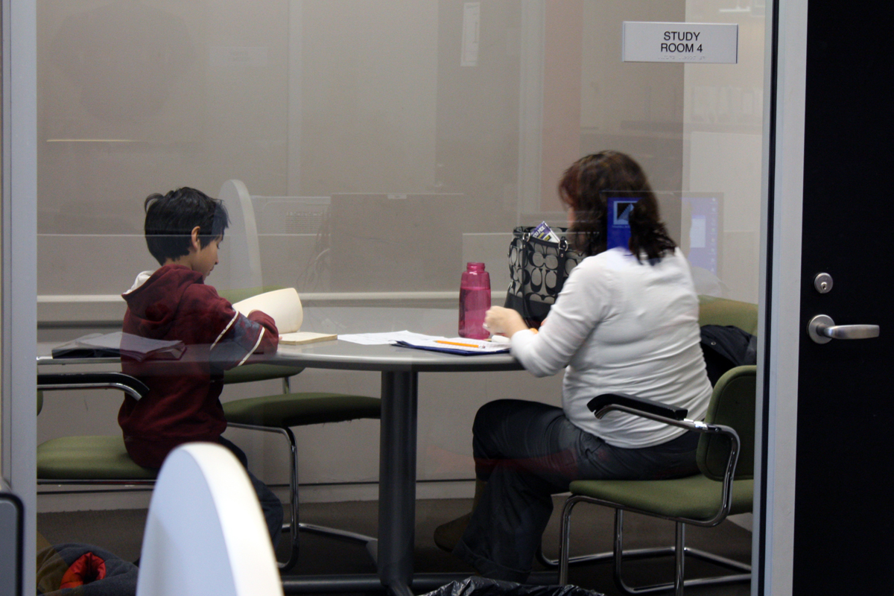
“Taking somebody else’s project, and then changing a lot of it, and then sharing it and giving credit ” Jon, 9
“if Green had actually said in the project notes: ‘this is a remix of Red’s project, full credit goes to him’, the a would consider it a remix.” Jon, 9
Skokie Public Library on Flickr

Slide 39

“I would like it even more if the person did it [give credit] on their own accord, because it would mean that [...] they weren’t trying to copy it, pirate it.”
Amy, 15
“No, [the “Based on” is not enough], because he [the remixer] didn’t put that, it always says that.”
Jon, 9
Skokie Public Library on Flickr

Slide 40
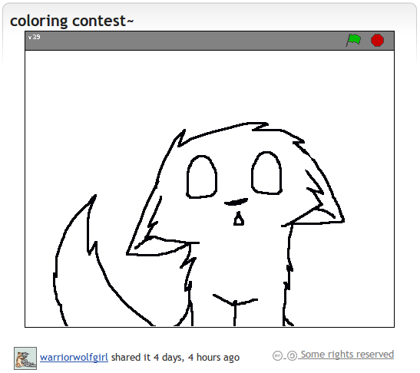
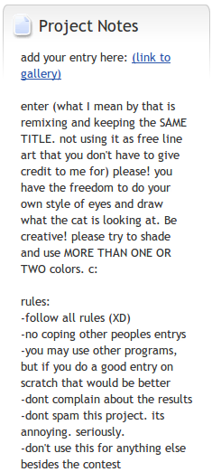
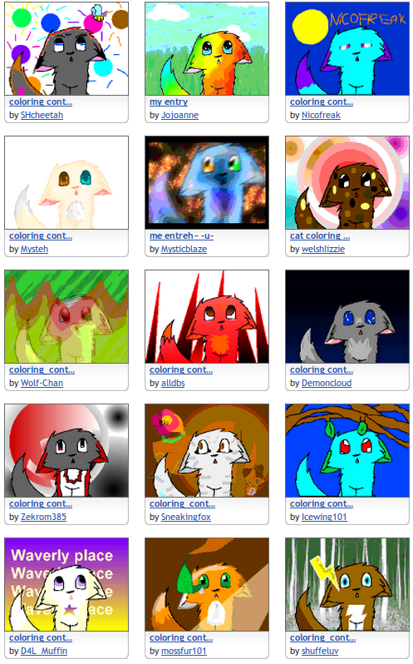
Nickerson, J. V., Monroy-Hernández, A. (2011). Appropriation and Creativity: User-initiated Contests in Scratch. HICSS ’11

Slide 41
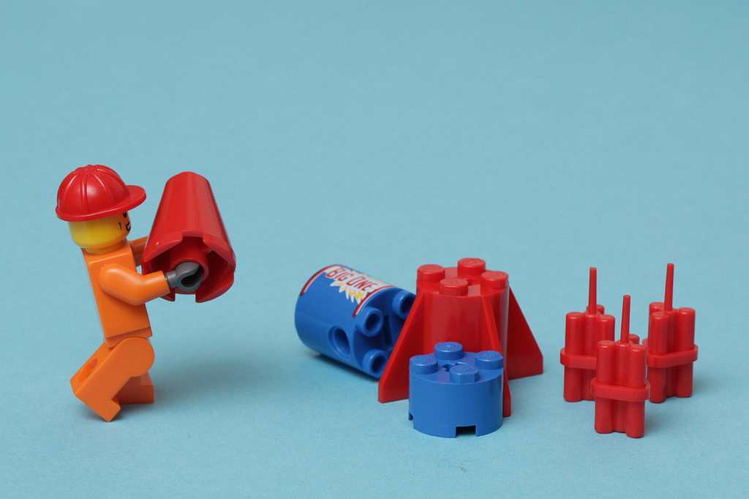
- Socio-technical system
- Large user base
- Log and interview data
- Empirical studies
photo by pasukaru76 on Flickr

Slide 42
1. Background
2. Research Questions
3. Online Community
4. Previous Work
5. Proposed Work
photo by ntr23 on Flickr
Notes:
Now, I have been thinking about a framework to study remixing that will be useful for designers and partioners. This framework not only helps me put together some of the work that I’ve been doing, like in the example of those 3 studies but also guide some of the work that I want to do in the following moths.

Slide 43
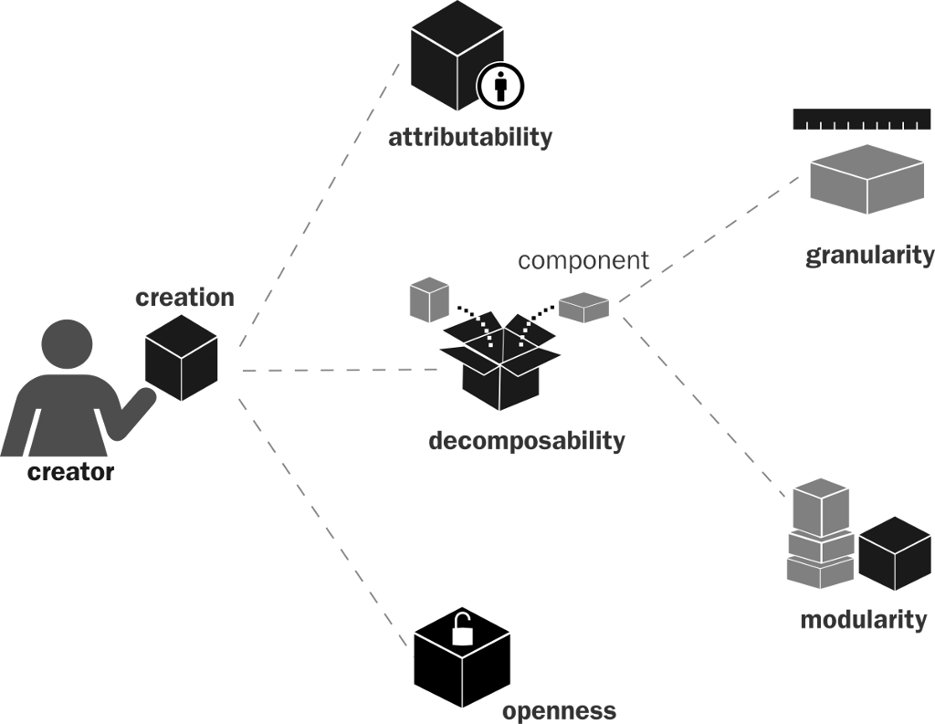
Structural
Notes:
1. What attributes are linked with component modularity? (technical or cultural )
2. New-comers – helped by modularization?
3. community-generated components more often created by advanced users?
How common is sharing and remixing across the
various levels of granularity available?
What are the types of participants and motivations for sharing finer grained components?

Slide 44
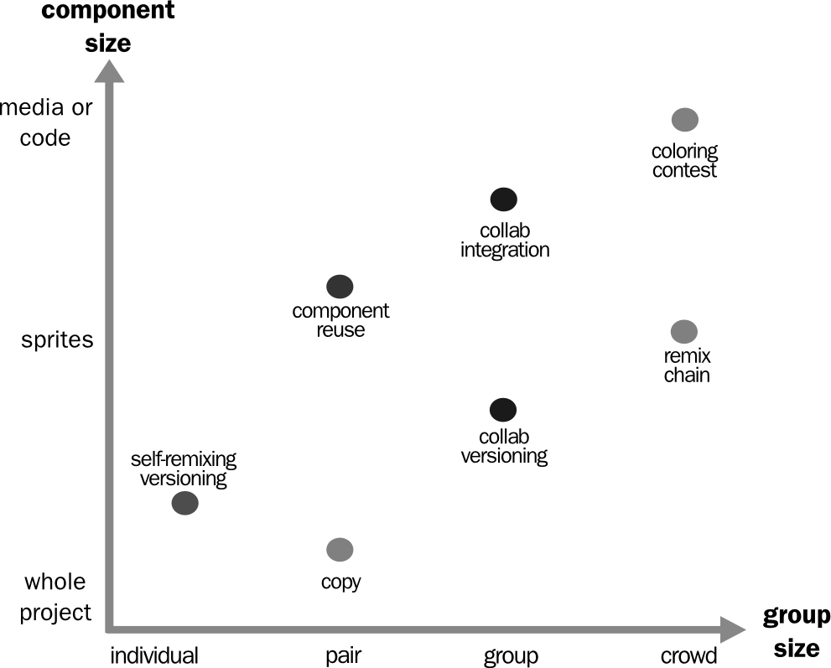
Functional
Notes:
1. How common is each type? Evolution
2. Types related to commitment? Newcomers more into one type than the other?
3. Remixing as scaffolding. Sociability, Usability, Learning.
4. How crowd remixing success?
4. Network differences between each structure.
5. Complexity and effort in each type.

Slide 45

Attitudinal
Encouraging
Restricting
Opposing
Permission seeking
Norm following
Antagonistic
Originator
Remixer

Slide 46
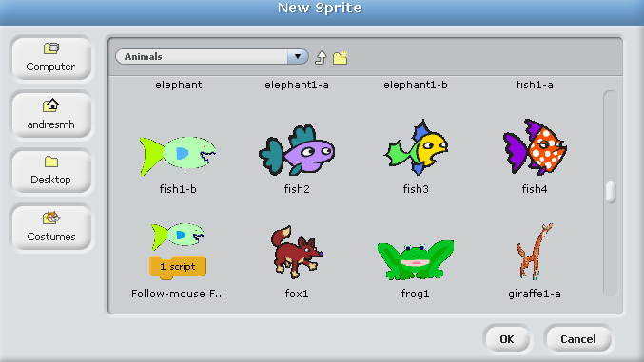
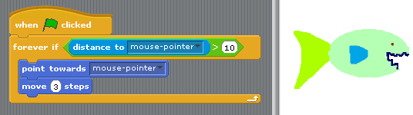
modularity
Notes:
Modularity ~ Operationalized via # remixes
“property of a project referring to the extent to which it can be broken down into smaller components, or modules, that can be independently and asynchronously produced before they are assembled into
a whole.”

Slide 47
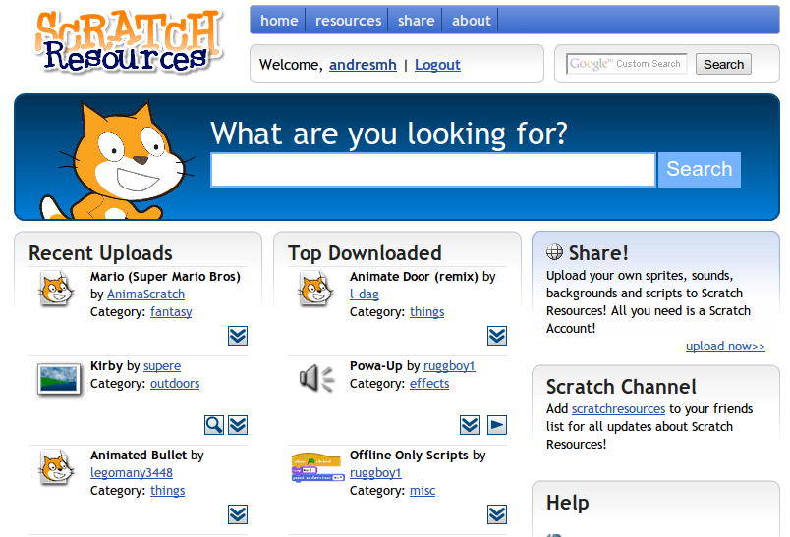
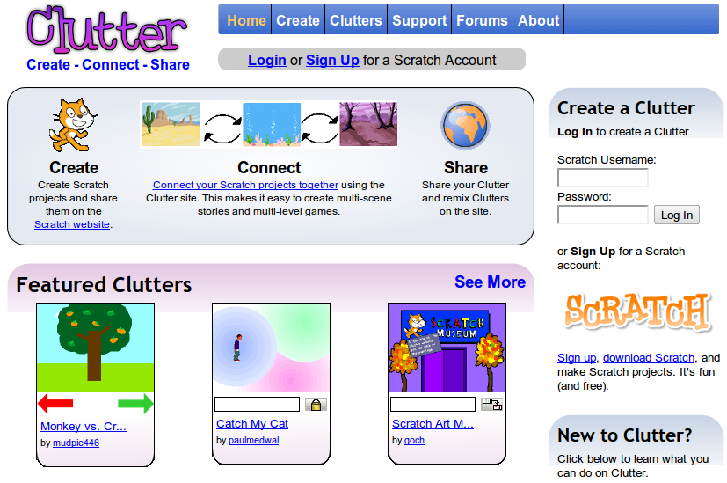
granularity
sprites & media
projects
Joren Lauwers
Paul Medlock-Walton
Notes:
API
Granularity.
Effort
Expertise – granularity

Slide 48
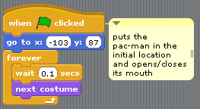

decomposability
Notes:
Decomposability.
- Easy vs hard code
- Obfuscation.

Slide 49


functional
(with Hill, B.M.)
Notes:
FUNCTIONAL
1. How common is each type? Evolution
2. Types related to commitment? Newcomers more into one type than the other?
3. Remixing as scaffolding. Sociability, Usability, Learning.
4. How crowd remixing success?
4. Network differences between each structure.
5. Complexity and effort in each type.

Slide 50




Network Structure
Notes:
Chain remixes.
Groups.

Slide 51

attitudinal
Notes:
Plasticity of virtue

Slide 52

(With Jude Yew)
Notes:
Generalizable

Slide 53
Q & A
photo by ntr23 on Flickr

Slide 55
extras

Slide 56
Andrés Monroy-Hernández, Mako Hill, Jazmin Gonzalez-Rivero et al. (2011) Computers can't Give Credit: How Automatic Attribution Falls Short in an Online Remixing Community. CHI '11
Jeff V. Nickerson and Andrés Monroy-Hernández (2011). Appropriation and Creativity: User-initiated Contests in Scratch. In Proceedings of the Hawaii International Conference on System Sciences (HICSS ’11)
Benjamin Hill, Andrés Monroy-Hernández, Kristina Olson (2010) Responses to remixing on a social media sharing website. In International Conference on Weblogs and Social Media.
Mitchel Resnick, John Maloney, Andrés Monroy-Hernández et al. (2009) Scratch: programming for all, 60-67. In Communications of the ACM 52 (11).
Andrés Monroy-Hernández, Mitchel Resnick (2008) Empowering kids to create and share programmable media, 50. In interactions 15 (2).

Slide 57



communication
Aragon, Poon, Monroy-Hernández, Aragon, 2009

Slide 58



Nickerson,, Monroy-Hernández (2011) HICSS

Slide 59
  People just as likely to leave positive comments (21%) as they were to leave a direct or indirect complaint of plagiarism (22%).
  Project complexity led to more complains of plagiarism
  Remixing a remix or being a remixer did not imply being more accepting of remixing
  Similar projects led to more plagiarism accusations
Hill, Monroy-Hernández, Olson, 2010

Slide 60



remixing memes
4chan and /b/: An Analysis of Anonymity and Ephemerality in a Large Online Community (2011) Bernstein, M.S., Monroy-Hernández, A., Harry, D., André, P., Panovich, K., Vargas, G. ICWSM '11
Notes:
4chan /b/
Median life of a thread is just 3.9 minutes
Min 29 sec, Max 6 hrs
43% threads without replies
Media life on front page 5 secs, mean 36 secs

