Slide 1
Graph Based EEG Analysis
Andres Nowak, Sajal Chaurasia, Sathvik Bhagavan, Yasaman Noorikhah

Slide 2
Problem Statement
Epilepsy involves recurrent seizures due to abnormal neuronal activity.
Detecting seizures from EEG signals is challenging due to their noisy, high-dimensional, and non-stationary nature.
Traditional methods (RNNs, transformers) often ignore spatial relationships between electrodes which is a key aspect of brain connectivity.
Graph-based methods may help capture these relationships and improve both performance and interpretability in seizure detection.
This project aims to compare graph-based approaches with traditional methods to determine their potential for improving seizure detection.
Notes:
1min
We are Group 22, presenting our work on the course project of graph based EEG analysis
Epilepsy involves recurrent seizures due to abnormal neuronal activity.
Detecting seizures from EEG signals is challenging due to their noisy, high-dimensional, and non-stationary nature.
Traditional methods (RNNs, transformers) often ignore spatial relationships between electrodes which is a key aspect of brain connectivity.
Graph-based methods may help capture these relationships and improve both performance and interpretability in seizure detection.
This project aims to compare graph-based approaches with traditional methods to determine their potential for improving seizure detection.

Slide 3
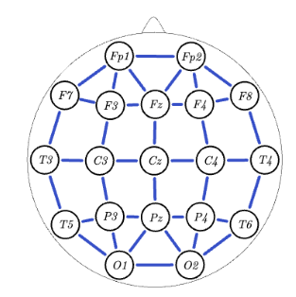
Dataset and Preprocessing
Subset of Temple University Hospital (TUSZ) dataset, a large and publicly available EEG database with seizures.
Comprises 12-second recordings (at 250 Hz) from 19 electrodes placed according to the international 10–20 system.
Training: 97 patients; Validation: 9; Test: 25; did a patient-wise split to avoid data leakage.
Class imbalance — seizures make up only ~20% of total segments (∼13,000 segments in total), used weighted loss in training.
Preprocessing — Signals were band-pass filtered (0.5–30 Hz) to focus on relevant brain activity, and transformed with FFT for frequency-domain features; both time-domain and frequency-domain representations were explored.
Notes:
Subset of Temple University Hospital (TUSZ) dataset, a large and publicly available EEG database with seizures.
Comprises 12-second recordings (at 250 Hz) from 19 electrodes placed according to the international 10–20 system.
Training: 97 patients; Validation: 9; Test: 25; did a patient-wise split to avoid data leakage.
Class imbalance — seizures make up only ~20% of total segments (∼13,000 segments in total), used weighted loss in training.
Preprocessing — Signals were band-pass filtered (0.5–30 Hz) to focus on relevant brain activity, and transformed with FFT for frequency-domain features; both time-domain and frequency-domain representations were explored.

Slide 4
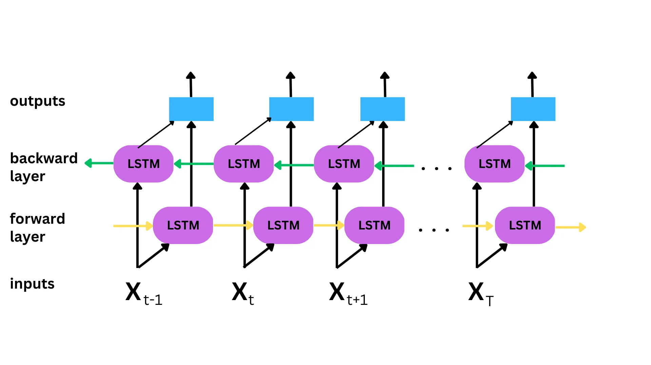
Baseline Methods: BiLSTM
Image Credits: Medium Article
Bidirectional LSTM — Processes sequences in both forward and backward directions, capturing complex temporal dependencies in EEG signals.
Provides context from both past and future time steps, which can be crucial for detecting seizures with subtle and context-dependent patterns.
Notes:
30 seconds for each method
Bidirectional LSTM — Processes sequences in both forward and backward directions, capturing complex temporal dependencies in EEG signals.
Provides context from both past and future time steps, which can be crucial for detecting seizures with subtle and context-dependent patterns.

Slide 5
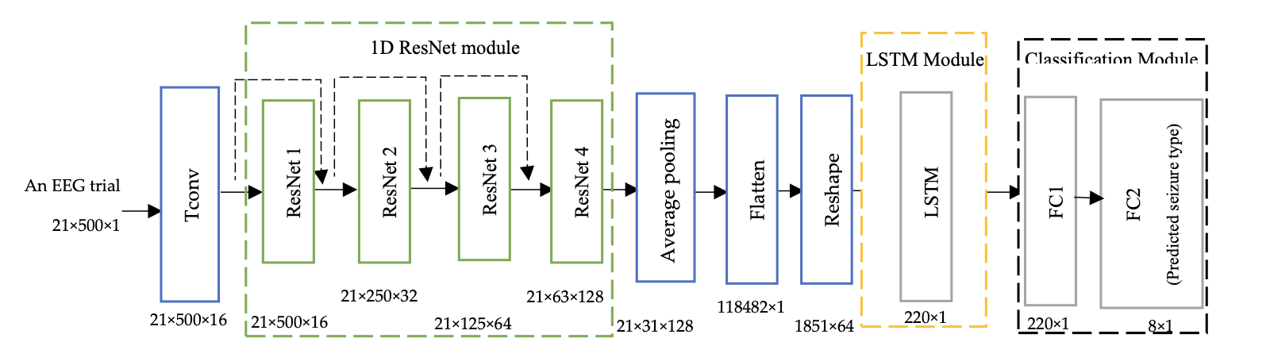
Baseline Methods: Resnet-LSTM
Image credits: EEG-Based Classification of Epileptic Seizure Types Using Deep Network Model
The ResNet-LSTM architecture leverages residual learning to enable deep CNNs to capture the temporal features from EEG signals.
The 1D ResNet extracts temporal features, which are reshaped into a time series and fed into an LSTM that effectively learns the long-term dependencies in the data and important temporal features.
Notes:
This architecture uses a 1D ResNet to extract multi-scale temporal features from raw EEG signals, capturing localized seizure patterns through residual learning. These features are reshaped into a time series and passed to an LSTM, which models long-range temporal dependencies. The output is then fed through fully connected layers for seizure classification. While the original paper used SMOTE for class balancing, in our implementation we tested class weighting instead, and added an extra dense layer with ReLU before the final binary output.

Slide 6
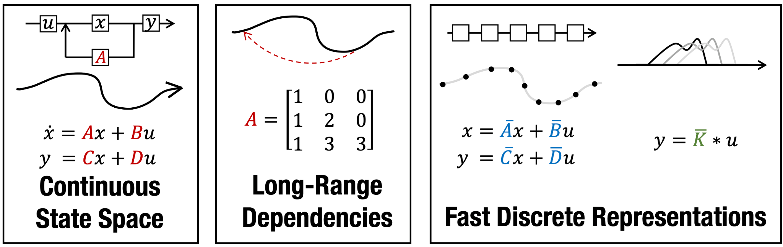
Baseline Methods: S4
Image Credits: Efficiently Modeling Long Sequences with Structured State Spaces
S4: Structured State Space Sequence modeling
Captures long-range dependencies by applying S4 layers to frequency-domain data from each EEG channel.
Generates a unified representation by mean pooling across temporal frames and channels before proceeding to the classifier.
Notes:
2-3min
The important thing of this method is the HIPPO matrix theory, that makes it so you can capture ver long range dependencies, and the theory is that state space also works like convolutions but instead you have a very big kernel
This model uses Structured State Space layers—S4—to capture long-range temporal dependencies, which is critical for detecting seizures that unfold over extended durations. Each EEG channel is processed independently with a single S4 layer. These layers rely on a HiPPO matrix, which maintains a compressed and structured memory of past inputs, enabling efficient modeling of long sequences. After temporal processing, outputs are mean-pooled over time for each channel, then averaged across channels to form a global representation. This final embedding is passed into a classifier for seizure prediction.

Slide 7
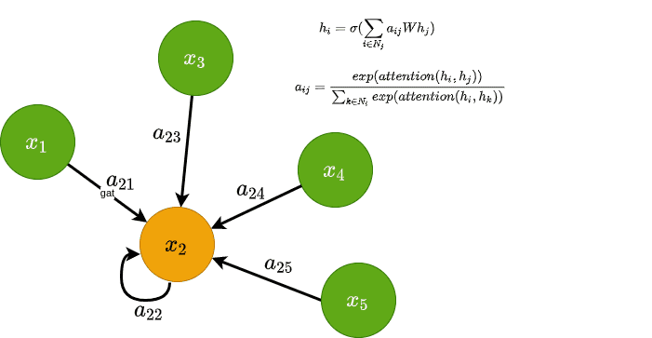
Graph Based Methods: GNN
Image Credits: AI Summer Blog
Nodes correspond to electrodes with features obtained from FFT of the time series obtained from that electrode.
Captures spatial dependencies between electrodes and feeds them into a classifier for final seizure prediction.
Notes:
2-3min
In this approach, each node in the graph represents an EEG electrode, with features derived from the frequency domain using FFT. Temporal information isn't explicitly modeled—instead, a Graph Neural Network, specifically a Graph Attention Network, is used to capture spatial dependencies between electrodes. The attention mechanism helps the model focus on the most relevant electrode interactions. The resulting spatial embeddings are then passed to a classifier for seizure prediction.

Slide 8
Graph Based Methods: LSTM-GNN
LSTM
GNN
Classifier
Seizure/
No Seizure
Combines temporal and spatial modeling — BiLSTM first produces temporal embeddings for each electrode, then GNN aggregates information from neighboring nodes.
Graph-level representation is fed into a classifier; implemented in three variants (BiLSTM + GCN, BiLSTM + GAT, BiLSTM + Graph Transformer), all with a common architecture (3-layer BiLSTM + 3-layer GNN with residual connections).
Notes:
2-3min
This model combines temporal and spatial modeling in sequence. A three-layer BiLSTM processes each EEG channel individually, capturing temporal dynamics in both forward and backward directions. The resulting temporal embeddings are then passed into a three-layer GNN—which could be a GCN, GAT, or Graph Transformer—to capture spatial dependencies by aggregating information from neighboring electrodes. Residual connections are used throughout the GNN. The final graph-level embedding is obtained via pooling and fed into a classifier to predict seizure activity.

Slide 9
Graph Based Methods: GNN-LSTM
EEG Time Series
GNN
LSTM
GNN
GNN
Classifier
Seizure/
No Seizure
GNN
Combines spatial and temporal modeling — The data at each time step are processed by separate GNNs. These features are then concatenated over time to form sequences that are inputted into the LSTM.
LSTM last node output is fed into a classifier; implemented in three variants (1 Layer GCN+LSTM, 2 Layers GCN+LSTM, 1 Layer GAT+LSTM, 2 Layers GAT+LSTM), All variants used 3 Layers of LSTM.
Notes:
Andres
30 seconds each method
In this approach, we reverse the typical LSTM-GNN pipeline. Instead of using LSTM first, we have the data at each time step that are processed by separate GNN’s. Then these spatial embeddings are then stacked over time and passed into a three-layer LSTM to model temporal dynamics. The last hidden state is fed into a classifier to predict the seizure. We tested four variants: GCN and GAT models with either one or two layers, all combined with the same LSTM configuration.

Slide 10
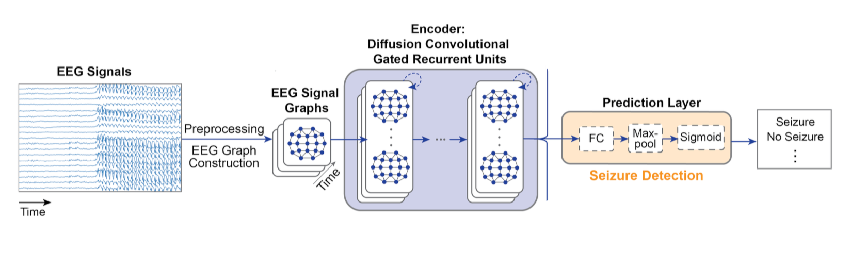
Graph Based Methods: Diffusion GNN
Image credits: Self-Supervised Graph Neural Networks for Improved Electroencephalographic Seizure Analysis
Uses Diffusion process to model electrodes relationships— Temporal dynamics are captured by GRUs, with matrix multiplications replaced by diffusion convolutions. Diffusion process modeled by a bidirectional random walk on the graph.
GRU Last node output is fed into a classifier; implemented in two variants (distance based graph to capture EEG sensor geometry and correlation based graph to capture dynamic connectivity in the brain).
Notes:
2-3min
This model uses a diffusion process to represent spatial relationships between electrodes, modeled as a bidirectional random walk on a graph with 2 diffusion steps. Then it captures temporal patterns using GRUs, but replaces matrix multiplications with diffusion convolutions. The architecture stacks several diffusion convolutional GRU layers, and the final output is passed to a classifier. We implemented two graph variants: one based on physical distance between EEG sensors, and another based on signal correlation to capture functional brain connectivity.

Slide 11
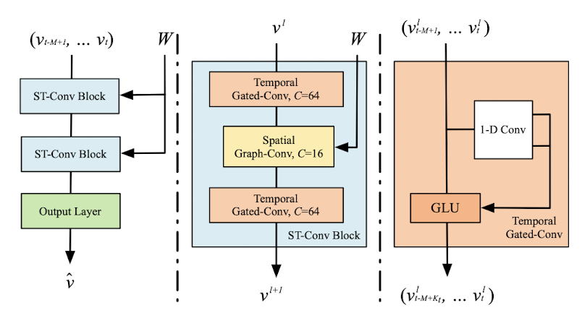
Graph Based Methods: STGCN
Image credits: Spatio-Temporal Graph Convolutional Networks: A Deep Learning Framework for Traffic Forecasting
The STGCN models spatial relations between electrodes using graph convolutions (via first-order spectral approximation of the normalized Laplacian) and captures temporal dynamics with gated 1D convolutions.
For seizure detection, two variants were tested: one using Adaptive Average Pooling 2D, the other with “Attention” based pooling (Adaptive average pooling was better)—both followed by two ReLU-activated dense layers and a final binary output layer.
Notes:
STGCN is a model that can jointly model spatial and temporal patterns in time series. Spatial dependencies between electrodes are captured using graph convolutions using first-order spectral approximation, which reduces parameters and has k-hop aggregation through depth. Temporal features are modeled using gated 1D convolutions applied independently to each electrode over time. For classification head, we tested two pooling strategies before the dense layers: one using adaptive average pooling 2D, and the other using “softmax attention”-based pooling on the node and sequence dimensions, both followed by fully connected layers for seizure detection (and we found Adaptive average pooling was better by a small difference).
The STGCN captures both spatial relations (between electrodes) and temporal signal evolution using graph and temporal convolutions.
Spatial dependencies are modeled via graph convolutions using first-order spectral approximation with the normalized Laplacian, reducing parameterization and using depth for k-hop, while gated 1D convolutions are used to capture dynamic temporal patterns per electrode.
For the seizure detection head, two variants were tested: one with Adaptive Average Pooling and another with attention-based pooling, both followed by two ReLU-activated dense layers and a dense layer head for the binary output.

Slide 12
Graph Based Methods: S4 - GNN
S4
GNN
Classifier
Seizure/
No Seizure
Integrating S4’s long-range temporal modeling with a graph-based module to capture spatial dependencies
Two hybrid models:
  S4 - GCN: one s4 layer per channel -> 2 GCN layers with residual connections and graph normalization
  S4 - GAT: one s4 layer per channel -> 3 GAT layers with 4 attention heads and residual connections
Notes:
2-3min
This model combines the great ability of S4 for long-range temporal modeling with a graph neural network to capture spatial dependencies across electrodes. Each EEG channel is first processed through a single S4 layer to extract temporal features. These are then passed into either a GCN or GAT module to model spatial relationships. The S4-GCN uses two GCN layers with residual connections and graph normalization, while the S4-GAT uses three GAT layers with four attention heads and also residual connections. The final embeddings are pooled and fed into a classifier for seizure prediction.

Slide 13
Results
Model | Test F1 (Time data) | Test F1 (Freq. data)
S4-GCN | 0.83765 | 0.83631
LSTM-GAT | 0.73549 | 0.82047
S4 | — | 0.81459
Resnet-LSTM | 0.81352 | 0.49908
S4-GAT | 0.80212 | 0.80066
LSTM-GCN | 0.69459 | 0.77297
STGCN [Avg pooling] | 0.76001 | 0.67699
Corr-DCRNN | — | 0.75721
Dist-DCRNN | — | 0.74920
GCN-LSTM | 0.64124 | 0.74132
GAT-LSTM | 0.67059 | 0.74101
LSTM | 0.69459 | 0.72943
GAT | — | 0.56997
Resnet-LSTM and S4 best among
non Graph based
S4-GCN best among Graph
based
Notes:
1 min

Slide 14
Findings
GNN seems to help in the task of seizure detection by our results, so it does seems that EEG seizure detection does benefit from spatial information.
S4 + GCN model achieves an F1 score of 0.838, outperforming the temporal-only S4 baseline F1 score of 0.814.
S4 proves to be the strongest temporal model among those tested.
Frequency-domain inputs led to better performance in models such as LSTM, LSTM-GNN variants, and DCRNN whereas time-domain data yielded better results for S4-GNN variants, STGCN and Resnet-LSTM.
Performance also improved when using Inverse Distance as edge weights instead of no weights.
Also we can see Resnet adds better results to only using LSTM where Resnet-LSTM has an F1 score of 0.813 compared to BiLSTM with score of 0.73.
Notes:
1min

Slide 15
Conclusion
Graph based methods can be potentially useful for doing seizure analysis.
Future work could explore integrating GNN’s into other temporal models and test performance of models trained with more EEG data.
Notes:
20-30 seconds

Slide 16
Thank you!

