Slide 1
Standard Library Containers and Iterators
Based on Chapter 15 of C++ How to Program, 10/e

Slide 2
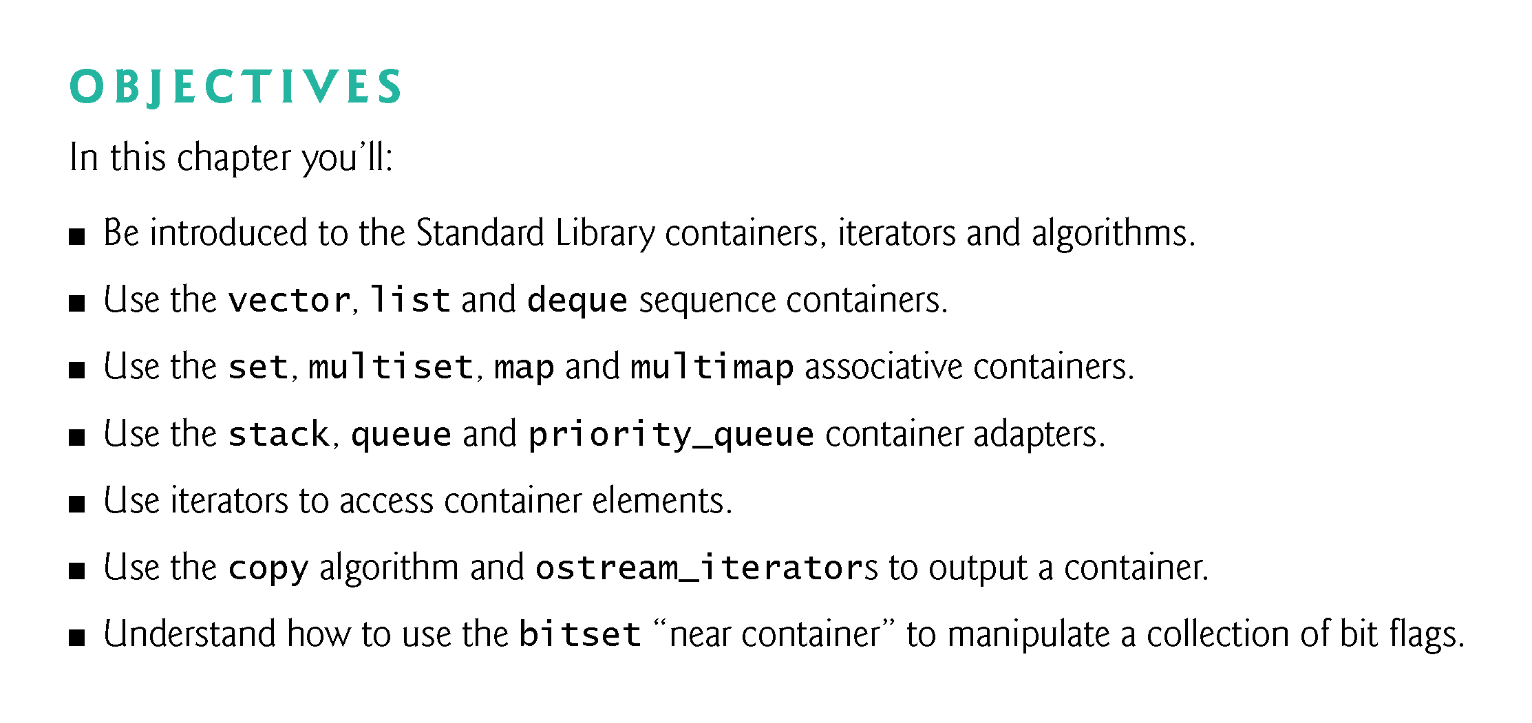

Slide 3
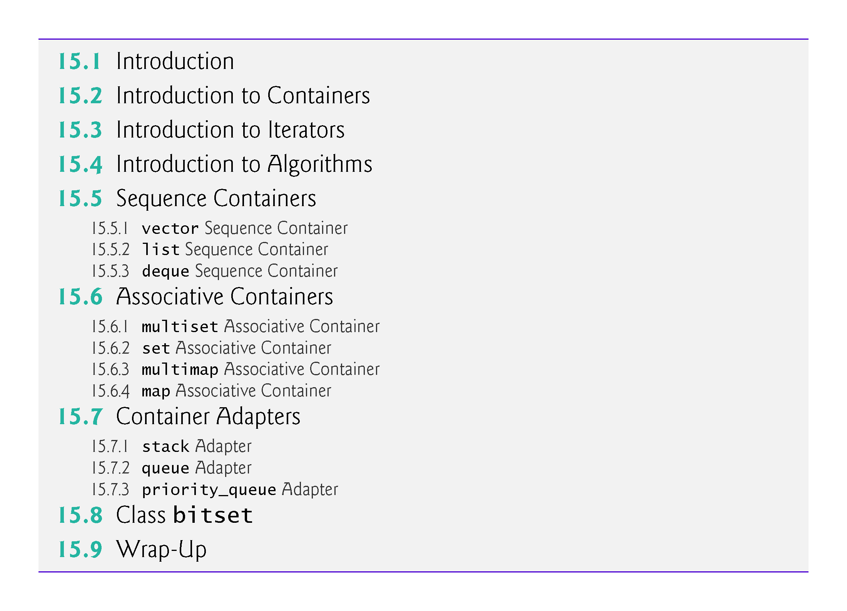

Slide 4
15.1 Introduction
The Standard Library defines powerful, template-based, reusable components that implement many common data structures and algorithms used to process those data structures.

Slide 5
15.1 Introduction (Cont.)
Containers, Iterators and Algorithms
This chapter introduces the three key components of the Standard Library—containers (templatized data structures), iterators and algorithms.
Containers are data structures capable of storing objects of almost any data type (there are some restrictions).
We’ll see that there are three styles of container classes—first-class containers, container adapters and near containers.

Slide 6
15.1 Introduction (Cont.)
Common Member Functions Among Containers
Each container has associated member functions—a subset of these is defined in all containers.
We illustrate most of this common functionality in our examples of array (which was introduced in Chapter 7), vector (which was introduced in Chapter 7 and we cover in more depth here), list (Section 15.5.2) and deque (Section 15.5.3).

Slide 7
15.1 Introduction (Cont.)
Iterators
Iterators, which have properties similar to those of pointers, are used to manipulate the container elements.
Built-in arrays can be manipulated by Standard Library algorithms, using pointers as iterators.
We’ll see that manipulating containers with iterators is convenient and provides tremendous expressive power when combined with Standard Library algorithms—in some cases, reducing many lines of code to a single statement.

Slide 8
15.1 Introduction (Cont.)
Algorithms
Standard Library algorithms are function templates that perform such common data manipulations as searching, sorting and comparing elements (or entire containers).
The Standard Library provides many algorithms.
Most of them use iterators to access container elements.
Each algorithm has minimum requirements for the types of iterators that can be used with it.
We’ll see that containers support specific iterator types, some more powerful than others.
A container’s supported iterator type determines whether the container can be used with a specific algorithm.

Slide 9
15.1 Introduction (Cont.)
Iterators encapsulate the mechanisms used to access container elements.
This encapsulation enables many of the algorithms to be applied to various containers independently of the underlying container implementation.
This also enables you to create new algorithms that can process the elements of multiple container types.

Slide 10
15.1 Introduction (Cont.)
Custom Templatized Data Structures
In Chapter 19, we’ll build custom templatized data structures
Linked lists are collections of data items logically “lined up in a row”—insertions and removals are made anywhere in a linked list.
Stacks are important in compilers and operating systems: Insertions and removals are made only at one end of a stack—its top.
Queues represent waiting lines; insertions are made at the tail and removals are made from the head
Binary trees are nonlinear, hierarchical data structures that facilitate searching and sorting data, duplicate elimination and compiling expressions into machine code.
We’ll carefully weave linked objects together with pointers.
Pointer-based code is complex and error-can be error prone.

Slide 11
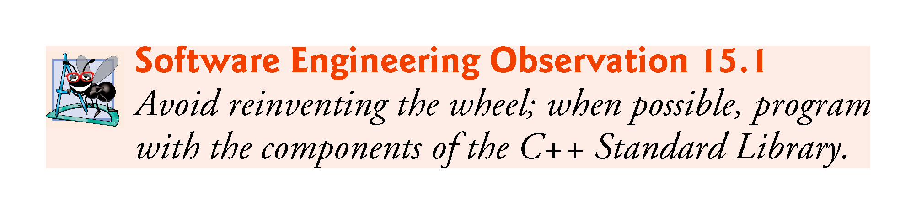

Slide 12
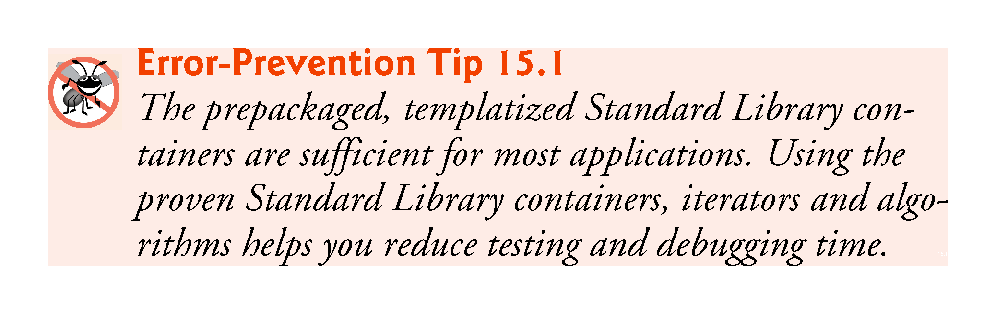

Slide 13


Slide 14
15.2 Introduction to Containers
The Standard Library container types are shown in Fig. 15.1.
The containers are divided into four major categories—sequence containers, ordered associative containers, unordered associative containers and container adapters.

Slide 15
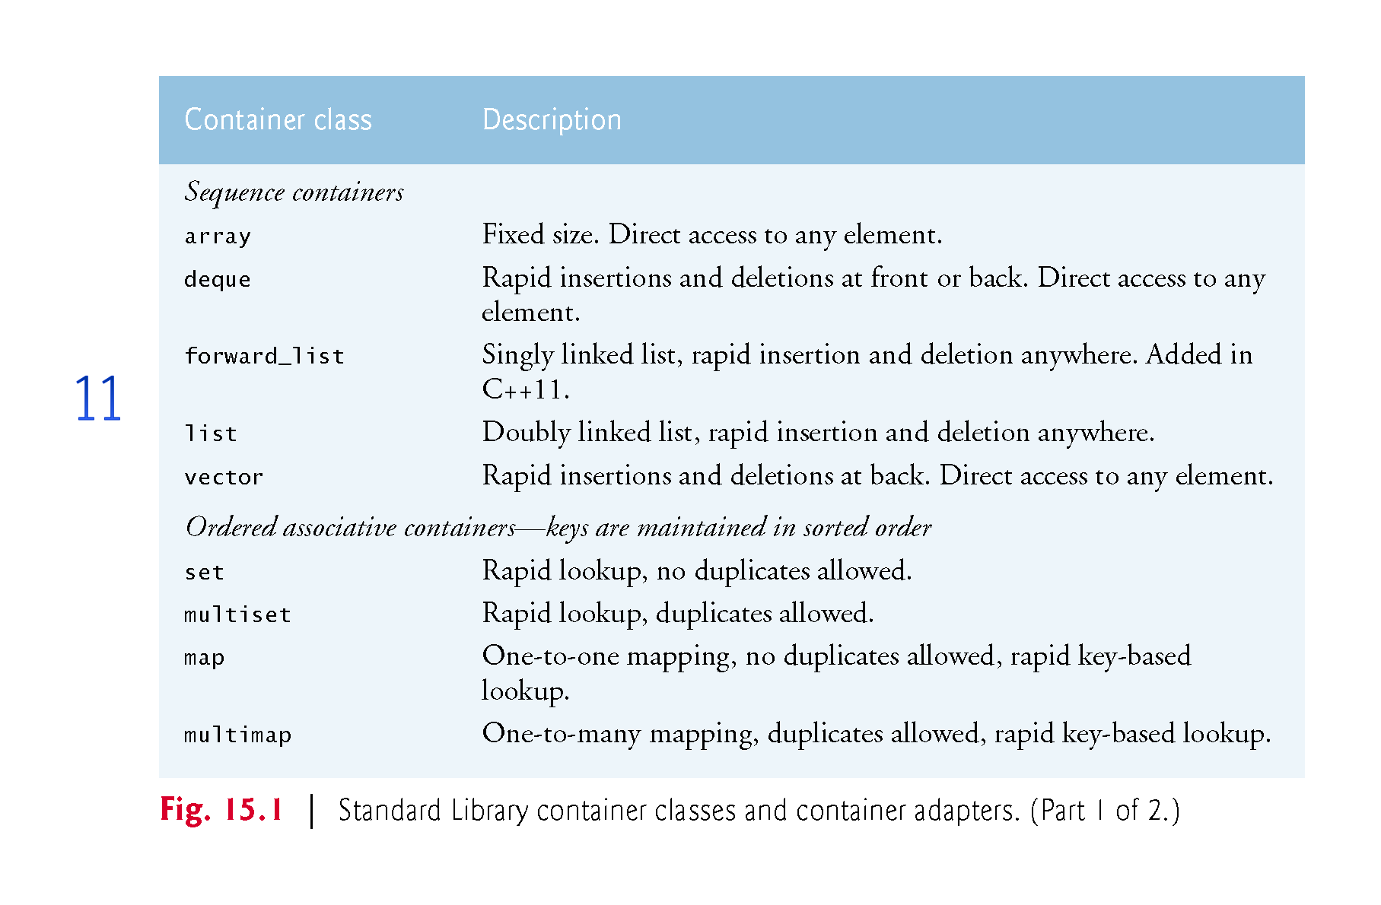

Slide 16
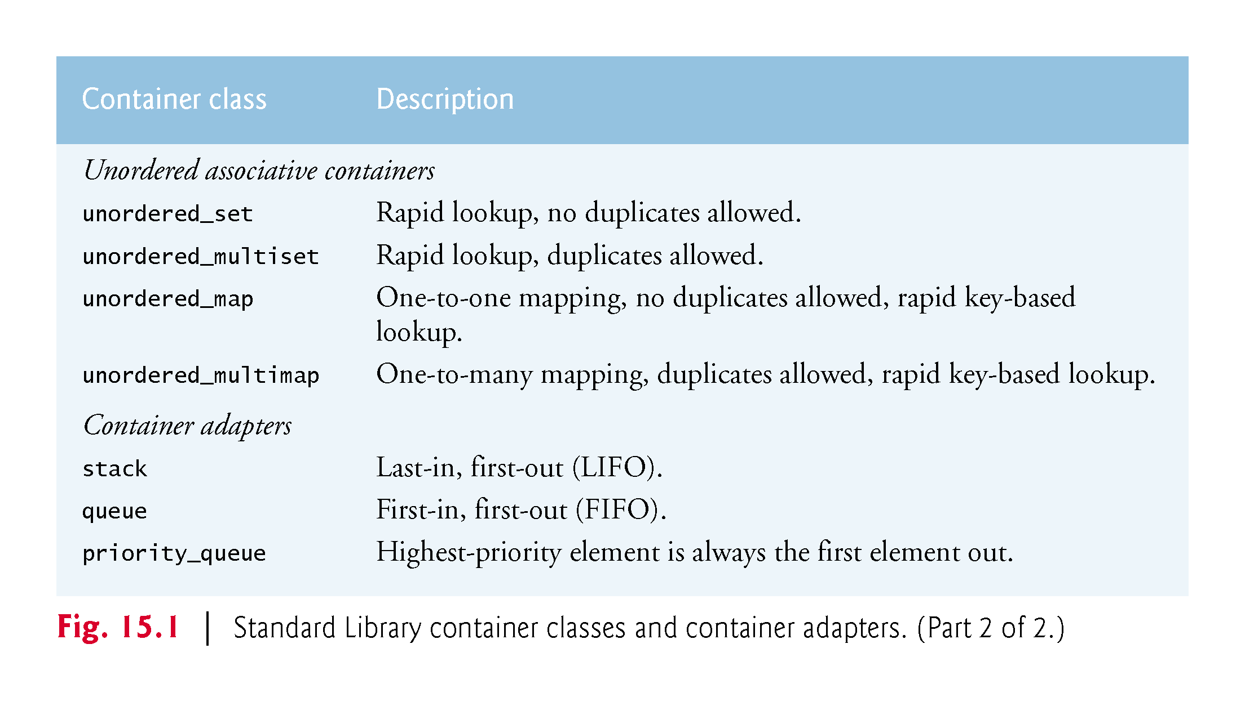

Slide 17
15.2 Introduction to Containers (cont.)
Containers Overview
The sequence containers represent linear data structures (i.e., all of their elements are conceptually “lined up in a row”), such as arrays, vectors and linked lists.
Associative containers are nonlinear data structures that typically can locate elements stored in the containers quickly.
Such containers can store sets of values or key-value pairs.
As of C++11, the keys in associative containers are immutable (they cannot be modified).

Slide 18
15.2 Introduction to Containers (cont.)
The sequence containers and associative containers are collectively referred to as the first-class containers.
Stacks and queues are typically constrained versions of sequence containers.
For this reason, the Standard Library implements class templates stacks, queue and priority_queue as container adapters that enable a program to view a sequence container in a constrained manner.
Class string supports the same functionality as a sequence container, but stores only character data.

Slide 19
15.2 Introduction to Containers (cont.)
Near Containers
There are other container types that are considered near containers—built-in arrays, bitsets for maintaining sets of flag values and valarrays for performing high-speed mathematical vector operations (not to be confused with the vector container).
These types are considered near containers because they exhibit some, but not all, capabilities of the first-class containers.

Slide 20
15.2 Introduction to Containers (cont.)
Common Container Functions
Most containers provide similar functionality.
Many operations apply to all containers, and other operations apply to subsets of similar containers.
Figure 15.2 describes the many functions that are commonly available in most Standard Library containers.
Overloaded operators <, <=, >, >=, == and != perform element by element comparisons.
These are not provided for priority_queues.

Slide 21
15.2 Introduction to Containers (cont.)
Overloaded operators <, <=, >, >= are not provided for the unordered associative containers.
Member functions rbegin, rend, crbegin and crend are not available in a forward_list.
Before using any container, you should study its capabilities.

Slide 22
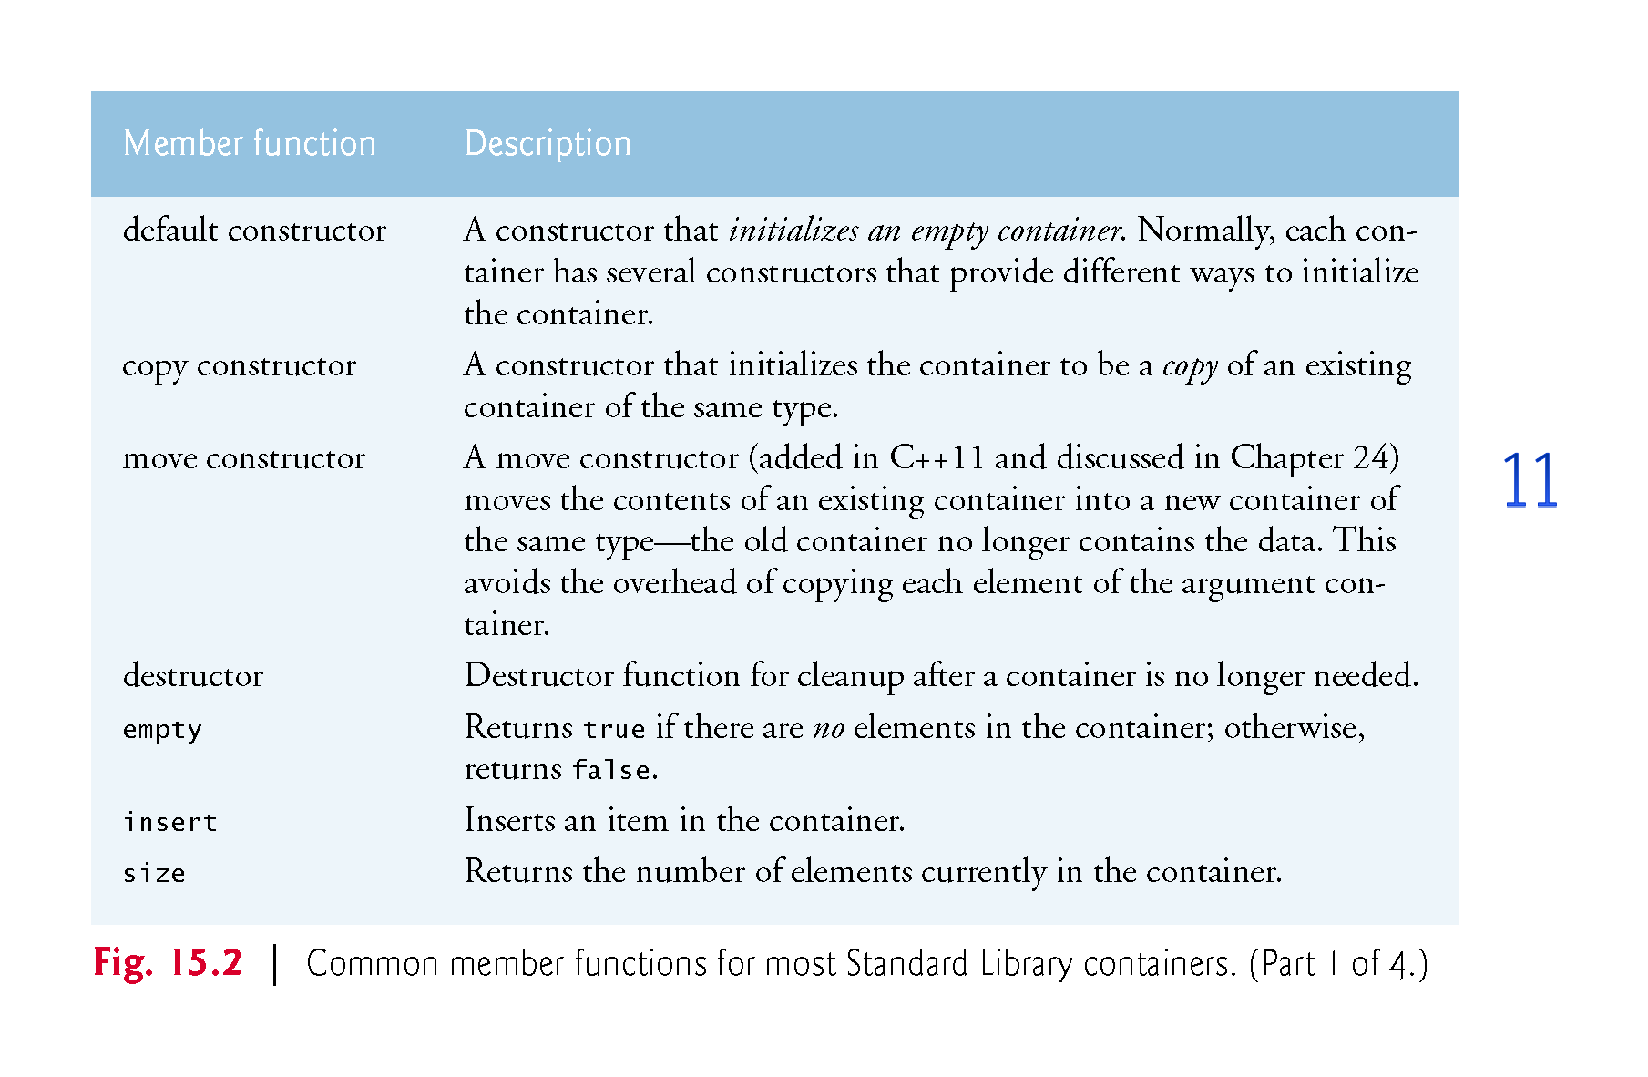

Slide 23
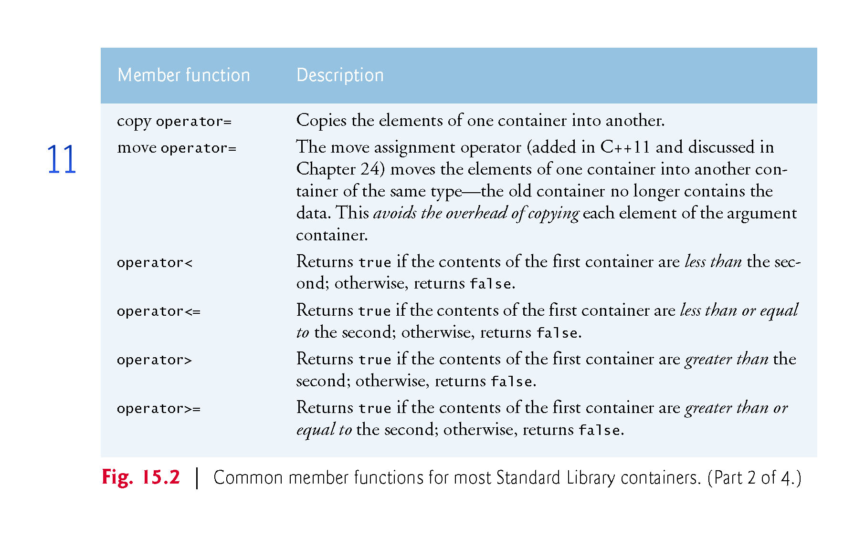

Slide 24
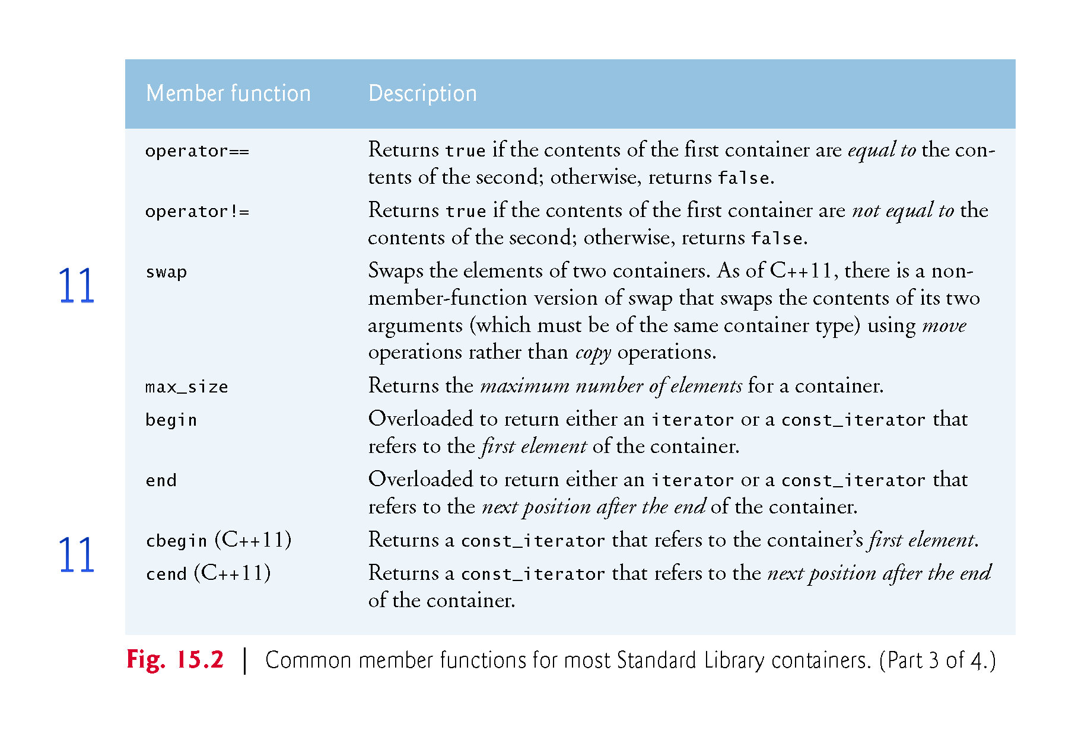

Slide 25
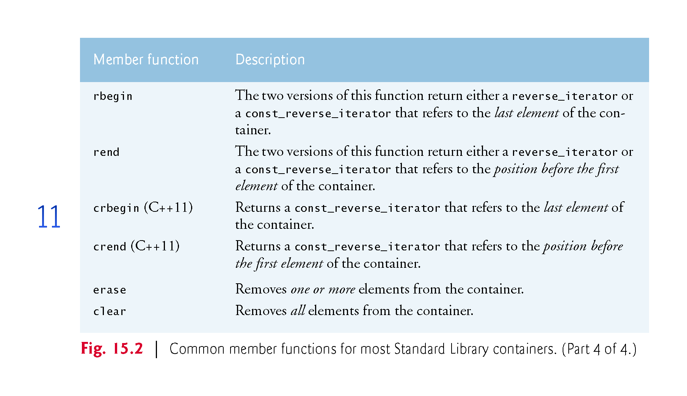

Slide 26
15.2 Introduction to Containers (cont.)
First-Class Container Common Nested Types
Figure 15.3 shows the common first-class container nested types (types defined inside each container class definition).
These are used in template-based declarations of variables, parameters to functions and return values from functions (as you’ll see in this chapter and Chapter 16).
For example, value_type in each container always represents the type of elements stored in the container.
The types reverse_iterator and const_reverse_iterator are not provided by class forward_list.

Slide 27
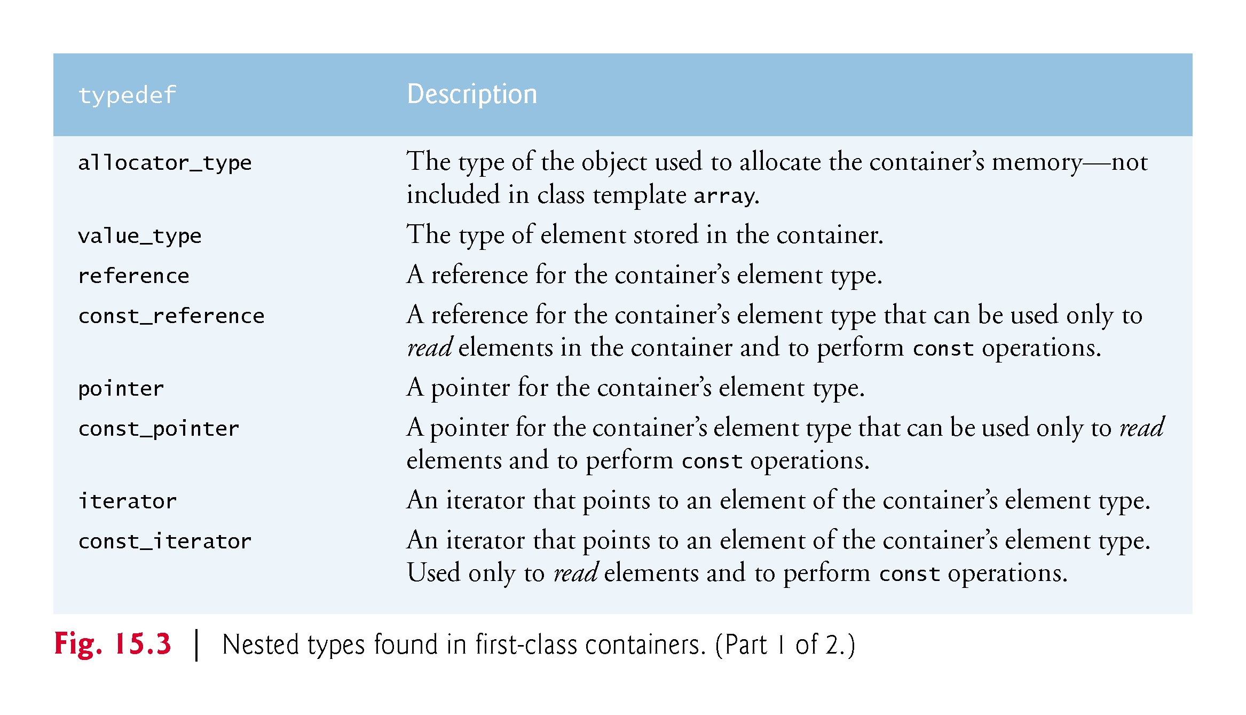

Slide 28
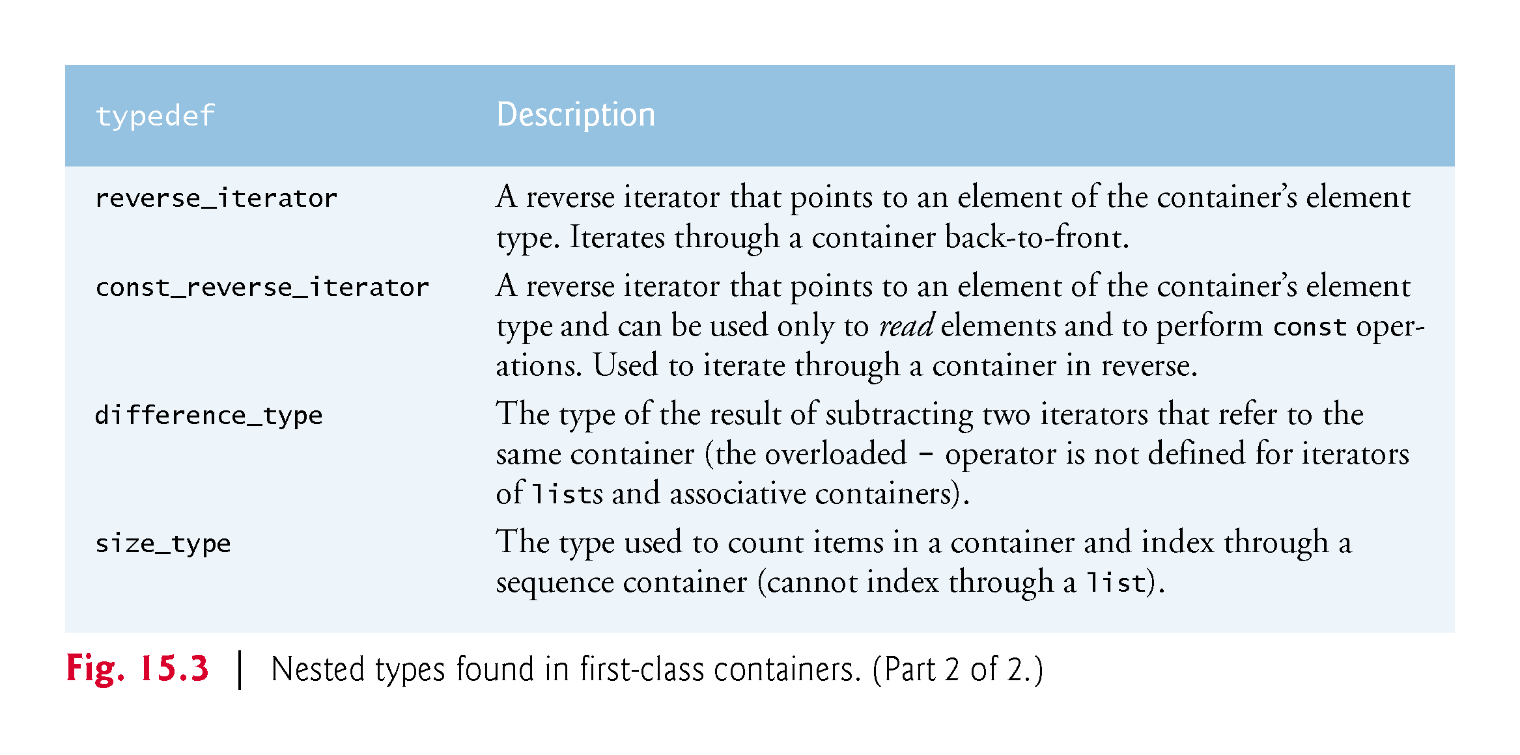

Slide 29
15.2 Introduction to Containers (cont.)
Requirements for Container Elements
Before using a Standard Library container, it’s important to ensure that the type of objects being stored in the container supports a minimum set of functionality.
When an object is inserted into a container, a copy of the object is made.
For this reason, the object type should provide a copy constructor and copy assignment operator (custom or default versions, depending on whether the class uses dynamic memory).
[Note: This is required only if default memberwise copy and default memberwise assignment do not perform proper copy and assignment operations for the element type.]

Slide 30
15.2 Introduction to Containers (cont.)
Also, the ordered associative containers and many algorithms require elements to be compared—for this reason, the object type should provide less than (<) and equality (==) operators.
As of C++11, objects can also be moved into container elements, in which case the object type needs a move constructor and move assignment operator—Chapter 24 discusses move semantics.

Slide 31
15.3 Introduction to Iterators
Iterators have many similarities to pointers and are used to point to first-class container elements and for other purposes.
Iterators hold state information sensitive to the particular containers on which they operate; thus, iterators are implemented for each type of container.
Certain iterator operations are uniform across containers.
For example, the dereferencing operator (*) dereferences an iterator so that you can use the element to which it points.
The ++ operation on an iterator moves it to the container’s next element (much as incrementing a pointer into a built-in array aims the pointer at the next array element.

Slide 32
15.3 Introduction to Iterators (cont.)
First-class containers provide member functions begin and end.
Function begin returns an iterator pointing to the first element of the container.
Function end returns an iterator pointing to the first element past the end of the container (one past the end)—a non-existent element that’s frequently used to determine when the end of a container is reached.

Slide 33
15.3 Introduction to Iterators (cont.)
If iterator i points to a particular element, then ++i points to the “next” element and *i refers to the element pointed to by i.
The iterator resulting from end is typically used in an equality or inequality comparison to determine whether the “moving iterator” (i in this case) has reached the end of the container.
An object of a container’s iterator type refers to a container element that can be modified.
An object of a container’s const_iterator type refers to a container element that cannot be modified.

Slide 34
15.3 Introduction to Iterators (cont.)
Using istream_iterator for Input and ostream_iterator for Output
We use iterators with sequences (also called ranges).
These sequences can be in containers, or they can be input sequences or output sequences.
The program of Fig. 15.4 demonstrates input from the standard input (a sequence of data for input into a program), using an istream_iterator, and output to the standard output (a sequence of data for output from a program), using an ostream_iterator.
The program inputs two integers from the user at the keyboard and displays the sum of the integers.

Slide 35
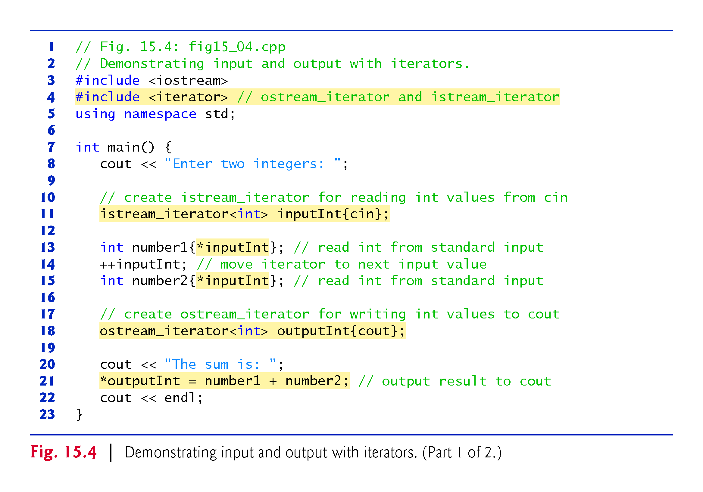

Slide 36
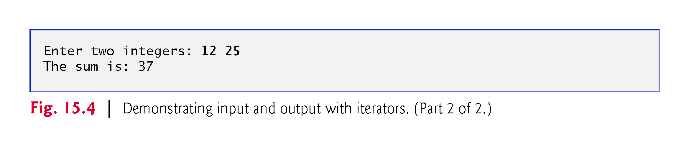

Slide 37
15.3 Introduction to Iterators (cont.)
istream_iterator
Line 11 creates an istream_iterator that is capable of extracting (inputting) int values from the standard input object cin.
Line 13 dereferences iterator inputInt to read the first integer from cin and assigns that integer to number1.
The dereferencing operator * applied to inputInt gets the value from the stream associated with inputInt; this is similar to dereferencing a pointer.
Line 14 positions iterator inputInt to the next value in the input stream.
Line 15 inputs the next integer from inputInt and assigns it to number2.

Slide 38
15.3 Introduction to Iterators (cont.)
ostream_iterator
Line 18 creates an ostream_iterator that is capable of inserting (outputting) int values in the standard output object cout.
Line 21 outputs an integer to cout by assigning to *outputInt the sum of number1 and number2.
Notice that we use the dereferenced outputInt iterator as an lvalue in the assignment statement.
If you want to output another value using outputInt, the iterator must be incremented with ++ first.
Either the prefix or postfix increment can be used—we use the prefix form for performance reasons because it does not create a temporary object).

Slide 39
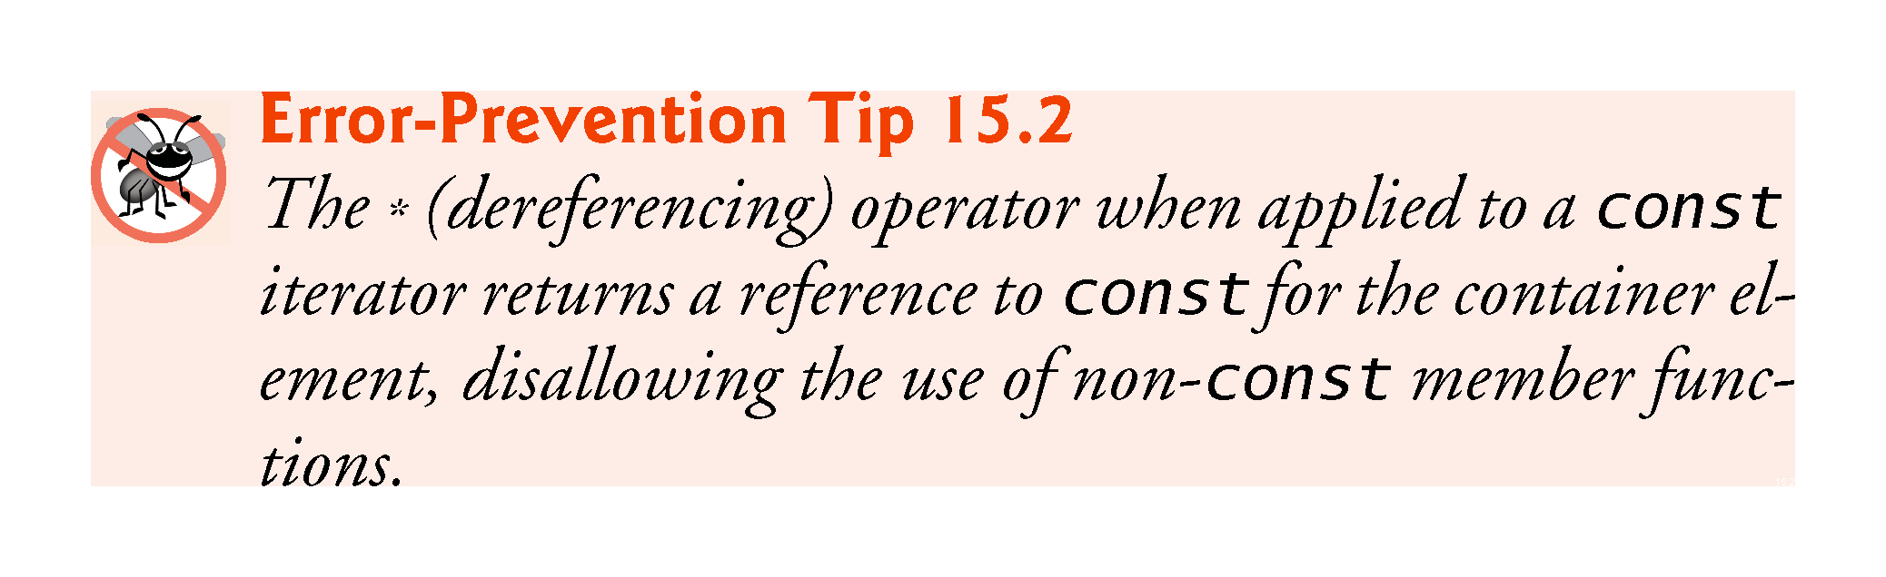

Slide 40
15.3 Introduction to Iterators (cont.)
Iterator Categories and Iterator Category Hierarchy
Figure 15.5 shows the iterator categories.
Each category provides a specific set of functionality.
Figure 15.6 illustrates the hierarchy of iterator categories.
As you follow the hierarchy from bottom to top, each iterator category supports all the functionality of the categories below it in the figure.
Thus the “weakest” iterator types are at the bottom and the most powerful one is at the top.
Note that this is not an inheritance hierarchy.

Slide 41
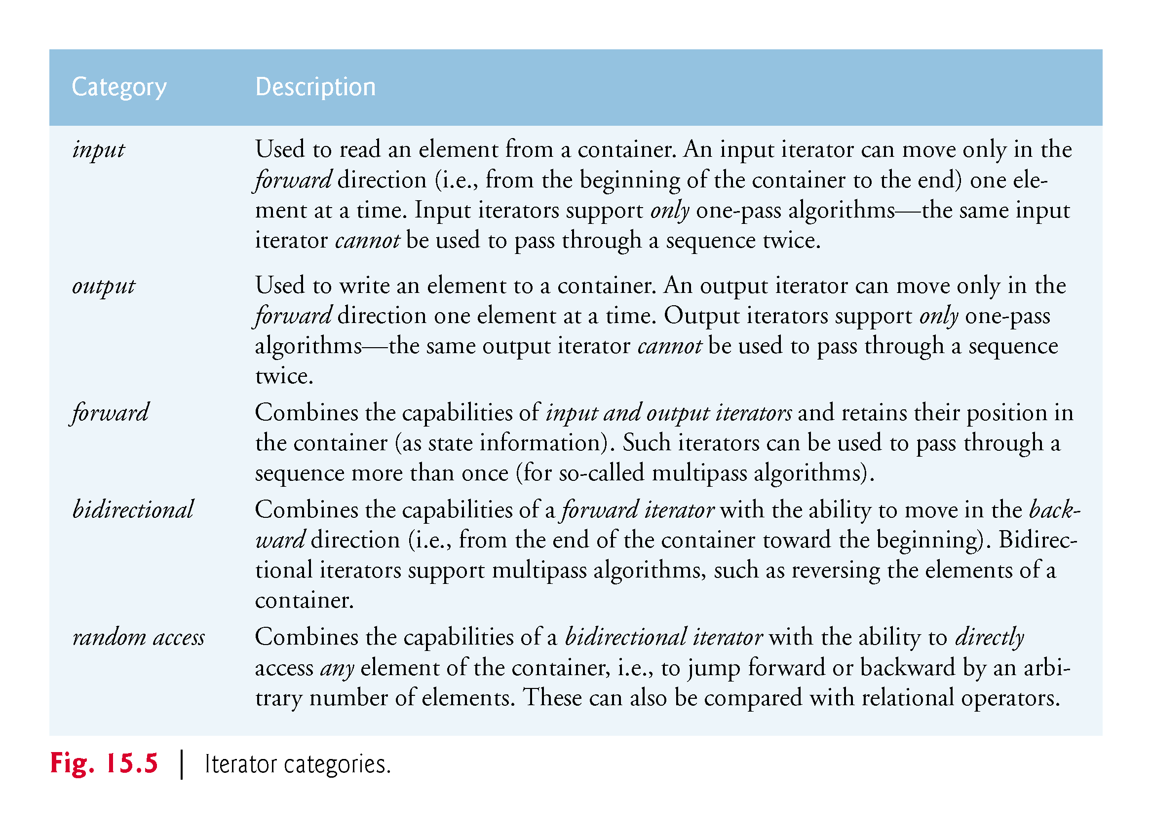

Slide 42
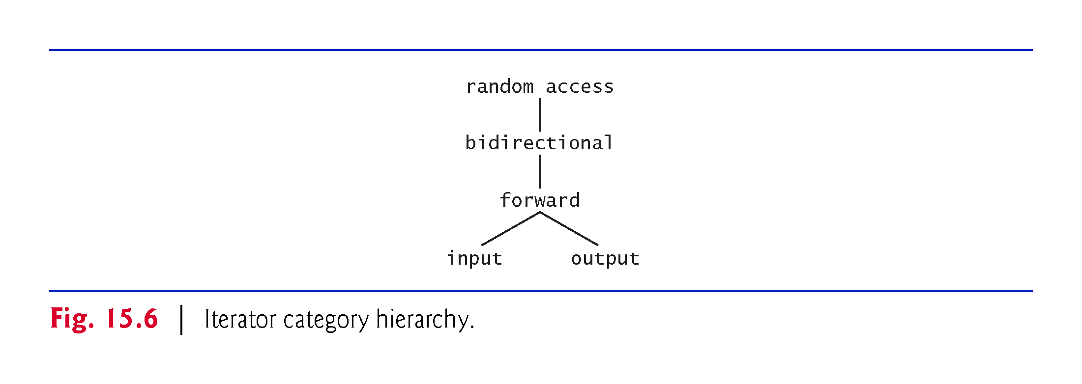

Slide 43
15.3 Introduction to Iterators (cont.)
Container Support for Iterators
The iterator category that each container supports determines whether that container can be used with specific algorithms.
Containers that support random-access iterators can be used with all Standard Library algorithms—with the exception that if an algorithm requires changes to a container’s size, the algorithm can’t be used on built-in arrays or array objects.
Pointers into built-in arrays can be used in place of iterators with most algorithms.
Figure 15.7 shows the iterator category of each container. The first-class containers, strings and built-in arrays are all traversable with iterators.

Slide 44
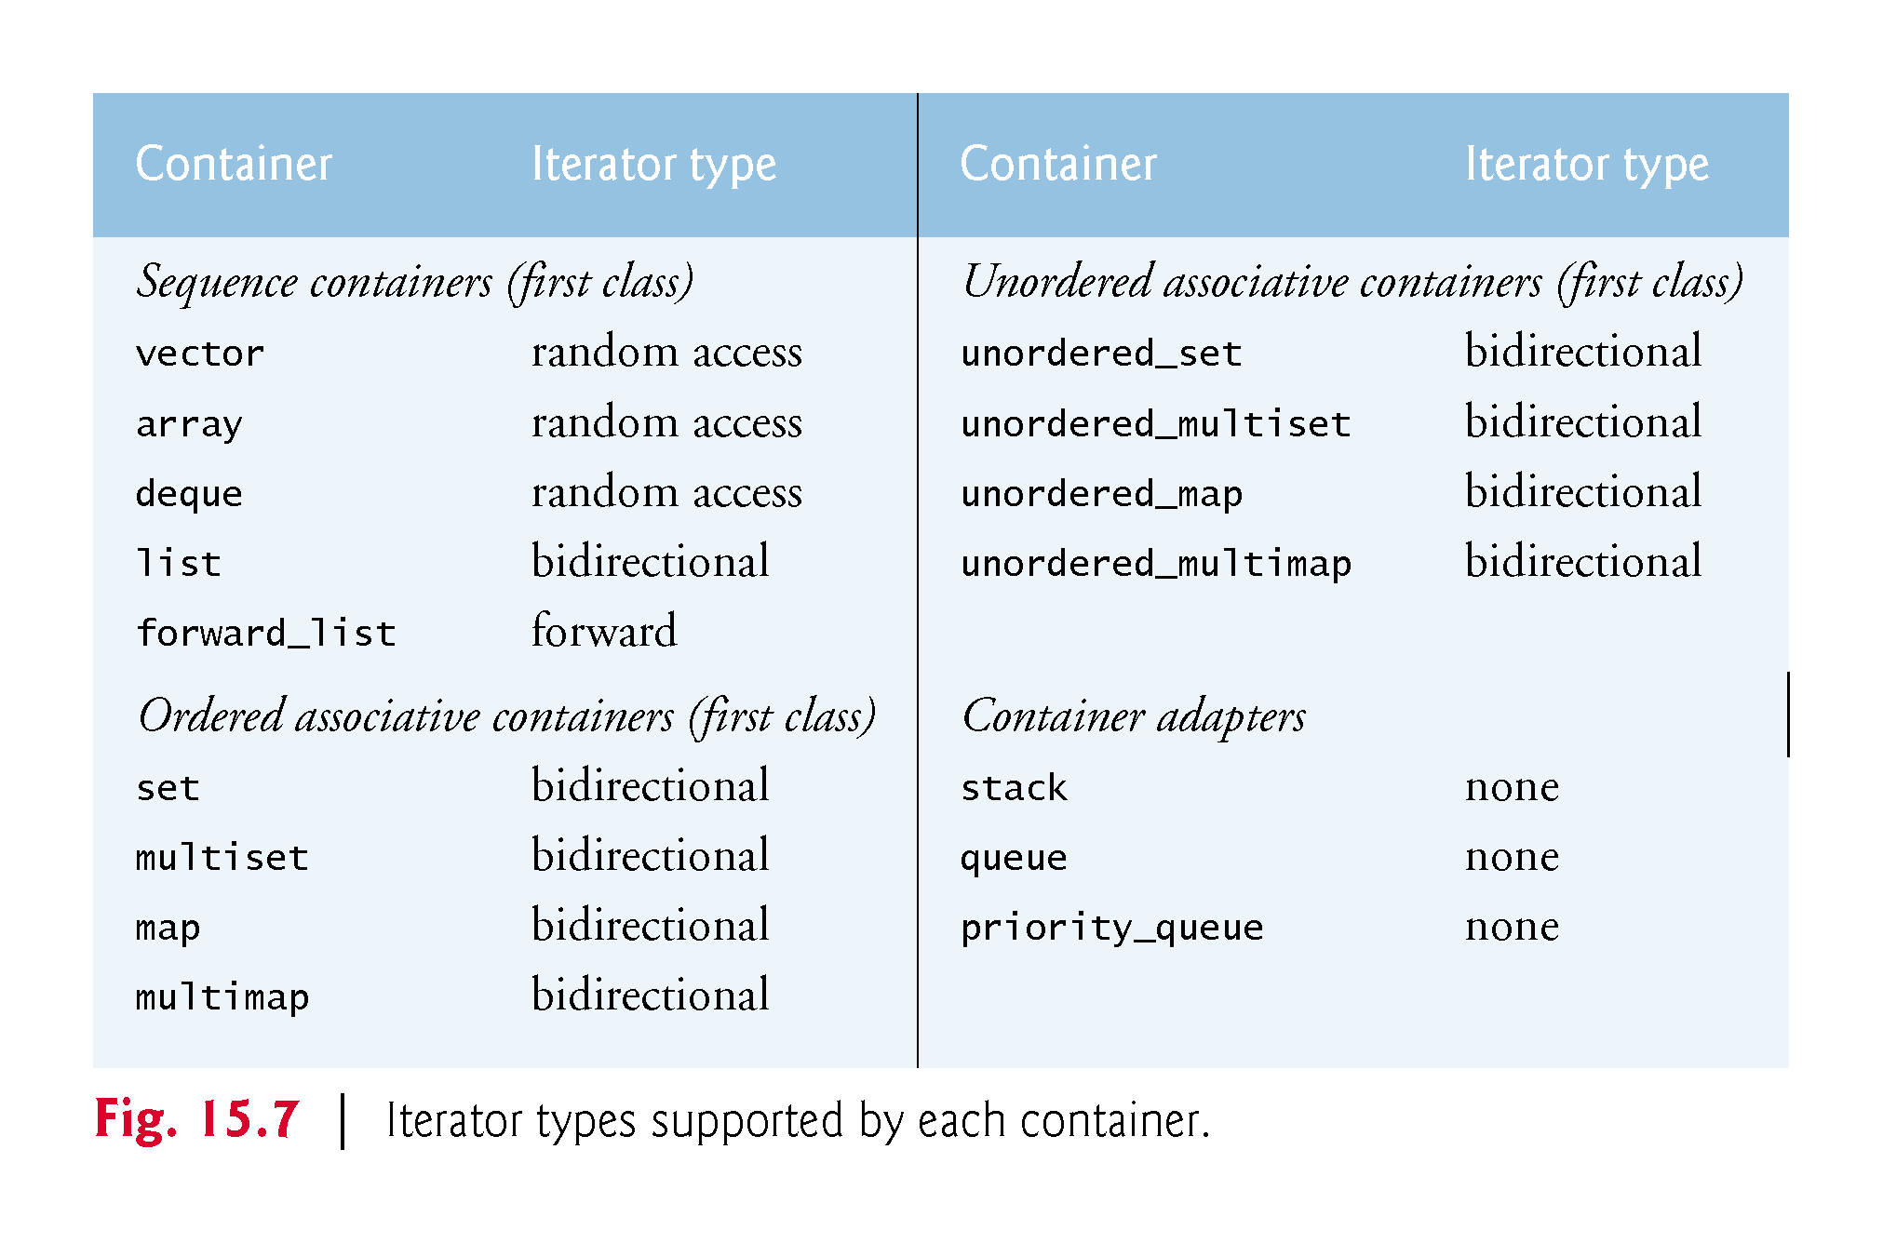

Slide 45
15.3 Introduction to Iterators (cont.)
Predefined Iterator typedefs
Figure 15.8 shows the predefined iterator typedefs that are found in Standard Library container class definitions.
Not every typedef is defined for every container.
We use const versions of the iterators for traversing const containers or non-const containers that should not be modified.
We use reverse iterators to traverse containers in the reverse direction.

Slide 46
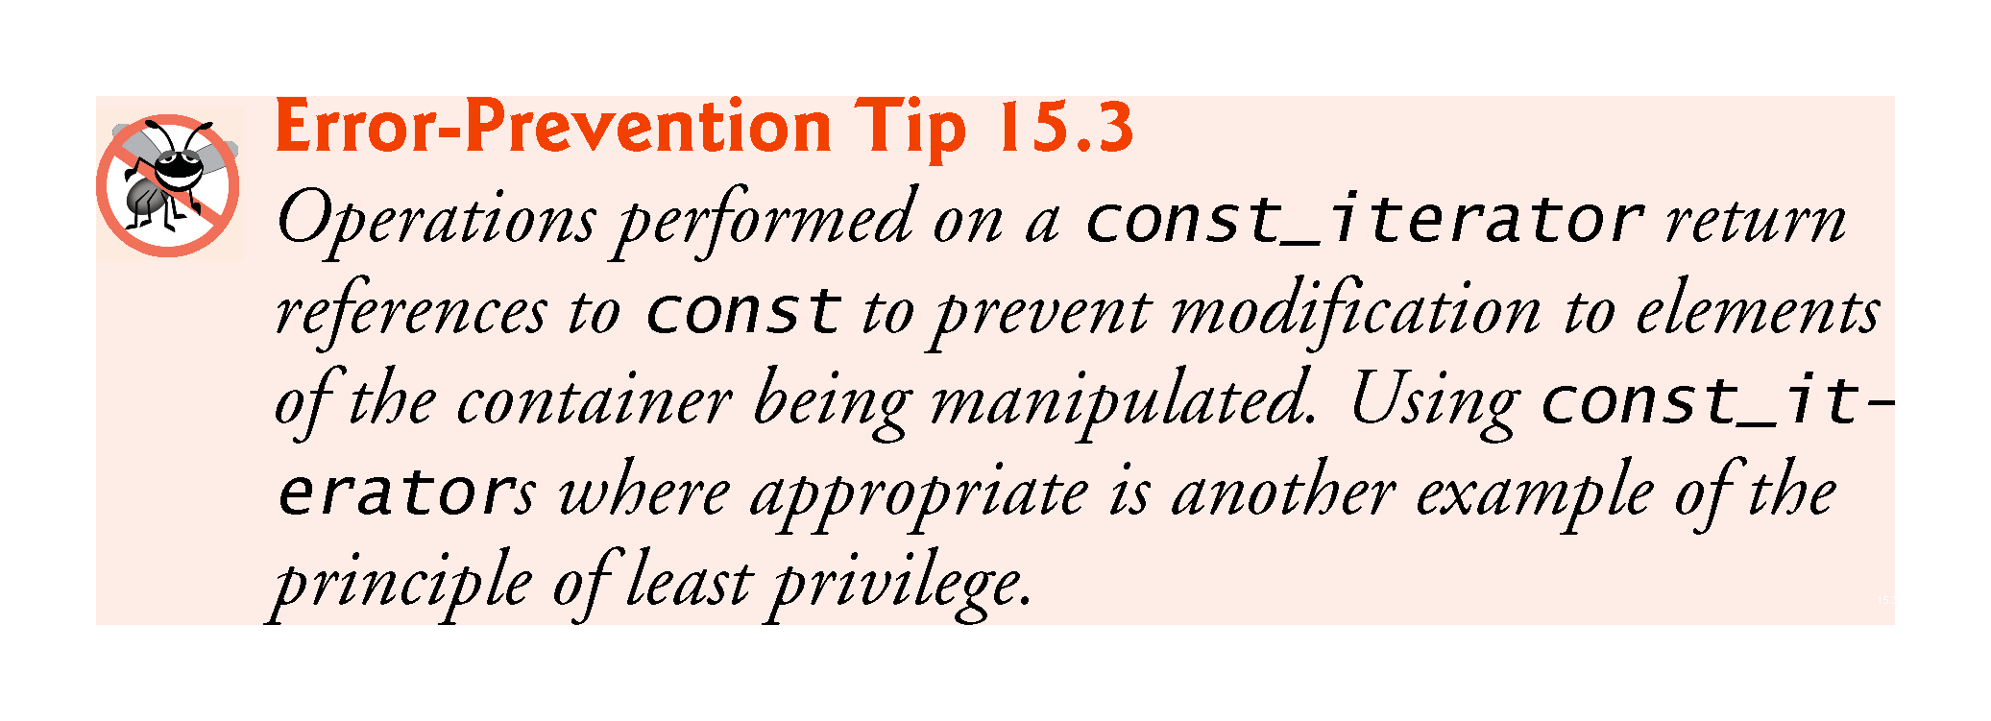

Slide 47
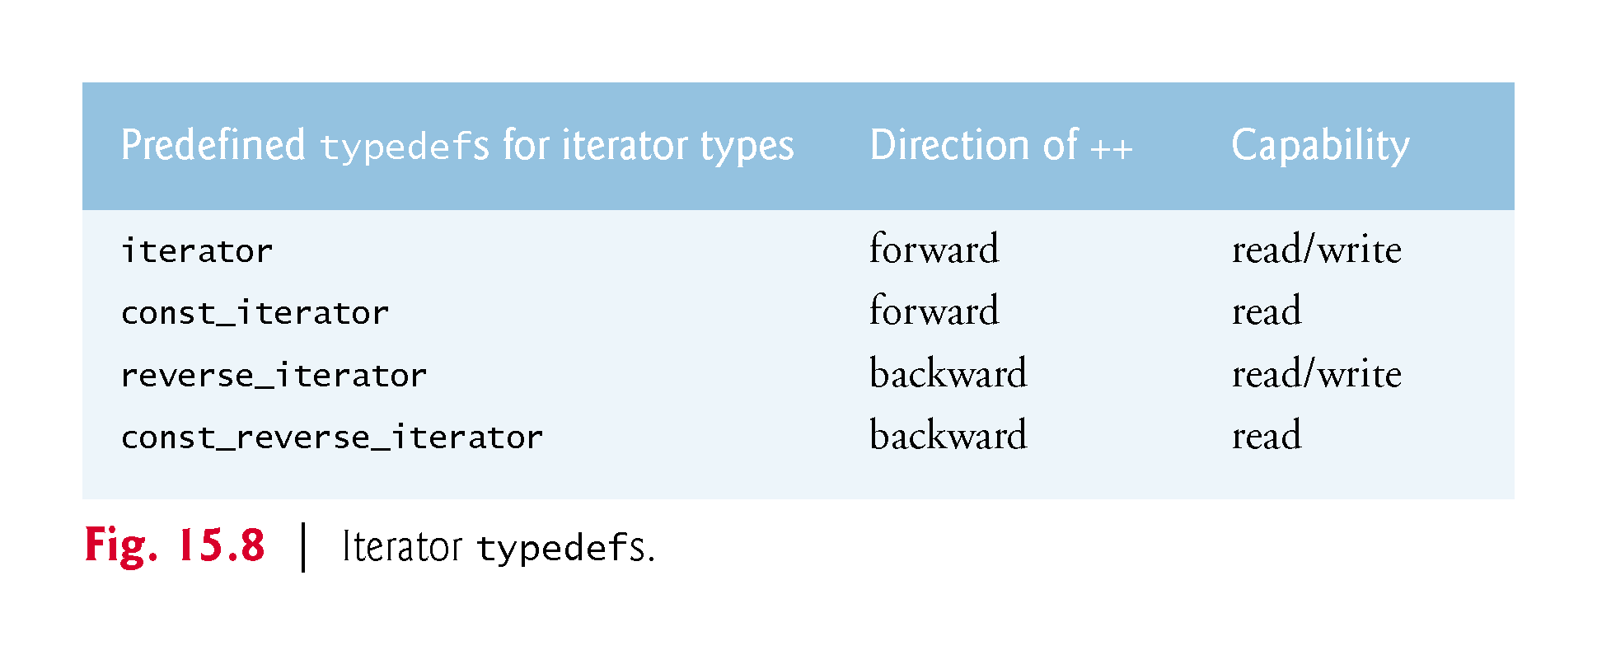

Slide 48
15.3 Introduction to Iterators (cont.)
Iterator Operations
Figure 15.9 shows some operations that can be performed on each iterator type.
Iterators must provide default constructors, copy constructors and copy assignment operators.
A forward iterator supports ++ and all of the input and output iterator capabilities.
A bidirectional iterator supports -- and all the capabilities of forward iterators.
A random access iterator supports all of the operations shown in the table.
For input iterators and output iterators, it’s not possible to save the iterator then use the saved value later.

Slide 49
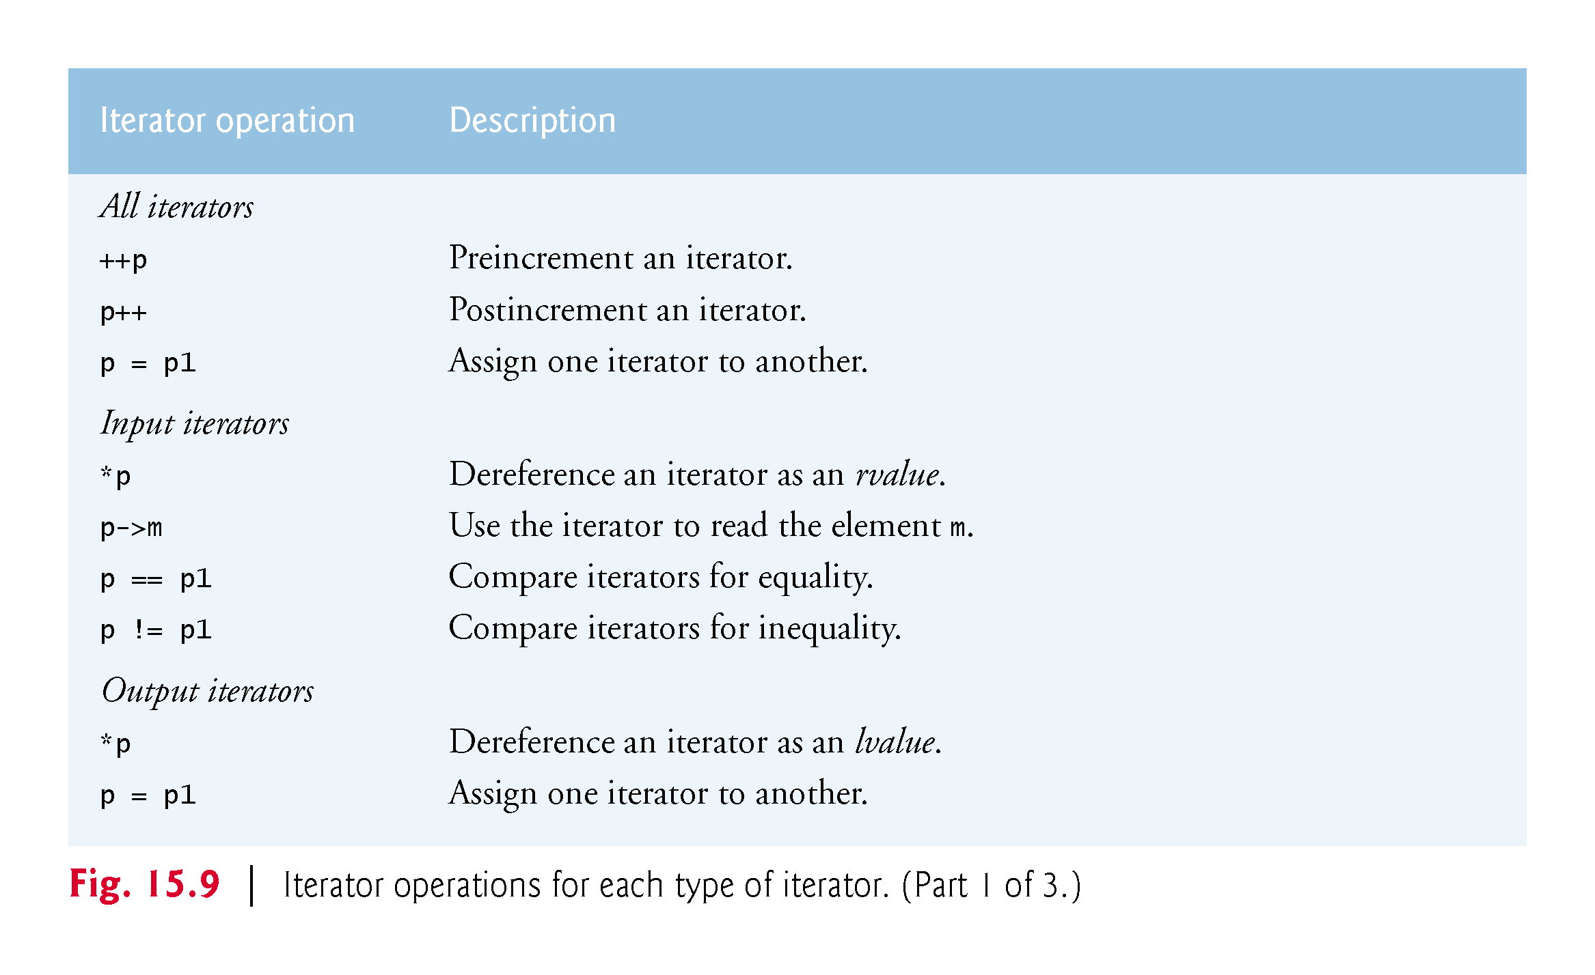

Slide 50
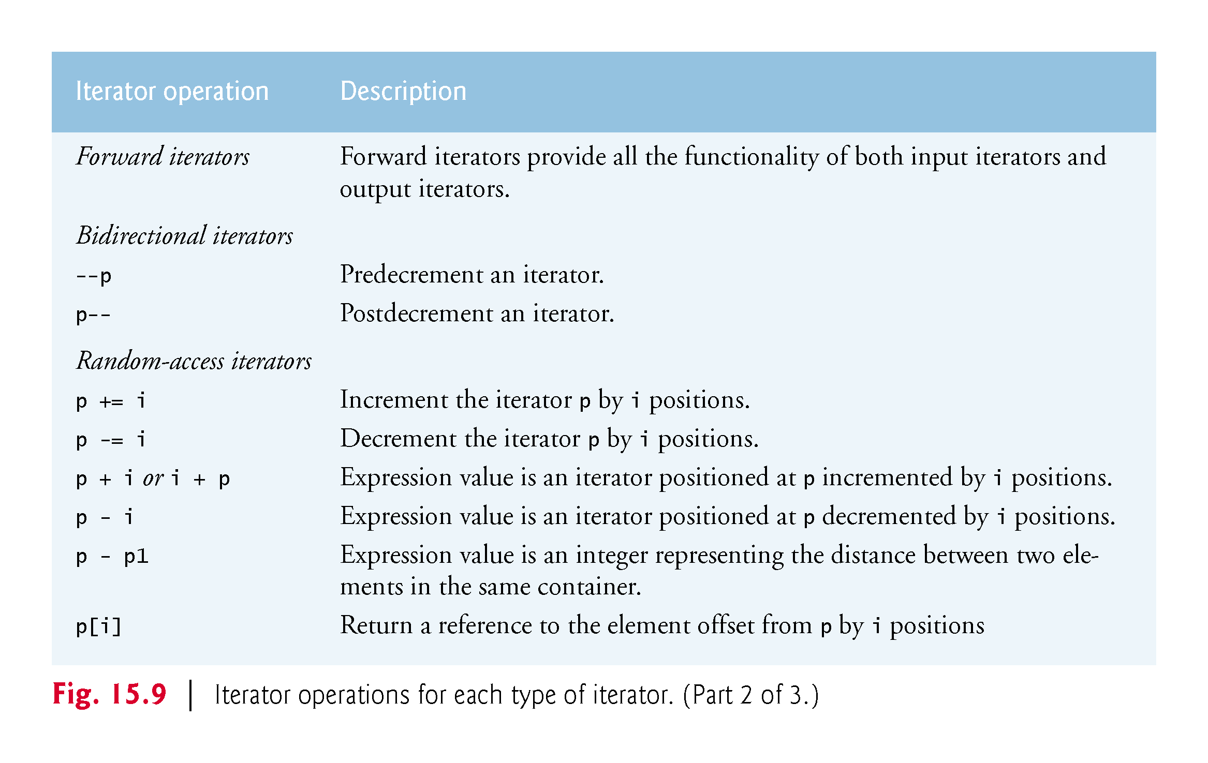

Slide 51
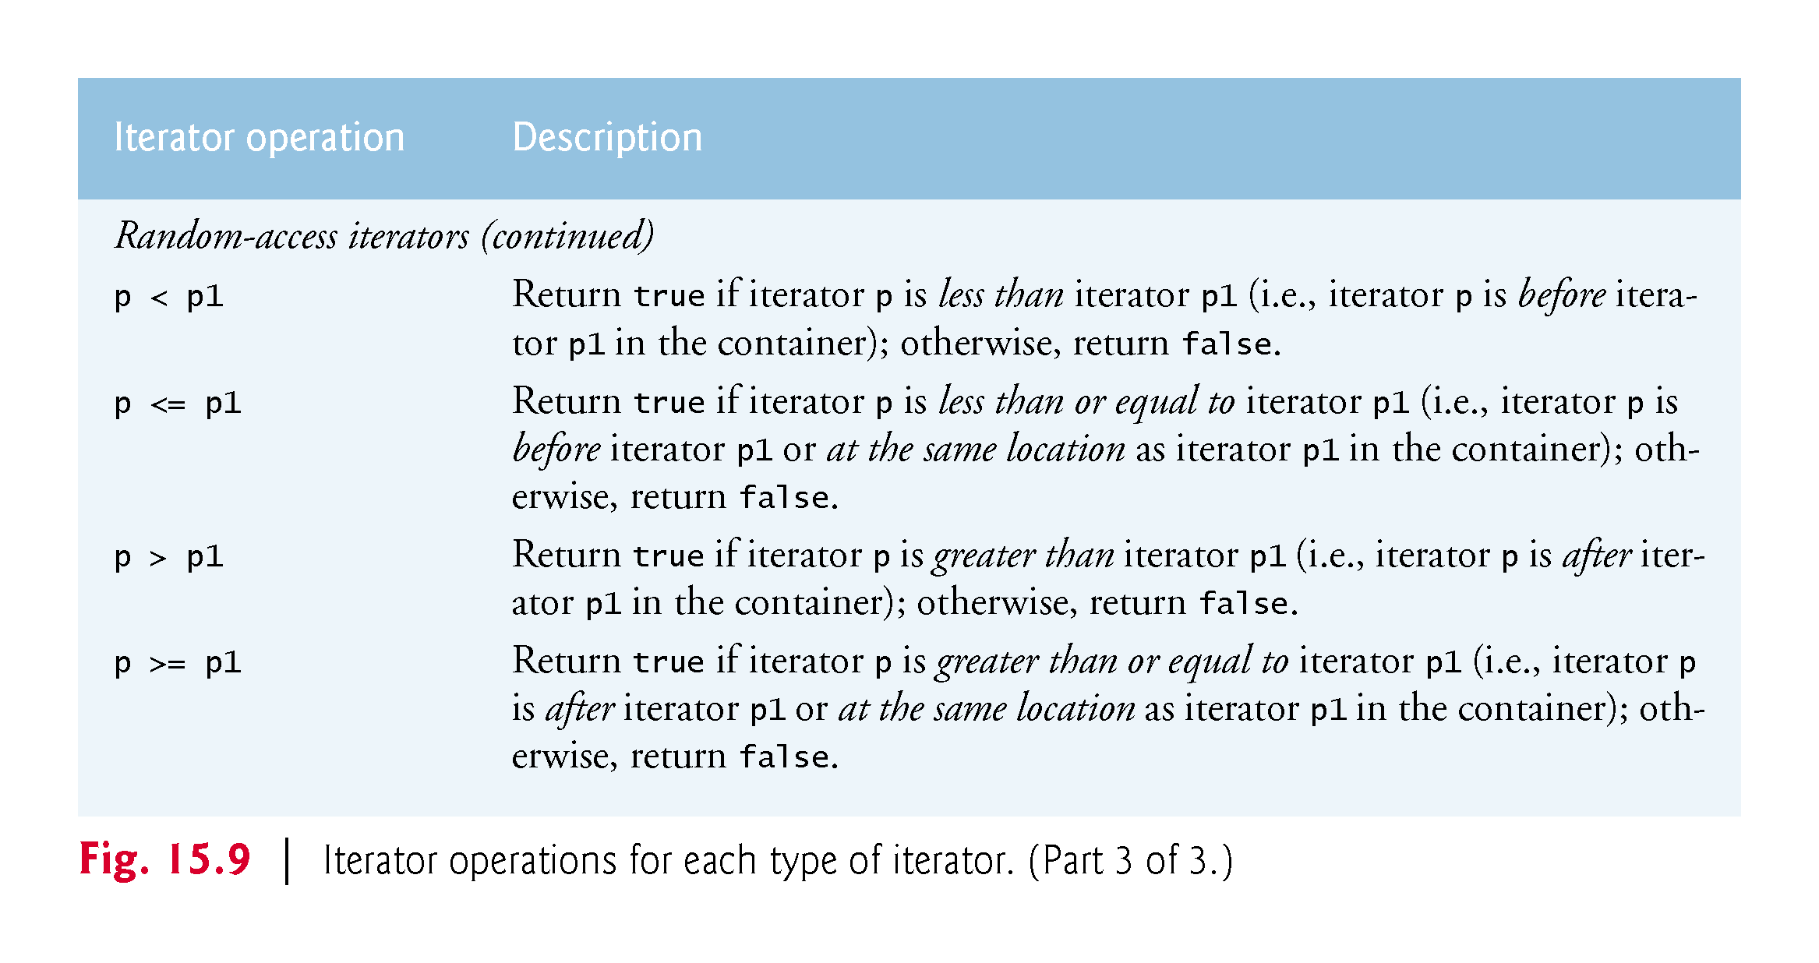

Slide 52
15.4 Introduction to Algorithms
The Standard Library provides scores of algorithms you’ll use frequently to manipulate a variety of containers.
Inserting, deleting, searching, sorting and others are appropriate for some or all of the sequence and associative containers.
The algorithms operate on container elements only indirectly through iterators.
Many algorithms operate on sequences of elements defined by iterators pointing to the first element of the sequence and to one element past the last element.

Slide 53
15.5 Sequence Containers
The C++ Standard Template Library provides five sequence containers—array, vector, deque, list and forward_list.
Class templates array, vector and deque are based on built-in arrays.
Class templates list and forward_list implement linked-list data structures, which we discuss in Chapter 19.

Slide 54
15.5 Sequence Containers (Cont.)
Performance and Choosing the Appropriate Container
Figure 15.2 presented the operations common to most of the Standard Library containers.
Beyond these operations, each container typically provides a variety of other capabilities.
Many of these are common to several containers, but they’re not always equally efficient for each container.

Slide 55
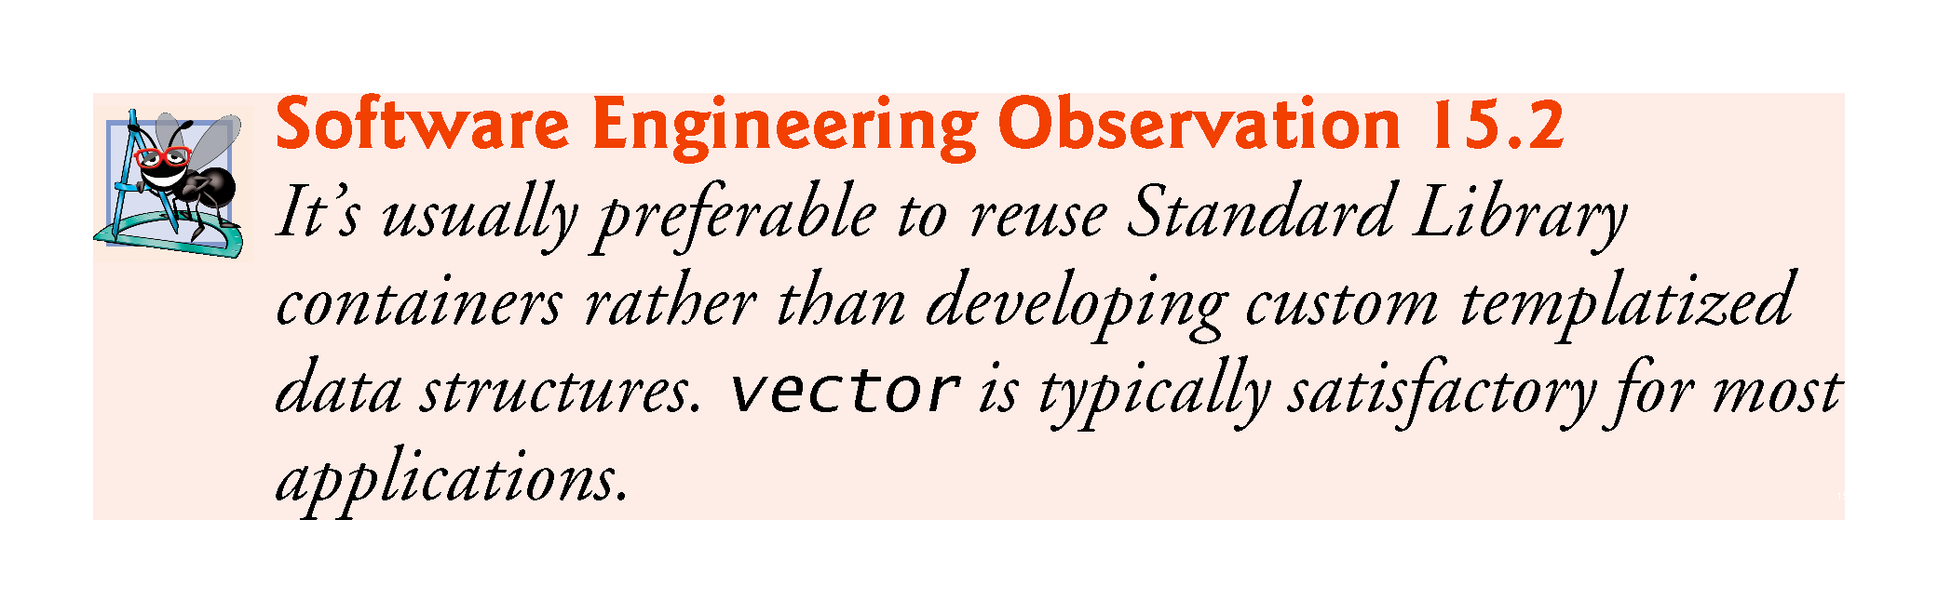

Slide 56
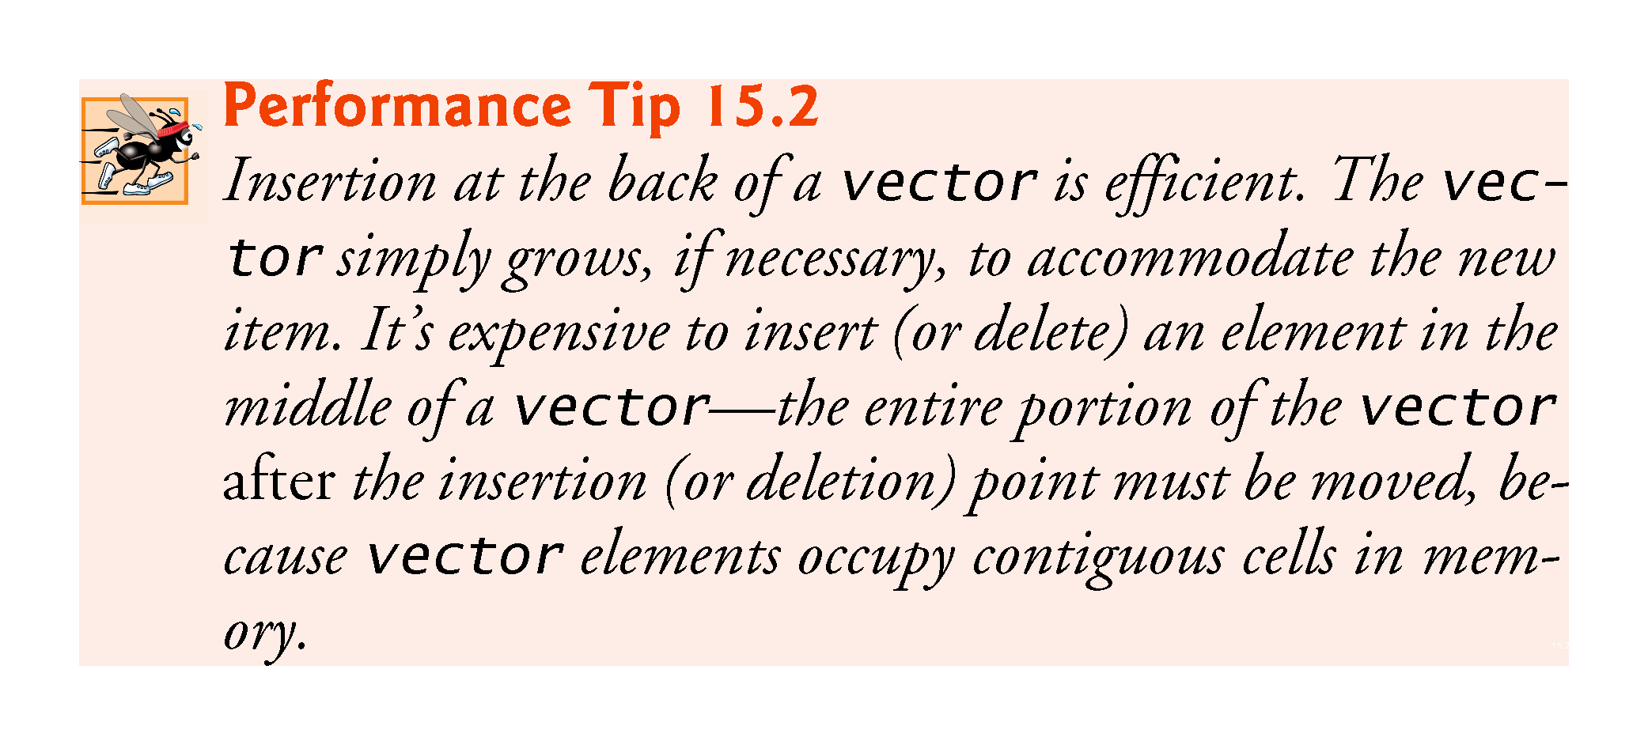

Slide 57
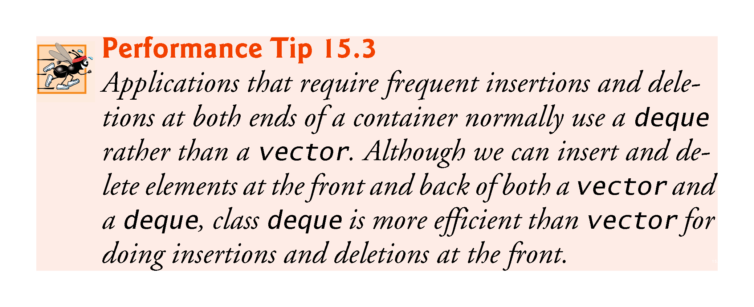

Slide 58
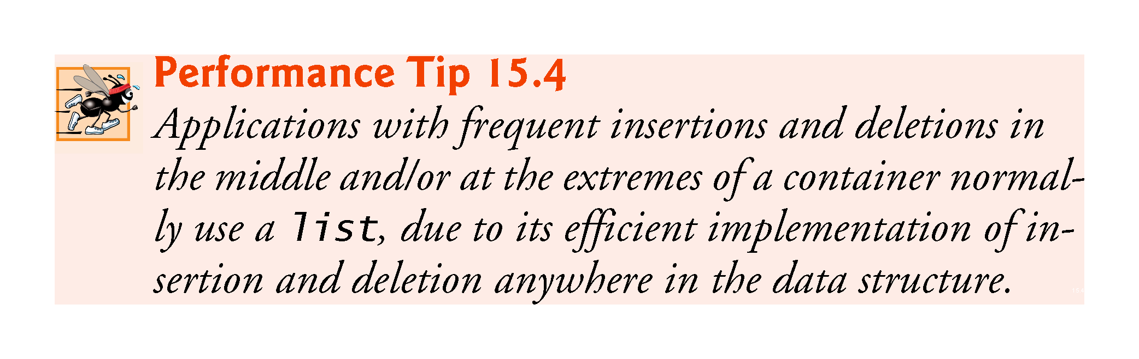

Slide 59
15.5.1 vector Sequence Container
Class template vector provides a data structure with contiguous memory locations.
This enables efficient, direct access to any element of a vector via the subscript operator [], exactly as with a built-in array.
Like class template array, template vector is most commonly used when the data in the container must be easily accessible via a subscript or will be sorted, and when the number of elements may need to grow.
When a vector’s memory is exhausted, the vector allocates a larger built-in array, copies (or moves) the original elements into the new built-in array and deallocates the old built-in array.

Slide 60


Slide 61
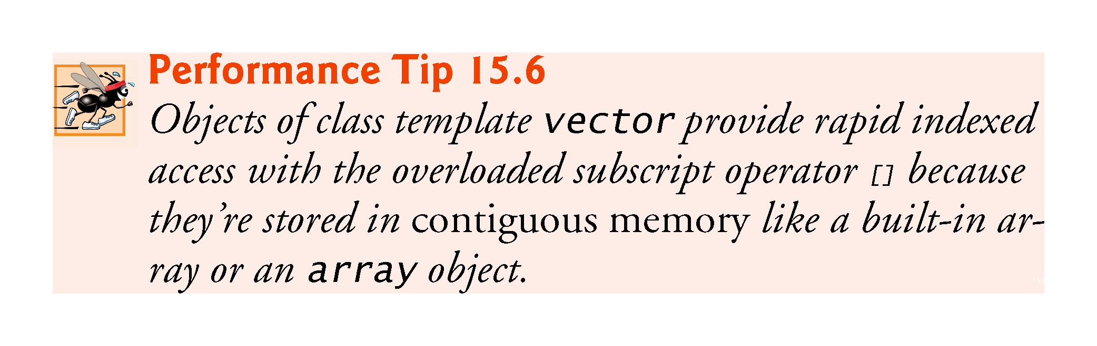

Slide 62
15.5.1 vector Sequence Container
Using vectors and Iterators
Figure 15.10 illustrates several functions of the vector class template.
Many of these functions are available in every first-class container.
You must include header <vector> to use class template vector.

Slide 63
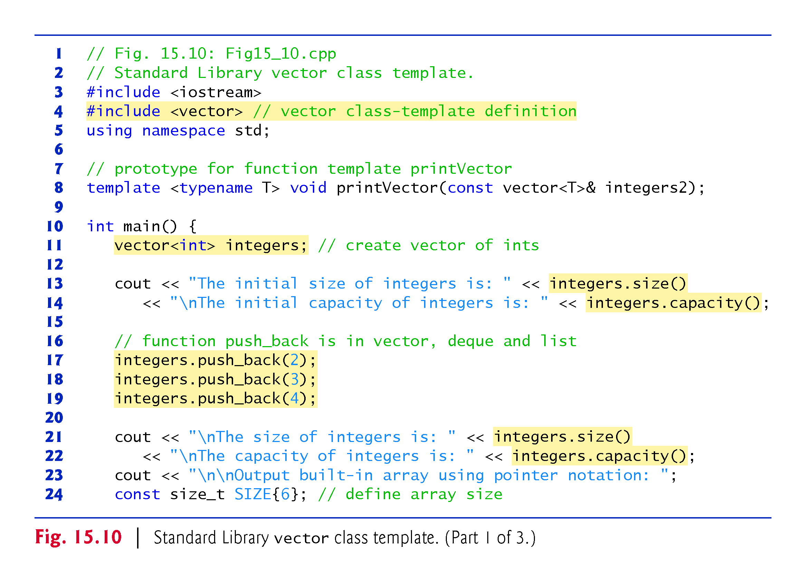

Slide 64
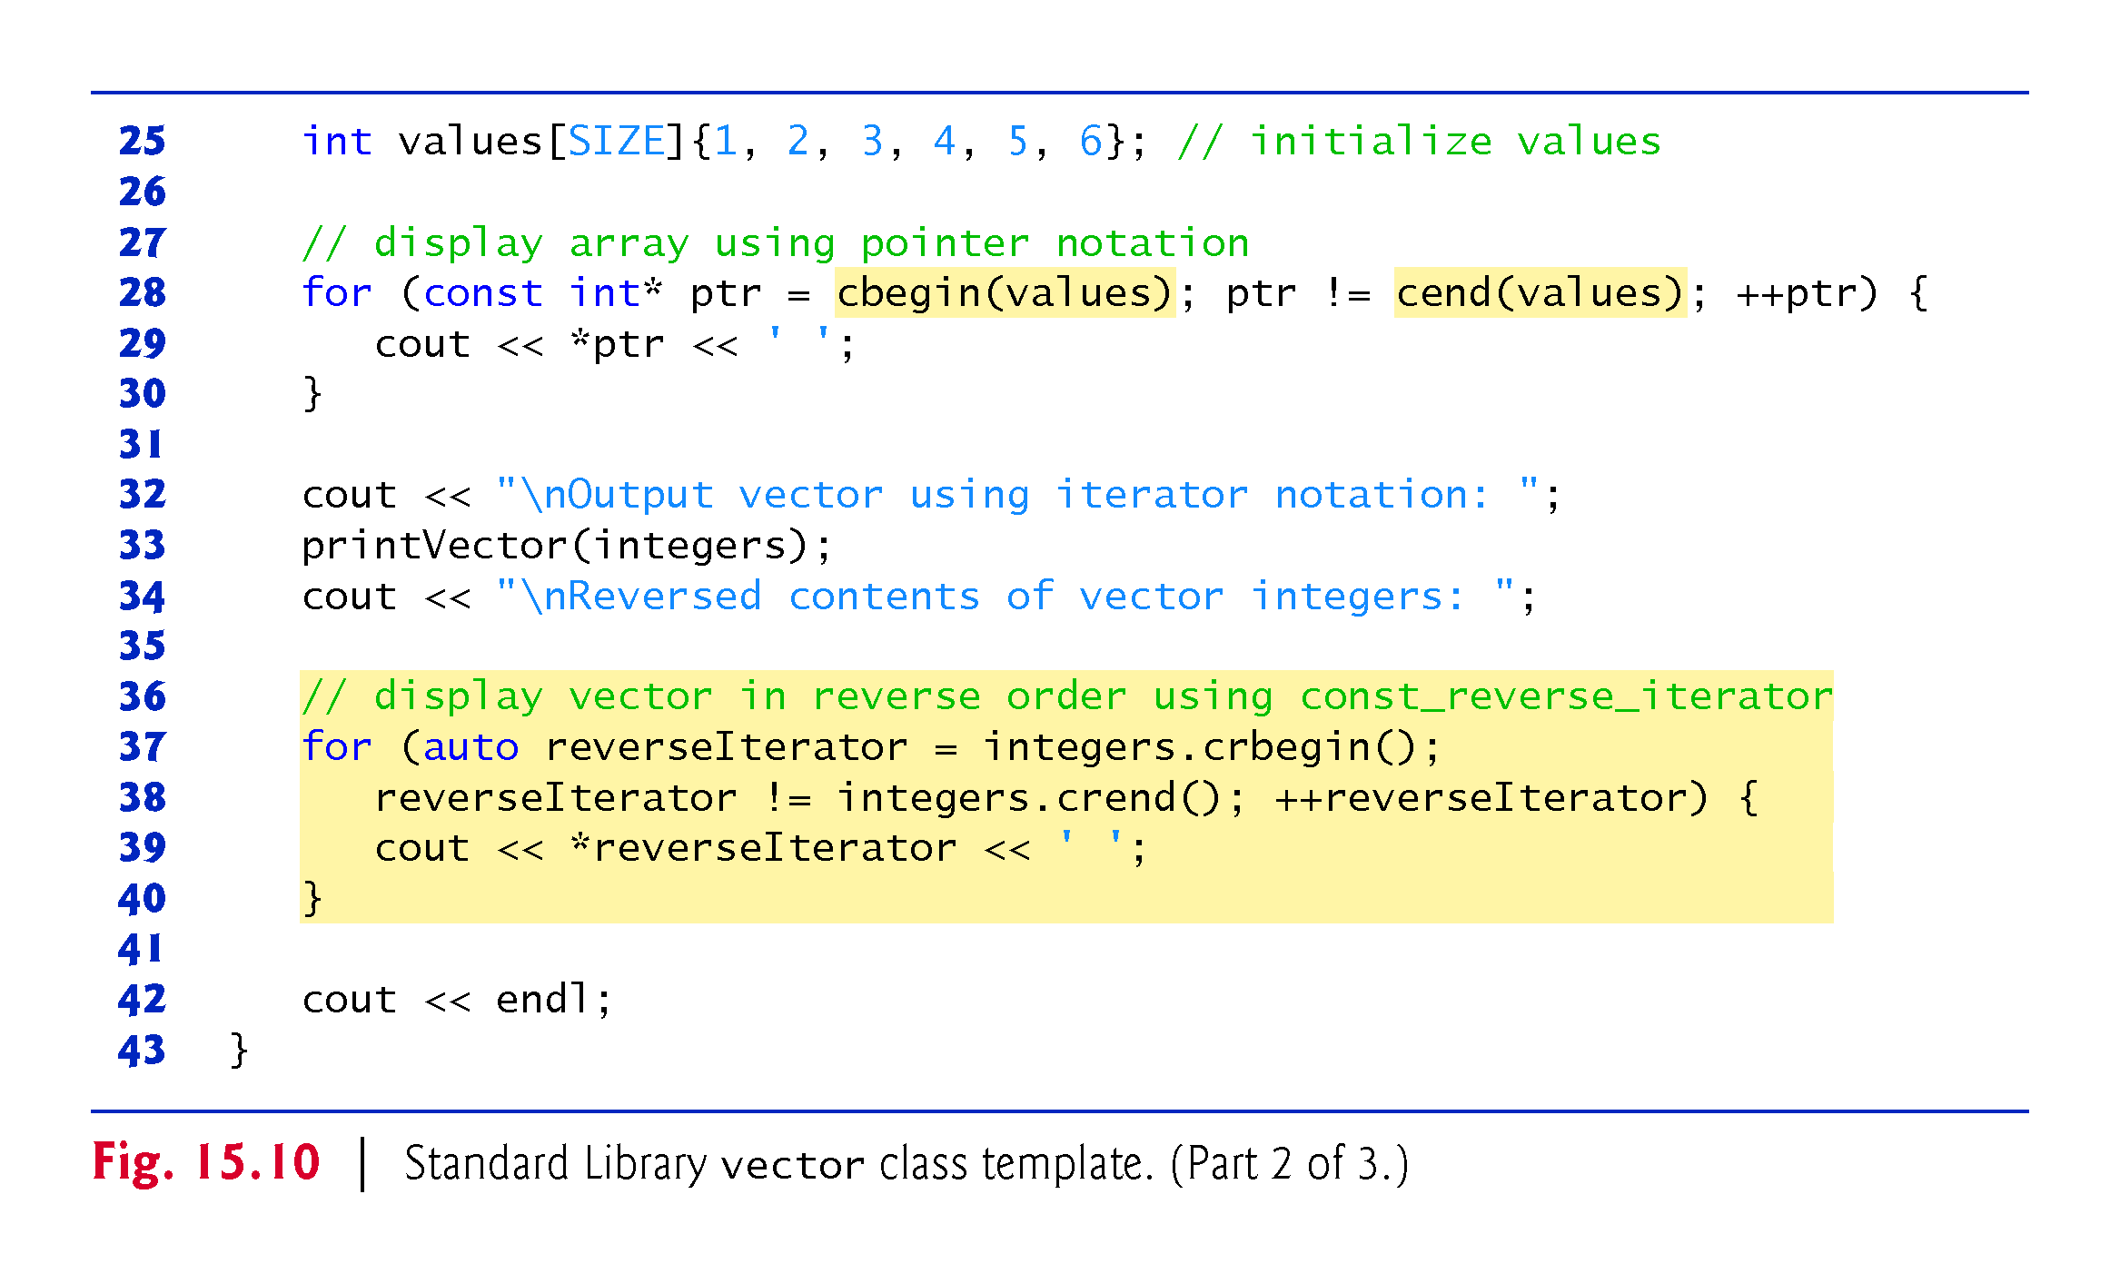

Slide 65
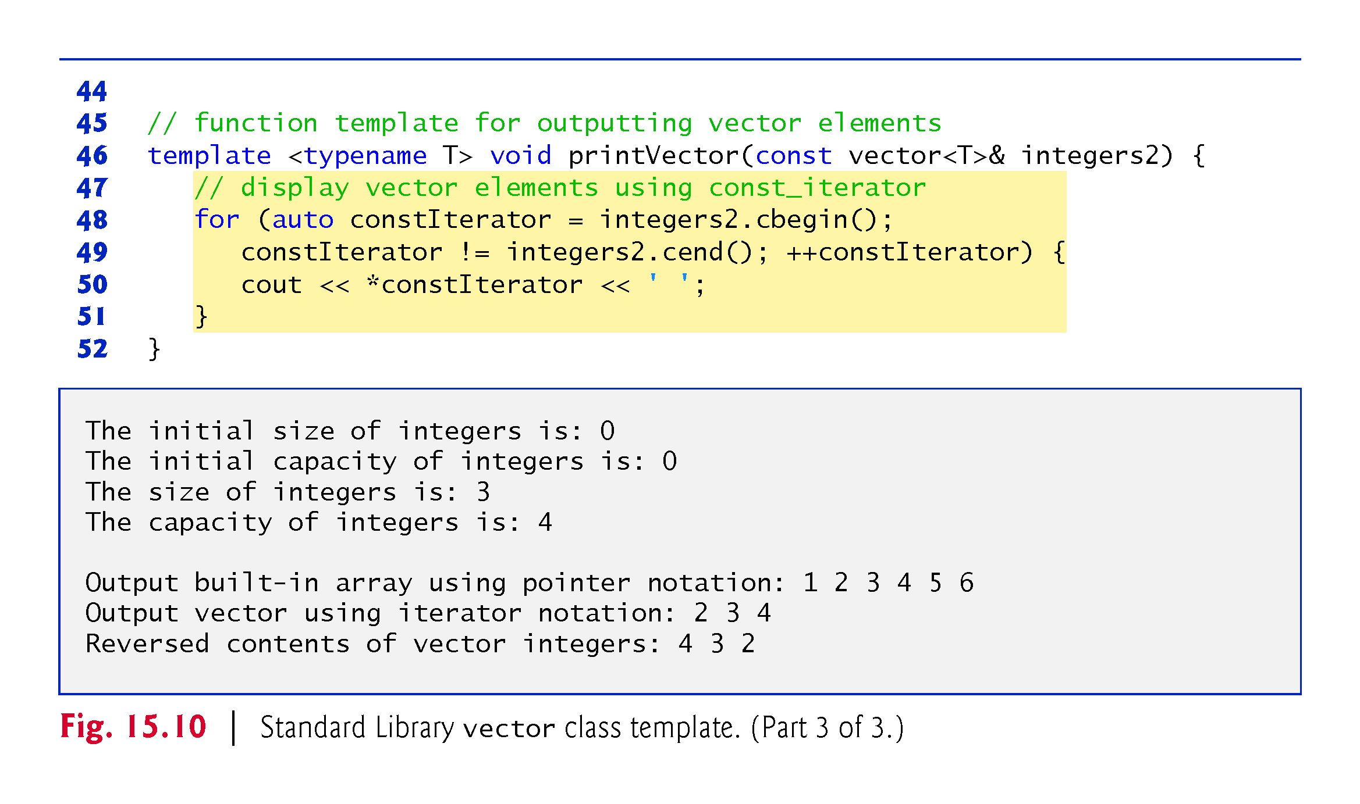

Slide 66
15.5.1 vector Sequence Container
Creating a vector
Line 11 defines an instance called integers of class template vector that stores int values.
When this object is instantiated, an empty vector is created with no elements (i.e., the number of elements stored in the vector) and no storage for elements (i.e., the number of elements that can be stored without allocating more memory to the vector).

Slide 67
15.5.1 vector Sequence Container
vector Member Functions size and capacity
Lines 13-14 demonstrate the size and capacity functions; each initially returns 0 for vector v in this example.
Function size—available in every container except forward_List—returns the number of elements currently stored in the container.
Function capacity (specific to vector and deque) returns the number of elements that can be stored in the vector before the vector needs to dynamically resize itself to accommodate more elements.

Slide 68
15.5.1 vector Sequence Container
vector Member Function push_back
Lines 17-19 use function push_back—available in sequence containers other than array and forward_list—to add an element to the end of the vector.
If an element is added to a full vector, the vector increases its size—some implementations have the vector double its capacity.
Sequence containers other than array and vector also provide a push_front function.

Slide 69
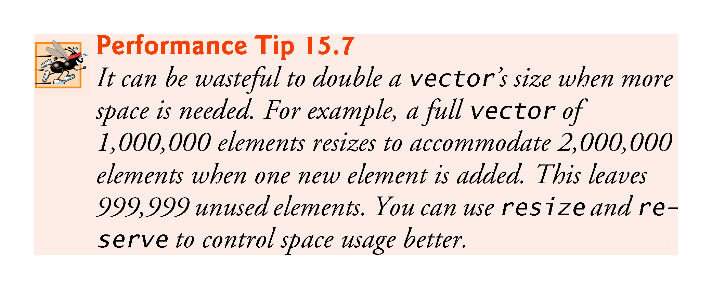

Slide 70
15.5.1 vector Sequence Container
Updated size and capacity After Modifying a vector
Lines 21-22 call size and capacity to illustrate the new size and capacity of the vector after the three push_back operations.
Function size returns 3—the number of elements added to the vector.
Function capacity returns 4 (though this could vary by compiler), indicating that we can add one more element before the vector needs to add more memory.
When we added the first element, the vector allocated space for one element, and the size became 1 to indicate that the vector contained only one element.

Slide 71
15.5.1 vector Sequence Container
When we added the second element, the capacity doubled to 2 and the size became 2 as well.
When we added the third element, the capacity doubled again to 4.
So we can actually add another element before the vector needs to allocate more space.
When the vector eventually fills its allocated capacity and the program attempts to add one more element to the vector, the vector will double its capacity to eight elements.

Slide 72
15.5.1 vector Sequence Container
vector Growth
The manner in which a vector grows to accommodate more elements—a time consuming operation—is not specified by the C++ Standard.
C++ library implementers use various clever schemes to minimize the overhead of resizing a vector.
Hence, the output of this program may vary, depending on the version of vector that comes with your compiler.
Some library implementers allocate a large initial capacity.
If a vector stores a small number of elements, such capacity may be a waste of space.

Slide 73
15.5.1 vector Sequence Container
However, it can greatly improve performance if a program adds many elements to a vector and does not have to reallocate memory to accommodate those elements.
This is a classic space–time trade-off.
Library implementers must balance the amount of memory used against the amount of time required to perform various vector operations.

Slide 74
15.5.1 vector Sequence Container
Outputting Built-in Array Contents with Pointers
Lines 28–30 use C++14’s global cbegin and cend functions, which work the same way as functions begin and end, but return const iterators that cannot be used to modify the data.
C++14 also introduces the global rbegin, rend, crbegin and crend functions for iterating through a built-in array or a container from back to front.
Functions begin and end and their C++14 const and reverse versions may also receive container objects as arguments—each function calls the corresponding member function in its container argument.
Note that we use the != operator in the loop-continuation condition at line 28. When iterating using iterators, it’s common for the loop-continuation condition to test whether the iterator has reached the end of the built-in array or the container. This technique is used by many Standard Library algorithms.

Slide 75
15.5.1 vector Sequence Container
Outputting vector Contents with Iterators
Line 33 calls function printVector (defined in lines 45–51) to output the contents of a vector using iterators.
The function receives a reference to a const vector.
The for statement in lines 48–51 initializes control variable constIterator using vector member function cbegin (added in C++11), which returns a const_iterator to the vector’s first element.
We infer the control variable’s type (vector<int>::const_iterator) using the auto keyword.
Prior to C++11, you would have used the overloaded begin member function to get the const_iterator—when called on a const container, begin returns a const_iterator. The other version of begin returns an iterator that can be used for non-const containers.

Slide 76
15.5.1 vector Sequence Container
The loop continues as long as constIterator has not reached the end of the vector.
This is determined by comparing constIterator to the result of calling the vector’s cend member function (added in C++11), which returns a const_iterator indicating the location past the last element of the vector.
If constIterator is equal to this value, the end of the vector has been reached.
Prior to C++11, you would have used the overloaded end member function to get the const_iterator.
Functions cbegin, begin, cend and end are available for all first-class containers.
The body of the loop dereferences constIterator to get the current element’s value.

Slide 77
15.5.1 vector Sequence Container
The expression ++constIterator (line 49) positions the iterator to the vector’s next element.
Lines 48–51 could have been replaced with the following range-based for statement:
for (auto const &item : integers2) {
cout << item << ' '; }

Slide 78
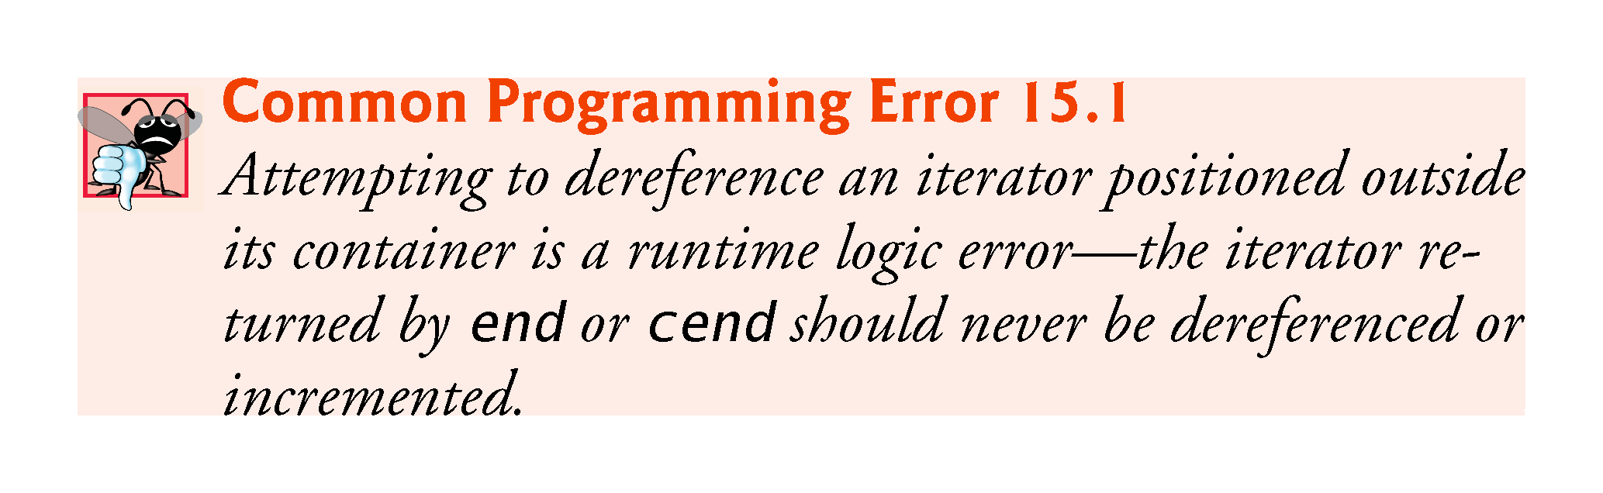

Slide 79
15.5.1 vector Sequence Container
Displaying the vector’s Contents in Reverse with const_reverse_iterators
Lines 37–40 use a for statement (similar to the one in printVector) to iterate through the vector in reverse.
C++11 added vector member functions crbegin and crend which return const_reverse_iterators that represent the starting and ending points when iterating through a container in reverse.
Most first-class containers support this type of iterator.
vector also contains rbegin and rend to obtain reverse_iterators.

Slide 80
15.5.1 vector Sequence Container
C++11: shrink_to_fit
As of C++11, you can ask a vector or deque to return unneeded memory to the system by calling member function shrink_to_fit.
This requests that the container reduce its capacity to the number of elements in the container.
According to the C++ standard, implementations can ignore this request so that they can perform implementation-specific optimizations.

Slide 81
15.5.1 vector Sequence Container
vector Element-Manipulation Functions
Figure 15.11 illustrates functions for retrieving and manipulating vector elements.
Line 13 initializes a vector<int> with the vector constructor that receives a C++11 list initializer.
Line 14 uses an overloaded vector constructor that takes two iterators as arguments to initialize integers with a copy of a range of elements from the vector values—in this case, the range from values.cbegin() up to, but not including, values.cend().

Slide 82
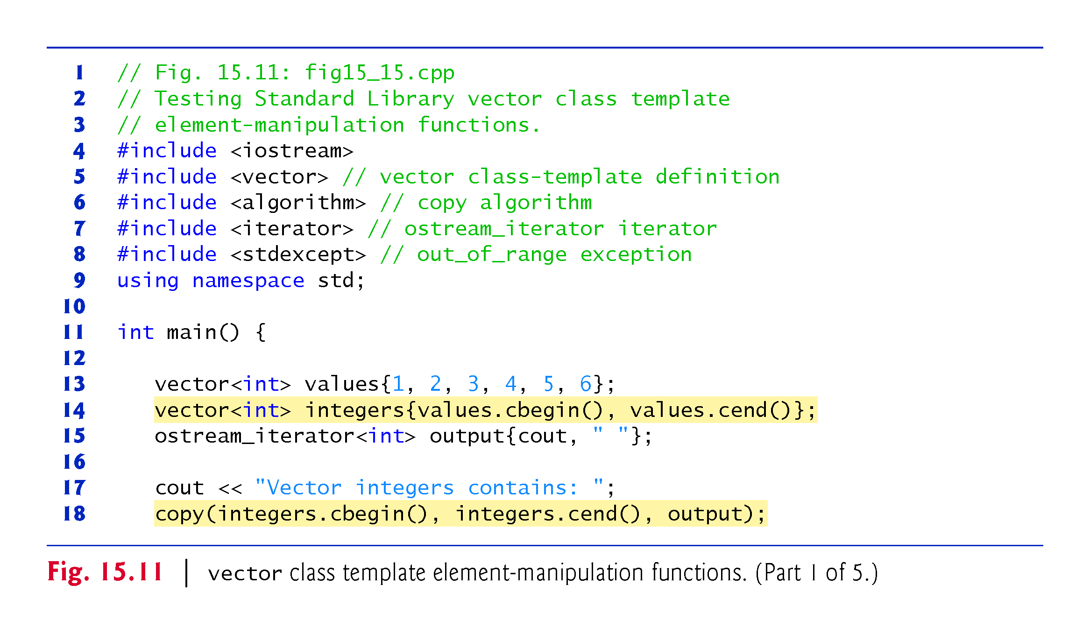

Slide 83
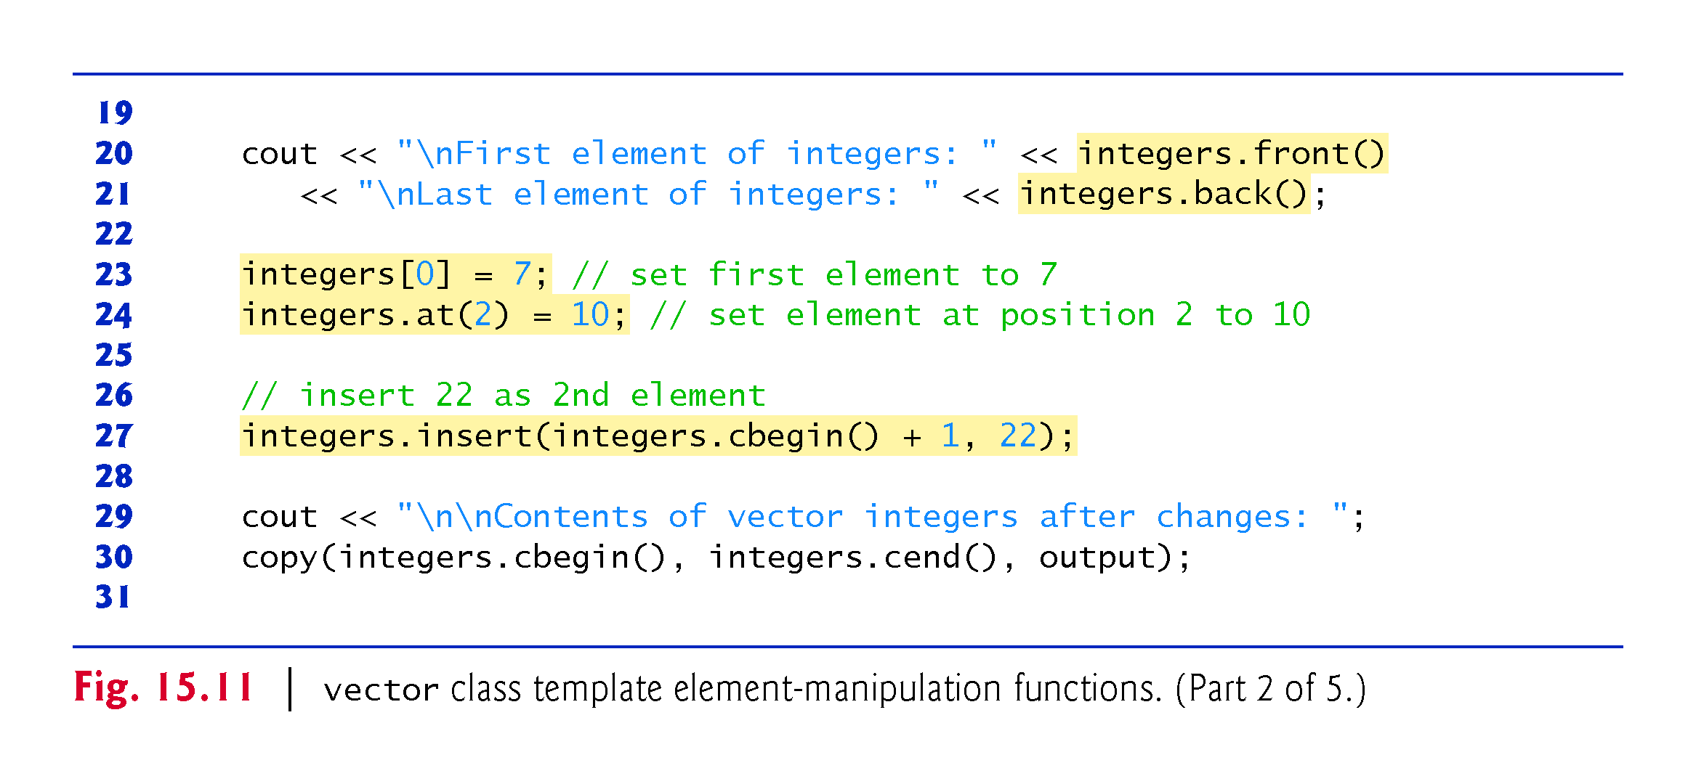

Slide 84
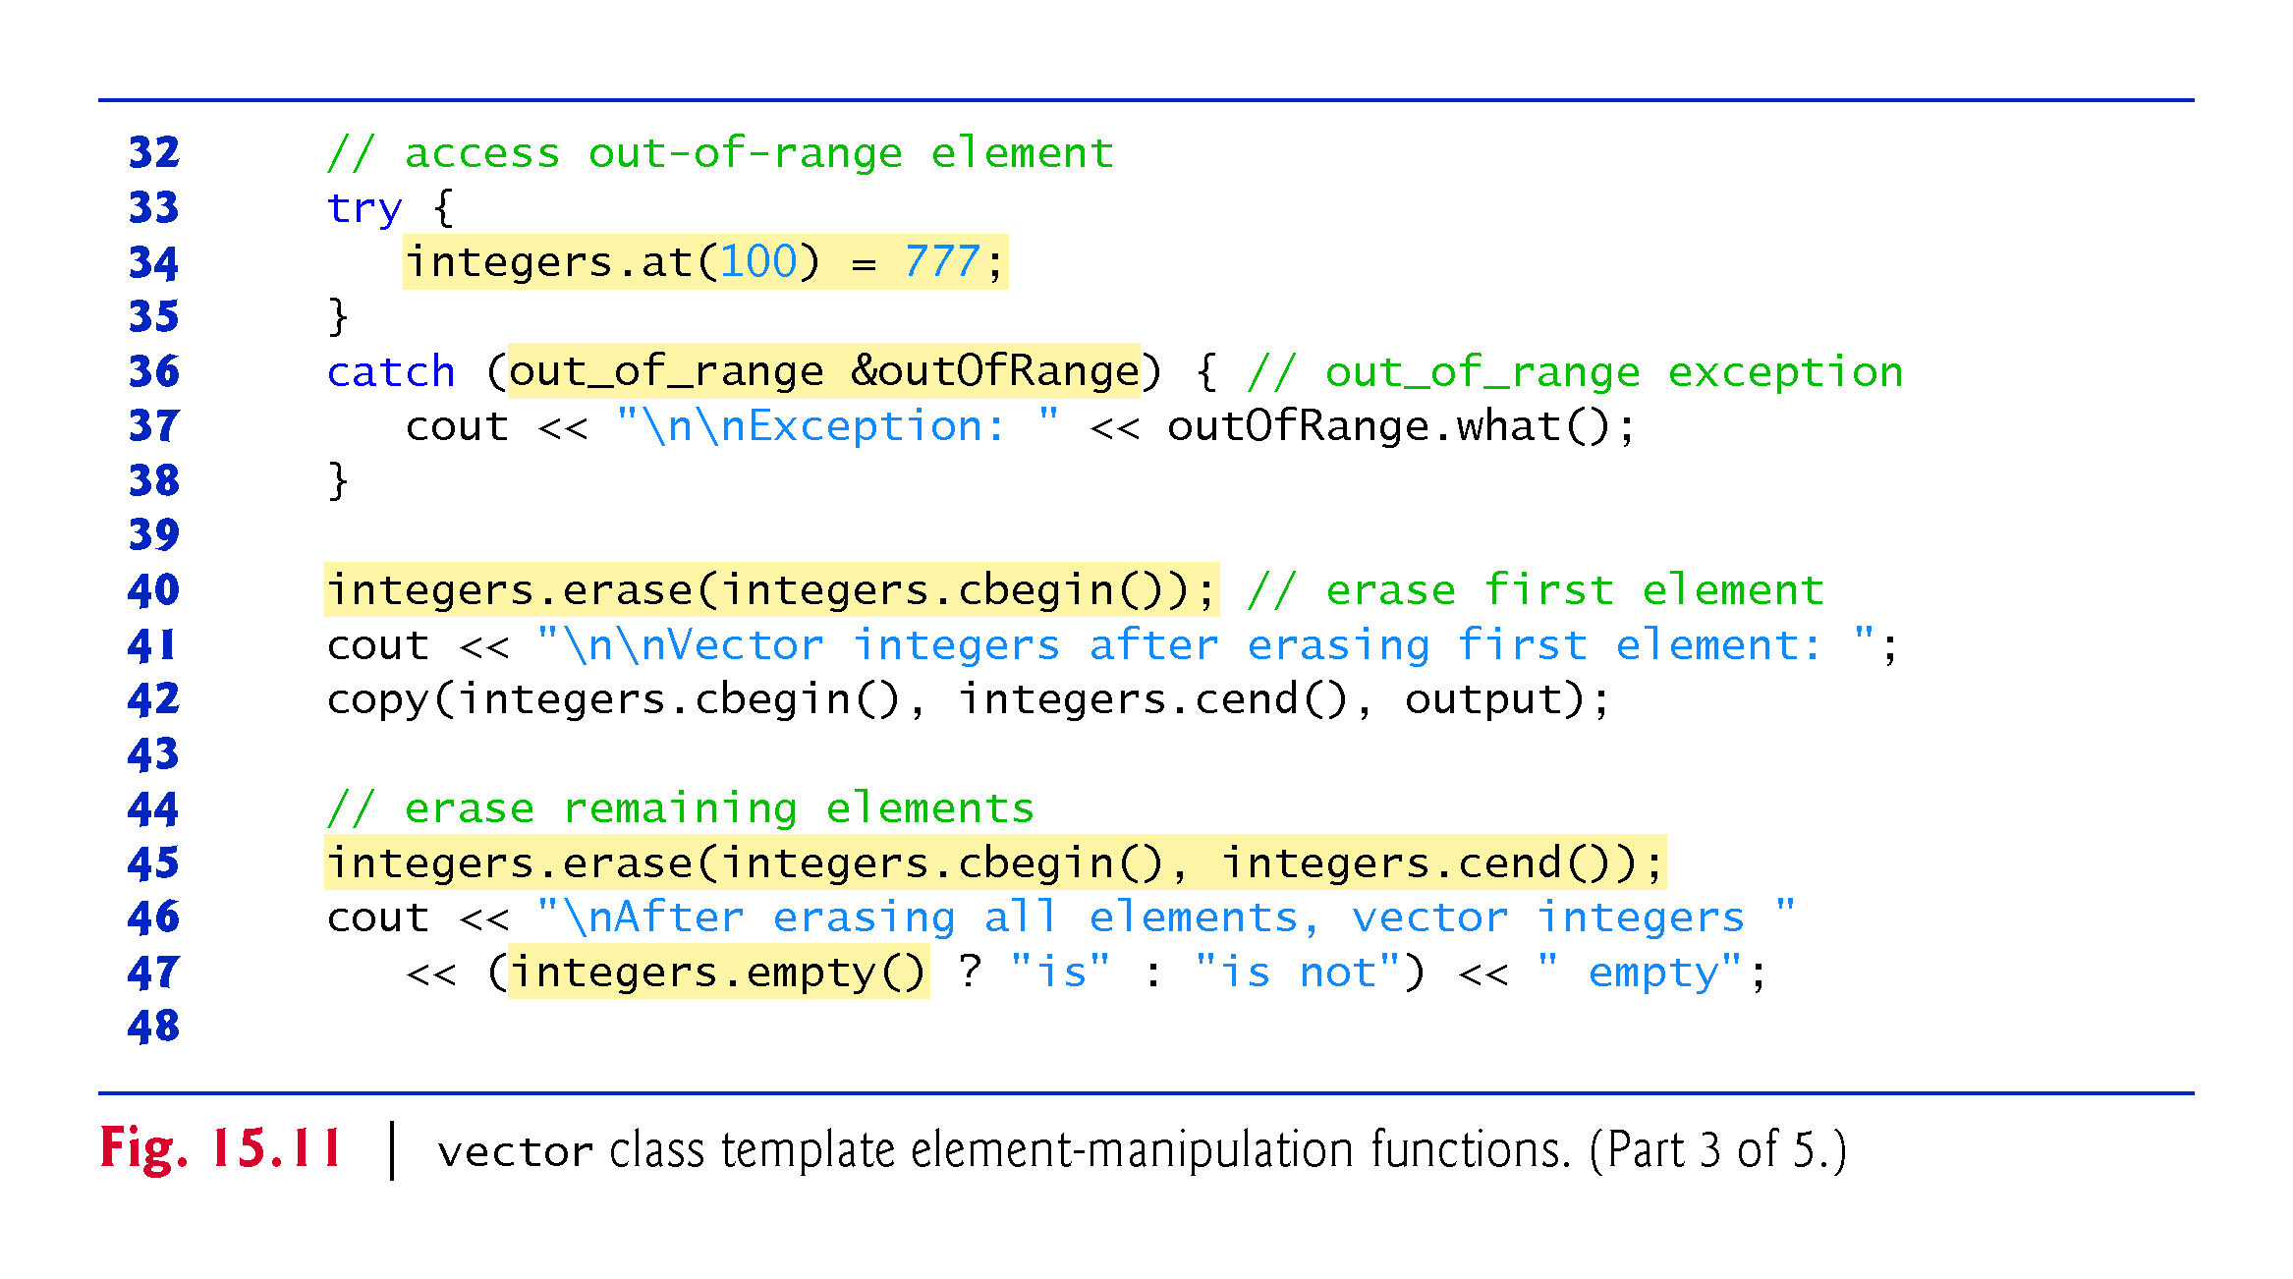

Slide 85
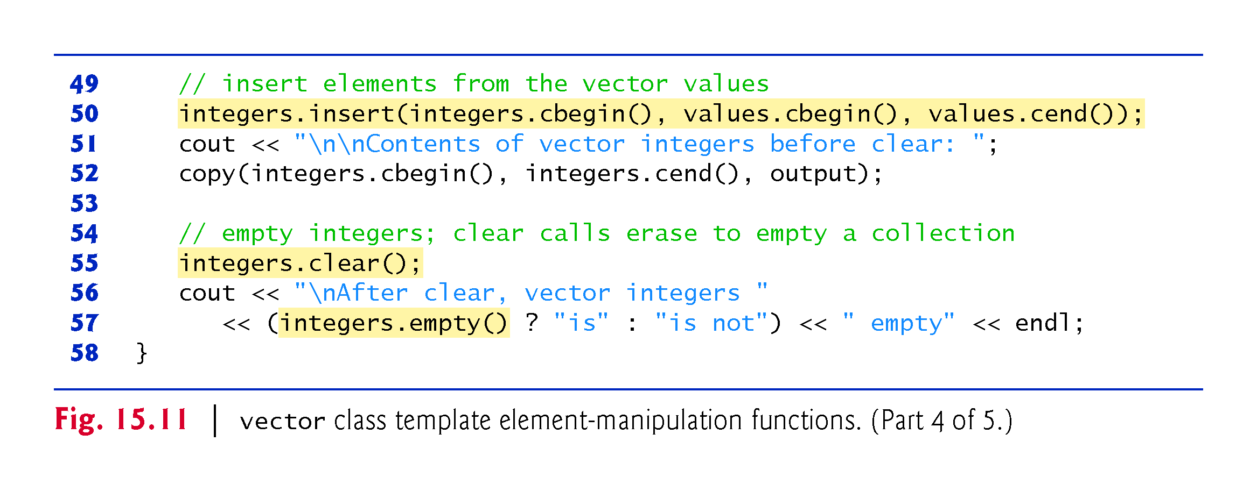

Slide 86
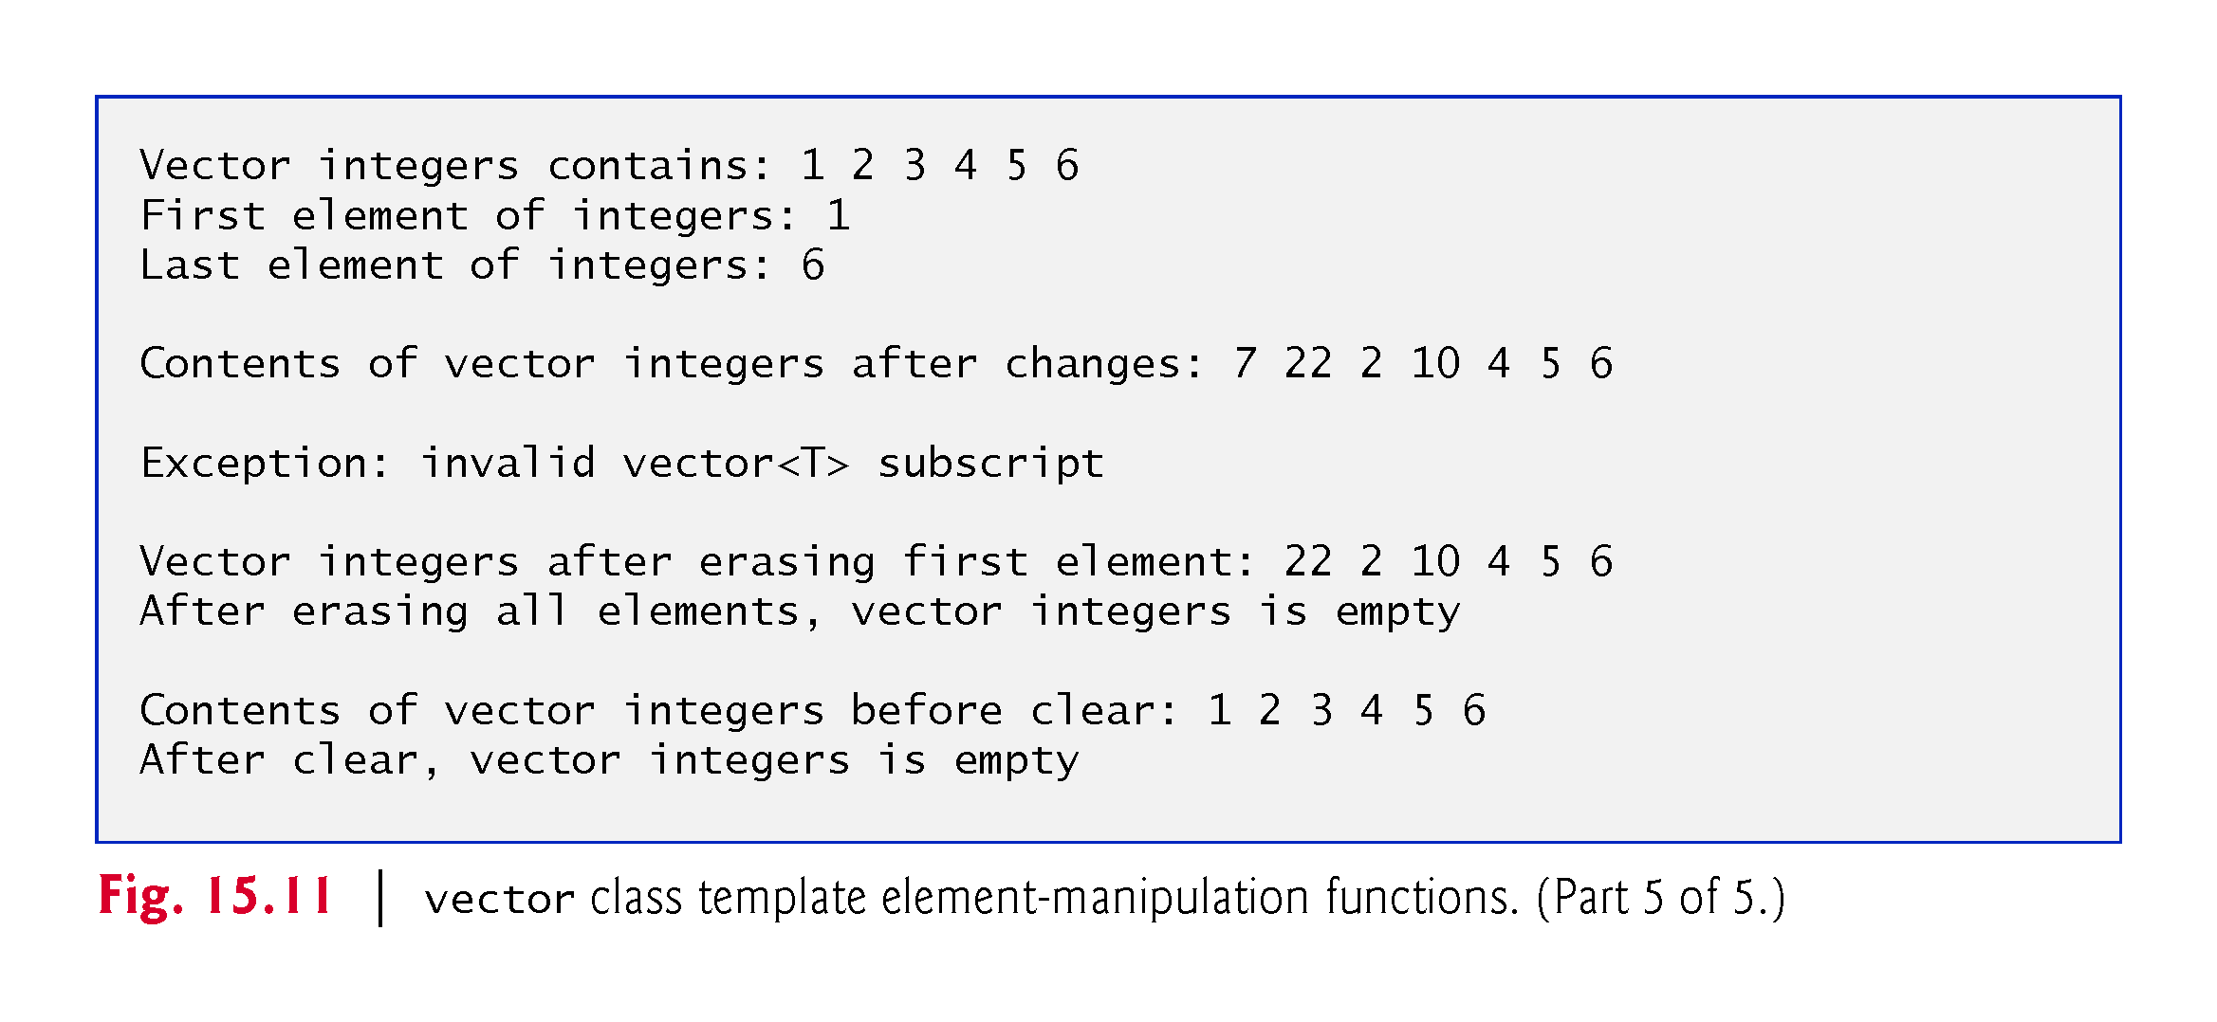

Slide 87
15.5.1 vector Sequence Container
ostream_iterator
Line 15 defines an ostream_iterator called output that can be used to output integers separated by single spaces via cout.
An ostream_iterator<int> outputs only values of type int or a compatible type.
The first argument to the constructor specifies the output stream, and the second argument is a string specifying the separator for the values output—in this case, the string contains a space character.
We use the ostream_iterator (defined in header <iterator>) to output the contents of the vector in this example.

Slide 88
15.5.1 vector Sequence Container
copy Algorithm
Line 18 uses Standard Library algorithm copy (from header <algorithm>) to output the entire contents of integers to the standard output.
The algorithm copies each element in a range from the location specified by the iterator in its first argument and up to, but not including, the location specified by the iterator in its second argument.
These two arguments must satisfy input iterator requirements—they must be iterators through which values can be read from a container, such as const_iterators.
They must also represent a range of elements—applying ++ to the first iterator must eventually cause it to reach the second iterator argument in the range.

Slide 89
15.5.1 vector Sequence Container
The elements are copied to the location specified by the output iterator (i.e., an iterator through which a value can be stored or output) specified as the last argument.
In this case, the output iterator is an ostream_iterator that is attached to cout, so the elements are copied to the standard output.

Slide 90
15.5.1 vector Sequence Container
vector Member Functions front and back
Lines 20–21 use functions front and back (available for most sequence containers) to determine the vector’s first and last elements, respectively.
Notice the difference between functions front and begin.
Function front returns a reference to the first element in the vector, while function begin returns a random access iterator pointing to the first element in the vector.
Also notice the difference between functions back and end.
Function back returns a reference to the vector’s last element, whereas function end returns a random access iterator pointing to the location after the last element.

Slide 91


Slide 92
15.5.1 vector Sequence Container
Accessing vector Elements
Lines 23–24 illustrate two ways to access vector elements. These can also be used with deque containers.
Line 23 uses the subscript operator that is overloaded to return either a reference to the value at the specified location or a reference to that const value, depending on whether the container is const.
Function at (line 24) performs the same operation, but with bounds checking.
Function at first checks the value supplied as an argument and determines whether it’s in the vector’s bounds
If not, function at throws an out_of_range exception (as demonstrated in lines 33–38).
Figure 15.12 shows some of the Standard Library exception types.

Slide 93
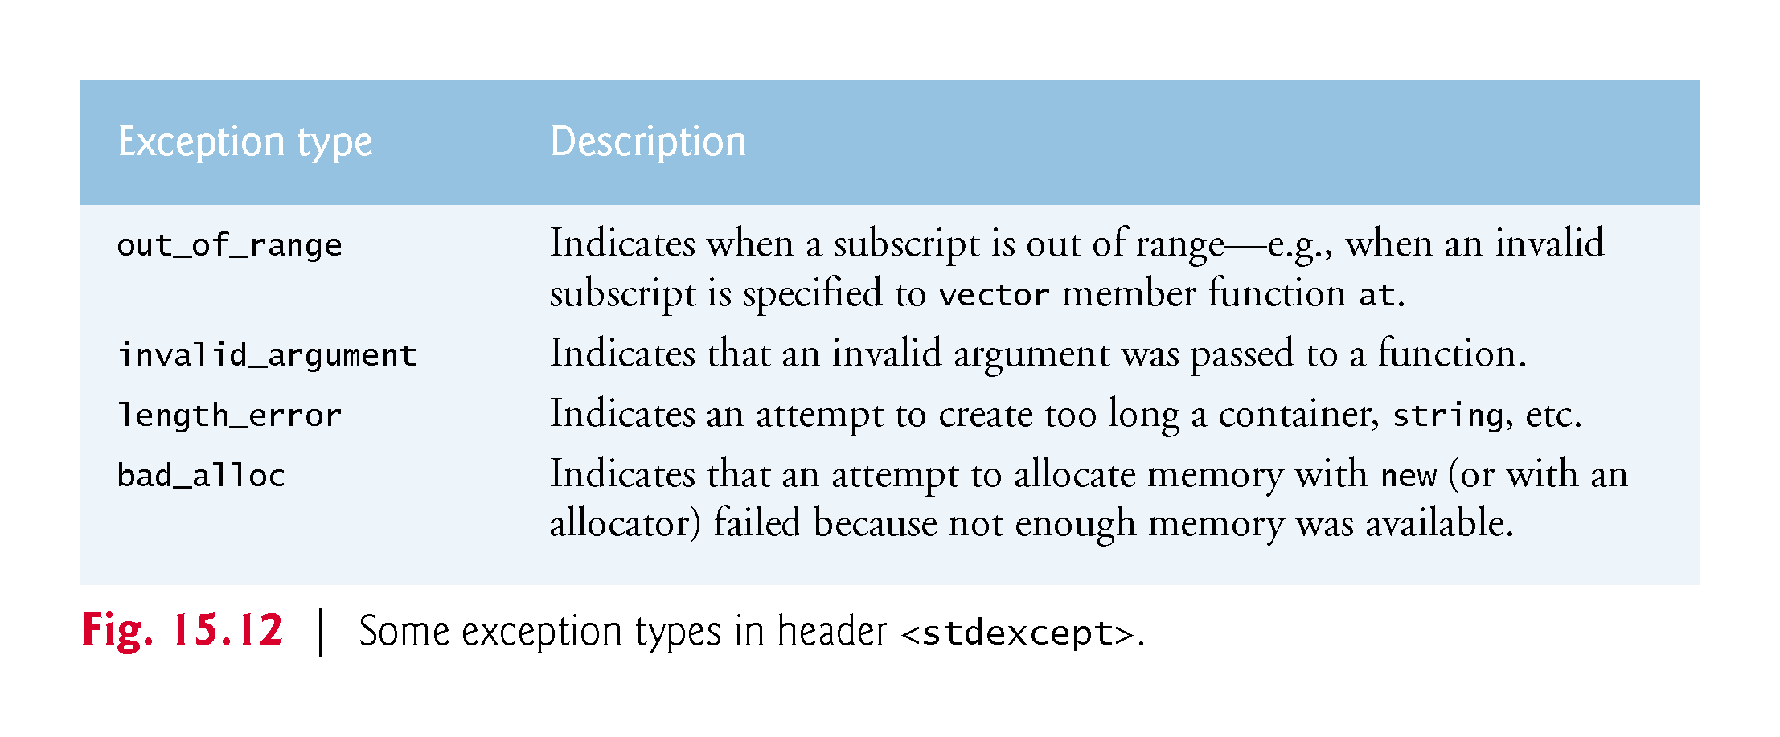

Slide 94
15.5.1 vector Sequence Container
vector Member Function insert
Line 27uses one of the several overloaded insert functions provided by each sequence container (except array, which has a fixed size, and forward_list, which has the function insert_after instead).
Line 27inserts the value 22 before the element at the location specified by the iterator in the first argument.
In this example, the iterator is pointing to the vector’s second element, so 22 is inserted as the second element and the original second element becomes the third element.

Slide 95
15.5.1 vector Sequence Container
Other versions of insert allow inserting multiple copies of the same value starting at a particular position, or inserting a range of values from another container, starting at a particular position.
As of C++11, this version of member function insert returns an iterator pointing to the item that was inserted.

Slide 96
15.5.1 vector Sequence Container
vector Member Function erase
Lines 45 and 45 use the two erase functions that are available in all first-class containers (except array, which has a fixed size, and forward_list, which has the function erase_after instead).
Line 40 erases the element at the location specified by the iterator argument (in this example, the first element).
Line 45 specifies that all elements in the range specified by two iterator arguments should be erased.
In this example, all the elements are erased.
Line 47 uses function empty (available for all containers and adapters) to confirm that the vector is empty.

Slide 97
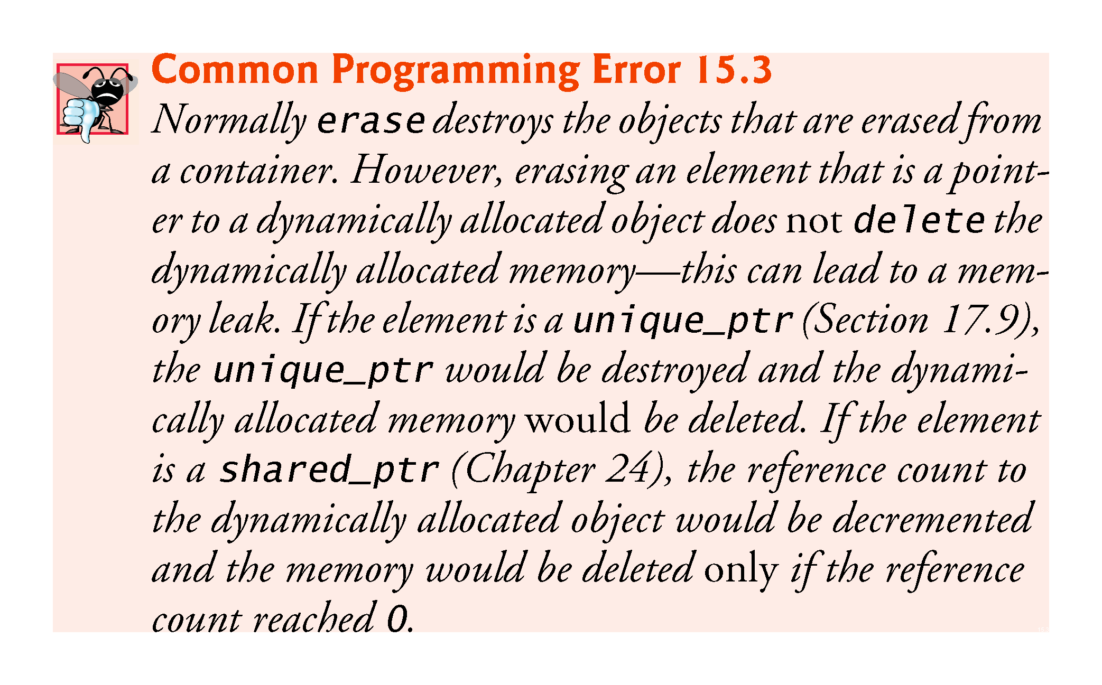

Slide 98
15.5.1 vector Sequence Container
vector Member Function insert with Three Arguments (Range insert)
Line 50 demonstrates the version of function insert that uses the second and third arguments to specify the starting location and ending location in a sequence of values (in this case, values) that should be inserted into the vector.
Remember that the ending location specifies the position in the sequence after the last element to be inserted; copying occurs up to, but not including, this location.
As of C++11, this version of member function insert returns an iterator pointing to the first item that was inserted—if nothing was inserted, the function returns its first argument.

Slide 99
15.5.1 vector Sequence Container
vector Member Function clear
Finally, line 55 uses function clear (found in all first-class containers except array) to empty the vector—this does not necessarily return any of the vector’s memory to the system.

Slide 100
15.5.2 list Sequence Container
The list sequence container (from header <list>) allows insertion and deletion operations at any location in the container.
If most of the insertions and deletions occur at the ends of the container, the deque data structure (Section 15.5.3) provides a more efficient implementation.
Class template list is implemented as a doubly linked list—every node in the list contains a pointer to the previous node in the list and to the next node in the list.
This enables class template list to support bidirectional iterators that allow the container to be traversed both forward and backward.

Slide 101
15.5.2 list Sequence Container (Cont.)
Any algorithm that requires input, output, forward or bidirectional iterators can operate on a list.
Many list member functions manipulate the elements of the container as an ordered set of elements.

Slide 102
15.5.2 list Sequence Container (Cont.)
C++11: forward_list Container
C++11’s forward_list sequence container (header <forward_list>), which is implemented as a singly linked list—every node in the list contains a pointer to the next node in the list.
This enables class template list to support forward iterators that allow the container to be traversed in the forward direction.
Any algorithm that requires input, output or forward iterators can operate on a forward_list.

Slide 103
15.5.2 list Sequence Container (Cont.)
list Member Functions
In addition to the member functions in Fig. 15.2 and the common member functions of all sequence containers discussed in Section 15.5, class template list provides nine other member functions—including splice, push_front, pop_front, remove, remove_if, unique, merge, reverse and sort.

Slide 104
15.5.2 list Sequence Container (Cont.)
Several of these member functions are list-optimized implementations of Standard Library algorithms presented in Chapter 16.
Both push_front and pop_front are also supported by forward_list and deque.
Figure 15.13 demonstrates several features of class list.
Remember that many of the functions presented in Figs. 15.10–15.11 can be used with class list, so we focus on the new features in this example’s discussion.

Slide 105
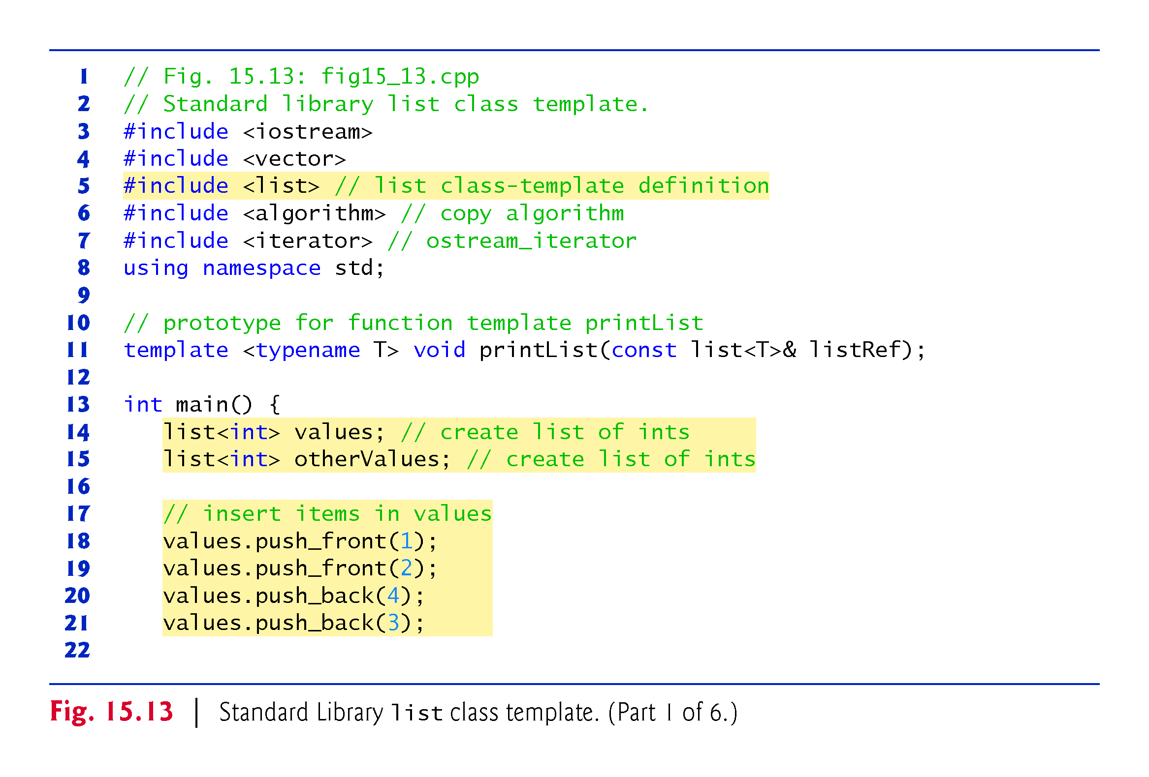

Slide 106
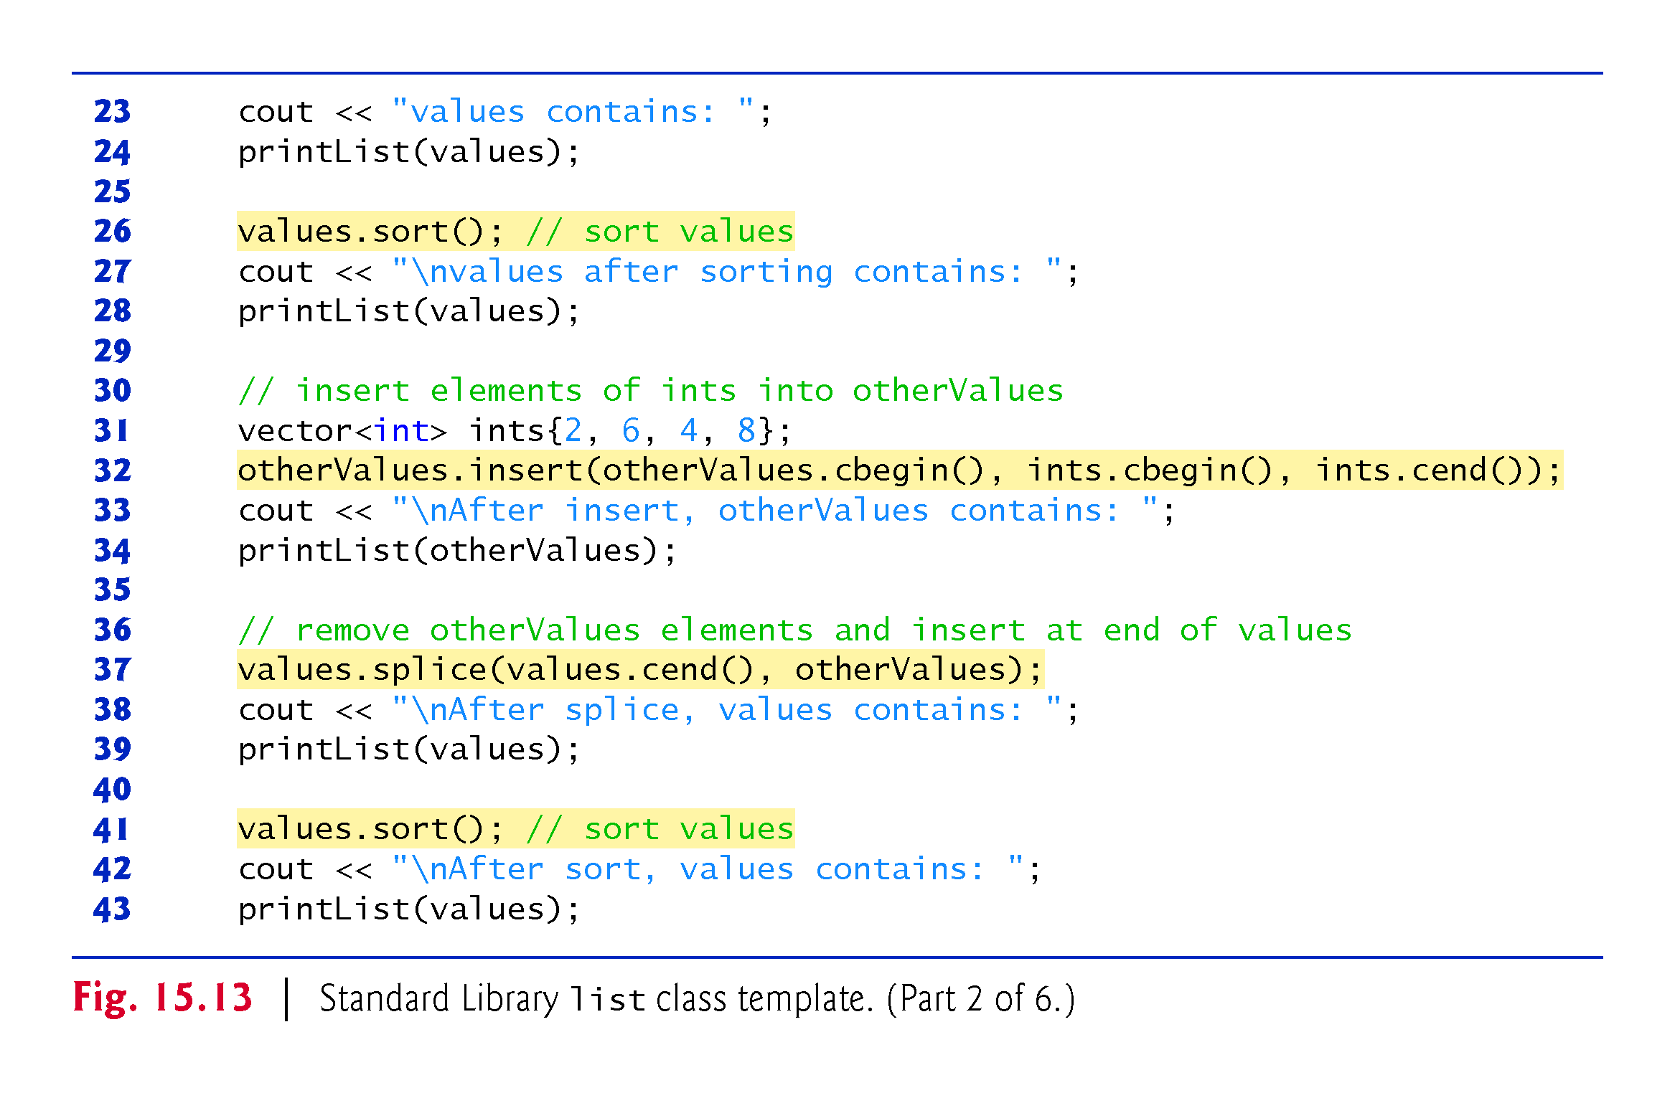

Slide 107
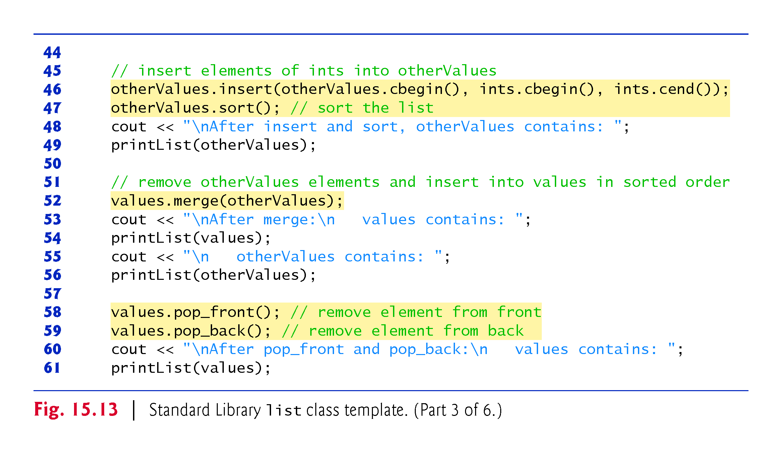

Slide 108
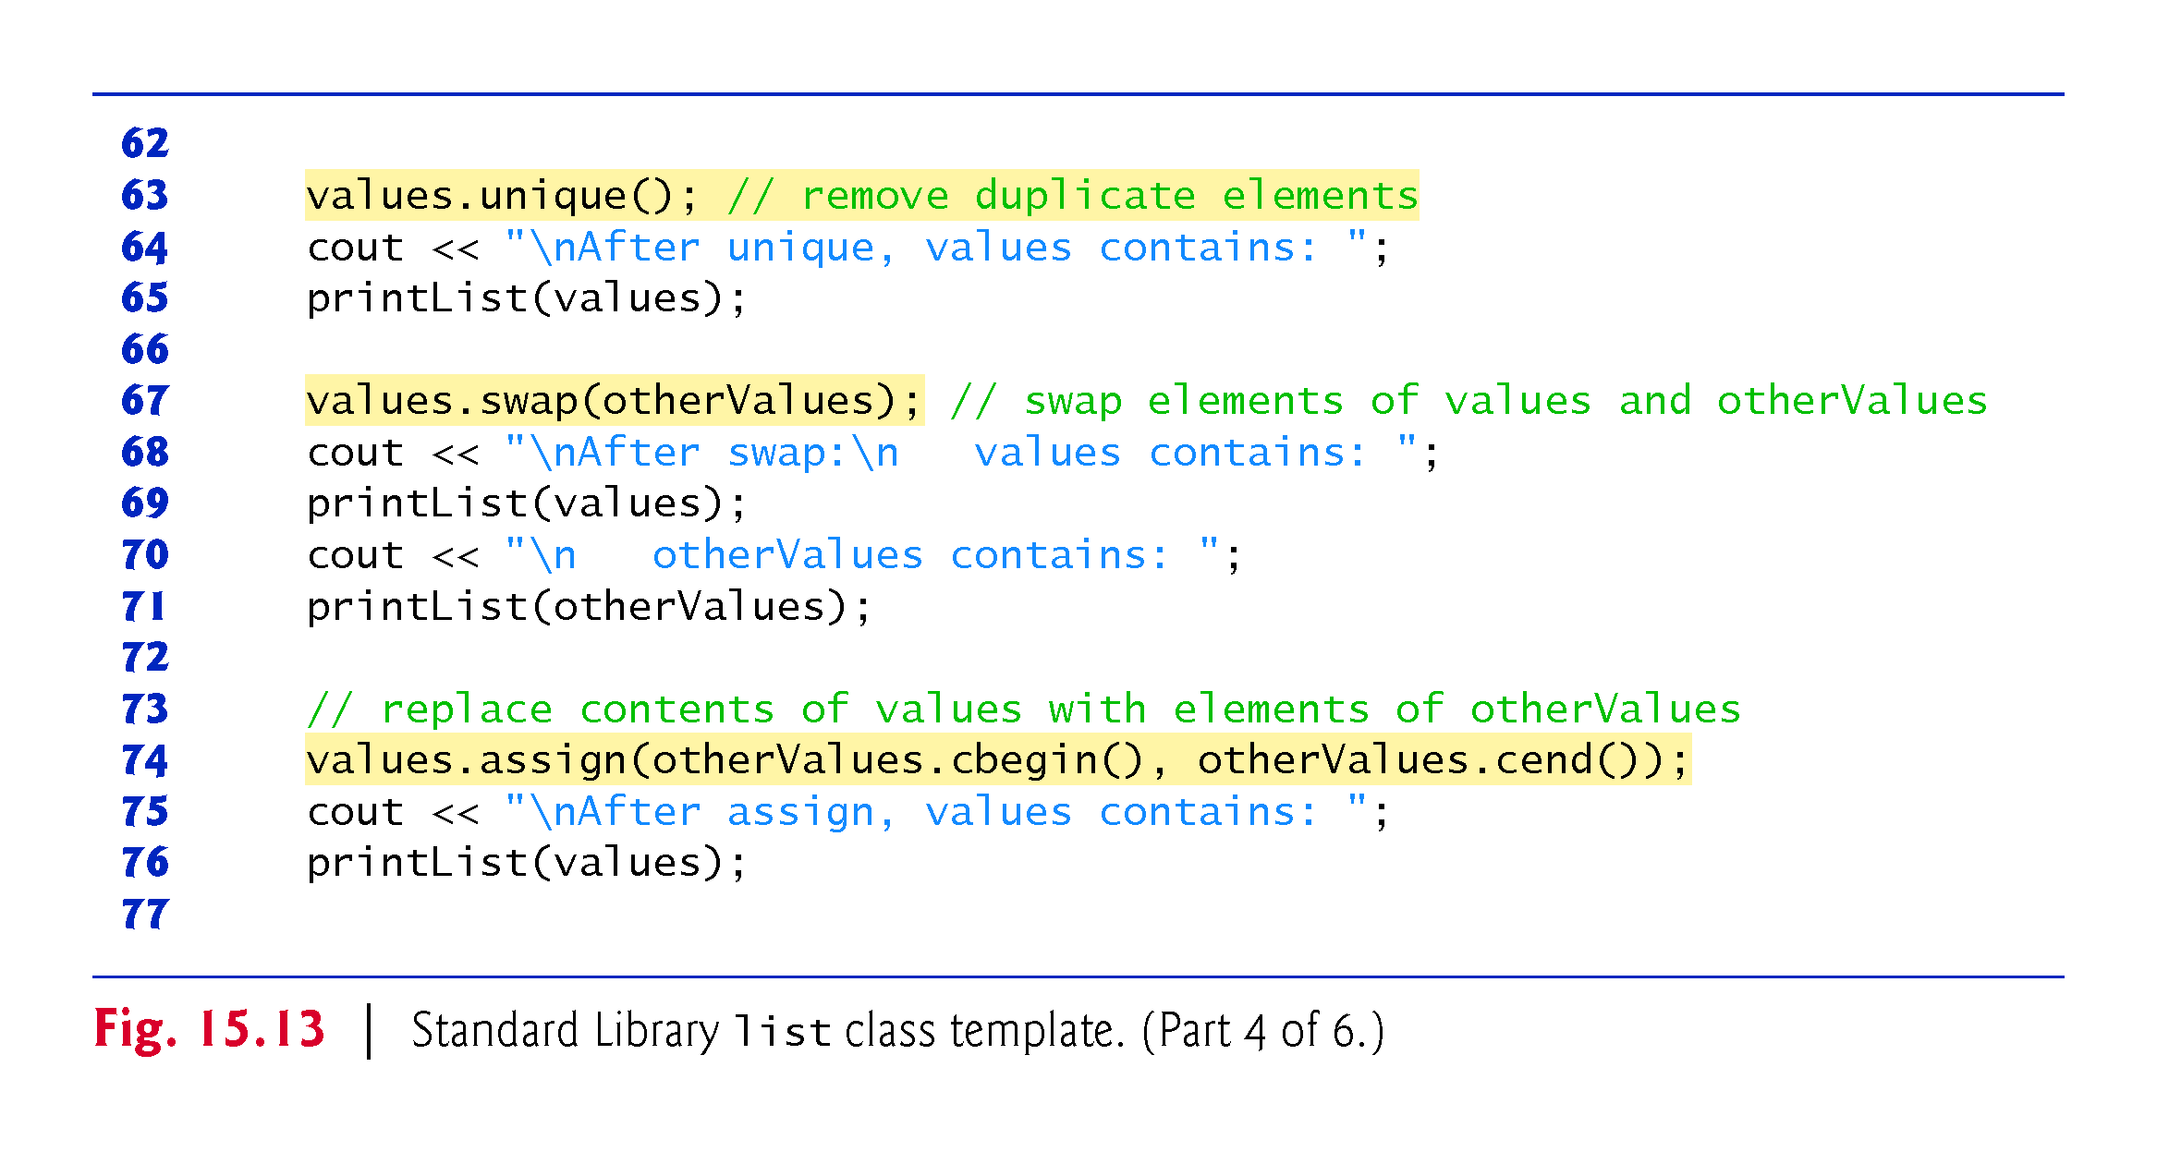

Slide 109
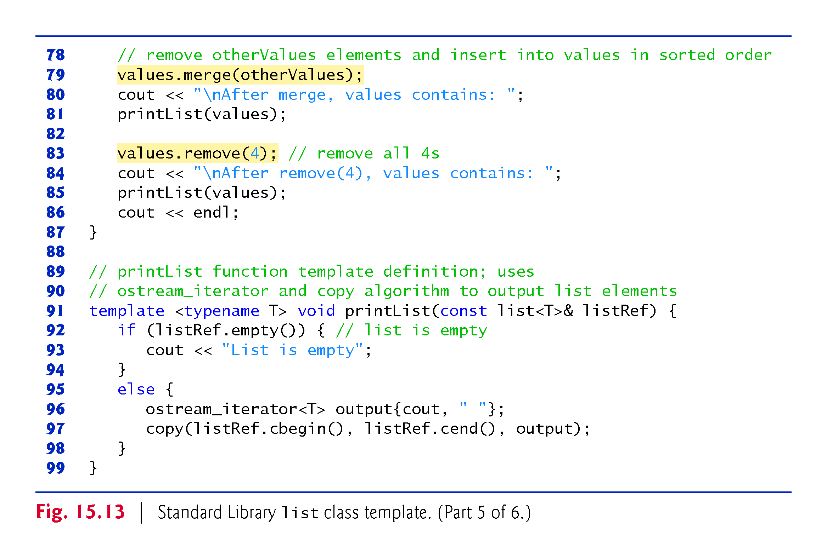

Slide 110
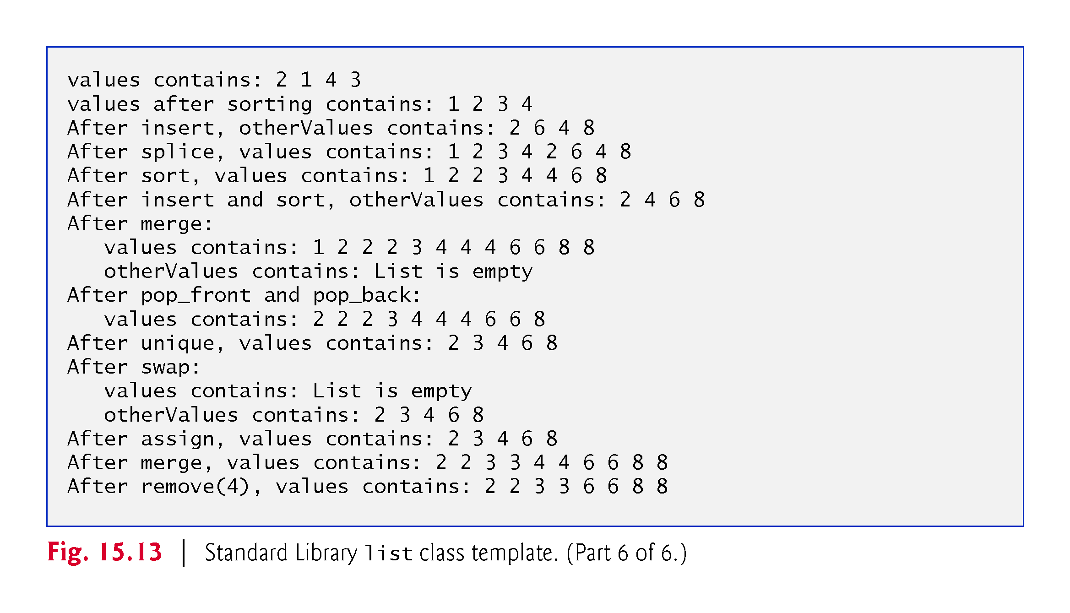

Slide 111
15.5.2 list Sequence Container (Cont.)
Creating list Objects
Lines 14–15 instantiate two list objects capable of storing ints.
Lines 18–19 use function push_front to insert integers at the beginning of values.
Function push_front is specific to classes forward_list, list and deque.
Lines 20–21 use function push_back to insert integers at the end of values.
Function push_back is common to all sequence containers, except array and forward_list.

Slide 112
15.5.2 list Sequence Container (Cont.)
list Member Function sort
Line 26 uses list member function sort to arrange the elements in the list in ascending order.
A second version of function sort allows you to supply a binary predicate function that takes two arguments (values in the list), performs a comparison and returns a bool value indicating whether the first argument should come before the second in the sorted contents.
This function determines the order in which the elements of the list are sorted.

Slide 113
15.5.2 list Sequence Container (Cont.)
This version could be particularly useful for a list that stores pointers rather than values.
[Note: We demonstrate a unary predicate function in Fig. 16.3.]
A unary predicate function takes a single argument, performs a comparison using that argument and returns a bool value indicating the result.]

Slide 114
15.5.2 list Sequence Container (Cont.)
list Member Function splice
Line 27 uses list function splice to remove the elements in otherValues and insert them into values before the iterator position specified as the first argument.
There are two other versions of this function.
Function splice with three arguments allows one element to be removed from the container specified as the second argument from the location specified by the iterator in the third argument.

Slide 115
15.5.2 list Sequence Container (Cont.)
Function splice with four arguments uses the last two arguments to specify a range of locations that should be removed from the container in the second argument and placed at the location specified in the first argument.
Class template forward_list provides a similar member function named splice_after.

Slide 116
15.5.2 list Sequence Container (Cont.)
list Member Function merge
After inserting more elements in otherValues and sorting both values and otherValues, line 52 uses list member function merge to remove all elements of otherValues and insert them in sorted order into values.
Both lists must be sorted in the same order before this operation is performed.
A second version of merge enables you to supply a binary predicate function that takes two arguments (values in the list) and returns a bool value.
The predicate function specifies the sorting order used by merge.

Slide 117
15.5.2 list Sequence Container (Cont.)
list Member Function pop_front
Line 58 uses list function pop_front to remove the first element in the list.
Line 59 uses function pop_back (available for sequence containers other than array and forward_list) to remove the last element in the list.

Slide 118
15.5.2 list Sequence Container (Cont.)
list Member Function unique
Line 63 uses list function unique to remove duplicate elements in the list.
The list should be in sorted order (so that all duplicates are side by side) before this operation is performed, to guarantee that all duplicates are eliminated.
A second version of unique enables you to supply a predicate function that takes two arguments (values in the list) and returns a bool value specifying whether two elements are equal.

Slide 119
15.5.2 list Sequence Container (Cont.)
list Member Function swap
Line 67 uses function swap (available to all first-class containers) to exchange the contents of values with the contents of otherValues.

Slide 120
15.5.2 list Sequence Container (Cont.)
list Member Functions assign and remove
Line 74 uses list function assign (available to all sequence containers) to replace the contents of values with the contents of otherValues in the range specified by the two iterator arguments.
A second version of assign replaces the original contents with copies of the value specified in the second argument.
The first argument of the function specifies the number of copies.
Line 83 uses list function remove to delete all copies of the value 4 from the list.

Slide 121
15.5.3 deque Sequence Container
Class deque provides many of the benefits of a vector and a list in one container.
The term deque is short for “double-ended queue.”
Class deque is implemented to provide efficient indexed access (using subscripting) for reading and modifying its elements, much like a vector.
Class deque is also implemented for efficient insertion and deletion operations at its front and back, much like a list (although a list is also capable of efficient insertions and deletions in the middle of the list).
Class deque provides support for random-access iterators, so deques can be used with all Standard Library algorithms.

Slide 122
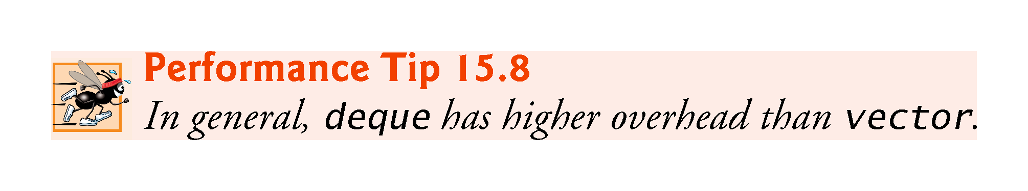

Slide 123
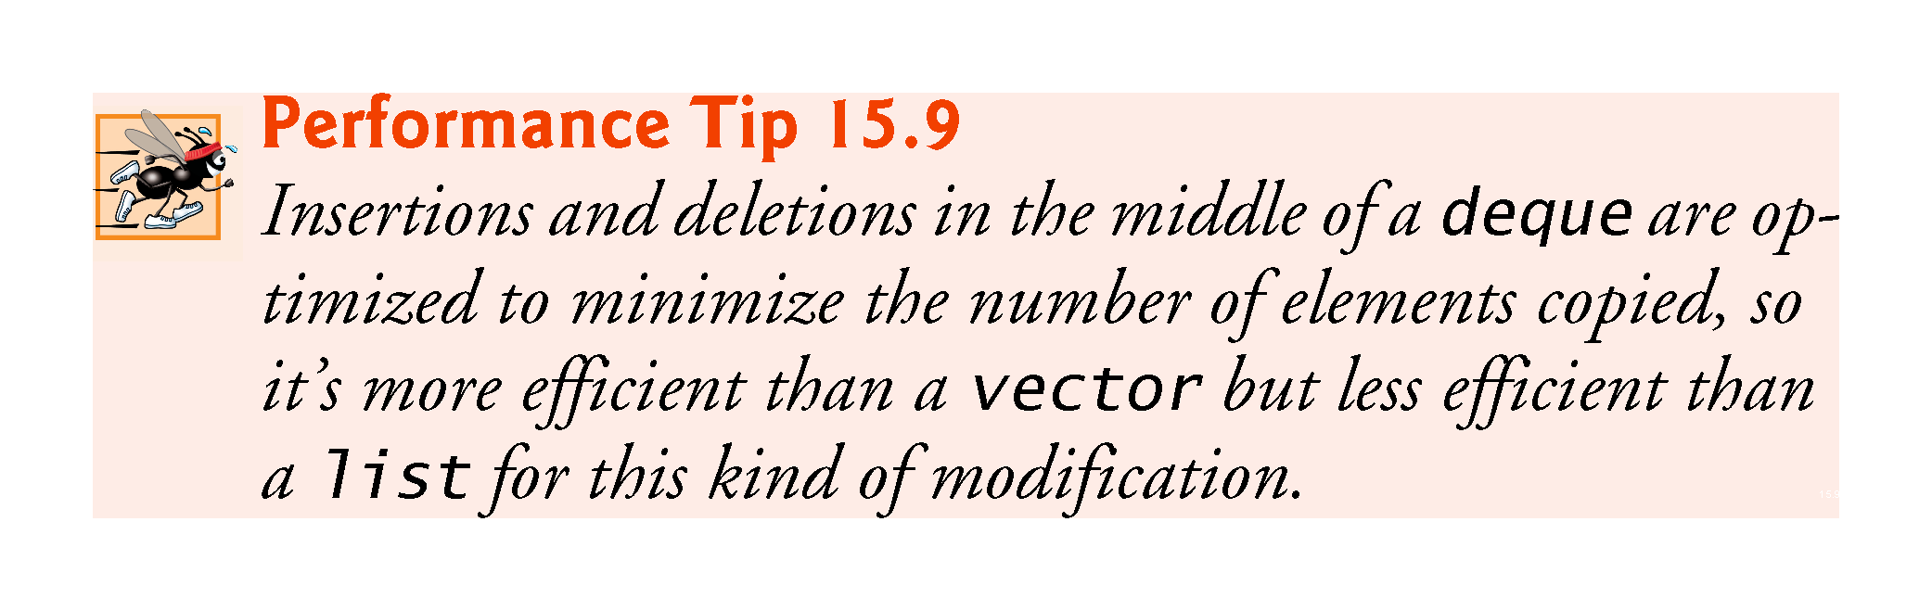

Slide 124
15.5.3 deque Sequence Container (Cont.)
One of the most common uses of a deque is to maintain a first-in, first-out queue of elements.
In fact, a deque is the default underlying implementation for the queue adaptor (Section 15.7.2).
Additional storage for a deque can be allocated at either end of the deque in blocks of memory that are typically maintained as a built-in array of pointers to those blocks.
Due to the noncontiguous memory layout of a deque, a deque iterator must be more “intelligent” than the pointers that are used to iterate through vectors, arrays or built-in arrays.

Slide 125
15.5.3 deque Sequence Container (Cont.)
Class deque provides the same basic operations as class vector, but like list adds member functions push_front and pop_front to allow insertion and deletion at the beginning of the deque, respectively.
Figure 15.14 demonstrates features of class deque.
Remember that many of the functions presented in Fig. 15.10, Fig. 15.11 and Fig. 15.13 also can be used with class deque.
Header <deque> must be included to use class deque.

Slide 126
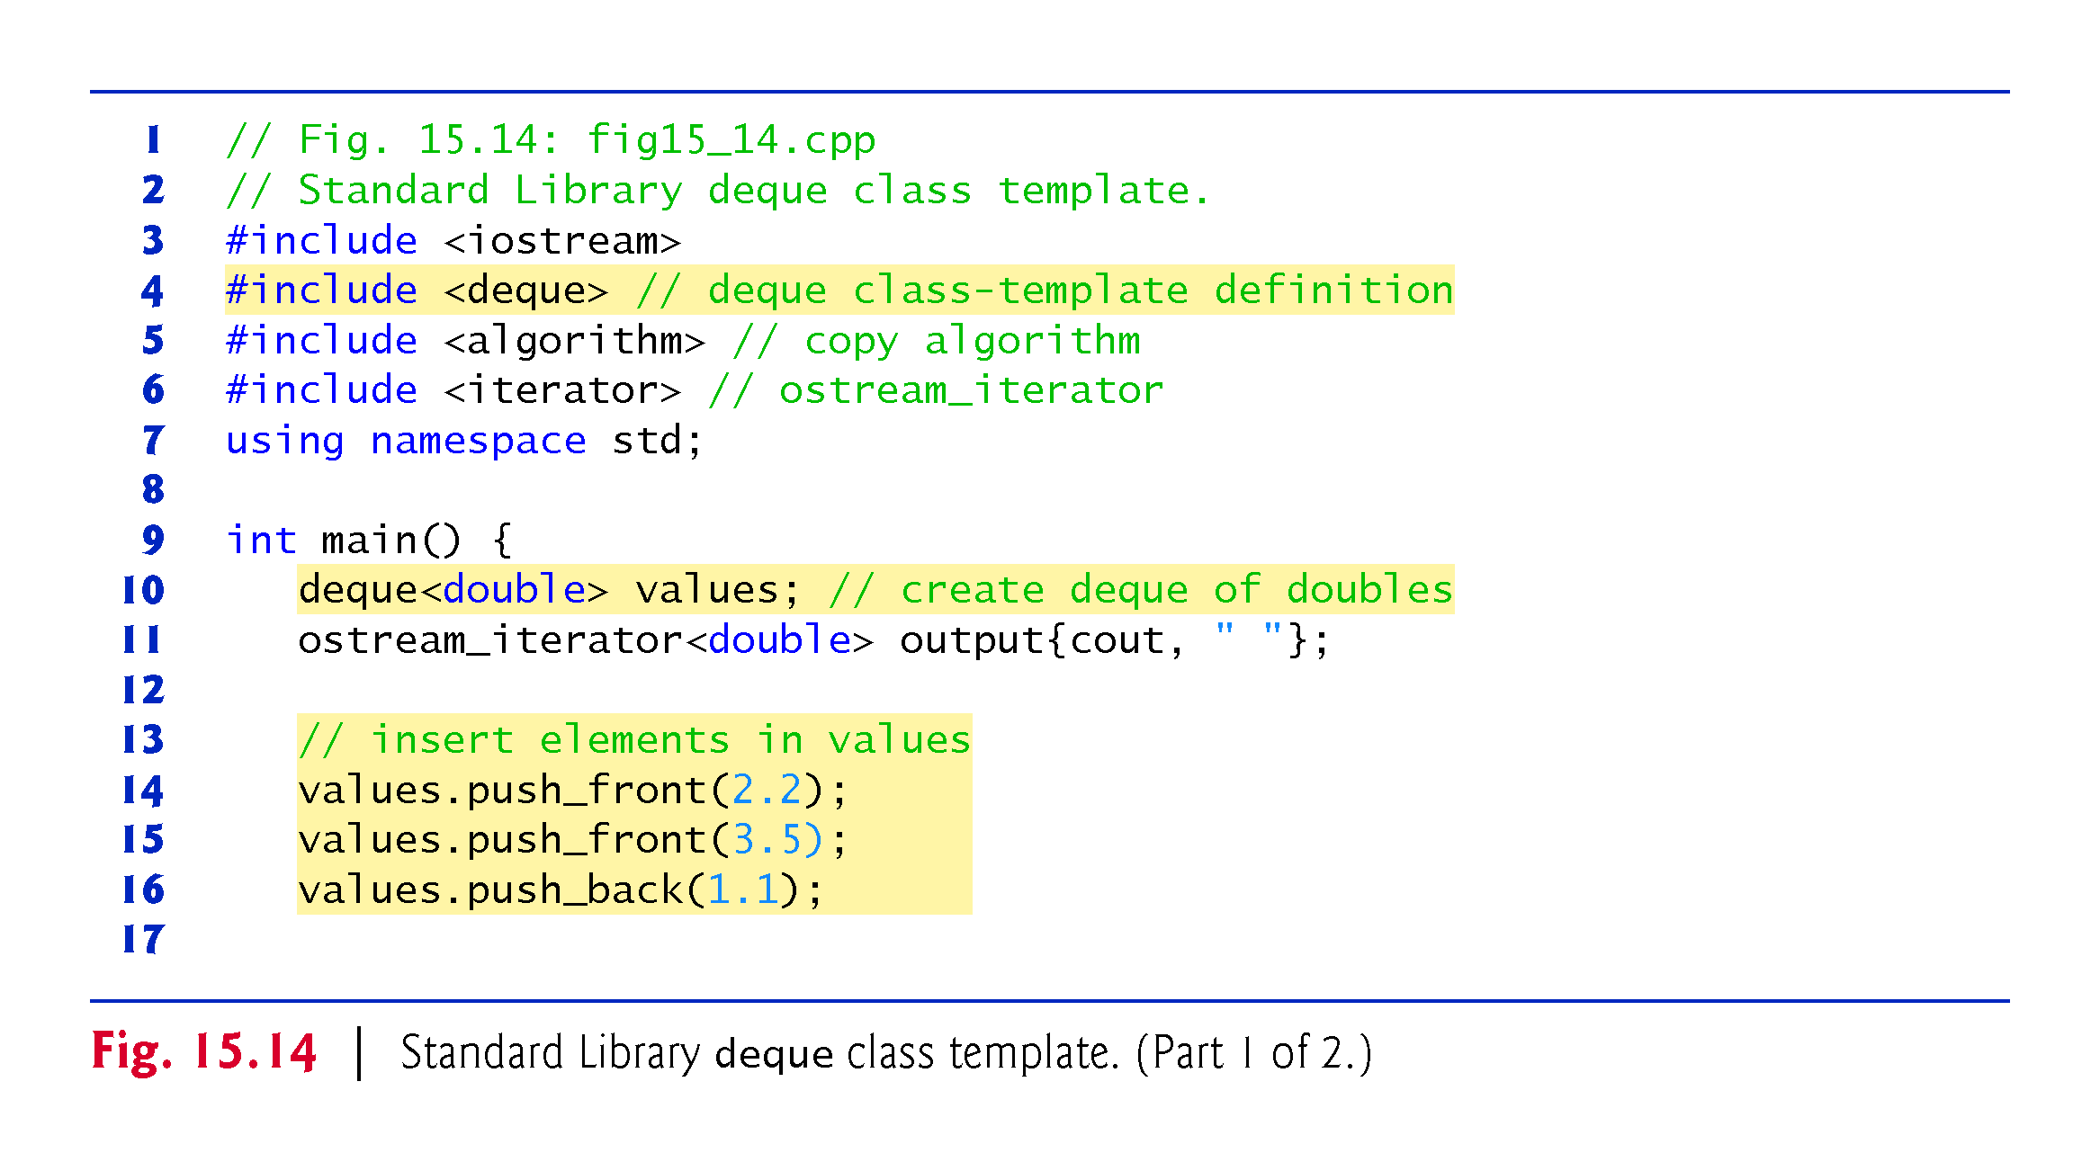

Slide 127
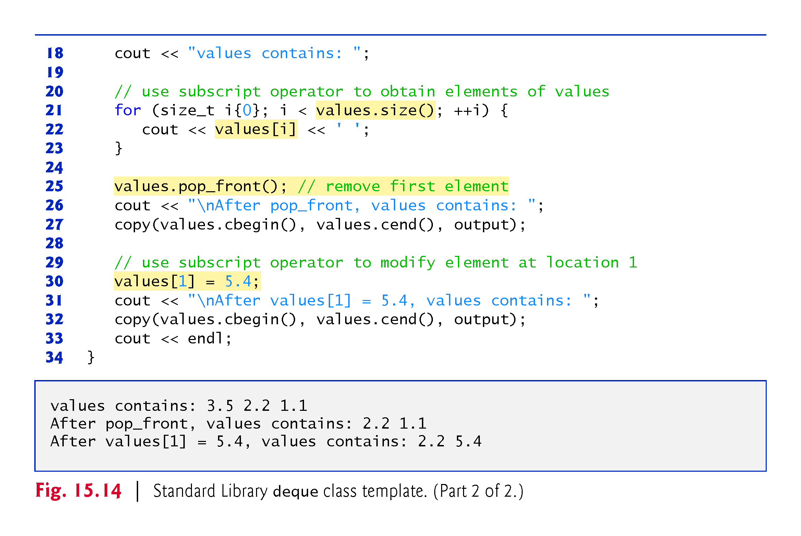

Slide 128
15.5.3 deque Sequence Container (Cont.)
Line 10 instantiates a deque that can store double values.
Lines 14–16 use functions push_front and push_back to insert elements at the beginning and end of the deque.
The for statement in lines 21–23 uses the subscript operator to retrieve the value in each element of the deque for output.
The condition uses function size to ensure that we do not attempt to access an element outside the bounds of the deque.

Slide 129
15.5.3 deque Sequence Container (Cont.)
Line 25 uses function pop_front to demonstrate removing the first element of the deque.
Line 30 uses the subscript operator to obtain an lvalue.
This enables values to be assigned directly to any element of the deque.

Slide 130
15.6 Associative Containers
The associative containers provide direct access to store and retrieve elements via keys (often called search keys).
The four ordered associative containers are multiset, set, multimap and map.
Each of these maintains its keys in sorted order.
There are also four corresponding unordered associative containers—unordered_multiset, unordered_set, unordered_multimap and unordered_map—that offer the most of the same capabilities as their ordered counterparts.
The primary difference between the ordered and unordered associative containers is that the unordered ones do not maintain their keys in sorted order. In this section, we focus on the ordered associative containers.

Slide 131


Slide 132
15.6 Associative Containers (cont.)
Iterating through an ordered associative container traverses it in the sort order for that container.
Classes multiset and set provide operations for manipulating sets of values where the values are the keys—there is not a separate value associated with each key.
The primary difference between a multiset and a set is that a multiset allows duplicate keys and a set does not.

Slide 133
15.6 Associative Containers (Cont.)
Classes multimap and map provide operations for manipulating values associated with keys (these values are sometimes referred to as mapped values).
The primary difference between a multimap and a map is that a multimap allows duplicate keys with associated values to be stored and a map allows only unique keys with associated values.
In addition to the common container member functions, ordered associative containers also support several other member functions that are specific to associative containers.
Examples of each of the ordered associative containers and their common member functions are presented in the next several subsections.

Slide 134
15.6.1 multiset Associative Container
The multiset ordered associative container (from header <set>) provides fast storage and retrieval of keys and allows duplicate keys.
The elements’ ordering is determined by a so-called comparator function object.
For example, in an integer multiset, elements can be sorted in ascending order by ordering the keys with comparator function object less<int>.
We discuss function objects in detail in Section 16.4.
The data type of the keys in all ordered associative containers must support comparison based on the comparator function object—keys sorted with less<T> must support comparison with operator<.

Slide 135
15.6.1 multiset Associative Container (Cont.)
If the keys used in the ordered associative containers are of user-defined data types, those types must supply the appropriate comparison operators.
A multiset supports bidirectional iterators (but not random-access iterators).
In if the order of the keys is not important, you can use unordered_multiset (header <unordered_set>) instead.
Figure 15.15 demonstrates the multiset ordered associative container for a multiset of ints with keys that are sorted in ascending order.
Containers multiset and set (Section 15.6.2) provide the same basic functionality.

Slide 136


Slide 137


Slide 138


Slide 139


Slide 140
15.6.1 multiset Associative Container (Cont.)
Creating a multiset
Line 11 creates a multiset of ints ordered in ascending order, using the function object less<int>.
Ascending order is the default for a multiset, so less<int> can be omitted.
C++11 fixed a compiler issue with spacing between the closing > of less<int> and the closing > of the multiset type.

Slide 141
15.6.1 multiset Associative Container (Cont.)
Before C++11, if you specified this multiset’s type as
multiset<int, less<int>> intMultiset;
the compiler would treat >> at the end of the type as the >> operator and generate a compilation error.
For this reason, you were required to put a space between the closing > of less<int> and the closing > of the multiset type (or any other similar template type, such as vector<vector<int>>).
As of C++11, the preceding declaration compiles correctly.

Slide 142
15.6.1 multiset Associative Container (Cont.)
multiset Member Function count
Line 13 uses function count (available to all associative containers) to count the number of occurrences of the value 15 currently in the multiset.

Slide 143
15.6.1 multiset Associative Container (Cont.)
multiset Member Function insert
Lines 16-17 use one of the several overloaded versions of function insert to add the value 15 to the multiset twice.
A second version of insert takes an iterator and a value as arguments and begins the search for the insertion point from the iterator position specified.
A third version of insert takes two iterators as arguments that specify a range of values to add to the multiset from another container.

Slide 144
15.6.1 multiset Associative Container (Cont.)
multiset Member Function find
Line 22 uses function find (available to all associative containers) to locate the value 15 in the multiset.
Function find returns an iterator or a const_iterator pointing to the earliest location at which the value is found.
If the value is not found, find returns an iterator or a const_iterator equal to the value returned by calling end on the container.
Line 31 demonstrates this case.

Slide 145
15.6.1 multiset Associative Container (Cont.)
Inserting Elements of Another Container into a multiset
Line 37 uses function insert to insert the elements of array a into the multiset.
In line 40, the copy algorithm copies the elements of the multiset to the standard output in ascending order.

Slide 146
15.6.1 multiset Associative Container (Cont.)
multiset Member Functions lower_bound and upper_bound
Lines 44 and 45 use functions lower_bound and upper_bound (available in all associative containers) to locate the earliest occurrence of the value 22 in the multiset and the element after the last occurrence of the value 22 in the multiset.
Both functions return iterators or const_iterators pointing to the appropriate location or the iterator returned by end if the value is not in the multiset.

Slide 147
15.6.1 multiset Associative Container (Cont.)
pair Objects and multiset Member Function equal_range
Line 49 creates and intializes a pair object called p.
Once again, we use C++11’s auto keyword to infer the variable’s type from its initializer—in this case, the return value of multiset member function equal_range, which is a pair object.
Such objects associate pairs of values.
The contents of a p will be two const_iterators for our multiset of ints.

Slide 148
15.6.1 multiset Associative Container (Cont.)
The multiset function equal_range returns a pair containing the results of calling both lower_bound and upper_bound.
Type pair contains two public data members called first and second. Line 49 uses function equal_range to determine the lower_bound and upper_bound of 22 in the multiset.
Line 52 uses p.first and p.second to access the lower_bound and upper_bound.
We dereferenced the iterators to output the values at the locations returned from equal_range.
Though we did not do so here, you should always ensure that the iterators returned by lower_bound, upper_bound and equal_range are not equal to the container’s end iterator before dereferencing the iterators.

Slide 149
15.6.1 multiset Associative Container (Cont.)
C++11: Variadic Class Template tuple
C++ also includes class template tuple, which is similar to pair, but can hold any number of items of various types.
As of C++11, class template tuple has been reimplemented using variadic templates—templates that can receive a variable number of arguments.
We discuss tuple and variadic templates in Chapter 24, C++11: Additional Features.

Slide 150
15.6.2 set Associative Container
The set associative container (from header <set>) is used for fast storage and retrieval of unique keys.
The implementation of a set is identical to that of a multiset, except that a set must have unique keys.
Therefore, if an attempt is made to insert a duplicate key into a set, the duplicate is ignored; because this is the intended mathematical behavior of a set, we do not identify it as a common programming error.
A set supports bidirectional iterators (but not random-access iterators).
Figure 15.16 demonstrates a set of doubles.

Slide 151


Slide 152


Slide 153


Slide 154
15.6.2 set Associative Container (Cont.)
Line 12 creates a set of doubles ordered in ascending order, using the function object less<double>.
The constructor call takes all the elements in vector and inserts them into the set.
Line 1uses algorithm copy to output the contents of the set.
Notice that the value 2.1—which appeared twice in array—appears only once i6 n doubleSet.
This is because container set does not allow duplicates.

Slide 155
15.6.2 set Associative Container (Cont.)
Line 21 defines and initializes a pair to store the result of a call to set function insert.
The pair returned consists of a const_iterator pointing to the item in the set inserted and a bool value indicating whether the item was inserted—true if the item was not in the set; false if it was.
Line 21 uses function insert to place the value 13.8 in the set.
The returned pair, p, contains an iterator p.first pointing to the value 13.8 in the set and a bool value that is true because the value was inserted.
Line 28 attempts to insert 9.5, which is already in the set.
The output of shows that 9.5 was not inserted again because sets don’t allow duplicate keys.
In this case, p.first in the returned pair points to the existing 9.5 in the set.

Slide 156
15.6.3 multimap Associative Container
The multimap associative container is used for fast storage and retrieval of keys and associated values (often called key/value pairs).
Many of the functions used with multisets and sets are also used with multimaps and maps.
The elements of multimaps and maps are pairs of keys and values instead of individual values.
When inserting into a multimap or map, a pair object that contains the key and the value is used.
The ordering of the keys is determined by a comparator function object.
For example, in a multimap that uses integers as the key type, keys can be sorted in ascending order by ordering them with comparator function object less< int >.

Slide 157
15.6.3 multimap Associative Container (Cont.)
Duplicate keys are allowed in a multimap, so multiple values can be associated with a single key.
This is often called a one-to-many relationship.
For example, in a credit-card transaction-processing system, one credit-card account can have many associated transactions; in a university, one student can take many courses, and one professor can teach many students; in the military, one rank (like “private”) has many people.
A multimap supports bidirectional iterators, but not random-access iterators.
Figure 15.17 demonstrates the multimap associative container.
Header <map> must be included to use class multimap.
If the order of the keys is not important, you can use unordered_multimap (header <unordered_map>) instead.

Slide 158


Slide 159


Slide 160


Slide 161


Slide 162
15.6.3 multimap Associative Container (Cont.)
Line 8 creates a multimap in which the key type is int, the type of a key’s associated value is double and the elements are ordered in ascending order.
Line 10 uses function count to determine the number of key-value pairs with a key of 15 (none yet, since the container is currently empty).

Slide 163
15.6.3 multimap Associative Container (Cont.)
Line 14 uses function insert to add a new key-value pair to the multimap.
make_pair creates a key-value pair object in which first is the key (15) of type int and second is the value (2.7) of type double.
Function make_pair automatically uses the types that you specified for the keys and values in the multimap’s declaration (line 8).
Line 15 inserts another pair object with the key 15 and the value 99.3.

Slide 164
15.6.3 multimap Associative Container (Cont.)
Then lines 17-18 output the number of pairs with key 15.
As of C++11, you can use list initialization for pair objects, so line 15 can be simplified as
pairs.insert({15, 2.7});
Similarly, C++11 list initialization can initialize an object being returned from a function.
For example, if a function returns a pair containing an int and a double, you could write:
return {15, 2.7};

Slide 165
15.6.3 multimap Associative Container (Cont.)
Lines 21-25 insert five additional pairs into the multimap.
The range-based for statement in lines 30–32 outputs the contents of the multimap, including both keys and values.
We infer the type of the loop’s control variable (a pair containing an int key and a double value) with keyword auto.
Line 31accesses the members of the current pair in each element of the multimap.
Notice in the output that the keys appear in ascending order.

Slide 166
15.6.3 multimap Associative Container (Cont.)
C++11: List Initializing a Key–Value Pair Container
In this example, we used separate calls to member function insert to place key–value pairs in a multimap.
If you know the key–value pairs in advance, you can use list initialization when you create the multimap.
For example, the following statement initializes a multimap with three key–value pairs that are represented by the sublists in the main intializer list:
multimap< int, double, less< int > > pairs =
{{10, 22.22}, {20, 9.345}, {5, 77.54}};

Slide 167
15.6.4 map Associative Container
The map associative container (from header <map>) performs fast storage and retrieval of unique keys and associated values.
Duplicate keys are not allowed—a single value can be associated with each key.
This is called a one-to-one mapping.
For example, a company that uses unique employee numbers, such as 100, 200 and 300, might have a map that associates employee numbers with their telephone extensions—4321, 4115 and 5217, respectively.
With a map you specify the key and get back the associated data quickly.
Providing the key in a map’s subscript operator [] locates the value associated with that key in the map.

Slide 168
15.6.4 map Associative Container (Cont.)
Insertions and deletions can be made anywhere in a map.
If the order of the keys is not important, you can use unordered_map (header <unordered_map>) instead.
Figure 15.18 demonstrates a map and uses the same features as Fig. 15.17 to demonstrate the subscript operator.
Lines 27–28 use the subscript operator of class map.
When the subscript is a key that is already in the map (line 27), the operator returns a reference to the associated value.

Slide 169
15.6.4 map Associative Container (Cont.)
When the subscript is a key that is not in the map (line 28), the operator inserts the key in the map and returns a reference that can be used to associate a value with that key.
Line 27 replaces the value for the key 25 (previously 33.333 as specified in line 15) with a new value, 9999.99.
Line 28 inserts a new key-value pair in the map (called creating an association).

Slide 170


Slide 171


Slide 172


Slide 173
15.7 Container Adapters
The three container adapters are stack, queue and priority_queue.
Container adapters are not first-class containers, because they do not provide the actual data-structure implementation in which elements can be stored and because adapters do not support iterators.
The benefit of an adapter class is that you can choose an appropriate underlying data structure.
All three adapter classes provide member functions push and pop that properly insert an element into each adapter data structure and properly remove an element from each adapter data structure.

Slide 174
15.7.1 stack Adapter
Class stack (from header <stack>) enables insertions into and deletions from the underlying container at one end called the top, so a stack is commonly referred to as a last-in, first-out data structure.
A stack can be implemented with vector, list or deque.
This example creates three integer stacks, using vector, list and deque as the underlying data structure to represent the stack.
By default, a stack is implemented with a deque.

Slide 175
15.7.1 stack Adapter (Cont.)
The stack operations are push to insert an element at the top of the stack (implemented by calling function push_back of the underlying container), pop to remove the top element of the stack (implemented by calling function pop_back of the underlying container), top to get a reference to the top element of the stack (implemented by calling function back of the underlying container), empty to determine whether the stack is empty (implemented by calling function empty of the underlying container) and size to get the number of elements in the stack (implemented by calling function size of the underlying container).

Slide 176
15.7.1 stack Adapter (Cont.)
Figure 15.19 demonstrates the stack adapter class.
Lines 107, 21 and 23 instantiate three integer stacks.
Line 17 specifies a stack of integers that uses the default deque container as its underlying data structure.
Line 20 specifies a stack of integers that uses a vector of integers as its underlying data structure.

Slide 177


Slide 178


Slide 179


Slide 180
15.7.1 stack Adapter (Cont.)
Line 23 specifies a stack of integers that uses a list of integers as its underlying data structure.
Function pushElements (lines 45–50) pushes the elements onto each stack.
Line 47 uses function push (available in each adapter class) to place an integer on top of the stack.
Line 48 uses stack function top to retrieve the top element of the stack for output.

Slide 181
15.7.1 stack Adapter (Cont.)
Function top does not remove the top element.
Function popElements (lines 53–58) pops the elements off each stack.
Line 55 uses stack function top to retrieve the top element of the stack for output.
Line 56 uses function pop (available in each adapter class) to remove the top element of the stack.
Function pop does not return a value.

Slide 182
15.7.2 queue Adapter
A queue is similar to a waiting line.
The item that has been in the queue the longest is the next one removed—so a queue is referred to as a first-in, first-out (FIFO) data structure.
Class queue (from header <queue>) enables insertions at the back of the underlying data structure and deletions from the front.
A queue can store its elements in objects of the Standard Library’s list or deque containers.
By default, a queue is implemented with a deque.

Slide 183
15.7.2 queue Adapter (Cont.)
The common queue operations are push to insert an element at the back of the queue (implemented by calling function push_back of the underlying container), pop to remove the element at the front of the queue (implemented by calling function pop_front of the underlying container), front to get a reference to the first element in the queue (implemented by calling function front of the underlying container), back to get a reference to the last element in the queue (implemented by calling function back of the underlying container), empty to determine whether the queue is empty (implemented by calling function empty of the underlying container) and size to get the number of elements in the queue (implemented by calling function size of the underlying container).

Slide 184
15.7.2 queue Adapter (Cont.)
Figure 15.20 demonstrates the queue adapter class.
Line 8 instantiates a queue of doubles.
Lines 11–13 use function push to add elements to the queue.
The while statement in lines 18–21 uses function empty (available in all containers) to determine whether the queue is empty (line 18).

Slide 185


Slide 186


Slide 187
15.7.3 priority_queue Adapter (Cont.)
Class priority_queue (from header <queue>) provides functionality that enables insertions in sorted order into the underlying data structure and deletions from the front of the underlying data structure.
By default, a priority_queue’s elements are stored in a vector.
When elements are added to a priority_queue, they’re inserted in priority order, such that the highest-priority element (i.e., the largest value) will be the first element removed from the priority_queue.

Slide 188
15.7.3 priority_queue Adapter (Cont.)
This is usually accomplished by arranging the elements in a data structure called a heap (not to be confused with the heap for dynamically allocated memory) that always maintains the largest value (i.e., highest-priority element) at the front of the data structure.
The comparison of elements is performed with comparator function object less<T> by default, but you can supply a different comparator.
There are several common priority_queue operations.
Function push inserts an element at the appropriate location based on priority order of the priority_queue (implemented by calling function push_back of the underlying container, which then reorders the elements in priority order).

Slide 189
15.7.3 priority_queue Adapter (Cont.)
pop removes the highest-priority element of the priority_queue (implemented by calling function pop_back of the underlying container after removing the top element of the heap).
top gets a reference to the top element of the priority_queue (implemented by calling function front of the underlying container).
empty determines whether the priority_queue is empty (implemented by calling function empty of the underlying container).
size gets the number of elements in the priority_queue (implemented by calling function size of the underlying container).

Slide 190
15.7.3 priority_queue Adapter (Cont.)
Figure 15.21 demonstrates the priority_queue adapter class.
Header <queue> must be included to use class priority_queue.

Slide 191
15.7.3 priority_queue Adapter (Cont.)
Line 8 instantiates a priority_queue that stores double values and uses a vector as the underlying data structure.
Lines 11-13 use function push to add elements to the priority_queue.
The while statement in lines 18–21 uses function empty (available in all containers) to determine whether the priority_queue is empty (line 18).
While there are more elements, line 19 uses priority_queue function top to retrieve the highest-priority element in the priority_queue for output.
Line 20 removes the highest-priority element in the priority_queue with function pop (available in all adapter classes).

Slide 192


Slide 193


Slide 194
15.8 Class bitset
Class bitset makes it easy to create and manipulate bit sets, which are useful for representing a set of bit flags.
bitsets are fixed in size at compile time.
Class bitset is an alternate tool for bit manipulation, discussed in Chapter 22.
The declaration
bitset<size> b;
creates bitset b, in which every one of the size bits is initially 0 (“off”)
The statement
b.set(bitNumber);
sets bit bitNumber of bitset b “on.” The expression b.set() sets all bits in b “on.”

Slide 195
15.8 Class bitset (Cont.)
The statement
b.reset(bitNumber);
sets bit bitNumber of bitset b “off.” The expression b.reset() sets all bits in b “off.”
The statement
b.flip(bitNumber);
“flips” bit bitNumber of bitset b (e.g., if the bit is on, flip sets it off).
The expression b.flip() flips all bits in b.

Slide 196
15.8 Class bitset (Cont.)
The statement
b[bitNumber];
returns a reference to the bit bitNumber of b.
Similarly,
b.at(bitNumber);
performs range checking on bitNumber first.
If bitNumber is in range, at returns a reference to the bit.
Otherwise, at throws an out_of_range exception.

Slide 197
15.8 Class bitset (Cont.)
The statement
b.test(bitNumber);
performs range checking on bitNumber first.
If bitNumber is in range, test returns true if the bit is on, false it’s off.
Otherwise, test throws an out_of_range exception.
The expression
b.size()
returns the number of bits in bitset b.
The expression
b.count()
returns the number of bits that are set in bitset b.

Slide 198
15.8 Class bitset (Cont.)
The expression
b.any()
returns true if any bit is set in bitset b.
The expression
b.none()
returns true if none of the bits is set in bitset b.
The expressions
b == b1 b != b1
compare the two bitsets for equality and inequality, respectively.

Slide 199
15.8 Class bitset (Cont.)
Each of the bitwise assignment operators &=, |= and ^= (discussed in detail in Section 22.5) can be used to combine bitsets.
For example,
b &= b1;
performs a bit-by-bit logical AND between bitsets b and b1.
The result is stored in b.
Bitwise logical OR and bitwise logical XOR are performed by
b |= b1; b ^= b2;
The expression
b >>= n;
shifts the bits in bitset b right by n positions.

Slide 200
15.8 Class bitset (Cont.)
The expression
b <<= n;
shifts the bits in bitset b left by n positions.
The expressions
b.to_string() b.to_ulong()
convert bitset b to a string and an unsigned long, respectively.

