Slide 1
Custom Templatized Data Structures
Based on Chapter 19 of C++ How to Program, 10/e

Slide 2
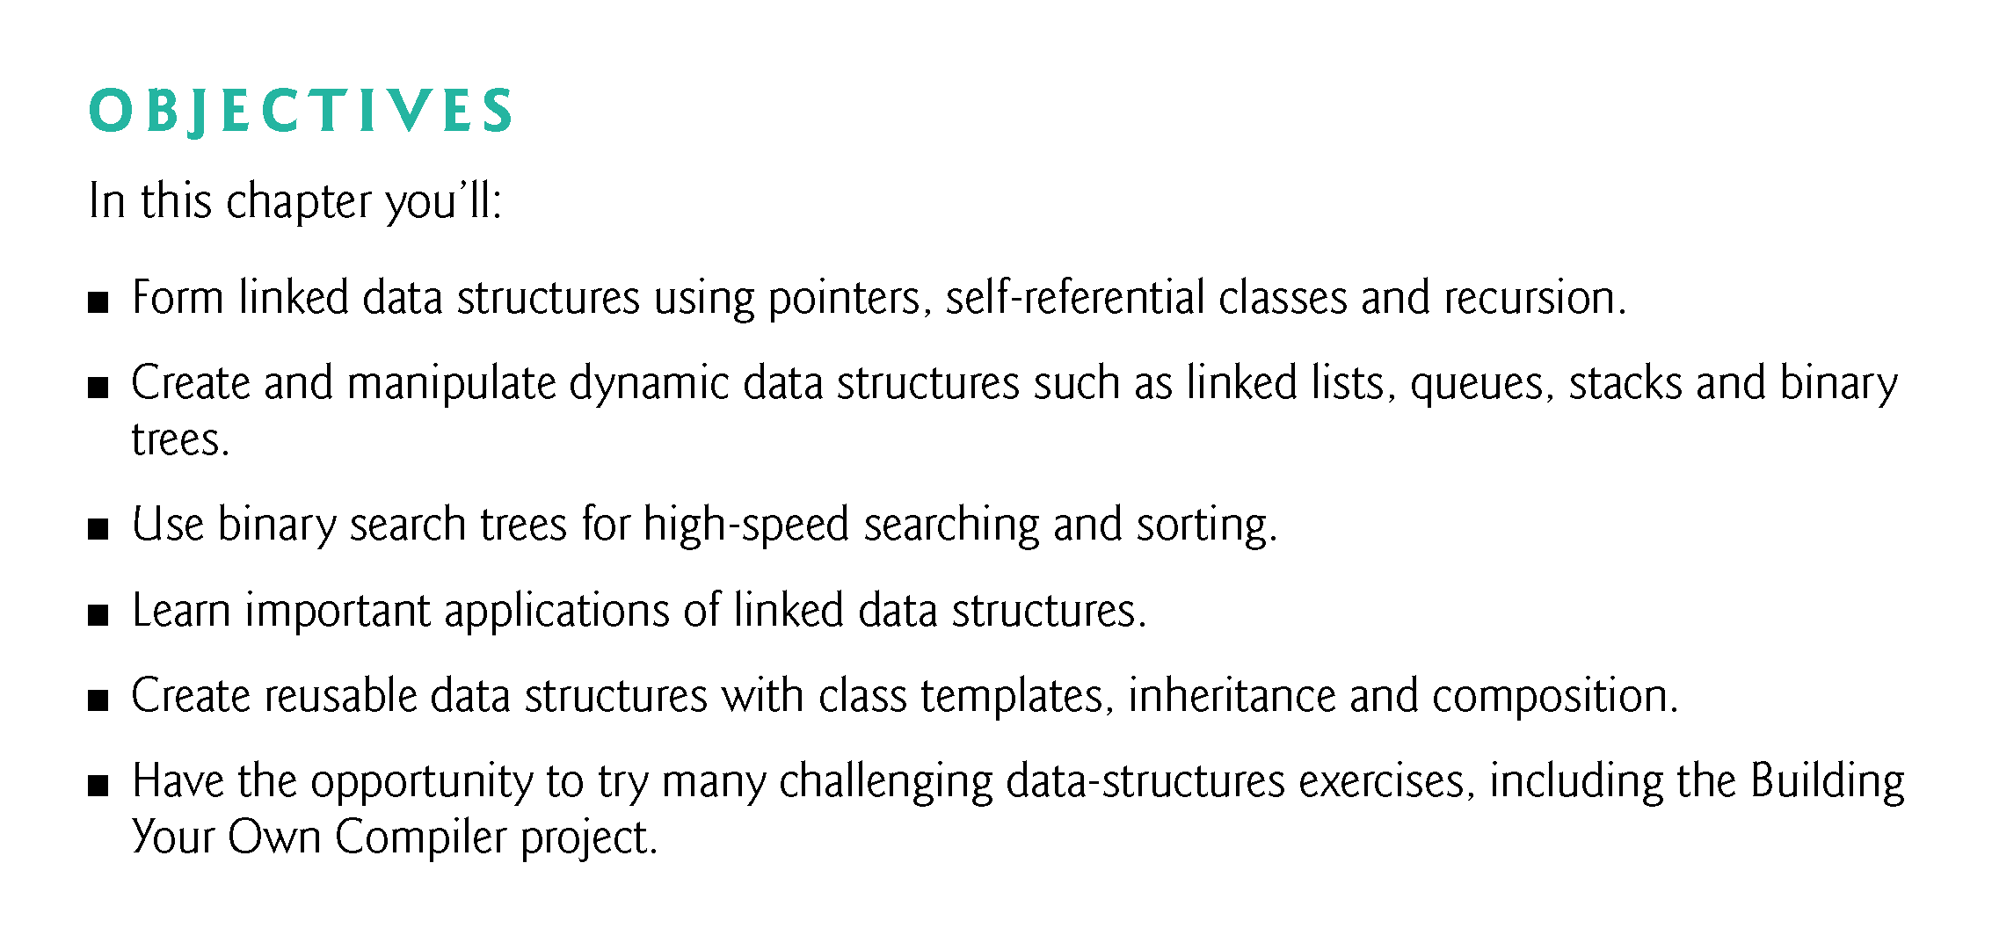

Slide 3
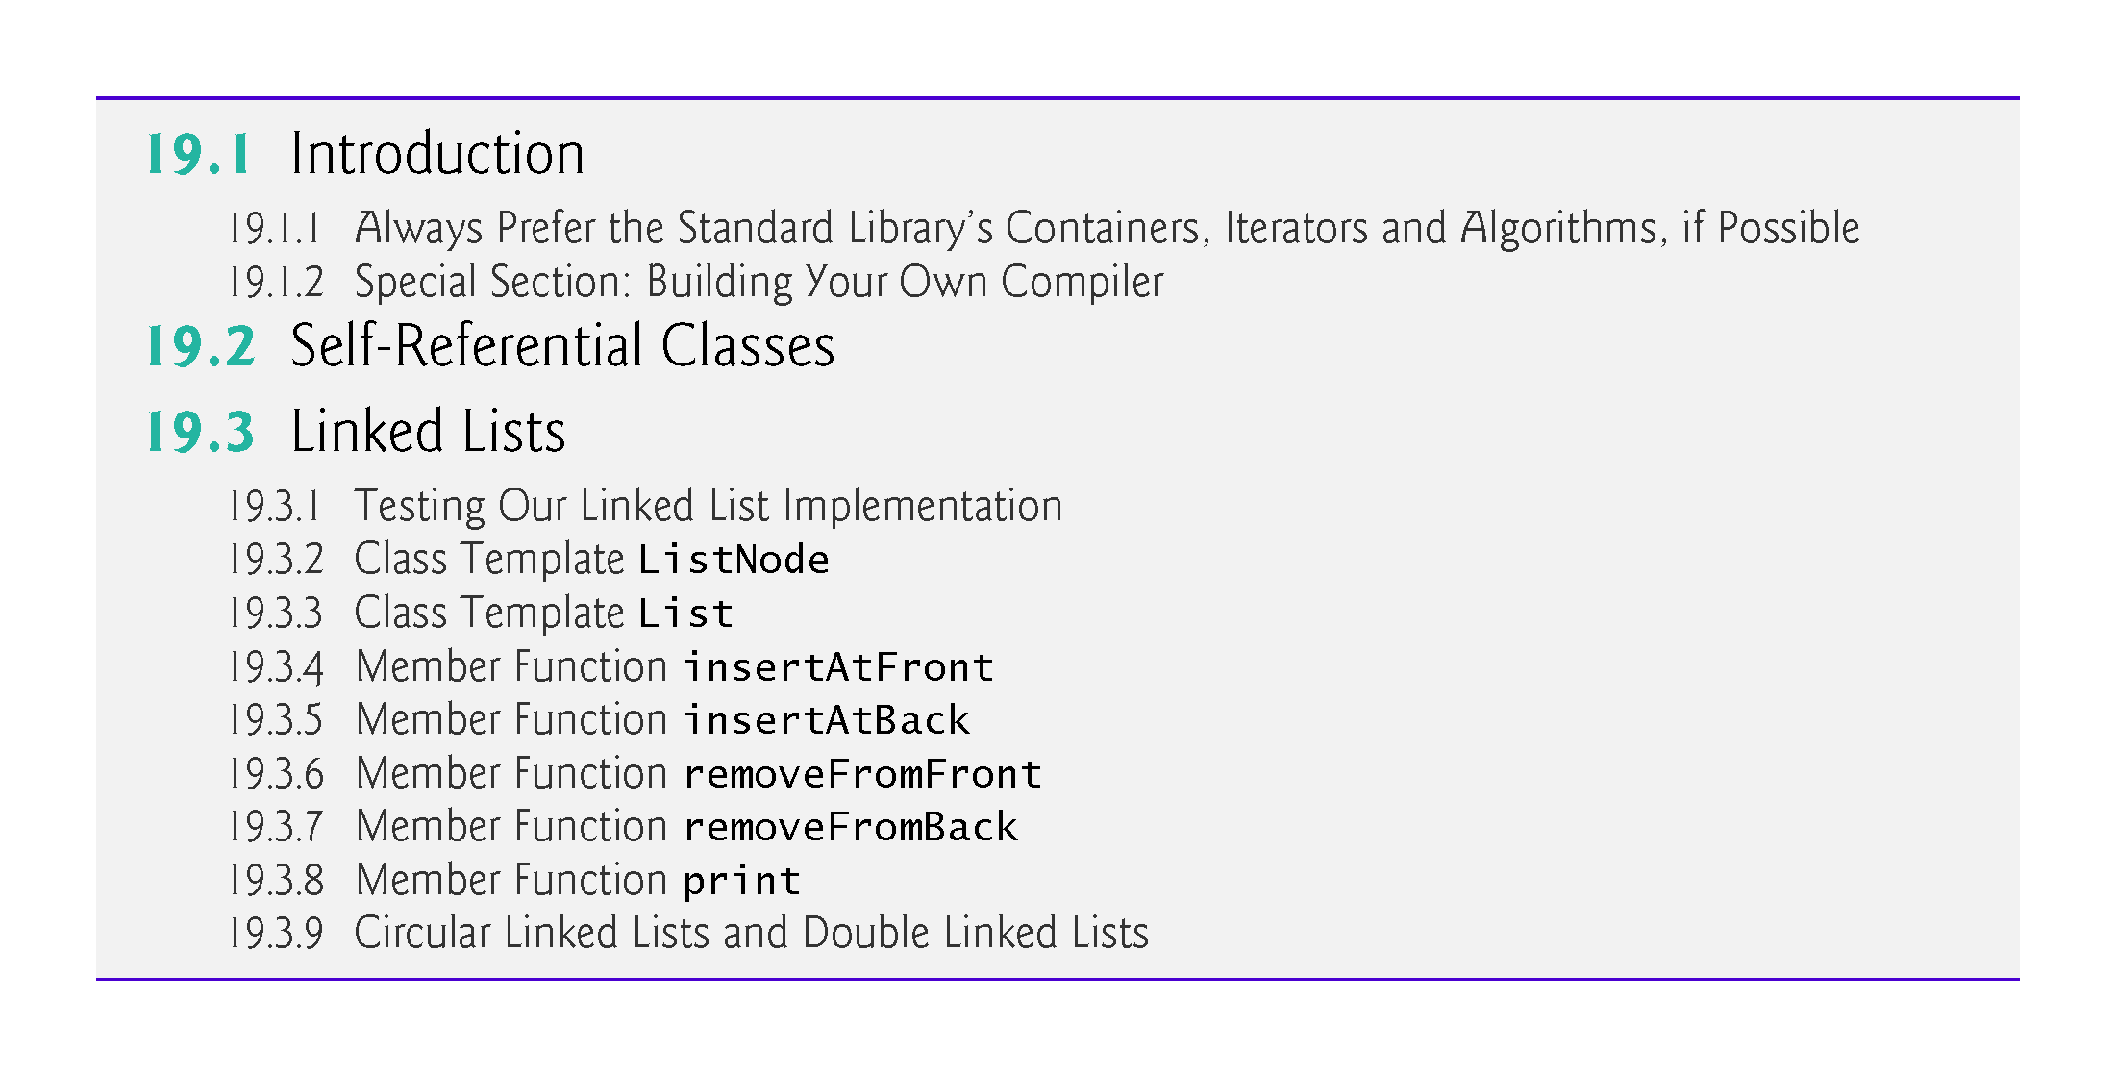

Slide 4
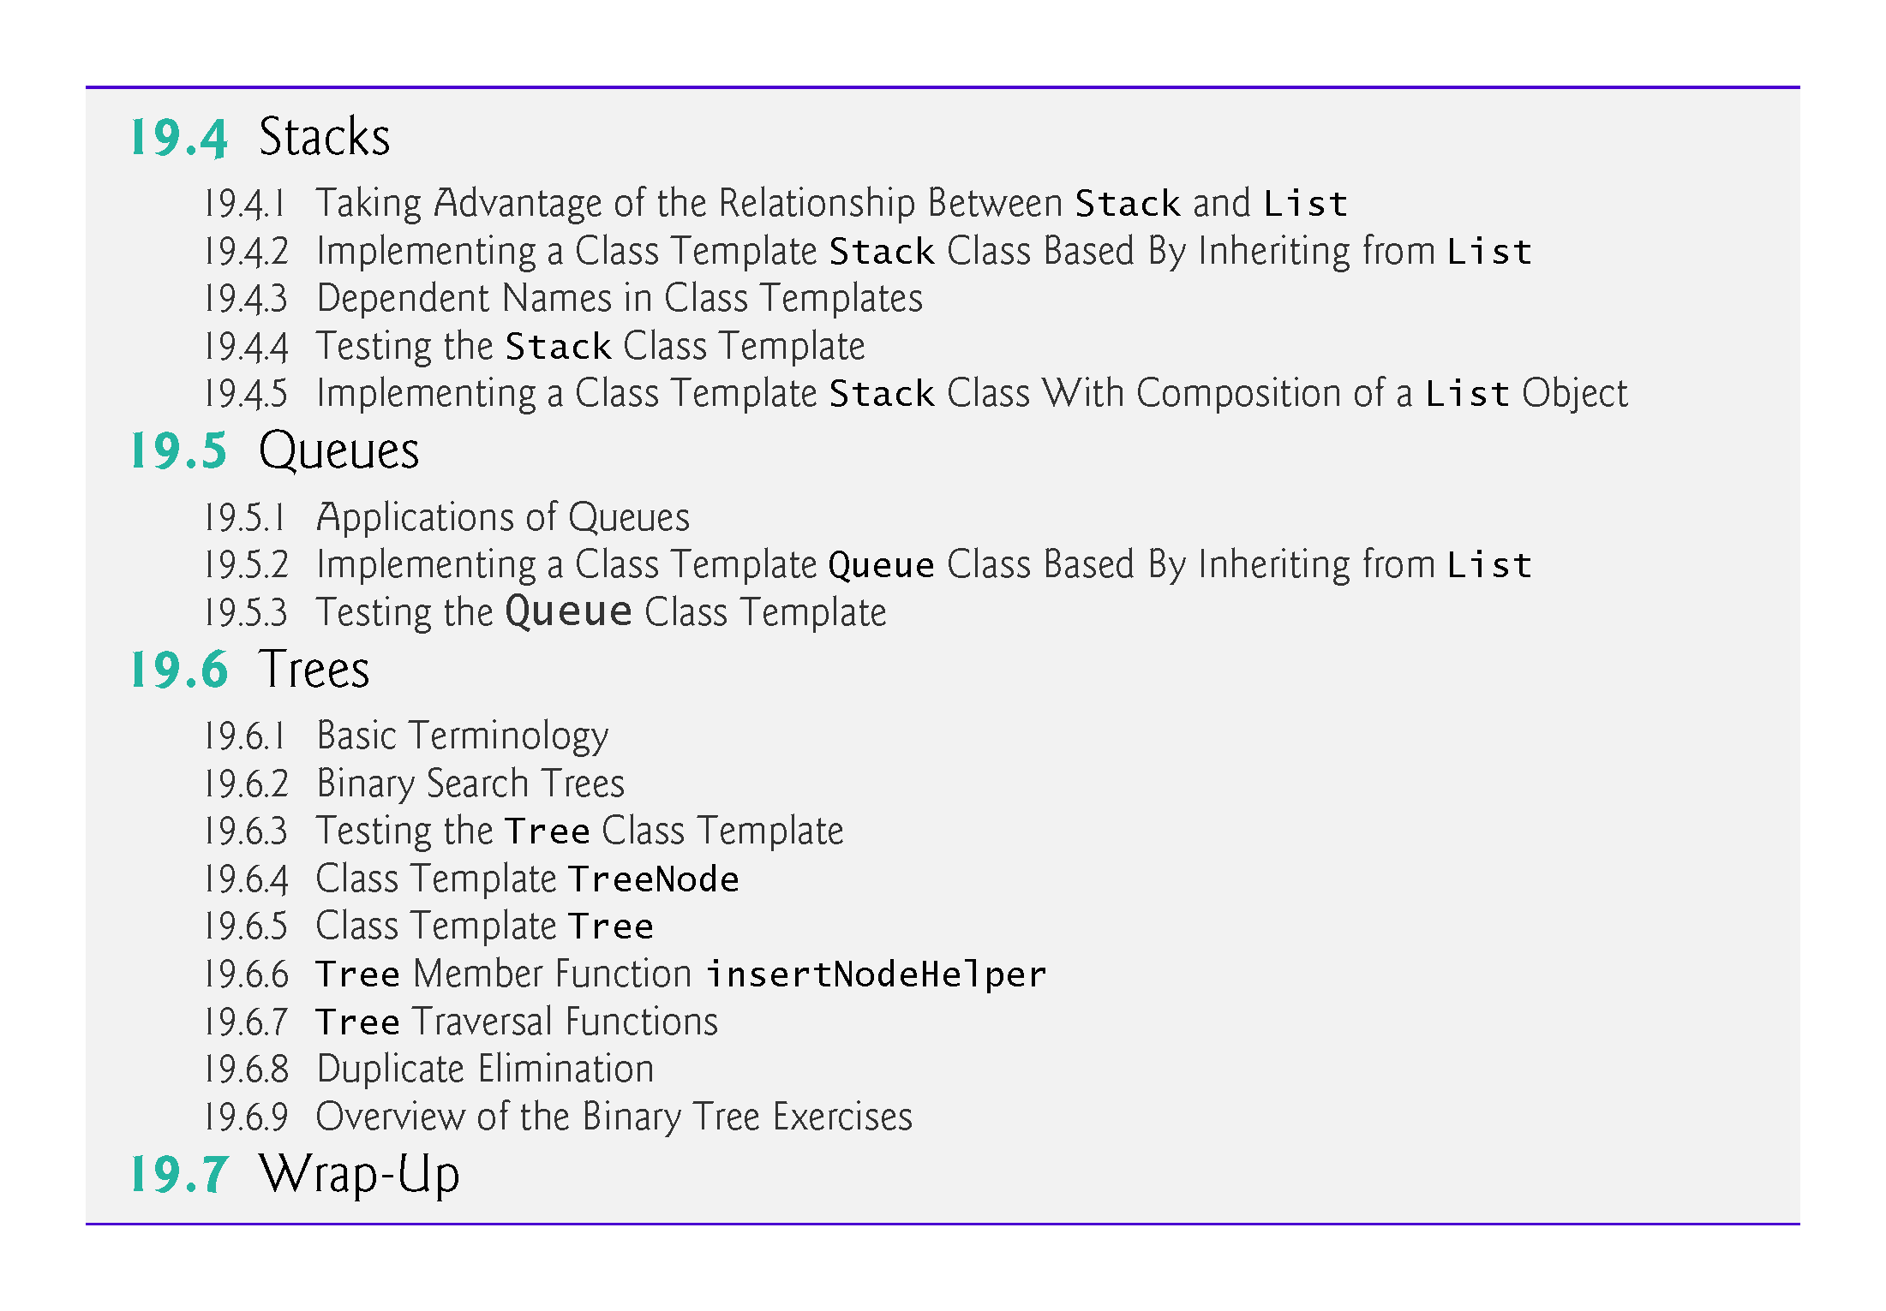

Slide 5
19.1 Introduction
We’ve studied fixed-size data structures—such as one and two-dimensional template-based arrays and built-in arrays (Chapter 8)—and various C++ Standard Library dynamic data structures (vectors in Chapter 7 and other template-based containers in Chapter 15) that can grow and shrink during execution.
In this chapter, we demonstrate how you can create your own custom templatized dynamic data structures.

Slide 6
19.1 Introduction
Linked lists are collections of data items logically “lined up in a row”—insertions and removals are made anywhere in a linked list.
Stacks are important in compilers and operating systems: Insertions and removals are made only at one end of a stack—its top.
Queues represent waiting lines; insertions are made at the back (also referred to as the tail) of a queue and removals are made from the front (also referred to as the head) of a queue.
Binary trees facilitate searching and sorting of data, duplicate elimination and compiling expressions into machine code.
We use classes, class templates, inheritance and composition to create and package these data structures for reusability and maintainability.

Slide 7
19.1.1 Always Prefer the Standard Library’s Containers, Iterators and Algorithms, if Possible
The C++ Standard Library’s containers, iterators for traversing those containers and algorithms for processing the containers’ elements meet the needs of most C++ programmers.
The Standard Library code is carefully written to be correct, portable, efficient and extensible.
Understanding how to build custom templatized data structures will also help you use the Standard Library containers, iterators and algorithms, more effectively.

Slide 8
19.2 Self-Referential Classes
A self-referential class contains a pointer member that points to a class object of the same class type.
Sample Node class definition:
class Node { public: explicit Node(int); // constructor void setData(int); // set data member int getData() const; // get data member void setNextPtr(Node*); // set pointer to next Node Node* getNextPtr() const; // get pointer to next Node private: int data; // data stored in this Node Node* nextPtr; // pointer to another object of same type };

Slide 9
19.2 Self-Referential Classes (cont.)
Member nextPtr points to an object of type Node—an object of the same type as the one being declared here, hence the term “self-referential class.”
Member nextPtr is referred to as a link—i.e., nextPtr can “tie” an object of type Node to another object of the same type.
Self-referential class objects can be linked together to form useful data structures such as lists, queues, stacks and trees.
Figure 19.1 illustrates two self-referential class objects linked together to form a list.
Note that a slash—representing a null pointer (nullptr)—is placed in the link member of the second self-referential class object to indicate that the link does not point to another object.
The slash is for illustration purposes only; it does not correspond to the backslash character in C++.
A null pointer normally indicates the end of a data structure.

Slide 10


Slide 11
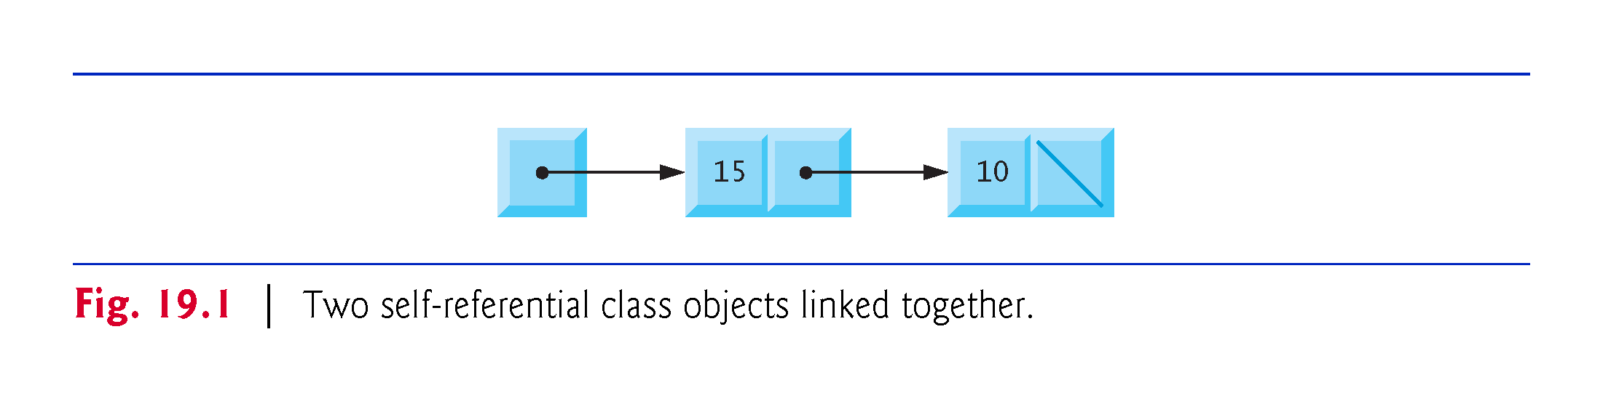

Slide 12
19.3 Linked Lists
A linked list is a linear collection of self-referential class objects, called nodes, connected by pointer links—hence, the term “linked” list.
A linked list is accessed via a pointer to the list’s first node.
Each subsequent node is accessed via the link-pointer member stored in the previous node.
By convention, the link pointer in the last node of a list is set to nullptr to mark the end of the list.
Data is stored in a linked list dynamically—each node is created and destroyed as necessary.
A node can contain data of any type, including objects of other classes.

Slide 13
19.3 Linked Lists (cont.)
If nodes contain base-class pointers to base-class and derived-class objects related by inheritance, we can have a linked list of such nodes and process them polymorphically using virtual function calls.
Stacks and queues are also linear data structures and, as we’ll see, can be viewed as constrained versions of linked lists.
Trees are nonlinear data structures.

Slide 14
19.3 Linked Lists (cont.)
Linked lists provide several advantages over array objects and built-in arrays.
A linked list is appropriate when the number of data elements to be represented at one time is unpredictable.
Linked lists are dynamic, so the length of a list can increase or decrease as necessary.
The size of an array object or built-in array, however, cannot be altered, because the array size is fixed at compile time.
An array object or built-in array can become full.
Linked lists become full only when the system has insufficient memory to satisfy dynamic storage allocation requests.

Slide 15
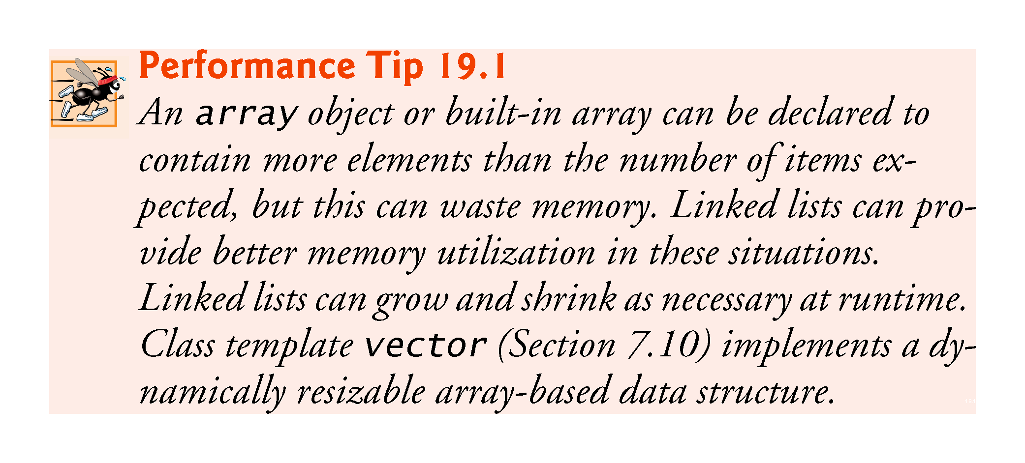

Slide 16
19.3 Linked Lists (cont.)
Linked lists can be maintained in sorted order by inserting each new element at the proper point in the list.
Existing list elements do not need to be moved.
Pointers merely need to be updated to point to the correct node.

Slide 17
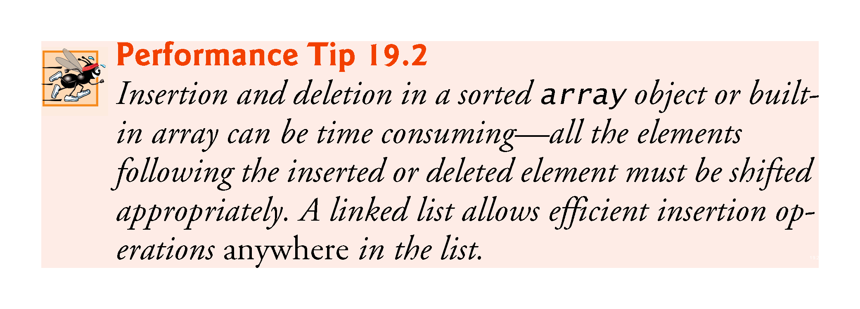

Slide 18
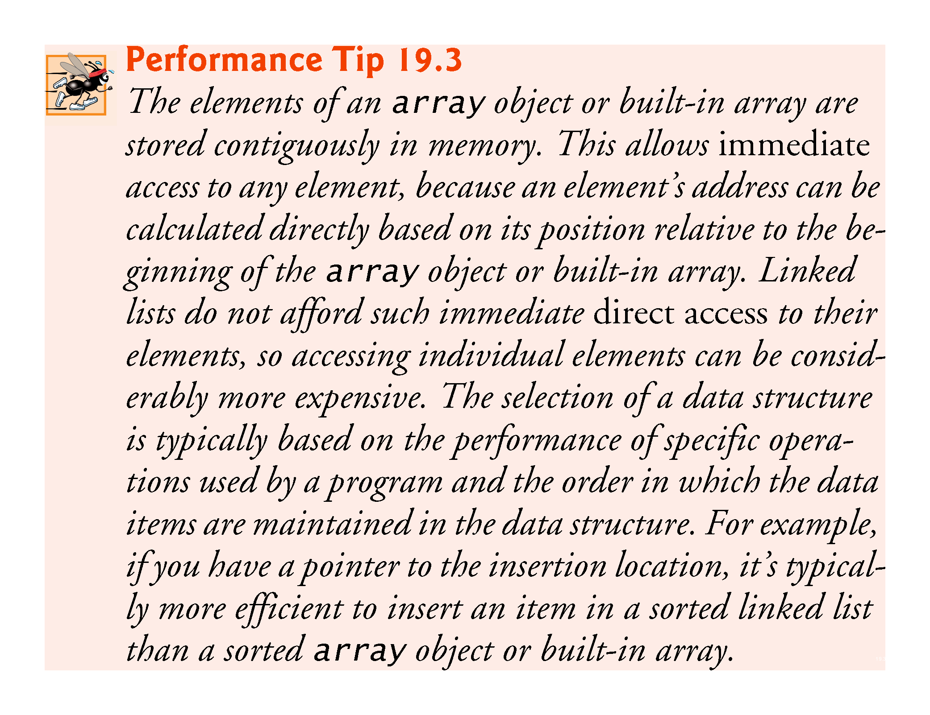

Slide 19
19.3 Linked Lists (cont.)
Linked-list nodes typically are not stored contiguously in memory, but logically they appear to be contiguous.
Figure 19.2 illustrates a linked list with several nodes.

Slide 20
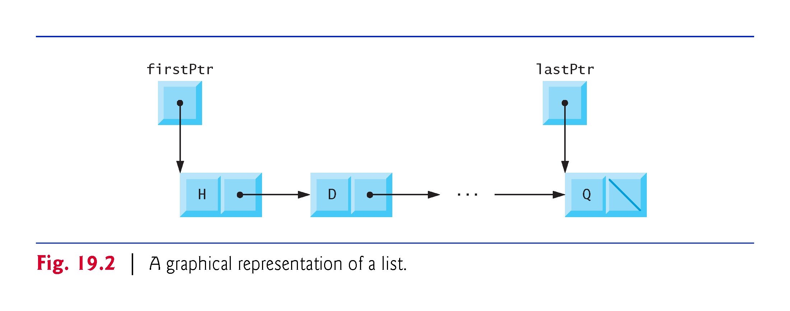

Slide 21


Slide 22
19.3.1 Testing Our Linked List Implementation
The program of Figs. 19.3–19.5 uses a List class template to manipulate a list of integer values and a list of floating-point values.

Slide 23
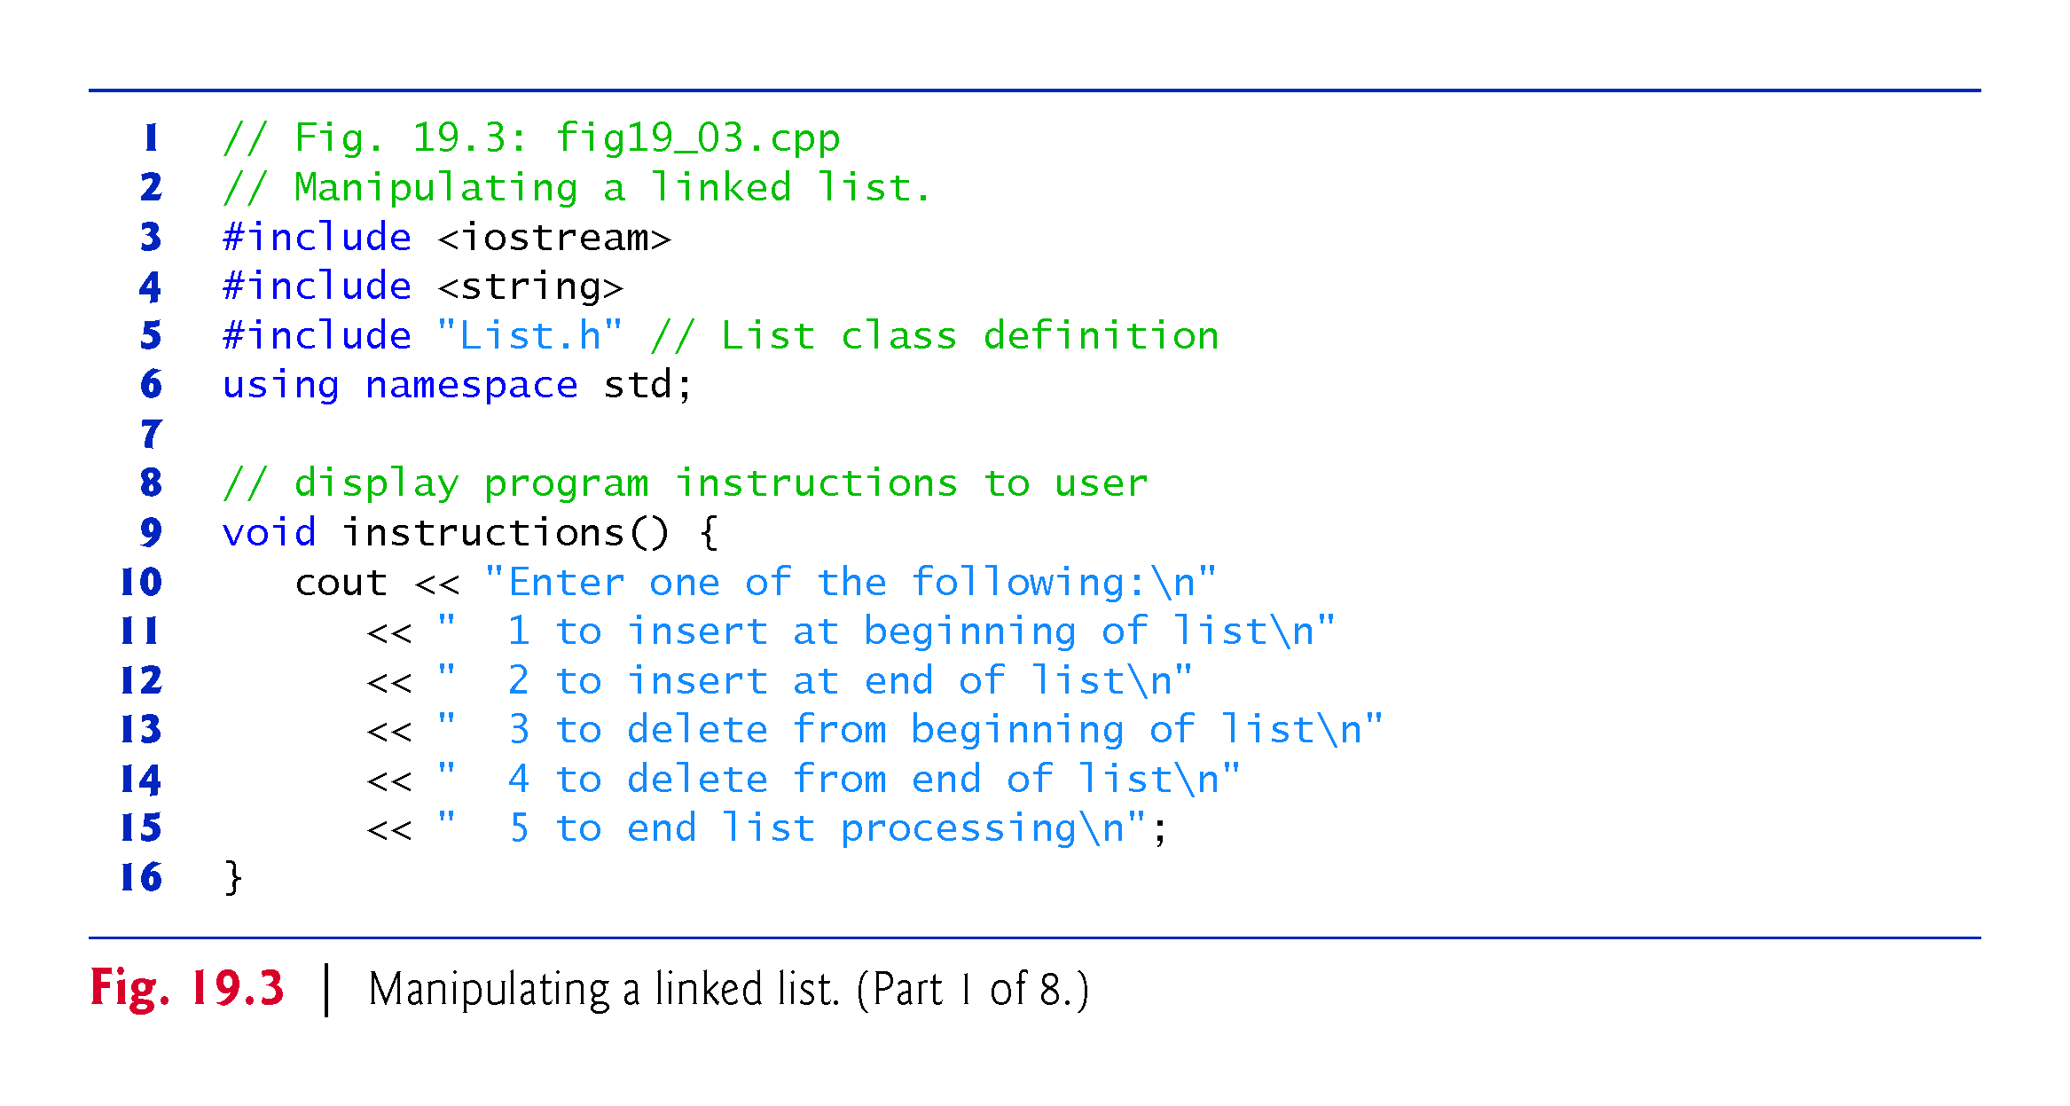

Slide 24
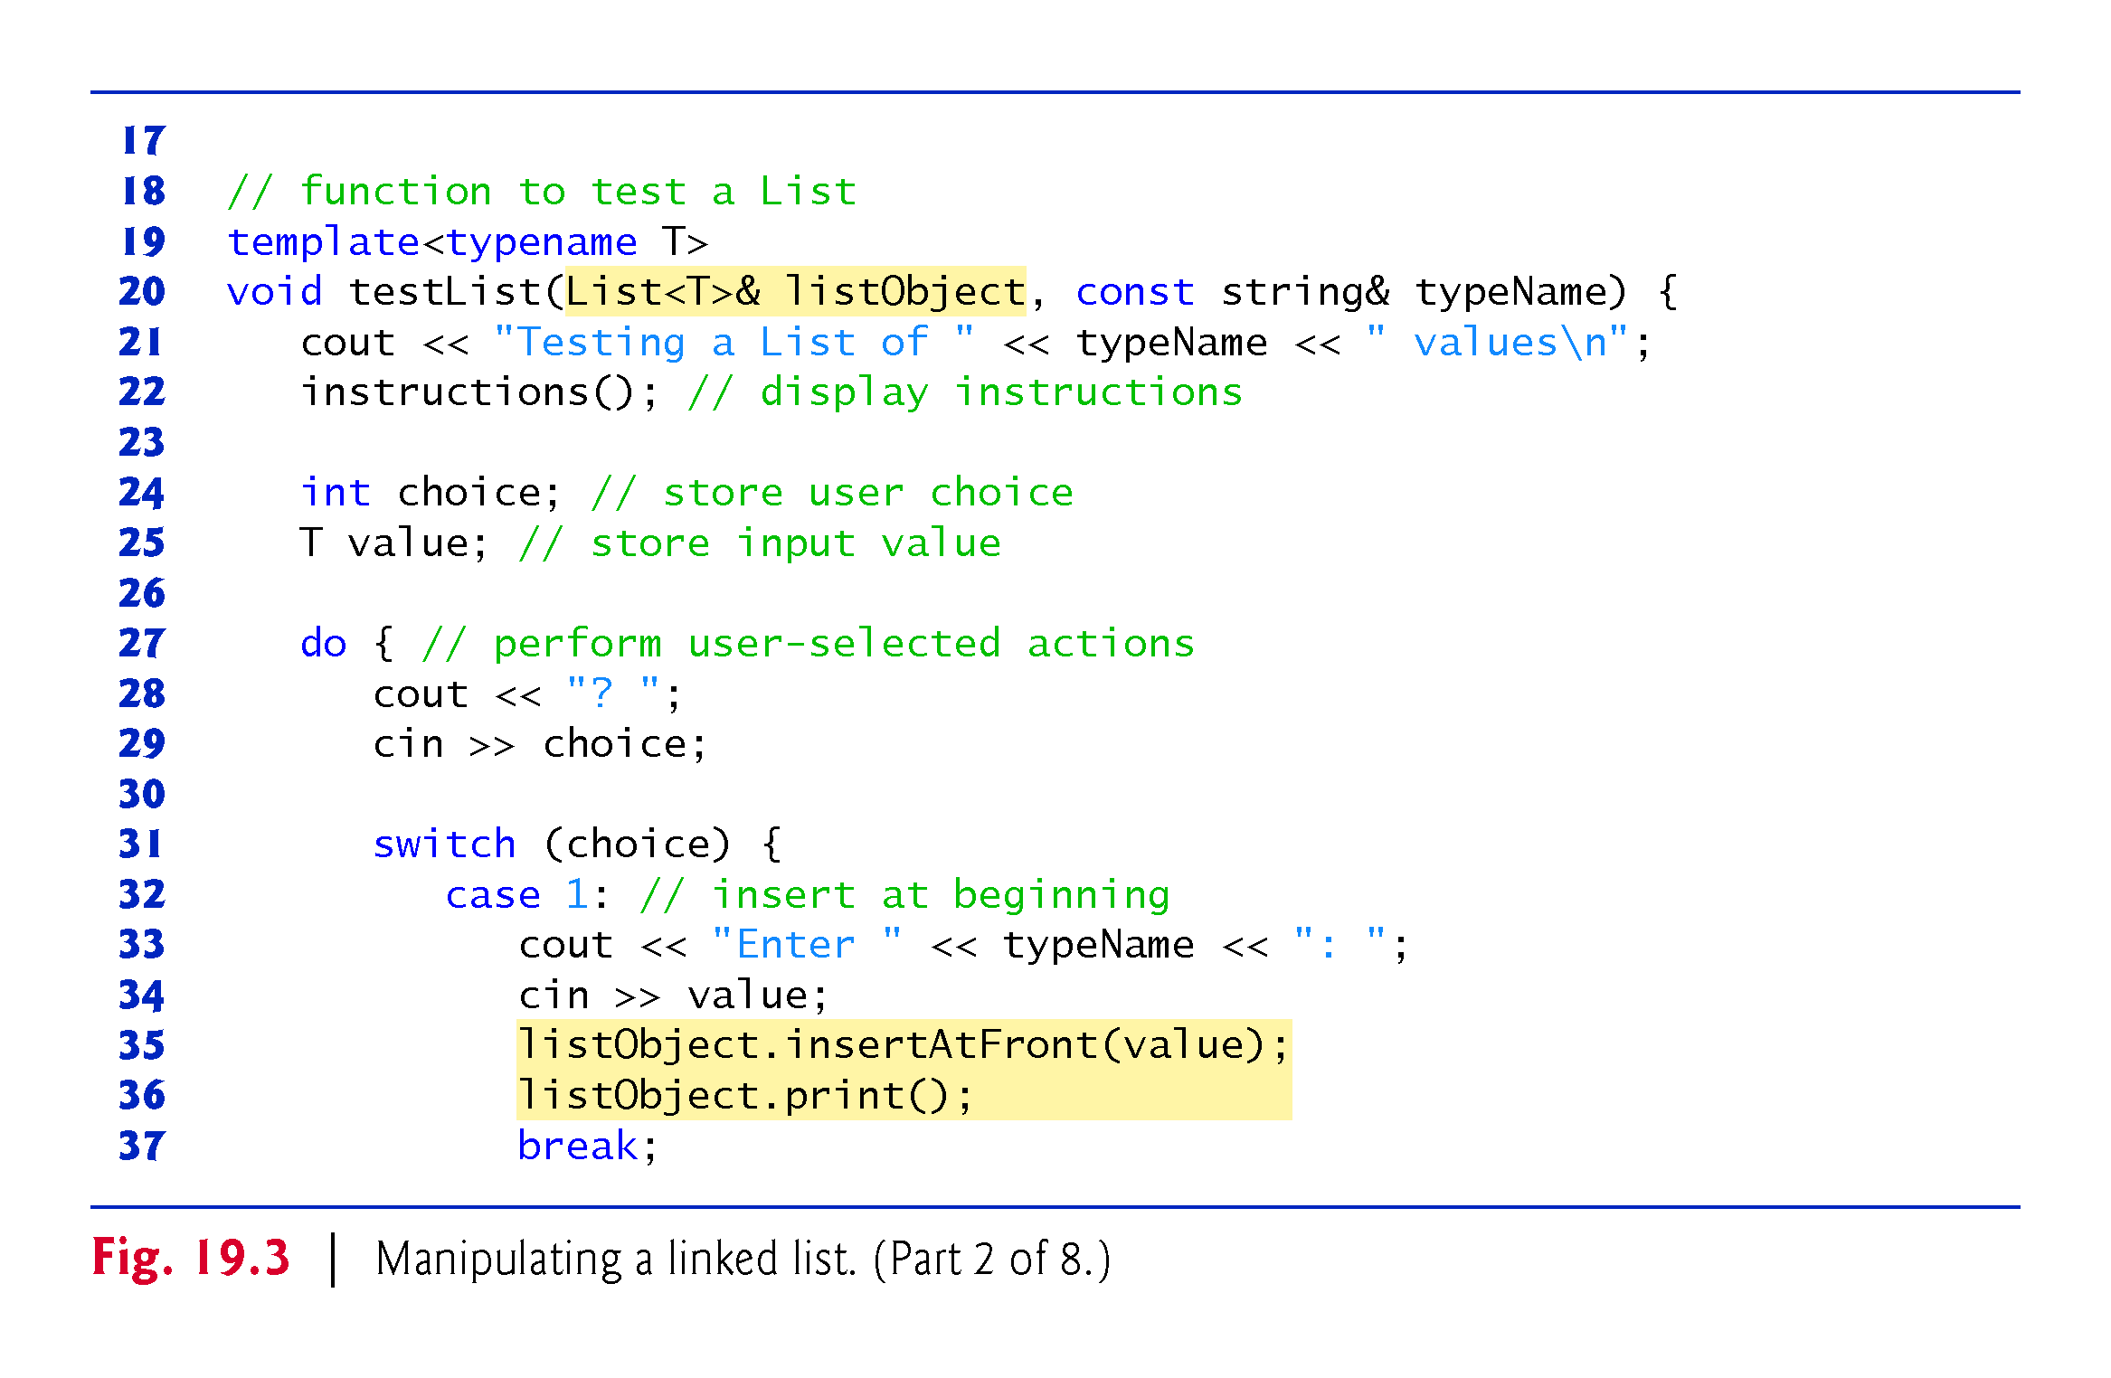

Slide 25
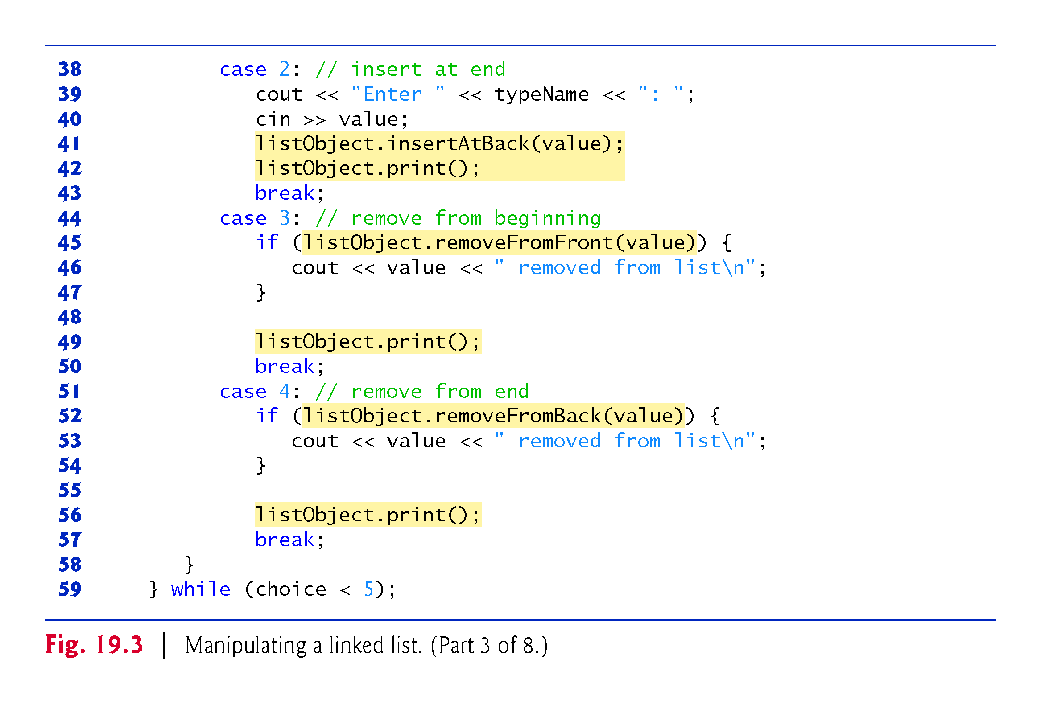

Slide 26
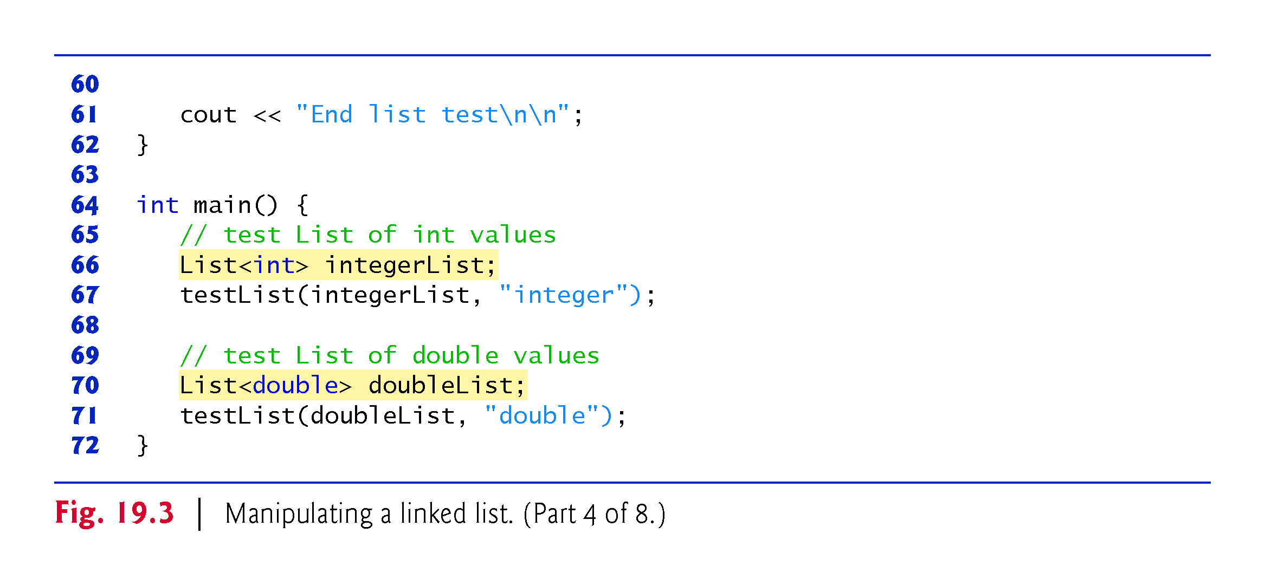

Slide 27
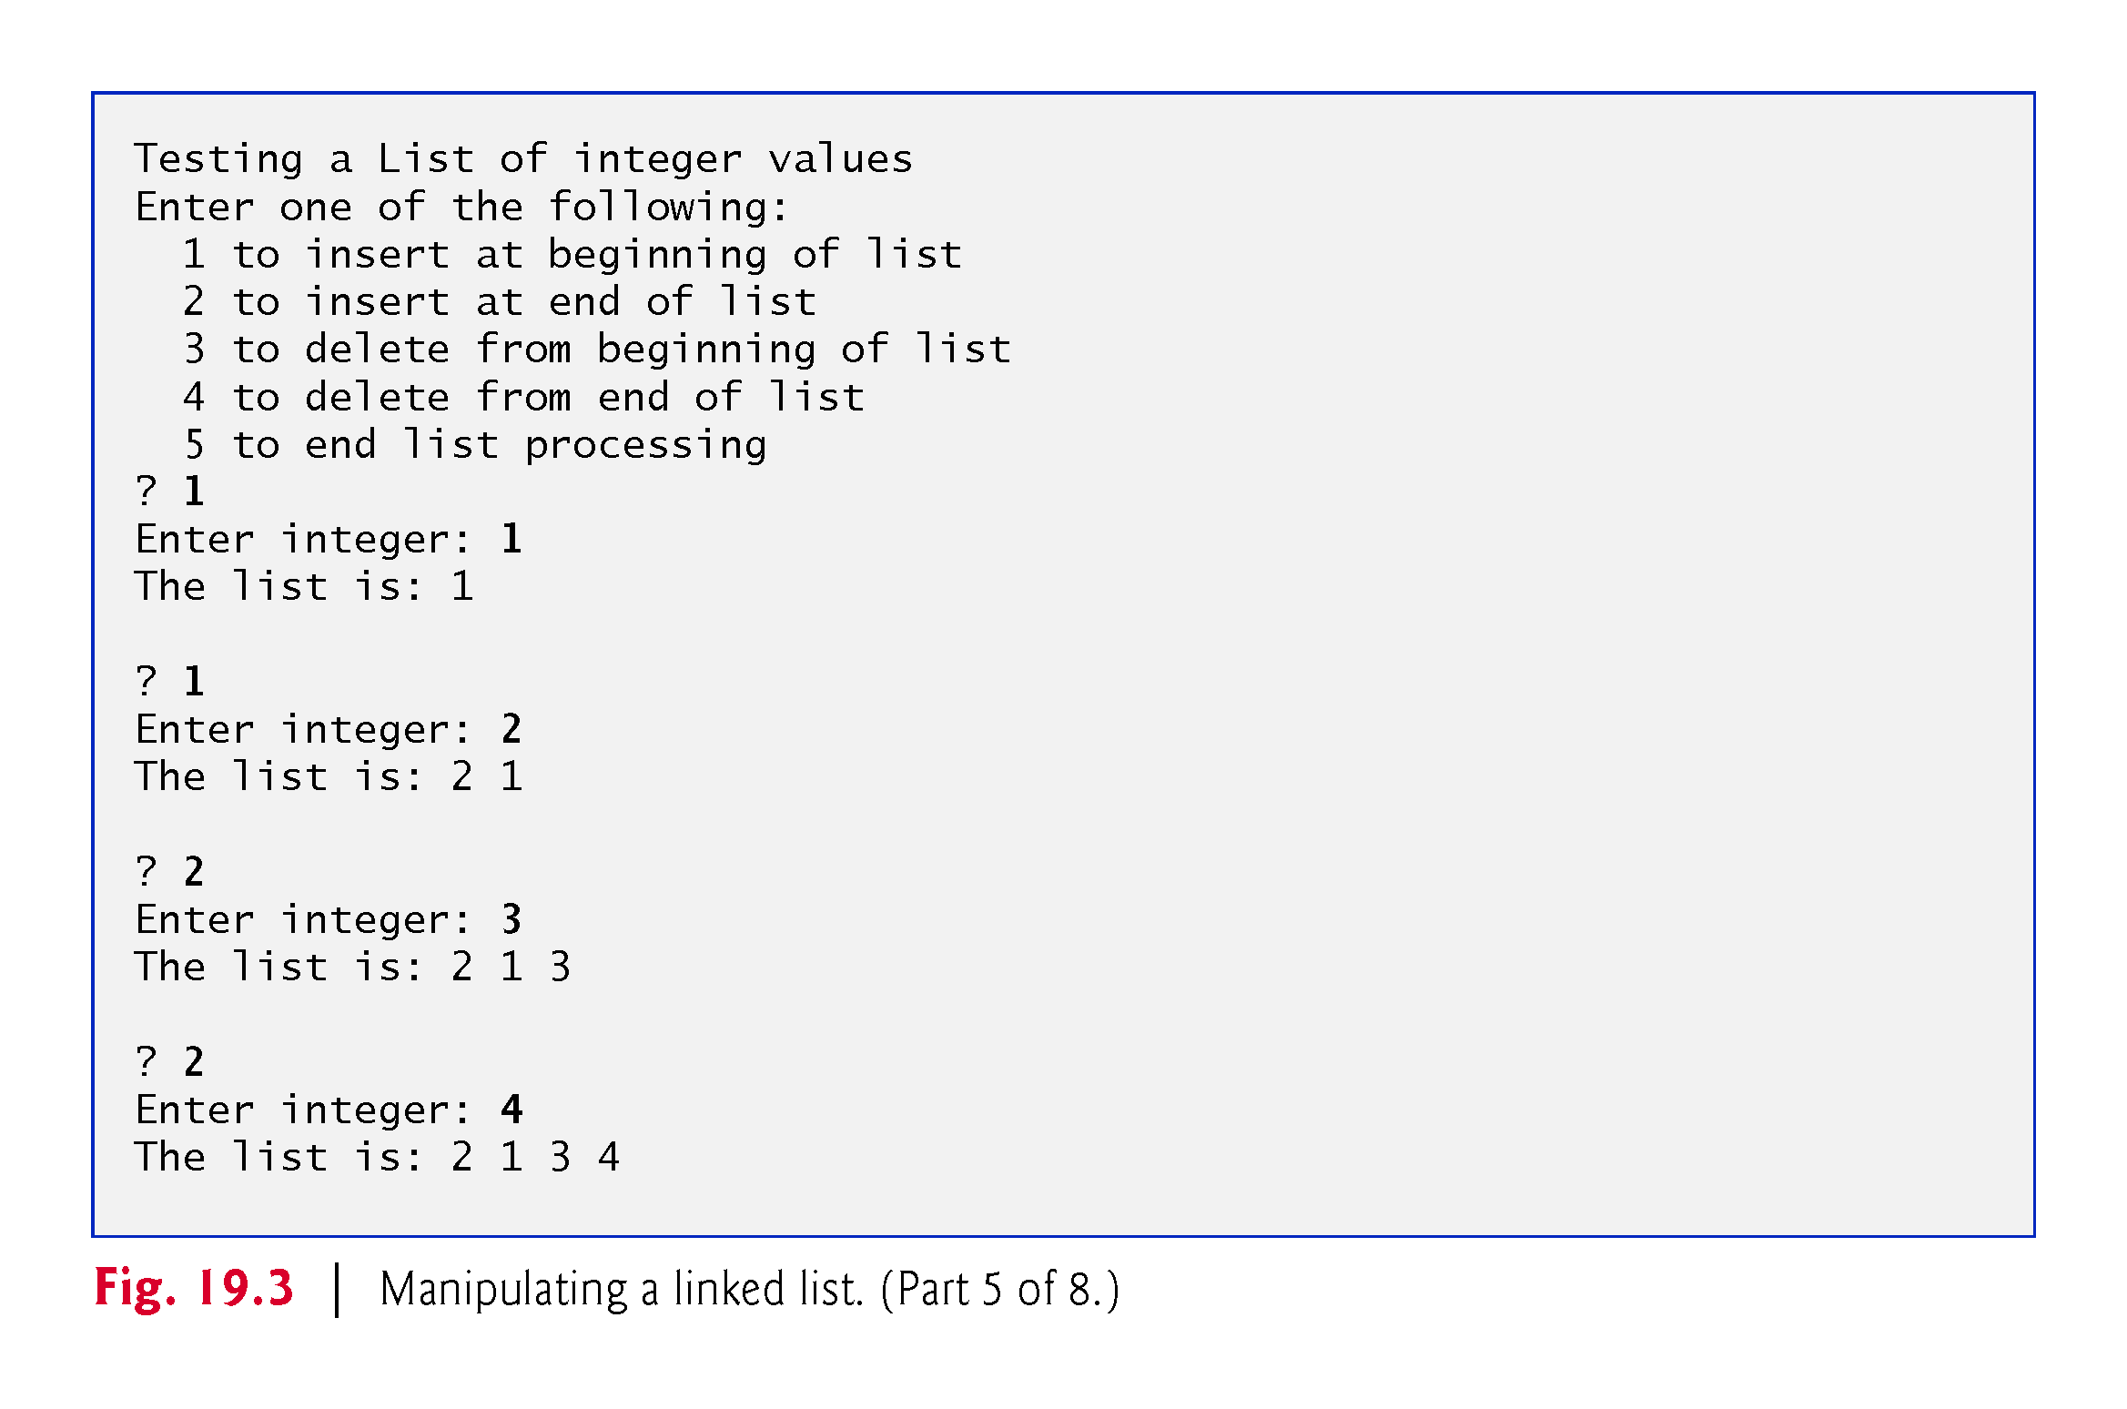

Slide 28
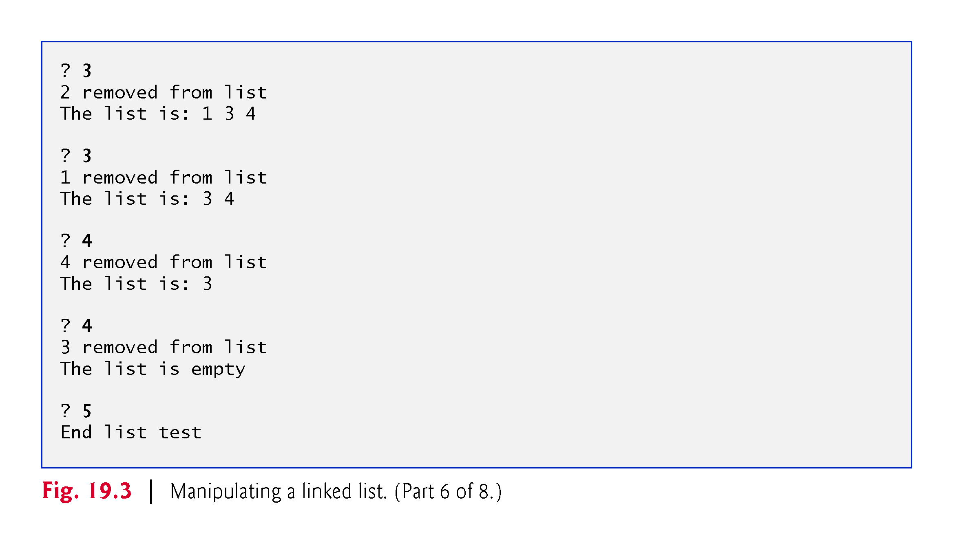

Slide 29
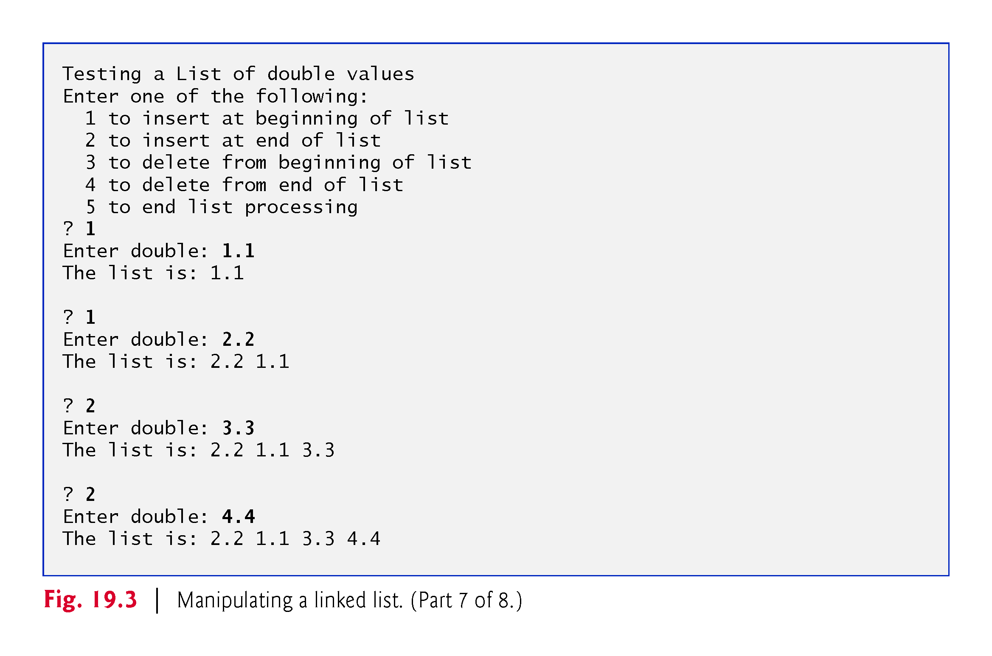

Slide 30
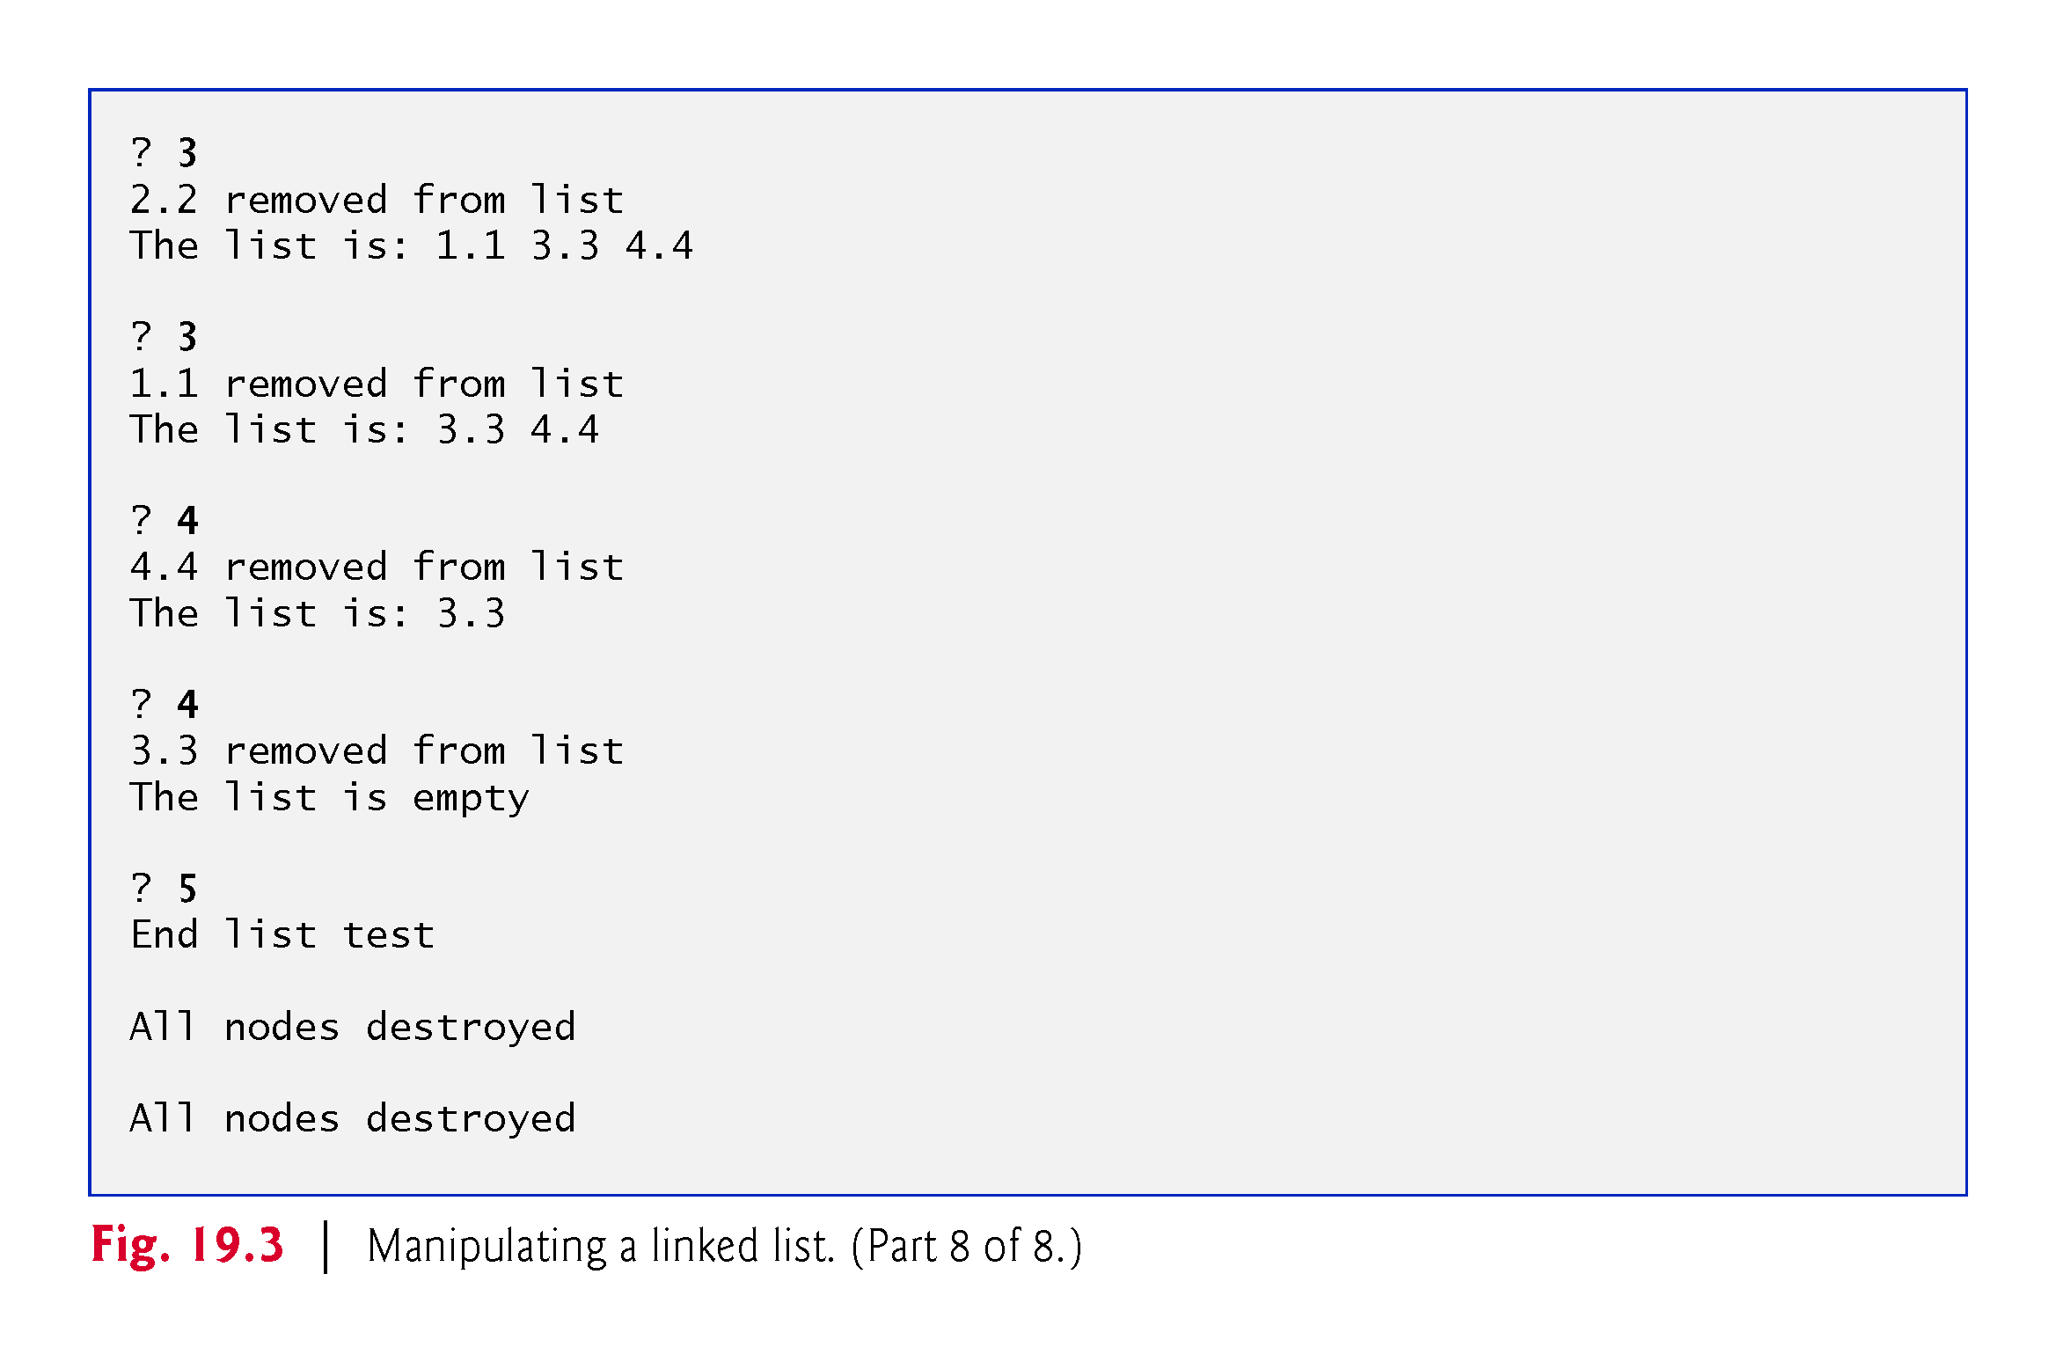

Slide 31
19.3.2 Class Template ListNode
Figure 19.3 uses class templates ListNode (Fig. 19.4) and List (Fig. 19.5).
Encapsulated in each List object is a linked list of ListNode objects.
Class template ListNode (Fig. 19.4) contains private members data and nextPtr (lines 20–21), a constructor (lines 15–16) to initialize these members and function getData (line 18) to return the data in a node.

Slide 32
19.3.2 Class Template ListNode
Member data stores a value of type NODETYPE, the type parameter passed to the class template.
Member nextPtr stores a pointer to the next ListNode object in the linked list.
Line 13 of the ListNode class template definition declares class List<NODETYPE> as a friend.
This makes all member functions of a given specialization of class template List friends of the corresponding specialization of class template ListNode, so they can access the private members of ListNode objects of that type.

Slide 33
19.3.2 Class Template ListNode
We do this for performance and because these two classes are tightly coupled—only class template List manipulates objects of class template ListNode.
Because the ListNode template parameter NODETYPE is used as the template argument for List in the friend declaration, ListNodes specialized with a particular type can be processed only by a List specialized with the same type (e.g., a List of int values manages ListNode objects that store int values).
To use the type name List<NODETYPE> in line 12, the compiler needs to know that class template List exists. Line 8 is a so-called forward declaration of class template List. A forward declaration tells the compiler that a type exists, even if it has not yet been defined.

Slide 34


Slide 35
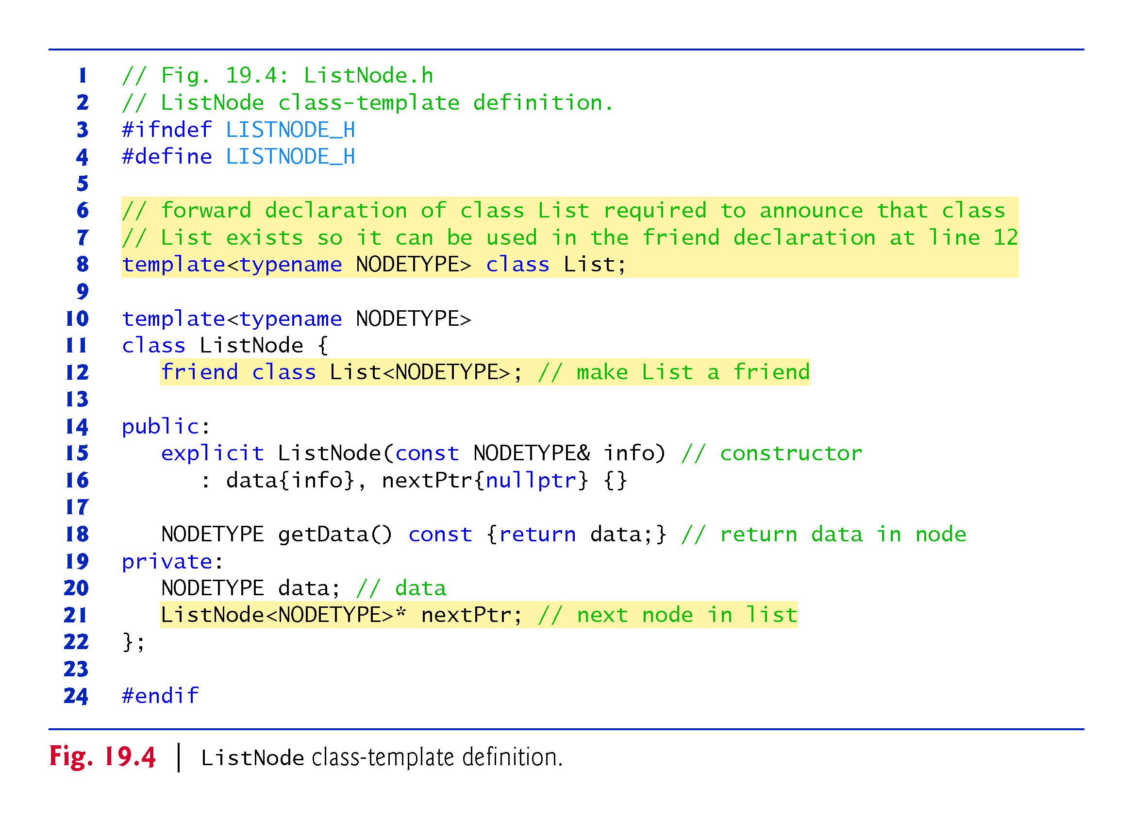

Slide 36
19.3.3 Class Template List
Lines 132–133 of the List class template (Fig. 19.5) declare and initialize to nullptr the private data members firstPtr and lastPtr—pointers to the List’s first and last ListNodes.
The destructor (lines 13–29) destroys all of the List’s ListNode objects when the List is destroyed.

Slide 37
19.3.3 Class Template List
The primary List functions are insertAtFront, insertAtBack, removeFromFront and removeFromBack.
Function isEmpty is called a predicate function
it does not alter the List; rather, it determines whether the List is empty.
If so, true is returned; otherwise, false is returned.
Function print displays the List’s contents.
Utility function getNewNode returns a dynamically allocated ListNode object.
Called from functions insertAtFront and insertAtBack.

Slide 38
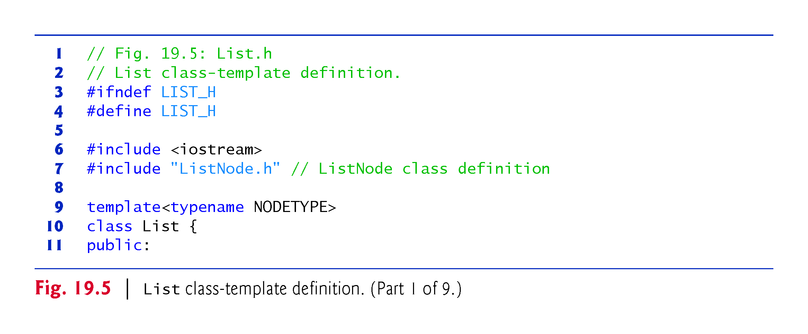

Slide 39
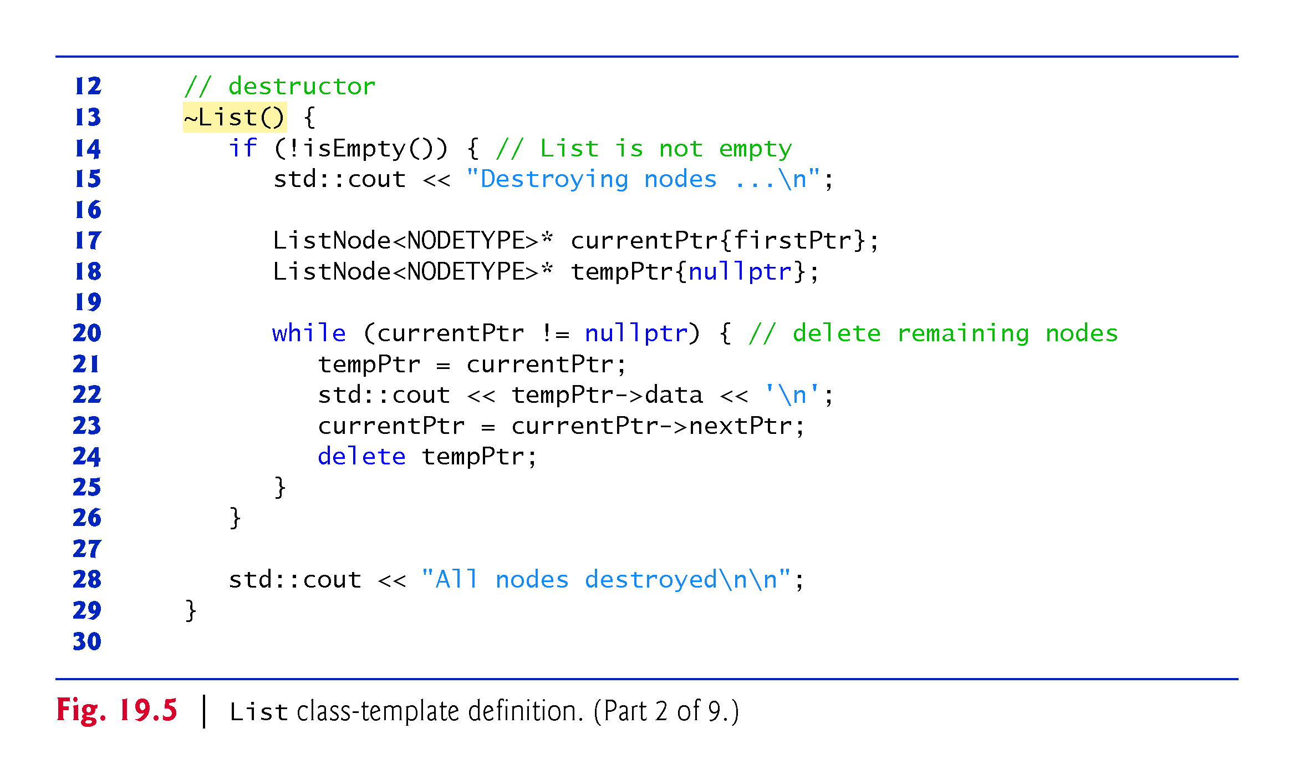

Slide 40
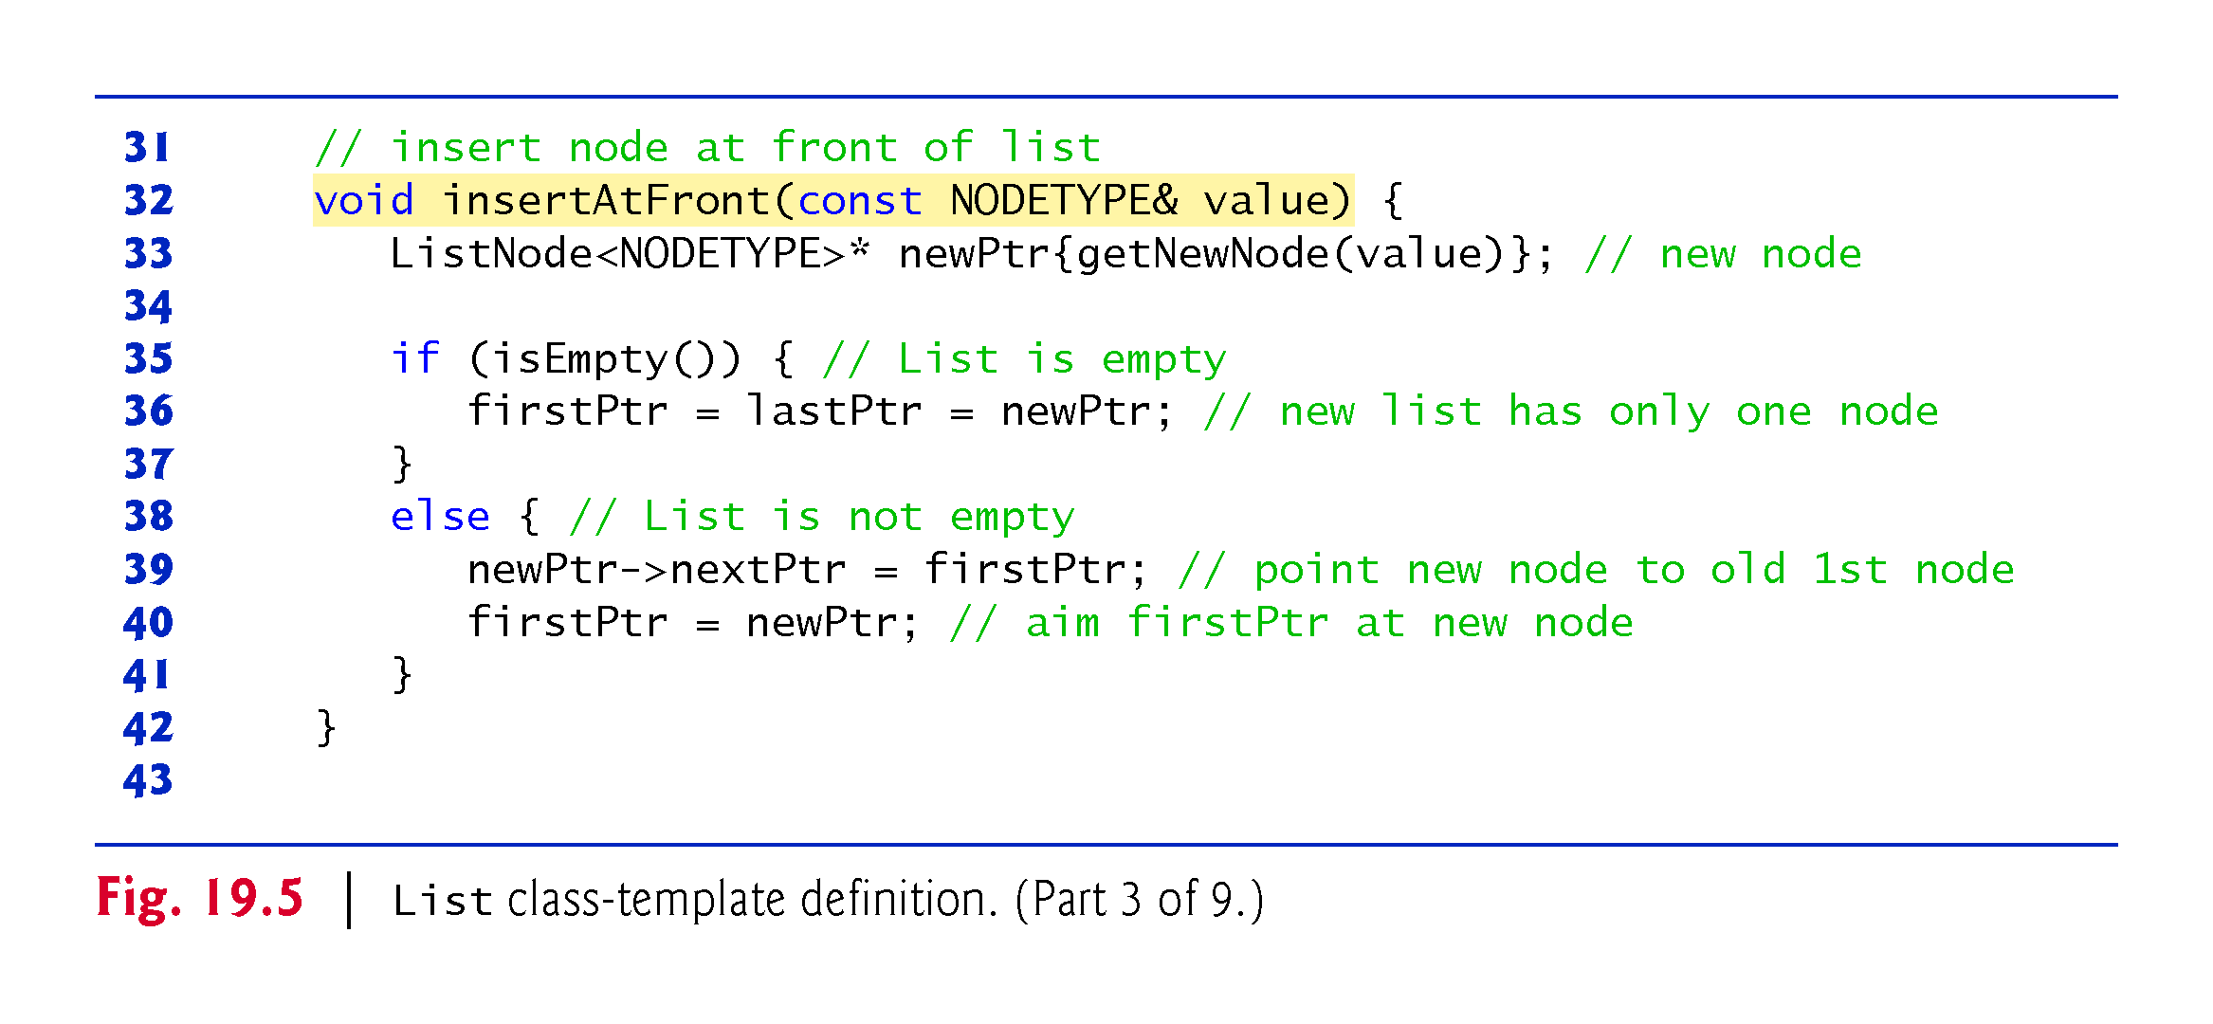

Slide 41
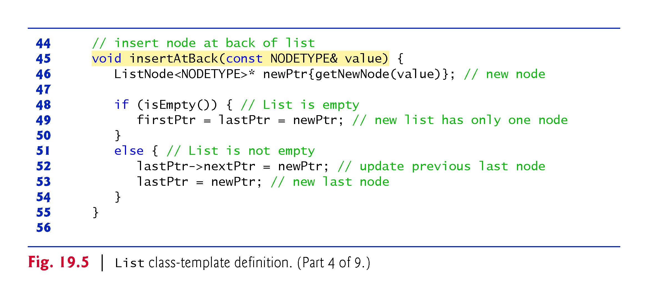

Slide 42
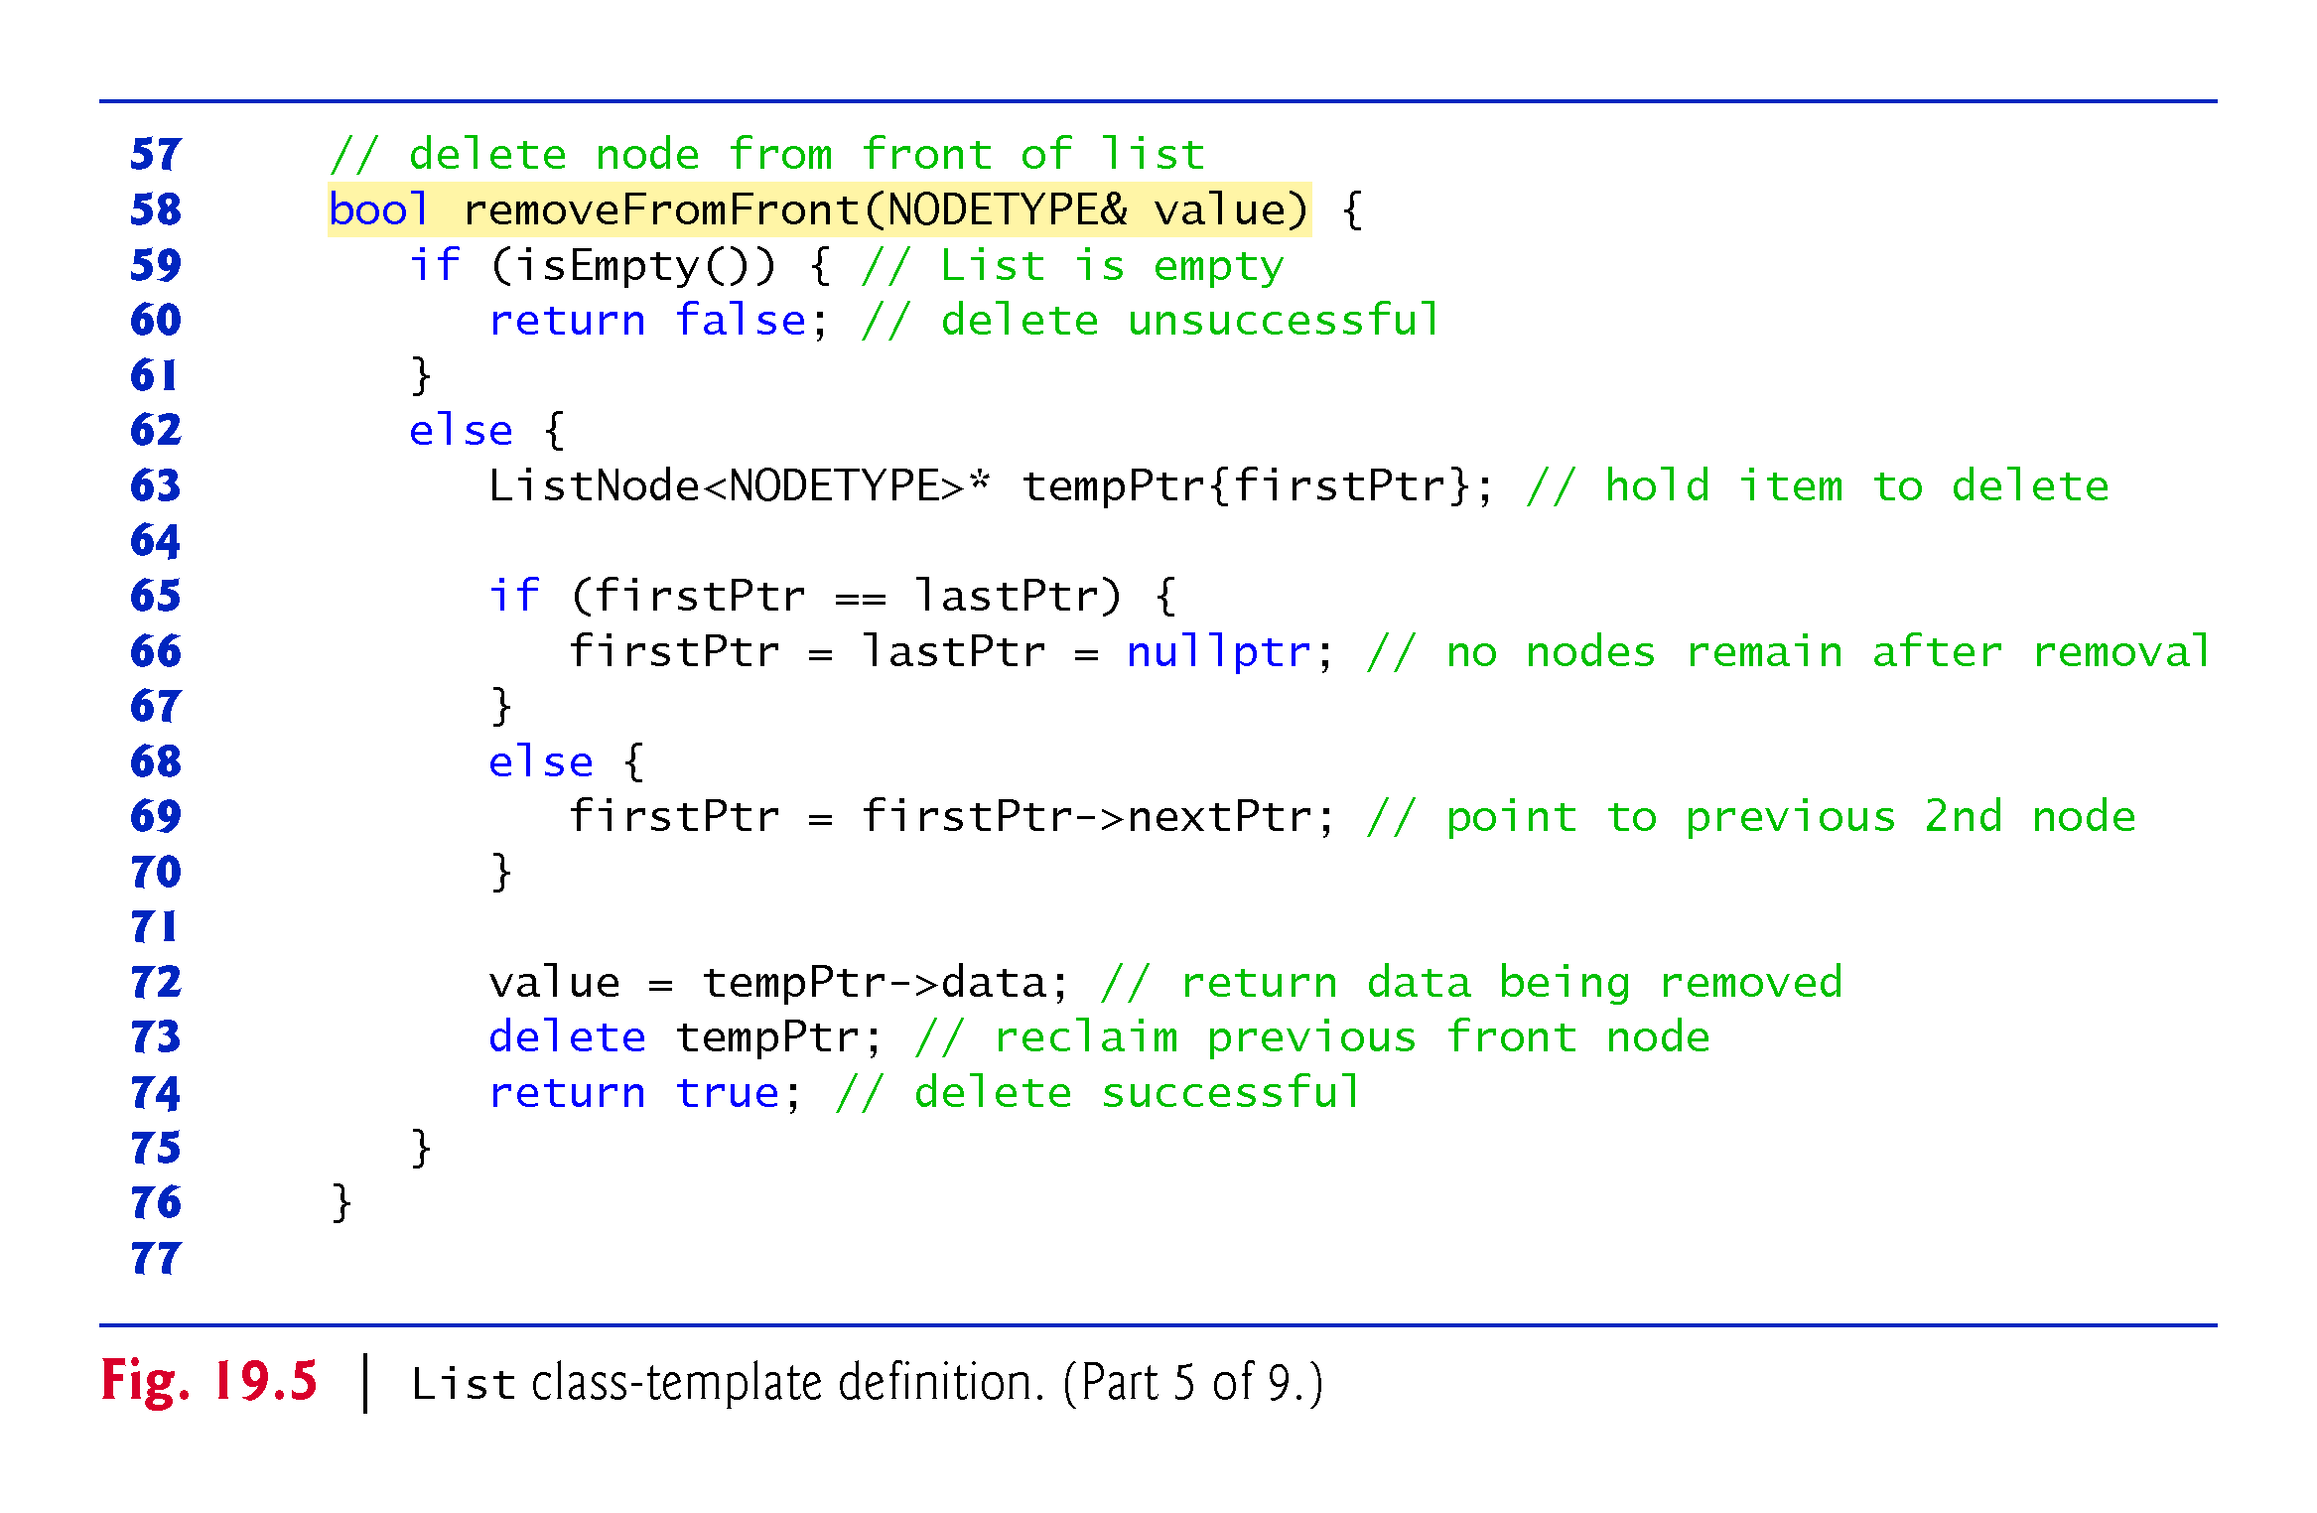

Slide 43
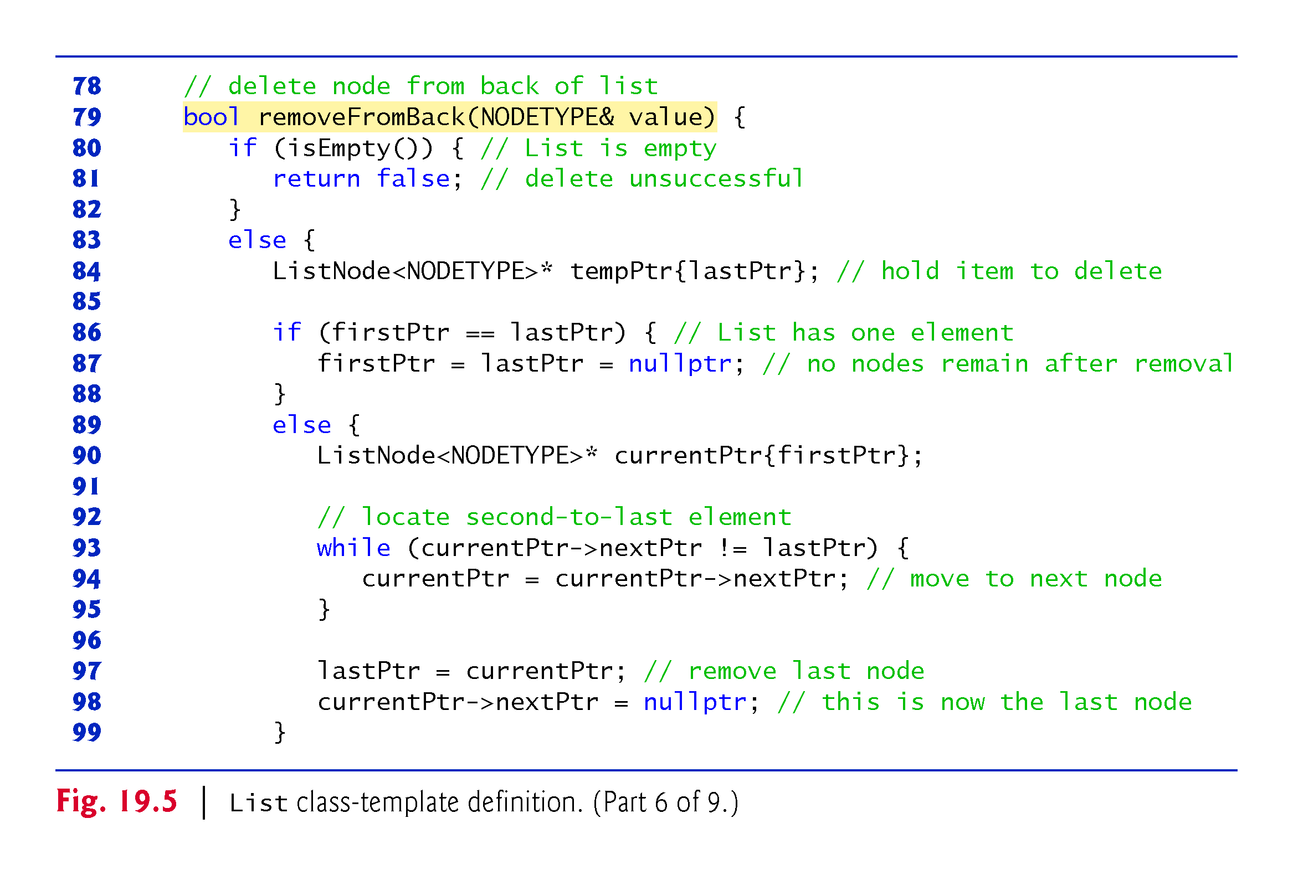

Slide 44
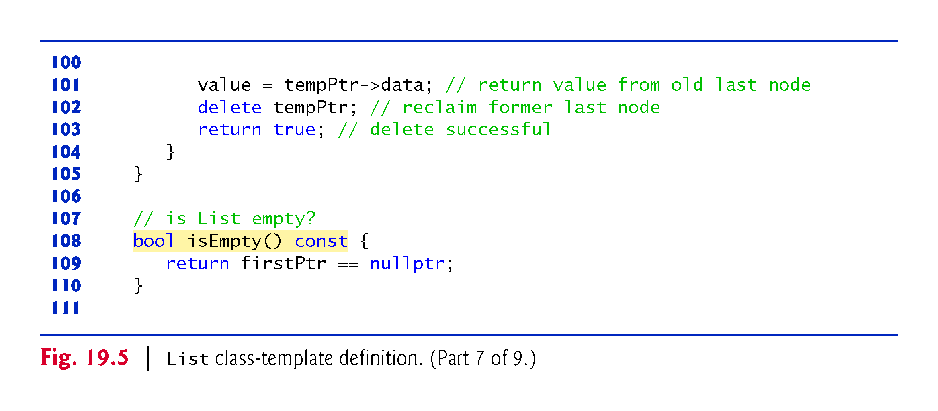

Slide 45
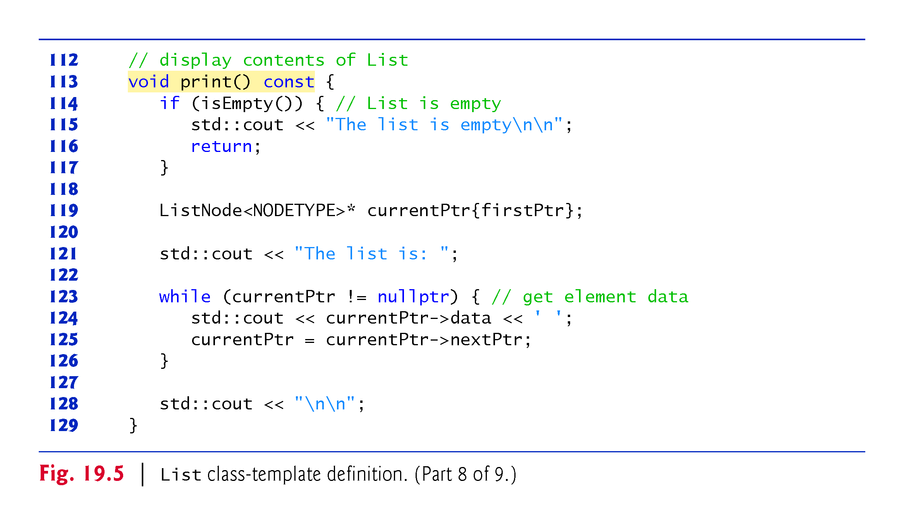

Slide 46
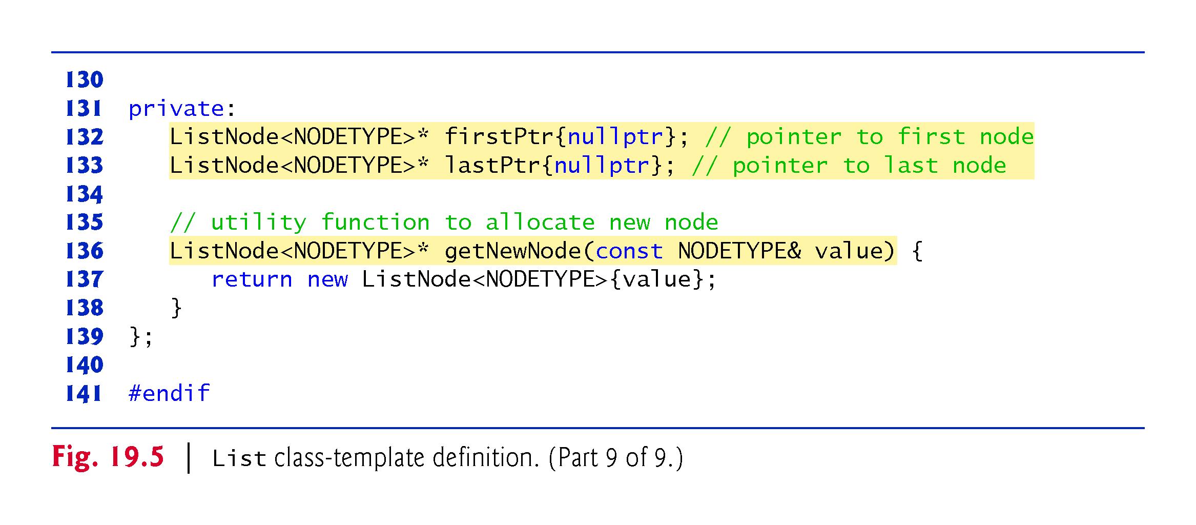

Slide 47
19.3.4 Member Function insertAtFront
Function insertAtFront places a new node at the front of the list.
The function consists of several steps:
Call function getNewNode, passing it value, which is a constant reference to the node value to be inserted.
Function getNewNode uses operator new to create a new list node and return a pointer to this newly allocated node, which is assigned to newPtr in insertAtFront.
If the list is empty, firstPtr and lastPtr are set to newPtr.
If the list is not empty, then the node pointed to by newPtr is threaded into the list by copying firstPtr to newPtr->nextPtr, so that the new node points to what used to be the first node of the list, and copying newPtr to firstPtr, so that firstPtr now points to the new first node of the list.

Slide 48
19.3.4 Member Function insertAtFront
Figure 19.6 illustrates function insertAtFront.
Part (a) shows the list and the new node before calling insertAtFront.
The dashed arrows in part (b) illustrate Step 4 of the insertAtFront operation that enables the node containing 12 to become the new list front.

Slide 49
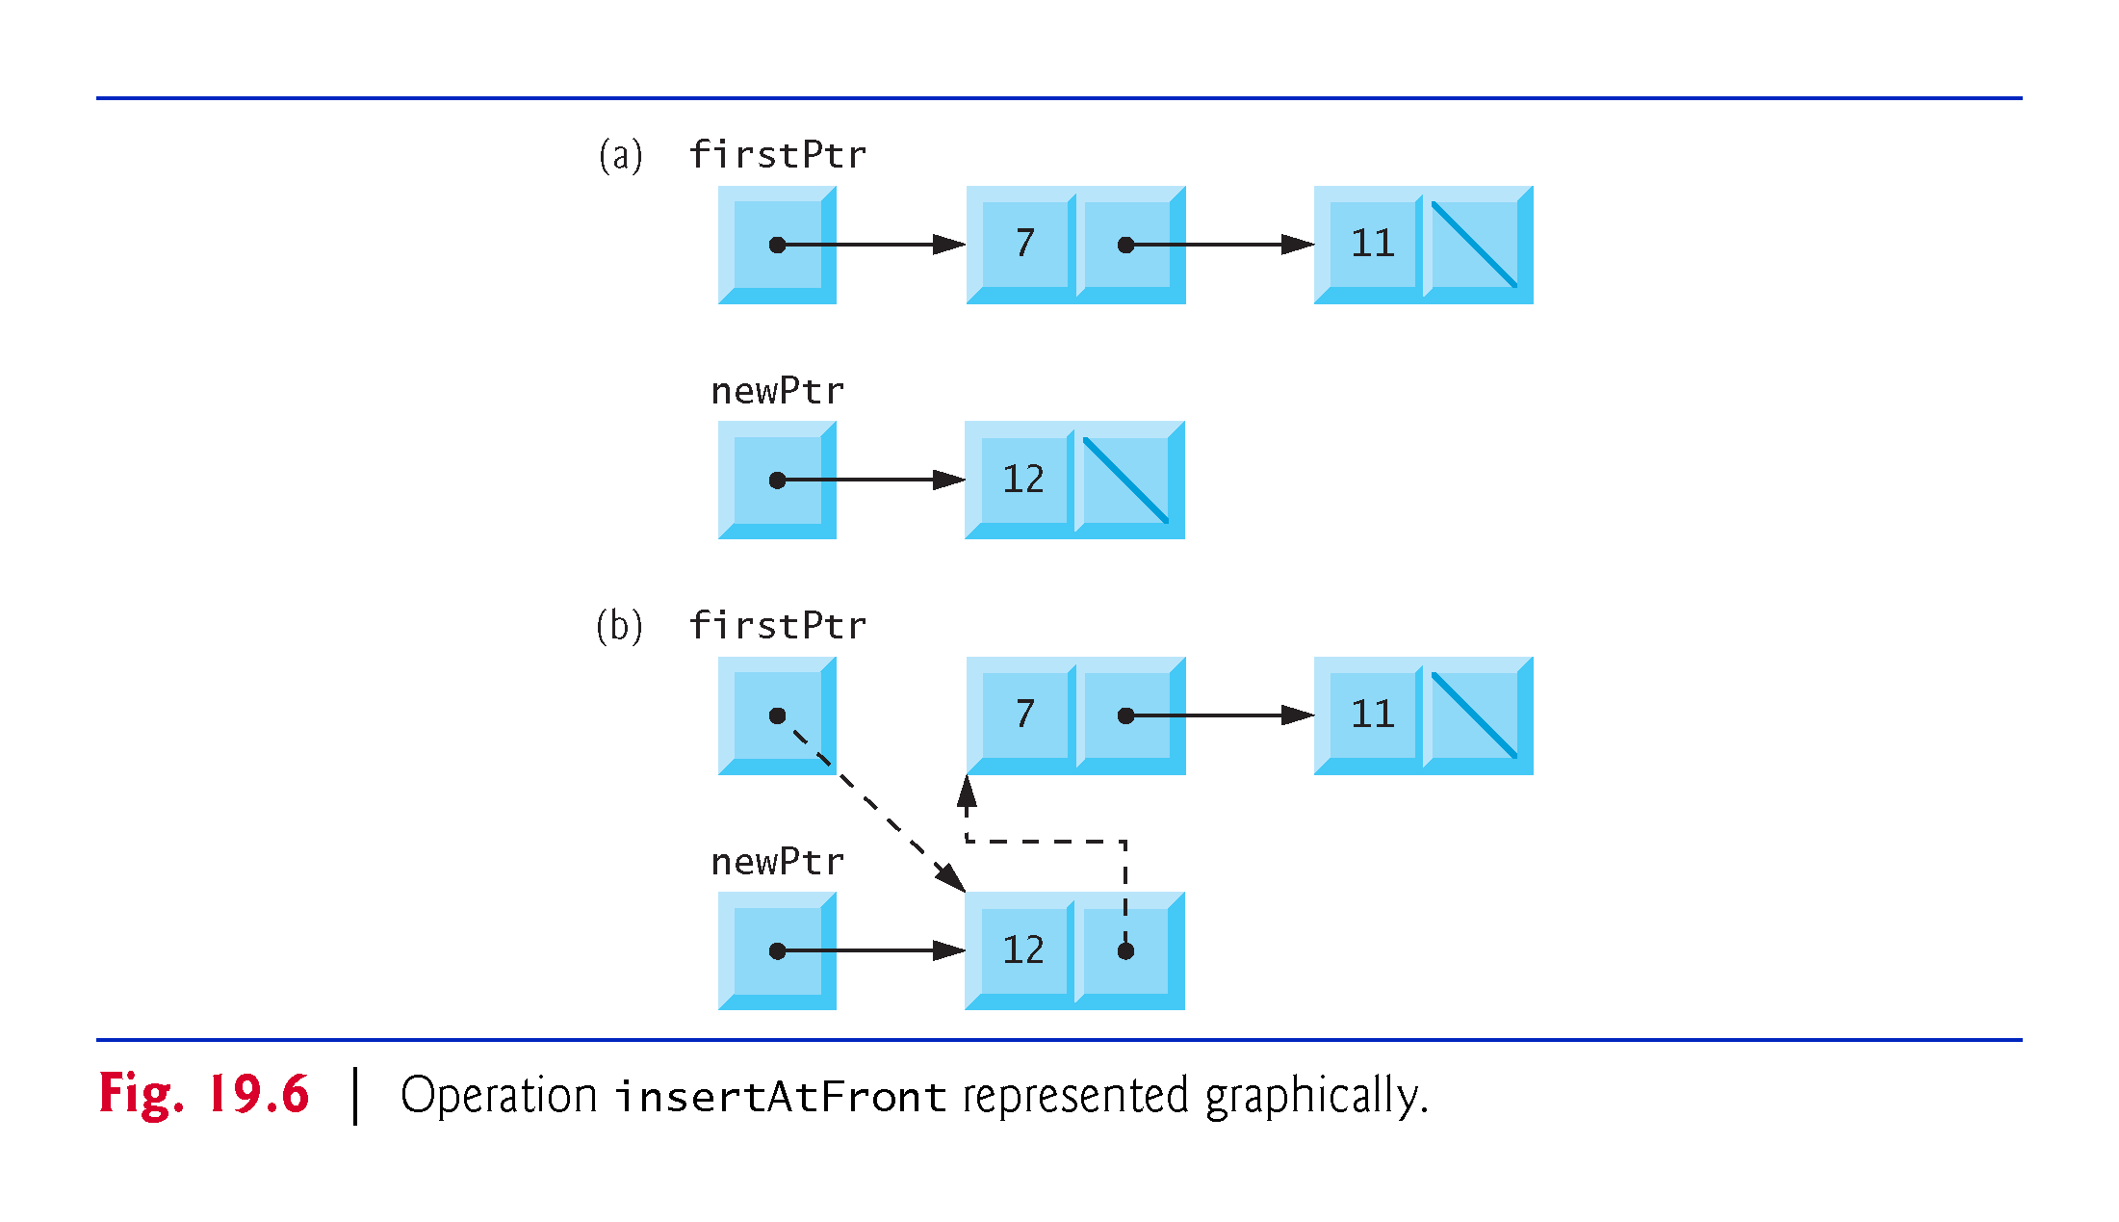

Slide 50
19.3.5 Member Function insertAtBack
Function insertAtBack places a new node at the back of the list.
The function consists of several steps:
Call function getNewNode, passing it value, which is a constant reference to the node value to be inserted.
Function getNewNode uses operator new to create a new list node and return a pointer to this newly allocated node, which is used to initialize newPtr in insertAtBack.
If the list is empty, then both firstPtr and lastPtr are set to newPtr.
If the list is not empty, then the node pointed to by newPtr is threaded into the list by copying newPtr into lastPtr->nextPtr, so that the new node is pointed to by what used to be the last node of the list, and copying newPtr to lastPtr, so that lastPtr now points to the new last node of the list.

Slide 51
19.3.5 Member Function insertAtBack
Figure 19.7 illustrates an insertAtBack operation.
Part (a) of the figure shows the list and the new node before the operation.
The dashed arrows in part (b) illustrate Step 4 of function insertAtBack that enables a new node to be added to the end of a list that is not empty.

Slide 52
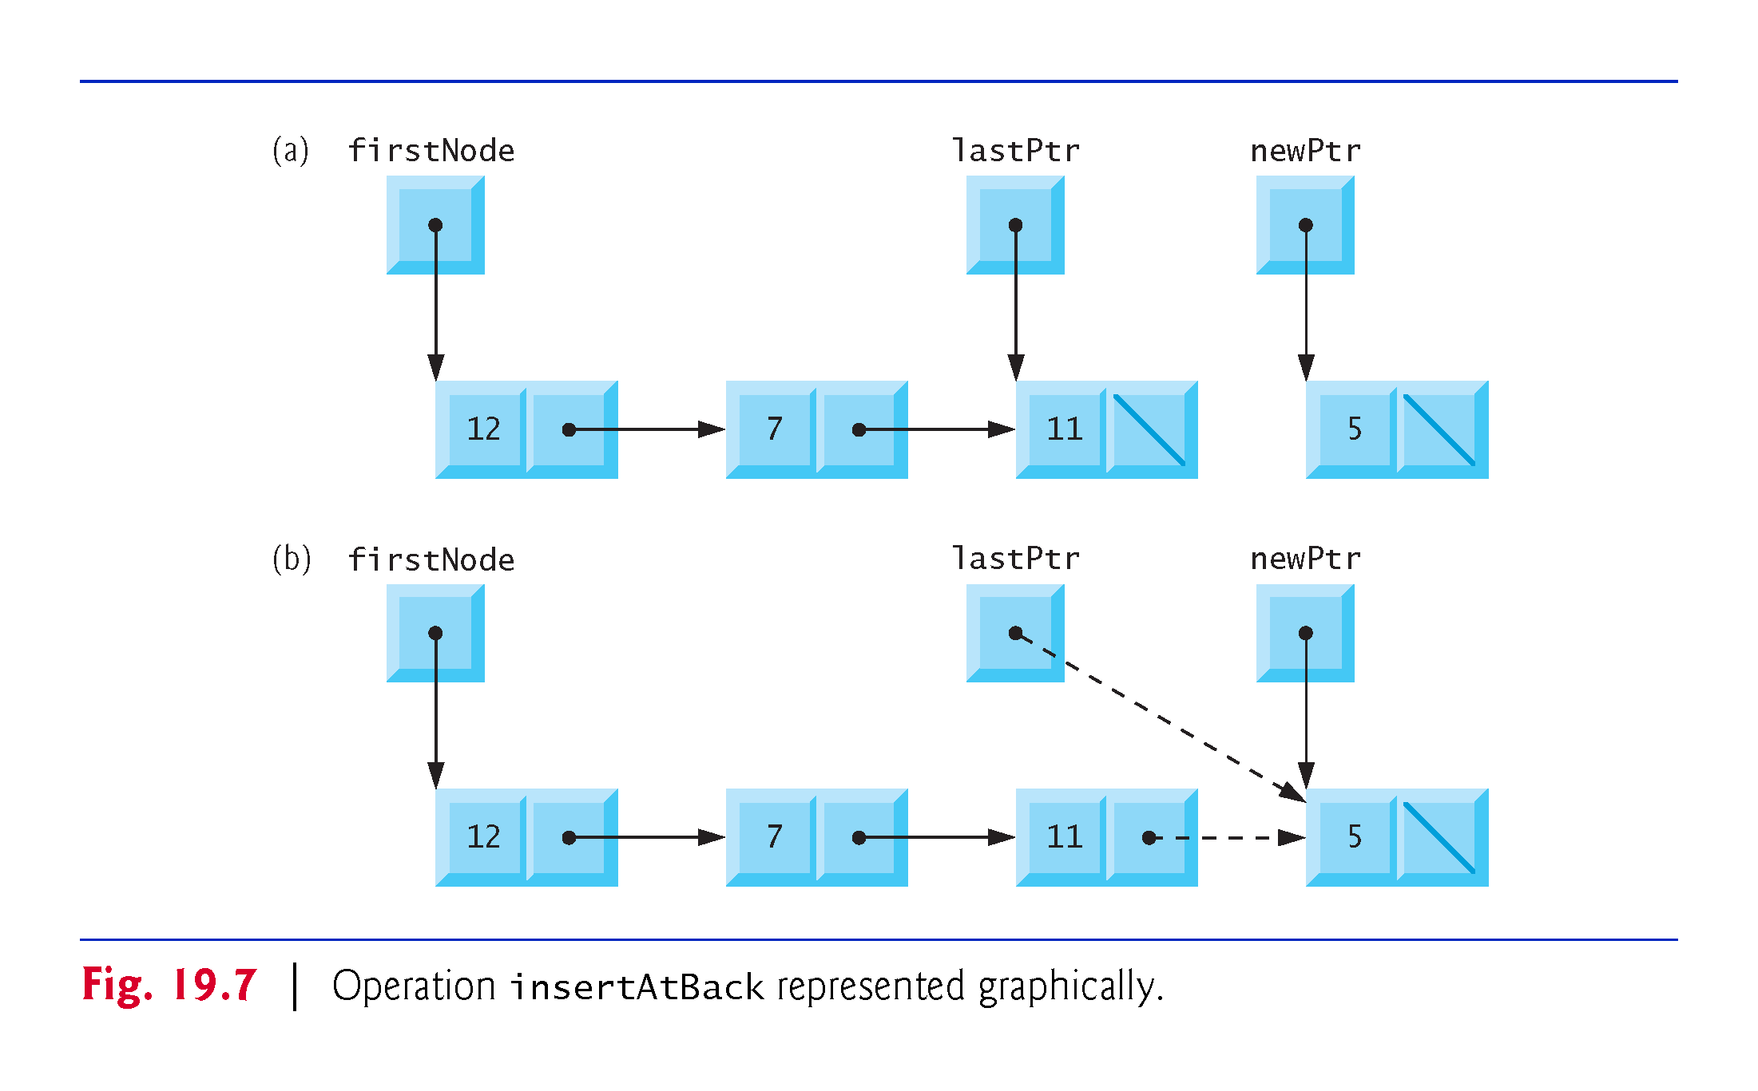

Slide 53
19.3.6 Member Function removeFromFront
Function removeFromFront removes the front node of the list and copies the node value to the reference parameter.
The function returns false if an attempt is made to remove a node from an empty list and returns true if the removal is successful.
The function consists of several steps:
Assign tempPtr the address to which firstPtr points. Eventually, tempPtr will be used to delete the node being removed.
If firstPtr is equal to lastPtr, i.e., if the list has only one element prior to the removal attempt, then set firstPtr and lastPtr to nullptr to dethread that node from the list (leaving the list empty).

Slide 54
19.3.6 Member Function removeFromFront
Steps continued:
If the list has more than one node prior to removal, then leave lastPtr as is and set firstPtr to firstPtr-> nextPtr; i.e., modify firstPtr to point to what was the second node prior to removal (and is now the new first node).
After all these pointer manipulations are complete, copy to reference parameter value the data member of the node being removed.
Now delete the node pointed to by tempPtr.
Return true, indicating successful removal.

Slide 55
19.3.6 Member Function removeFromFront
Figure 19.8 illustrates function removeFromFront.
Part (a) illustrates the list before the removal operation.
Part (b) shows the actual pointer manipulations for removing the front node from a nonempty list.

Slide 56
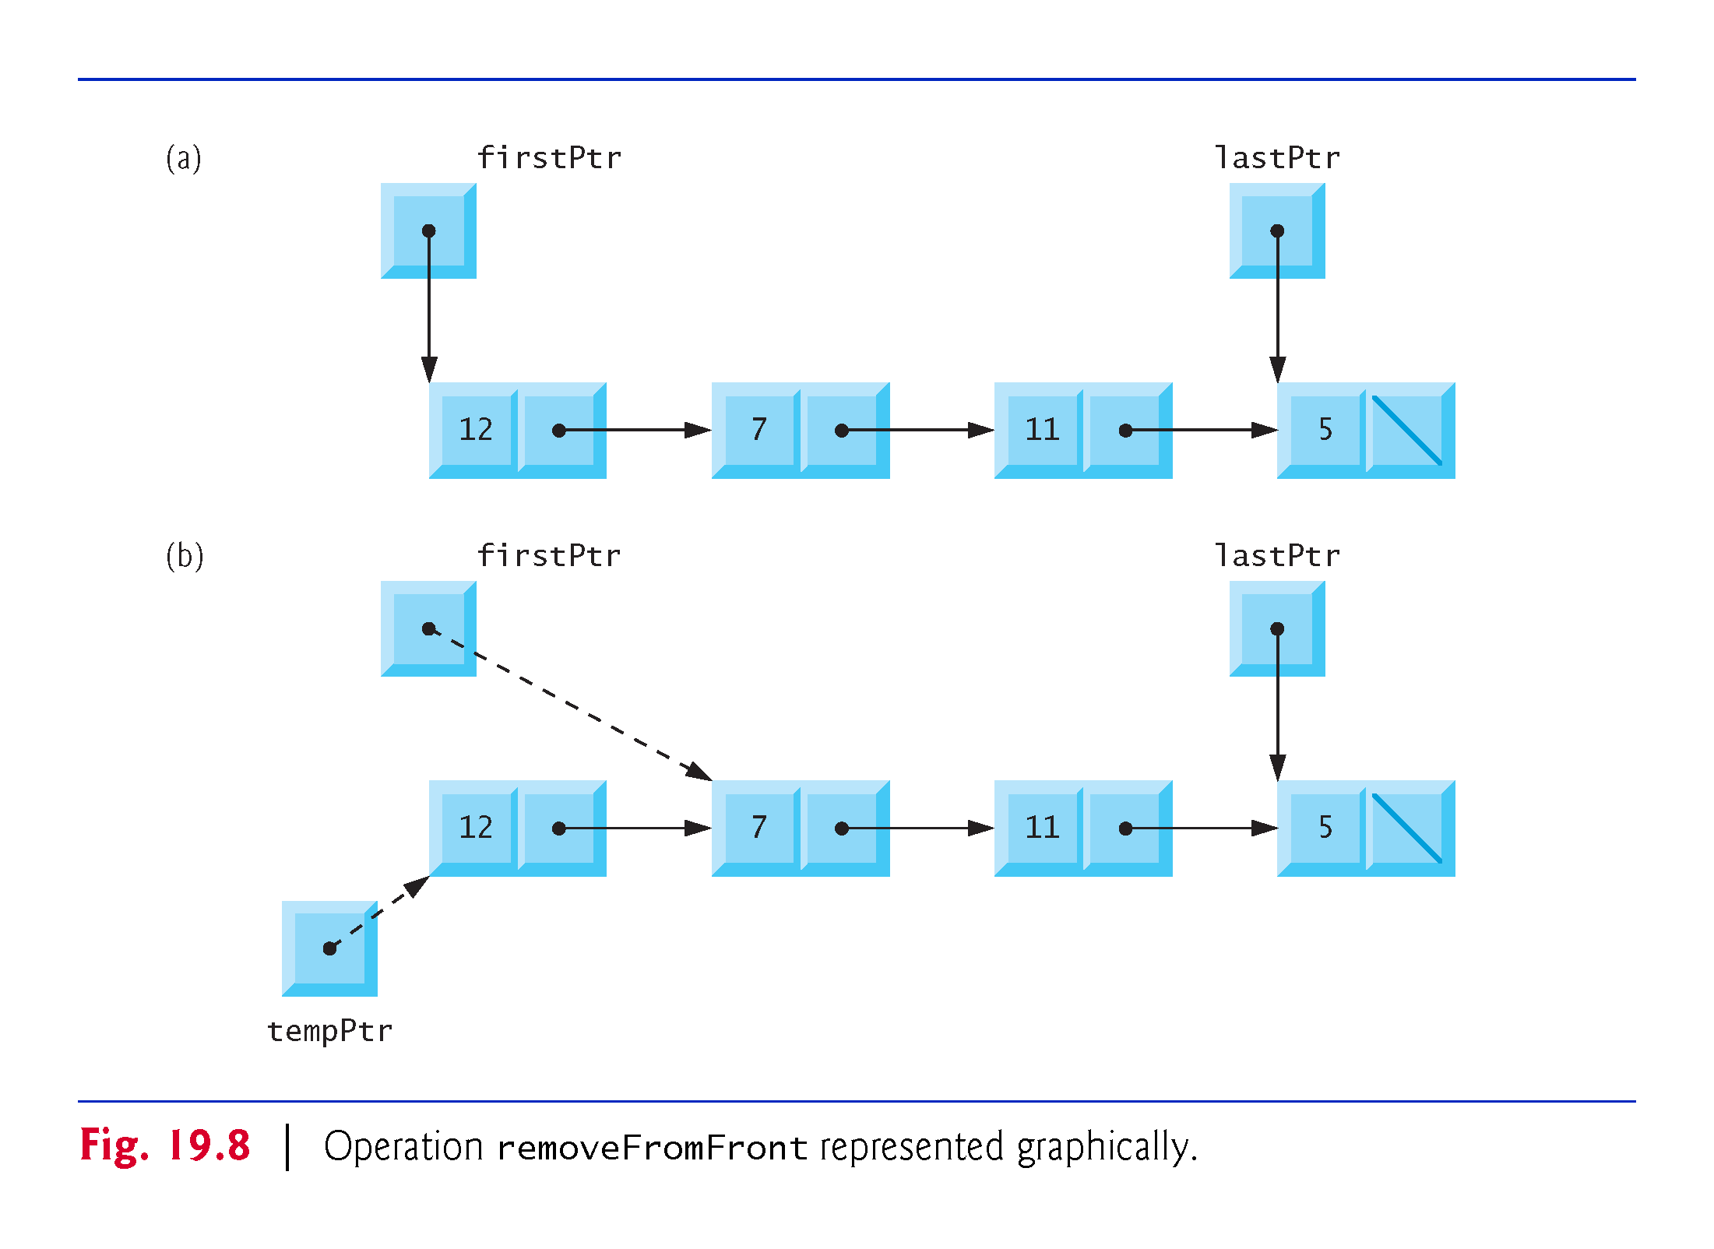

Slide 57
19.3.7 Member Function removeFromBack
Function removeFromBack removes the back node of the list and copies the node value to the reference parameter.
The function returns false if an attempt is made to remove a node from an empty list and returns true if the removal is successful.
The function consists of several steps:
Initialize tempPtr with the address to which lastPtr points. Eventually, tempPtr will be used to delete the node being removed.
If firstPtr is equal to lastPtr, i.e., if the list has only one element prior to the removal attempt, then set firstPtr and lastPtr to nullptr to dethread that node from the list (leaving the list empty).
If the list has more than one node prior to removal, then assign currentPtr the address to which firstPtr points to prepare to “walk the list.”

Slide 58
19.3.7 Member Function removeFromBack
Steps continued:
Now “walk the list” with currentPtr until it points to the node before the last node. This node will become the last node after the remove operation completes. This is done with a while loop that keeps replacing currentPtr by currentPtr-> nextPtr, while currentPtr->nextPtr is not lastPtr.
Assign lastPtr to the address to which currentPtr points to dethread the back node from the list.
Set currentPtr->nextPtr to zero in the new last node of the list.
After all the pointer manipulations are complete, copy to reference parameter value the data member of the node being removed.
delete the node pointed to by tempPtr.
Return true, indicating successful removal.

Slide 59
19.3.7 Member Function removeFromBack
Figure 19.9 illustrates removeFromBack.
Part (a) of the figure illustrates the list before the removal operation.
Part (b) of the figure shows the actual pointer manipulations.

Slide 60
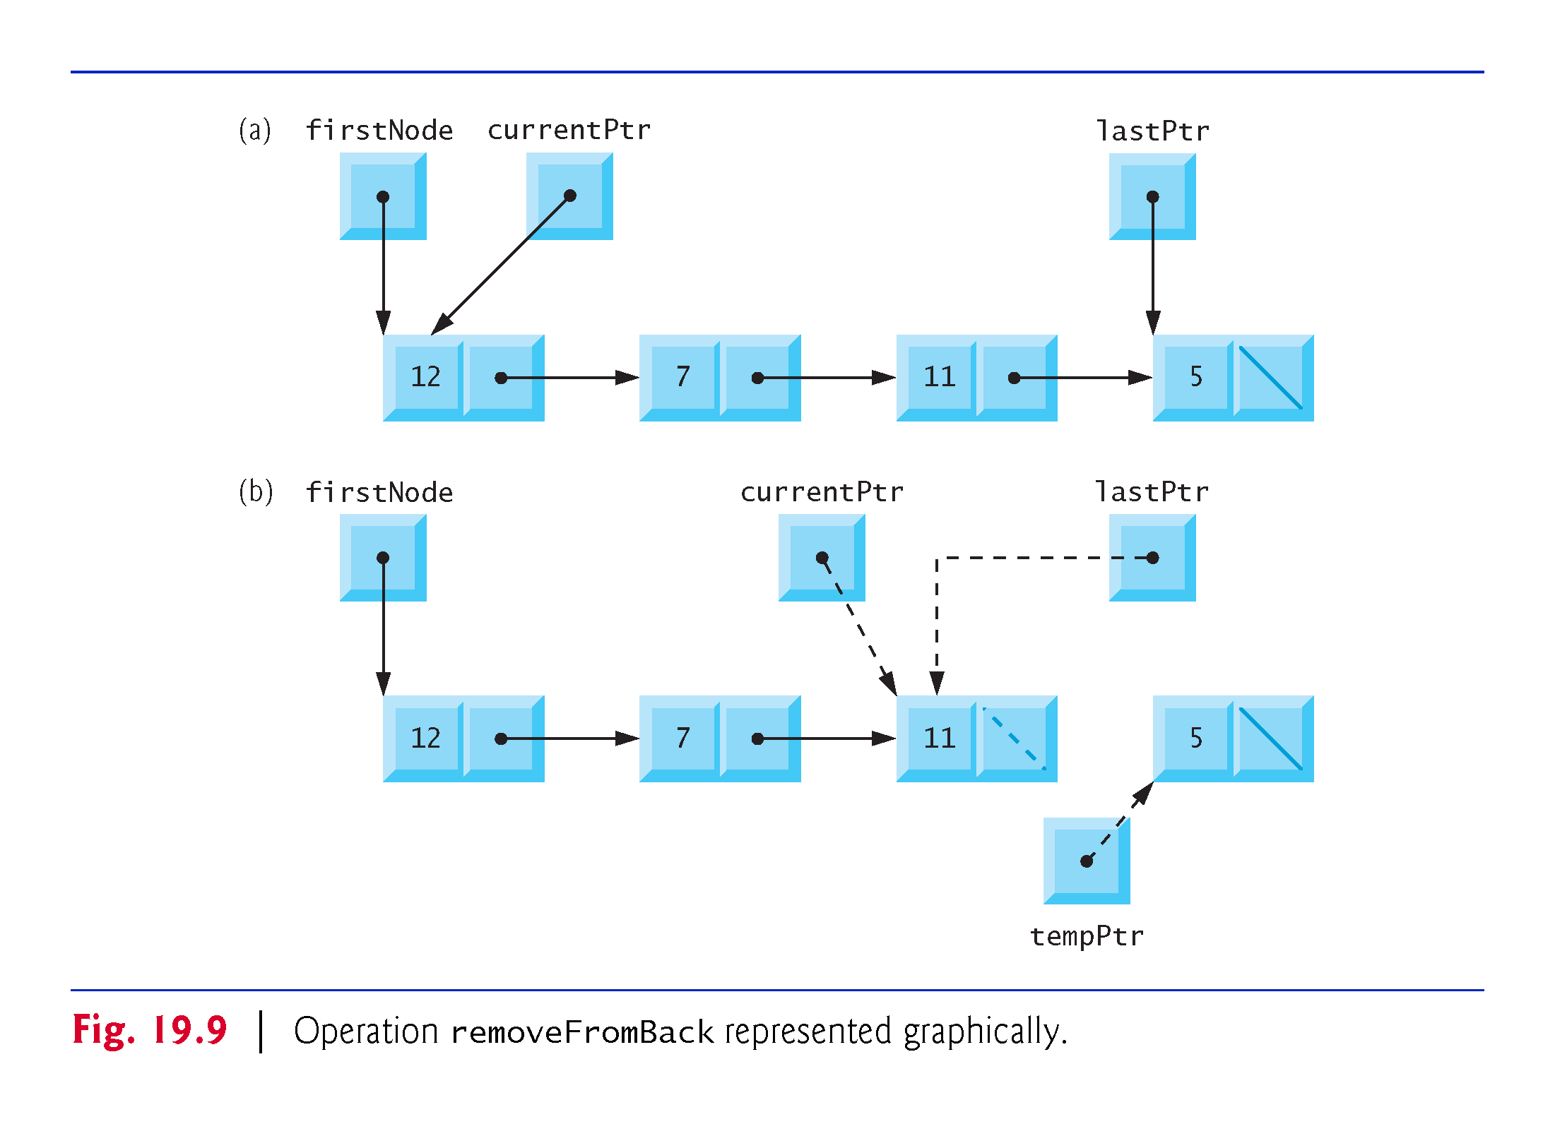

Slide 61
19.3.8 Member Function print
Function print first determines whether the list is empty.
If so, it prints "The list is empty" and returns
Otherwise, it iterates through the list and outputs the value in each node.
The function initializes currentPtr as a copy of firstPtr, then prints the string "The list is: "
While currentPtr is not nullptr, currentPtr->data is printed and currentPtr is assigned the value of currentPtr->nextPtr
Note that if the link in the last node of the list does not have the value nullptr, the printing algorithm will erroneously attempt to print past the end of the list.
Our printing algorithm is identical for linked lists, stacks and queues (because we base each of these data structures on the same linked list infrastructure).

Slide 62
19.3.9 Circular Linked Lists and Double Linked Lists
The kind of linked list we’ve been discussing is a singly linked list—the list begins with a pointer to the first node, and each node contains a pointer to the next node “in sequence.”
This list terminates with a node whose pointer member has the value nullptr.
A singly linked list may be traversed in only one direction.
A circular, singly linked list (Fig. 19.10) begins with a pointer to the first node, and each node contains a pointer to the next node.
The “last node” does not contain nullptr; rather, the pointer in the last node points back to the first node, thus closing the “circle.”

Slide 63
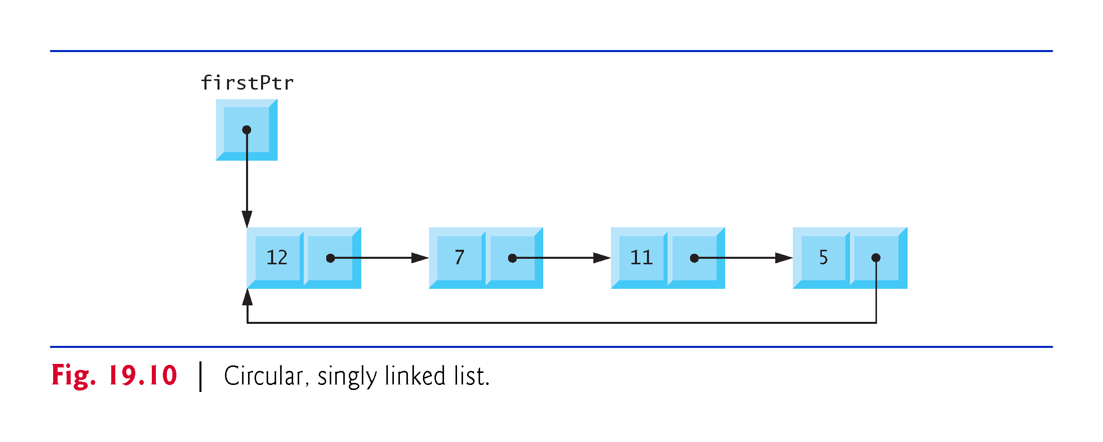

Slide 64
19.3.9 Circular Linked Lists and Double Linked Lists
A doubly linked list (Fig. 19.11) —such as the Standard Library list class template—allows traversals both forward and backward.
Such a list is often implemented with two “start pointers”—one that points to the first element of the list to allow front-to-back traversal of the list and one that points to the last element to allow back-to-front traversal.
Each node has both a forward pointer to the next node in the list in the forward direction and a backward pointer to the next node in the list in the backward direction.
If your list contains an alphabetized telephone directory, for example, a search for someone whose name begins with a letter near the front of the alphabet might best begin from the front of the list.
Searching for someone whose name begins with a letter near the end of the alphabet might best begin from the back of the list.

Slide 65
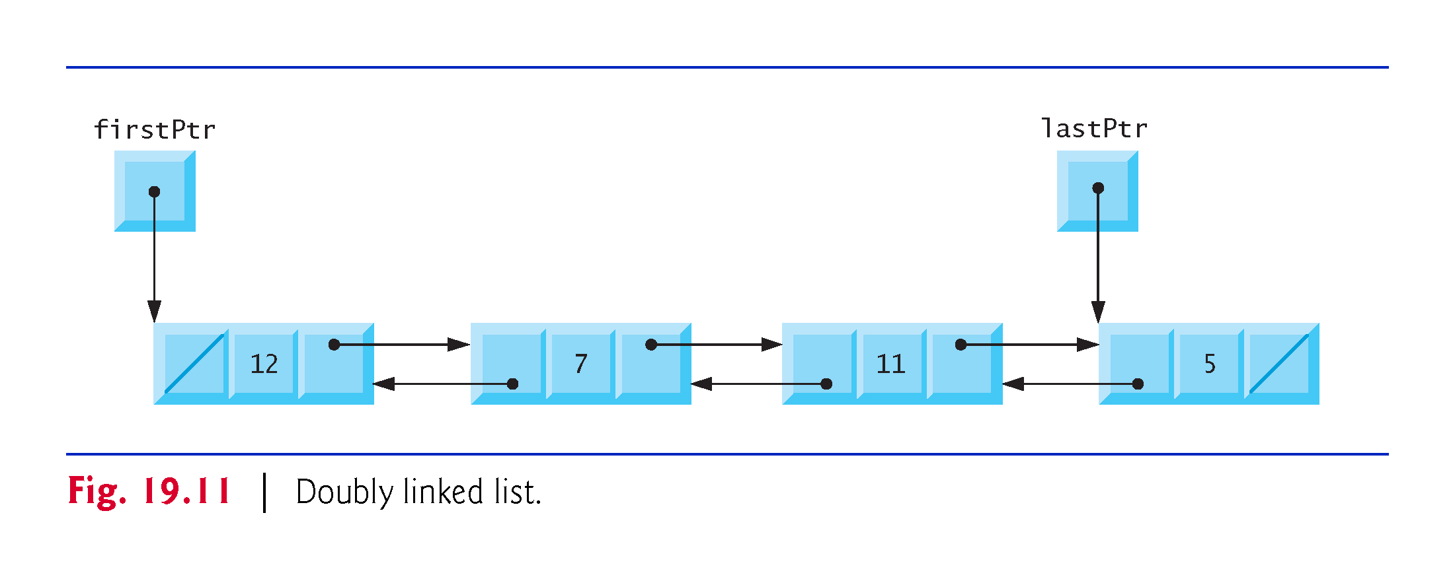

Slide 66
19.3.9 Circular Linked Lists and Double Linked Lists
In a circular, doubly linked list (Fig. 19.12), the forward pointer of the last node points to the first node, and the backward pointer of the first node points to the last node, thus closing the “circle.”

Slide 67
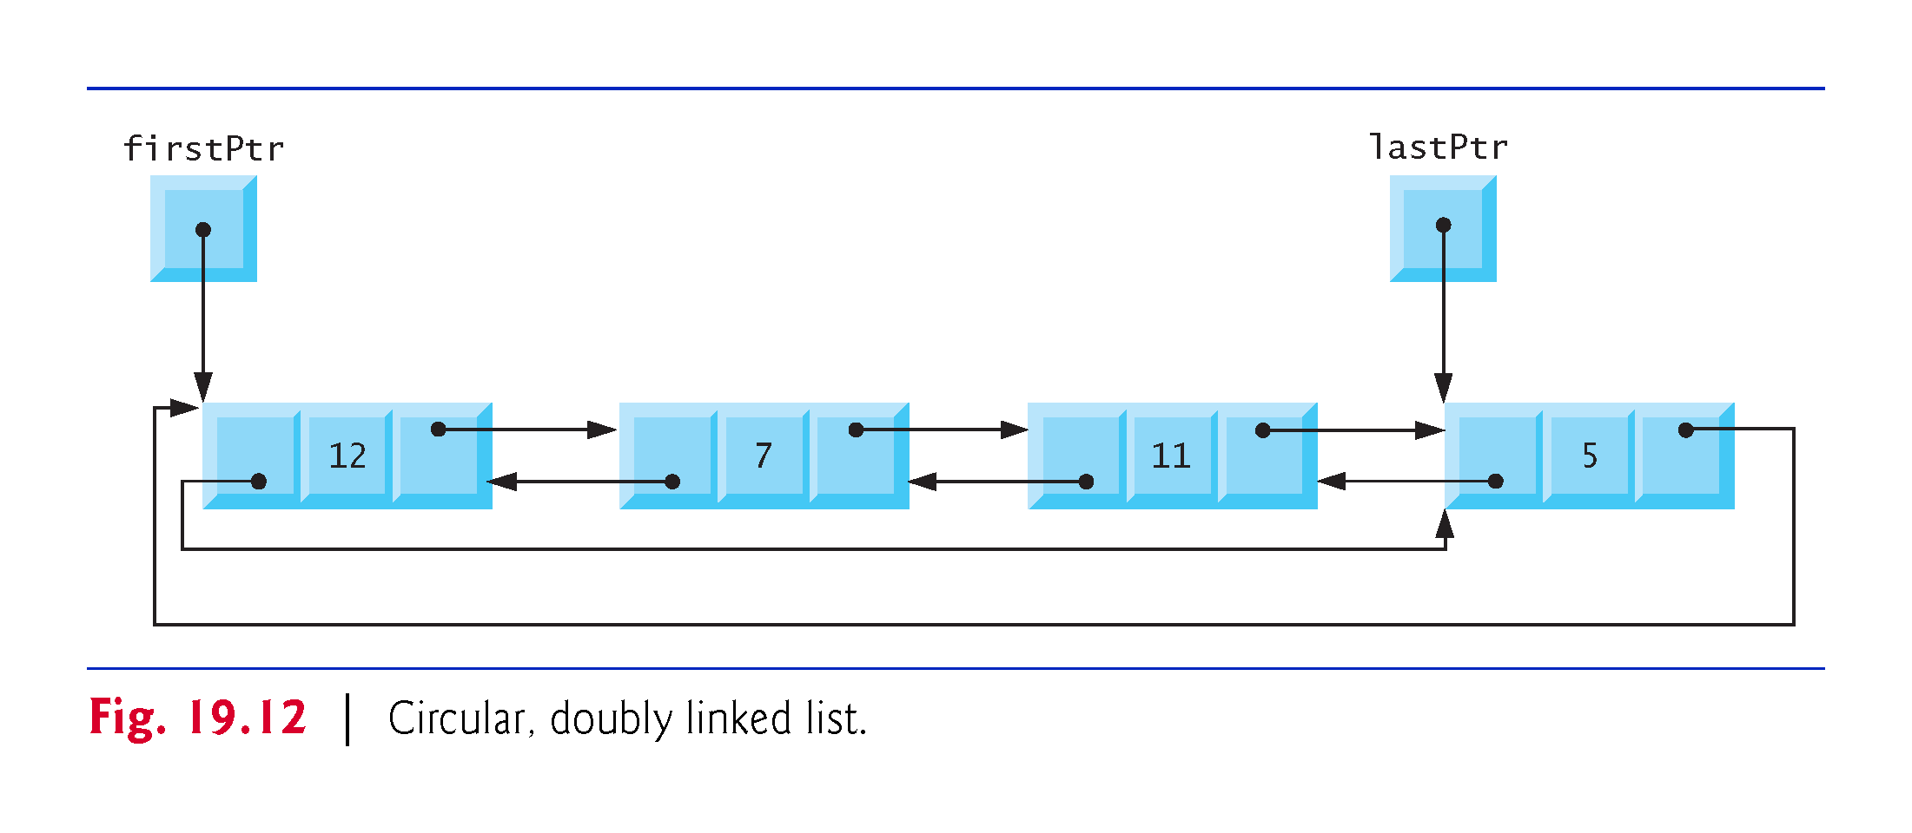

Slide 68
19.4 Stacks
You learned the concept of a stack in Section 6.12, Section 15.7.1, stack Adapter and Section 18.2.
Recall that a nodes can be added to a stack and removed from a stack only at its top, so a stack is referred to as a last-in, first-out (LIFO) data structure.
One way to implement a stack is as a constrained version of a linked list.

Slide 69
19.4 Stacks (cont.)
In such an implementation, the link member in the last node of the stack is set to nullptr to indicate the bottom of the stack.
The primary member functions used to manipulate a stack are push and pop.
Function push inserts a new node at the top of the stack.
Function pop removes a node from the top of the stack, stores the popped value in a reference variable that is passed to the calling function and returns true if the pop operation was successful (false otherwise).

Slide 70
19.4 Stacks (cont.)
Applications of Stacks
Stacks have many interesting applications.
In Section 6.12 you learned that when a function call is made, the called function must know how to return to its caller, so the return address is pushed onto a stack.
If a series of function calls occurs, the successive return values are pushed onto the stack in last-in, first-out order, so that each function can return to its caller.
Stacks support recursive function calls in the same manner as conventional nonrecursive calls.
Stacks provide the memory for, and store the values of, automatic variables on each invocation of a function.
When the function returns to its caller or throws an exception, the destructor (if any) for each local object is called, the space for that function’s automatic variables is popped off the stack and those variables are no longer known to the program.
Stacks are used by compilers in the process of evaluating expressions and generating machine-language code.

Slide 71
19.4.1 Taking Advantage of the Relationship Between Stack and List
We’ll take advantage of the close relationship between lists and stacks to implement a stack class primarily by reusing our List class template.
First, we’ll implement the Stack class template via private inheritance from our List class template.
Then we’ll implement an identically performing Stack class template through composition by including a List object as a private member of Stack class template.

Slide 72
19.4.2 Implementing a Class Template Stack Class Based By Inheriting from List
The program of Figs. 19.13–19.14 creates a Stack class template (Fig. 19.13) primarily through private inheritance of the List class template of Fig. 19.4.
We want the Stack to have member functions push, pop, isStackEmpty and printStack
These are essentially the insertAtFront, removeFromFront, isEmpty and print functions of the List class template.

Slide 73
19.4.2 Implementing a Class Template Stack Class Based By Inheriting from List
Of course, the List class template contains other member functions (i.e., insertAtBack and removeFromBack) that we would not want to make accessible through the public interface to the Stack class.
So when we indicate that the Stack class template is to inherit from the List class template, we specify private inheritance.
This makes all the List class template’s member functions private in the Stack class template.
When we implement the Stack’s member functions, we then have each of these call the appropriate member function of the List class—push calls insertAtFront, pop calls removeFromFront, isStackEmpty calls isEmpty and printStack calls print—this is referred to as delegation.

Slide 74
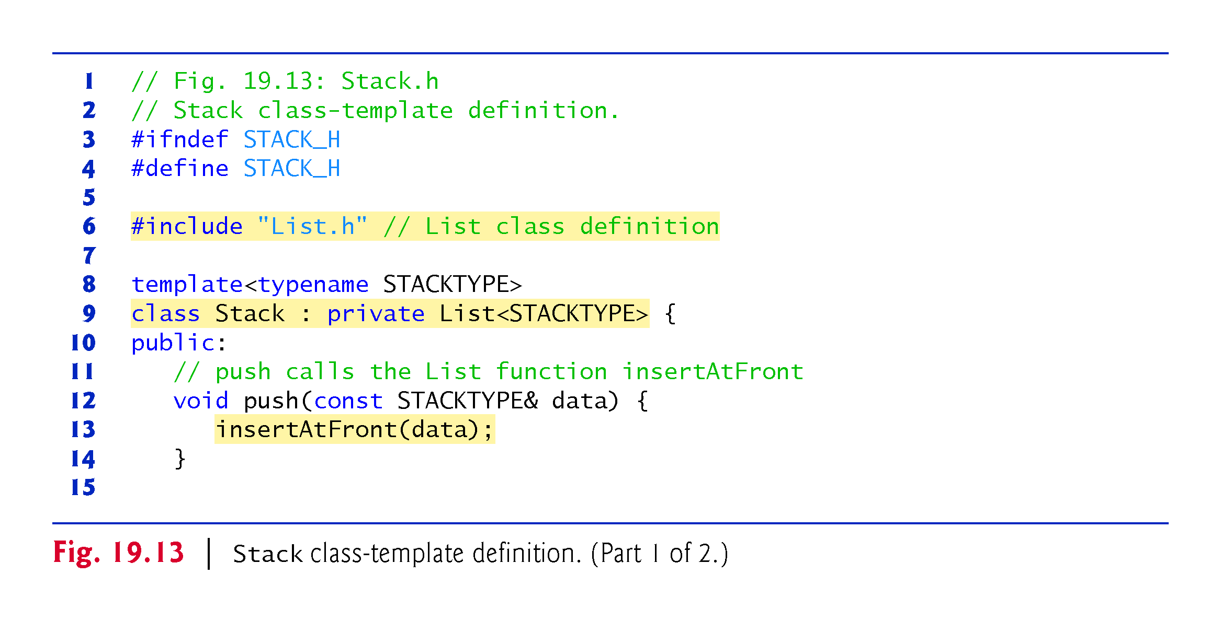

Slide 75
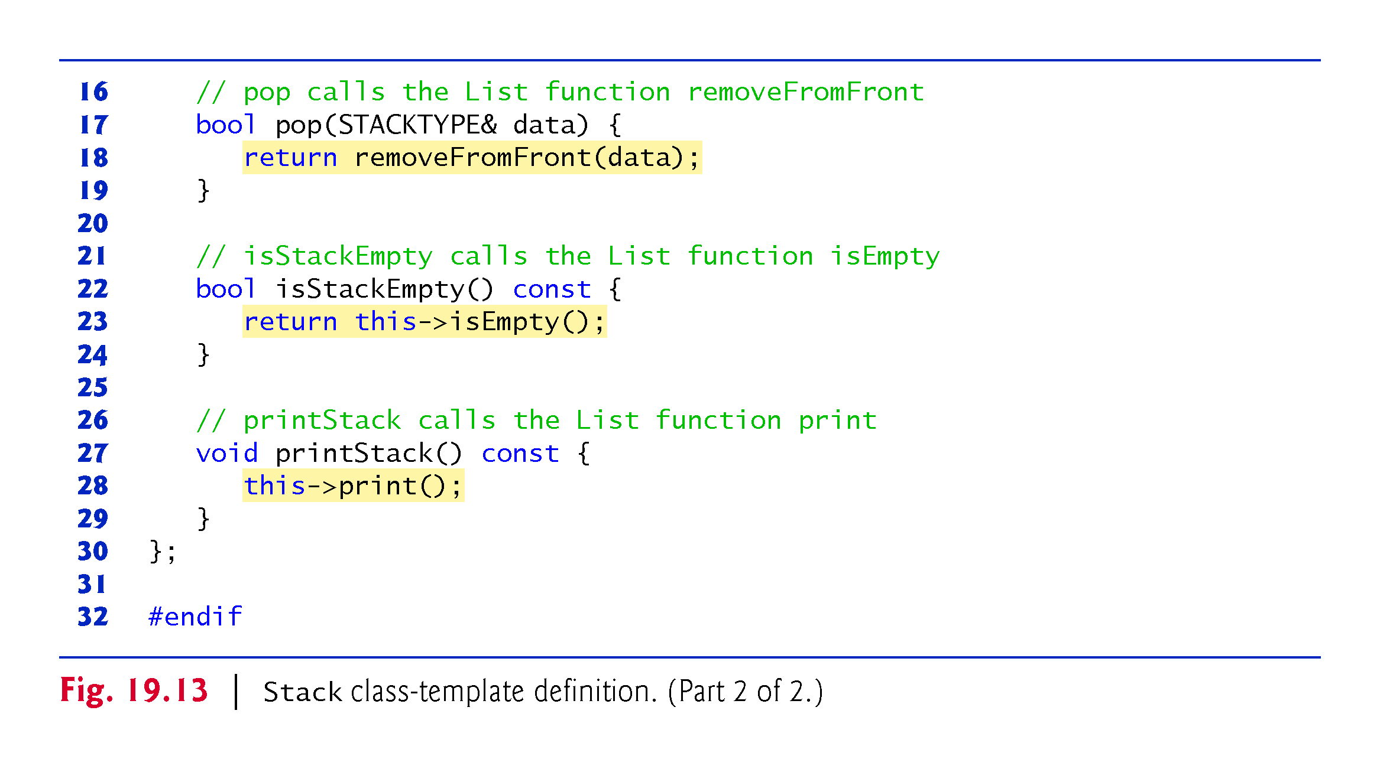

Slide 76
19.4.3 Dependent Names in Class Templates
The explicit use of this on lines 23 and 28 is required so the compiler can resolve identifiers in template definitions.
A dependent name is an identifier that depends on a template parameter.
For example, the call to removeFromFront depends on the argument data which has a type that is dependent on the template parameter STACKTYPE.
Resolution of dependent names occurs when the template is instantiated.

Slide 77
19.4.3 Dependent Names in Class Templates
In contrast, the identifier for a function that takes no arguments like isEmpty or print in the List superclass is a non-dependent name.
Such identifiers are normally resolved at the point where the template is defined.
If the template has not yet been instantiated, then the code for the function with the non-dependent name does not yet exist and some compilers will generate compilation errors.
Adding the explicit use of this-> in lines 23 and 28 makes the calls to the base class’s member functions dependent on the template parameter and ensures that the code will compile properly.

Slide 78
19.4.4 Testing the Stack Class Template
The stack class template is used in main (Fig. 19.14) to instantiate integer stack intStack of type Stack<int>
Integers 0 through 2 are pushed onto intStack, then popped off intStack
The program uses the Stack class template to create doubleStack of type Stack<double>
Values 1.1, 2.2 and 3.3 are pushed onto doubleStack, then popped off doubleStack

Slide 79
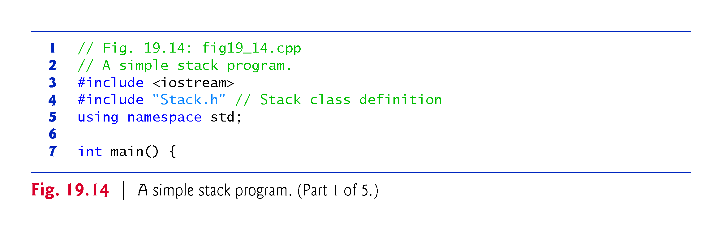

Slide 80
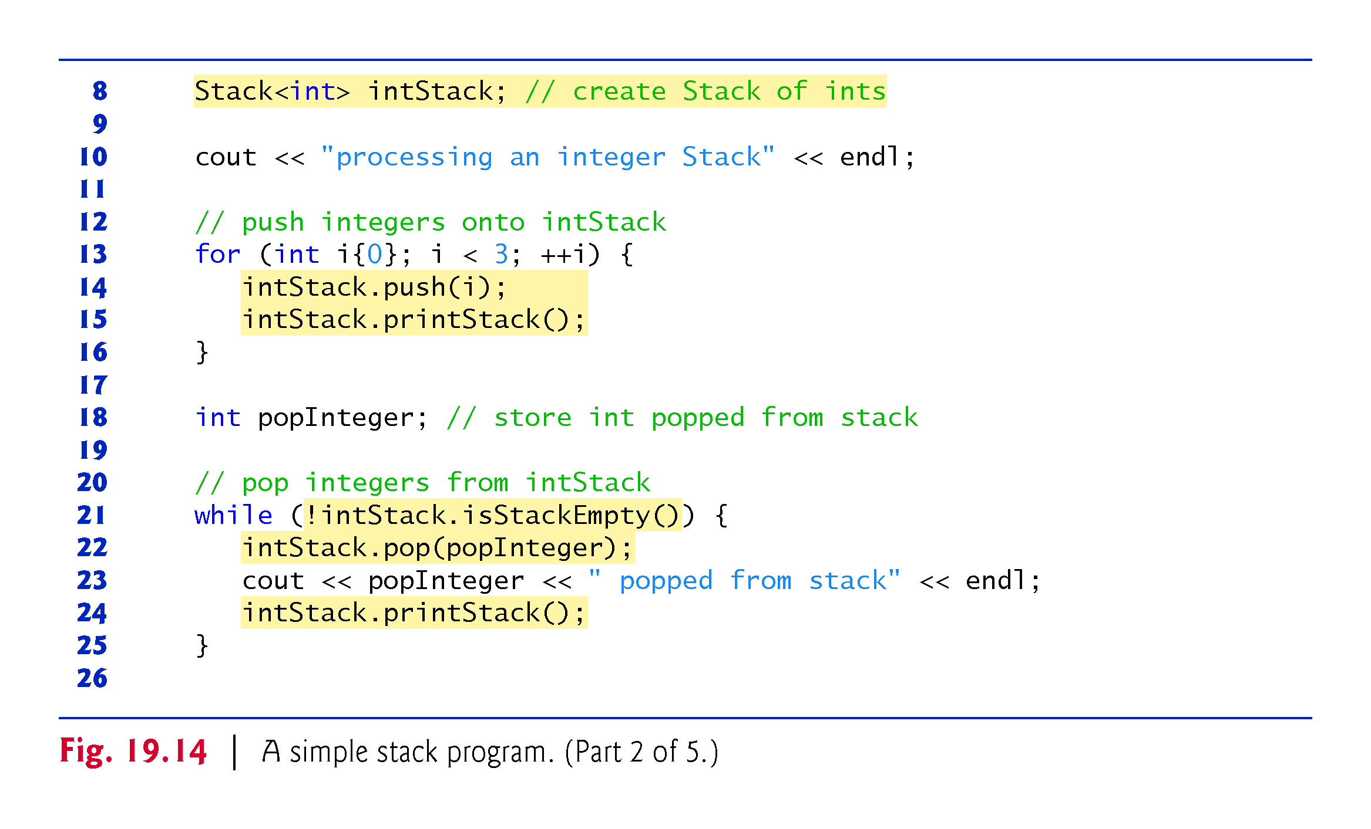

Slide 81
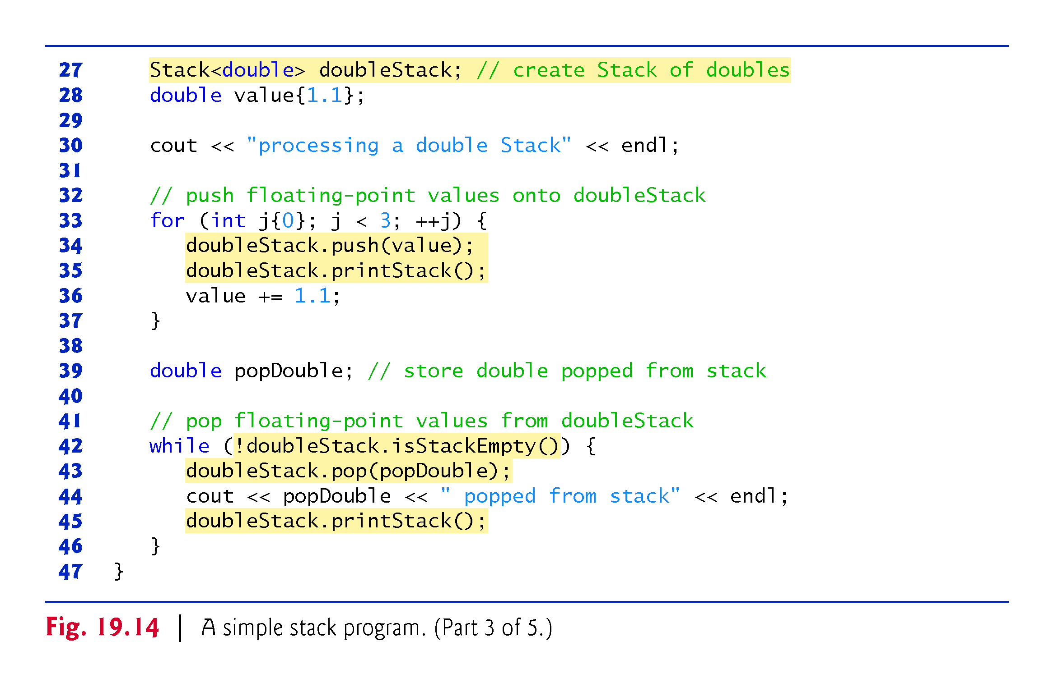

Slide 82
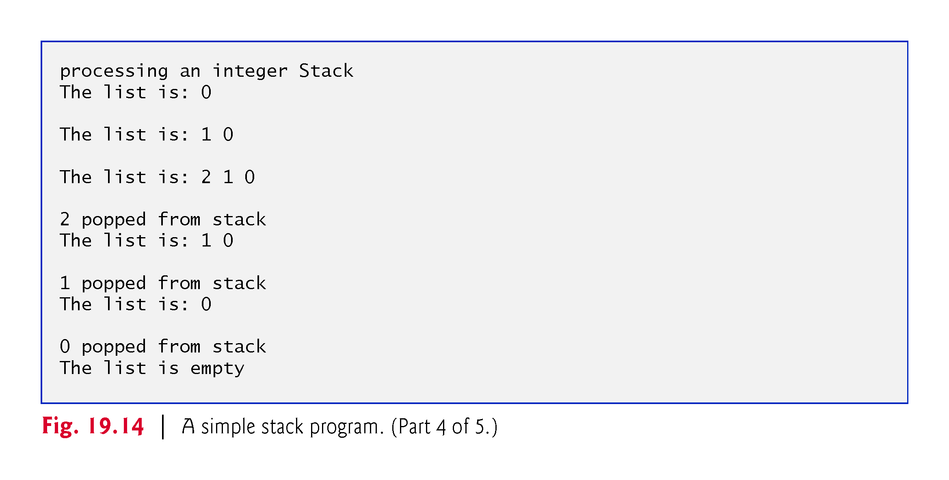

Slide 83
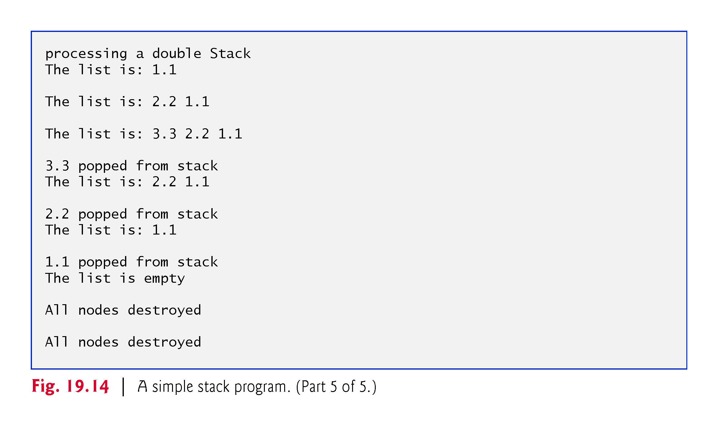

Slide 84
19.4.5 Implementing a Class Template Stack Class With Composition of a List Object
Another way to implement a Stack class template is by reusing the List class template through composition.
Figure 19.15 is a new implementation of the Stack class template that contains a List<STACKTYPE> object called stackList
This version of the Stack class template uses class List from Fig. 19.4.
To test this class, use the driver program in Fig. 19.14, but include the new header—Stackcomposition.h in line 4 of that file.
The output of the program is identical for both versions of class Stack.

Slide 85
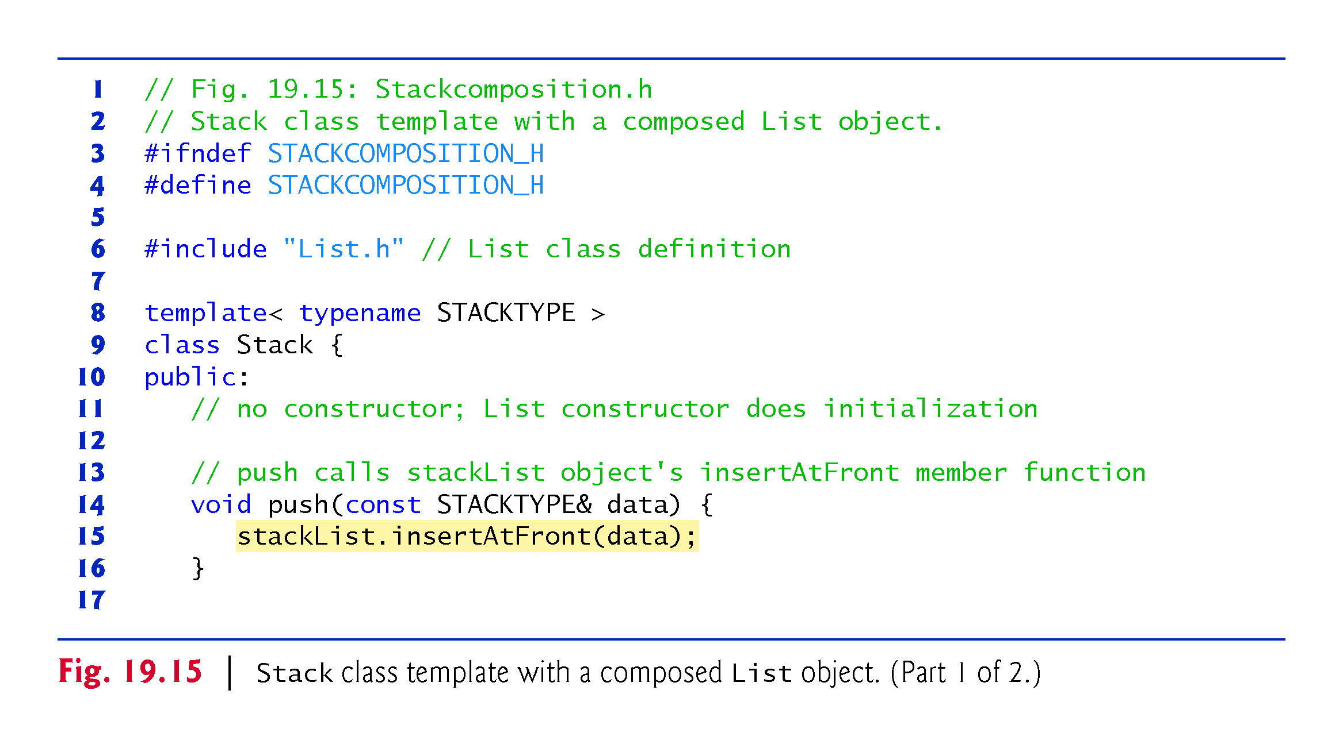

Slide 86
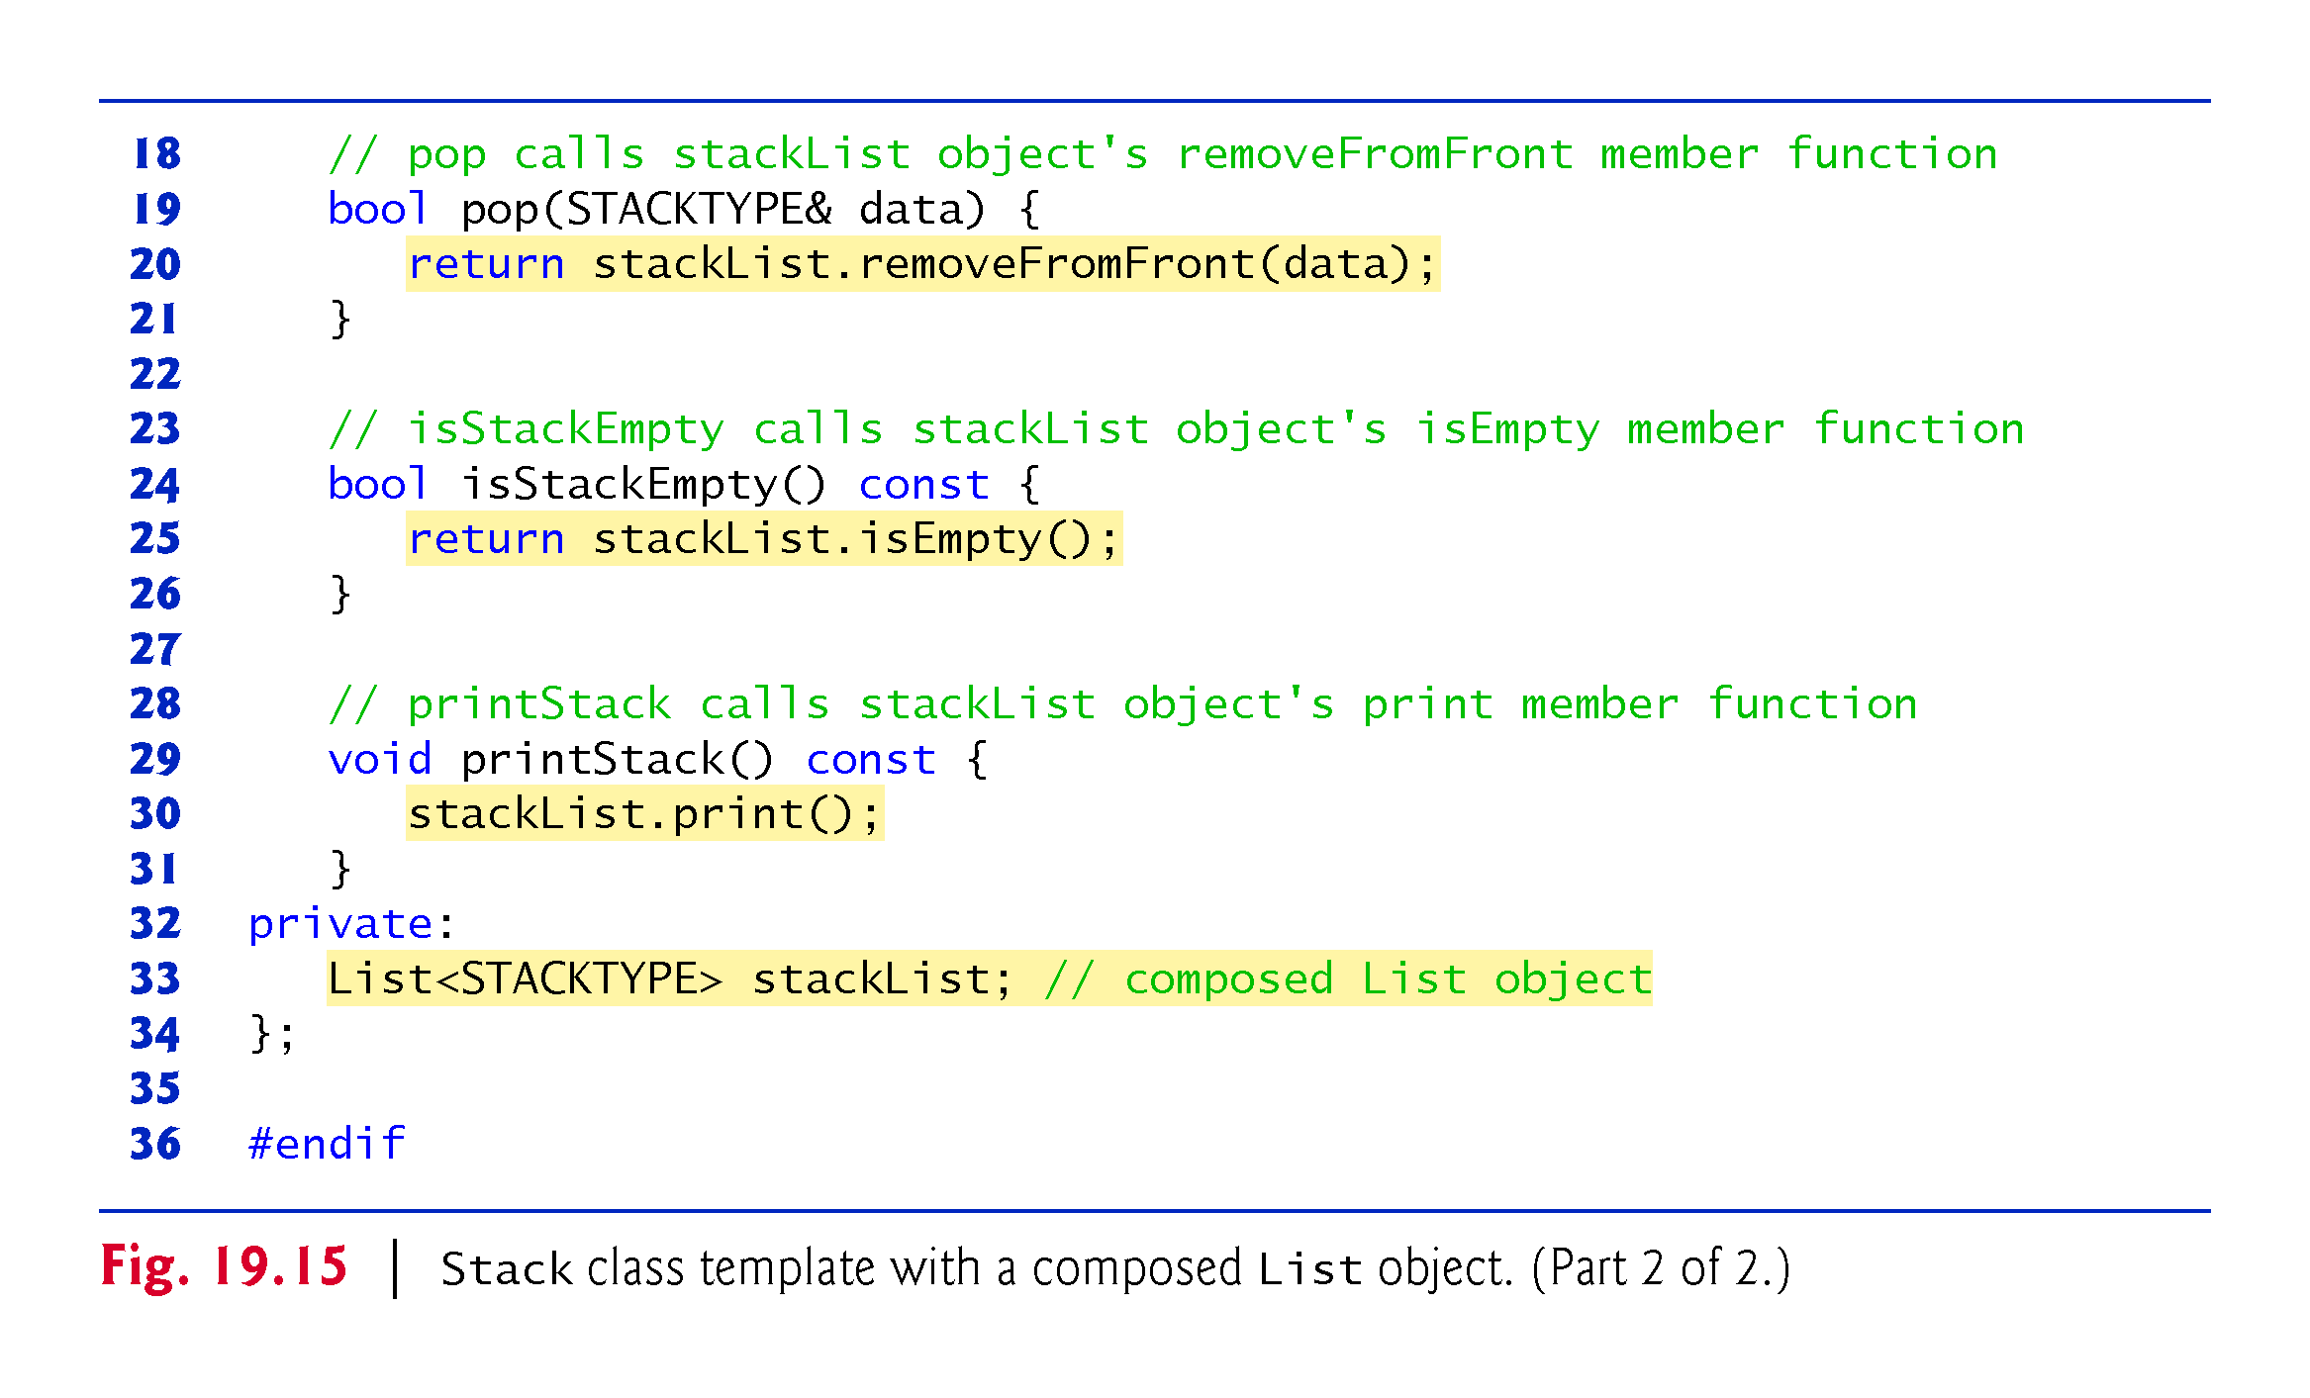

Slide 87
19.5 Queues
Recall that queue nodes are removed only from the head of the queue and are inserted only at the tail of the queue.
For this reason, a queue is referred to as a first-in, first-out (FIFO) data structure.
The insert and remove operations are known as enqueue and dequeue.

Slide 88
19.5.1 Applications of Queues
Queues have many applications in computer systems.
Computers that have a single processor can service only one user at a time.
Entries for the other users are placed in a queue.
Each entry gradually advances to the front of the queue as users receive service.
The entry at the front of the queue is the next to receive service.

Slide 89
19.5 Queues (cont.)
Queues are also used to support print spooling.
For example, a single printer might be shared by all users of a network.
Many users can send print jobs to the printer, even when the printer is already busy.
These print jobs are placed in a queue until the printer becomes available.
A program called a spooler manages the queue to ensure that, as each print job completes, the next print job is sent to the printer.

Slide 90
19.5 Queues (cont.)
Information packets also wait in queues in computer networks.
Each time a packet arrives at a network node, it must be routed to the next node on the network along the path to the packet’s final destination.
The routing node routes one packet at a time, so additional packets are enqueued until the router can route them.
A file server in a computer network handles file access requests from many clients throughout the network.
Servers have a limited capacity to service requests from clients.
When that capacity is exceeded, client requests wait in queues.

Slide 91
19.5.2 Implementing a Class Template Queue Class Based By Inheriting from List
The program of Figs. 19.16–19.17 creates a Queue class template (from Fig. 19.5) through private inheritance of the List class template (Fig. 19.4).
The Queue has member functions enqueue, dequeue, isQueueEmpty and printQueue.
These are essentially the insertAtBack, removeFromFront, isEmpty and print functions of the List class template.

Slide 92
19.5.2 Implementing a Class Template Queue Class Based By Inheriting from List
The List class template contains other member functions that we do not want to make accessible through the public interface to the Queue class.
So when we indicate that the Queue class template is to inherit the List class template, we specify private inheritance.
This makes all the List class template’s member functions private in the Queue class template.
When we implement the Queue’s member functions, we have each of these call the appropriate member function of the list class—enqueue calls insertAtBack, dequeue calls removeFromFront, isQueueEmpty calls isEmpty and printQueue calls print
As with the Stack example in Fig. 19.13, this delegation requires explicit use of the this pointer in isQueueEmpty and printQueue to avoid compilation errors.

Slide 93
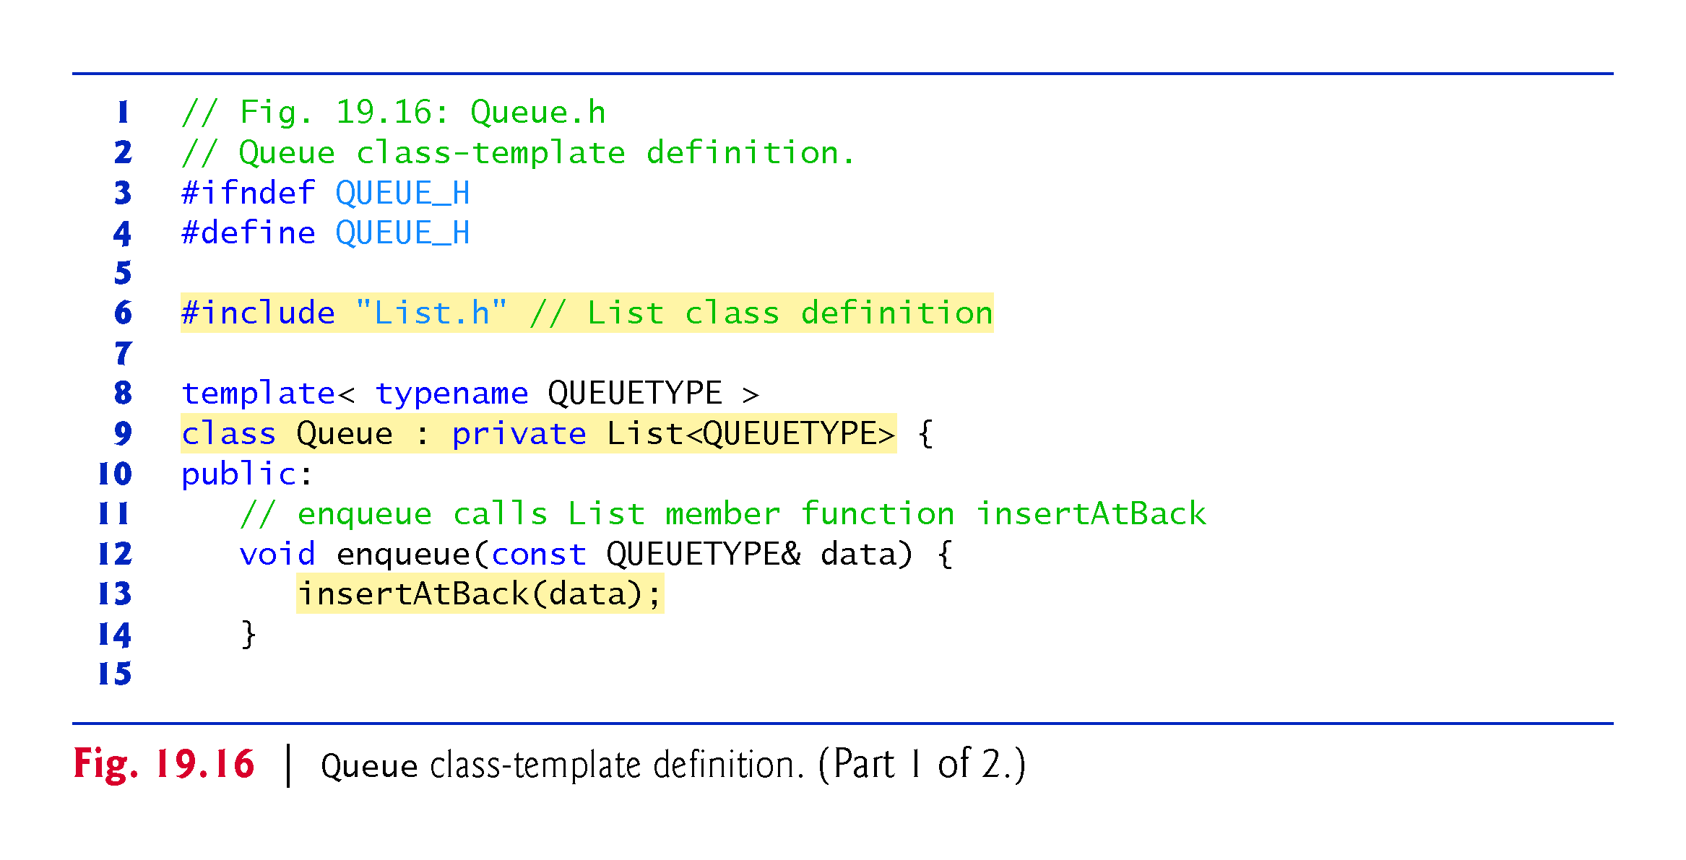

Slide 94
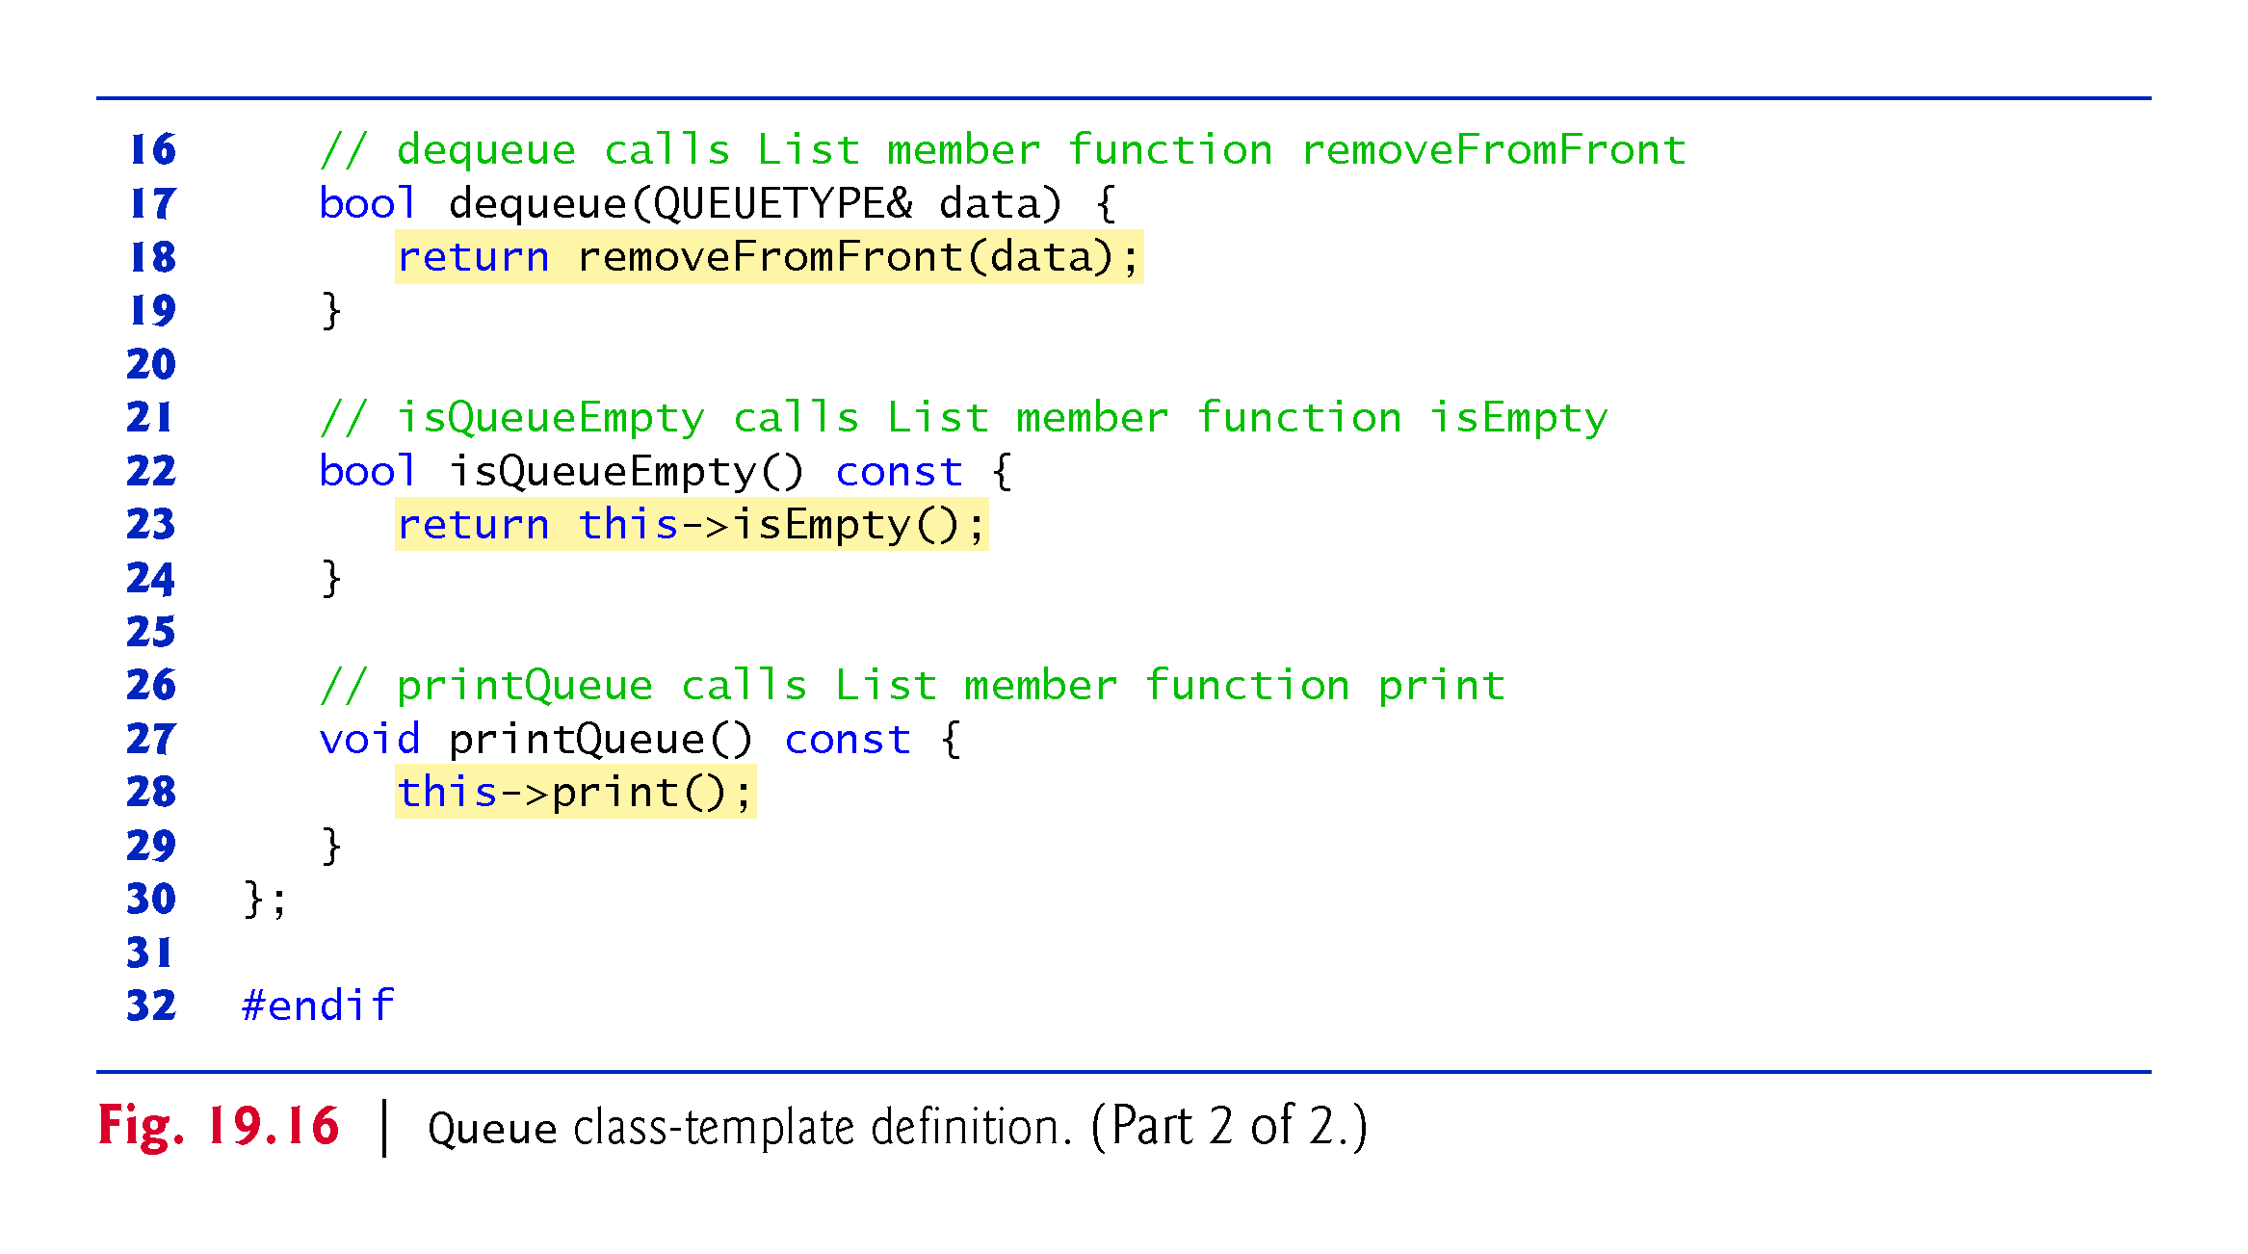

Slide 95
19.5.3 Testing the Queue Class Template
Figure 19.17 uses the Queue class template to instantiate integer queue intQueue of type Queue<int>
Integers 0 through 2 are enqueued to intQueue, then dequeued from intQueue in first-in, first-out order
Next, the program instantiates queue doubleQueue of type Queue<double>
Values 1.1, 2.2 and 3.3 are enqueued to doubleQueue, then dequeued from doubleQueue in first-in, first-out order

Slide 96
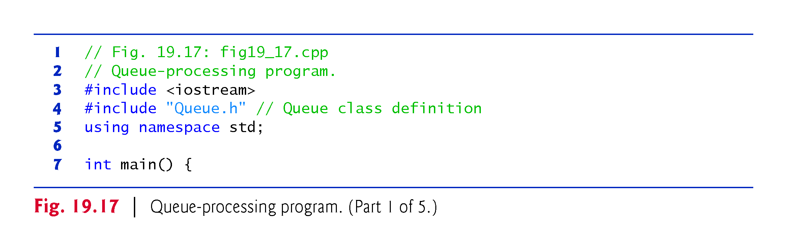

Slide 97
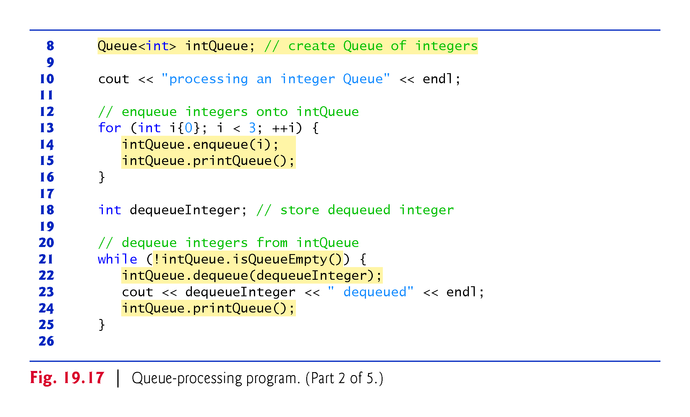

Slide 98
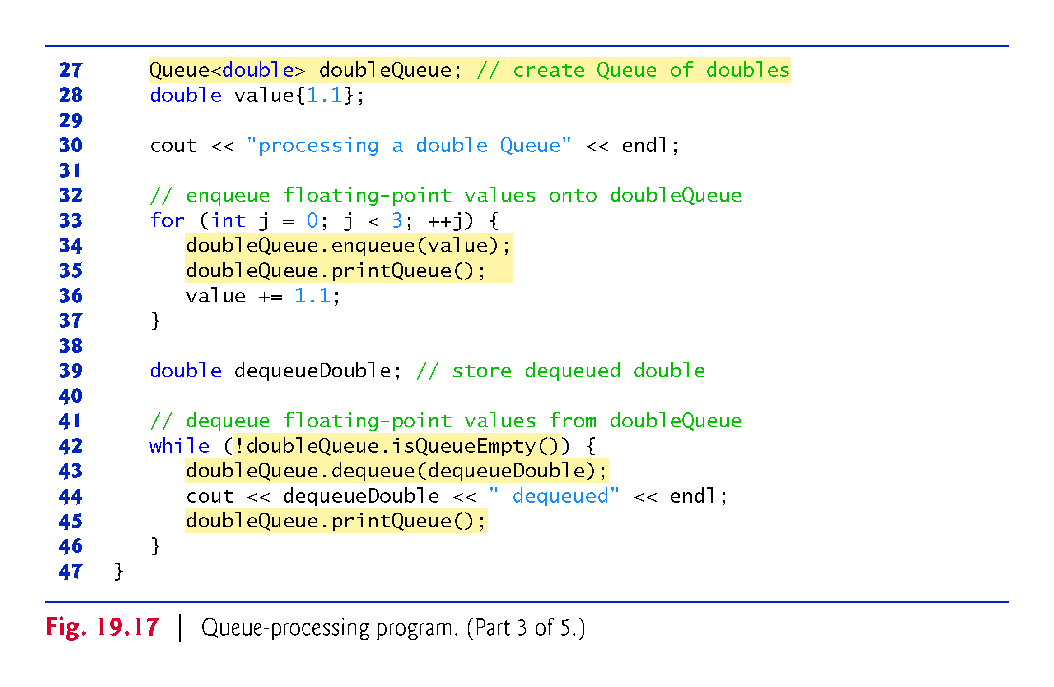

Slide 99
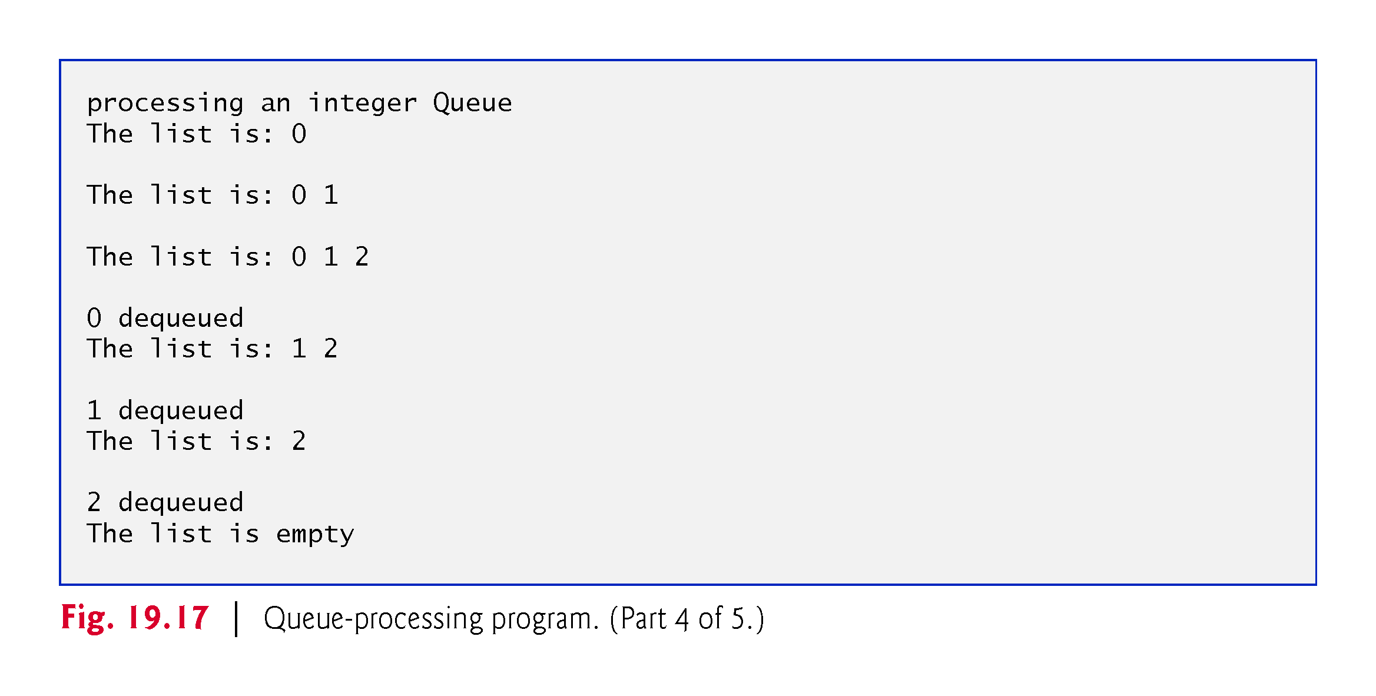

Slide 100
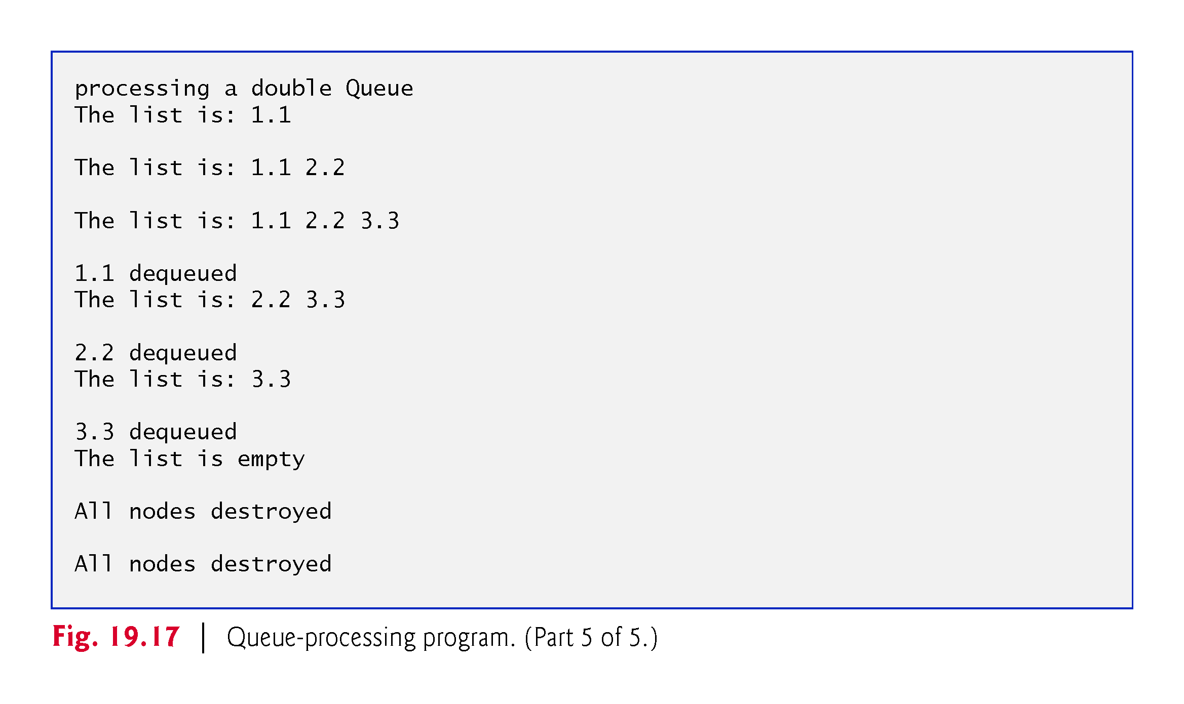

Slide 101
19.6 Trees
Linked lists, stacks and queues are linear data structures.
A tree is a nonlinear, two-dimensional data structure.
Tree nodes contain two or more links.
This section discusses binary trees (Fig. 19.18)—trees whose nodes all contain two links (none, one or both of which may have the value nullptr).

Slide 102
19.6.1 Basic Terminology
For this discussion, refer to nodes A, B, C and D in Fig. 19.18.
The root node (node B) is the first node in a tree.
Each link in the root node refers to a child (nodes A and D).
The left child (node A) is the root node of the left subtree (which contains only node A), and the right child (node D) is the root node of the right subtree (which contains nodes D and C).
The children of a given node are called siblings (e.g., nodes A and D are siblings).
A node with no children is a leaf node (e.g., nodes A and C are leaf nodes).
Computer scientists normally draw trees from the root node down—the opposite of how trees grow in nature.

Slide 103
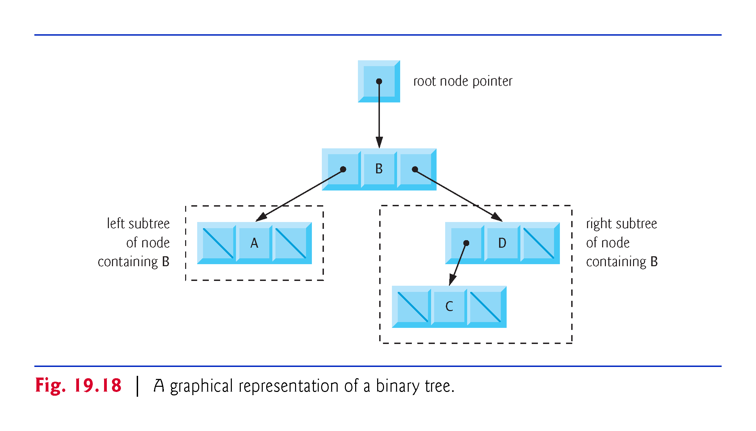

Slide 104
19.6.2 Binary Search Trees (cont.)
A binary search tree (with no duplicate node values) has the characteristic that the values in any left subtree are less than the value in its parent node, and the values in any right subtree are greater than the value in its parent node.
Figure 19.19 illustrates a binary search tree with 9 values.
Note that the shape of the binary search tree that corresponds to a set of data can vary, depending on the order in which the values are inserted into the tree.

Slide 105


Slide 106
19.6.2 Binary Search Trees (cont.)
Implementing the Binary Search Tree Program
The program of Figs. 19.20–19.22 creates a binary search tree and traverses it (i.e., walks through all its nodes) three ways—using recursive inorder, preorder and postorder traversals.
We explain these traversal algorithms shortly.

Slide 107
19.6.3 Testing the Tree Class Template
We begin our discussion with the driver program (Fig. 19.22), then continue with the implementations of classes TreeNode (Fig. 19.20) and Tree (Fig. 19.21).
Function main (Fig. 19.22) begins by instantiating integer tree intTree of type Tree<int>
The program prompts for 10 integers, each of which is inserted in the binary tree by calling insertNode
The program then performs preorder, inorder and postorder traversals (these are explained shortly) of intTree

Slide 108
19.6.3 Testing the Tree Class Template
The program then instantiates floating-point tree doubleTree of type Tree<double> (line 31).
The program prompts for 10 double values, each of which is inserted in the binary tree by calling insertNode (line 41).
The program then performs preorder, inorder and postorder traversals of doubleTree (lines 45, 48 and 51, respectively).

Slide 109


Slide 110


Slide 111


Slide 112


Slide 113
19.6.4 Class Template TreeNode
The TreeNode class template (Fig. 19.20) definition declares Tree<NODETYPE> as its friend.
This makes all member functions of a given specialization of class template Tree (Fig. 19.21) friends of the corresponding specialization of class template TreeNode, so they can access the private members of TreeNode objects of that type.
Because the TreeNode template parameter NODETYPE is used as the template argument for Tree in the friend declaration, TreeNodes specialized with a particular type can be processed only by a Tree specialized with the same type (e.g., a Tree of int values manages TreeNode objects that store int values).

Slide 114
19.6.4 Class Template TreeNode
Lines 20–22 declare a TreeNode’s private data—the node’s data value, and pointers leftPtr (to the node’s left subtree) and rightPtr (to the node’s right subtree).
The constructor sets data to the value supplied as a constructor argument and sets pointers leftPtr and rightPtr to nullptr (thus initializing this node to be a leaf node).
Member function getData returns the data value.

Slide 115


Slide 116


Slide 117
19.6.5 Class Template Tree
Class template Tree (Fig. 19.21) has as private data rootPtr, a pointer to the tree’s root node.
The Tree constructor initializes rootptr to nullptr to indicate that the tree is initially empty.
The class’s public member functions are insertNode that inserts a new node in the tree and preOrderTraversal, inOrderTraversal and postOrderTraversal, each of which walks the tree in the designated manner.

Slide 118
19.6.5 Class Template Tree
Each of these member functions calls its own recursive utility function to perform the appropriate operations on the internal representation of the tree, so the program is not required to access the underlying private data to perform these functions.
Remember that the recursion requires us to pass in a pointer that represents the next subtree to process.

Slide 119


Slide 120


Slide 121


Slide 122


Slide 123


Slide 124


Slide 125
19.6.6 Tree Member Function insertNodeHelper
The Tree class’s utility function insertNodeHelper (lines 46–66) is called by insertNode to recursively insert a node into the tree.
A node can only be inserted as a leaf node in a binary search tree.
If the tree is empty, a new TreeNode is created, initialized and inserted in the tree
If the tree is not empty, the program compares the value to be inserted with the data value in the root node.
If the insert value is smaller, the program recursively calls insertNodeHelper to insert the value in the left subtree.
If the insert value is larger, the program recursively calls insertNodeHelper to insert the value in the right subtree.

Slide 126
19.6.6 Tree Member Function insertNodeHelper
If the value to be inserted is identical to the data value in the root node, the program prints the message " dup" and returns without inserting the duplicate value into the tree.
insertNode passes the address of rootPtr to insertNodeHelper so it can modify the value stored in rootPtr (i.e., the address of the root node).
To receive a pointer to rootPtr (which is also a pointer), insertNodeHelper’s first argument is declared as a pointer to a pointer to a TreeNode.

Slide 127
19.6.7 Tree Traversal Functions
Member functions preOrderTraversal inOrderTraversal and postOrderTraversal traverse the tree and print the node values.
For the purpose of the following discussion, we use the binary search tree in Fig. 19.23.

Slide 128


Slide 129
19.6.7 Tree Traversal Functions
Inorder Traversal Algorithm
Function inOrderTraversal invokes utility function inOrderHelper to perform the inorder traversal of the binary tree.
The steps for an inorder traversal are:
Traverse the left subtree with an inorder traversal. (This is performed by the call to inOrderHelper at line 72.)
Process the value in the node—i.e., print the node value (line 73).
Traverse the right subtree with an inorder traversal. (This is performed by the call to inOrderHelper at line 74.)
The value in a node is not processed until the values in its left subtree are processed, because each call to inOrderHelper immediately calls inOrderHelper again with the pointer to the left subtree.

Slide 130
19.6.7 Tree Traversal Functions
The inorder traversal of the tree in Fig. 19.23 is
6 13 17 27 33 42 48
The inorder traversal of a binary search tree prints the node values in ascending order.
The process of creating a binary search tree actually sorts the data—thus, this process is called the binary tree sort.

Slide 131
19.6.7 Tree Traversal Functions
Preorder Traversal Algorithm
Function preOrderTraversal invokes utility function preOrderHelper to perform the preorder traversal of the binary tree.
The steps for a preorder traversal are:
Process the value in the node (line 63).
Traverse the left subtree with a preorder traversal. (This is performed by the call to preOrderHelper at line 64.)
Traverse the right subtree with a preorder traversal. (This is performed by the call to preOrderHelper at line 65.)
The value in each node is processed as the node is visited.
After the value in a given node is processed, the values in the left subtree are processed.
Then the values in the right subtree are processed.
The preorder traversal of the tree in Fig. 19.23 is
27 13 6 17 42 33 48

Slide 132
19.6.7 Tree Traversal Functions
Postorder Traversal Algorithm
Function postOrderTraversal invokes utility function postOrderHelper to perform the postorder traversal of the binary tree.
The steps for a postorder traversal are:
Traverse the left subtree with a postorder traversal. (This is performed by the call to postOrderHelper at line 81.)
Traverse the right subtree with a postorder traversal. (This is performed by the call to postOrderHelper at line 82.)
Process the value in the node (line 83).
The value in each node is not printed until the values of its children are printed.
The postOrderTraversal of the tree in Fig. 19.23 is
6 17 13 33 48 42 27

Slide 133
19.6.8 Duplicate Elimination
The binary search tree facilitates duplicate elimination.
As the tree is being created, an attempt to insert a duplicate value will be recognized, because a duplicate will follow the same “go left” or “go right” decisions on each comparison as the original value did when it was inserted in the tree.
Thus, the duplicate will eventually be compared with a node containing the same value.
The duplicate value may be discarded at this point.

Slide 134
19.6.8 Duplicate Elimination
Searching a binary tree for a value that matches a key value is also fast.
If the tree is balanced, then each branch contains about half the number of nodes in the tree.
Each comparison of a node to the search key eliminates half the nodes.
This is called an O(log n) algorithm (Big O notation is discussed in Chapter 20).
So a binary search tree with n elements would require a maximum of log₂ n comparisons either to find a match or to determine that no match exists.
This means, for example, that when searching a (balanced) 1000-element binary search tree, no more than 10 comparisons need to be made, because 2¹⁰> 1000.
When searching a (balanced) 1,000,000-element binary search tree, no more than 20 comparisons need to be made, because 2²⁰> 1,000,000.

Slide 135
19.6.9 Overview of the Binary Tree Exercises
In the exercises, algorithms are presented for several other binary tree operations such as deleting an item from a binary tree, printing a binary tree in a two-dimensional tree format and performing a level-order traversal of a binary tree.
The level-order traversal of a binary tree visits the nodes of the tree row by row, starting at the root node level.
On each level of the tree, the nodes are visited from left to right.
Other binary tree exercises include allowing a binary search tree to contain duplicate values, inserting string values in a binary tree and determining how many levels are contained in a binary tree.

