Slide 1
Searching and Sorting
Based on Chapter 20 of C++ How to Program, 10/e

Slide 2
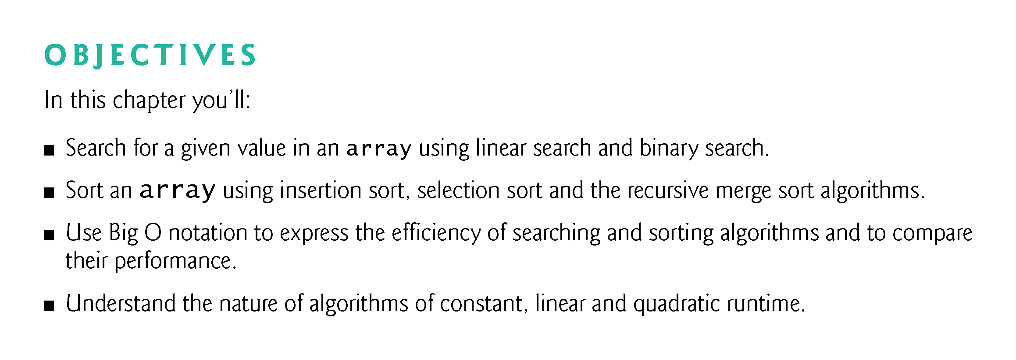

Slide 3
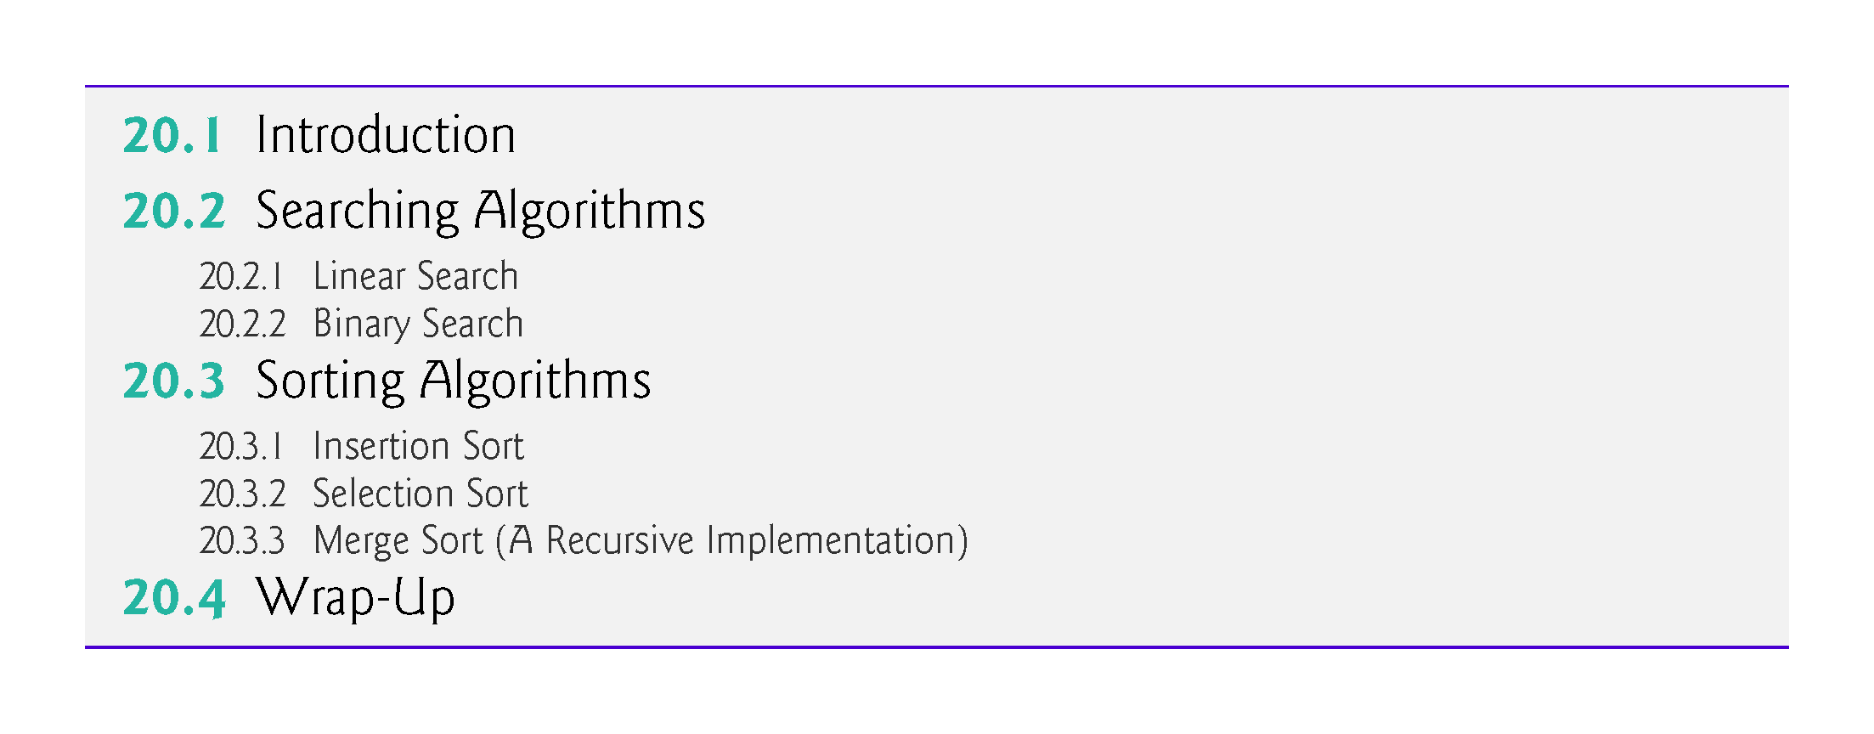

Slide 4
20.1 Introduction
Searching data involves determining whether a value (referred to as the search key) is present in the data and, if so, finding the value’s location.
Two popular search algorithms are the simple linear search (Section 20.2.1) and the faster but more complex binary search (Section 20.2.2).
Sorting places data in ascending or descending order, based on one or more sort keys.
You’ll learn about insertion sort (Section 20.3.1) and selection sort (Section 20.3.2) and the more efficient, but more complex merge sort (Section 20.3.3).
Figure 20.1 summarizes the searching and sorting algorithms discussed in the book’s examples and exercises.
This chapter also introduces Big O notation, which is used to characterize an algorithm’s worst-case runtime—that is, how hard an algorithm may have to work to solve a problem.

Slide 5
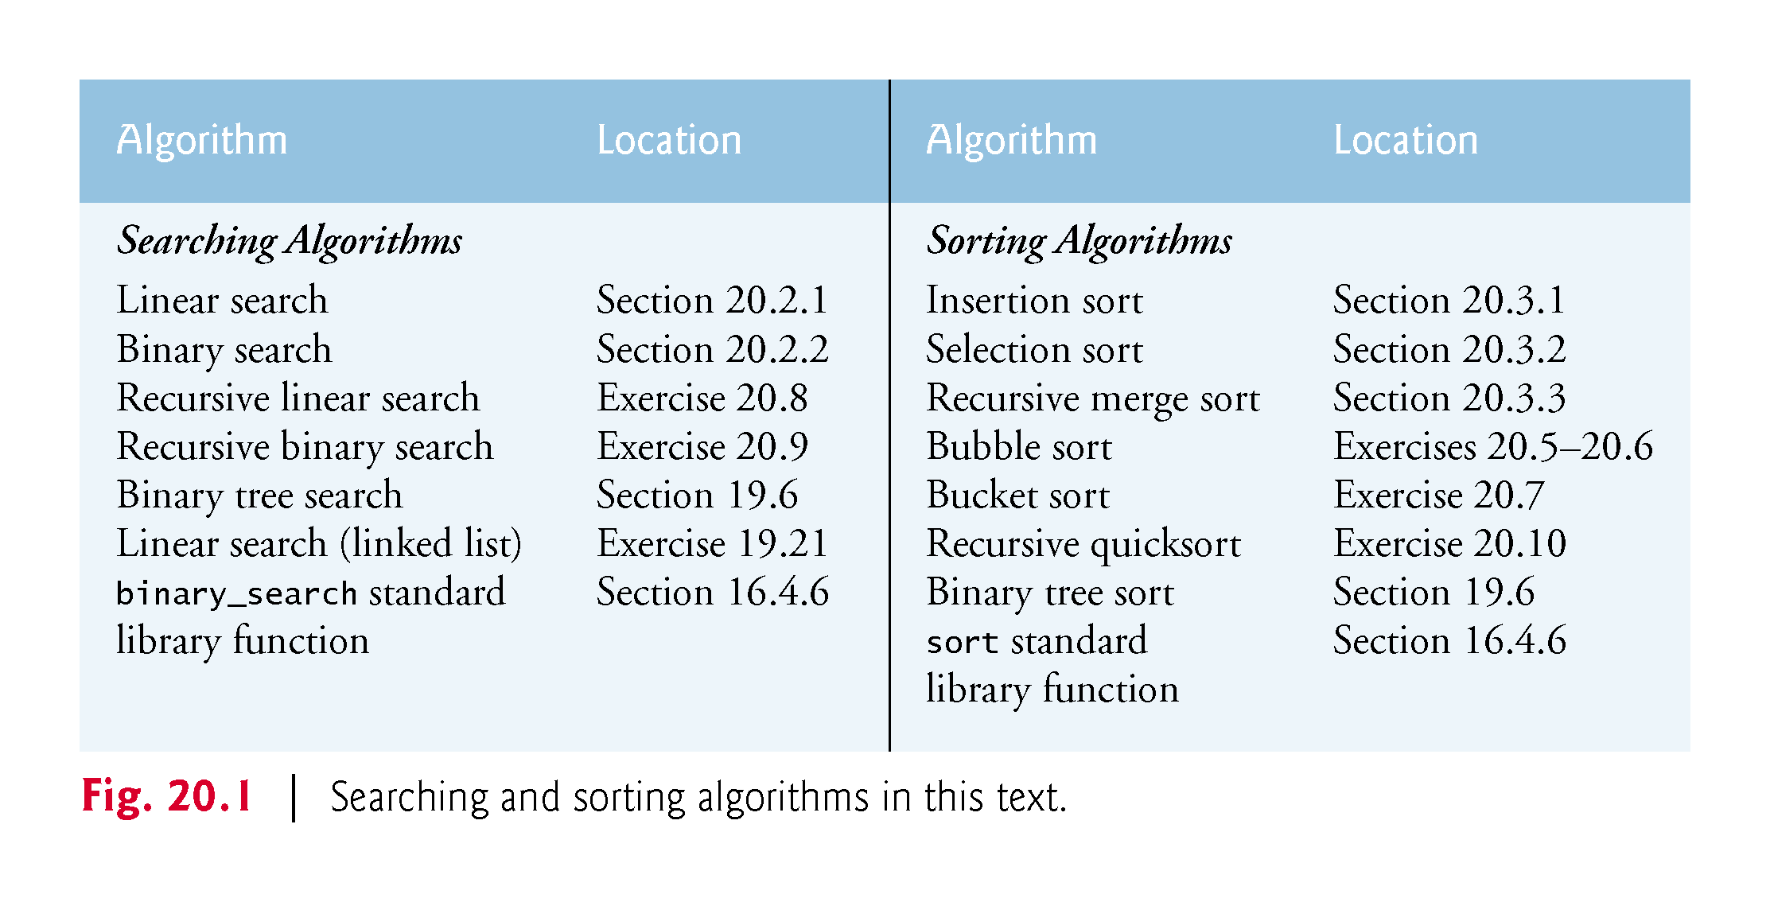

Slide 6
20.2 Searching Algorithms
Looking up a phone number, accessing a website and checking a word’s definition in a dictionary all involve searching through large amounts of data.
Searching algorithms all accomplish the same goal—finding an element that matches a given search key, if such an element does, in fact, exist.
The major difference is the amount of effort they require to complete the search.
One way to describe this effort is with Big O notation.
For searching and sorting algorithms, this is particularly dependent on the number of data elements.

Slide 7
20.2 Searching Algorithms (cont.)
In Section 20.2.1, we present the linear search algorithm then discuss the algorithm’s efficiency as measured by Big O notation.
In Section 20.2.2, we introduce the binary search algorithm, which is much more efficient but more complex to implement.

Slide 8
20.2.1 Linear Search
Function Template linearSearch
Function template linearSearch (Fig. 20.2) compares each element of an array with a search key
Because the array is not in any particular order, it’s just as likely that the search key will be found in the first element as the last.
On average, therefore, the program must compare the search key with half of the array’s elements.
To determine that a value is not in the array, the program must compare the search key to every array element.
Linear search works well for small or unsorted arrays.
However, for large arrays, linear searching is inefficient.
If the array is sorted (e.g., its elements are in ascending order), you can use the high-speed binary search technique (Section 20.2.2).

Slide 9
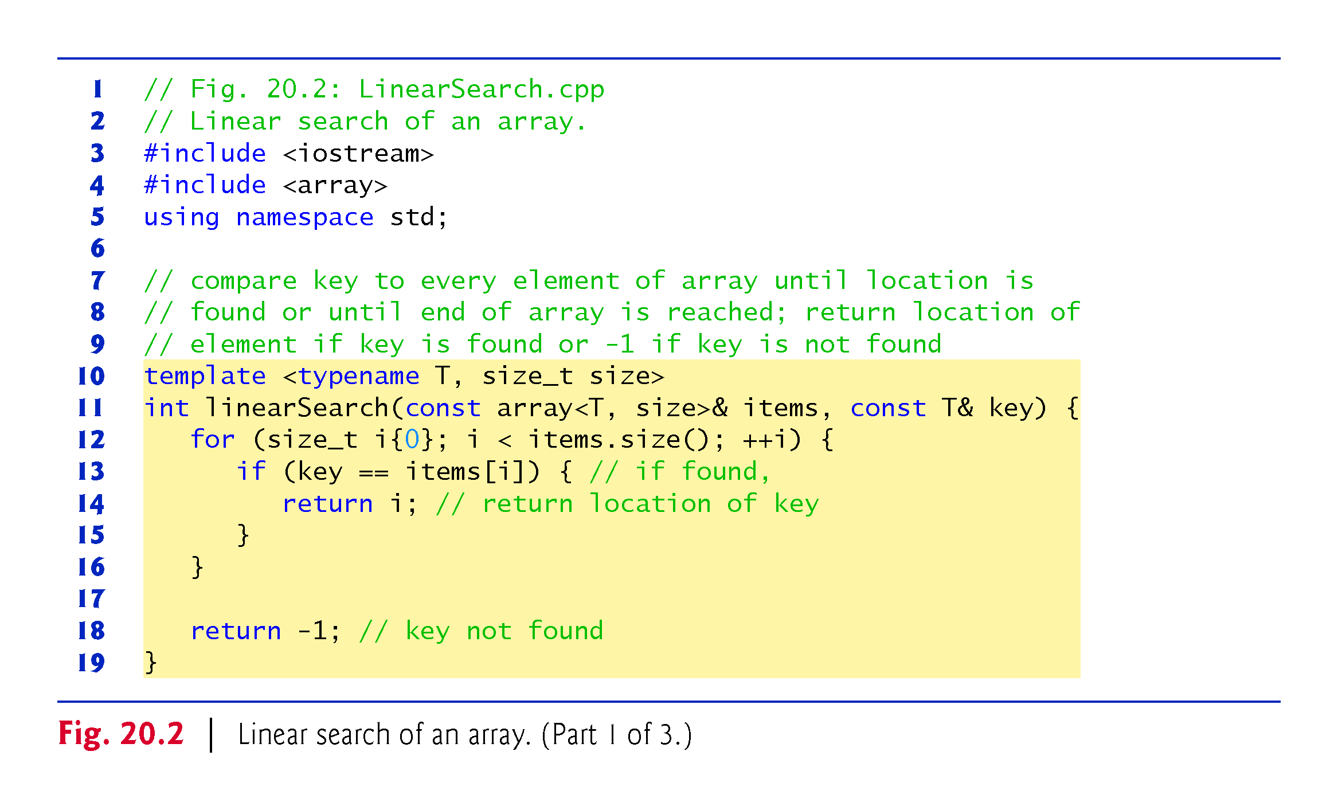

Slide 10
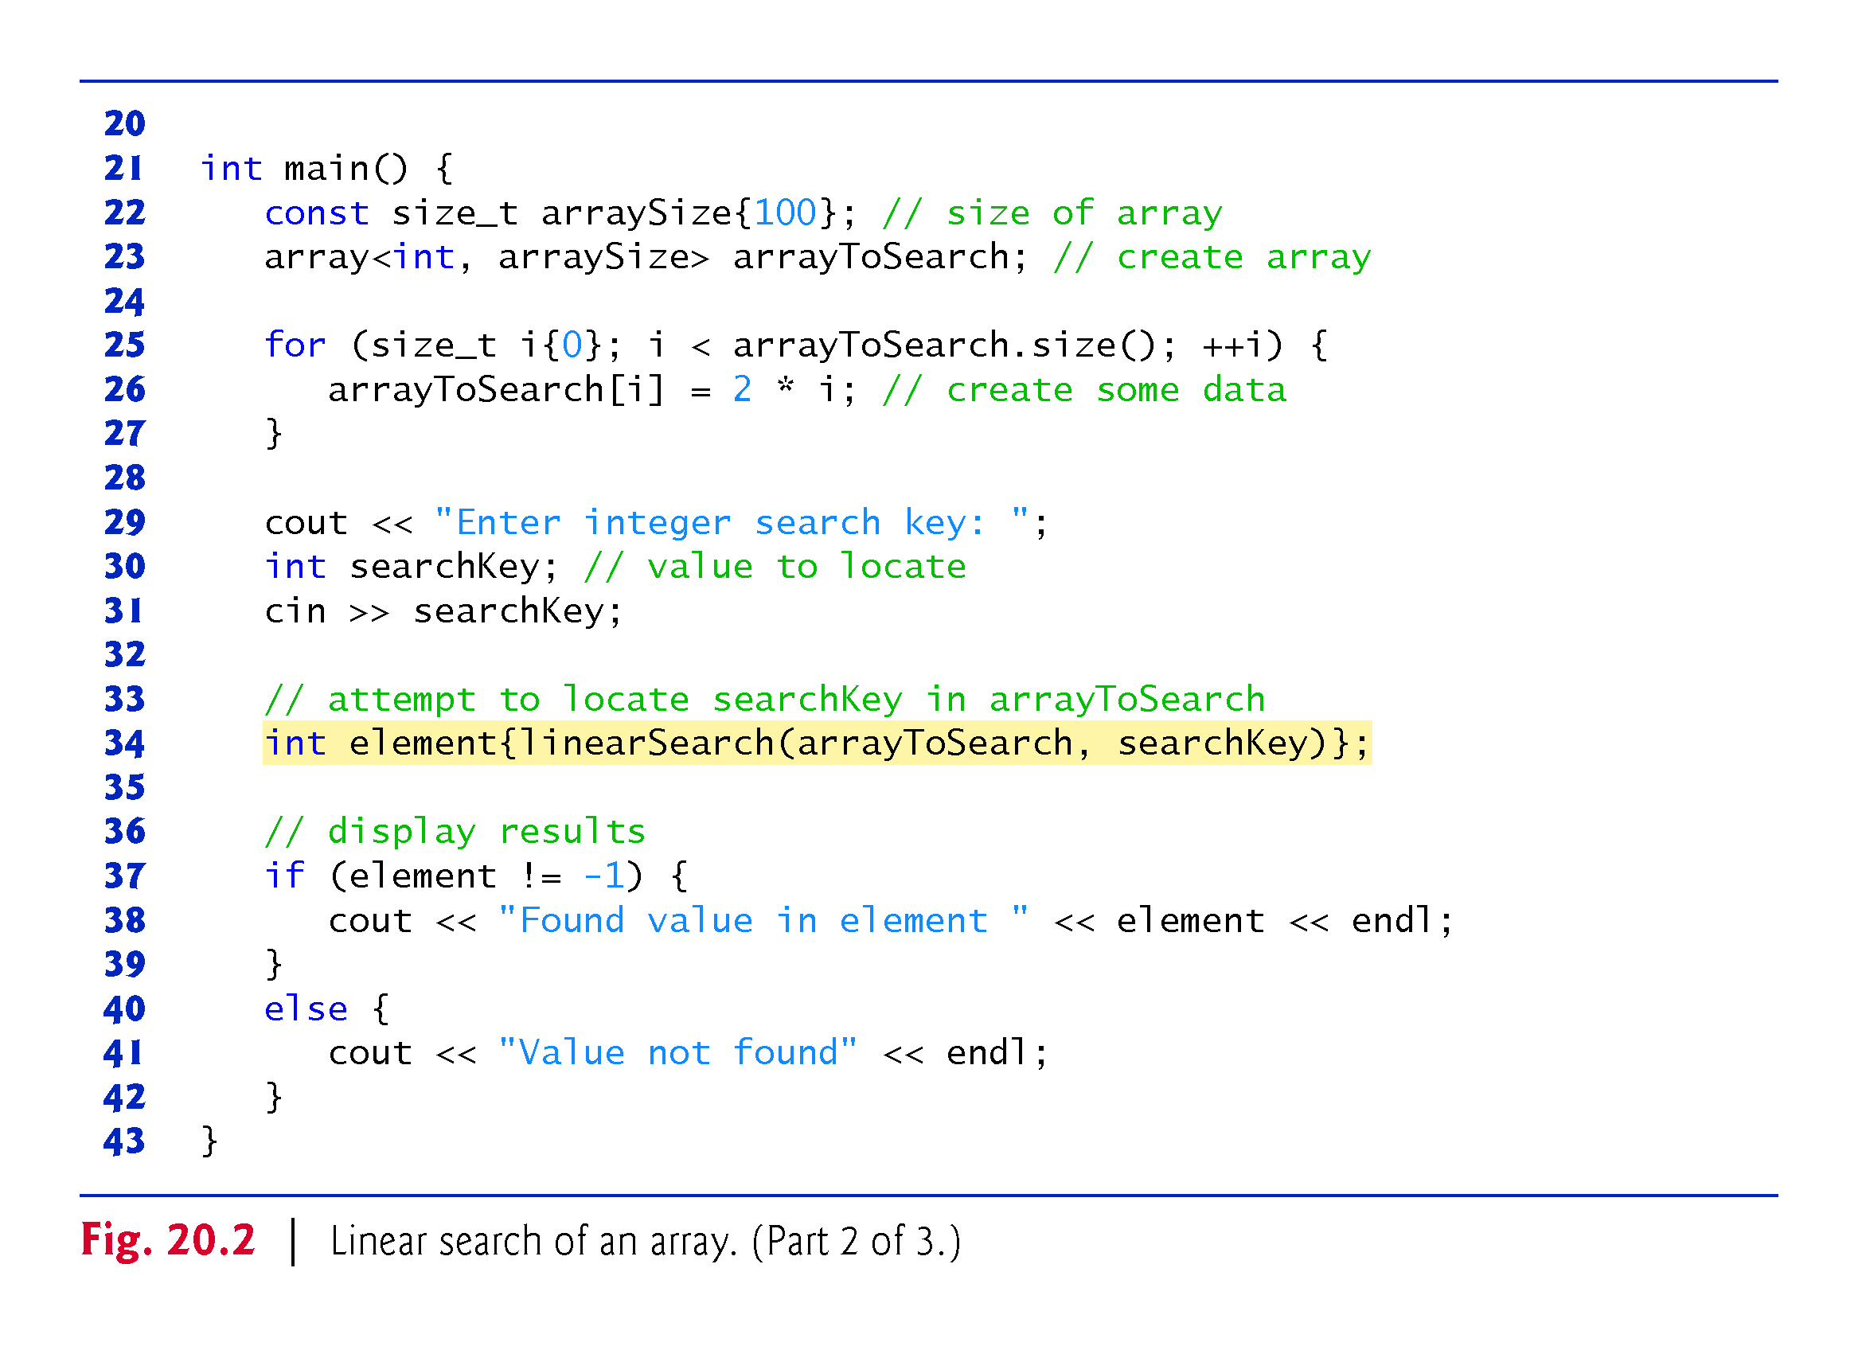

Slide 11
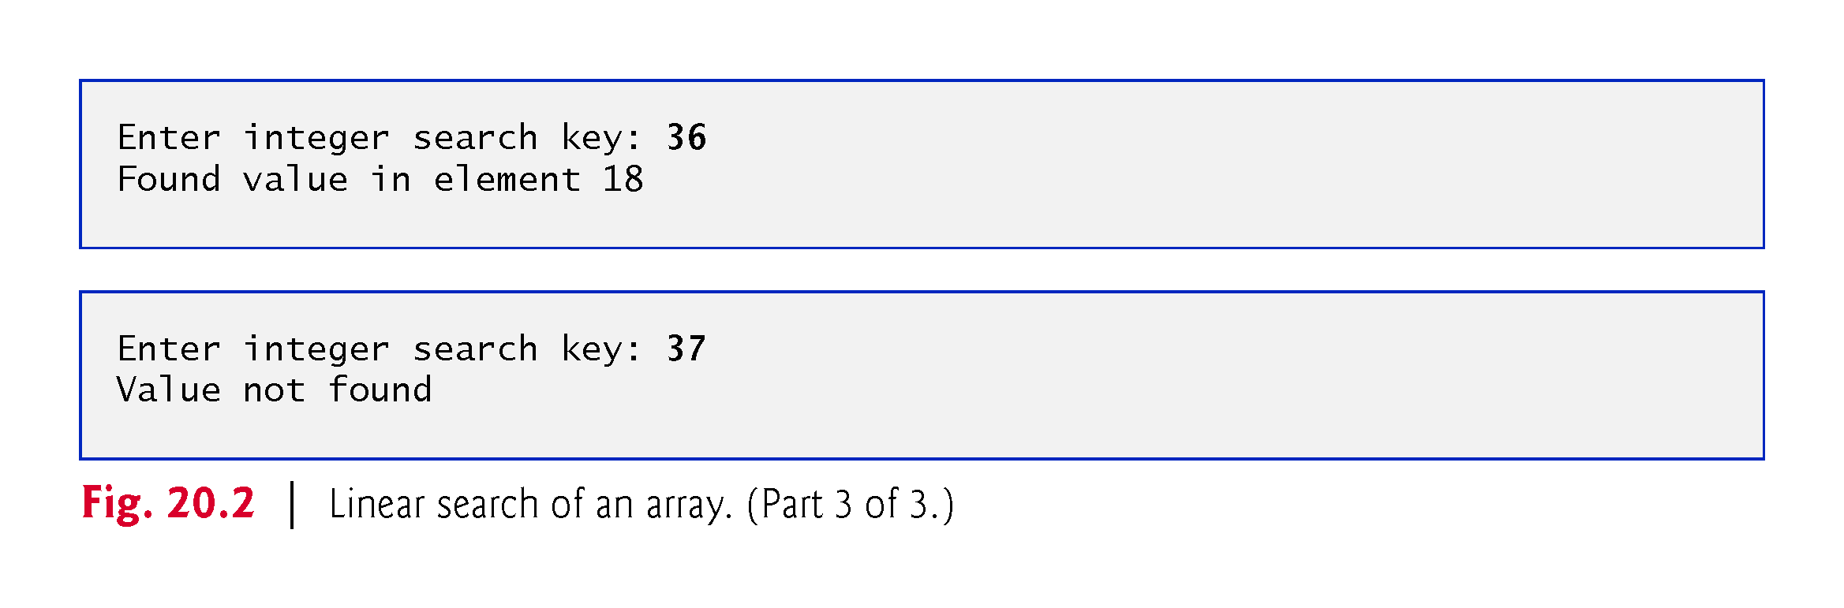

Slide 12
20.2.1 Efficiency of Linear Search
Big O: Constant Runtime
Suppose an algorithm simply tests whether the first element of an array is equal to the second element.
If the array has 10 elements, this algorithm requires only one comparison.
If the array has 1000 elements, the algorithm still requires only one comparison.
In fact, the algorithm is independent of the number of array elements.
This algorithm is said to have a constant runtime, which is represented in Big O notation as O(1).
An algorithm that is O(1) does not necessarily require only one comparison.
O(1) just means that the number of comparisons is constant—it does not grow as the size of the array increases.
An algorithm that tests whether the first element of an array is equal to any of the next three elements will always require three comparisons, but in Big O notation it’s still considered O(1).
O(1) is often pronounced “on the order of 1” or more simply “order 1.”

Slide 13
20.2.1 Efficiency of Linear Search (cont.)
Big O: Linear Runtime
An algorithm that tests whether the first element of an array is equal to any of the other elements of the array requires at most n – 1 comparisons, where n is the number of elements in the array.
If the array has 10 elements, the algorithm requires up to nine comparisons.
If the array has 1000 elements, the algorithm requires up to 999 comparisons.
As n grows larger, the n part of the expression n – 1 “dominates,” and subtracting one becomes inconsequential.
Big O is designed to highlight these dominant terms and ignore terms that become unimportant as n grows.

Slide 14
20.2.1 Efficiency of Linear Search (cont.)
An algorithm that requires a total of n – 1 comparisons is said to be O(n) and is referred to as having a linear runtime.
O(n) is often pronounced “on the order of n” or more simply “order n.”

Slide 15
20.2.1 Efficiency of Linear Search (cont.)
Big O: Quadratic Runtime
Now suppose you have an algorithm that tests whether any element of an array is duplicated elsewhere in the array.
The first element must be compared with every other element in the array.
The second element must be compared with every other element except the first (it was already compared to the first).
The third element then must be compared with every other element except the first two.
In the end, this algorithm will end up making (n – 1) + (n – 2) + … + 2 + 1 or n²/2 – n/2 comparisons.
As n increases, the n² term dominates and the n term becomes inconsequential.
Again, Big O notation highlights the n² term, leaving n²/2.

Slide 16
20.2.1 Efficiency of Linear Search (cont.)
Big O is concerned with how an algorithm’s runtime grows in relation to the number of items processed.
Suppose an algorithm requires n² comparisons.
With four elements, the algorithm will require 16 comparisons; with eight elements, 64 comparisons.
With this algorithm, doubling the number of elements quadruples the number of comparisons.
Consider a similar algorithm requiring n²/2 comparisons.
With four elements, the algorithm will require eight comparisons; with eight elements, 32 comparisons.
Again, doubling the number of elements quadruples the number of comparisons.
Both of these algorithms grow as the square of n, so Big O ignores the constant, and both algorithms are considered to be O(n²), which is referred to as quadratic runtime and pronounced “on the order of n-squared” or more simply “order n-squared.”

Slide 17
20.2.1 Efficiency of Linear Search (cont.)
O(n2) Performance
When n is small, O(n²) algorithms will not noticeably affect performance.
As n grows, you’ll start to notice the performance degradation.
An O(n²) algorithm running on a million-element array would require a trillion “operations” (where each could actually require several machine instructions to execute).
This could require hours to execute.
A billion-element array would require a quintillion operations, a number so large that the algorithm could take decades! Unfortunately, O(n²) algorithms tend to be easy to write.

Slide 18
20.2.1 Efficiency of Linear Search (cont.)
In this chapter, you’ll see algorithms with more favorable Big O measures.
These efficient algorithms often take a bit more cleverness and effort to create, but their superior performance can be worth the extra effort, especially as n gets large and as algorithms are compounded into larger programs.

Slide 19
20.2.1 Efficiency of Linear Search (cont.)
Linear Search’s Runtime
The linear search algorithm runs in O(n) time.
The worst case in this algorithm is that every element must be checked to determine whether the search key is in the array.
If the array’s size doubles, the number of comparisons that the algorithm must perform also doubles.
Linear search can provide outstanding performance if the element matching the search key happens to be at or near the front of the array.
But we seek algorithms that perform well, on average, across all searches, including those where the element matching the search key is near the end of the array.
If a program needs to perform many searches on large arrays, it may be better to implement a different, more efficient algorithm, such as the binary search which we present in the next section.

Slide 20
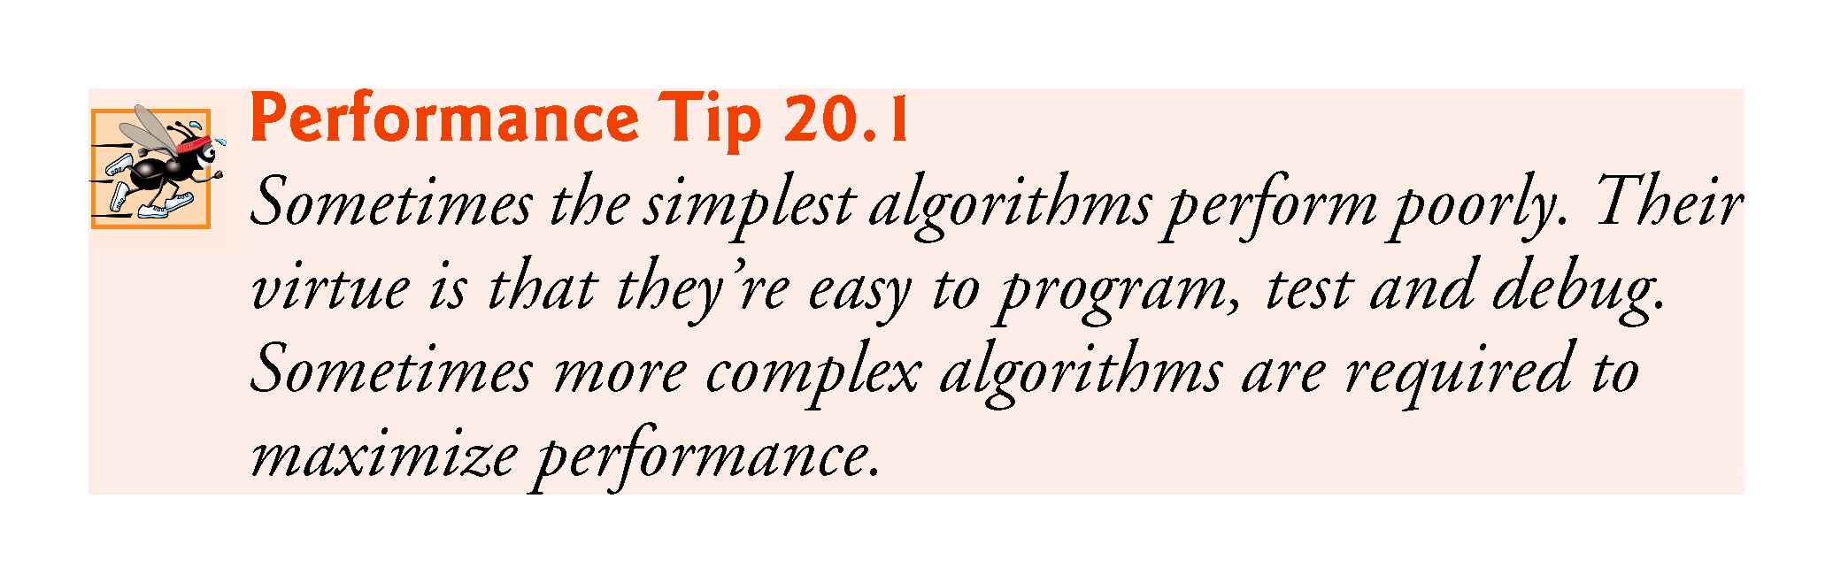

Slide 21
20.2.2 Binary Search
The binary search algorithm is more efficient than the linear search algorithm, but it requires that the array first be sorted.
This is only worthwhile when the vector, once sorted, will be searched a great many times—or when the searching application has stringent performance requirements.
The first iteration of this algorithm tests the middle array element.
If this matches the search key, the algorithm ends.

Slide 22
20.2.2 Binary Search (cont.)
Assuming the array is sorted in ascending order, then if the search key is less than the middle element, the search key cannot match any element in the array’s second half so the algorithm continues with only the first half (i.e., the first element up to, but not including, the middle element).
If the search key is greater than the middle element, the search key cannot match any element in the array’s first half so the algorithm continues with only the second half (i.e., the element after the middle element through the last element).
Each iteration tests the middle value of the array’s remaining elements.
If the element does not match the search key, the algorithm eliminates half of the remaining elements.
The algorithm ends either by finding an element that matches the search key or by reducing the sub-array to zero size.

Slide 23
20.2.2 Binary Search (cont.)
Binary Search Example
Figure 20.3 implements and demonstrates the binary-search algorithm.
Throughout the program’s execution, we use function template displayElements to display the portion of the array that’s currently being searched.

Slide 24
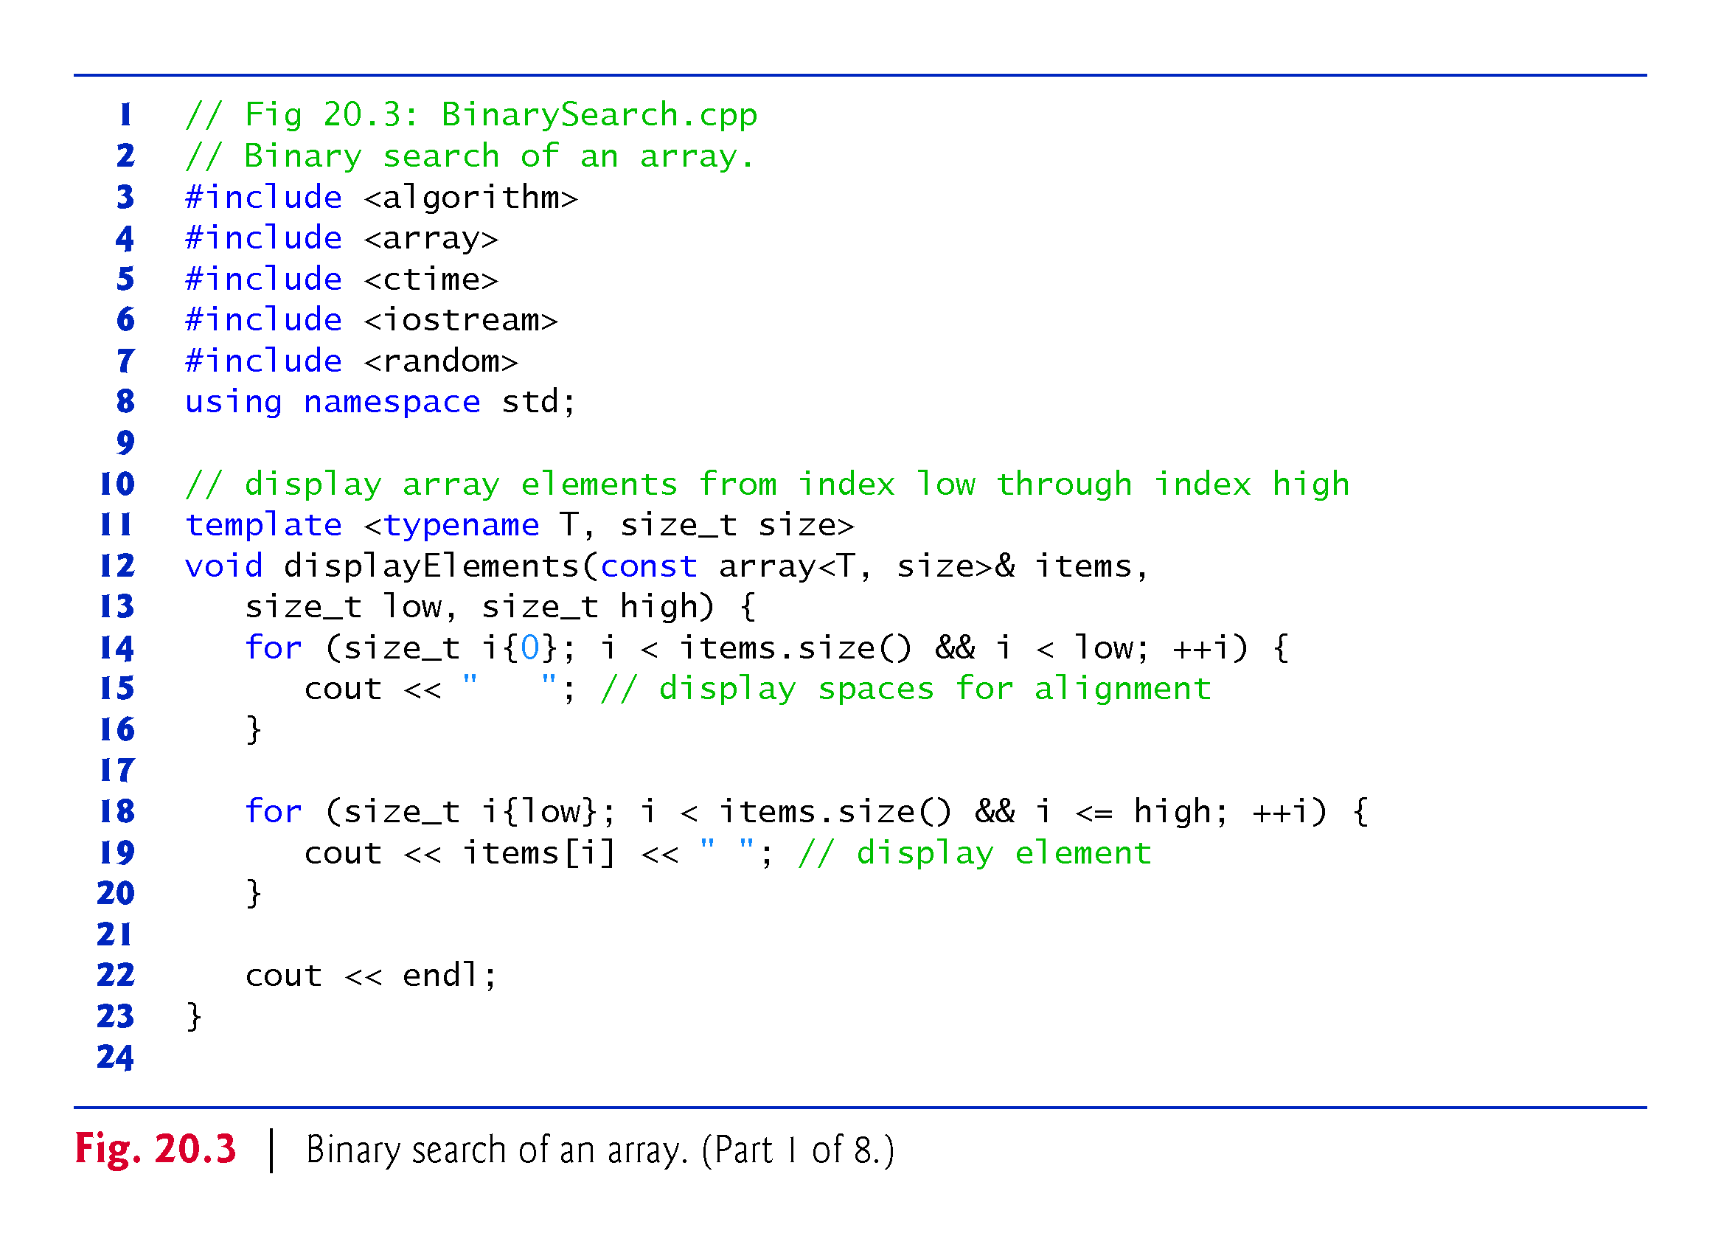

Slide 25
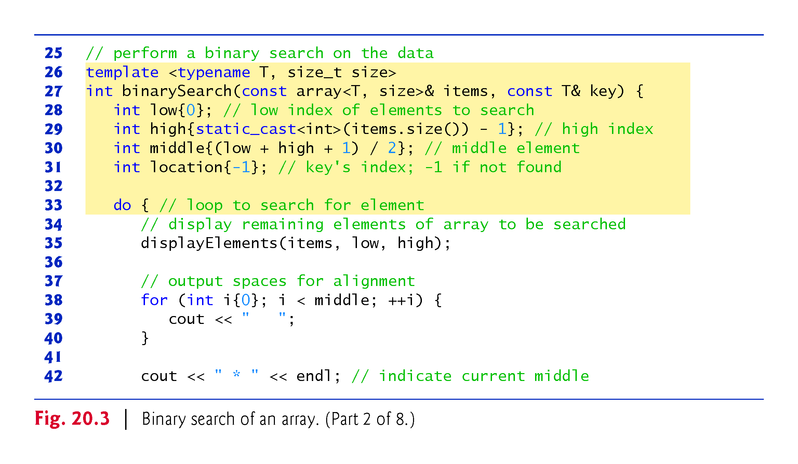

Slide 26
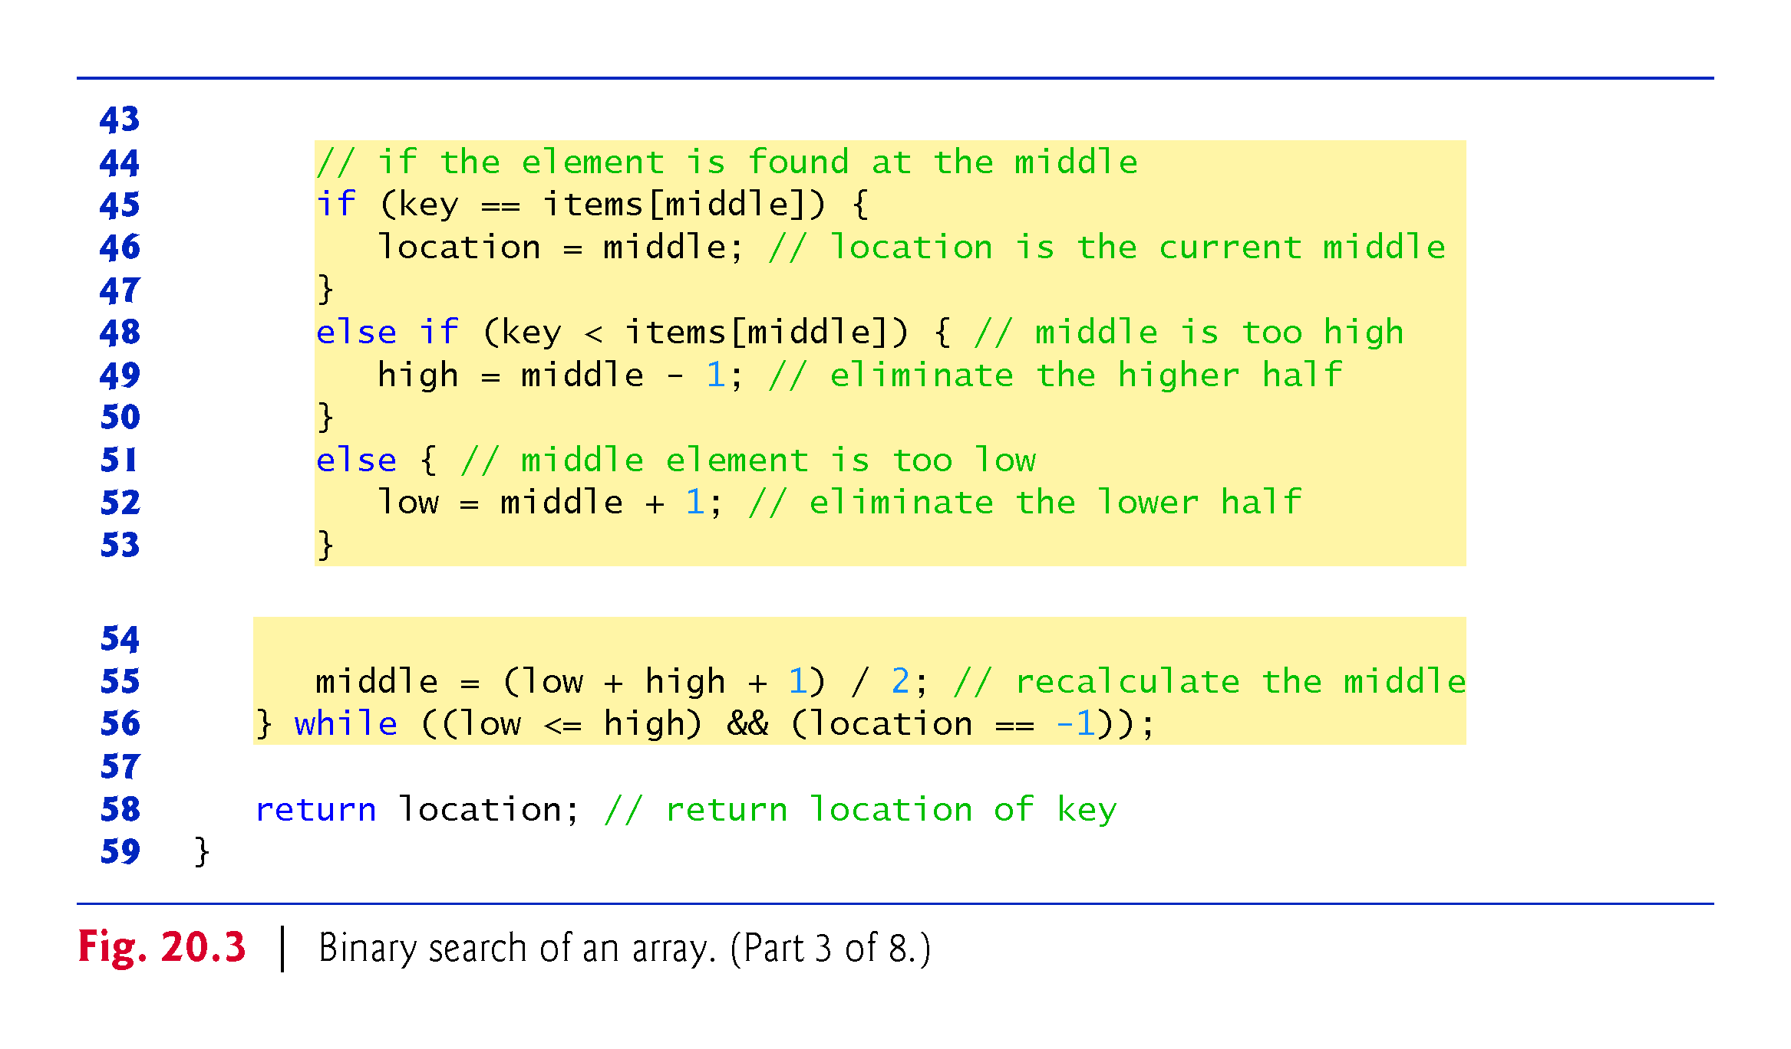

Slide 27
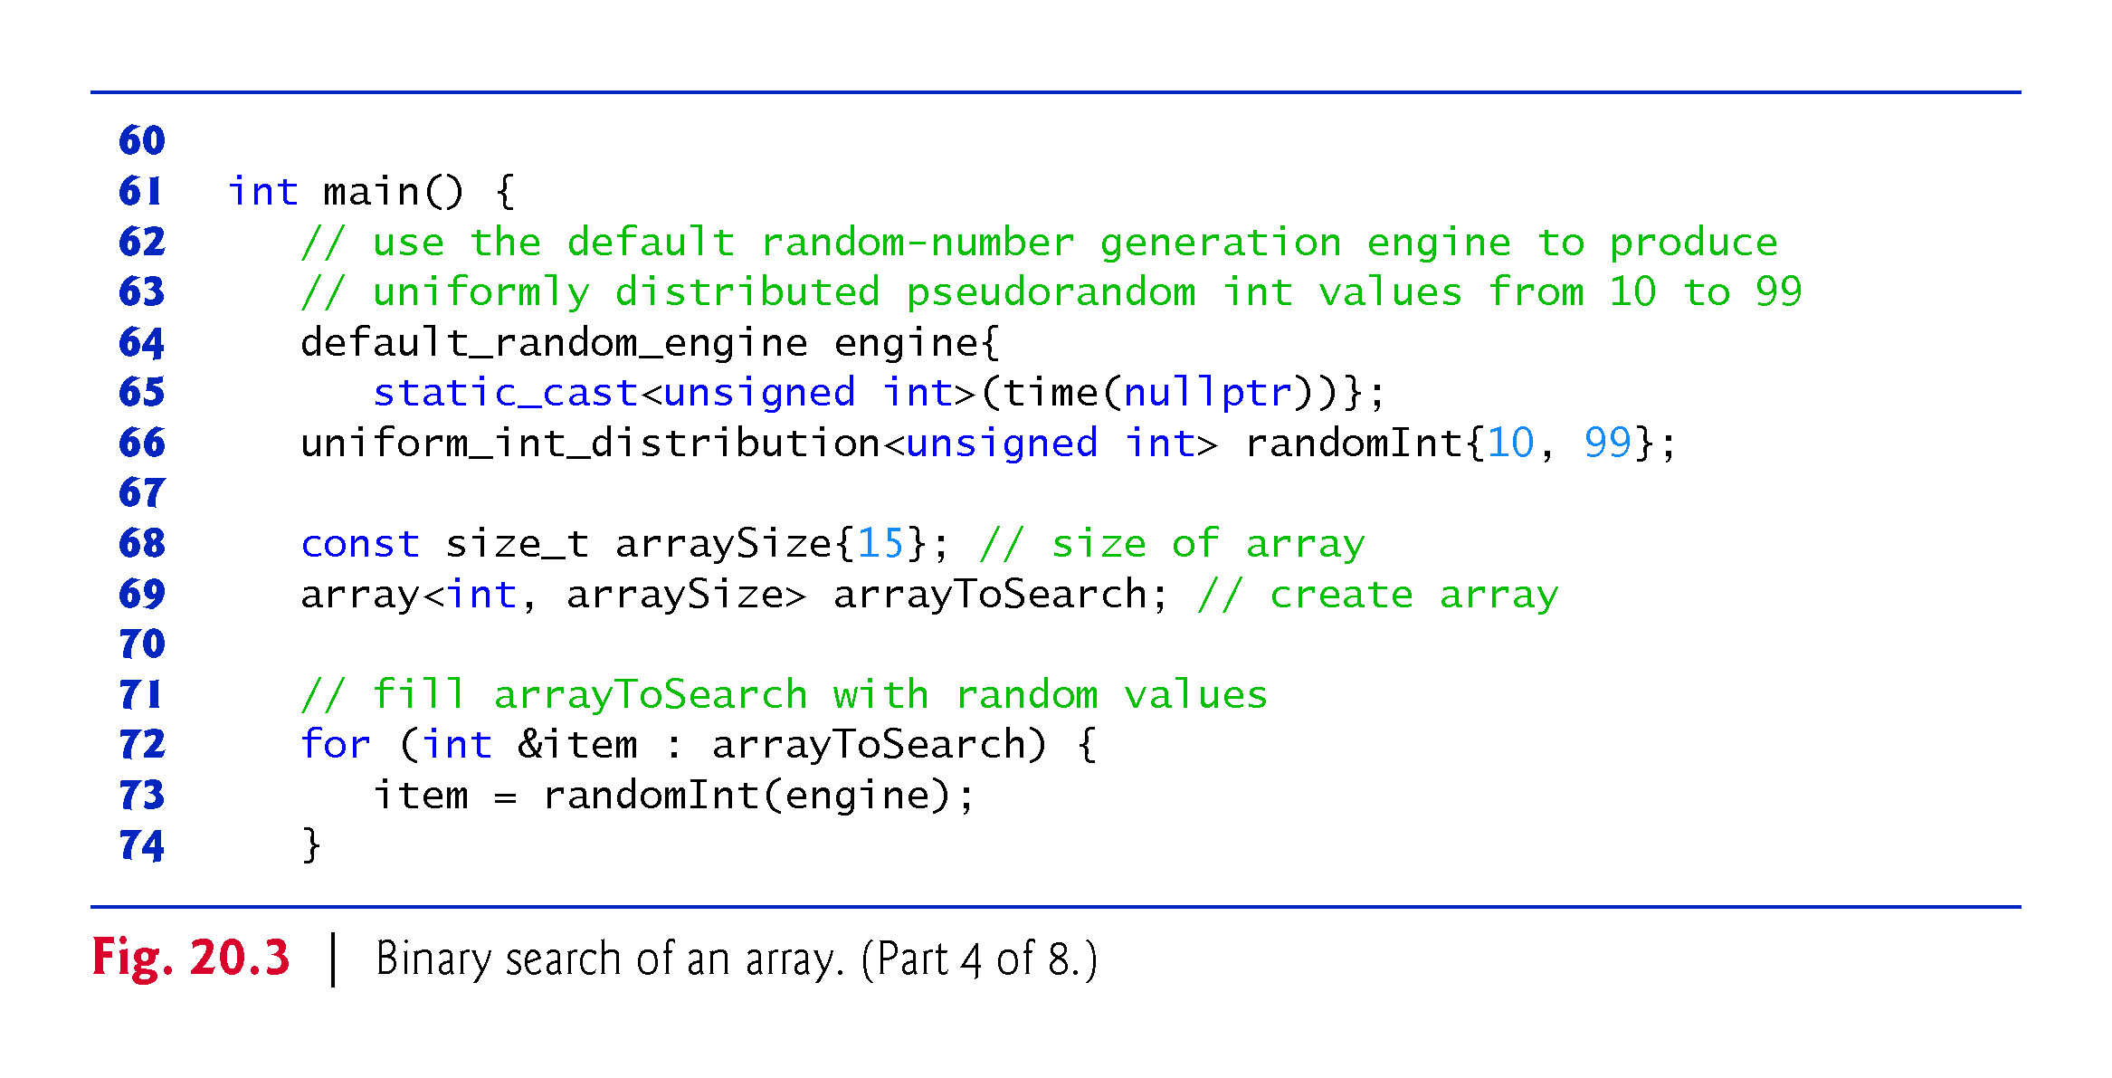

Slide 28
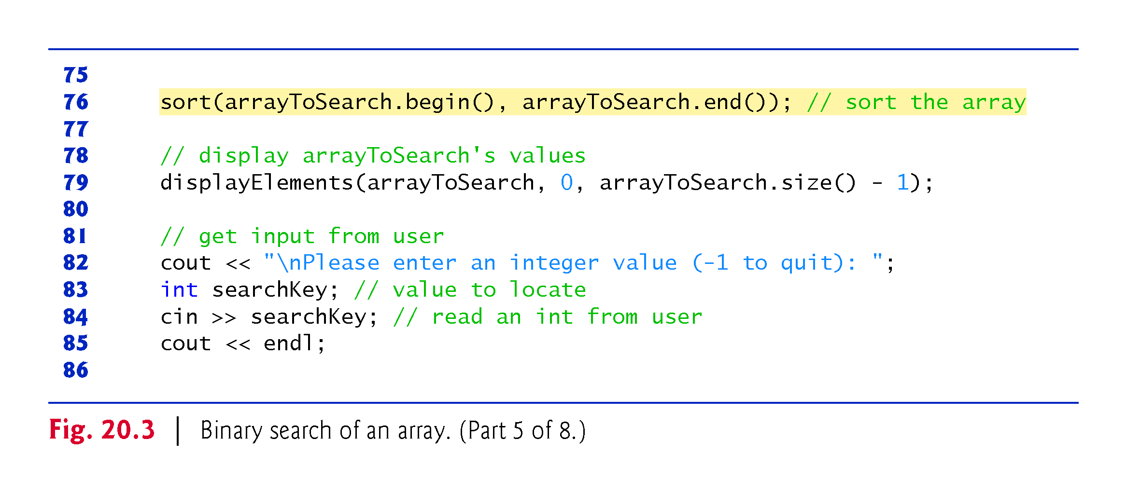

Slide 29
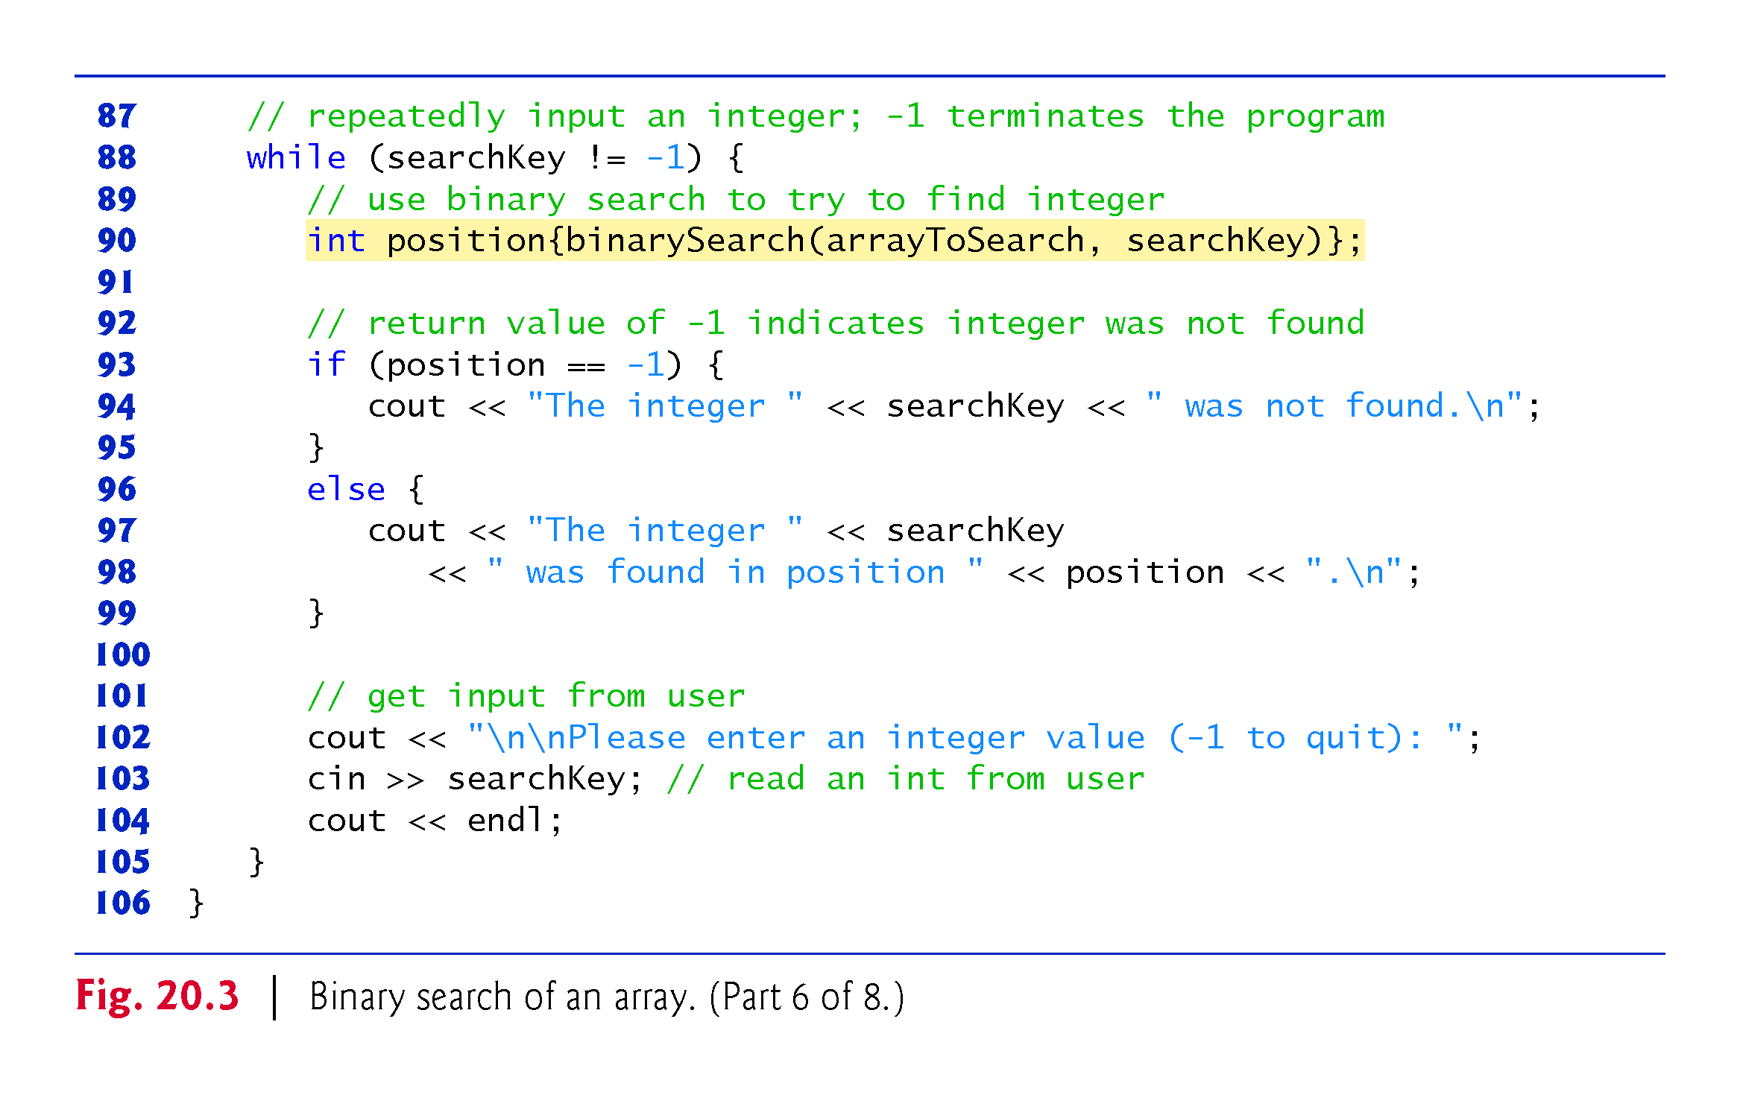

Slide 30
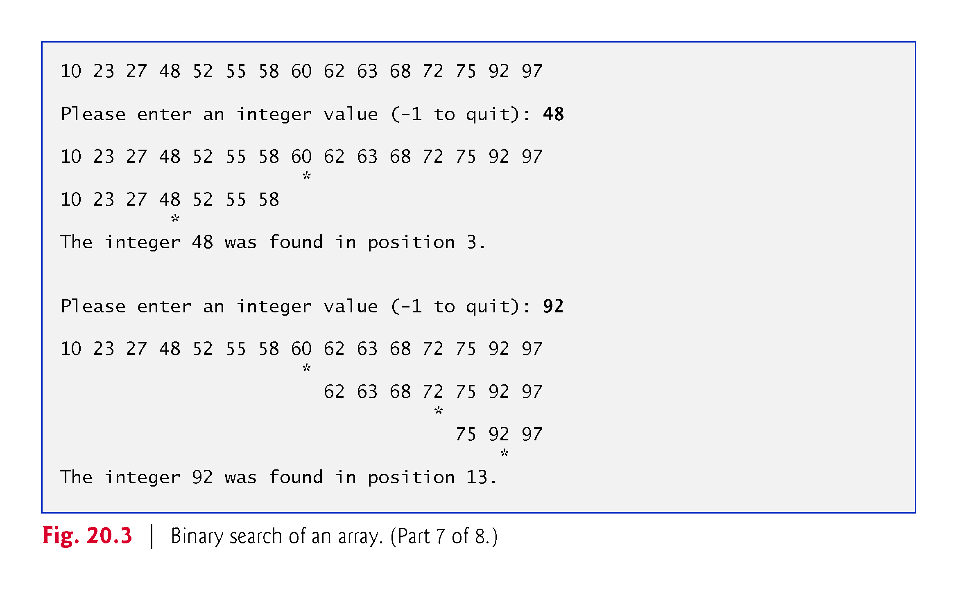

Slide 31
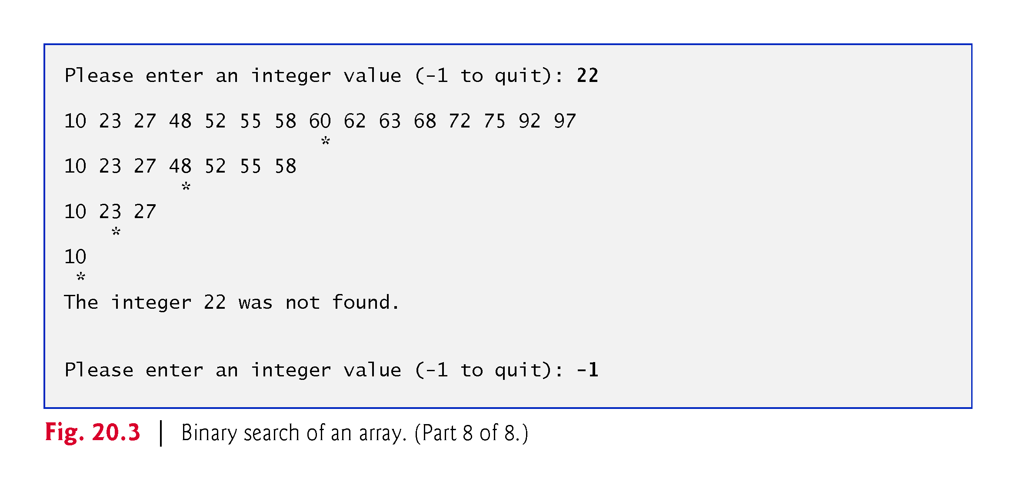

Slide 32
20.2.2 Binary Search (cont.)
Function template binarySearch has two parameters—a reference to the array to search and a reference to the search key.
The function calculates the low end index, high end index and middle index of the portion of the array that the algorithm is currently searching.
When binarySearch is first called, low is 0, high is the array’s size minus 1 and middle is the average of these two values.

Slide 33
20.2.2 Binary Search (cont.)
Line 31 initializes location to -1—the value that binarySearch returns if the search key is not found.
Lines 33–56 loop until low is greater than high (indicating that the element was not found) or location does not equal -1 (indicating that the search key was found).
Line 45 tests whether the value in the middle element is equal to key.
If so, line 46 assigns the middle index to location.
Then the loop terminates and location is returned to the caller.
Each iteration of the loop that does not find the search key tests a single value (line 48) and eliminates half of the remaining values in the array (line 49 or 51).

Slide 34
20.2.2 Binary Search (cont.)
Efficiency of Binary Search
In the worst-case scenario, searching a sorted array of 1023 elements will take only 10 comparisons when using a binary search.
Repeatedly dividing 1023 by 2 (because, after each comparison, we can eliminate from consideration half of the remaining elements) and rounding down (because we also remove the middle element) yields the values 511, 255, 127, 63, 31, 15, 7, 3, 1 and 0.
The number 1023 (2¹⁰ – 1) is divided by 2 only 10 times to get the value 0, which indicates that there are no more elements to test.

Slide 35
20.2.2 Binary Search (cont.)
Dividing by 2 is equivalent to one comparison in the binary search algorithm.
Thus, an array of 1,048,575 (2²⁰ – 1) elements takes a maximum of 20 comparisons to find the key, and an array of approximately one billion elements takes a maximum of 30 comparisons to find the key.
This is a tremendous performance improvement over the linear search.
For a one-billion-element array, this is a difference between an average of 500 million comparisons for the linear search and a maximum of only 30 comparisons for the binary search!
The maximum number of comparisons needed for the binary search of any sorted array is the exponent of the first power of 2 greater than the number of elements in the array, which is represented as log₂ n.

Slide 36
20.2.2 Binary Search (cont.)
All logarithms grow at roughly the same rate, so in Big O notation the base can be omitted.
This results in a Big O of O(log n) for a binary search, which is also known as logarithmic runtime and pronounced “on the order of log n” or more simply “order log n.”

Slide 37
20.3 Sorting Algorithms
Sorting data (i.e., placing the data into some particular order, such as ascending or descending) is one of the most important computing applications.
Your algorithm choice affects only the algorithm’s runtime and memory use.
The next two sections introduce the selection sort and insertion sort—simple algorithms to implement, but not efficient.
In each case, we examine the efficiency of the algorithms using Big O notation.
We then present the merge sort algorithm, which is much faster but is more difficult to implement.

Slide 38
20.3.1 Insertion Sort
Figure 20.4 uses insertion sort—a simple, but inefficient, sorting algorithm—to sort a 10-element array’s values into ascending order.
Function template insertionSort implements the algorithm.

Slide 39
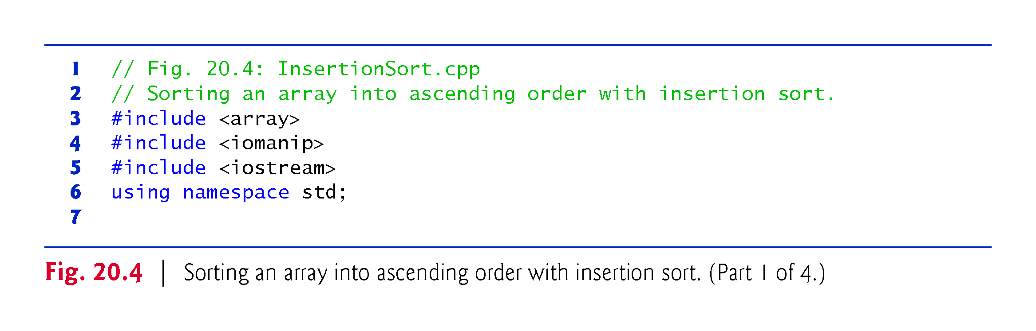

Slide 40
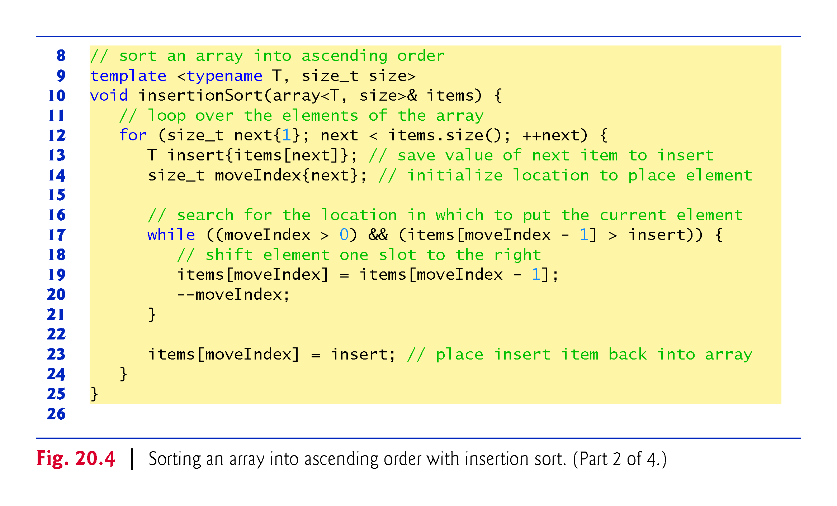

Slide 41
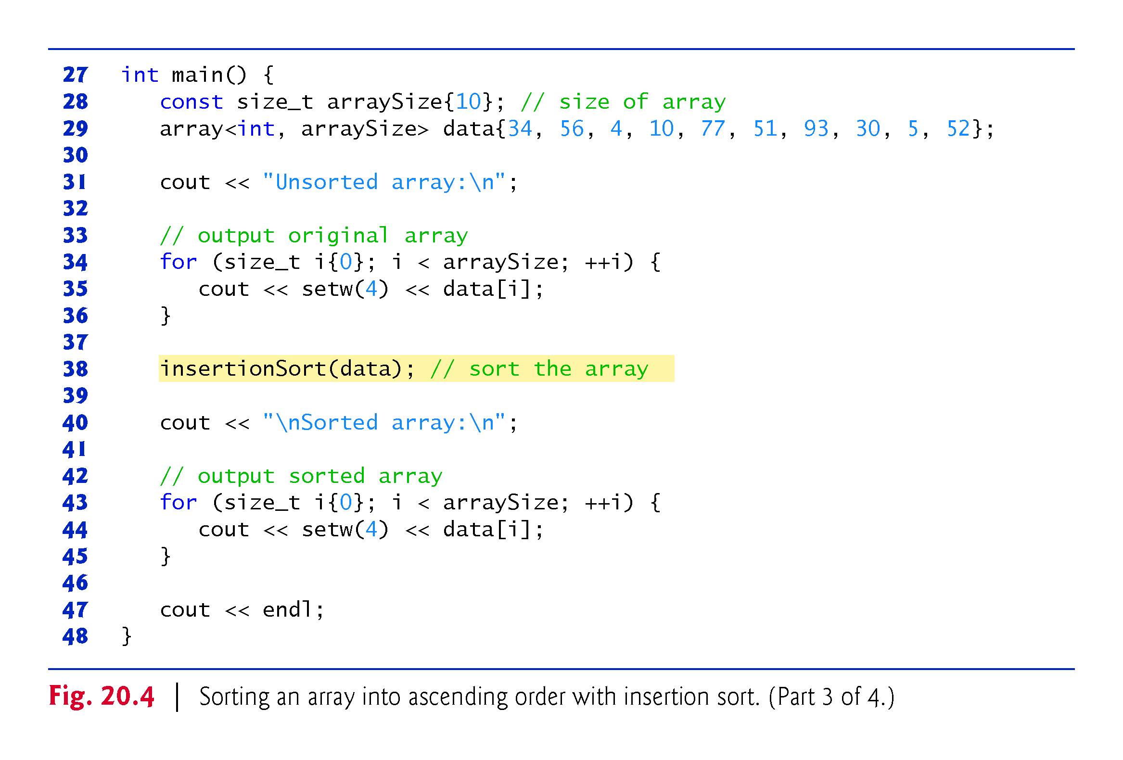

Slide 42
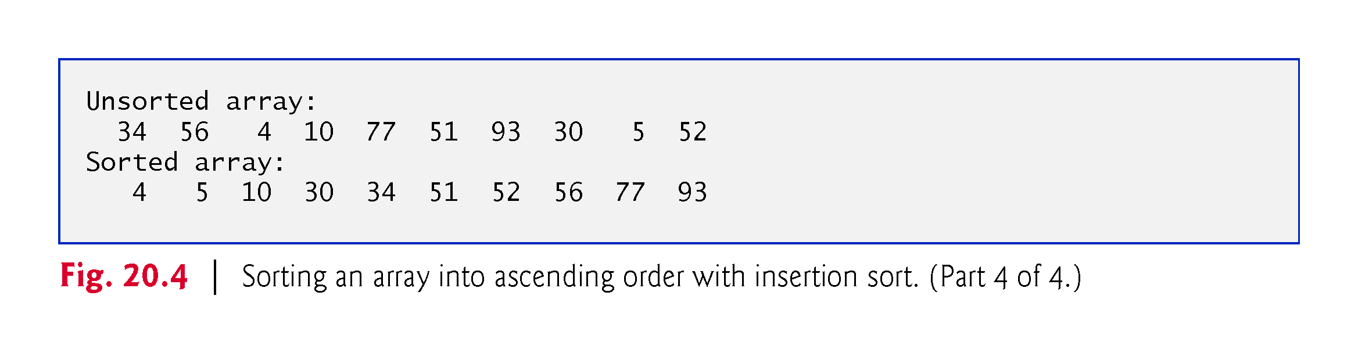

Slide 43
20.3.1 Insertion Sort
Insertion Sort Algorithm
The algorithm’s first iteration takes the array’s second element and, if it’s less than the first element, swaps it with the first element (i.e., the algorithm inserts the second element in front of the first element).
The second iteration looks at the third element and inserts it into the correct position with respect to the first two elements, so all three elements are in order.
At the ith iteration of this algorithm, the first i elements in the original array will be sorted.

Slide 44
20.3.1 Insertion Sort
First Iteration
The array named data contains the following values:
34 56 4 10 77 51 93 30 5 52
Line 38 passes the array to the insertionSort function, which receives the array in parameter items.
The function first looks at items[0] and items[1], whose values are 34 and 56, respectively.
These two elements are already in order, so the algorithm continues—if they were out of order, the algorithm would swap them.

Slide 45
20.3.1 Insertion Sort
Second Iteration
In the second iteration, the algorithm looks at the value of items[2] (that is, 4).
This value is less than 56, so the algorithm stores 4 in a temporary variable and moves 56 one element to the right.
The algorithm then determines that 4 is less than 34, so it moves 34 one element to the right.
At this point, the algorithm has reached the beginning of the array, so it places 4 in items[0].
The array now is
4 34 56 10 77 51 93 30 5 52

Slide 46
20.3.1 Insertion Sort
Third Iteration and Beyond
In the third iteration, the algorithm places the value of items[3] (that is, 10) in the correct location with respect to the first four array elements.
The algorithm compares 10 to 56 and moves 56 one element to the right because it’s larger than 10.
Next, the algorithm compares 10 to 34, moving 34 right one element.
When the algorithm compares 10 to 4, it observes that 10 is larger than 4 and places 10 in items[1].
The array now is
4 10 34 56 77 51 93 30 5 52
Using this algorithm, after the ith iteration, the first i + 1 array elements are sorted.
They may not be in their final locations, however, because the algorithm might encounter smaller values later in the array.

Slide 47
20.3.1 Insertion Sort
Function Template insertionSort
Function template insertionSort performs the sorting
In each iteration, line 13 temporarily stores in variable insert the value of the element that will be inserted into the array’s sorted portion.
Line 14 declares and initializes the variable moveIndex, which keeps track of where to insert the element.
Lines 17–21 loop to locate the correct position where the element should be inserted.
The loop terminates either when the program reaches the array’s first element or when it reaches an element that’s less than the value to insert.
Line 19 moves an element to the right, and line 20 decrements the position at which to insert the next element.
After the while loop ends, line 23 inserts the element into place.
When the for statement in lines 12–24 terminates, the array’s elements are sorted.

Slide 48
20.3.1 Insertion Sort
Big O: Efficiency of Insertion Sort
Insertion sort is simple, but inefficient, sorting algorithm.
This becomes apparent when sorting large arrays.
Insertion sort iterates n – 1 times, inserting an element into the appropriate position in the elements sorted so far.
For each iteration, determining where to insert the element can require comparing the element to each of the preceding elements—n – 1 comparisons in the worst case.
Each individual iteration statement runs in O(n) time.
To determine Big O notation, nested statements mean that you must multiply the number of comparisons.
For each iteration of an outer loop, there will be a certain number of iterations of the inner loop. In this algorithm, for each O(n) iteration of the outer loop, there will be O(n) iterations of the inner loop, resulting in a Big O of O(n * n) or O(n²).

Slide 49
20.3.2 Selection Sort
Figure 20.5 uses the selection sort algorithm—another easy-to-implement, but inefficient, sorting algorithm—to sort a 10-element array’s values into ascending order.
Function template selectionSort implements the algorithm.

Slide 50
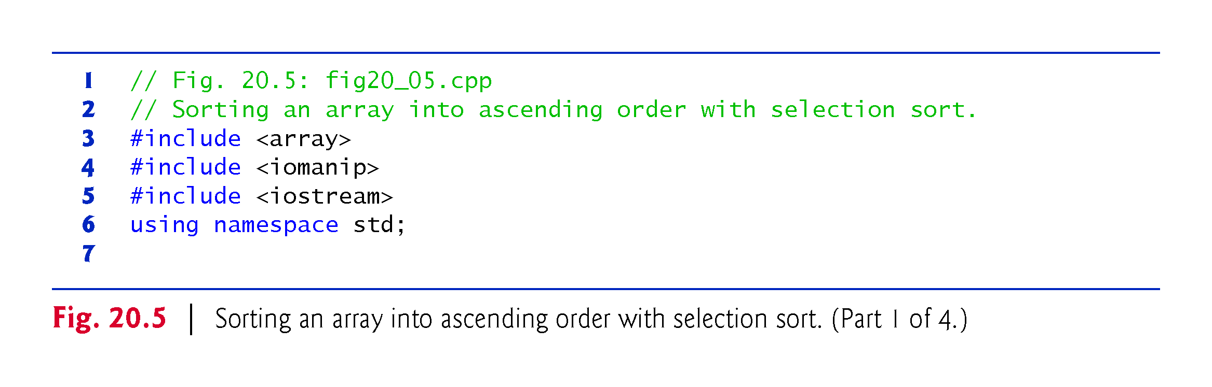

Slide 51
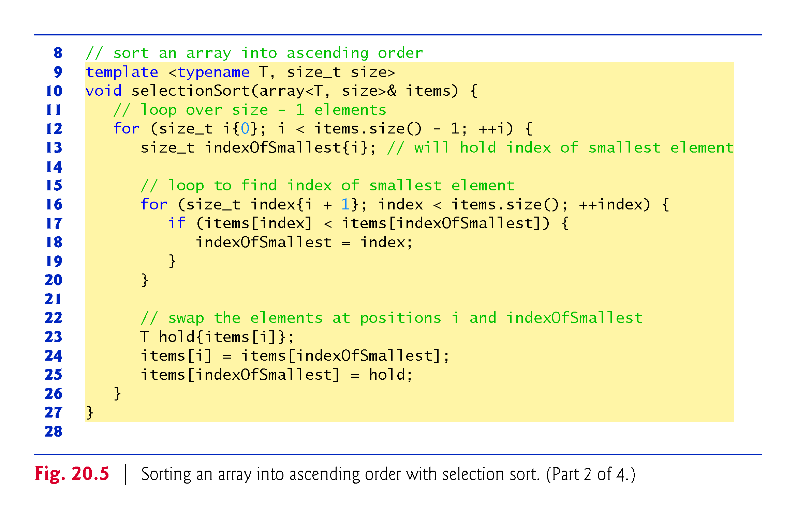

Slide 52
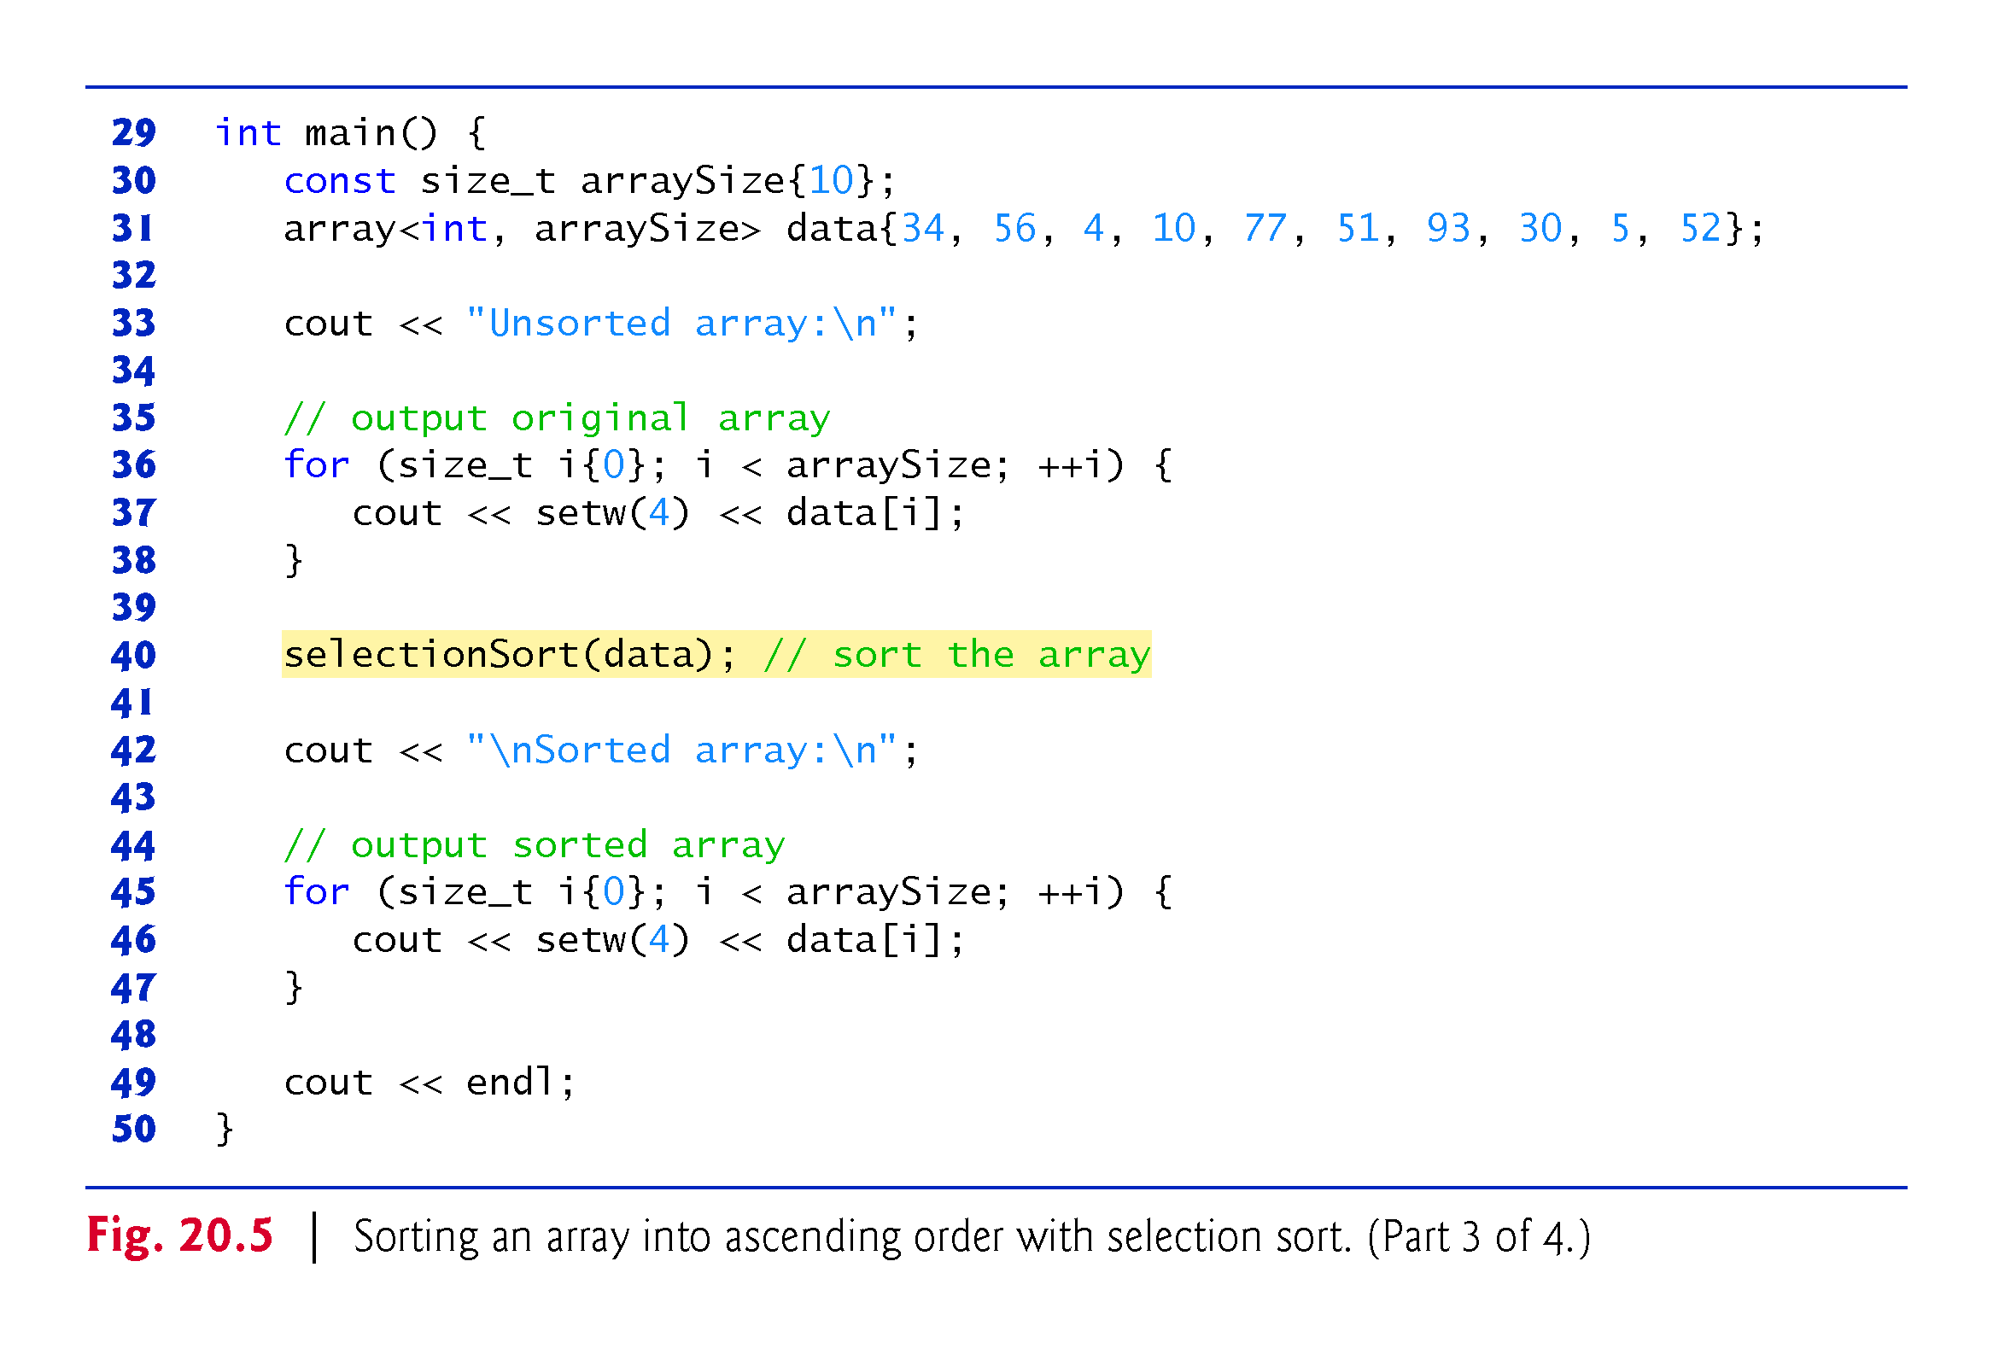

Slide 53


Slide 54
20.3.2 Selection Sort (cont.)
Selection Sort Algorithm
The algorithm’s first iteration of the algorithm selects the smallest element value and swaps it with the first element’s value.
The second iteration selects the second-smallest element value (which is the smallest of the remaining elements) and swaps it with the second element’s value.
The algorithm continues until the last iteration selects the second-largest element and swaps it with the second-to-last element’s value, leaving the largest value in the last element.
After the i^{th} iteration, the smallest i values will be sorted into increasing order in the first array elements.

Slide 55
20.3.2 Selection Sort (cont.)
First Iteration
The array named data is initialized with the following values:
34 56 4 10 77 51 93 30 5 52
The selection sort first determines the smallest value (4) in the array, which is in element 2.
The algorithm swaps 4 with the value in element 0 (34), resulting in
4 56 34 10 77 51 93 30 5 52

Slide 56
20.3.2 Selection Sort (cont.)
Second Iteration
The algorithm then determines the smallest value of the remaining elements (all elements except 4), which is 5, contained in element 8.
The program swaps the 5 with the 56 in element 1, resulting in
4 5 34 10 77 51 93 30 56 52

Slide 57
20.3.2 Selection Sort (cont.)
Third Iteration
On the third iteration, the program determines the next smallest value, 10, and swaps it with the value in element 2 (34).
4 5 10 34 77 51 93 30 56 52
The process continues until the array is fully sorted.
4 5 10 30 34 51 52 56 77 93
After the first iteration, the smallest element is in the first position; after the second iteration, the two smallest elements are in order in the first two positions and so on.

Slide 58
20.3.2 Selection Sort (cont.)
Function Template selectionSort
Function template selectionSort performs the sorting.

Slide 59
20.3.2 Selection Sort (cont.)
The selection sort algorithm iterates n – 1 times, each time swapping the smallest remaining element into its sorted position.
Locating the smallest remaining element requires n – 1 comparisons during the first iteration, n – 2 during the second iteration, then n – 3, … , 3, 2, 1.
This results in a total of n(n – 1)/2 or (n² – n)/2 comparisons.
In Big O notation, smaller terms drop out and constants are ignored, leaving a Big O of O(n²).

Slide 60
20.3.3 Merge Sort (A Recursive Implementation)
Merge sort is an efficient sorting algorithm but is conceptually more complex than insertion sort and selection sort.
The merge sort algorithm sorts an array by splitting it into two equal-sized sub-arrays, sorting each sub-array then merging them into one larger array.
Merge sort performs the merge by looking at each sub-arrays first element, which is also the smallest element in that sub-array.
Merge sort takes the smallest of these and places it in the first element of merged, sorted array.
If there are still elements in the sub-arrays, merge sort looks at the second element in that sub-array (which is now the smallest element remaining) and compares it to the first element in the other sub-array.

Slide 61
20.3.3 Merge Sort (A Recursive Implementation) (cont.)
Merge sort continues this process until the merged array is filled.
Once a sub-array has no more elements, the merge copies the other array’s remaining elements into the merged array.

Slide 62
20.3.3 Merge Sort (A Recursive Implementation) (cont.)
Demonstrating Merge Sort
Figure 20.6 implements and demonstrates the merge sort algorithm.
Throughout the program’s execution, we use function template displayElements to display the portions of the array that are currently being split and merged.
Function templates mergeSort and merge implement the merge sort algorithm.
Function main creates an array, populates it with random integers, executes the algorithm and displays the sorted array.
The output from this program displays the splits and merges performed by merge sort, showing the progress of the sort at each step of the algorithm.

Slide 63
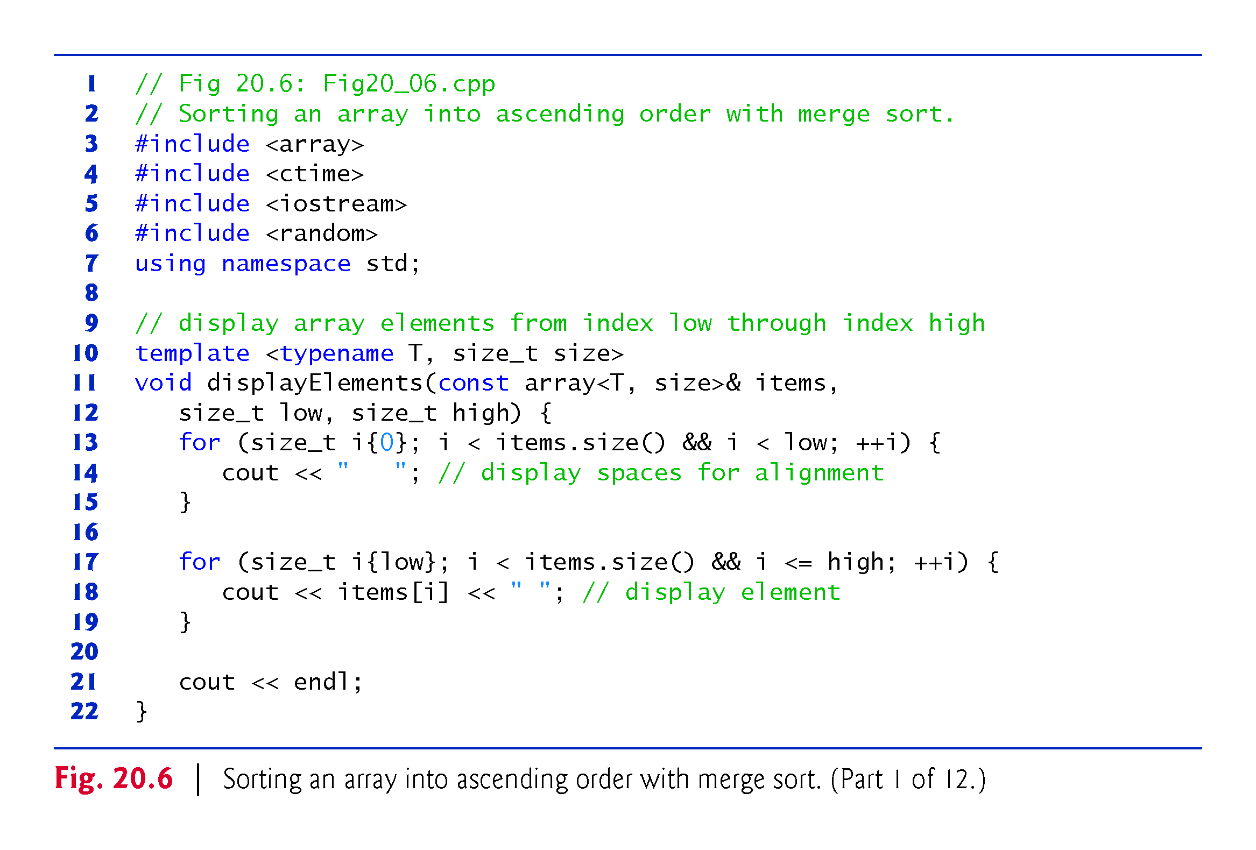

Slide 64
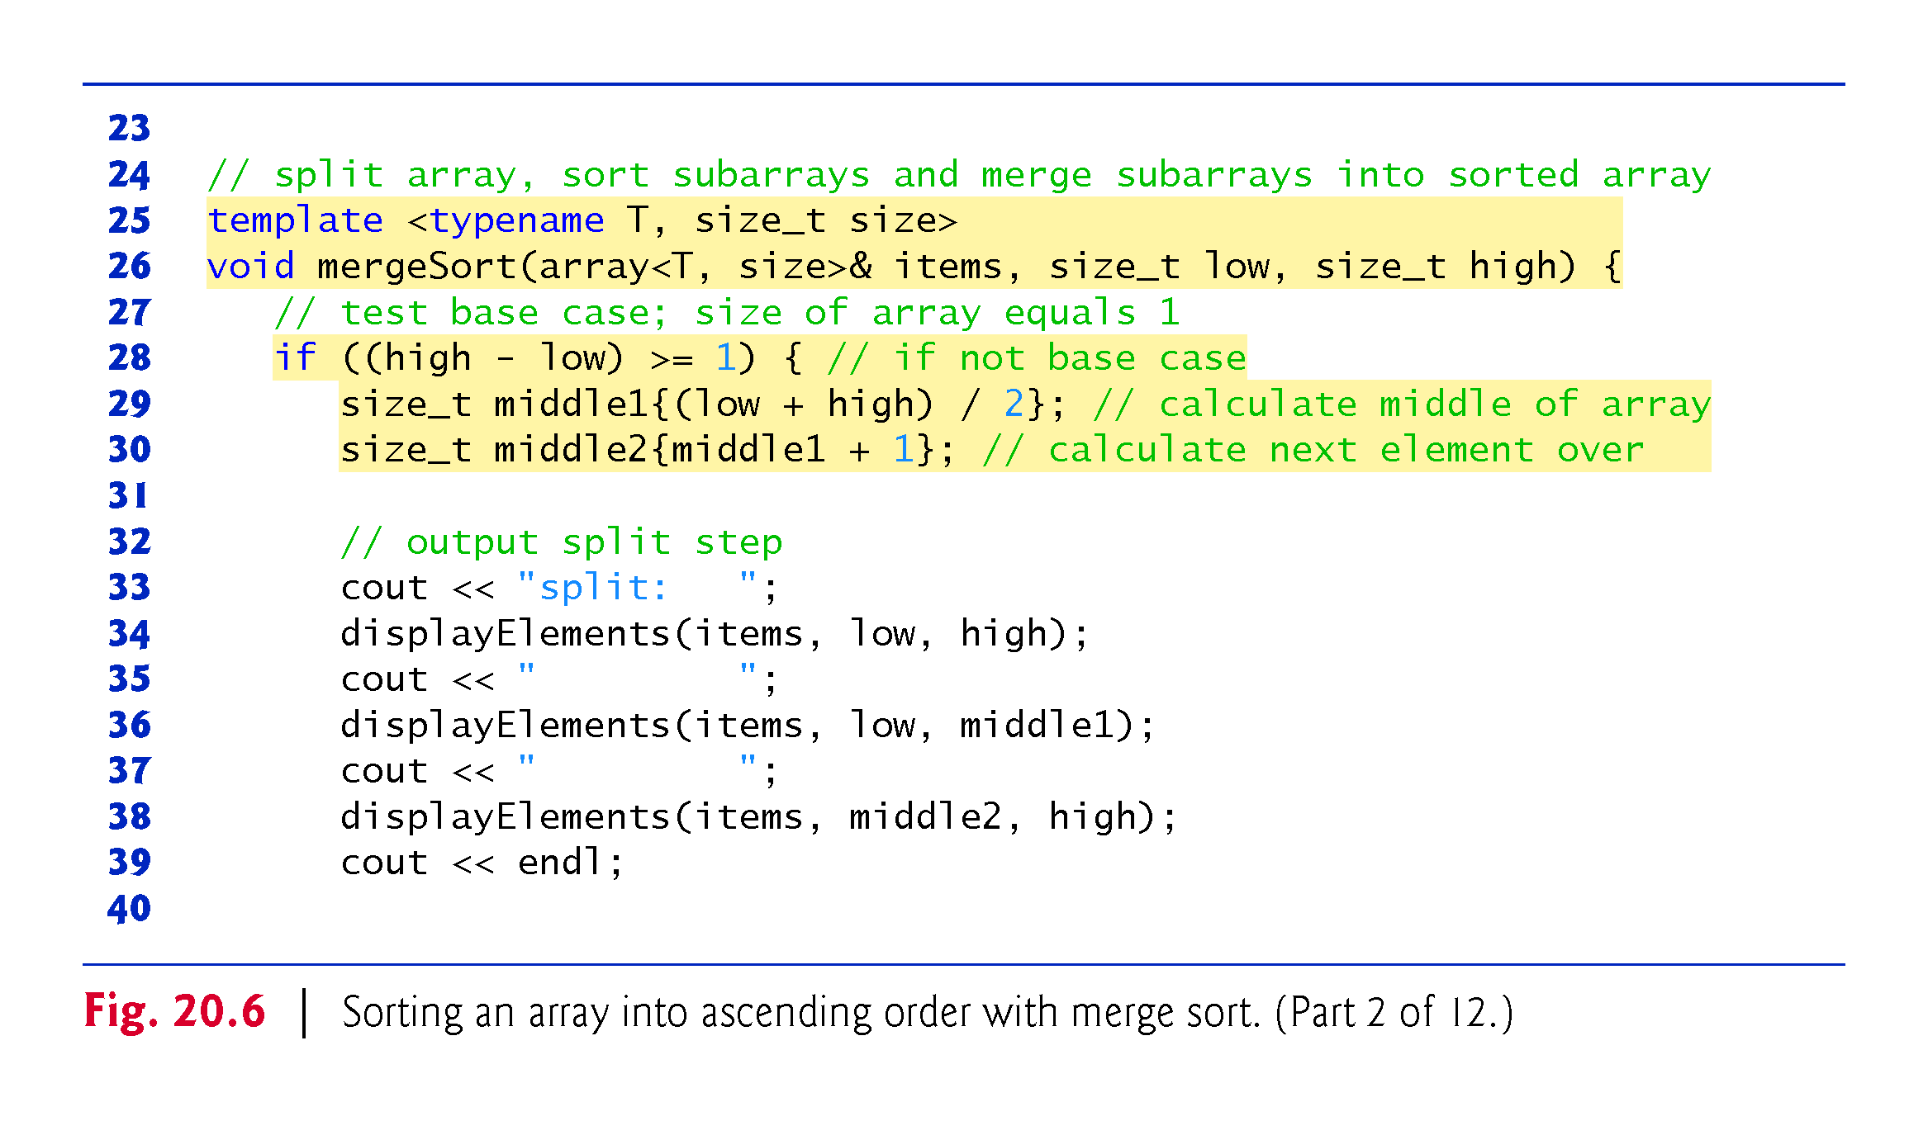

Slide 65
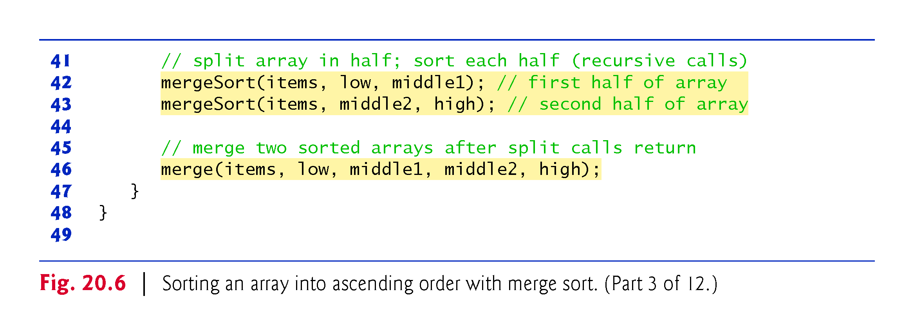

Slide 66
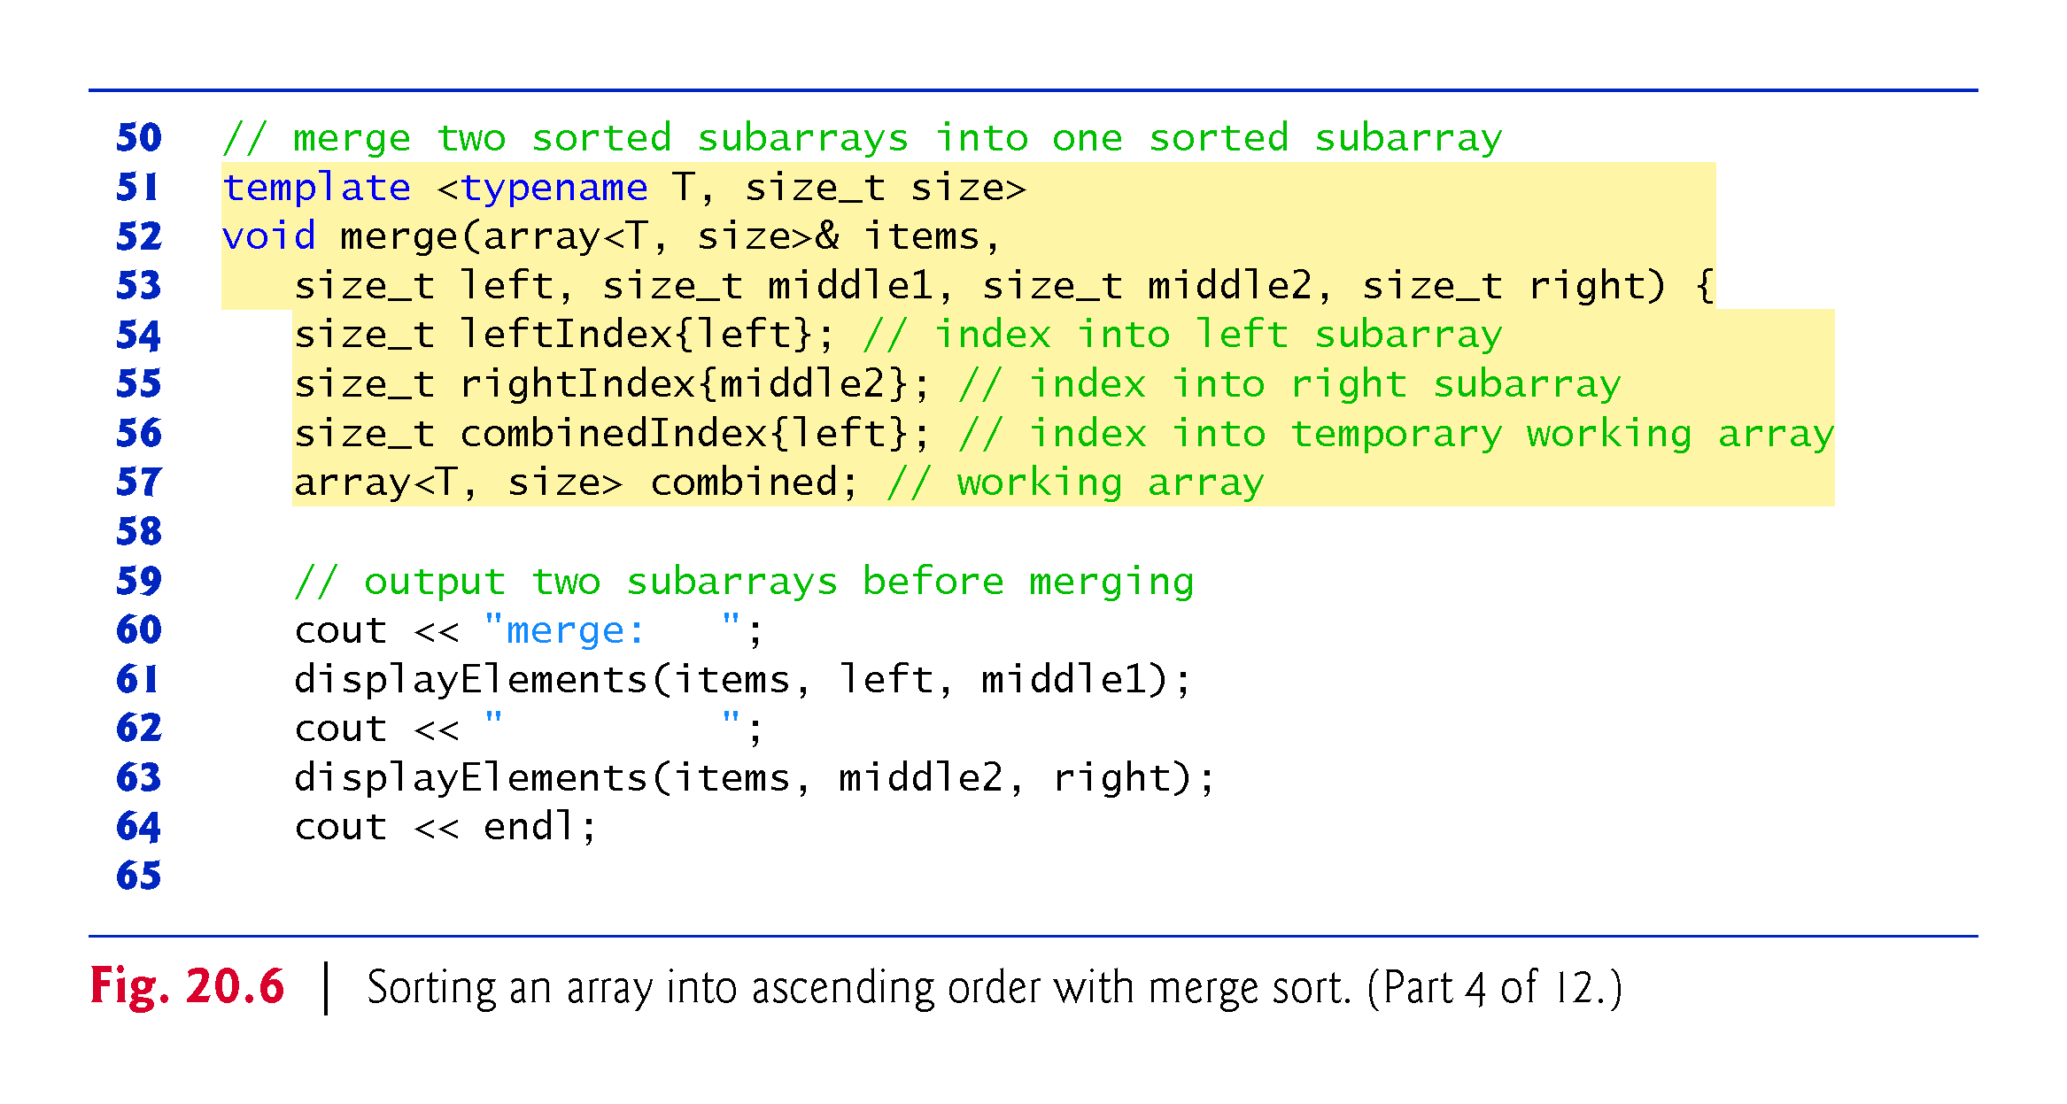

Slide 67
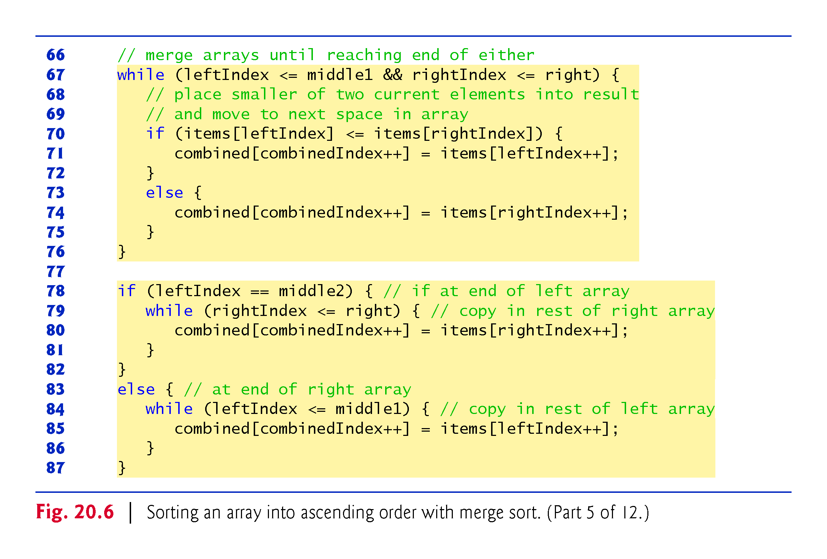

Slide 68
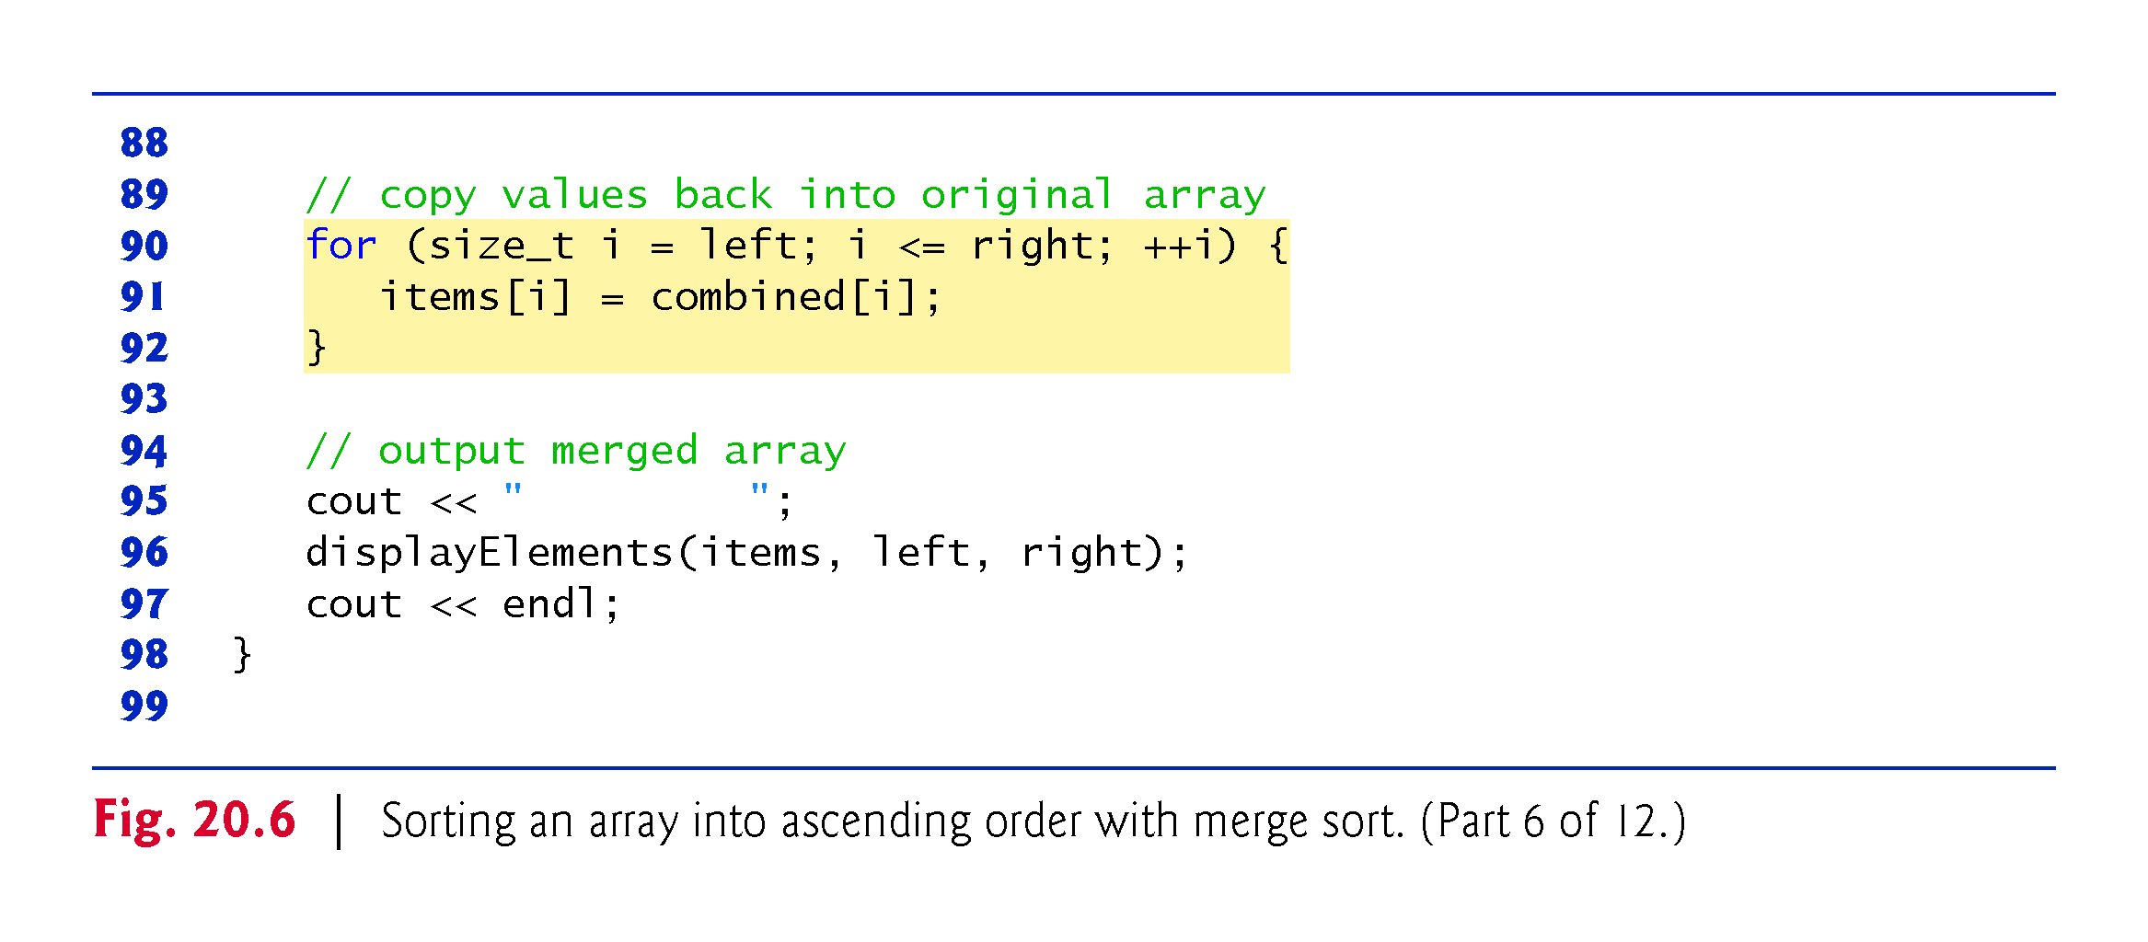

Slide 69
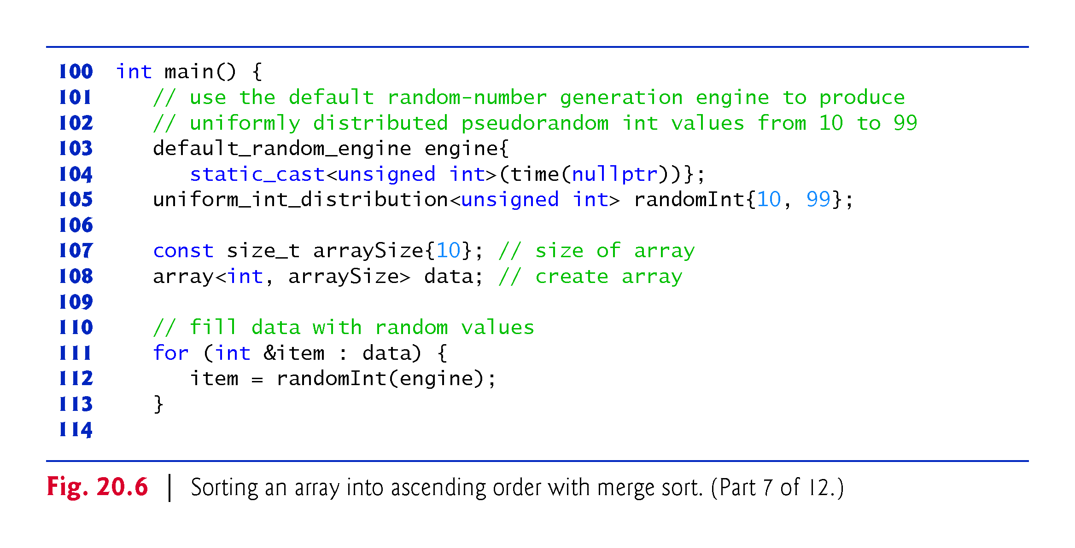

Slide 70
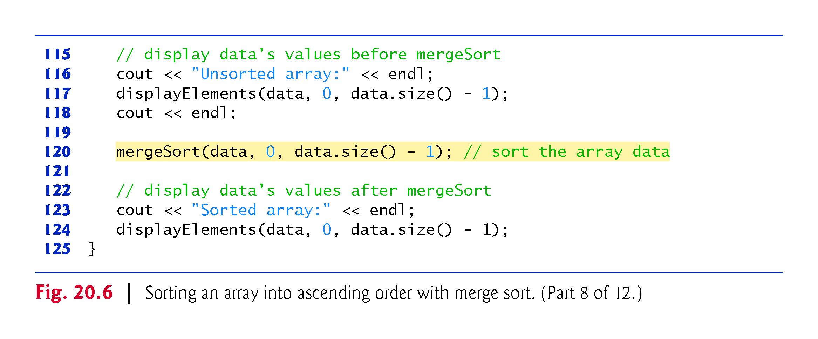

Slide 71
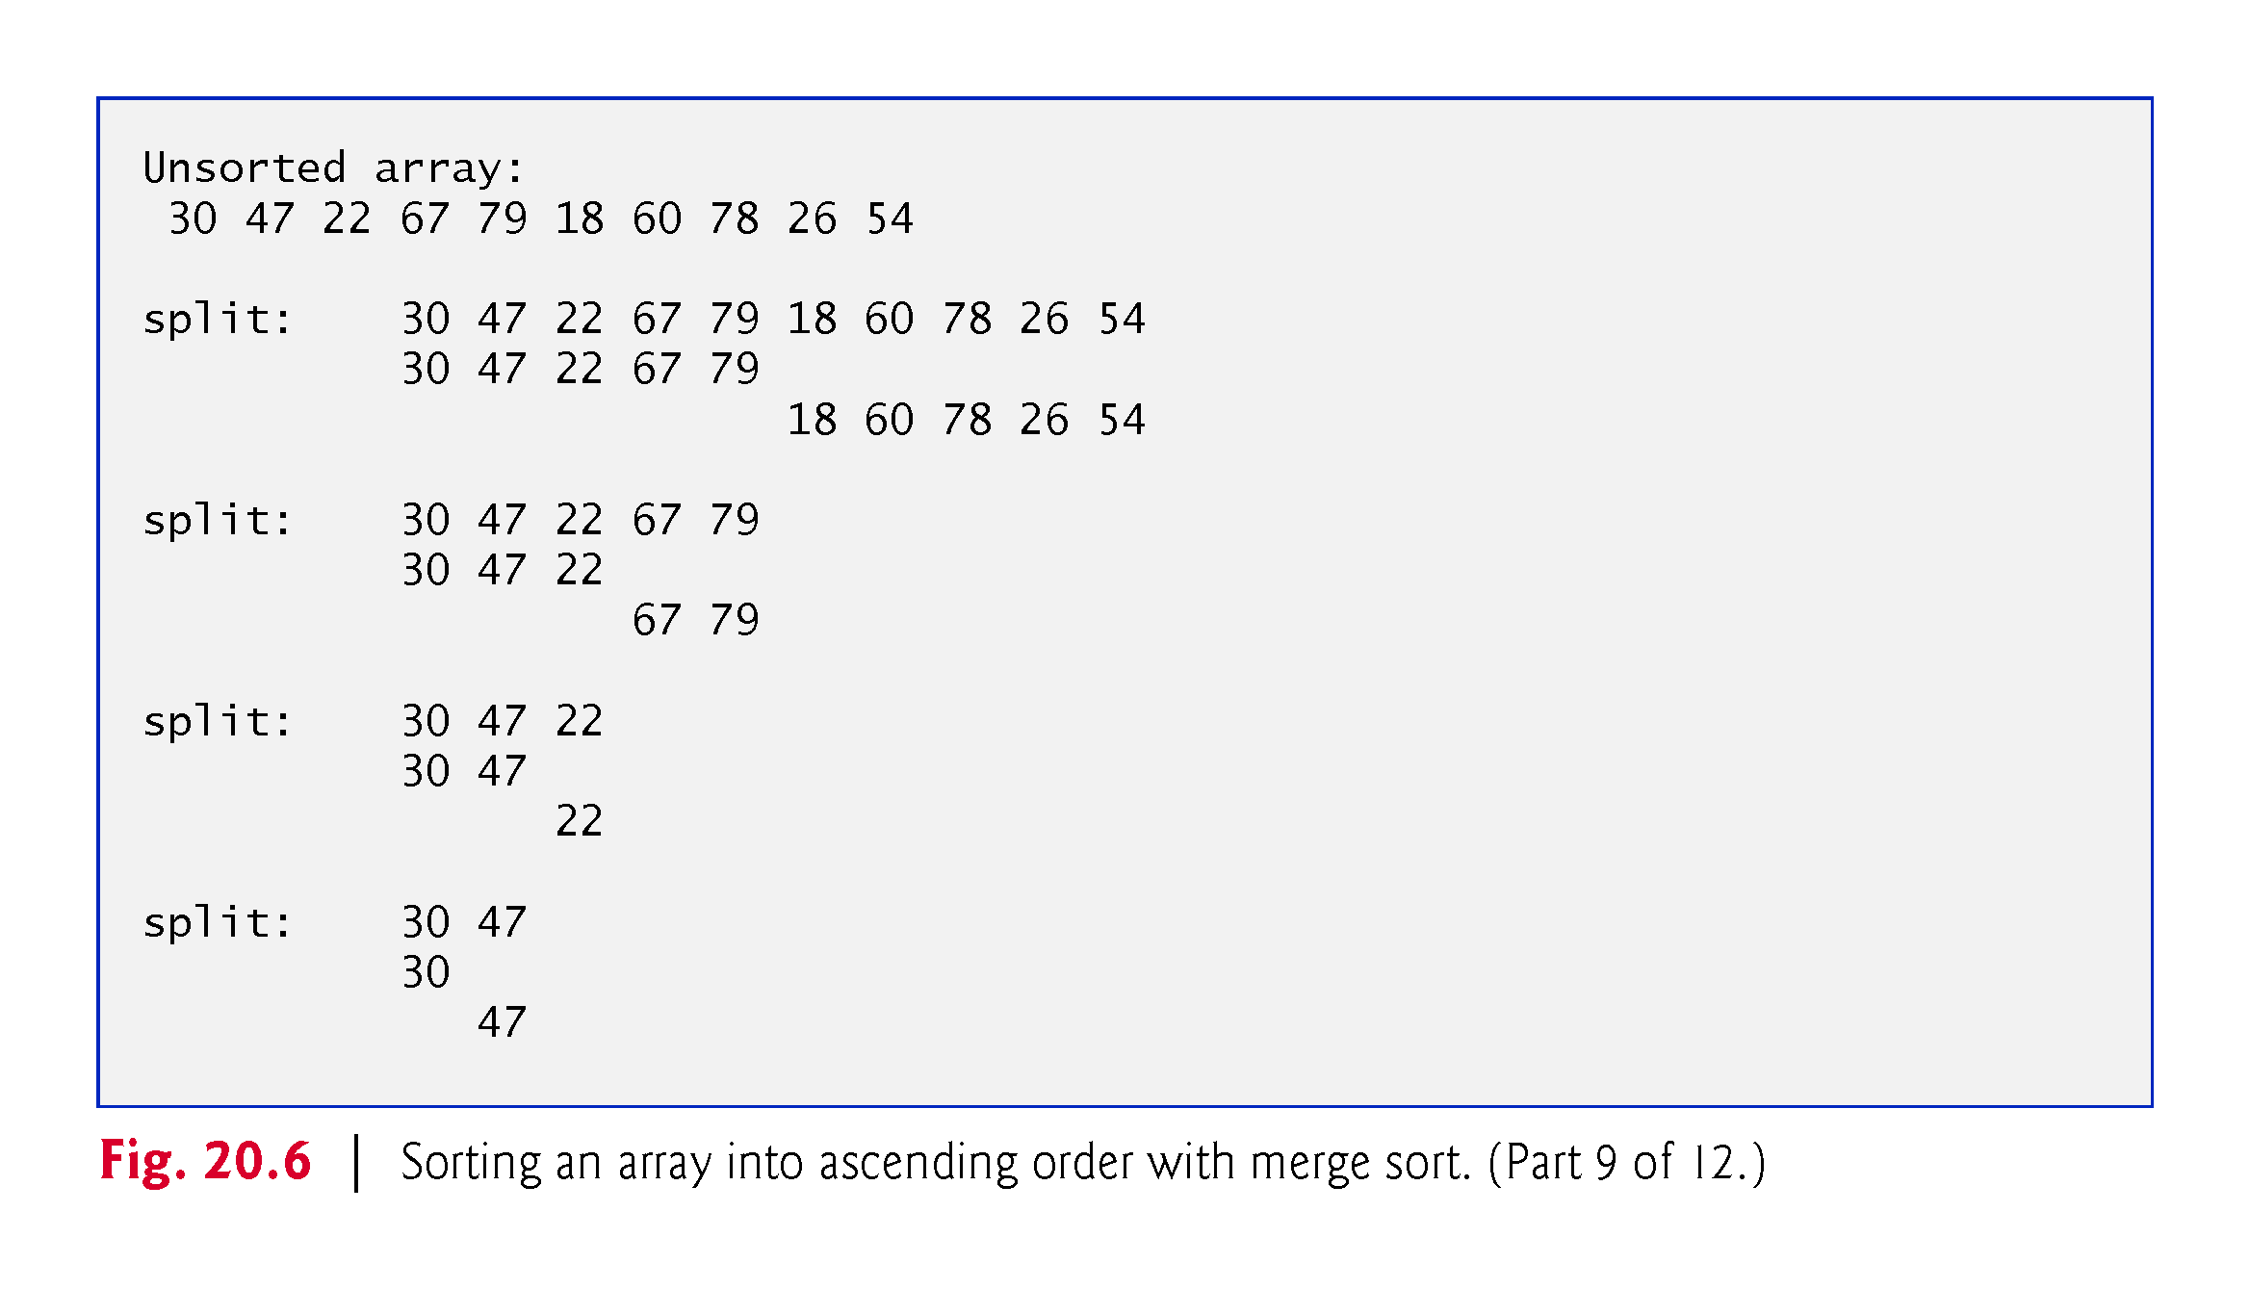

Slide 72
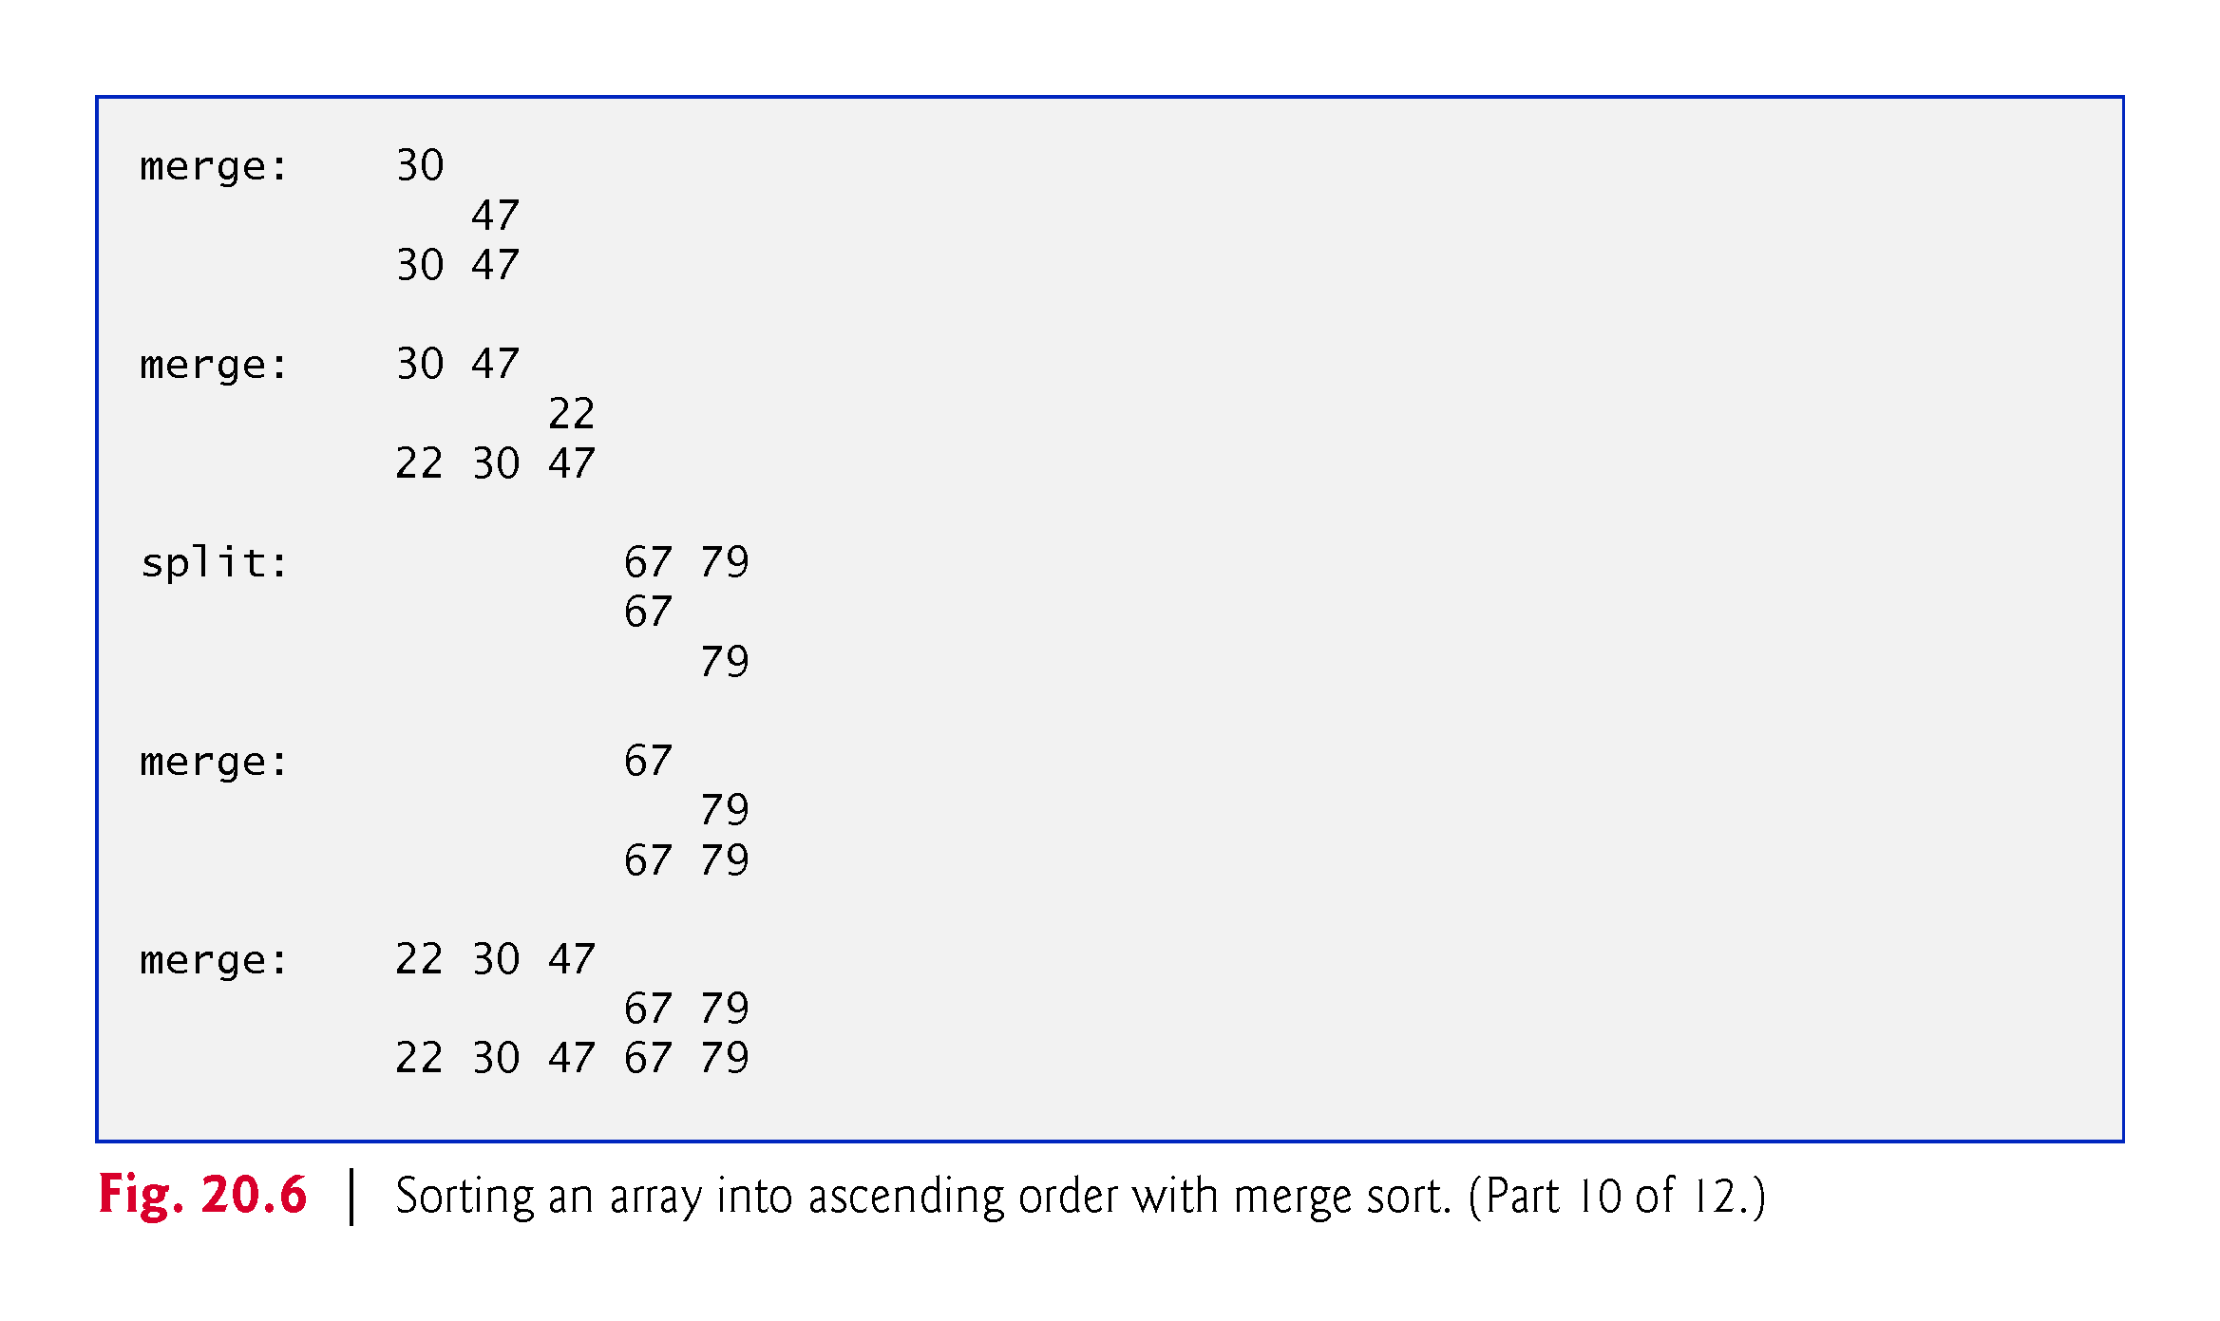

Slide 73
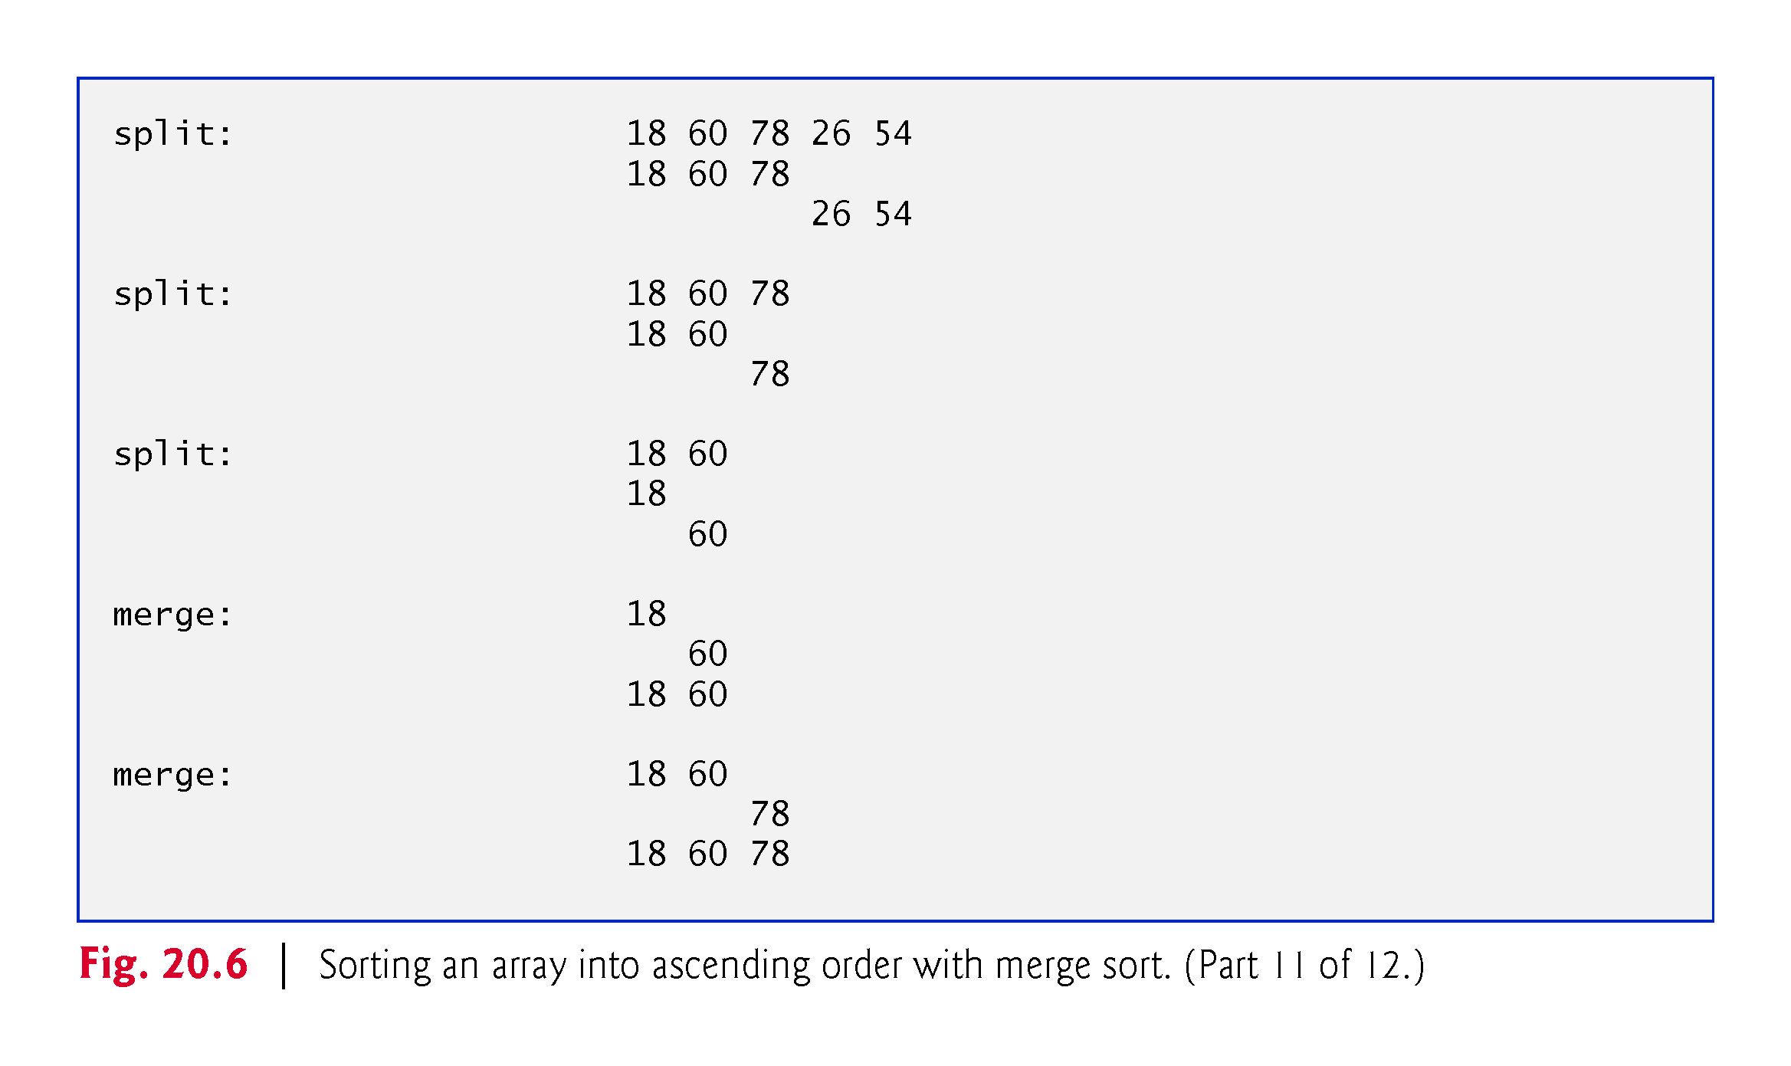

Slide 74
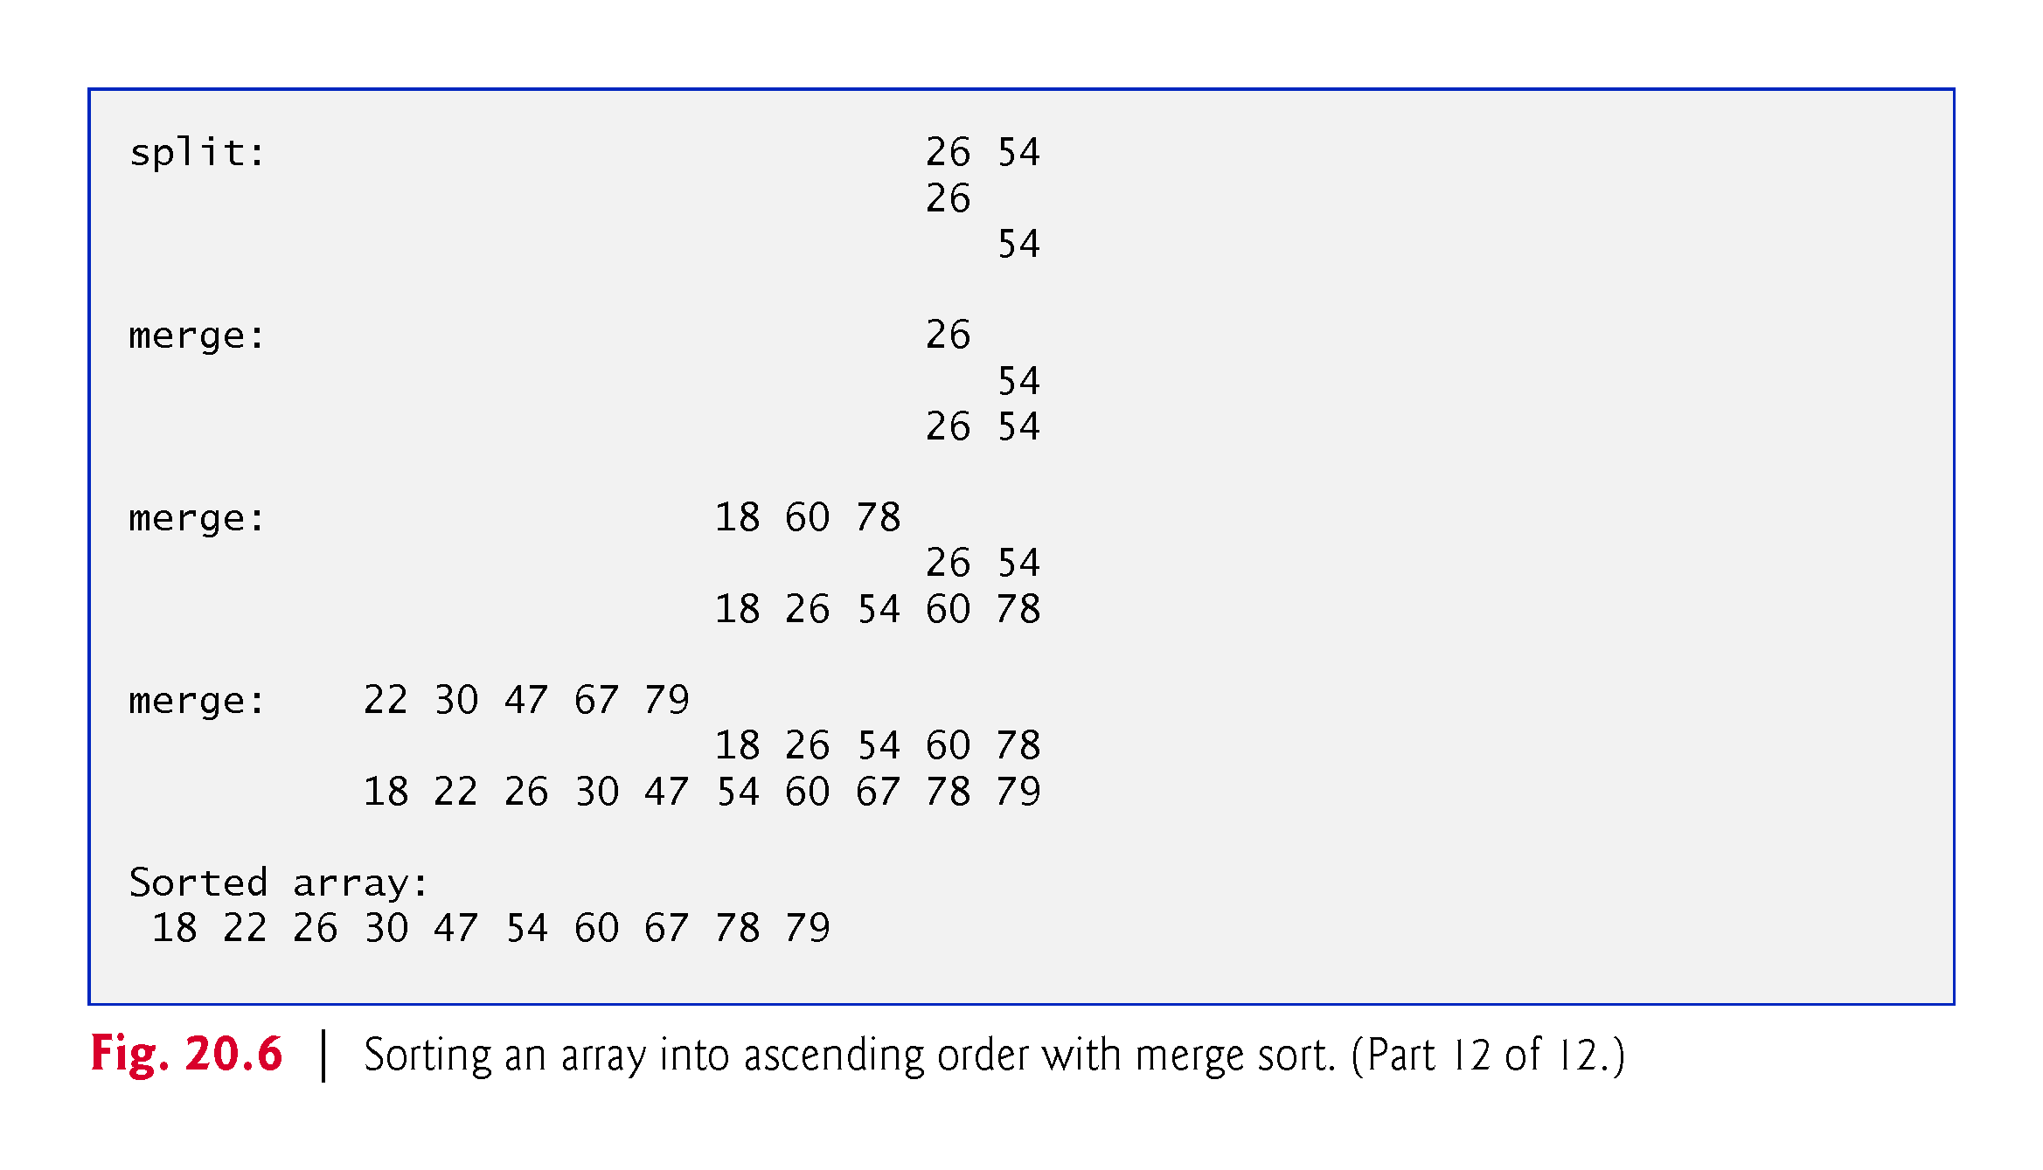

Slide 75
20.3.3 Merge Sort (A Recursive Implementation) (cont.)
Function mergeSort
Recursive function mergeSort receives as parameters the array to sort and the low and high indices of the range of elements to sort.
Line 28 tests the base case.
If the high index minus the low index is 0 (i.e., a one-element sub-array), the function simply returns.
If the difference between the indices is greater than or equal to 1, the function splits the array in two—lines 29–30 determine the split point.

Slide 76
20.3.3 Merge Sort (A Recursive Implementation) (cont.)
Next, line 42 recursively calls function mergeSort on the array’s first half, and line 43 recursively calls function mergeSort on the array’s second half.
When these two function calls return, each half is sorted. Line 46 calls function merge (lines 51–98) on the two halves to combine the two sorted arrays into one larger sorted array.

Slide 77
20.3.3 Merge Sort (A Recursive Implementation) (cont.)
Function merge
Lines 67–76 in function merge loop until the program reaches the end of either sub-array.
Line 70 tests which element at the beginning of the two sub-arrays is smaller.
If the element in the left sub-array is smaller or both are equal, line 71 places it in position in the combined array.
If the element in the right sub-array is smaller, line 74 places it in position in the combined array.
When the while loop completes, one entire sub-array is in the combined array, but the other sub-array still contains data.
Line 78 tests whether the left sub-array has reached the end.
If so, lines 79–81 fill the combined array with the elements of the right sub-array.

Slide 78
20.3.3 Merge Sort (A Recursive Implementation) (cont.)
If the left sub-array has not reached the end, then the right sub-array must have reached the end, and lines 86–87 fill the combined array with the elements of the left sub-array.
Finally, lines 90–92 copy the combined array into the original array.

Slide 79
20.3.3 Merge Sort (A Recursive Implementation) (cont.)
Efficiency of Merge Sort
Merge sort is a far more efficient algorithm than either insertion sort or selection sort—although that may be difficult to believe when looking at the busy output in Fig. 20.6.
Consider the first (nonrecursive) call to function mergeSort
This results in two recursive calls to function mergeSort with sub-arrays that are each approximately half the original array’s size, and a single call to function merge.
The call to merge requires, at worst, n – 1 comparisons to fill the original array, which is O(n).
The two calls to function mergeSort result in four more recursive calls to function mergeSort—each with a sub-array approximately one-quarter the size of the original array—and two calls to function merge.
These two calls to function merge each require, at worst, n/2 – 1 comparisons, for a total number of comparisons of O(n).

Slide 80
20.3.3 Merge Sort (A Recursive Implementation) (cont.)
This process continues, each call to mergeSort generating two additional calls to mergeSort and a call to merge, until the algorithm has split the array into one-element sub-arrays.
At each level, O(n) comparisons are required to merge the sub-arrays.
Each level splits the size of the arrays in half, so doubling the size of the array requires one more level.
Quadrupling the size of the array requires two more levels.
This pattern is logarithmic and results in log₂ n levels.
This results in a total efficiency of O(n log n).

Slide 81
20.3.3 Merge Sort (A Recursive Implementation) (cont.)
Summary of Searching and Sorting Algorithm Efficiencies
Figure 20.7 summarizes the searching and sorting algorithms we cover in this chapter and lists the Big O for each.
Figure 20.8 lists the Big O categories we’ve covered in this chapter along with a number of values for n to highlight the differences in the growth rates.

Slide 82
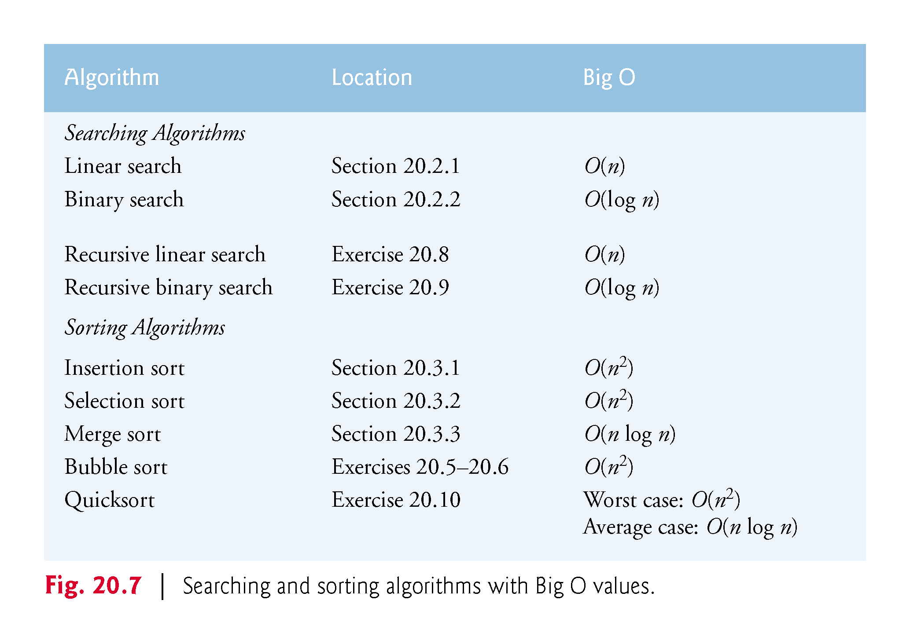

Slide 83
