Slide 1
Class string and String Stream Processing: A Deeper Look
Based on Chapter 21 of C++ How to Program, 10/e

Slide 2
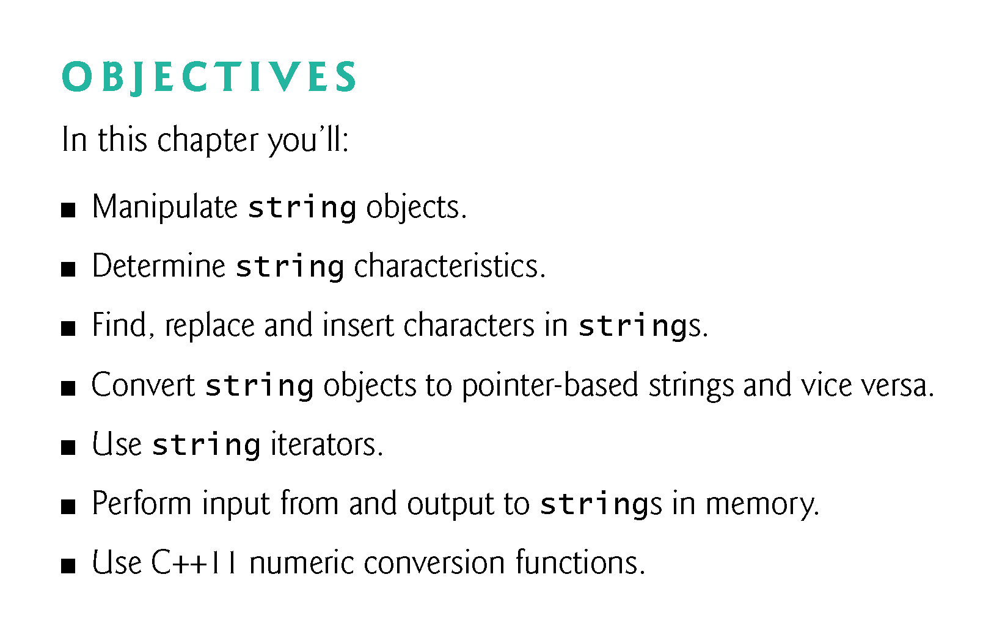

Slide 3
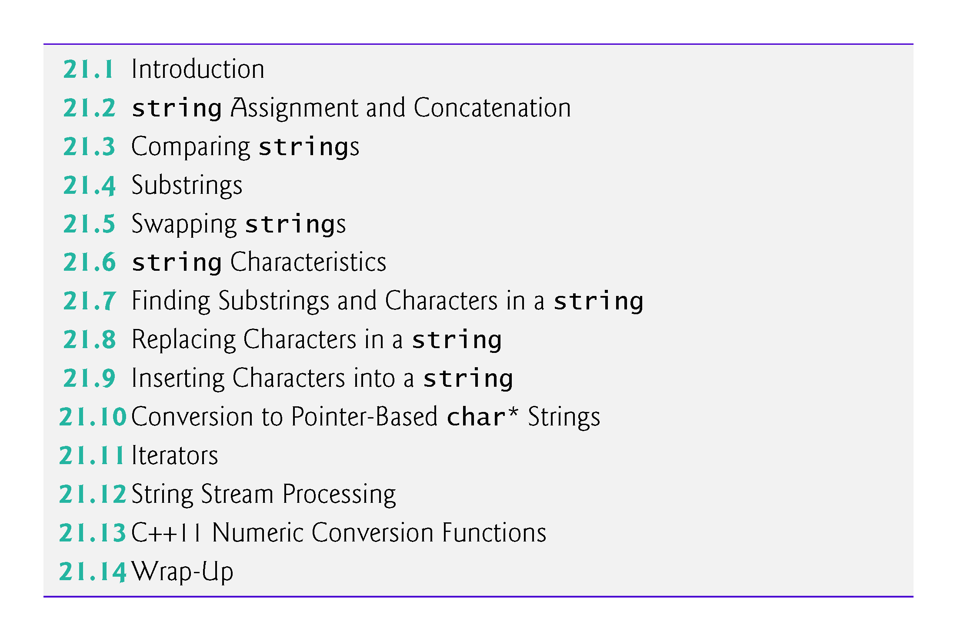

Slide 4
21.1 Introduction
The class template basic_string provides typical string-manipulation operations such as copying, searching, etc.
The template definition and all support facilities are defined in namespace std; these include the typedef statement
typedef basic_string< char > string;
A typedef is also provided for the wchar_t type (wstring).
Type wchar_t stores characters (e.g., two-byte characters, four-byte characters, etc.) for supporting other character sets.
To use strings, include header <string>.

Slide 5
21.1 Introduction (cont.)
Initializing a string Object
A string object can be initialized with a constructor argument such as
// creates a string from a const char* string text("Hello");
which creates a string containing the characters in "Hello", or with two constructor arguments as in
string name(8, 'x'); // string of 8 'x' characters
which creates a string containing eight 'x' characters.
Class string also provides a default constructor (which creates an empty string) and a copy constructor.

Slide 6
21.1 Introduction (cont.)
A string also can be initialized via the alternate constructor syntax in the definition of a string as in
// same as: string month("March"); string month = "March";
Remember that operator = in the preceding declaration is not an assignment; rather it’s an implicit call to the string class constructor, which does the conversion.

Slide 7
21.1 Introduction (cont.)
strings Are Not Necessarily Null Terminated
Unlike pointer-based char* strings, string objects are not necessarily null terminated.
[Note: The C++ standard document provides only a description of the capabilities of class string—implementation is platform dependent.]

Slide 8
21.1 Introduction (cont.)
The length of a string can be retrieved with member function size and with member function length.
The subscript operator, [] (which does not perform bounds checking), can be used with strings to access and modify individual characters.
A string object has a first subscript of 0 and a last subscript of size() – 1.

Slide 9
21.1 Introduction (cont.)
Processing strings
Most string member functions take as arguments a starting subscript location and the number of characters on which to operate.

Slide 10
21.1 Introduction (cont.)
string I/O
The stream extraction operator (>>) is overloaded to support strings.
Input is delimited by whitespace characters.
When a delimiter is encountered, the input operation is terminated.
Function getline also is overloaded for strings.
Assuming string1 is a string, the statement
getline(cin, string1);
reads a string from the keyboard into string1.
Input is delimited by a newline ('\n'), so getLine can read a line of text into a string object.

Slide 11
21.1 Introduction (cont.)
Validating Input
In earlier chapters, we mentioned the importance of validating user input in industrial-strength code.
The capabilities presented in this chapter—and the regular-expression capabilities shown in Section 24.14—are frequently used to perform validation.

Slide 12
21.2 string Assignment and Concatenation
Figure 21.1 demonstrates string assignment and concatenation.
Line 4 includes header <string> for class string.
Line 12 assigns the value of string1 to string2.
After the assignment takes place, string2 is a copy of string1.
Line 13 uses member function assign to copy string1 into string3.
A separate copy is made (i.e., string1 and string3 are independent objects).

Slide 13
21.2 string Assignment and Concatenation (cont.)
Class string also provides an overloaded version of member function assign that copies a specified number of characters, as in
targetString.assign( sourceString, start, numberOfCharacters);
sourceString is the string to be copied,
start is the starting subscript and
numberOfCharacters is the number of characters to copy.

Slide 14
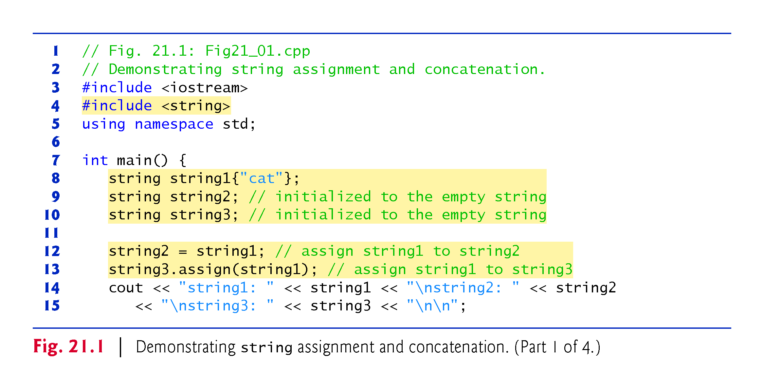

Slide 15
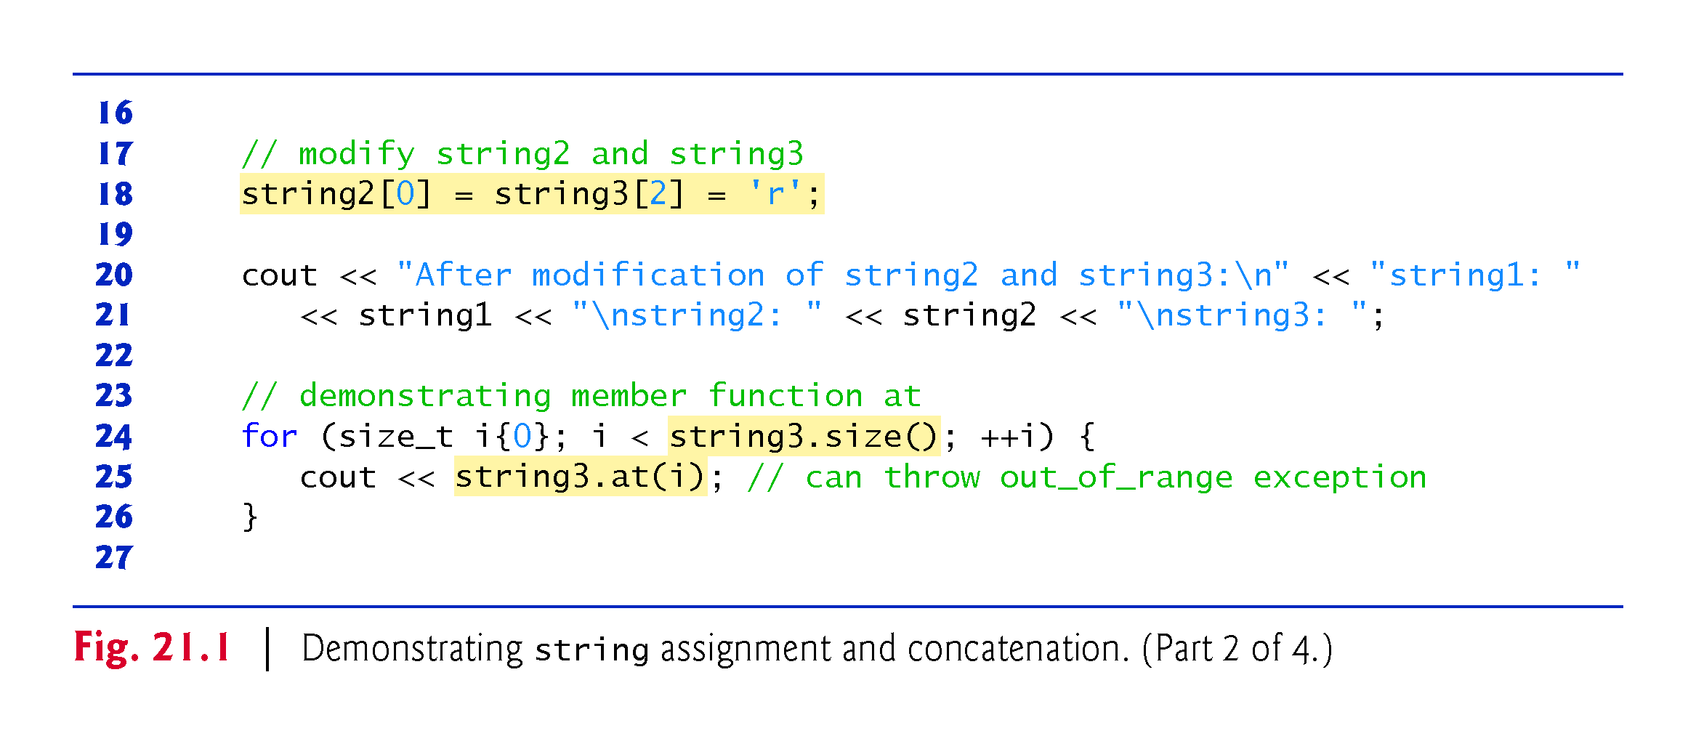

Slide 16
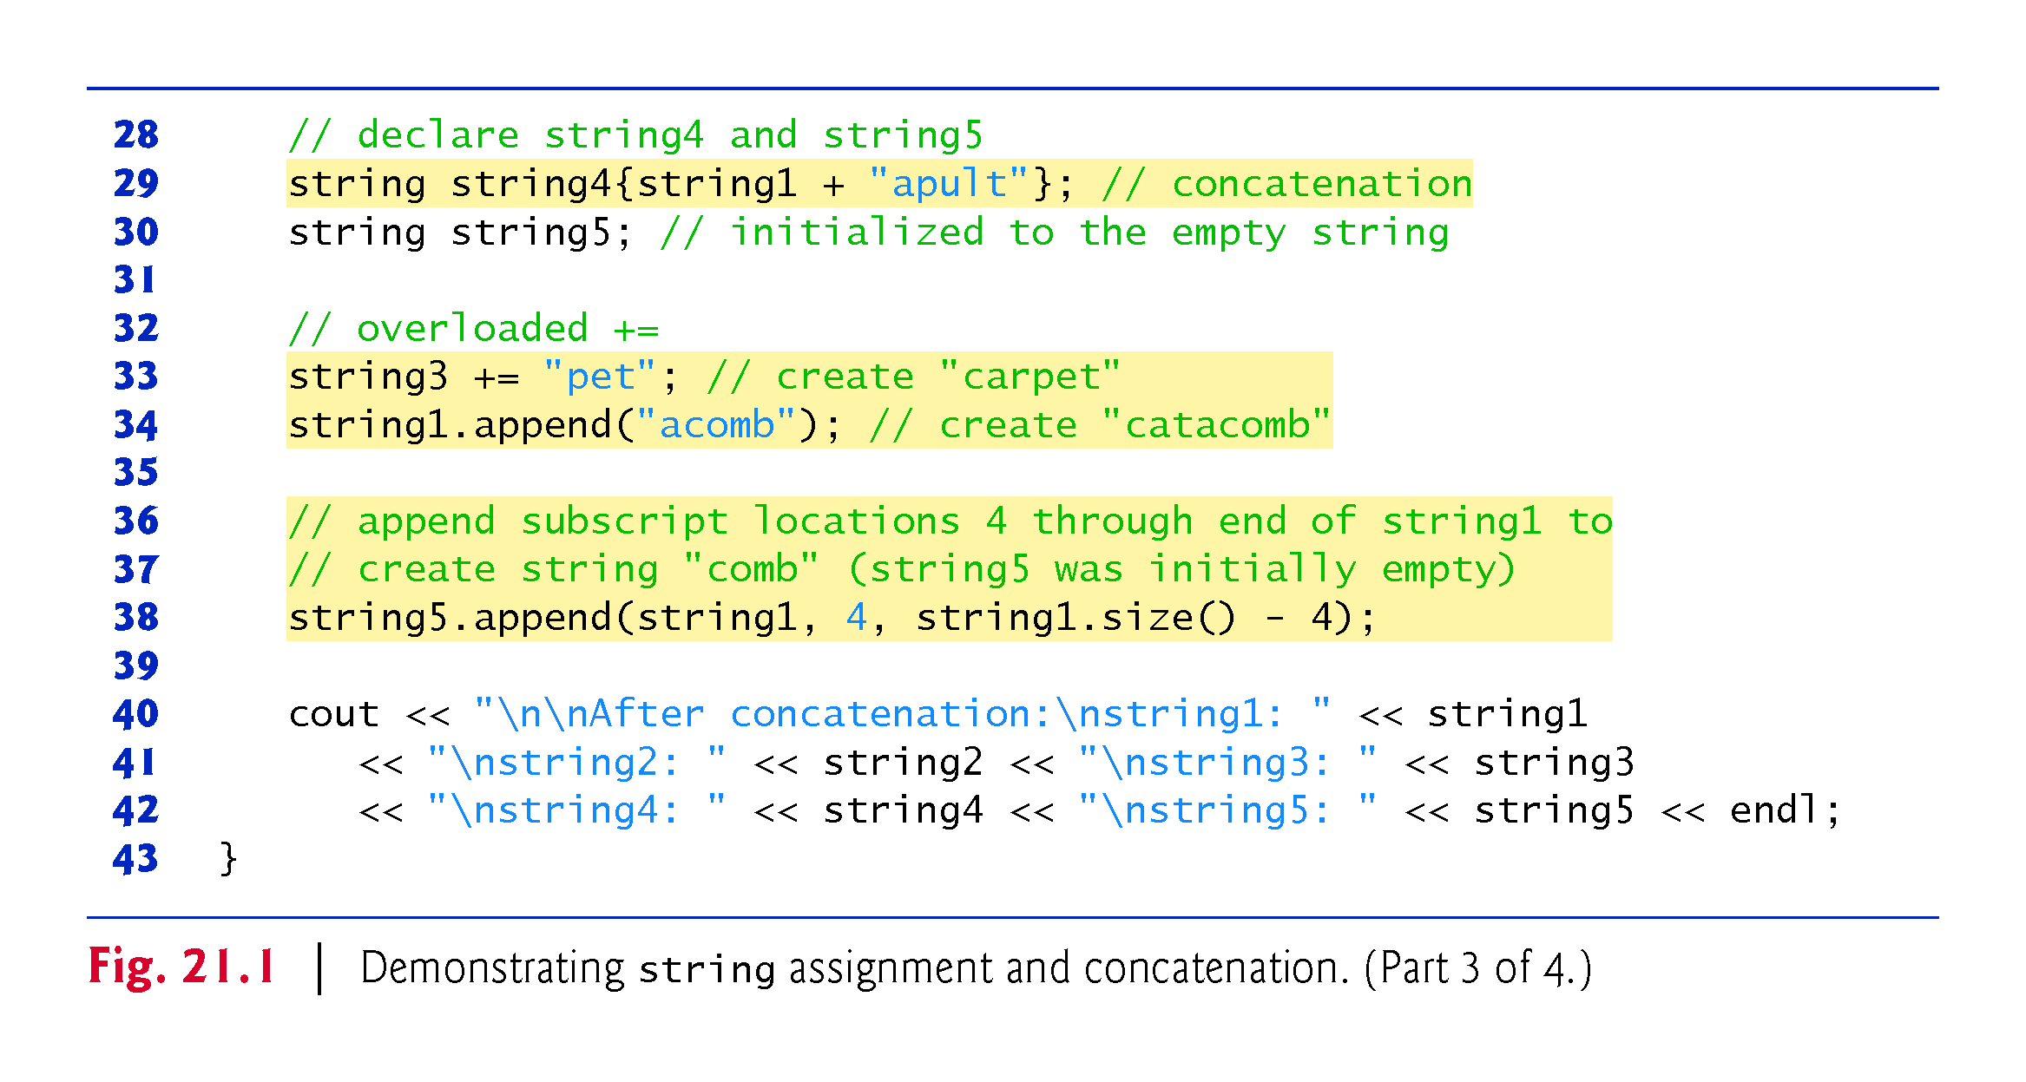

Slide 17
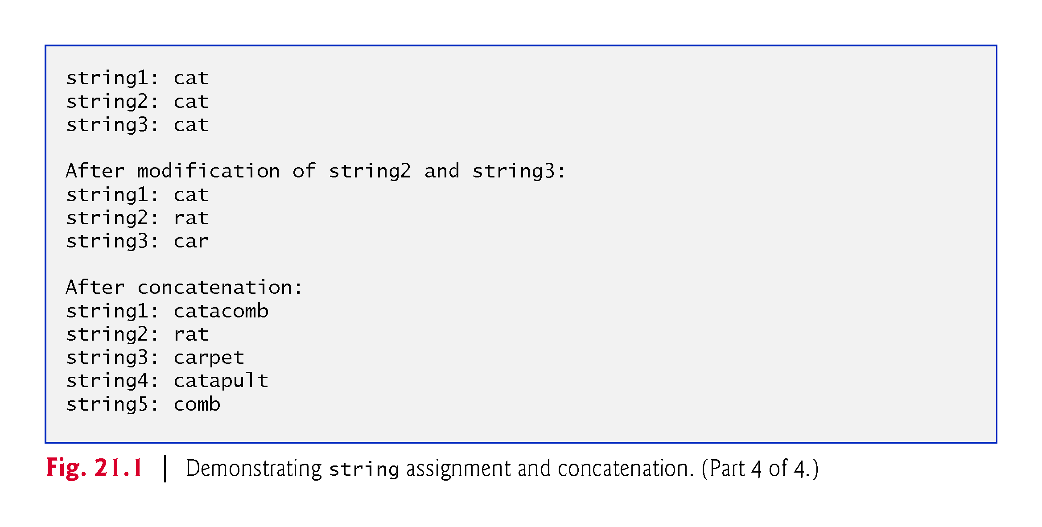

Slide 18
21.2 string Assignment and Concatenation (cont.)
Line 18 uses the subscript operator to assign 'r' to string3[2] (forming "car") and to assign 'r' to string2[0] (forming "rat").
Lines 24–26 output the contents of string3 one character at a time using member function at, which provides checked access (or range checking)
going past the end of the string throws an out_of_range exception.
The subscript operator, [], does not provide checked access.

Slide 19
21.2 string Assignment and Concatenation (cont.)
This is consistent with its use on arrays.
Note that you can also iterate through the characters in a string using C++11’s range-based for as in
for (char c : string3)
cout << c;
which ensures that you do not access any elements outside the string’s bounds.

Slide 20


Slide 21
21.2 string Assignment and Concatenation (cont.)
String string4 is declared (line 29) and initialized to the result of concatenating string1 and "apult" using the overloaded + operator, which for class string denotes concatenation.
Line 33 uses the overloaded addition assignment operator, +=, to concatenate string3 and "pet".
Line 34 uses member function append to concatenate string1 and "acomb".
Line 38 appends the string "comb" to empty string string5.
This member function is passed the string (string1) to retrieve characters from, the starting subscript in the string (4) and the number of characters to append (the value returned by string1.size() - 4).

Slide 22
21.3 Comparing strings
Class string provides member functions for comparing strings.
Figure 21.2 demonstrates class string’s comparison capabilities.

Slide 23
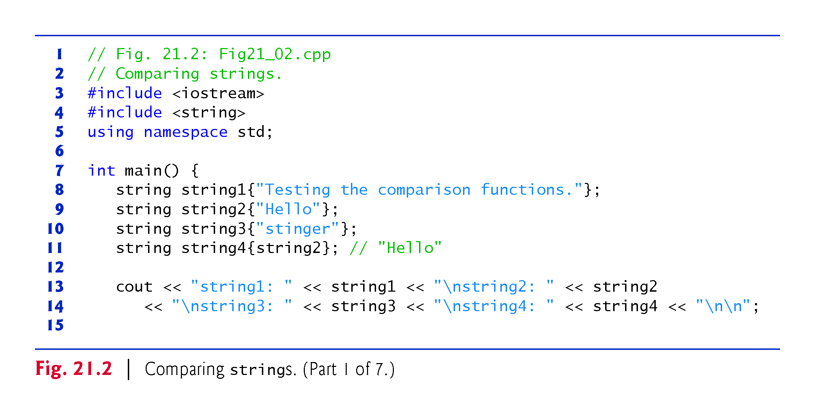

Slide 24
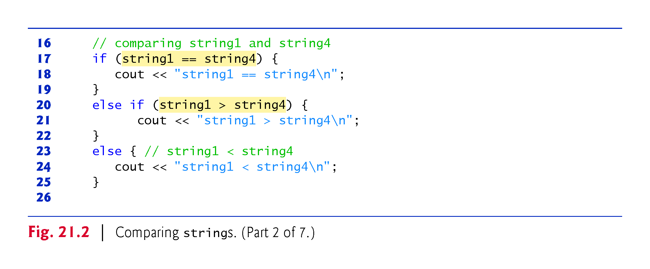

Slide 25
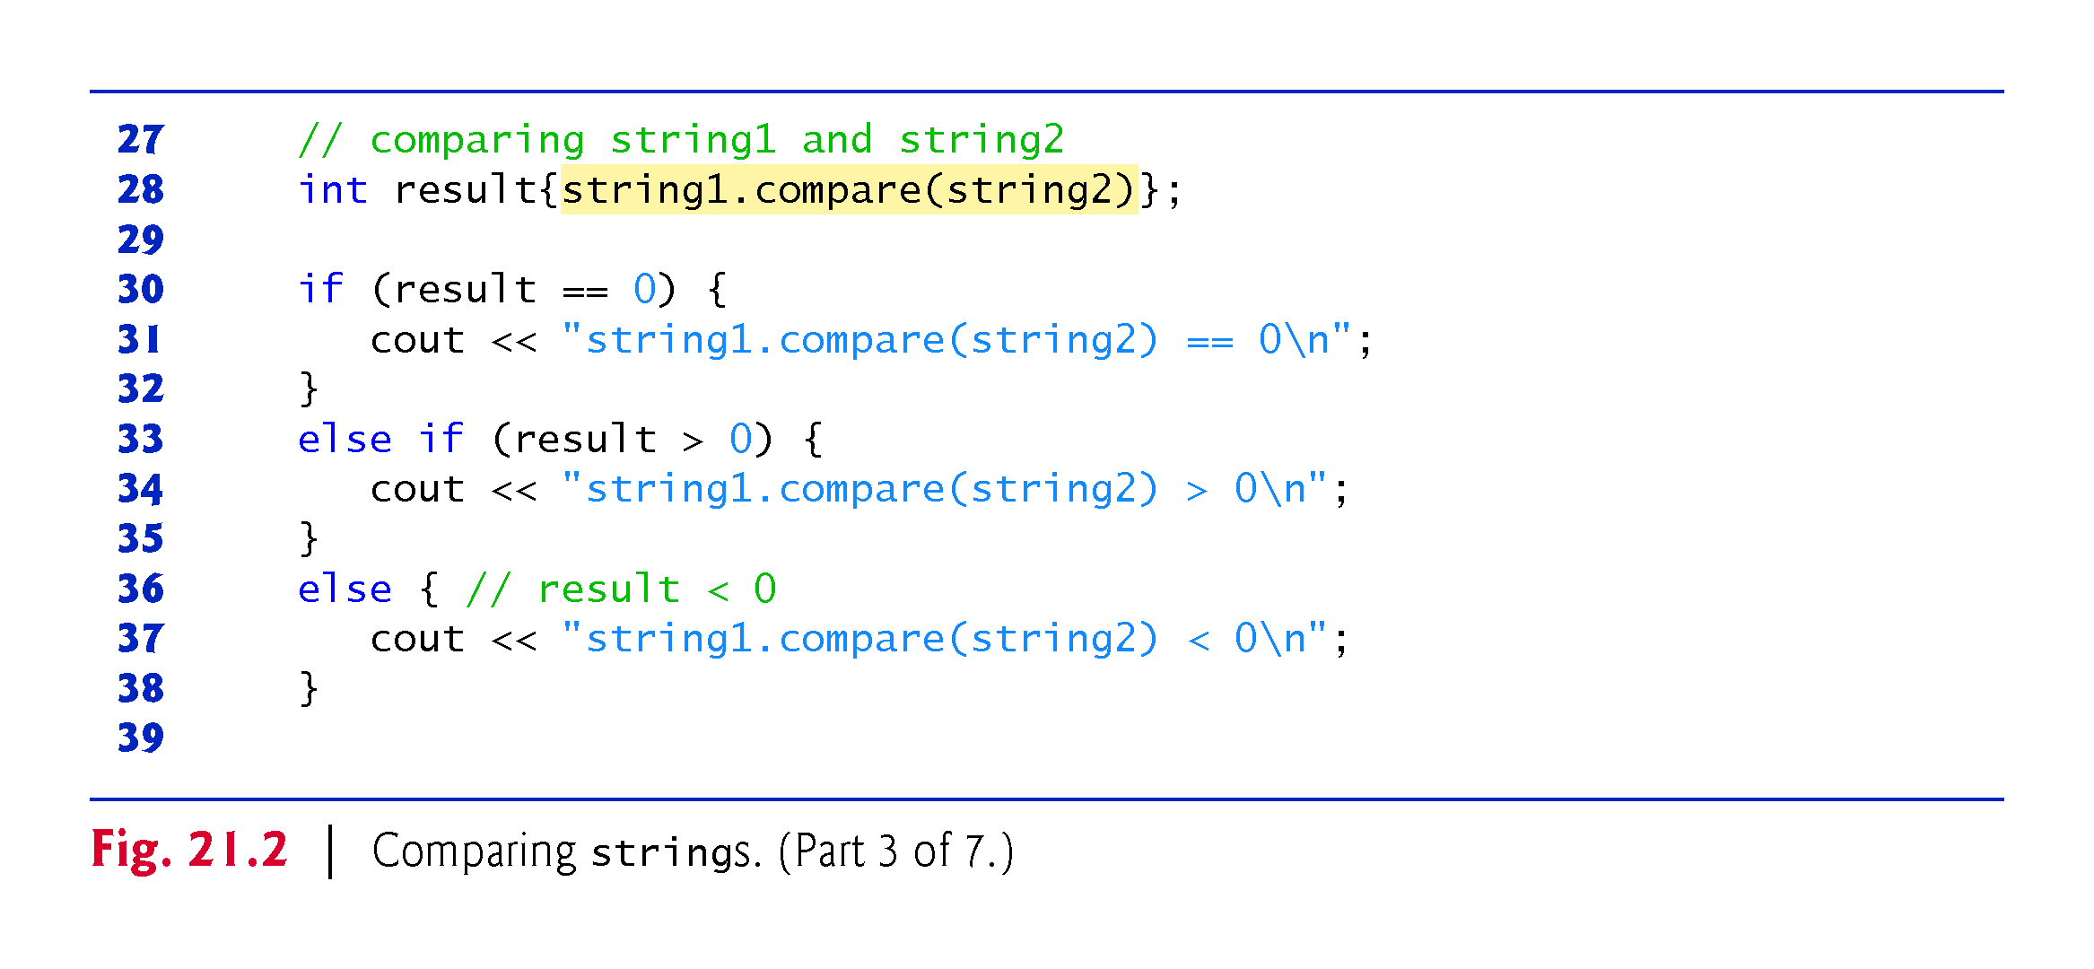

Slide 26
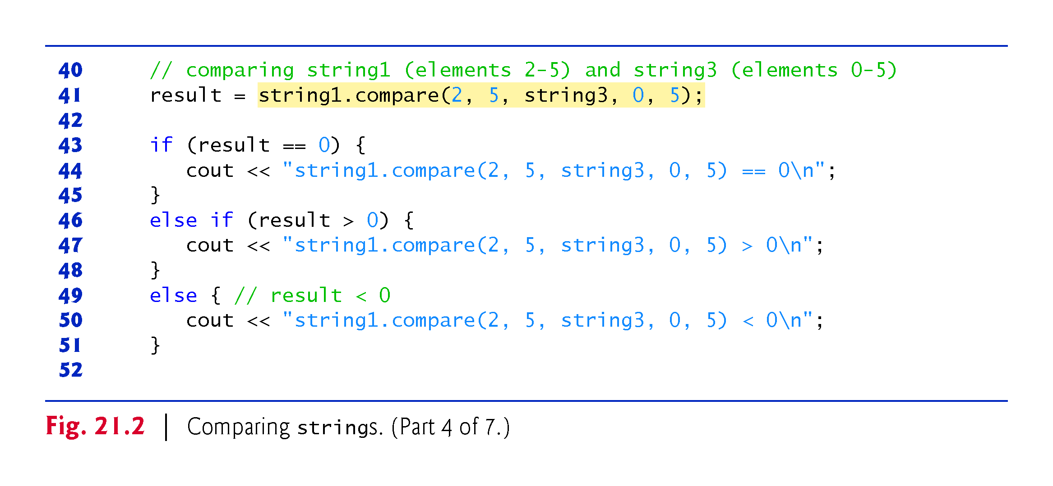

Slide 27
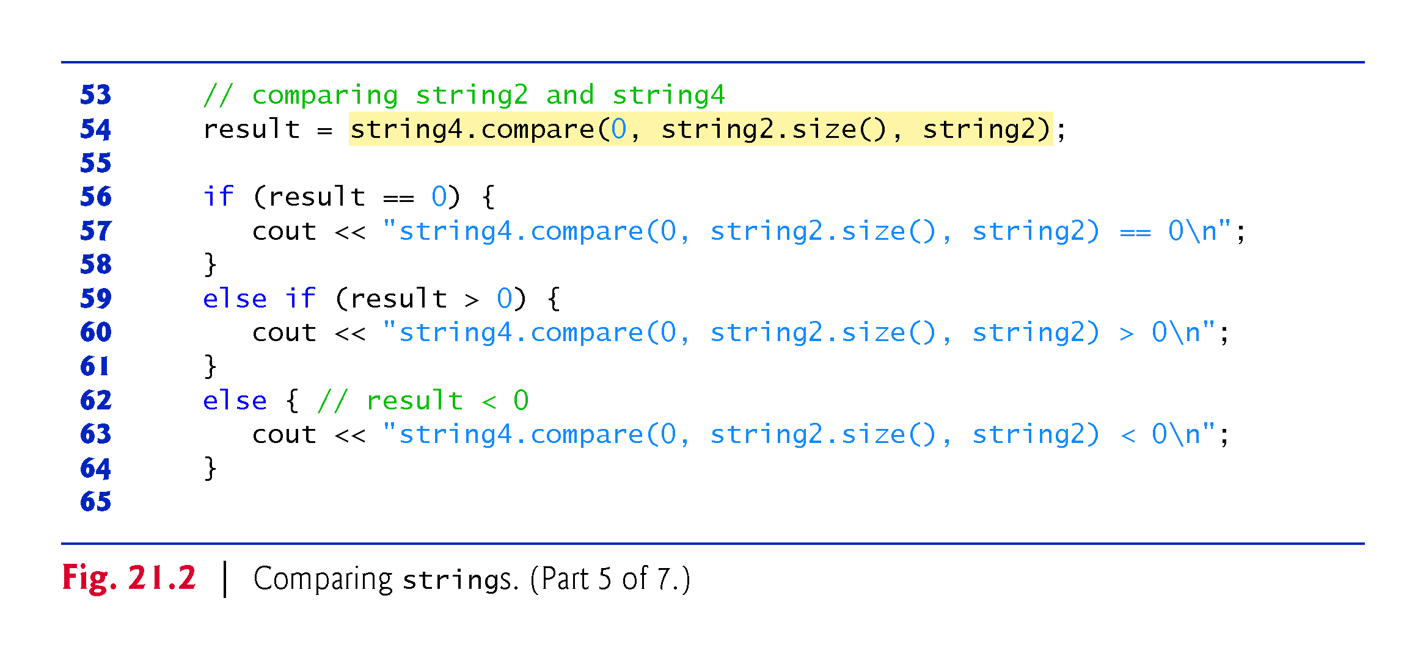

Slide 28
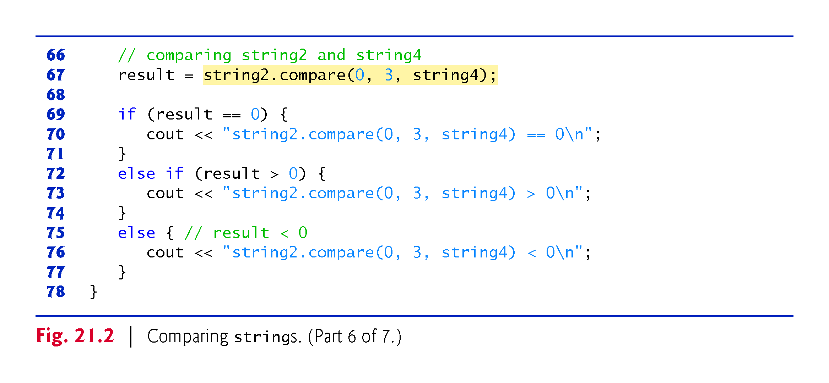

Slide 29
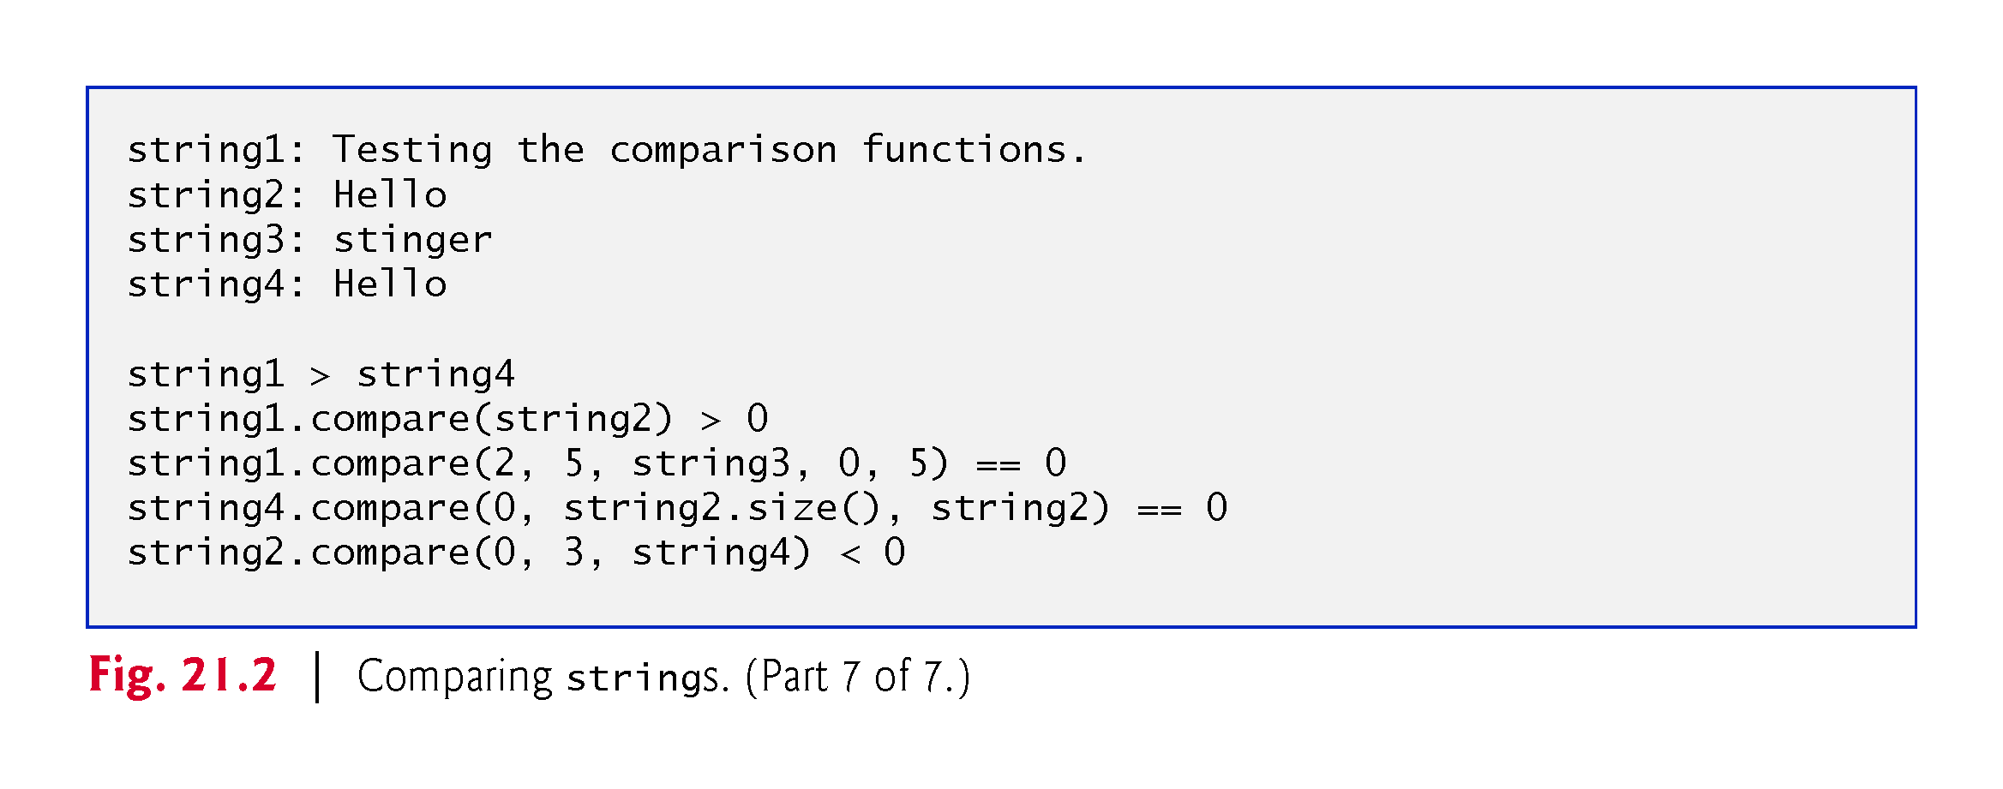

Slide 30
21.3 Comparing strings (cont.)
All the string class overloaded relational and equality operator functions return bool values.
Line 28 uses string member function compare to compare string1 to string2.
The function returns 0 if the strings are equivalent, a positive number if string1 is lexicographically greater than string2 or a negative number if string1 is lexicographically less than string2.
When we say that a string is lexicographically less than another, we mean that the compare member function uses the numerical values of the characters (see Appendix B, ASCII Character Set) in each string to determine that the first string is less than the second.

Slide 31
21.3 Comparing strings (cont.)
Line 41 compares portions of string1 and string3 using an overloaded version of member function compare.
The first two arguments (2 and 5) specify the starting subscript and length of the portion of string1 ("sting") to compare with string3.
The third argument is the comparison string.
The last two arguments (0 and 5) are the starting subscript and length of the portion of the comparison string being compared (also "sting").

Slide 32
21.3 Comparing strings (cont.)
Line 54 uses another overloaded version of function compare to compare string4 and string2.
The first two arguments are the same—the starting subscript and length.
The last argument is the comparison string.

Slide 33
21.4 Substrings
Class string provides member function substr for retrieving a substring from a string.
The result is a new string object that is copied from the source string.
Figure 21.3 demonstrates substr.
The first argument of substr specifies the beginning subscript of the desired substring; the second argument specifies the substring’s length.

Slide 34
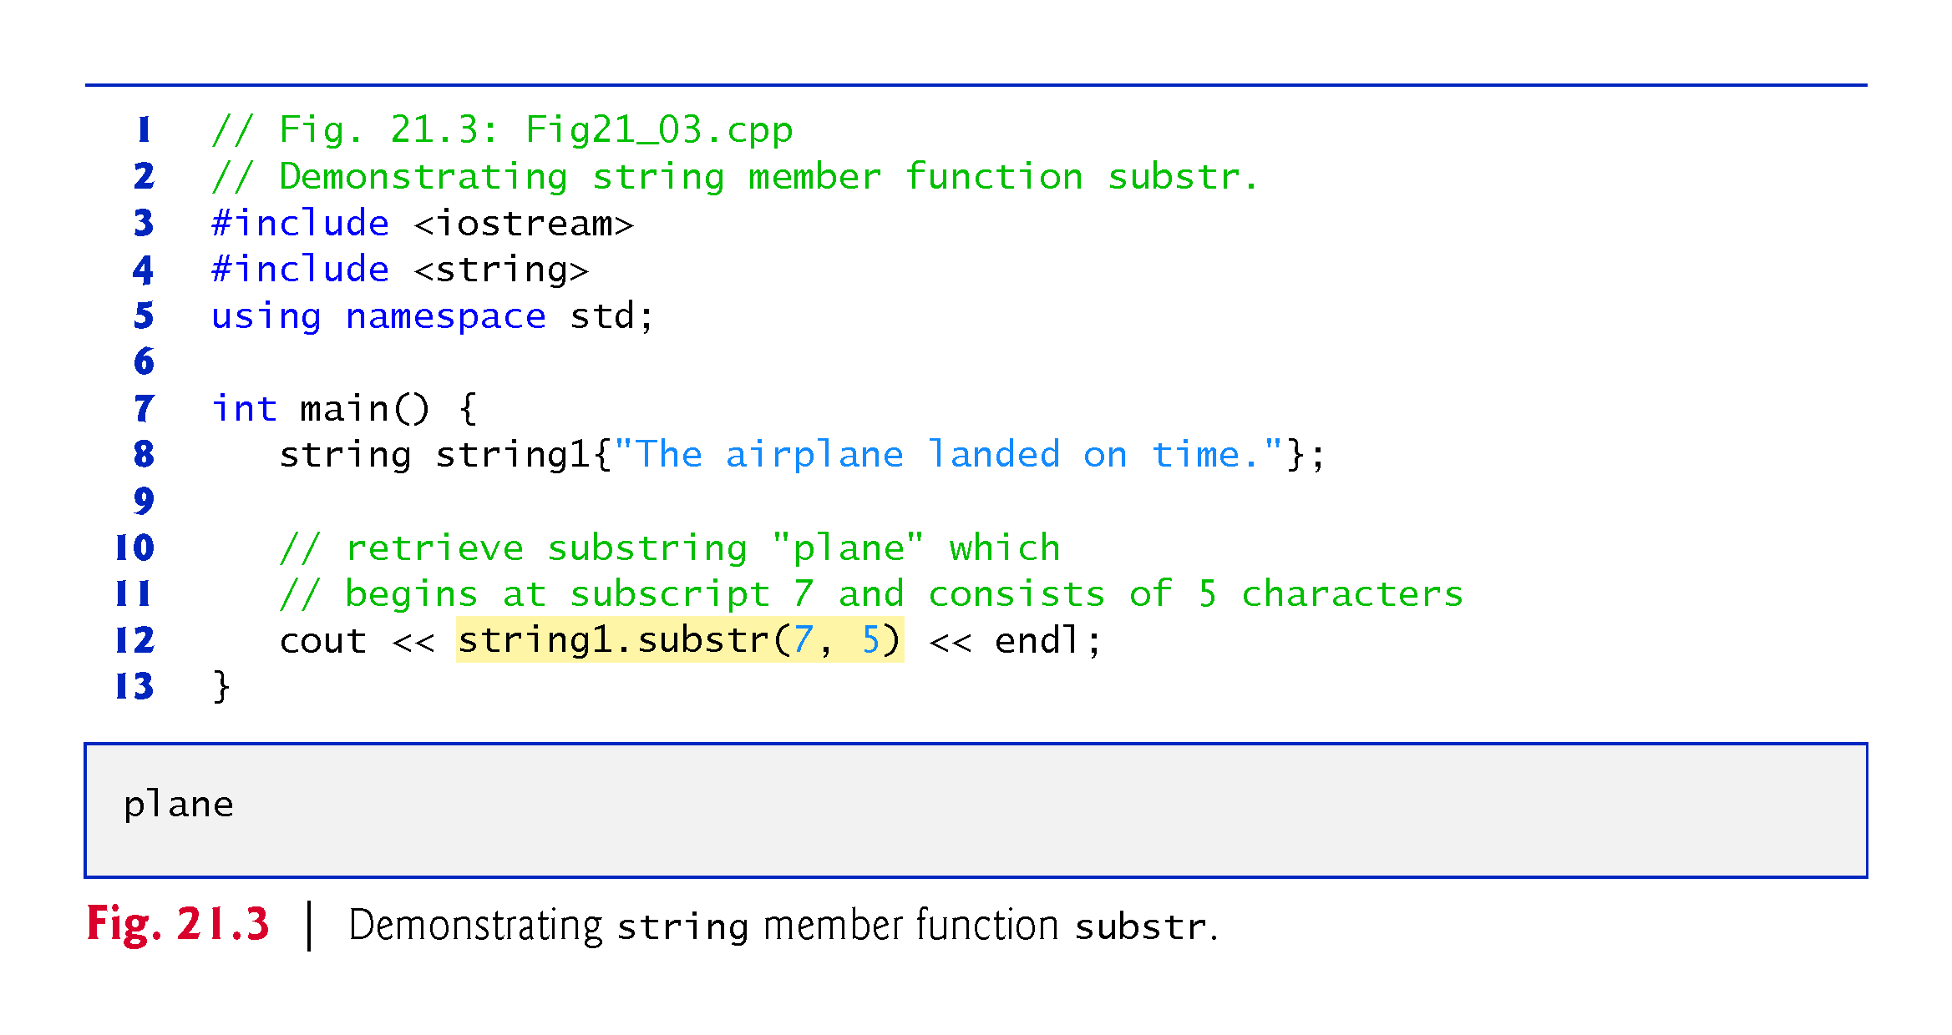

Slide 35
21.5 Swapping strings
Class string provides member function swap for swapping strings.
Figure 21.4 swaps two strings.
Lines 8–9 declare and initialize strings first and second.
Each string is then output.
Line 14 uses string member function swap to swap the values of first and second.
The string member function swap is useful for implementing programs that sort strings.

Slide 36
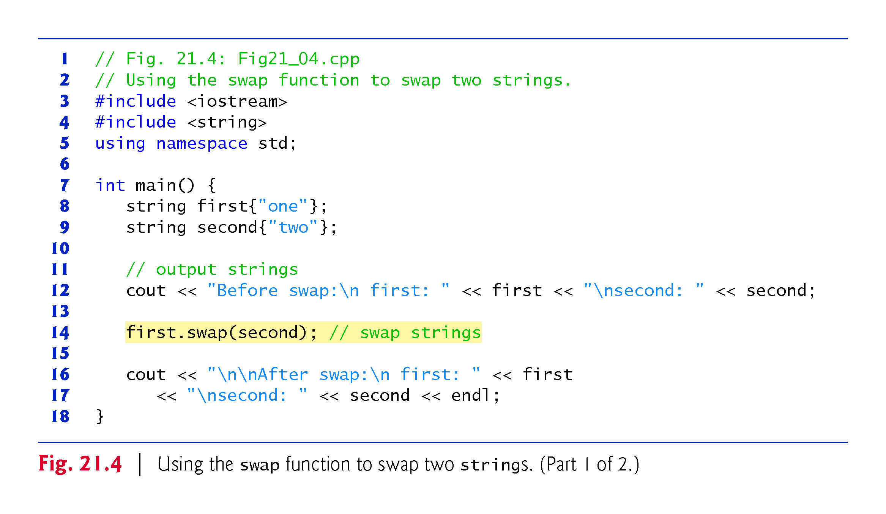

Slide 37
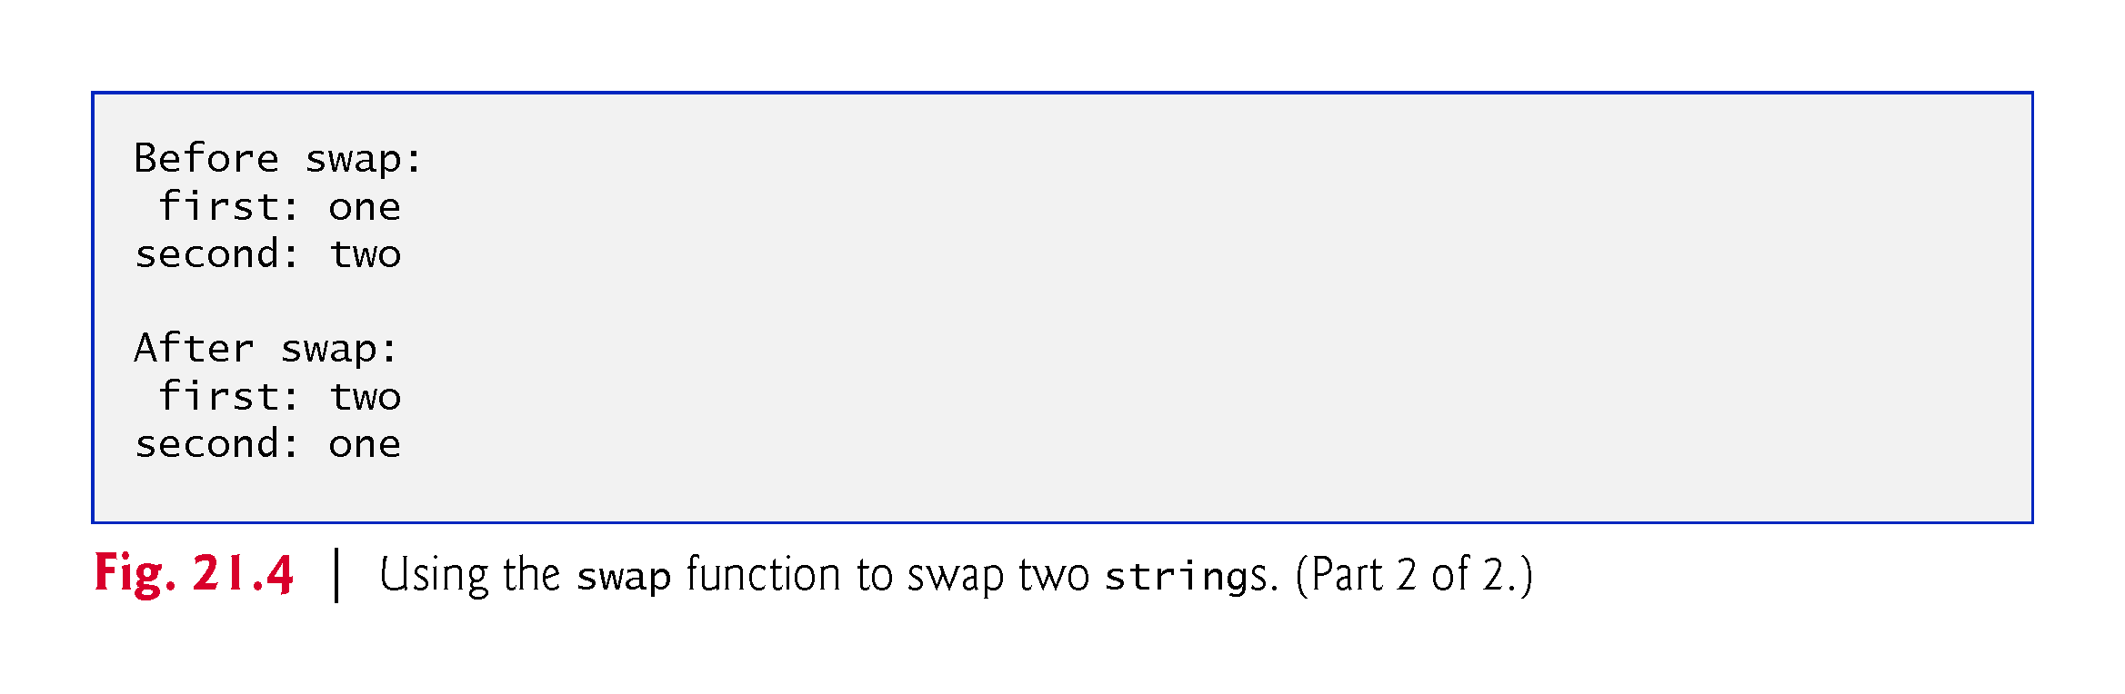

Slide 38
21.6 string Characteristics
Class string provides member functions for gathering information about a string’s size, length, capacity, maximum length and other characteristics.
A string’s size or length is the number of characters currently stored in the string.
A string’s capacity is the number of characters that can be stored in the string without allocating more memory.
The capacity of a string must be at least equal to the current size of the string, though it can be greater.
The exact capacity of a string depends on the implementation.
The maximum size is the largest possible size a string can have.
If this value is exceeded, a length_error exception is thrown.
Figure 21.5 demonstrates string class member functions for determining various characteristics of strings.

Slide 39
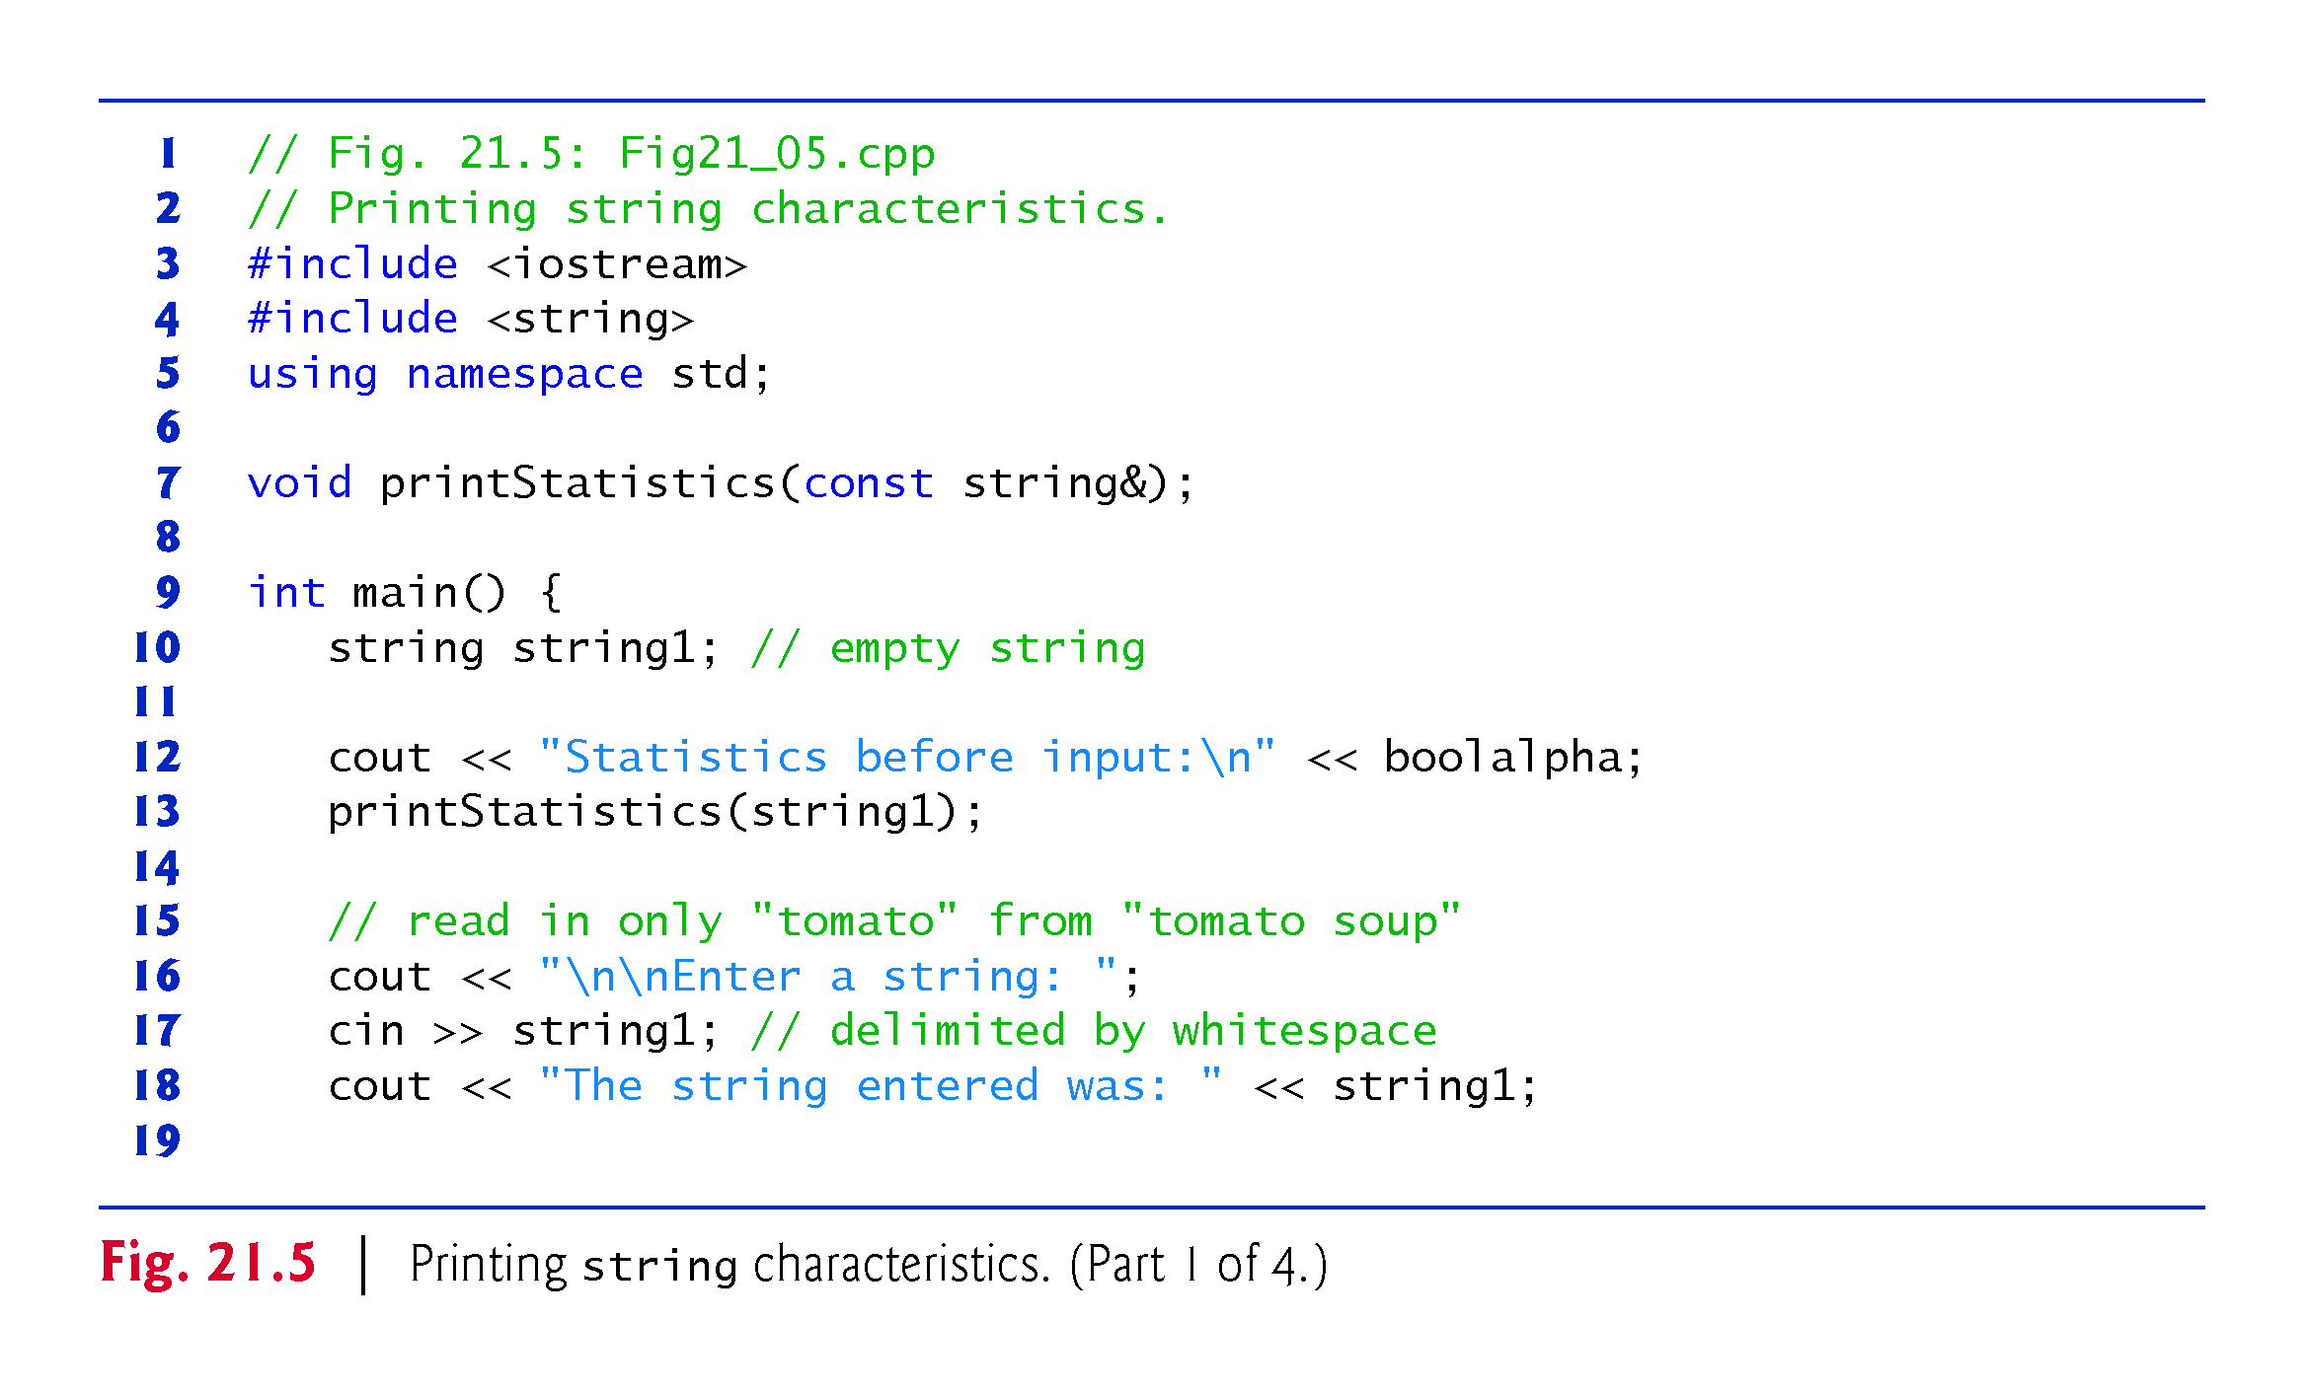

Slide 40
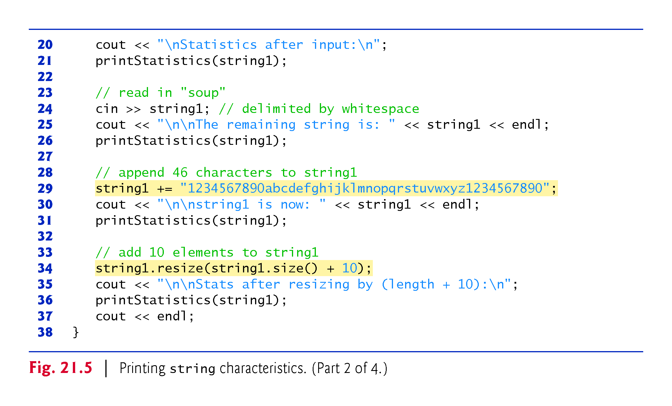

Slide 41
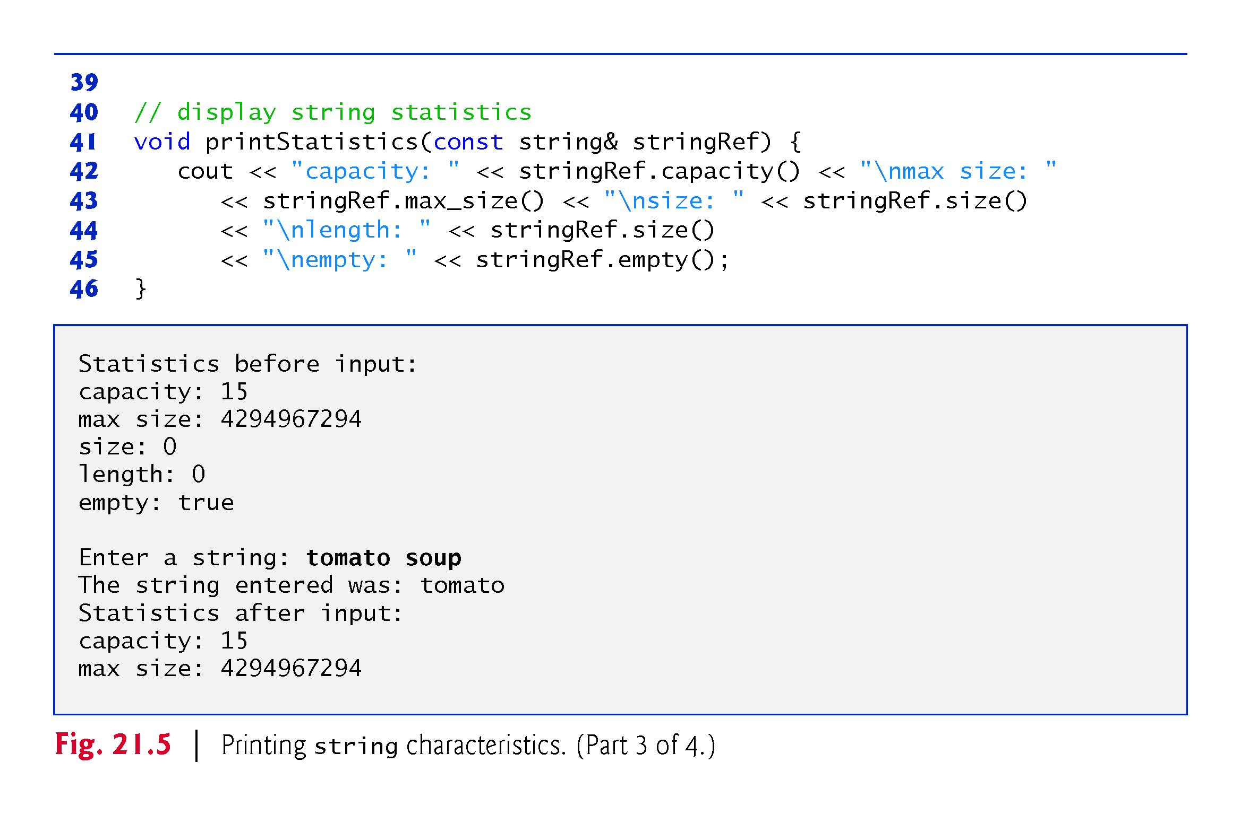

Slide 42
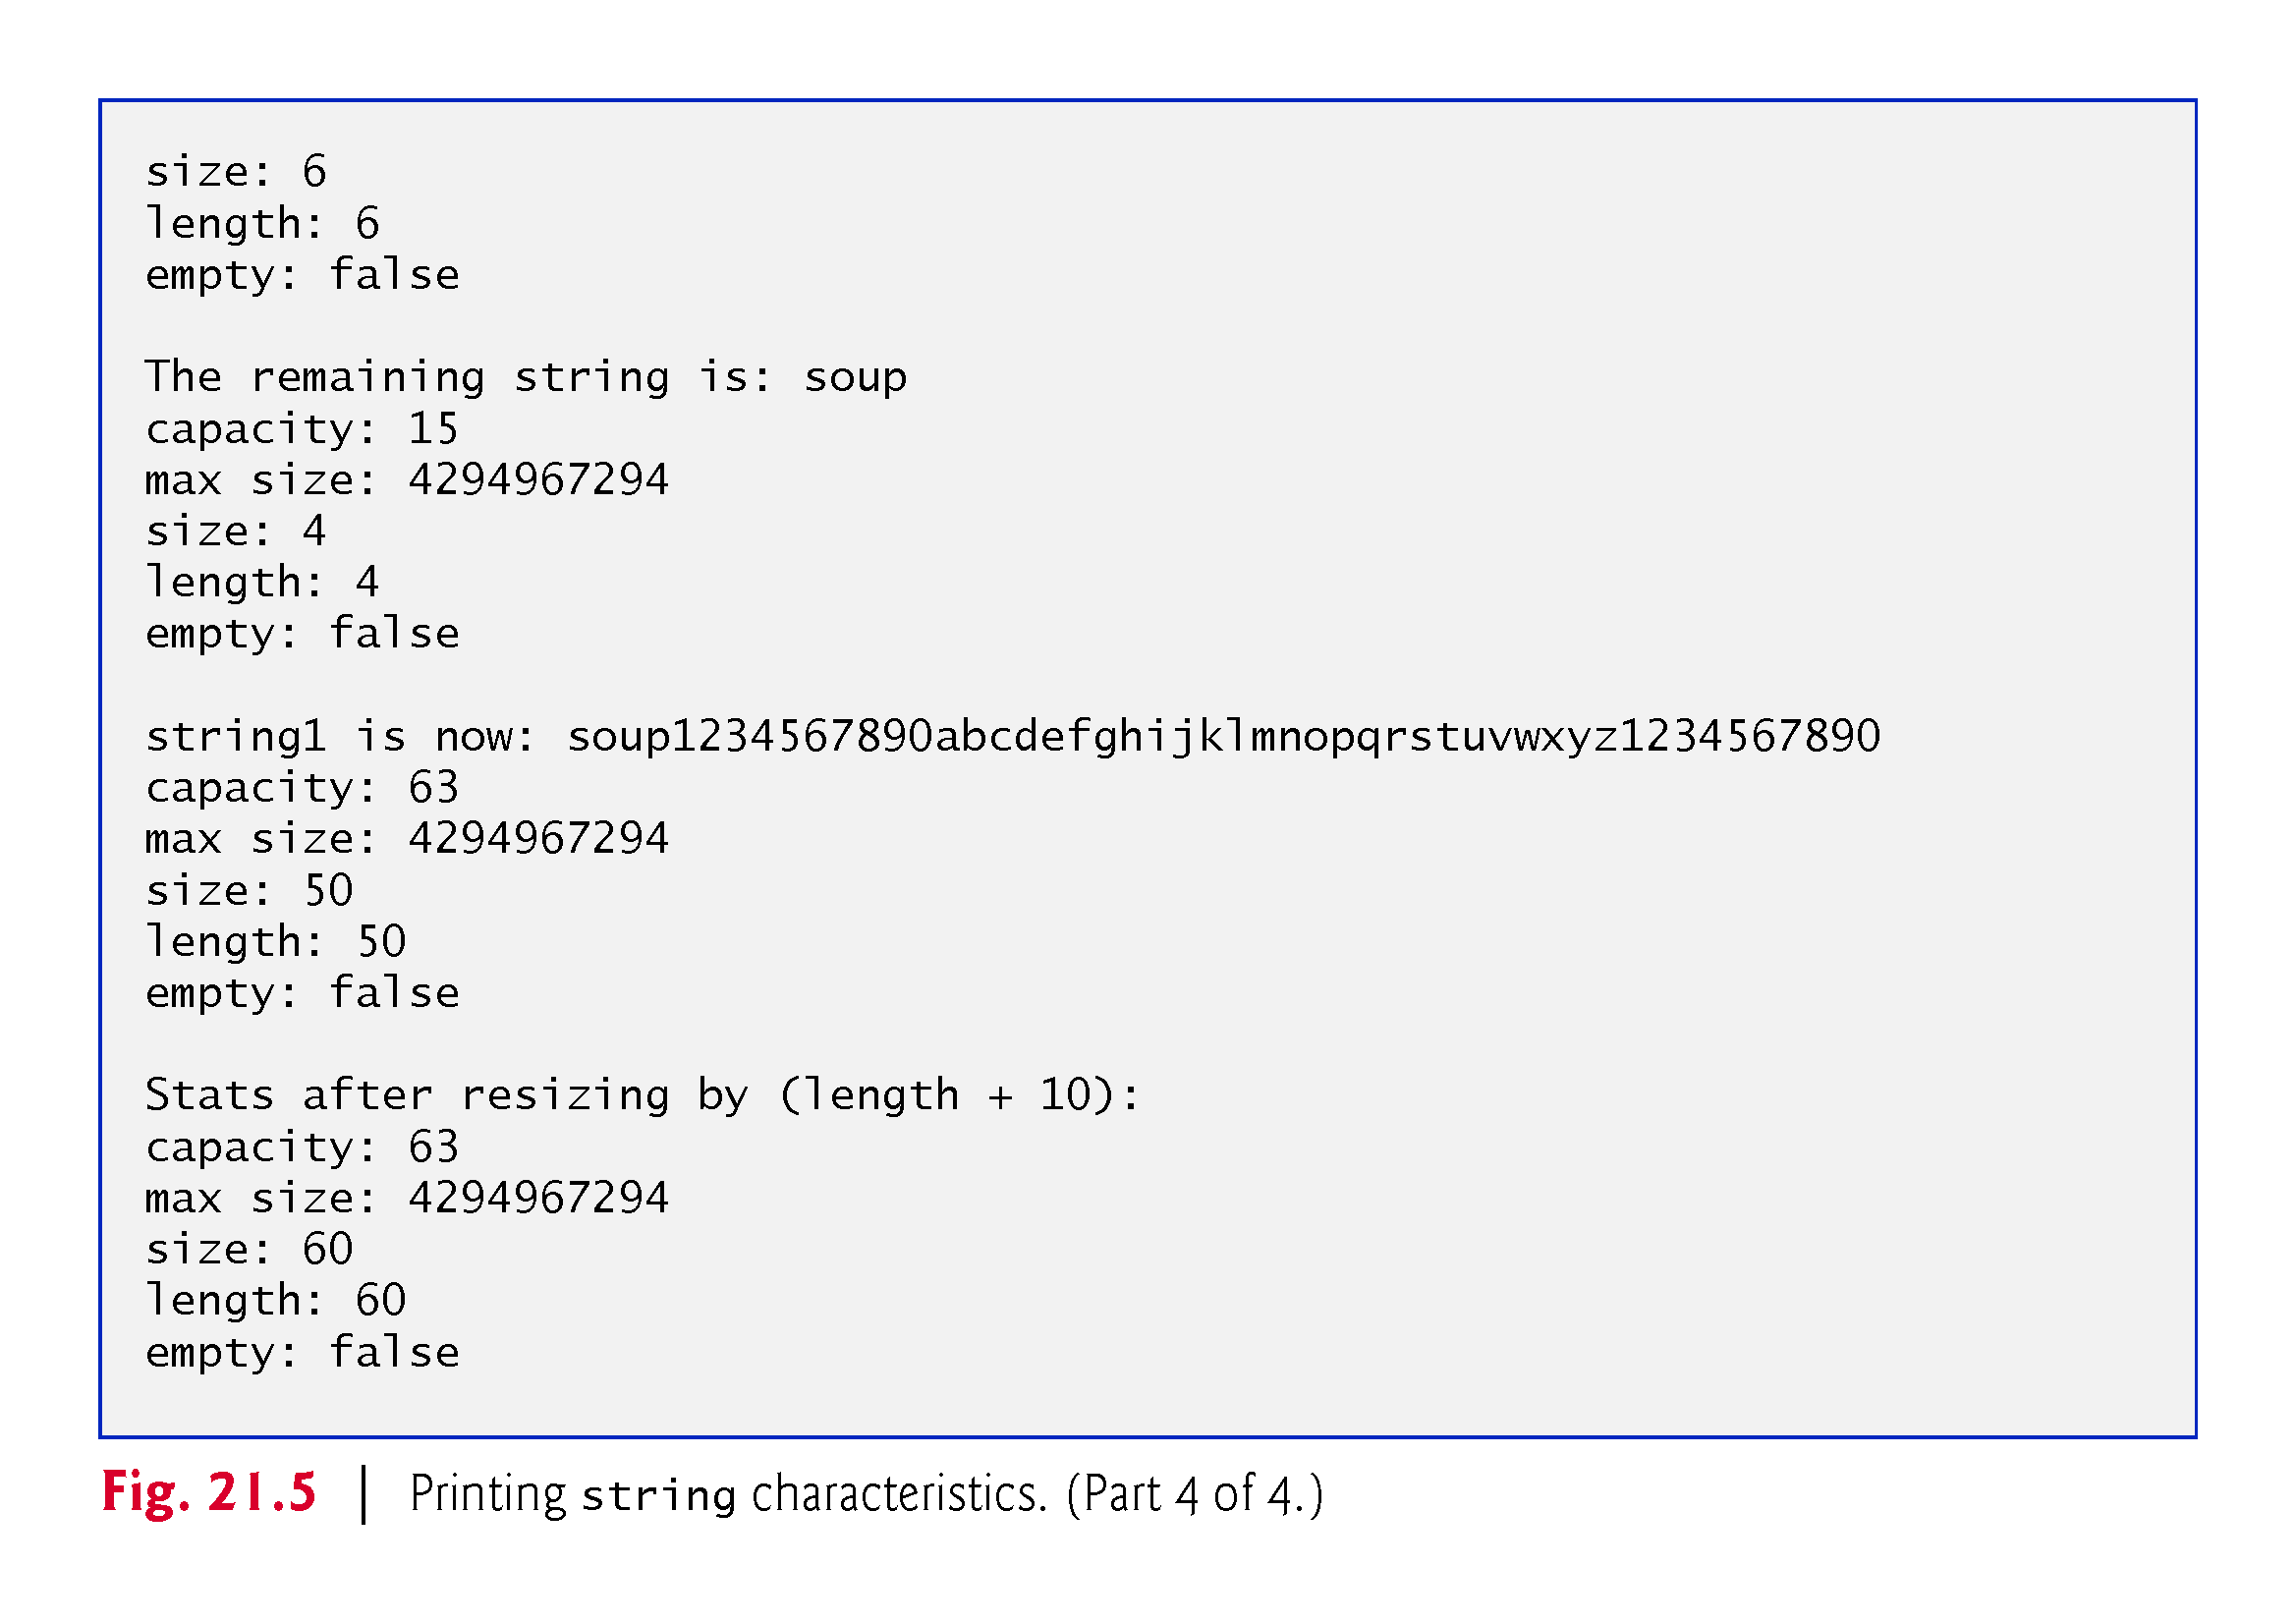

Slide 43
21.6 string Characteristics (cont.)
The program declares empty string string1 (line 10) and passes it to function printStatistics (line 13).
Function printStatistics (lines 41–46) takes a reference to a const string as an argument and outputs
capacity (using member function capacity),
maximum size (using member function max_size), size (using member function size),
length (using member function size) and
whether the string is empty (using member function empty).
The size and length of 0 indicate that there are no characters stored in a string.

Slide 44
21.6 string Characteristics (cont.)
Line 29 uses the overloaded += operator to concatenate a 46-character-long string to string1.
The capacity has increased to 63 elements and the length is now 50.
Line 34 uses member function resize to increase the length of string1 by 10 characters.
The additional elements are set to null characters.
The output shows that the capacity has not changed and the length is now 60.

Slide 45
21.7 Finding Substrings and Characters in a string
Class string provides const member functions for finding substrings and characters in a string.
Figure 21.6 demonstrates the find functions.

Slide 46
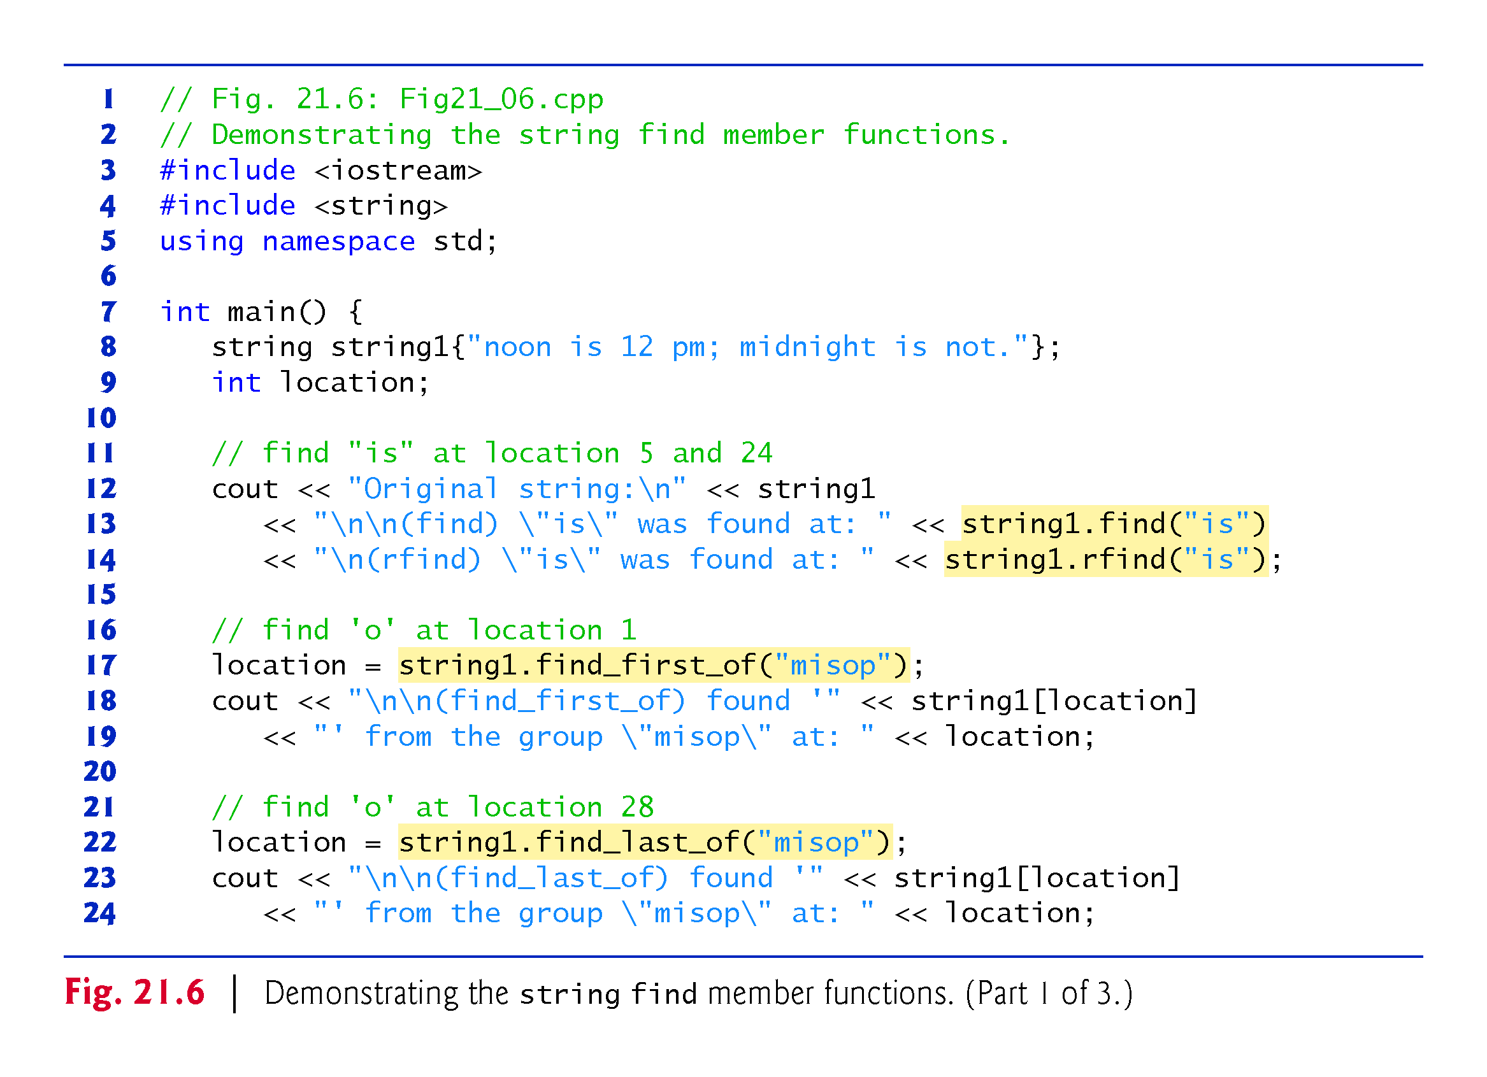

Slide 47
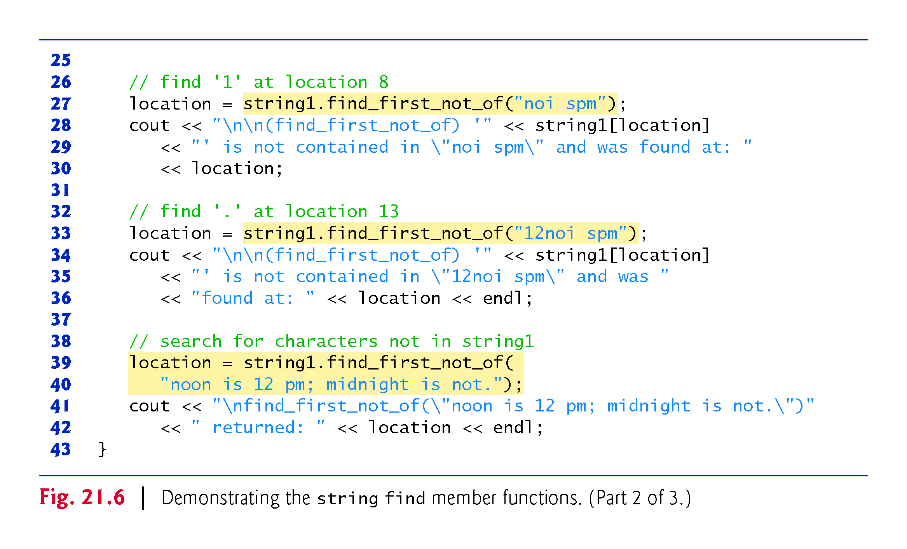

Slide 48
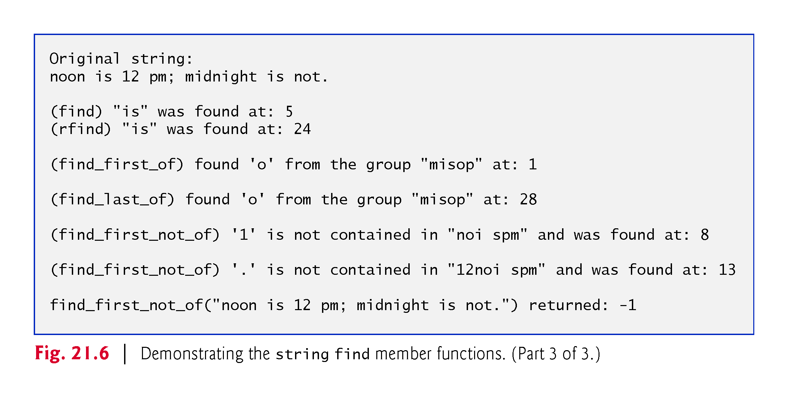

Slide 49
21.7 Finding Substrings and Characters in a string (cont.)
Line 13 attempts to find "is" in string1 using function find.
If "is" is found, the subscript of the starting location of that string is returned.
If the string is not found, the value string::npos (a public static constant defined in class string) is returned.
This value is returned by the string find-related functions to indicate that a substring or character was not found in the string.

Slide 50
21.7 Finding Substrings and Characters in a string (cont.)
Line 14 uses member function rfind to search string1 backward (i.e., right-to-left).
If "is" is found, the subscript location is returned.
If the string is not found, string::npos is returned.
[Note: The rest of the find functions presented in this section return the same type unless otherwise noted.]

Slide 51
21.7 Finding Substrings and Characters in a string (cont.)
Line 17 uses member function find_first_of to locate the first occurrence in string1 of any character in "misop".
The searching is done from the beginning of string1.
Line 22 uses member function find_last_of to find the last occurrence in string1 of any character in "misop".
The searching is done from the end of string1.
Line 27 uses member function find_first_not_of to find the first character in string1 not contained in "noi spm".
Searching is done from the beginning of string1.
Line 33 uses member function find_first_not_of to find the first character not contained in "12noi spm".
Searching is done from the end of string1.

Slide 52
21.7 Finding Substrings and Characters in a string (cont.)
Lines 39–40 use member function find_first_not_of to find the first character not contained in "noon is 12 pm; midnight is not.".
In this case, the string being searched contains every character specified in the string argument.
Because a character was not found, string::npos (which has the value –1 in this case) is returned.

Slide 53
21.8 Replacing Characters in a string
Figure 21.7 demonstrates string member functions for replacing and erasing characters.
Line 19 uses string member function erase to erase everything from (and including) the character in position 62 to the end of string1.
[Note: Each newline character occupies one element in the string.]

Slide 54
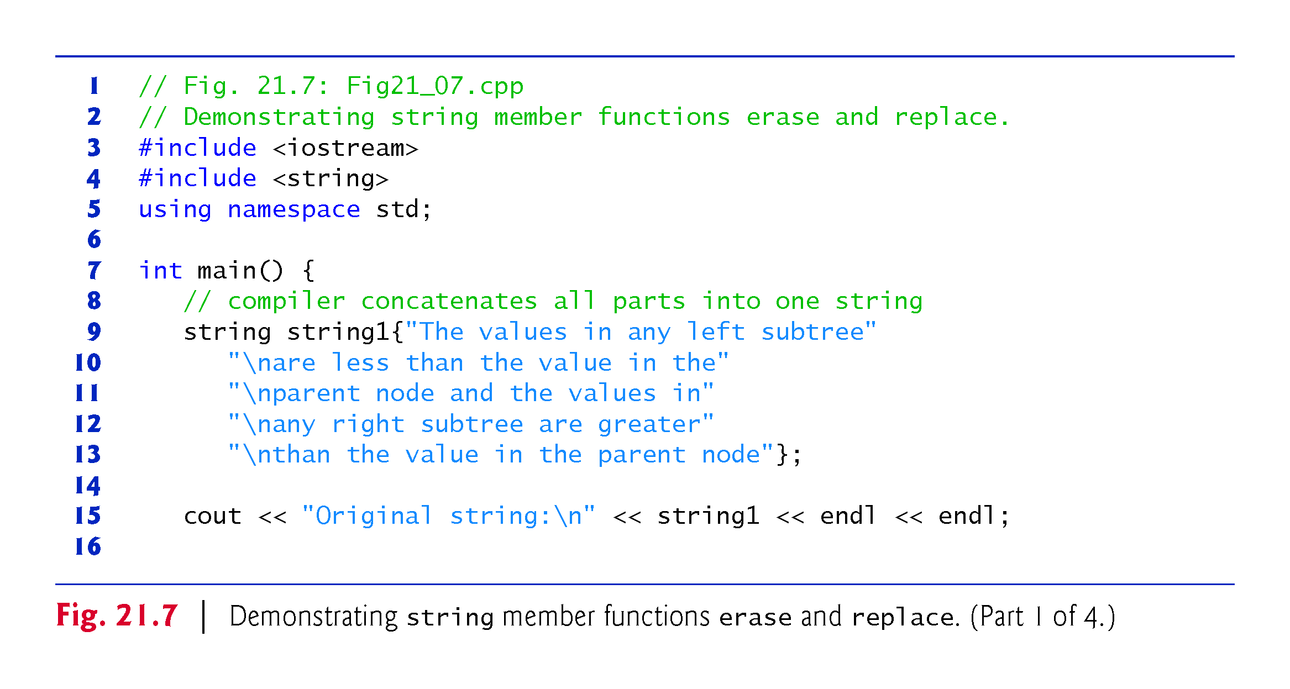

Slide 55
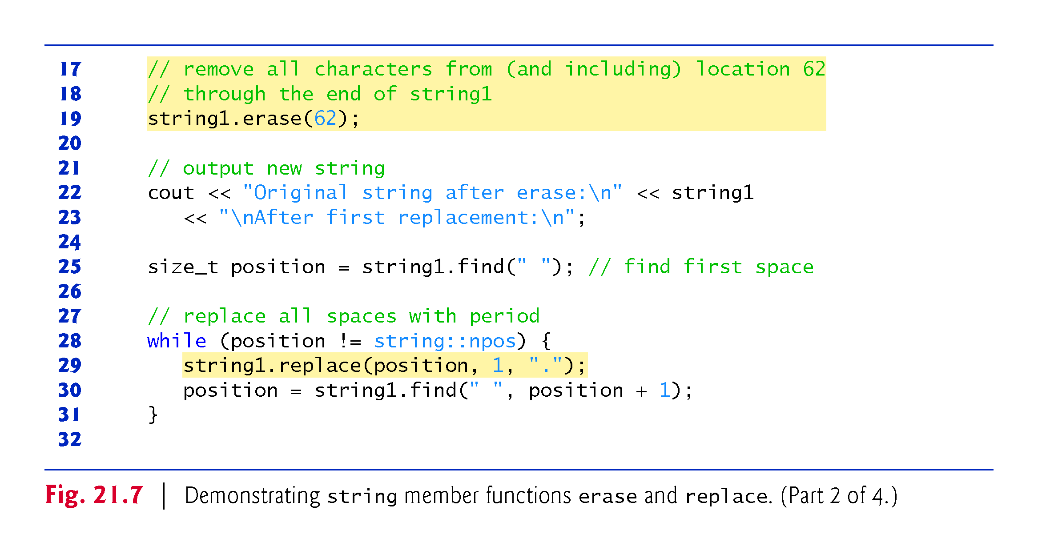

Slide 56
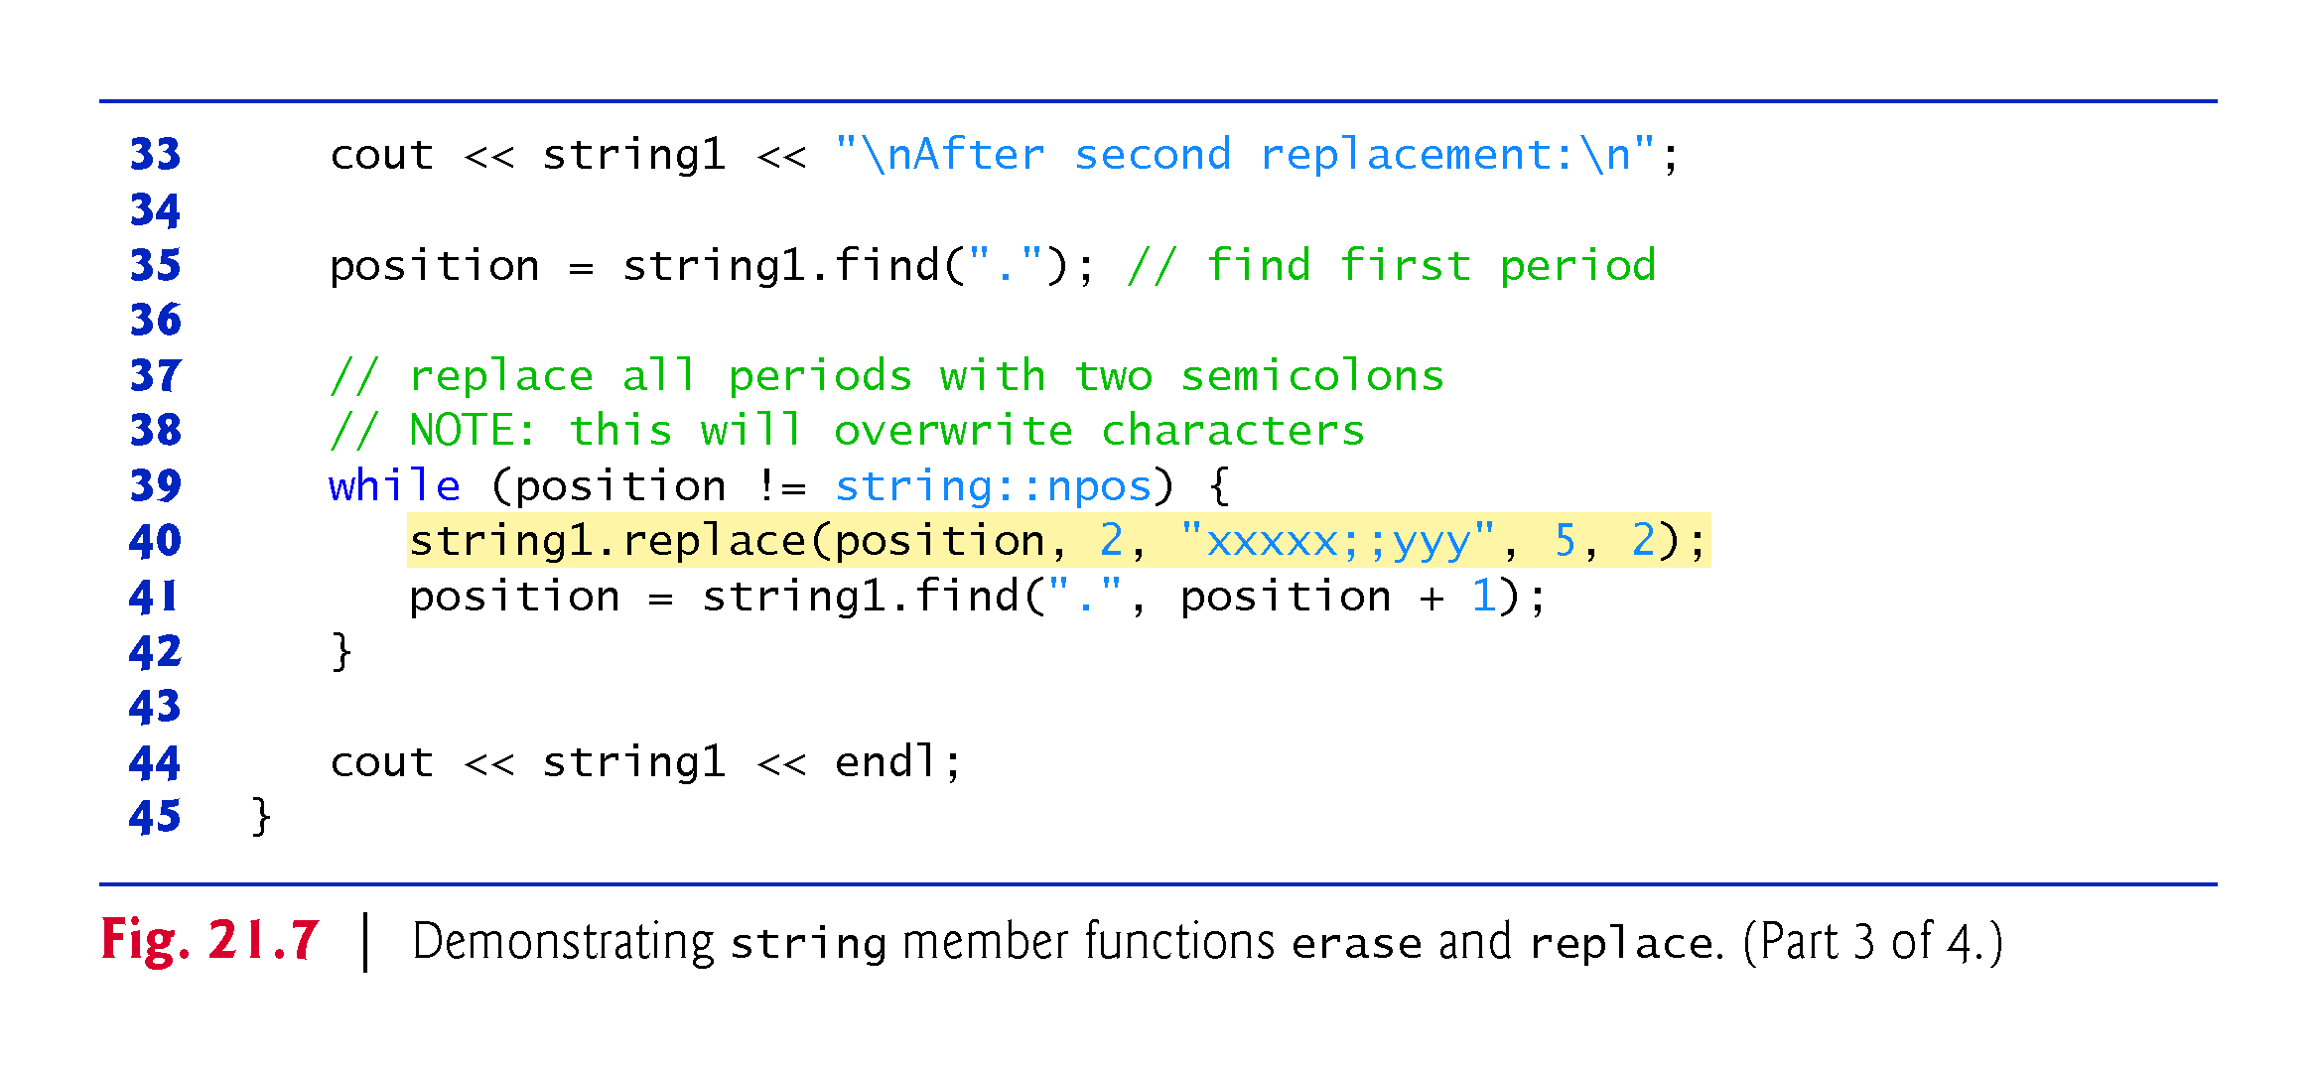

Slide 57
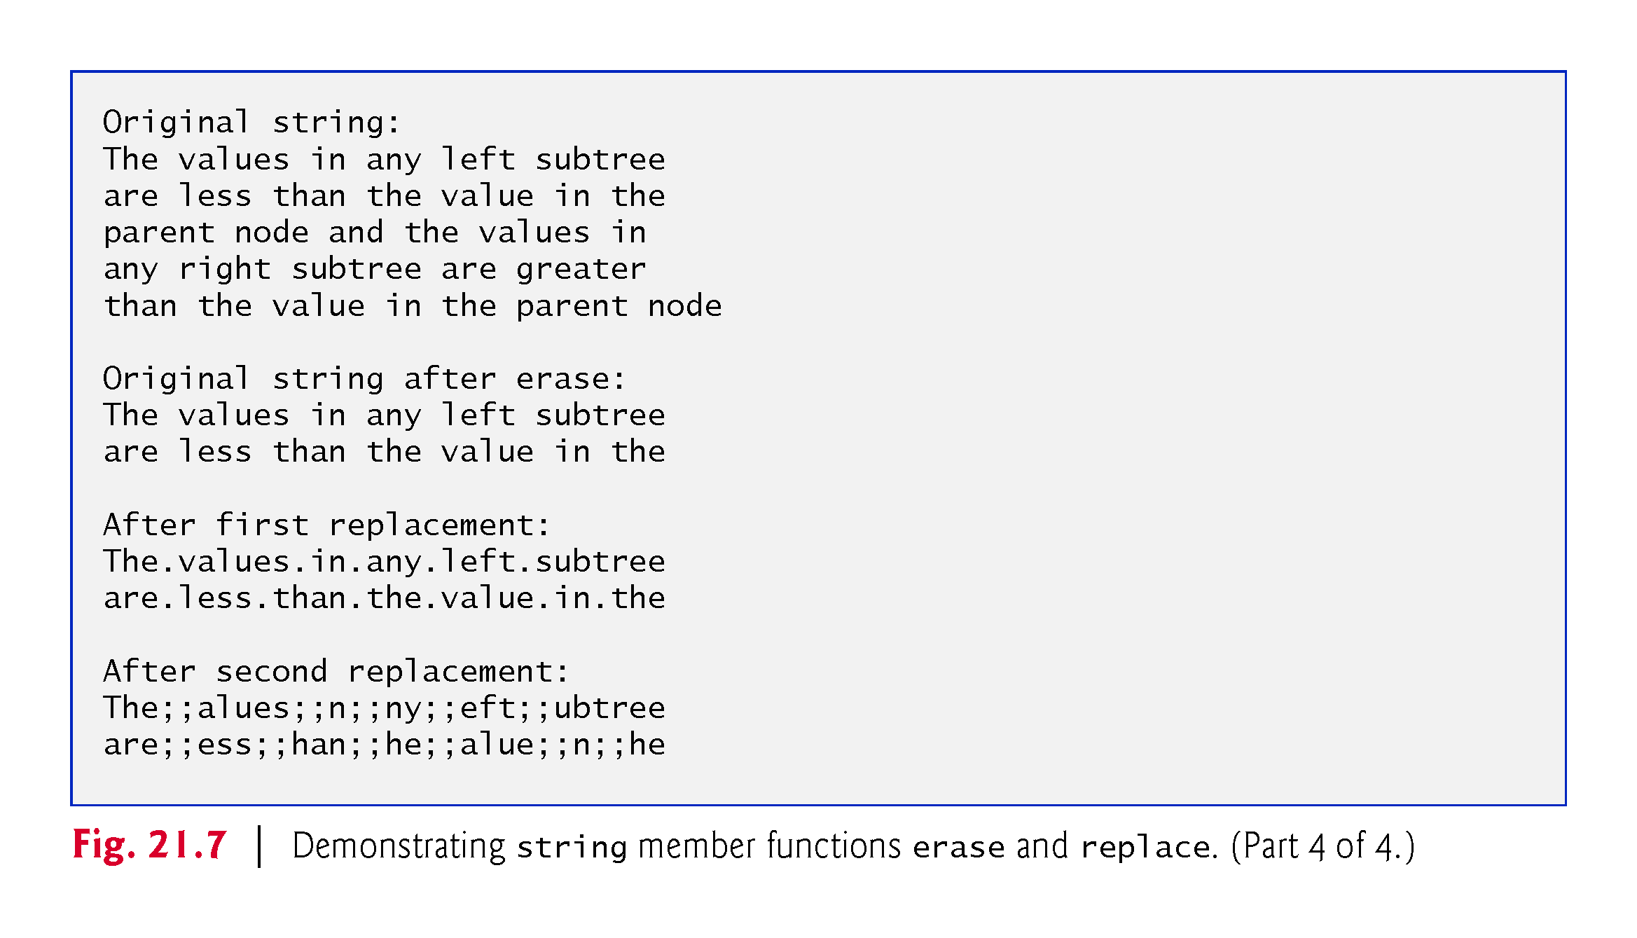

Slide 58
21.8 Replacing Characters in a string (cont.)
Lines 25–31 use find to locate each occurrence of the space character.
Each space is then replaced with a period by a call to string member function replace.
Function replace takes three arguments:
the subscript of the character in the string at which replacement should begin,
the number of characters to replace and
the replacement string.

Slide 59
21.8 Replacing Characters in a string (cont.)
Lines 35–42 use function find to find every period and another overloaded function replace to replace every period and its following character with two semicolons.
The arguments passed to this version of replace are
the subscript of the element where the replace operation begins,
the number of characters to replace,
a replacement character string from which a substring is selected to use as replacement characters,
the element in the character string where the replacement substring begins and
the number of characters in the replacement character string to use.

Slide 60
21.9 Inserting Characters into a string
Class string provides member functions for inserting characters into a string.
Figure 21.8 demonstrates the string insert capabilities.
Line 18 uses string member function insert to insert string2’s content before element 10 of string1.
Line 21 uses insert to insert string4 before string3’s element 3.
The last two arguments specify the starting and last element of string4 that should be inserted.
Using string::npos causes the entire string to be inserted.

Slide 61
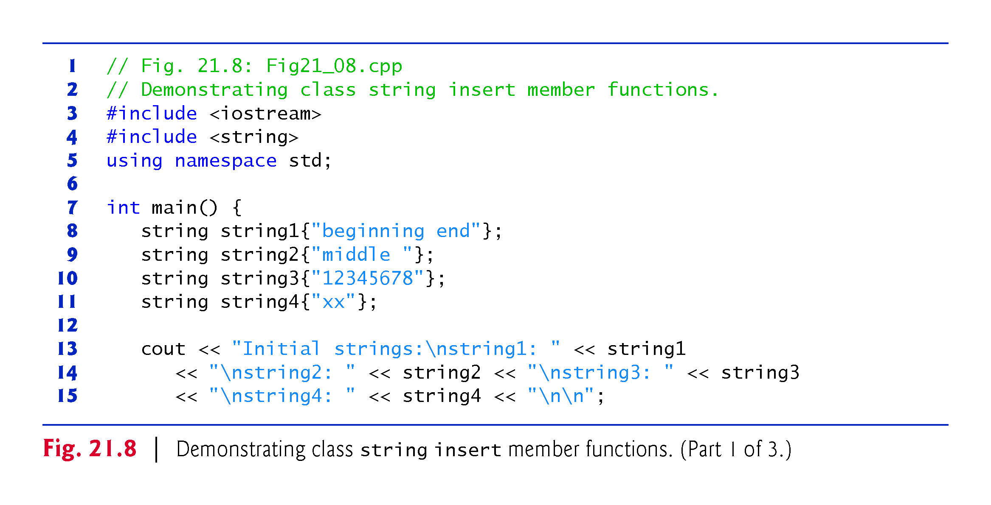

Slide 62
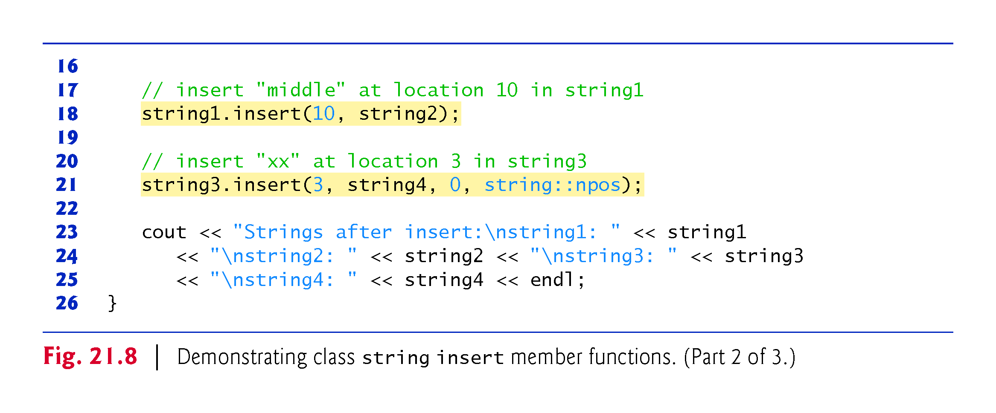

Slide 63
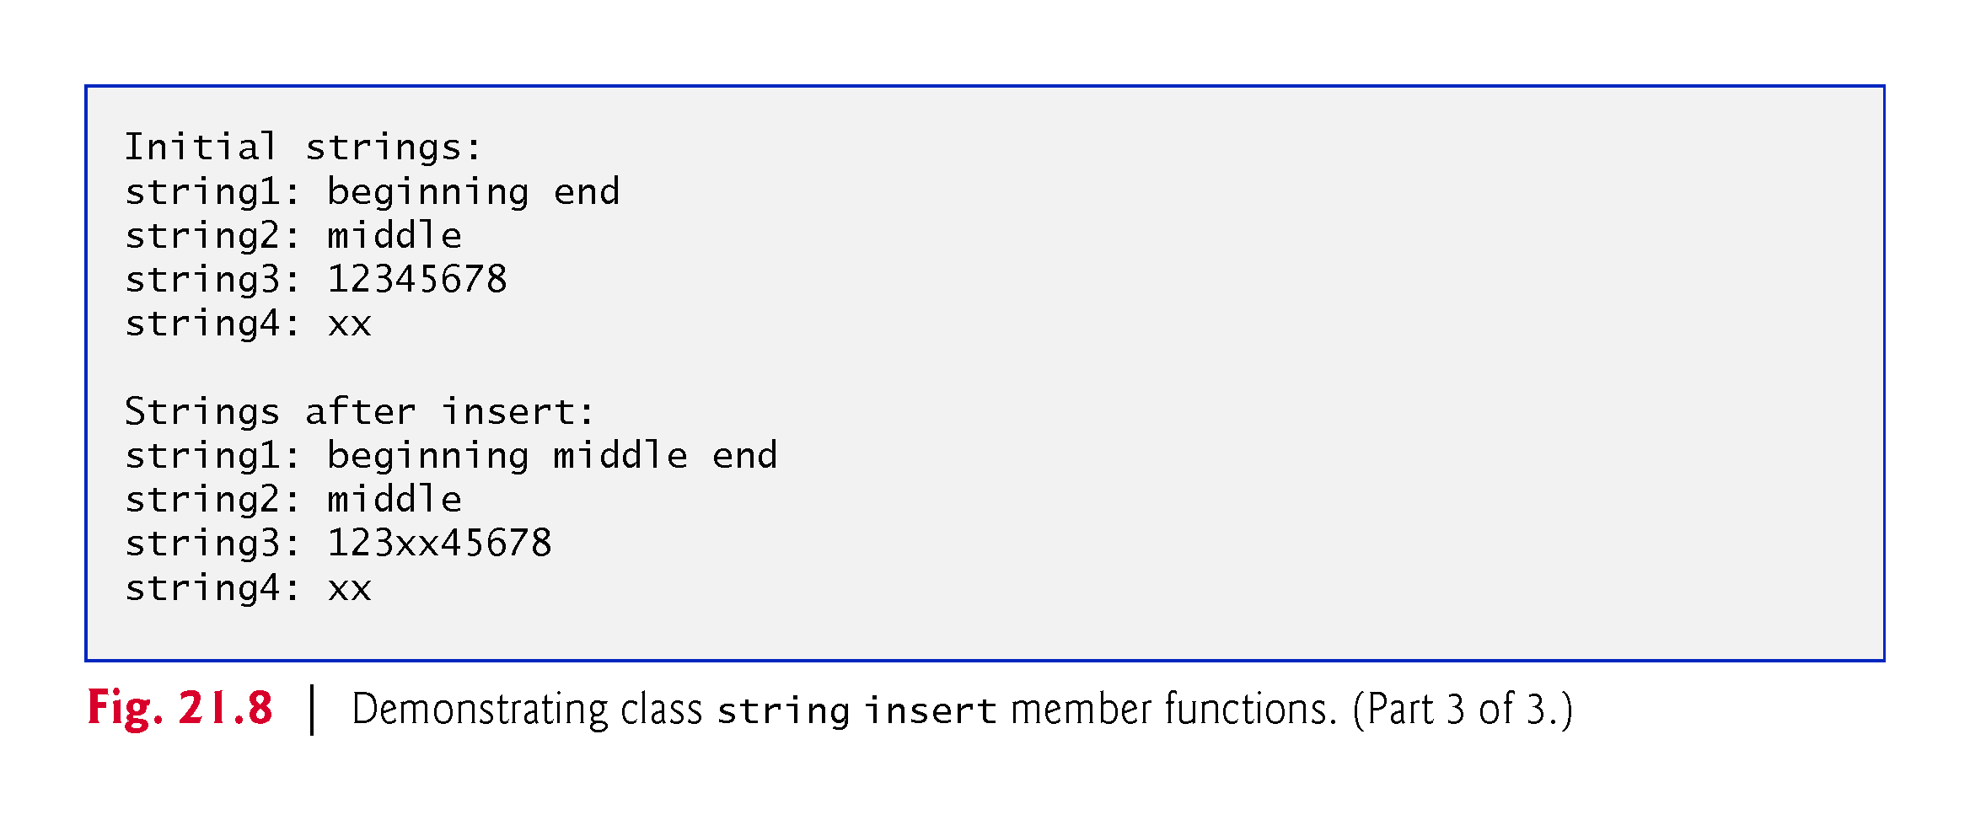

Slide 64
21.10 Conversion to Pointer-Based char* Strings
You can convert string class objects to pointer-based strings.
As mentioned earlier, unlike pointer-based strings, strings are not necessarily null terminated.
These conversion functions are useful when a given function takes a pointer-based string as an argument.
Figure 21.9 demonstrates conversion of strings to pointer-based strings.
The string string1 is initialized to "STRINGS", ptr1 is initialized to 0 and length is initialized to the length of string1.
Memory of sufficient size to hold a pointer-based string equivalent of string string1 is allocated dynamically and attached to char pointer ptr2.

Slide 65
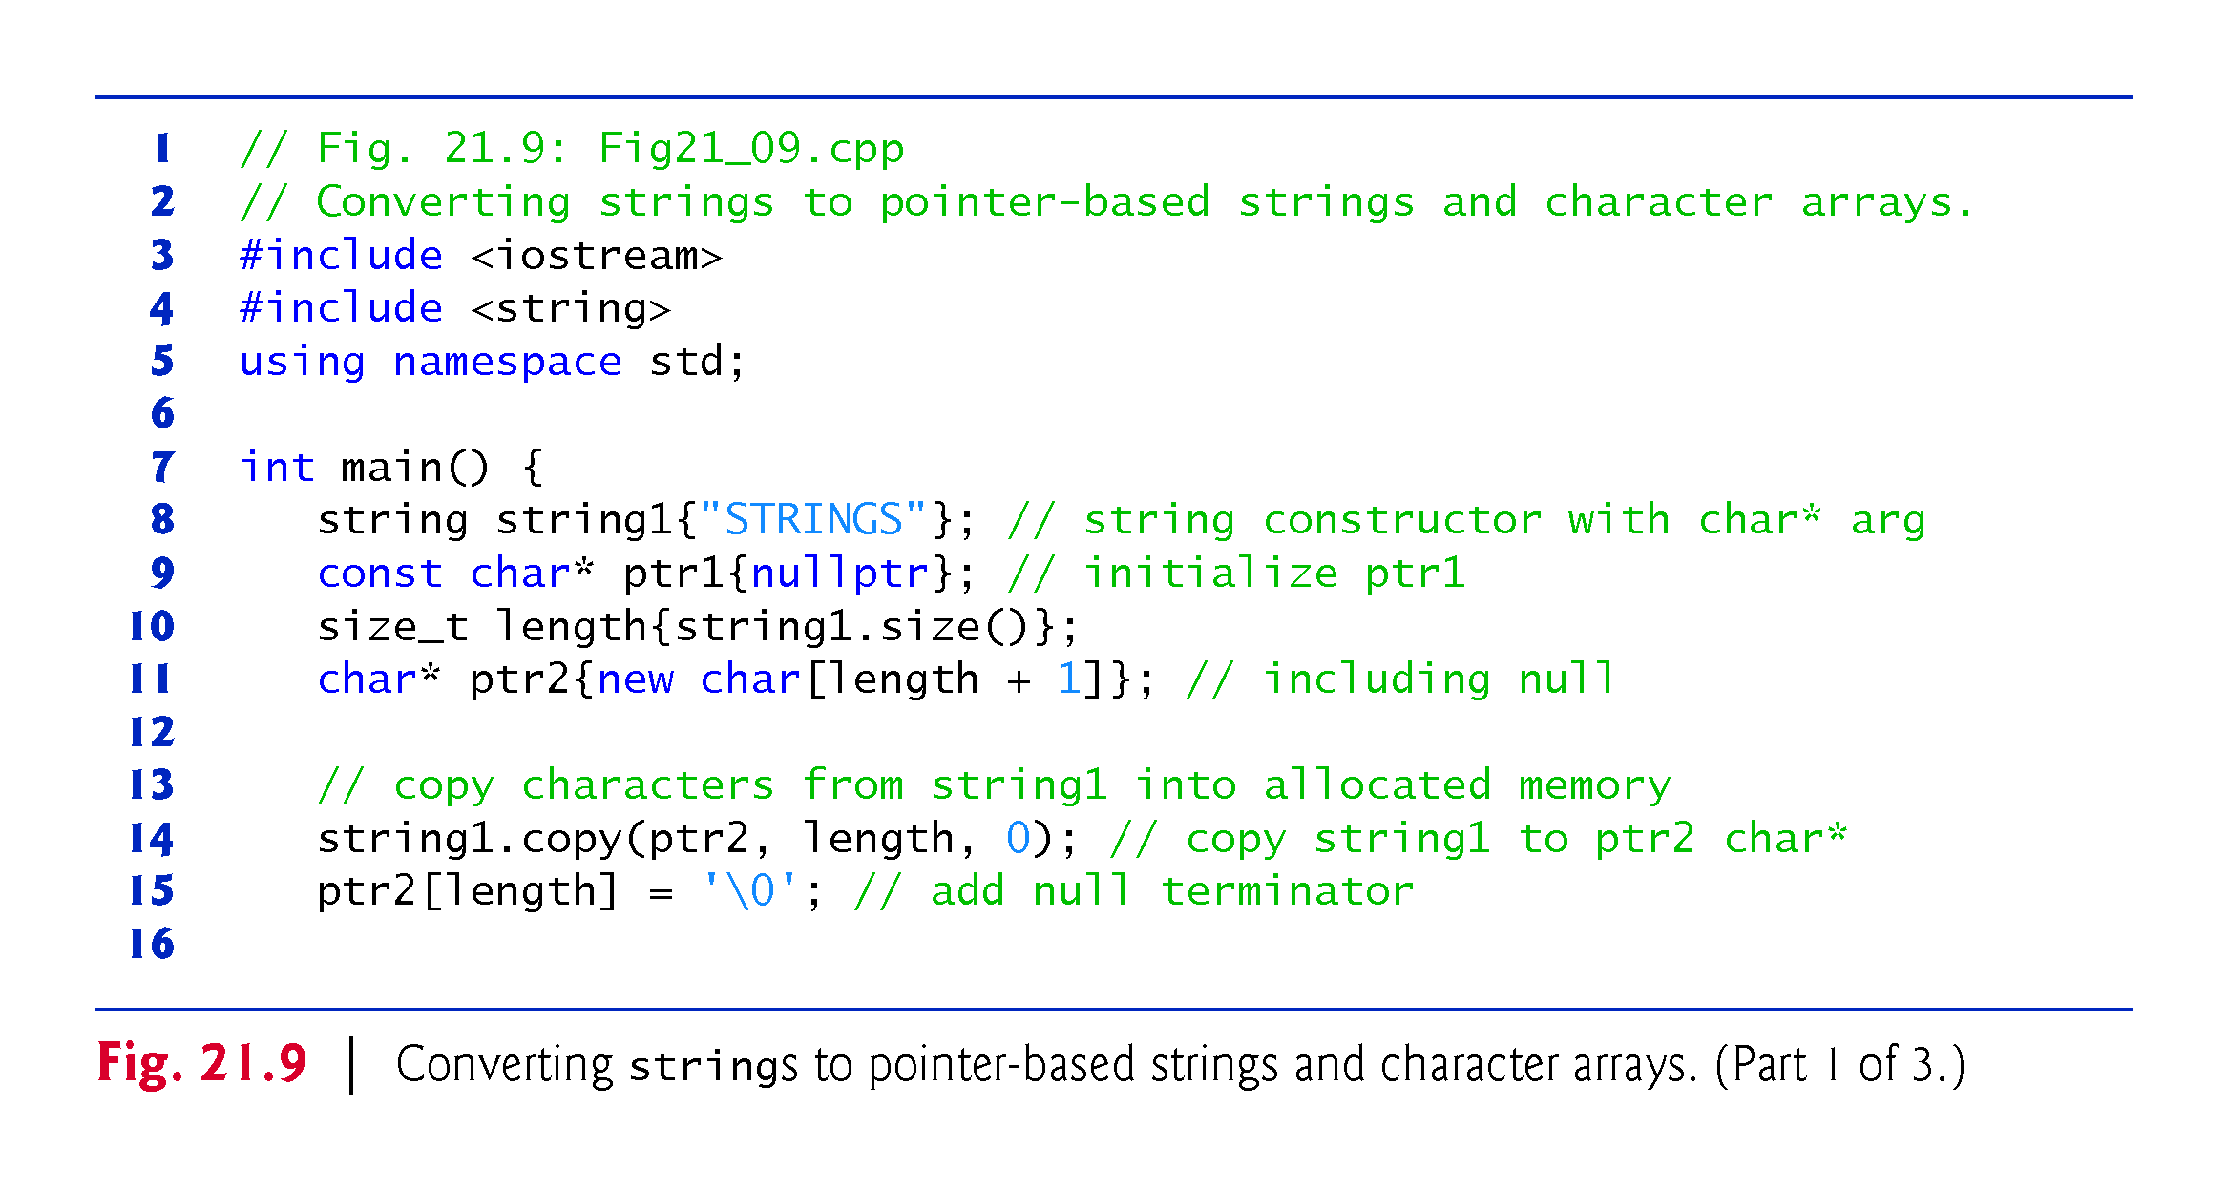

Slide 66
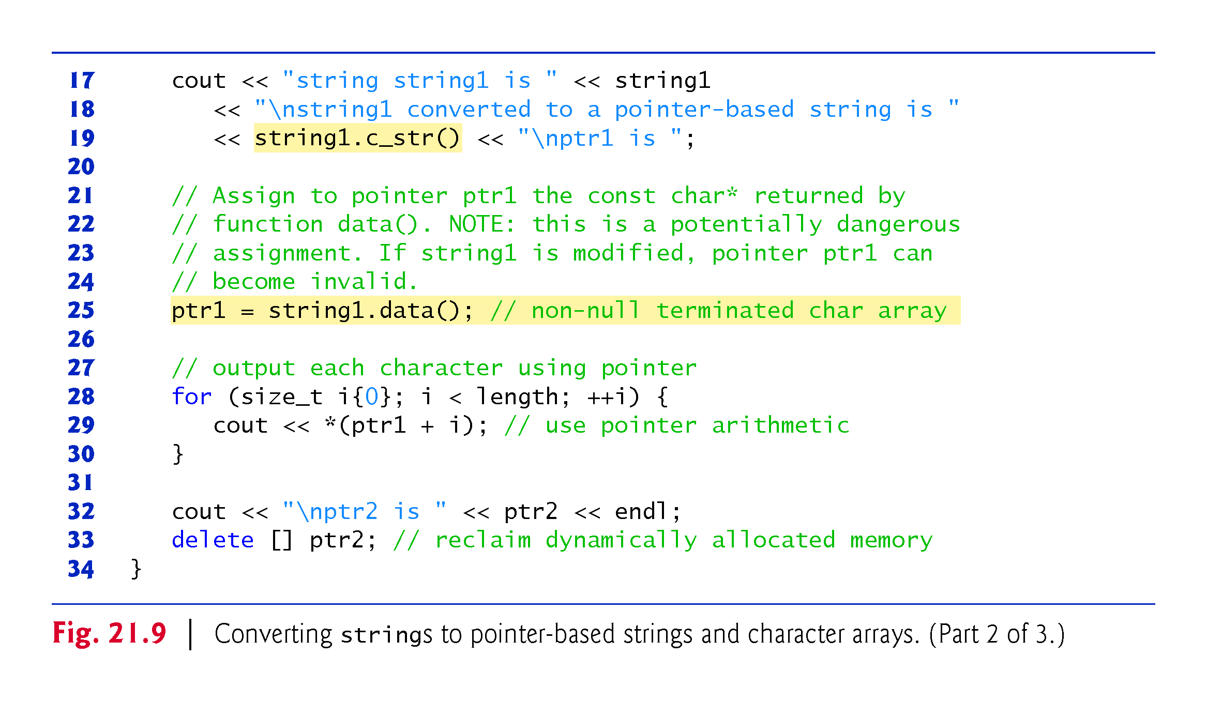

Slide 67
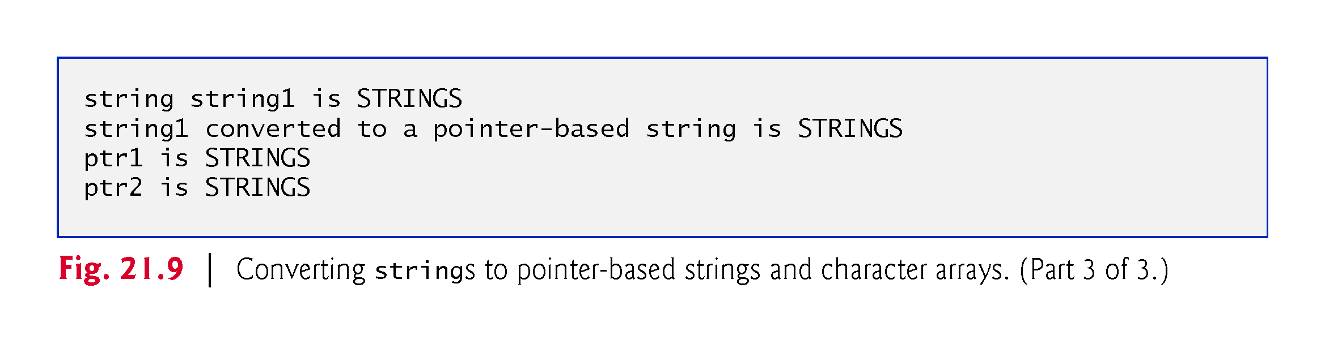

Slide 68
21.10 Conversion to Pointer-Based char* Strings (cont.)
Line 14 uses string member function copy to copy object string1 into the char array pointed to by ptr2.
Line 15 places a terminating null character in the array pointed to by ptr2.
Line 19 uses function c_str to obtain a const char* that points to a null terminated pointer-based string with the same content as string1.
The pointer is passed to the stream insertion operator for output.

Slide 69
21.10 Conversion to Pointer-Based char* Strings (cont.)
Line 25 assigns the const char* ptr1 a pointer returned by class string member function data.
This member function returns a non-null-terminated built-in character array.
We do not modify string string1 in this example.
If string1 were to be modified (e.g., the string’s dynamic memory changes its address due to a member function call such as string1.insert(0, "abcd");), ptr1 could become invalid—which could lead to unpredictable results.
Lines 28–30 use pointer arithmetic to output the character array pointed to by ptr1.
In lines 32–33, the pointer-based string ptr2 is output and the memory allocated for ptr2 is deleted to avoid a memory leak.

Slide 70
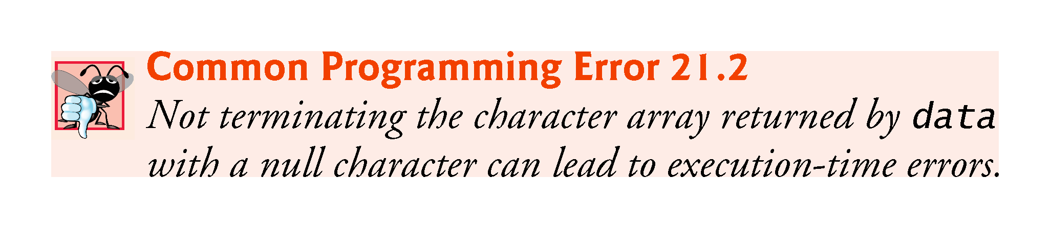

Slide 71
21.13 Iterators
Class string provides iterators (introduced in Chapter 15) for forward and backward traversal of strings.
Iterators provide access to individual characters with a syntax that is similar to pointer operations.
Iterators are not range checked.
Figure 21.10 demonstrates iterators.

Slide 72
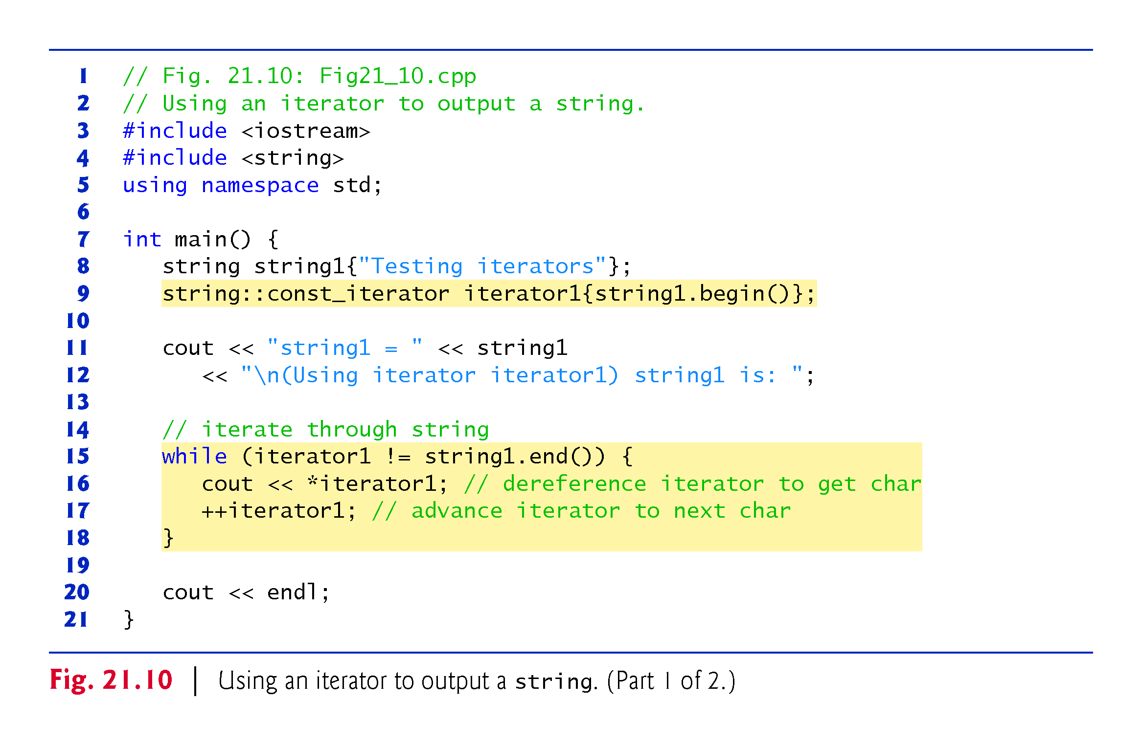

Slide 73
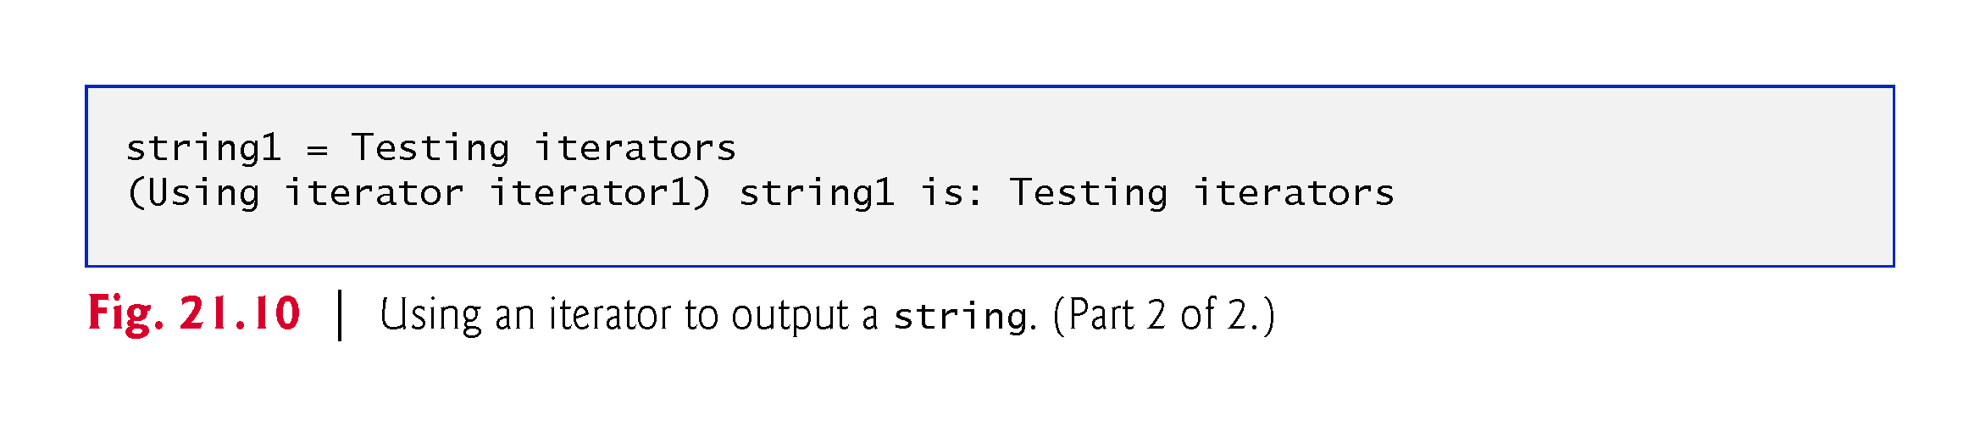

Slide 74
21.13 Iterators (cont.)
Lines 8–9 declare string string1 and string::const_iterator iterator1.
Recall that a const_iterator cannot be used to modify the data that you’re interating through—in this case the string.
Iterator iterator1 is initialized to the beginning of string1 with the string class member function begin.
Two versions of begin exist—one that returns an iterator for iterating through a non-const string and a const version that returns a const_iterator for iterating through a const string.

Slide 75
21.11 Iterators (cont.)
Lines 15–18 use iterator iterator1 to “walk through” string1.
Class string member function end returns an iterator (or a const_iterator) for the position past the last element of string1.
Each element is printed by dereferencing the iterator much as you’d dereference a pointer, and the iterator is advanced one position using operator ++.
In C++11, lines 9 and 15–18 can be replaced with a range-based for, as in
for (char c : string1)
cout << c;

Slide 76
21.11 Iterators (cont.)
Class string provides member functions rend and rbegin for accessing individual string characters in reverse from the end of a string toward the beginning.
Member functions rend and rbegin return reverse_iterators or const_reverse_iterators (based on whether the string is non-const or const).

Slide 77
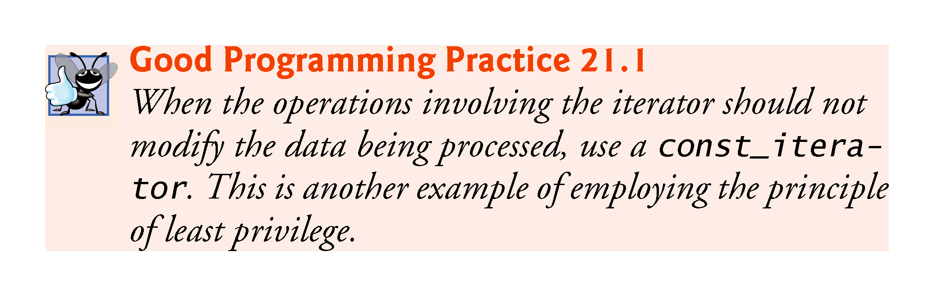

Slide 78
21.12 String Stream Processing
In addition to standard stream I/O and file stream I/O, C++ stream I/O includes capabilities for inputting from, and outputting to, strings in memory.
These capabilities often are referred to as in-memory I/O or string stream processing.
Input from a string is supported by class istringstream.
Output to a string is supported by class ostringstream.

Slide 79
21.12 String Stream Processing (cont.)
The class names istringstream and ostringstream are actually aliases defined by the typedefs
typedef basic_istringstream< char > istringstream; typedef basic_ostringstream< char > ostringstream;
Class templates basic_istringstream and basic_ostringstream provide the same functionality as classes istream and ostream plus other member functions specific to in-memory formatting.
Programs that use in-memory formatting must include the <sstream> and <iostream> headers.

Slide 80
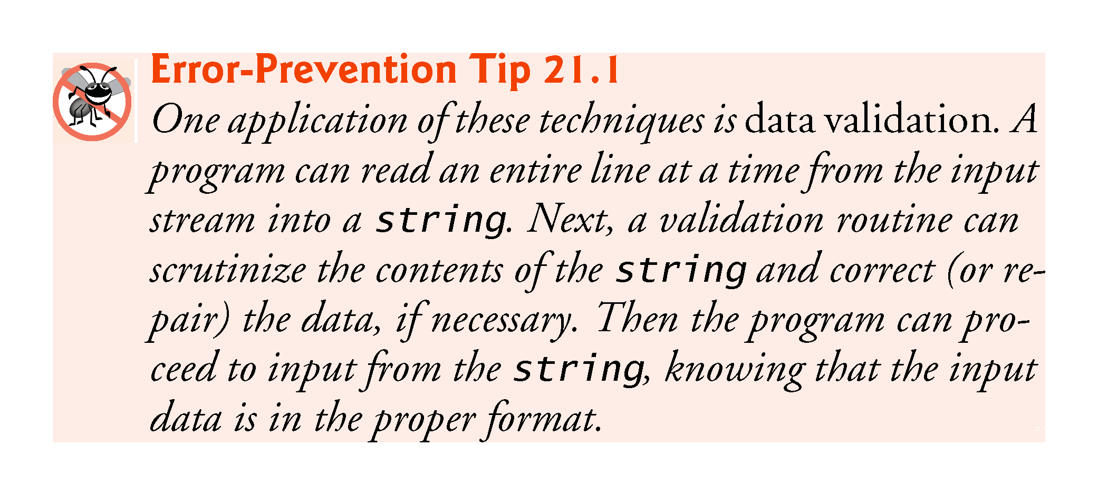

Slide 81
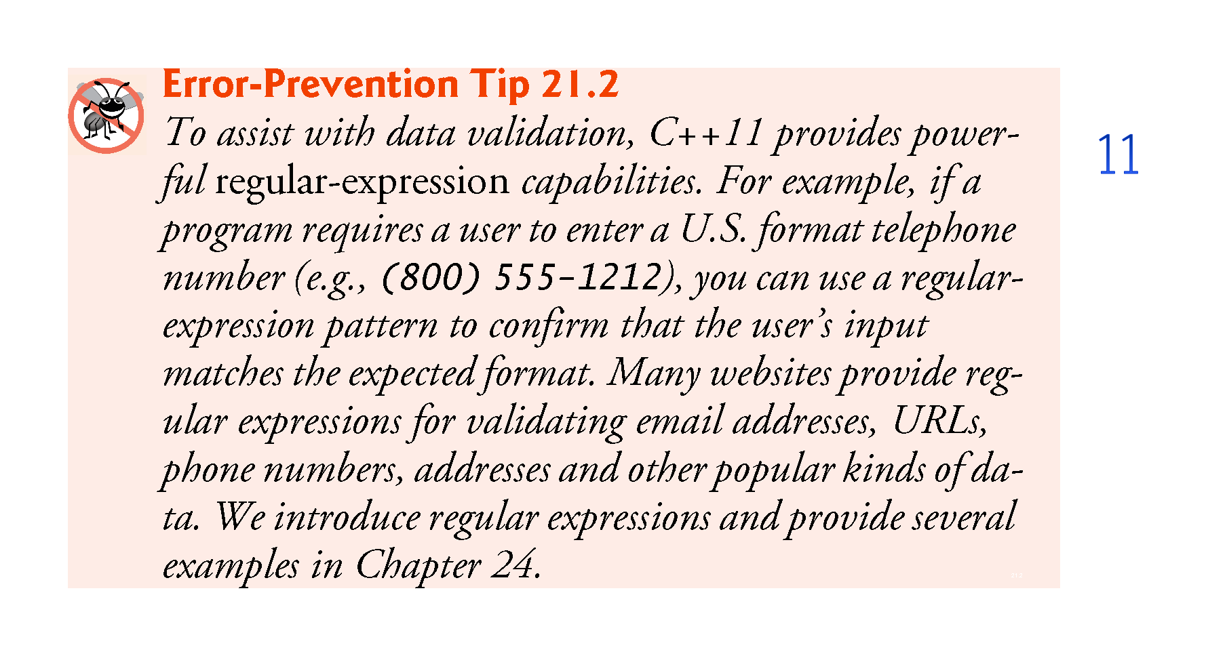

Slide 82
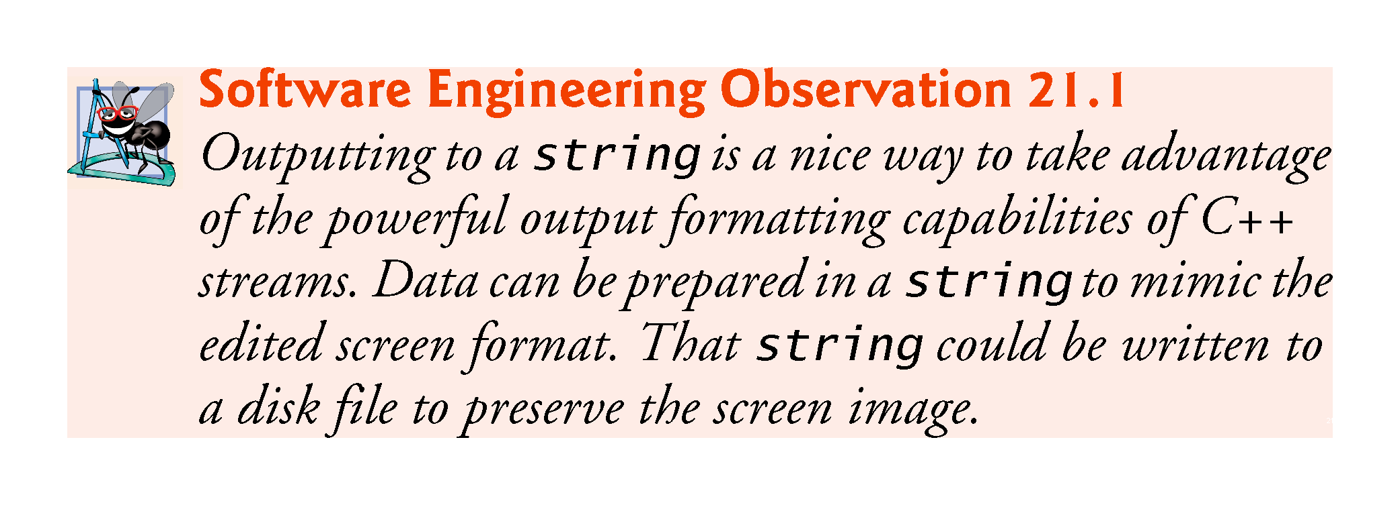

Slide 83
21.12 String Stream Processing (cont.)
An ostringstream object uses a string object to store the output data.
The str member function of class ostringstream returns a copy of that string.

Slide 84
21.12 String Stream Processing (cont.)
Demonstrating ostringstream
Figure 21.11 demonstrates an ostringstream object.
The program creates ostringstream object outputString (line 9) and uses the stream insertion operator to output a series of strings and numerical values to the object.

Slide 85
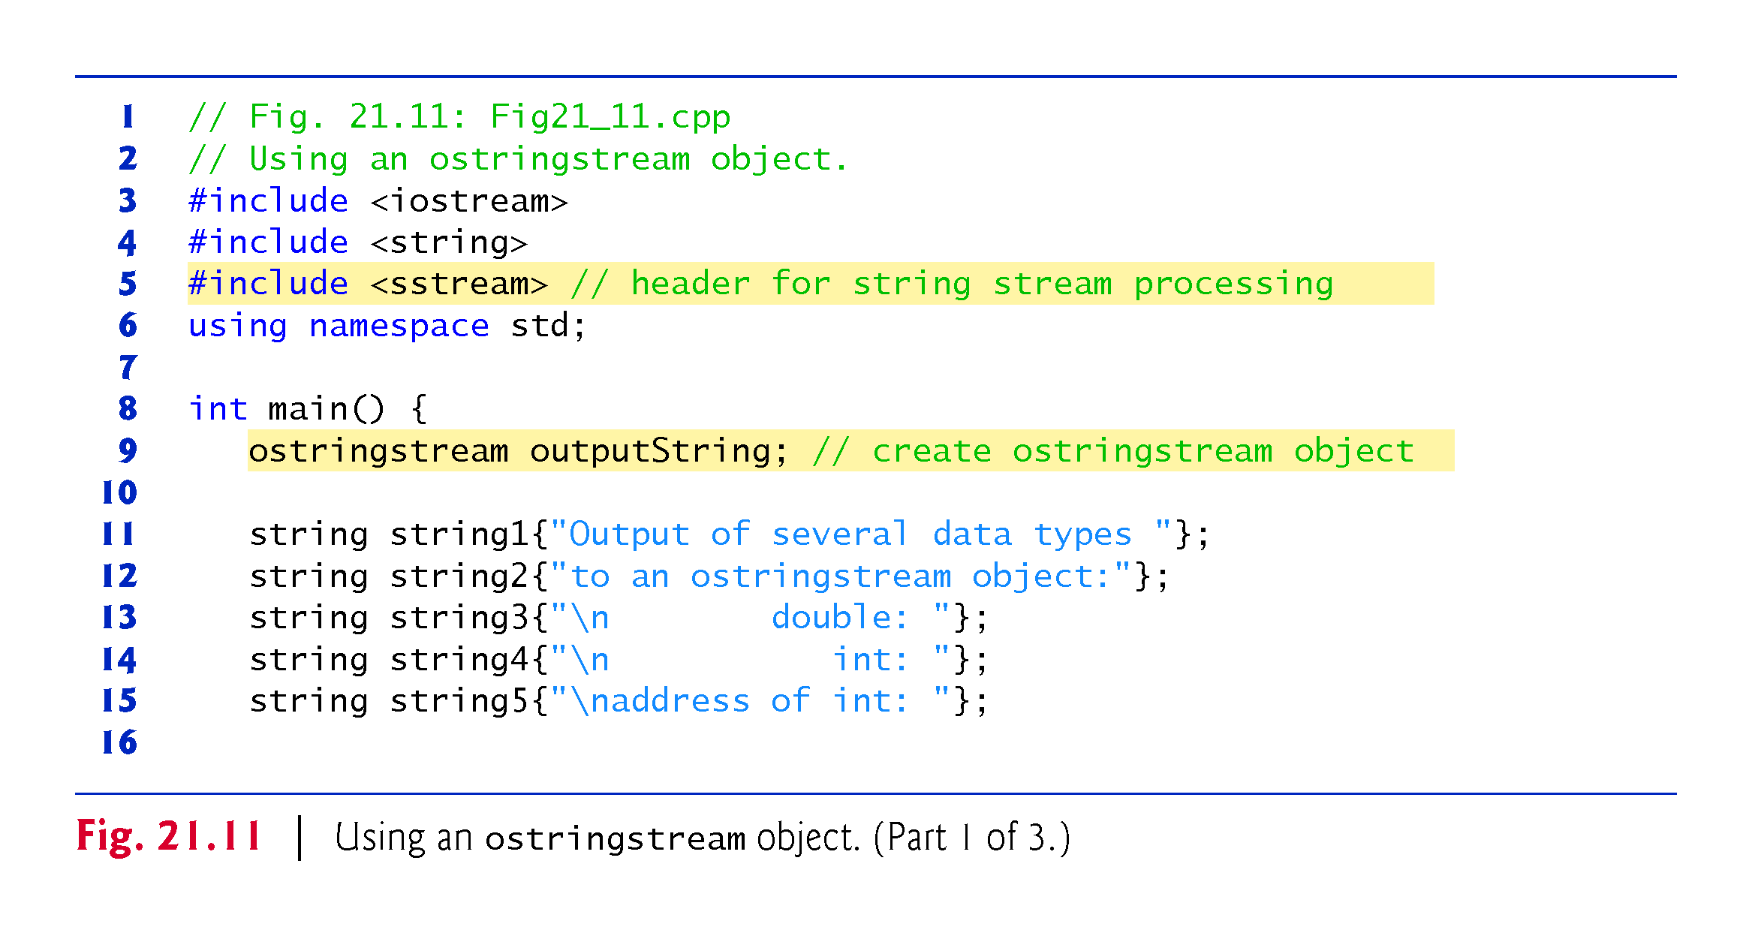

Slide 86
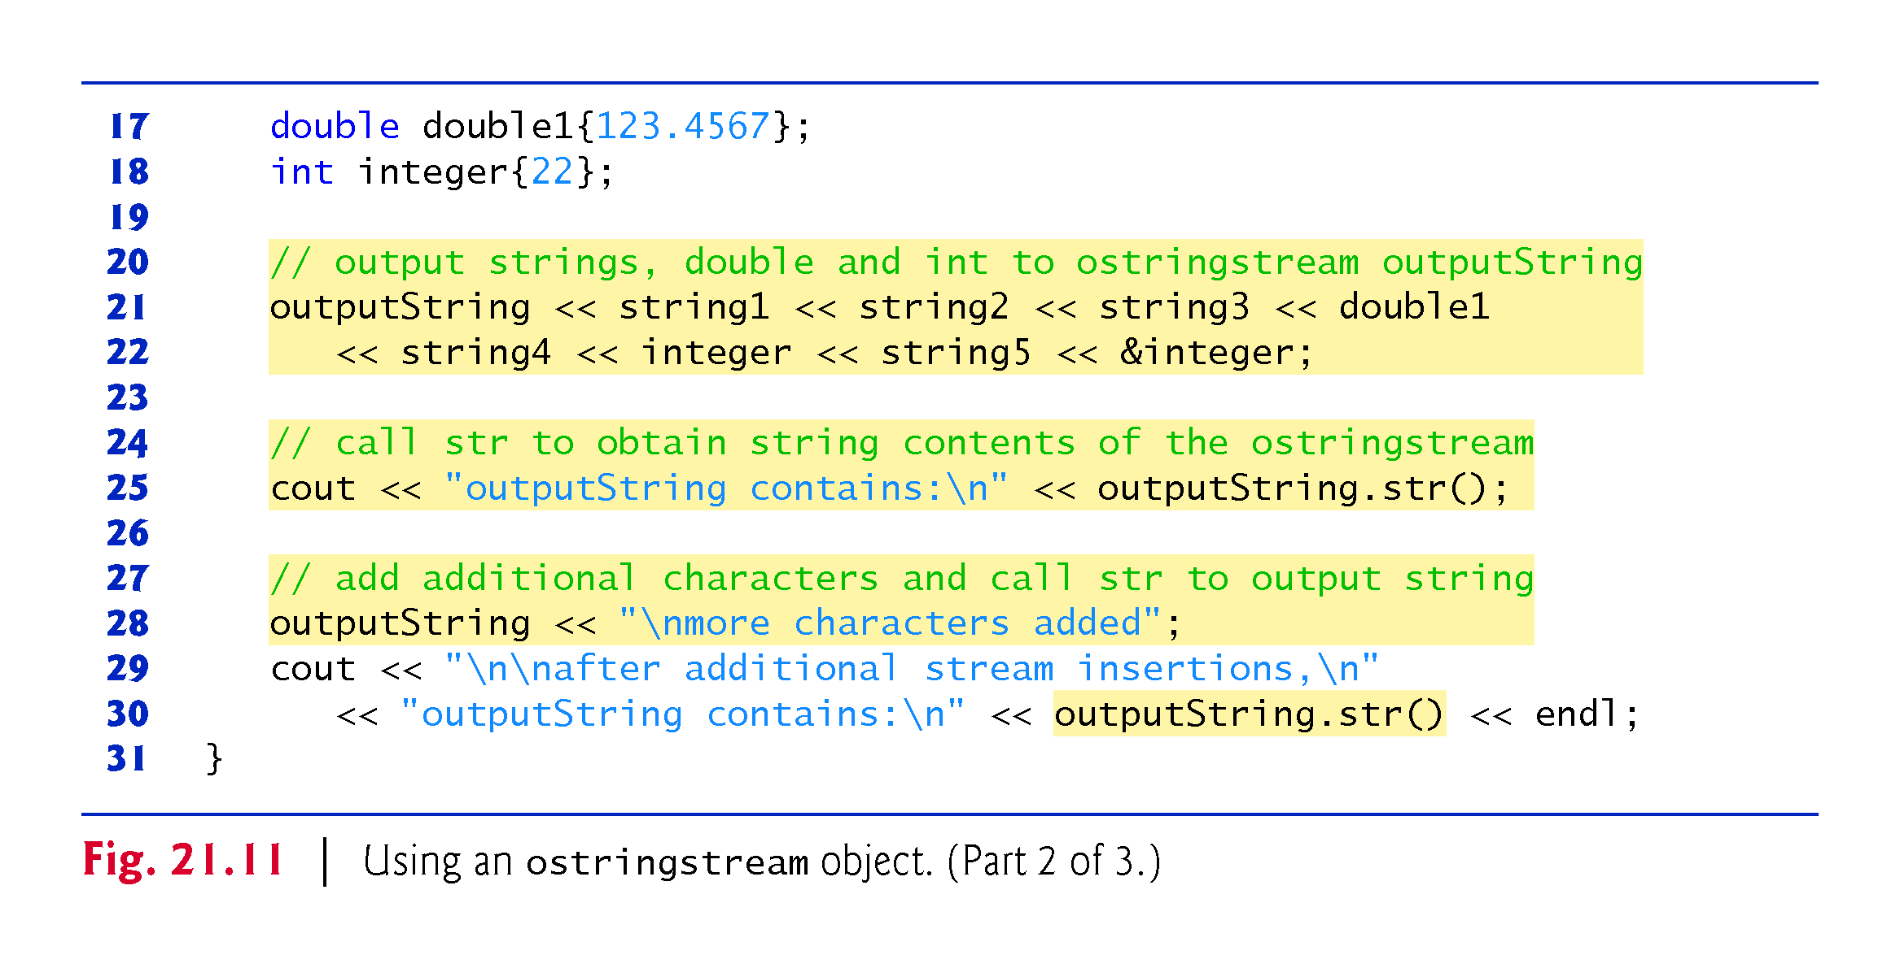

Slide 87
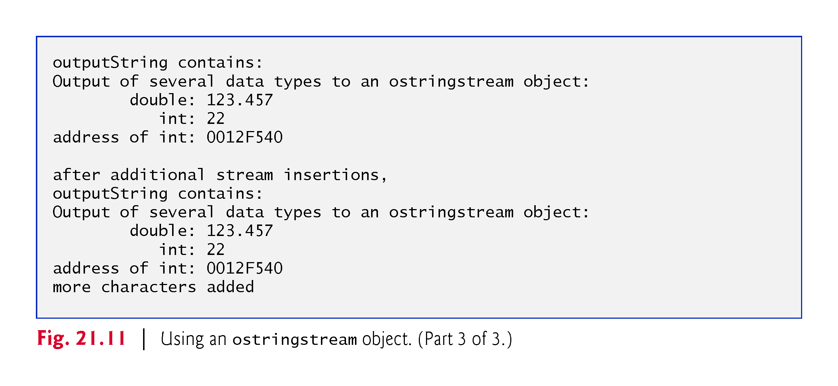

Slide 88
21.14 String Stream Processing (cont.)
Lines 21–22 output string string1, string string2, string string3, double double1, string string4, int integer, string string5 and the address of int integer—all to outputString in memory.
Line 25 uses the stream insertion operator and the call outputString.str() to display a copy of the string created in lines 21–22.
Line 28 demonstrates that more data can be appended to the string in memory by simply issuing another stream insertion operation to outputString.

Slide 89
21.12 String Stream Processing (cont.)
An istringstream object inputs data from a string in memory to program variables.
Data is stored in an istringstream object as characters.
Input from the istringstream object works identically to input from any file.
The end of the string is interpreted by the istringstream object as end-of-file.

Slide 90
21.12 String Stream Processing (cont.)
Demonstrating istringstream
Figure 21.12 demonstrates input from an istringstream object.

Slide 91
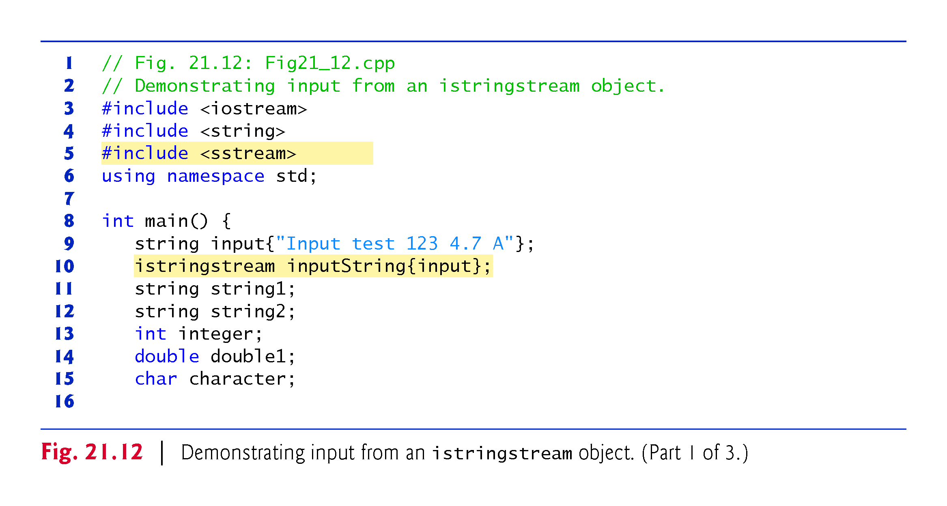

Slide 92
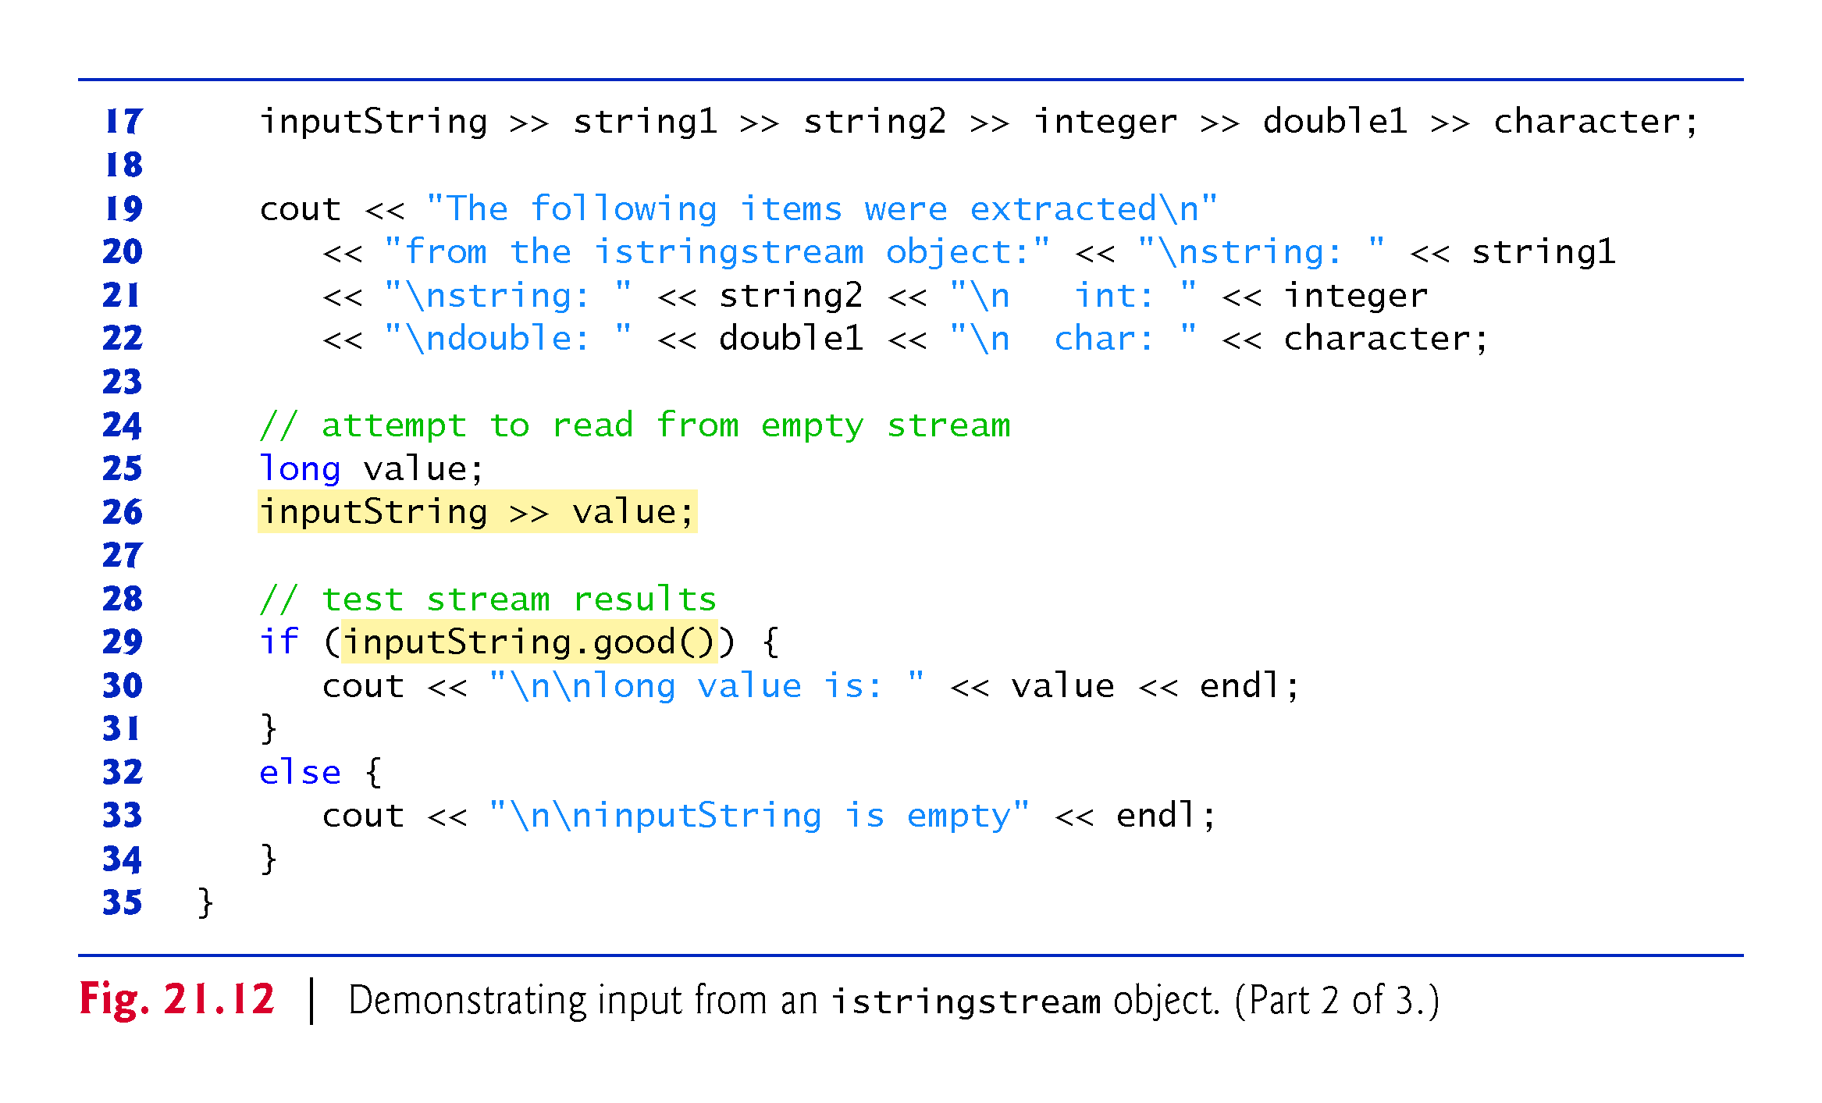

Slide 93
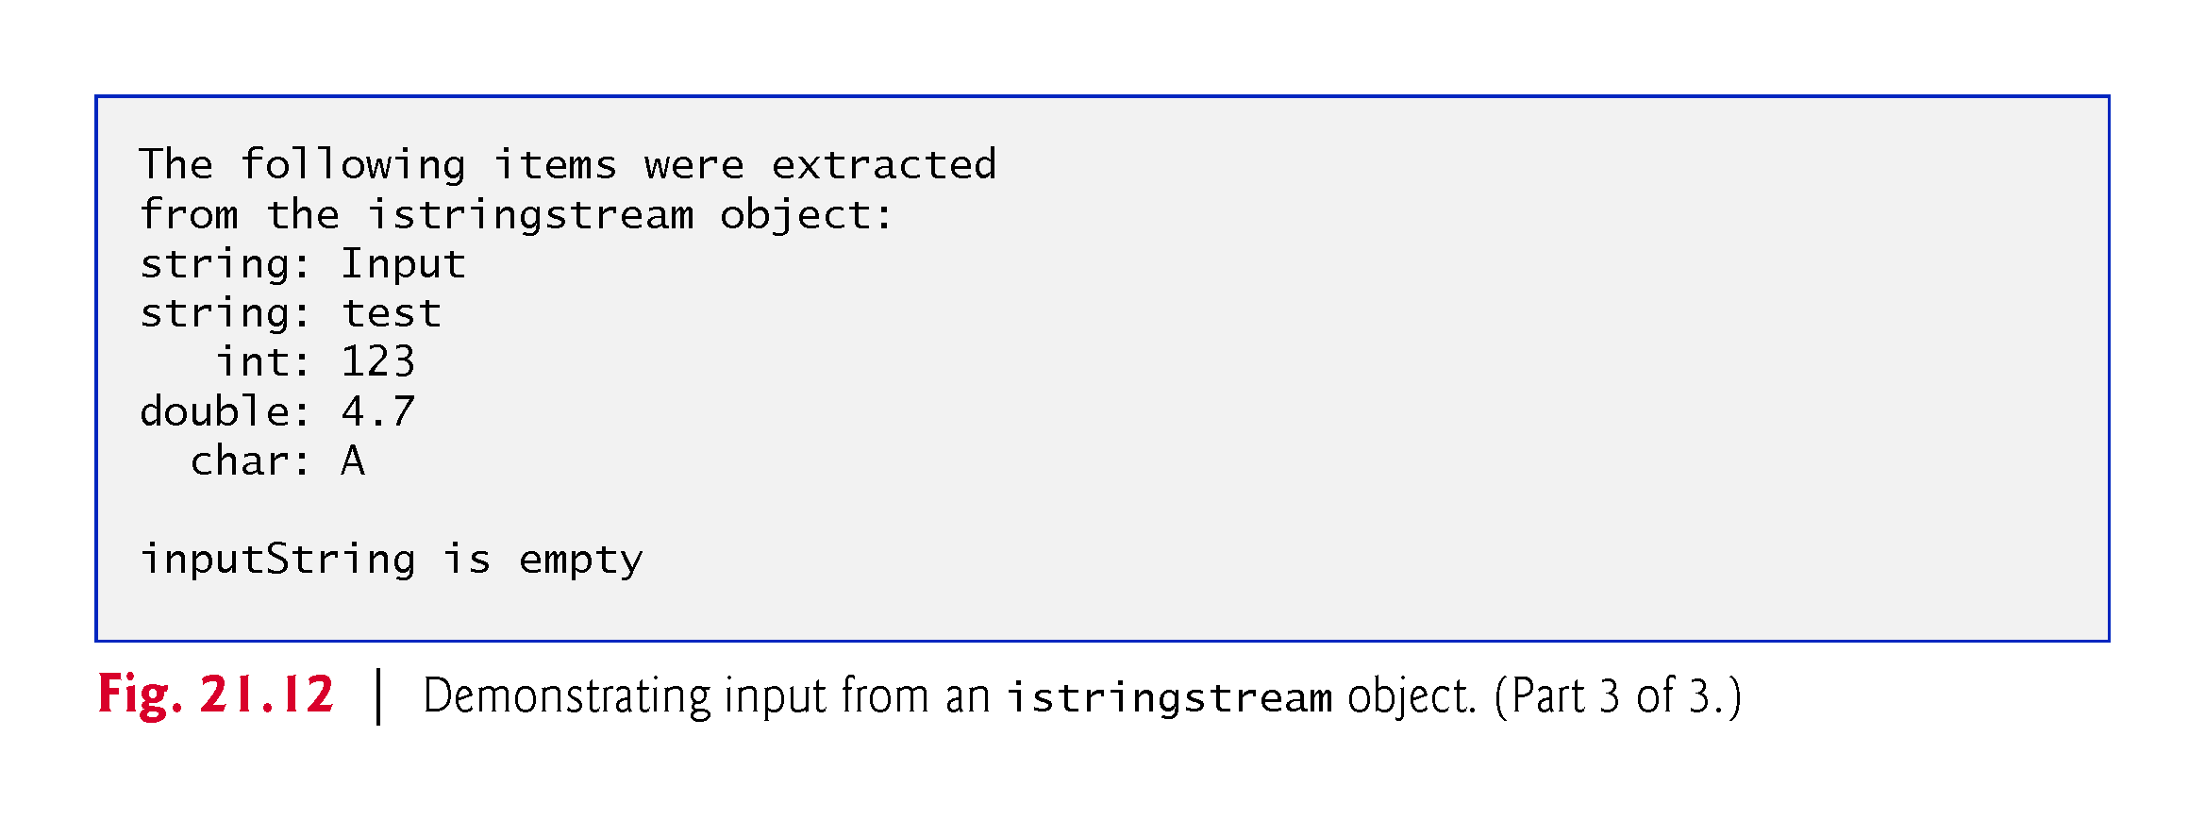

Slide 94
21.12 String Stream Processing (cont.)
Lines 9–10 create string input containing the data and istringstream object inputString constructed to contain the data in string input.
The string input contains the data
Input test 123 4.7 A
which, when read as input to the program, consist of two strings ("Input" and "test"), an int (123), a double (4.7) and a char ('A').
These characters are extracted to variables string1, string2, integer, double1 and character in line 17.

Slide 95
21.12 String Stream Processing (cont.)
The program attempts to read from inputString again in line 26.
The if condition in line 29uses function good (Section 13.8) to test if any data remains.
Because no data remains, the function returns false and the else part of the if…else statement is executed.

Slide 96
21.13 C++11 Numeric Conversion Functions
C++11 now contains functions for converting from numeric values to strings and from strings to numeric values.
Though you could previously perform such conversions using other techniques, the functions presented in this section were added for convenience.

Slide 97
21.13 C++11 Numeric Conversion Functions (cont.)
Converting Numeric Values to string Objects
C++11’s to_string function (from the <string> header) returns the string representation of its numeric argument.
The function is overloaded for types int, unsigned int, long, unsigned long, long long, unsigned long long, float, double and long double.

Slide 98
21.13 C++11 Numeric Conversion Functions (cont.)
Converting string Objects to Numeric Values
C++11 provides eight functions (Fig. 21.13; from the <string> header) for converting string objects to numeric values.
Each function attempts to convert the beginning of its string argument to a numeric value.
If no conversion can be performed, each function throws an invalid_argument exception.
If the result of the conversion is out of range for the function’s return type, each function throws an out_of_range exception.

Slide 99
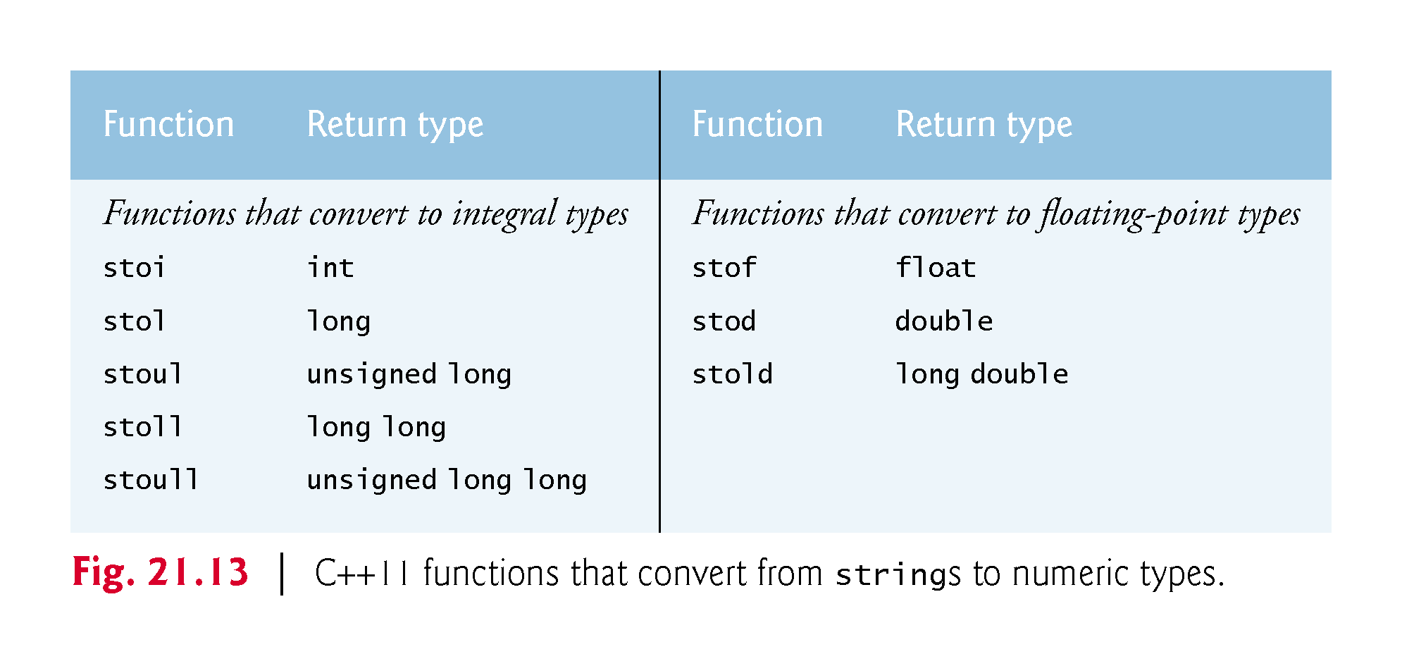

Slide 100
21.13 C++11 Numeric Conversion Functions (cont.)
Functions That Convert strings to Integral Types
Consider an example of converting a string to an integral value.
Assuming the string:
string s("100hello");
the following statement converts the beginning of the string to the int value 100 and stores that value in convertedInt:
int convertedInt = stoi(s);
Each function that converts a string to an integral type actually receives three parameters—the last two have default arguments.

