Slide 1
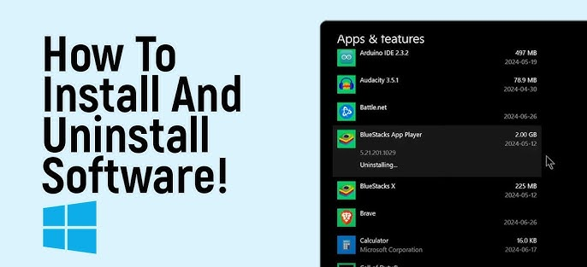
Pre-requisites

Slide 2
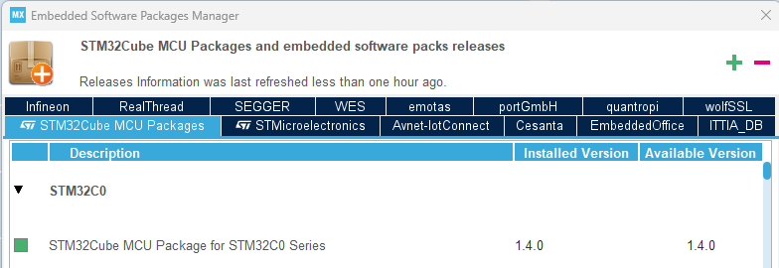
Pre-requisites
Visual Studio code version 1.117.0 or latest Download Visual Studio Code - Mac, Linux, Windows
STM32CubeMX version 6.17 or latest STM32CubeMX - STM32Cube initialization code generator - STMicroelectronics
STM32CubeC0 Firmware Package version 1.4.0 STM32CubeC0 | Product - STMicroelectronics or in STM32CubeMX, go to HELP -> Manage embedded software packages and install the latest version of STM32Cube MCU Package for STM32C0 Series (1.4.0)

