Slide 1
TITLE
Cloud Commitment Sizing:
Initial Review
Agentic AI accelerated workflow
business-first, explicit confidence level and human-in-loop review
Andres Rogers
Senior Data Scientist

Slide 2
GOAL
Goal: The Challenge
• We are given anonymized AWS cost and usage data for one organization with multiple linked accounts.
• The challenge is to understand how the organization uses cloud resources and how much it currently saves through discounts and commitments.
• We need to evaluate whether current commitments are well sized, underused, or leaving savings opportunities unused.
• The analysis must separate real savings from waste, incomplete months, and billing artifacts.
• The final goal is to recommend a defensible commitment strategy and explain what evidence supports it.
Confidence: strong on mechanics, medium on product-risk framing | Source: repo_report.md

Slide 3
PROBLEM
Problem: commitment sizing is a coverage-versus-waste tradeoff
• [Strong] Commit too little and discounts are left on the table; commit too much and idle hours become waste.
• [Strong] Commitments allocate hour by hour to eligible usage; unused commitment is use-it-or-lose-it.
• [Strong] Spot, coverage, utilization, waste, and net savings must stay separate.
• [Medium] The product choice is risk tolerance under changing usage, not just optimizer output.
Confidence: strong on mechanics, medium on product-risk framing | Source: repo_report.md

Slide 4
METHOD
Approach: AI-generated breadth, human-reviewed confidence
• [Strong] Scope is one organization with 42 linked accounts, 20.9M usage rows, and 10,955 pricing rows.
• [Strong] Headlines use complete months 2025-07 through 2026-05; partial 2026-06 is excluded.
• [Strong] AI produced repeatable scripts, plots, tables, methodologies, and ledgers for each challenge.
• [Medium] Human review bounded definitions, anomalies, windows, and recommendation risk.
Confidence: medium | Ledger basis: reproducible outputs checked; domain judgment still required

Slide 5
APPENDIX
Understanding ledger: where confidence is strong versus weak
• [Strong] Verified: formulas, complete-period windows, hourly allocation, and coverage/utilization denominators.
• [Medium] Trusted after checks: DuckDB aggregates, repeated breakpoint sweeps, CSV exports, and plot rendering.
• [Preliminary] Still weak: future usage stability, business risk appetite, and exact comparison scope for current posture.
• [Needs review] Next human decision: choose acceptable downside risk before buying more commitment.
Confidence: mixed by claim | Ledger basis: explicit verified/trusted/unsure sections

Slide 6
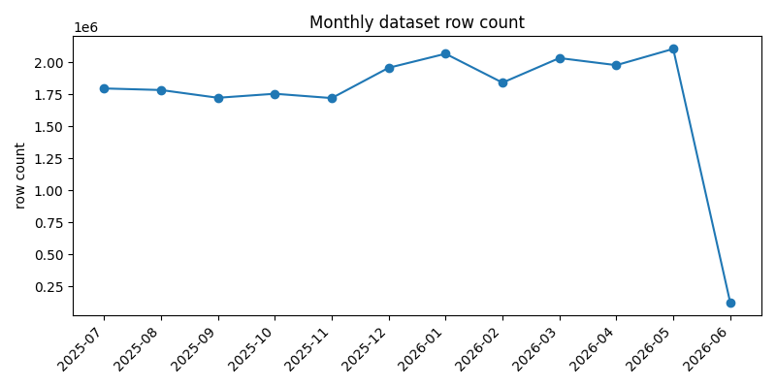
DATA SNAPSHOT
Challenge 0: dataset is usable, with one visible artifact
• [Strong] 20.9M usage rows and 10,955 pricing rows were profiled with no fatal readiness issue (no duplicates, extreme outliers, impossible values).
• [Strong] Complete periods are 2025-07 through 2026-05; 2026-06 is partial.
• [Strong] The 13 off-hour rows are all Unused Commitment rows and preserve original source timestamps.
• [Medium] Data readiness checks are structural; they do not prove every row is semantically or numerically perfect.
The 13 row normalization changed timestamp buckets only, not economics.
Confidence: medium | Ledger basis: schema/hour checks verified; deeper business rules may be needed

Slide 7
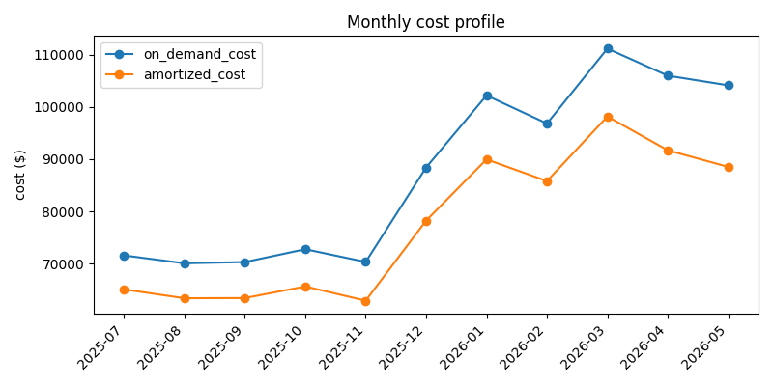
DATA SNAPSHOT
Challenge 0: monthly growth has a positive trend
• [Strong] Current strategy is better than on-demand cost, generating savings.
• [Strong] total compute demand increased after 2025-12, stabilizing around a new regime.
Confidence: medium | Ledger basis: schema/hour checks verified; deeper business rules may be needed

Slide 8
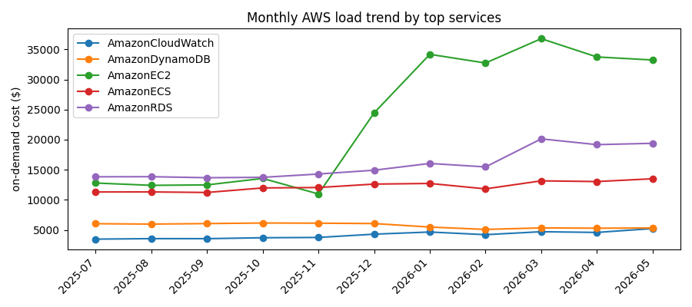
DATA SNAPSHOT
Challenge 0: biggest change in demand comes from EC2
• [Strong] The biggest jump was on EC2 (VMs) demand
The 13 row normalization changed timestamp buckets only, not economics.
Confidence: medium | Ledger basis: schema/hour checks verified; deeper business rules may be needed

Slide 9
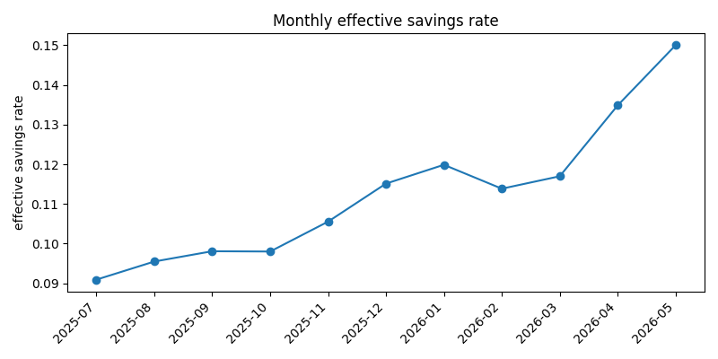
CHART INSIGHT
Challenge 1: current all-in savings are real but incomplete
• [Strong] Complete-month savings are $111.0k, or 11.52% of $963.8k on-demand equivalent.
• [Strong] Commitment discount contributes $105.8k; Spot adds $6.9k.
• [Strong] $7.0k of unused commitment waste is included instead of hidden.
• [Medium] Stability outside the 2025-07 to 2026-05 complete-month window is not proven here.
Table backup: output/challenge_01/tables/effective_savings_by_service.csv
Confidence: medium | Ledger basis: formula and reconciliation verified; alternate windows not tested

Slide 10
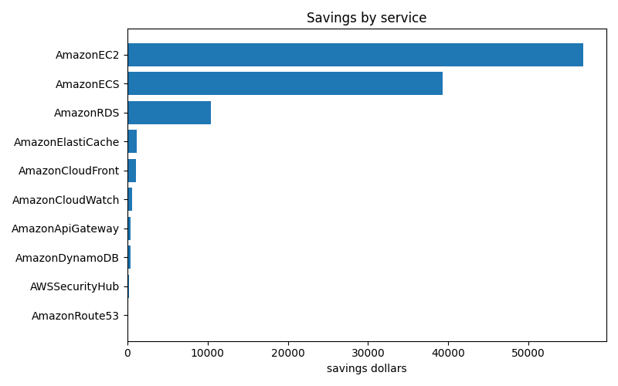
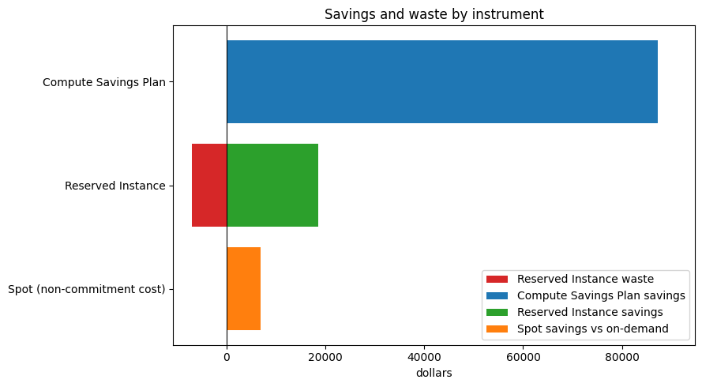
CHART INSIGHT
Challenge 1: savings by instrument
Confidence: medium | Ledger basis: formula and reconciliation verified; alternate windows not tested

Slide 11
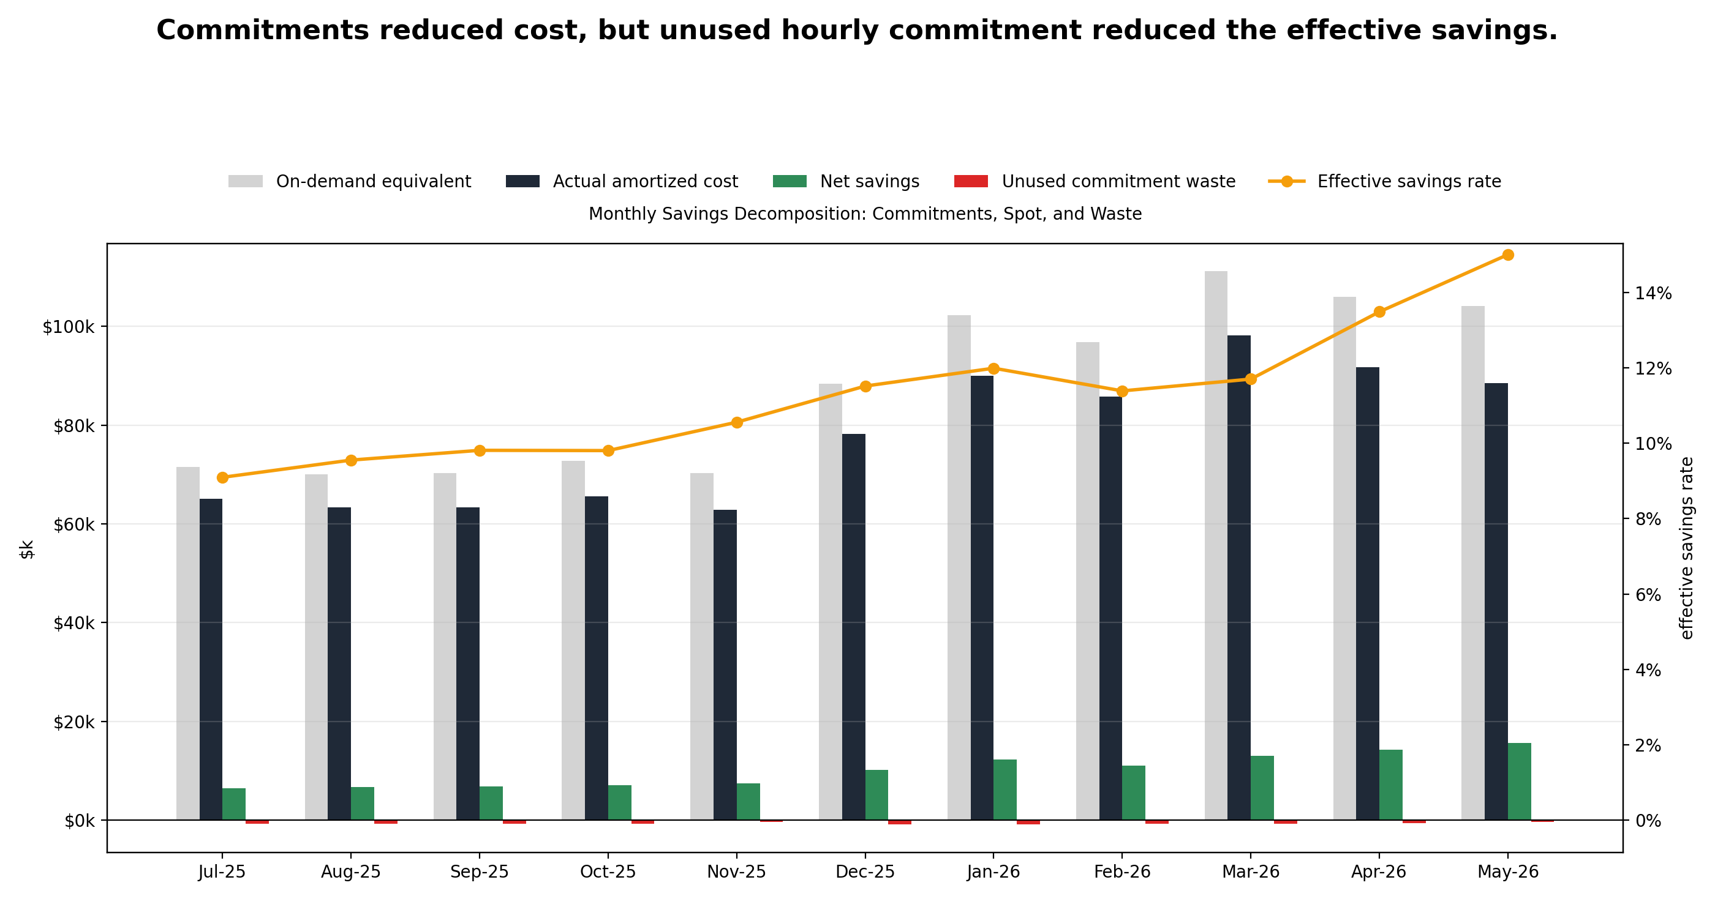
CHART INSIGHT
Challenge 1: monthly commitments
Confidence: medium | Ledger basis: formula and reconciliation verified; alternate windows not tested

Slide 12
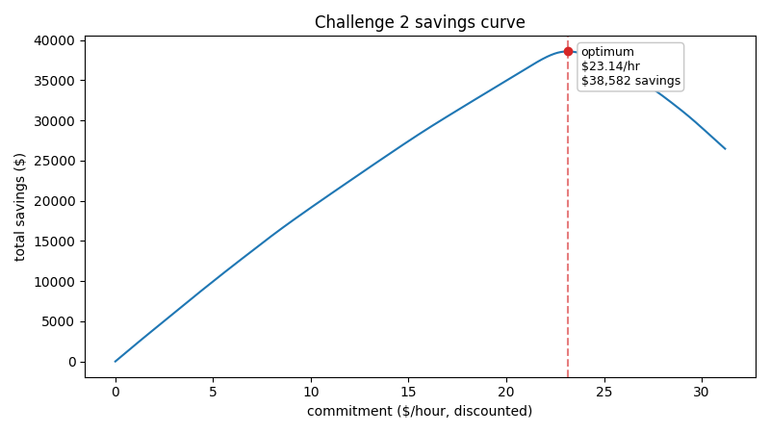
CHART INSIGHT
Challenge 2: recent 3-month math optimum is high and efficient
• [Strong] Recent-window optimum is $23.14/hour discounted commitment.
• [Strong] Modeled savings are $38.6k with 94.1% coverage and 99.4% utilization.
• [Strong] Waste at the optimum is small but nonzero: $300 over 2,208 hours.
• [Medium] Future representativeness of the latest three complete months remains the main uncertainty.
Table backup: output/challenge_02/tables/commitment_options.csv
Confidence: medium | Ledger basis: optimizer mechanics verified; future demand unresolved

Slide 13
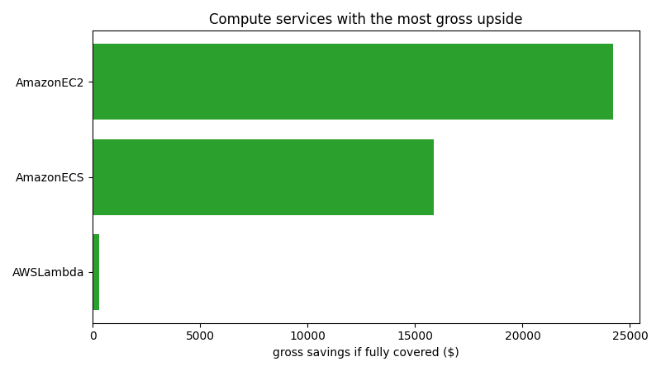
CHART INSIGHT
Challenge 2: recent 3-month biggest gross upside
• [Strong] Biggest savings could be achieved on EC2 and ECS commitments
Table backup: output/challenge_02/tables/commitment_options.csv
Confidence: medium | Ledger basis: optimizer mechanics verified; future demand unresolved

Slide 14
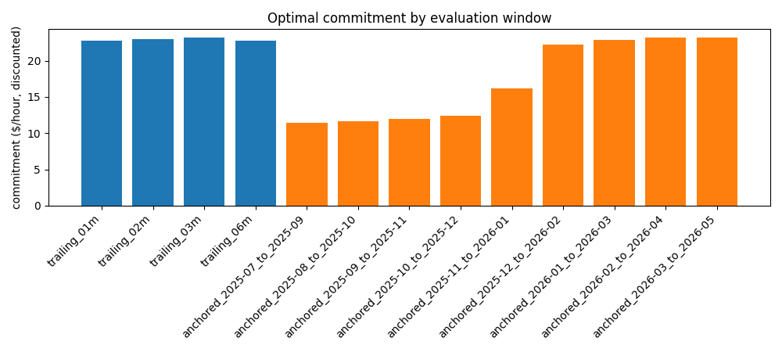
CHART INSIGHT
Challenge 3: the answer changes materially by time window
• [Strong] Optimal commitment spread is $11.71/hour across evaluated windows.
• [Medium] The recommended sizing rule is the most recent 3 complete months.
• [Strong] Discounted compute spend jumped 50.1% around 2025-12.
• [Preliminary] If the account is mid-migration, a broader or different planning window may be better.
Table backup: output/challenge_03/tables/window_sensitivity.csv
Confidence: medium | Ledger basis: repeated optimizer verified; planning cadence unknown

Slide 15
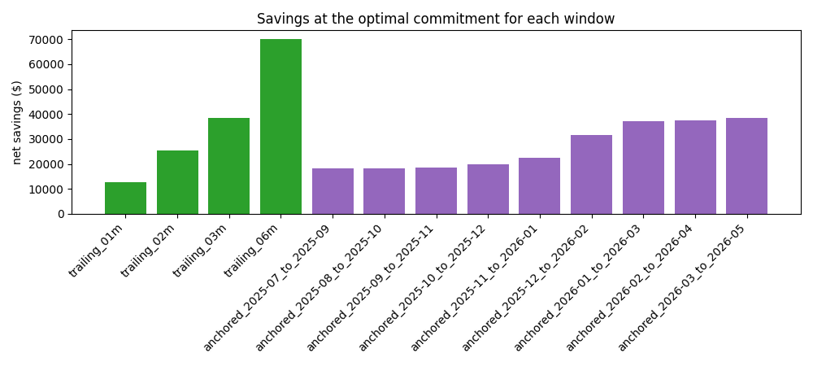
CHART INSIGHT
Challenge 3: savings by time window
Confidence: medium | Ledger basis: repeated optimizer verified; planning cadence unknown

Slide 16
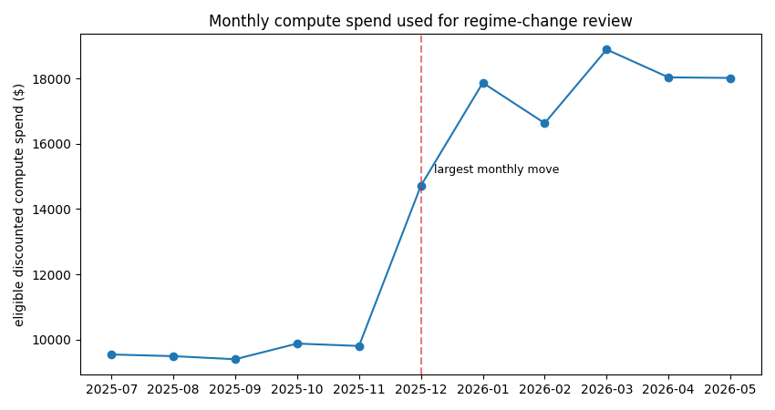
CHART INSIGHT
Challenge 3: regime change
Confidence: medium | Ledger basis: repeated optimizer verified; planning cadence unknown

Slide 17
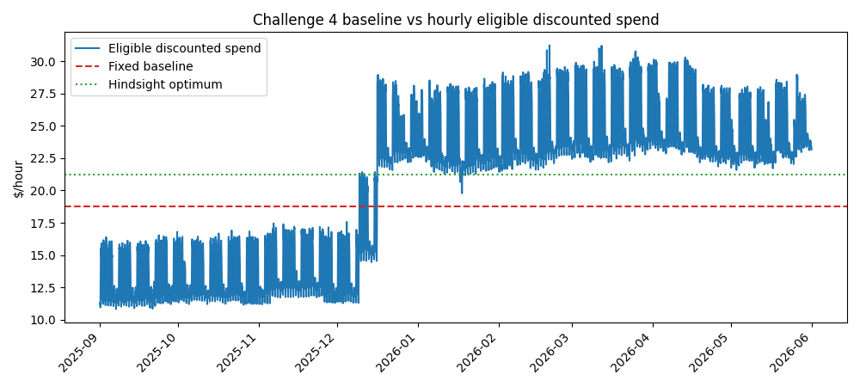
CHART INSIGHT
Challenge 4: old baseline was close on savings, but demand changed
• [Strong] 2025-08 baseline commitment was $18.77/hour.
• [Strong] Baseline saved $70.1k versus $70.5k for the hindsight optimum; gap was $343.
• [Strong] Baseline still created $13.3k of waste and averaged 89.1% utilization.
• [Medium] The exact anchor choice may change details, but not the conservative-baseline lesson.
Table backup: output/challenge_04/tables/baseline_vs_optimal.csv
Confidence: medium | Ledger basis: fixed backtest reconciled; anchor convention uncertain

Slide 18
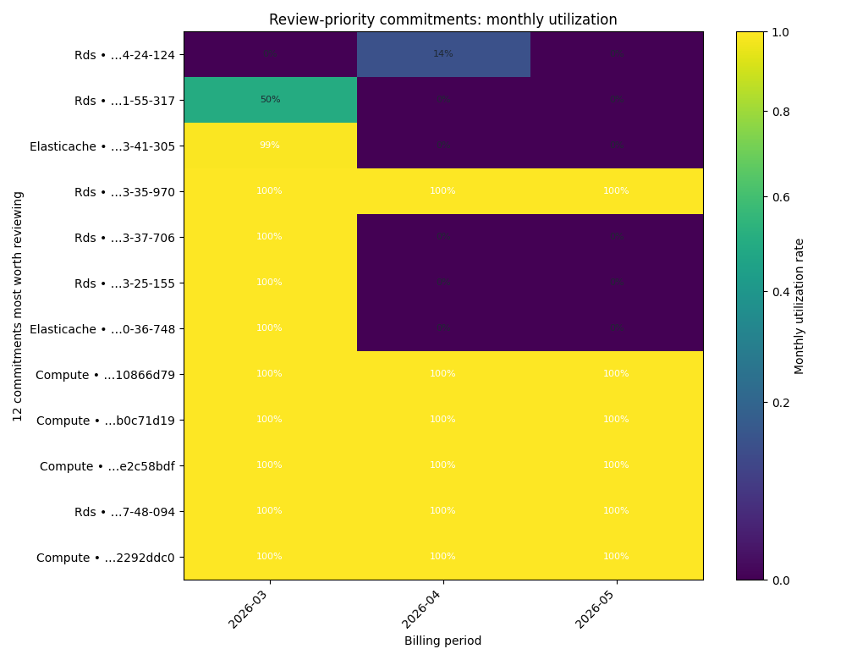
CHART INSIGHT
Challenge 5: current portfolio is mostly used, but under-covered
• [Strong] 29 commitments were observed over the current 3-month audit window.
• [Strong] Portfolio utilization is 97.2% with $1.56k waste, mostly from one RDS RI.
• [Medium] Coverage is only 29.1%; 27 commitments look under-committed and 2 over-committed by the audit rule.
• [Preliminary] Scope-specific commitment logic could refine the under-commitment classification.
Table backup: output/challenge_05/tables/commitment_inventory.csv
Confidence: medium | Ledger basis: inventory reconciled; residual-on-demand proxy is simple

Slide 19
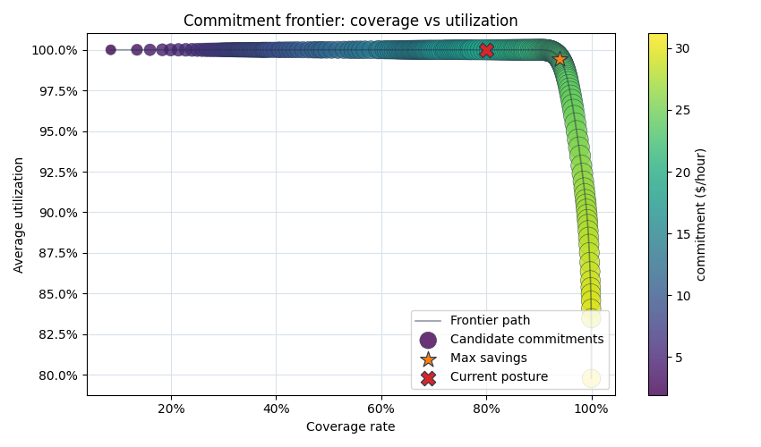
CHART INSIGHT
Challenge 6: frontier supports a controlled increase
• [Strong] Max historical savings point is $23.12/hour for $38.6k savings.
• [Medium] Recommended operating point is $21.51/hour for $37.2k savings.
• [Strong] Current compute posture is $19.46/hour, $33.3k savings, and zero waste in this slice.
• [Medium] Recommendation preserves 100% utilization while capturing most upside, but the 95% rule is a business choice.
Table backup: output/challenge_06/tables/frontier.csv
Confidence: medium | Ledger basis: frontier definitions verified; risk threshold subjective

Slide 20
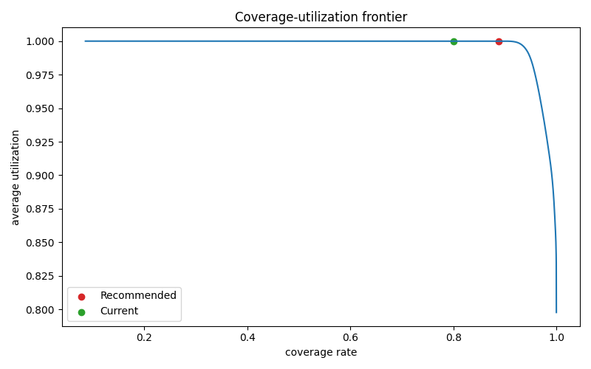
RECOMMENDATION
Recommendation: use $21.51/hour as the decision anchor for now
• [Medium] Move the discussion anchor from $19.46/hour toward $21.51/hour, not immediately to the max point.
• [Strong] Re-run monthly as new complete periods arrive; keep partial months out of headline decisions.
• [Medium] Escalate to $23.12/hour only if stakeholders accept more historical-fit risk for about $1.4k extra modeled upside.
• [Needs review] Treat the model as stale if product plans materially change demand. Recalculate trailing optimum next month.
Close with operating cadence and decision conditions, not one-off certainty.
Confidence: medium | Ledger basis: recommendation is reviewed judgment, not a guaranteed forecast

Slide 21
NEXT STEPS
Main Take-aways
• [Medium] Recommend modest expansion now, not max-at-all-costs. Current compute posture is conservative at about $19.46/h; use $21.51/h as the near-term decision anchor because it captures most modeled upside while preserving ~100% utilization.
• [Strong] Demand is changing dynamically, so static historical sizing has limits. The analysis found material window sensitivity and a regime shift around 2025-12; trailing recent months are the best current baseline, but they are still backward-looking.
• [Medium] Forecasting could improve savings and adaptation. A forward-looking model could anticipate demand trends, product growth, migrations, or seasonality instead of waiting for trailing-window metrics to catch up.
• [Medium] Next research should expand into Challenges 7–8. These are harder and take more time because they move from hindsight optimization to forecast-driven commitment planning, but the trade-off is potentially higher savings and faster alignment with business needs.
• [Needs review] Product input features becomes essential. Forecast-based commitment sizing should include expected launches, customer growth, infra changes, and risk tolerance, because the “best” commitment depends on future business direction, not only past usage.
Confidence: medium | Ledger basis: warnings verified; future regime still uncertain

