Slide 1
An Iterative Image Registration Technique with an Application to Stereo Vision
Bruce D. Lucas & Takeo Kanade
&
Determining Optical Flow
B. K. P. Horn & B. G. Schunck
Andrew Cosand
ECE CVRR
CSE 291 11-1-01

Slide 2
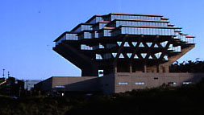
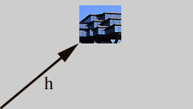

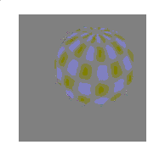
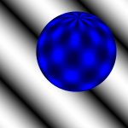

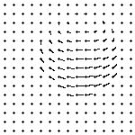
Image Registration
Basic Problem

Slide 3
Image Registration
Align two images to achieve the best match.
Determine motion between sequence images
There are a number of choices to make:
  What error metric to use.
  What type of search to perform.
    How to control a search.

Slide 4
Optical Flow
Flow of brightness through image
  Analogous to fluid flow
  Optic flow field resembles projection of motion field
Problem is underconstrained:
  For a single pixel, we only have information on the velocity normal to the difference contour
  Need 2 velocity vectors, only have one equation
  Need another constraint

Slide 5
Aperture Problem

Slide 6
Aperture Problem

Slide 7

Aperture Problem

Slide 8
Aperture Problem

Slide 9
Lucas & Kanade
Assume images are roughly aligned
  On the order of ½ feature size
Newton-Raphson type iteration
  Take gradient of error
  Assume linearity and move in that direction
Constant velocity constraint

Slide 10
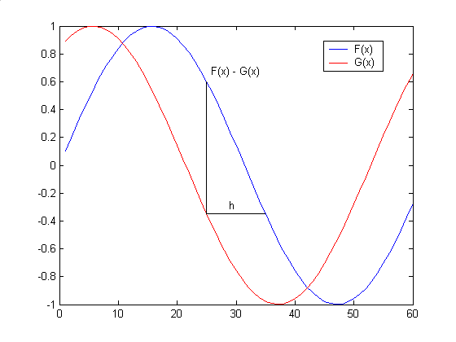
One Dimensional Registration

Slide 11
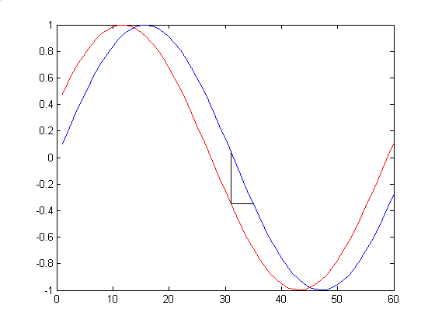
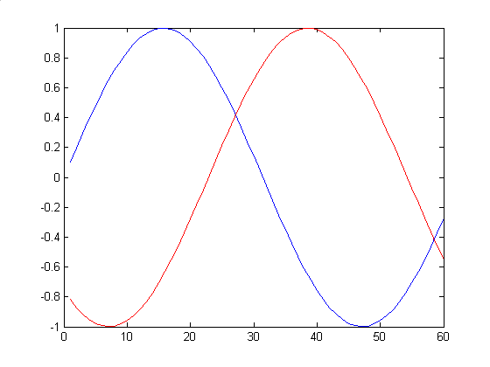
Allowable Pixel Shift
Algorithm only works for small (<1) pixel shifts
Larger motion can be dealt with in subsampled images where it is sub pixel

Slide 12
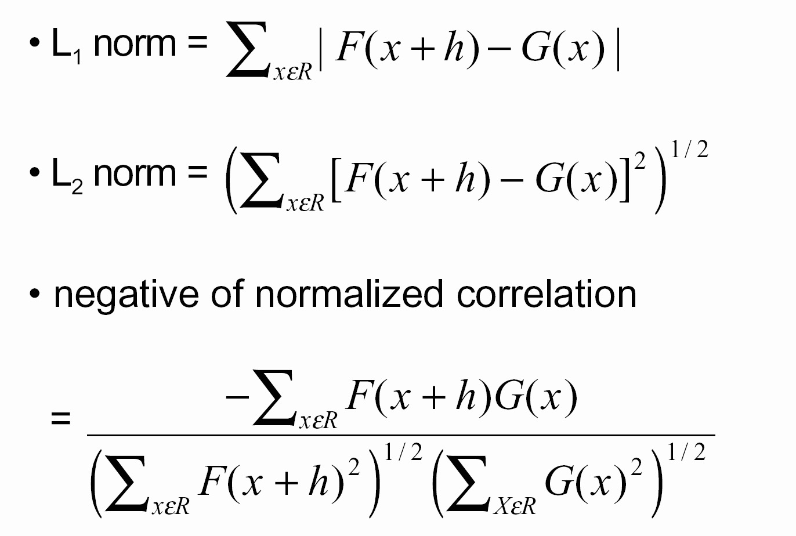
Error Metrics

Slide 13
Error Metric
Use a linear approximation
F(x+h) ≈ F(x) + h F’(x)
L2 norm error
E = Σ_{x}[F(x+h)-G(x)]²
Becomes
E = Σ_{x}[F(x) + h F’(x) -G(x)]²
Set derivative wrt h = 0 to minimize error

Slide 14
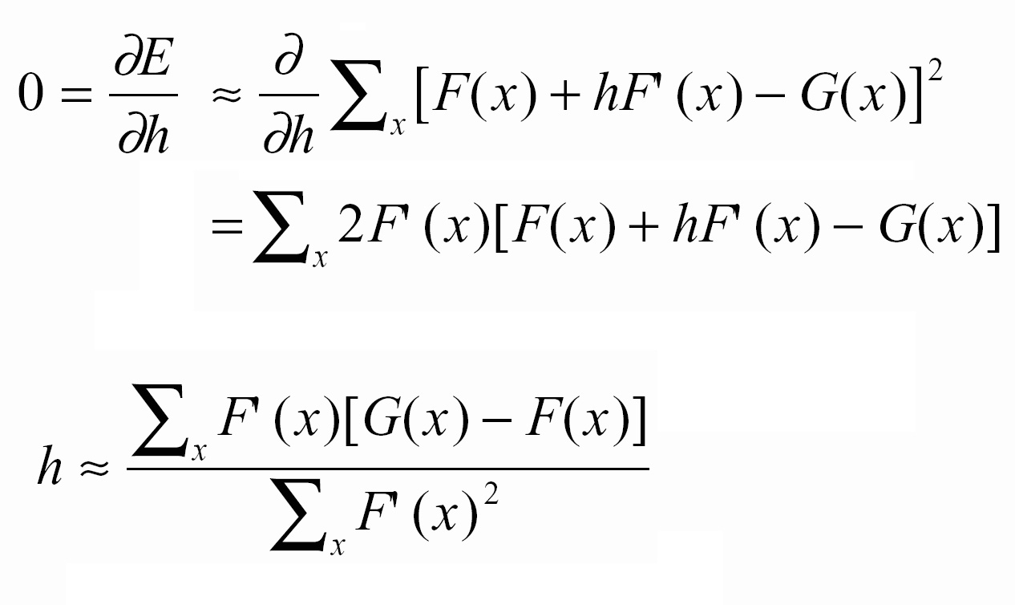
Estimating h
∂E = 0 ≈ ∂ Σ_{x}[F(x) + h F’(x) -G(x)]²
= Σ_{x} 2 F’(x)[F(x) + h F’(x) -G(x)]²
Solving for h
h ≈ Σ_{x} F’(x)[G(x) -F(x)]
Σ_{x}F’(x) ²
∂h
∂h

Slide 15
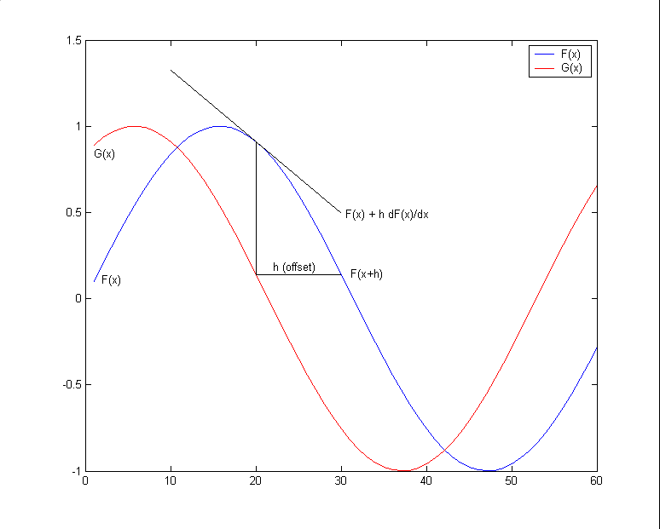
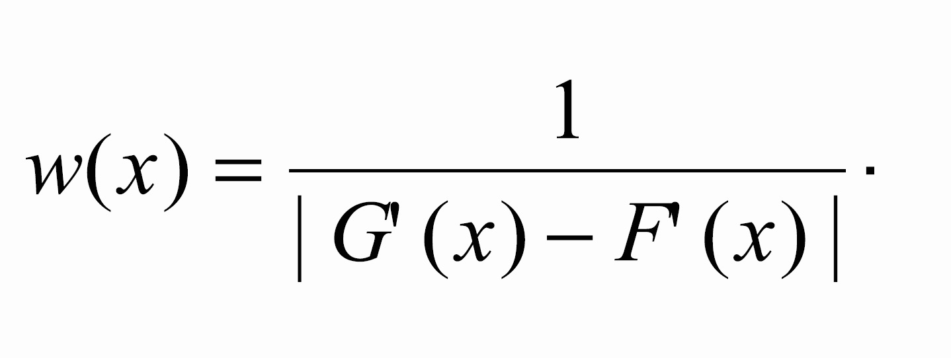
Weighting
Approximation works well in linear areas (low F”(x)) and not so well in areas with large F”(x)
Add a weighting factor to account for this.
F” ≈ (F’-G’)/h

Slide 16
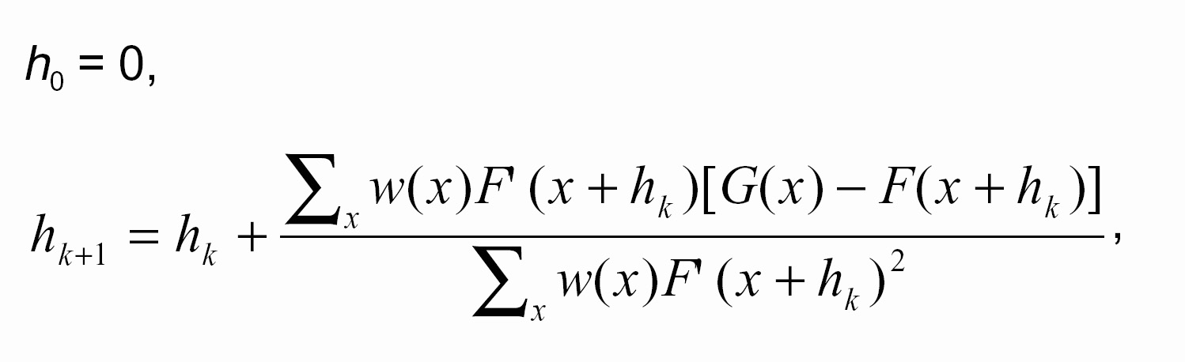
1D Algorithm

Slide 17
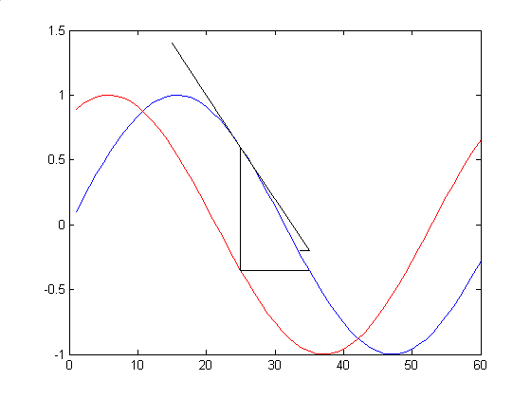
First Iteration

Slide 18
More Dimensions
Images are two dimensional signals.
Goal is to figure out how each pixel moves from one image to the next.
Conservation of image brightness
( ∇E)^{T}v+E_{t}=0
E_{x}v + E_{y}u + E_{t} = 0

Slide 19
Constant Velocity Constraint
Single pixel gives one equation
( ∇E)^{T}v+E_{t}=0
But this won’t solve 2 components of v
Force pixel to be similar to neighbors in order to get many constraining equations
  5x5 block of neighbors is common
Find a good simultaneous solution for entire block of solutions

Slide 20
Aperature Problem

Slide 21
Constant Velocity Solution
For a 5x5 block, we get a vector of 25 constraints
Find least squares solution
A^{T} (Av=b) , Av=b → ( ∇E)^{T}v+E_{t}=0
  A is gradients, v is velocities, b is time
A^{T}Av = A^{t}b
A^{T}A= Σ(E_{x})² ΣE_{x}E_{y} λ₁, λ₂
ΣE_{x}E_{y} Σ(E_{y})²
[ ]

Slide 22
Corner Features
[ ] [ ]
C= Σ(E_{x})² ΣE_{x}E_{y} = λ₁ 0
ΣE_{x}E_{y} Σ(E_{y})² 0 λ₂
Rank 0 λ₁= λ₂=0
Rank 1 λ₁> λ₂=0
Rank 2 λ₁> λ₂>0

Slide 23
Multiple Pixel Smoothness
Single Pixels, rank deficient, Underconstrained
Too Similar, rank deficient, Underconstrained
Non-parallel contours, overcomes aperature problem, overconstrained (Solvable!)

Slide 24
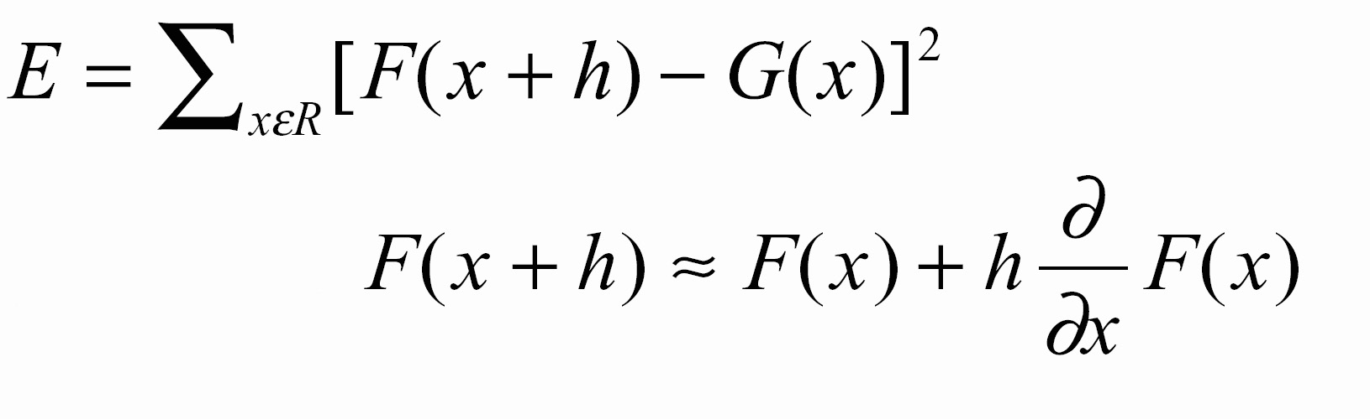
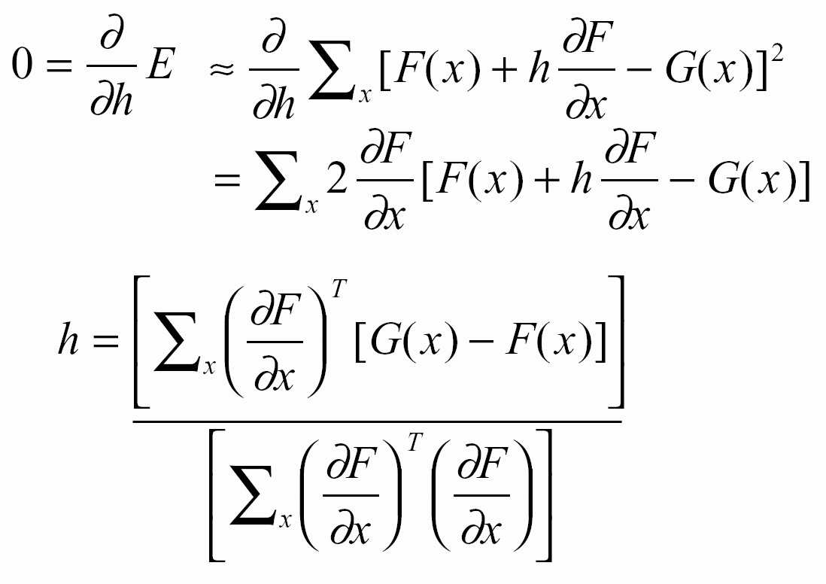
More Dimensions

Slide 25
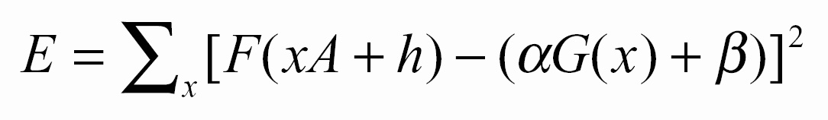
Generalizing
Linear transformations with a matrix A
G( x) = F( xA + h)
Brightness and contrast scalars α and β
F( x) = αG( x) + β
Error measure to minmize

Slide 26
Horn & Schunck
Start with single pixel equation
( ∇E)^{T}v+E_{t}=0
Sum ( ∇E)^{T}v+E_{t} over the entire image, minimize the sum
H(u,v)= Σ[E_{x}(i)u(i) + E_{y}(i)v(i) + E_{t}(i)]²
Simply minimizing this can get ugly
i

Slide 27
Regularization
Use regularization to impose a smoothness constraint on the solution
Try to reduce higher derivative terms
λ∫∫[(∂²u/ ∂x²)² + (∂²u/ ∂y²)² + (∂²v/ ∂x²)² + (∂²v/ ∂y²)² ]dxdy

Slide 28
Iterative Solution
H(u,v)= Σ[E_{x}(i)u(i) + E_{y}(i)v(i) + E_{t}(i)]² +
λ∫∫[(∂²u/ ∂x²)² + (∂²u/ ∂y²)² + (∂²v/ ∂x²)² + (∂²v/ ∂y²)² ]dxdy
Simultaneously minimize both to get a smooth solution
  λ determines how smooth to make it
An iterative version propagates information to pixels without enough local info

Slide 29
Iterative Propagation

Slide 30
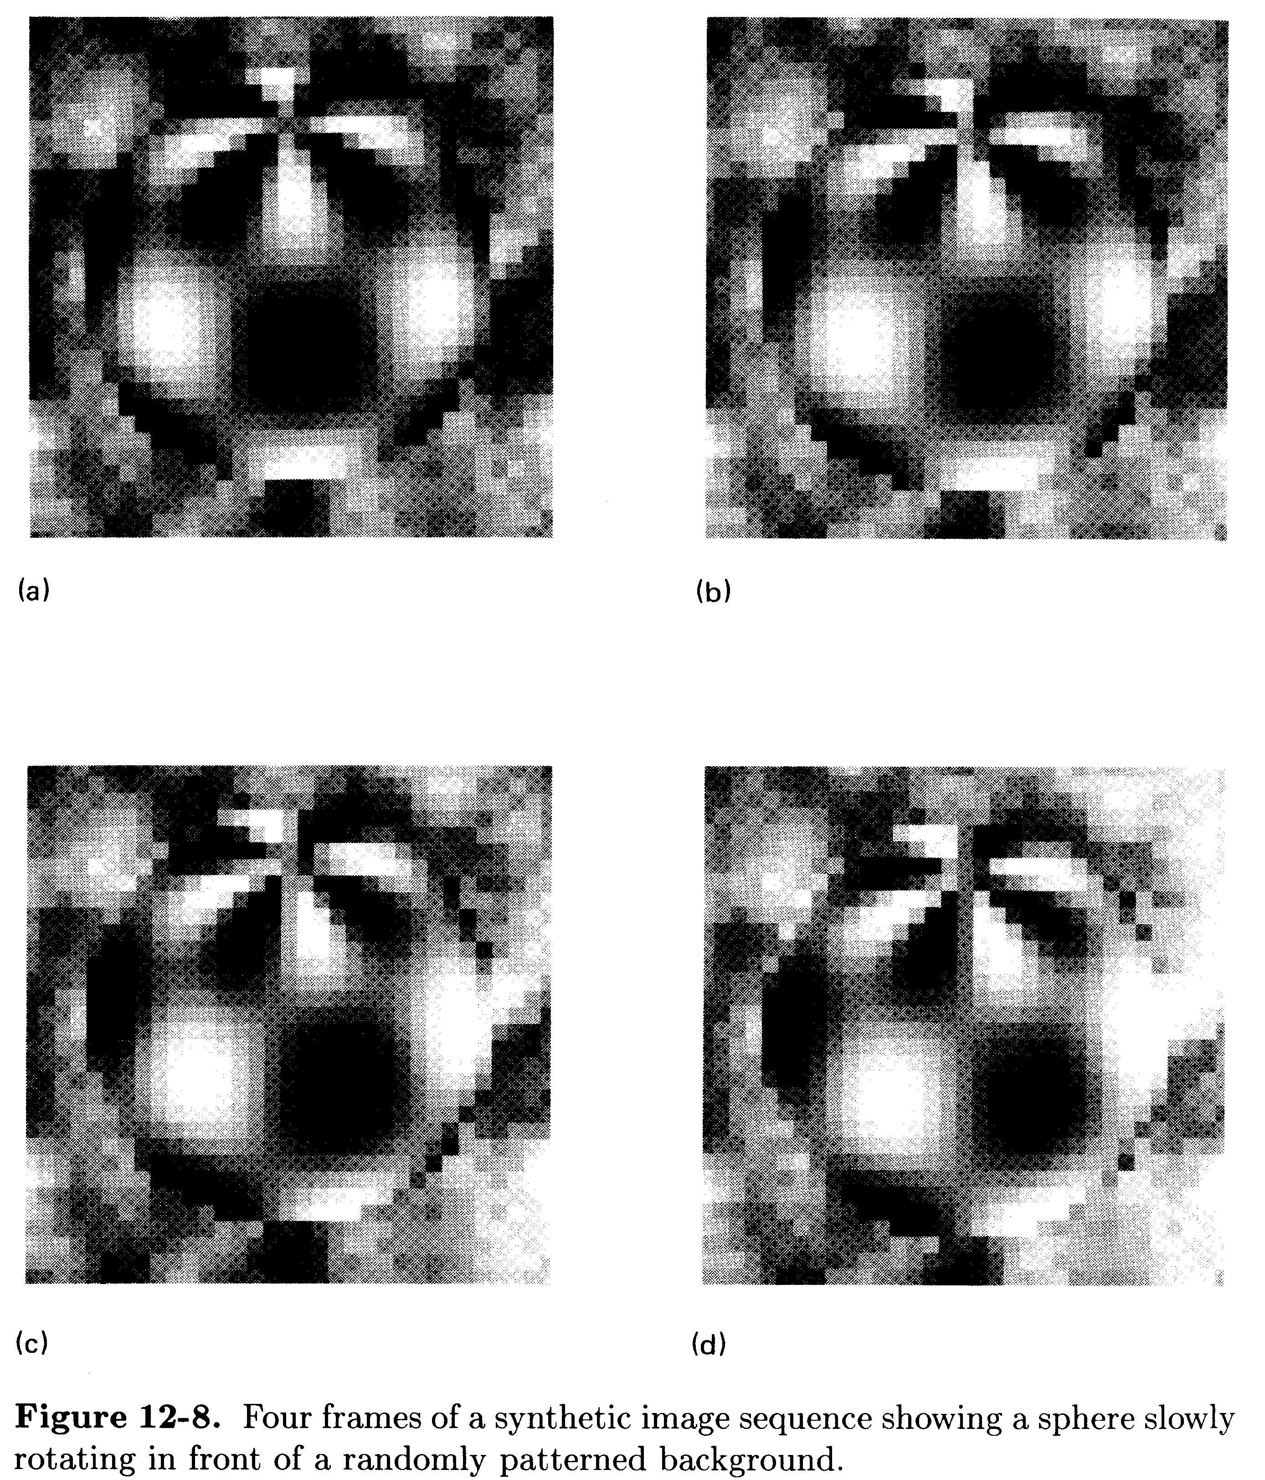
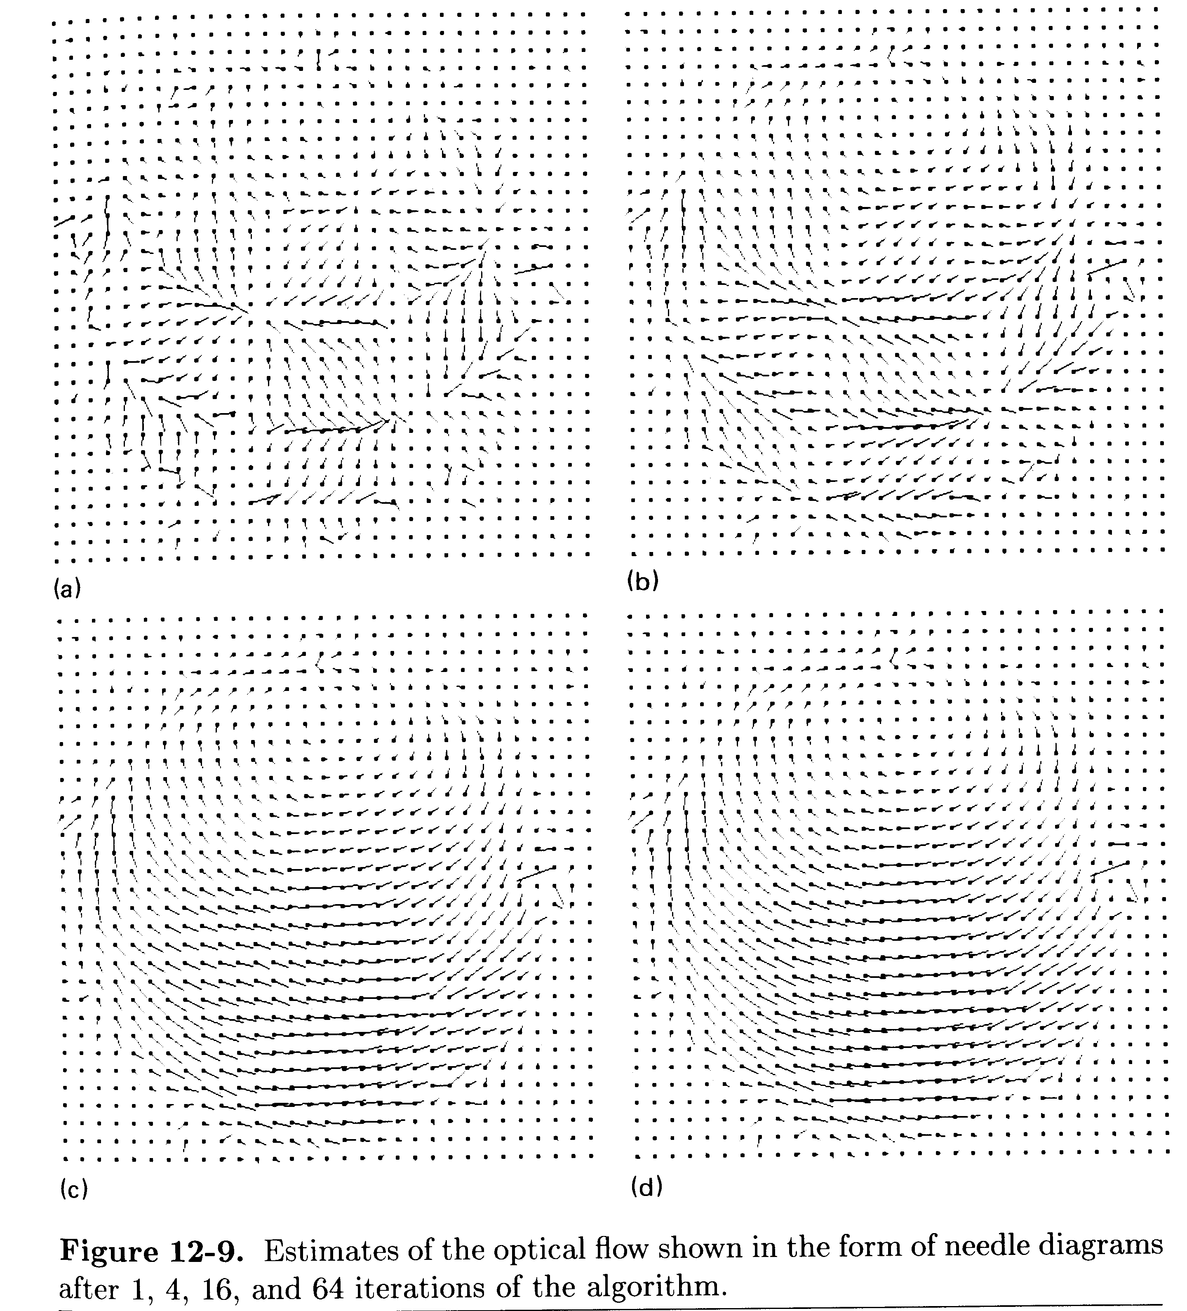
Results

Slide 31
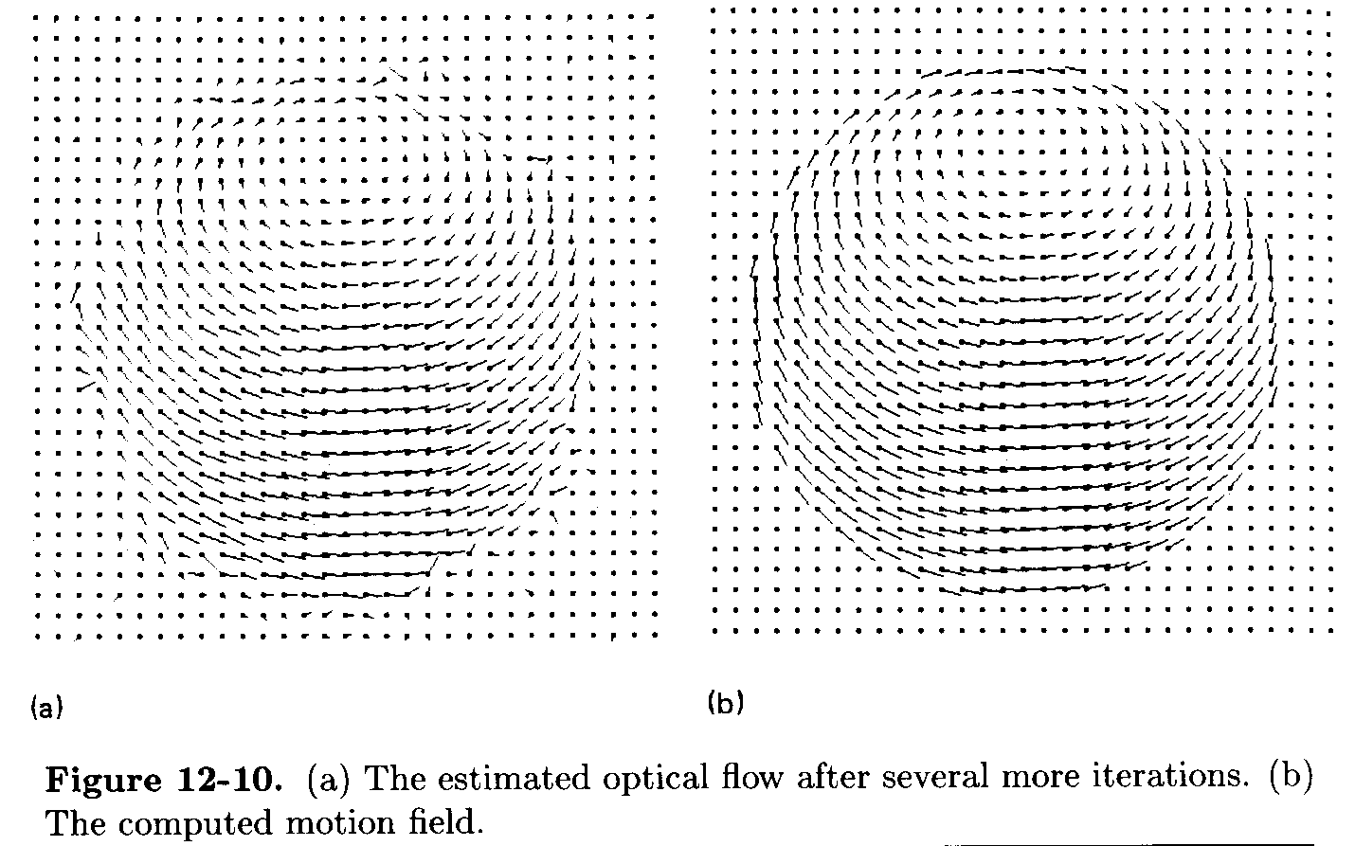
Results

Slide 32
Issues
When does optic flow work?
When does it fail?
  Edges, large movement, even sphere, barber pole
Recent improvements
  Multi-resolution
  Multi-body for independently moving obejcts
  Robust methods

Slide 33
h

