Slide 1
A New Concept for Passenger Traffic in Elevators
Juha-Matti Kuusinen, Harri Ehtamo
Helsinki University of Technology
Janne Sorsa, Marja-Liisa Siikonen
KONE Corporation

Slide 2
Introduction
Reliable simulation and forecasting require accurate traffic statistics
Our new concept, passenger journey, enables:
  Floor-to-floor description of the traffic
  Estimation of the passenger arrival process

Slide 3
Passenger Journeys
Passenger journey:
  A batch of passengers that travels from the same departure floor to the same destination floor in the same elevator car
Elevator trip:
  Successive stops in one direction with passengers inside the elevator

Slide 4
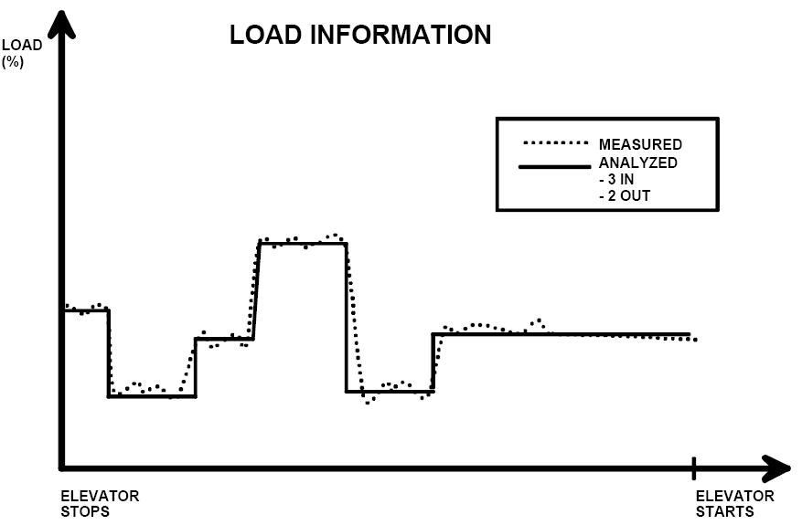
Passenger Traffic Measurements
Passenger transfer data
Call data
Passenger
exited the
elevator
Passenger
entered the
elevator

Slide 5
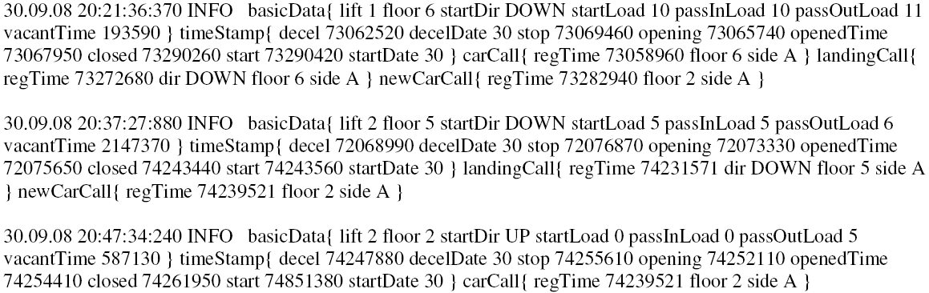
Log File
Elevator group control combines the data into a log file

Slide 6
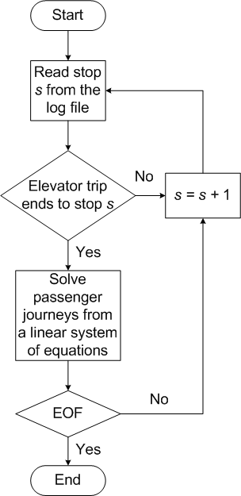


Passenger Journey Algorithm
Stops are read one by one
A linear system of equations is defined for each elevator trip
Conservation of passenger flow in an elevator trip

Slide 7
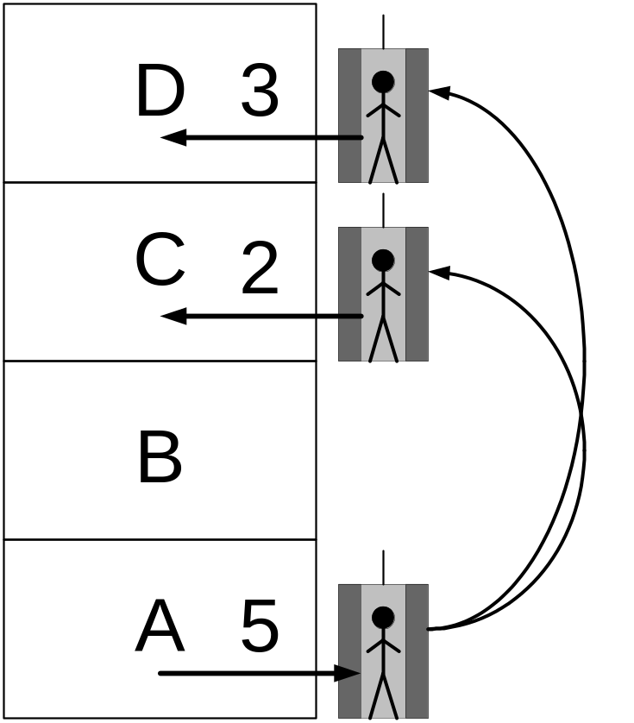
Passenger Journeys: Example
Passenger journey of batch size 2 from departure floor A to destination floor C
Passenger journey of batch size 3 from departure floor A to destination floor D

Slide 8
Batch Arrival Times
Assumption:
  Batch arrival times correspond to call registration times
Checked using call response time:
  Time from registering a call until the serving elevator starts to open its doors at the departure floor

Slide 9
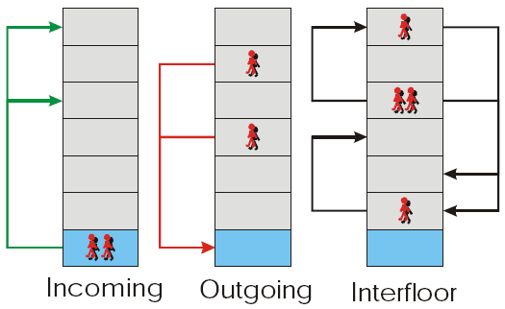
Passenger Traffic Statistics and Traffic Components
Given time period, e.g. day, is divided into K intervals [t_{k},t_{k+1}], k=0,1,...,K-1
Number of passengers per interval, i.e. intensity, is recorded

Slide 10
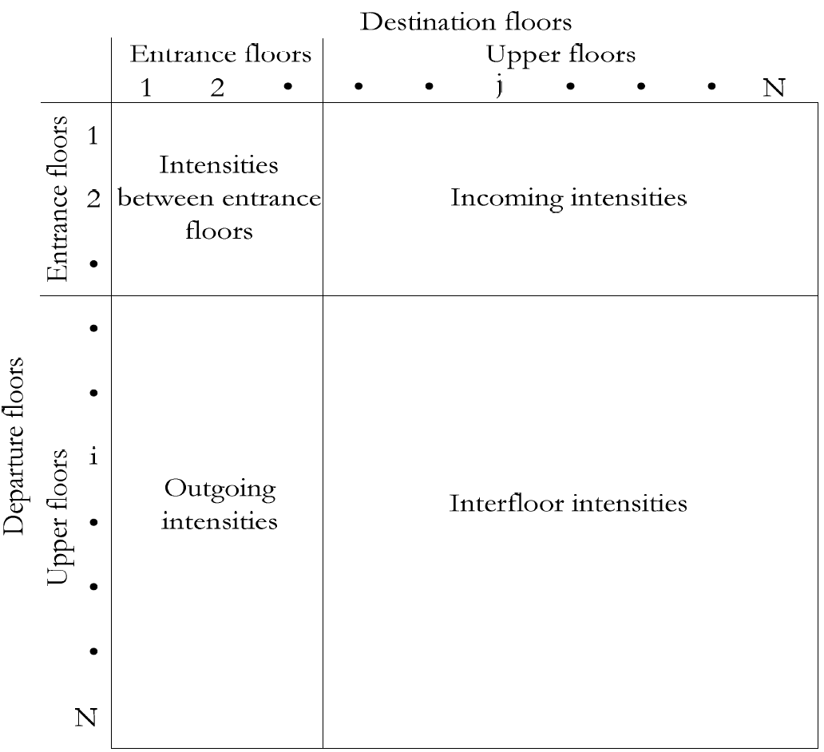
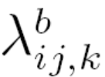
Passenger Journey Statistics
Intensity of b sized batches from departure floor i to destination floor j is
  k defines the interval [t_{k},t_{k+1}]
Departure-destination floor matrix:
  Contains traffic components as subsets

Slide 11
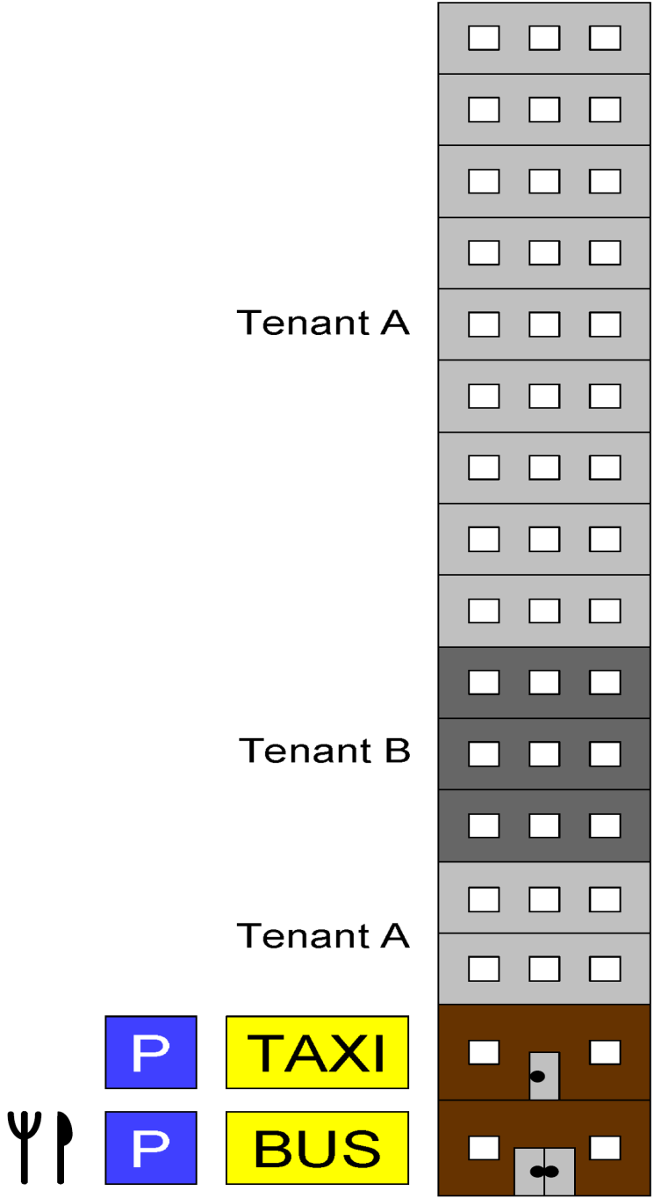
Case Study
Office building:
  16 floors
  Two entrances
  Two tenants
Notes:
Componentwise averages of all weekday (79) passenger journeys per five minutes between 6:00 and 22:00. The component patterns are typical for an office building with flexible working hours: incoming traffic is heavy in the morning when people come to work and at lunch time when people return from lunch and outgoing traffic at lunch time when people go to lunch and in the evening when people leave work. Interfloor traffic varies quite strongly throughout the day. Also, because of the flexible working hours, the different peak periods extend to long time periods. The incoming traffic is heavier from the first than from the second floor during lunch time because there is a restaurant at the first floor.

Slide 12
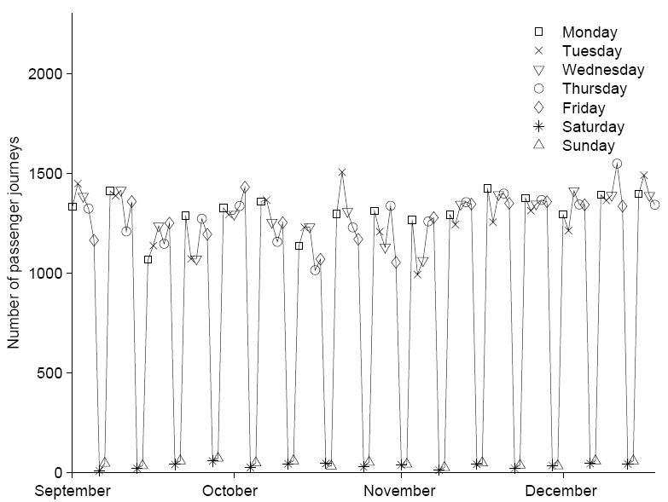
Daily Number of Passenger Journeys
No distinctive outliers
No apparent weekly or monthly patterns
Average number of passenger journeys same regardless of the week
No traffic during weekends

Slide 13
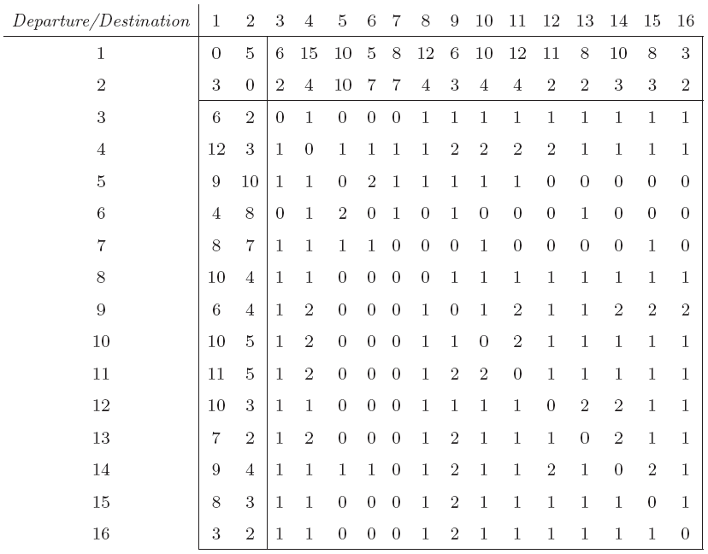
Measured Departure-Destination Floor Matrix: Lunch Time
Average of 79 weekdays
All batch sizes considered
Heavy incoming and outgoing traffic

Slide 14
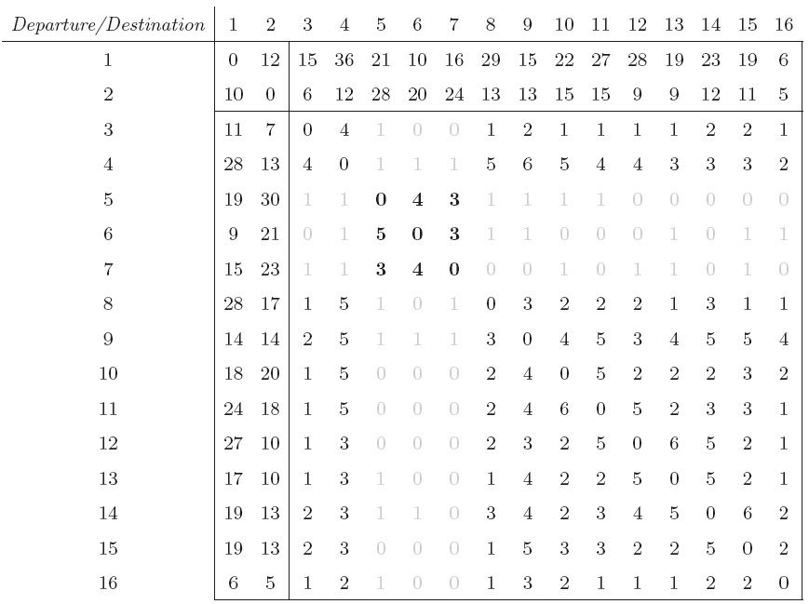
Measured Departure-Destination Floor Matrix: Whole Day
The two tenants are recognized

Slide 15
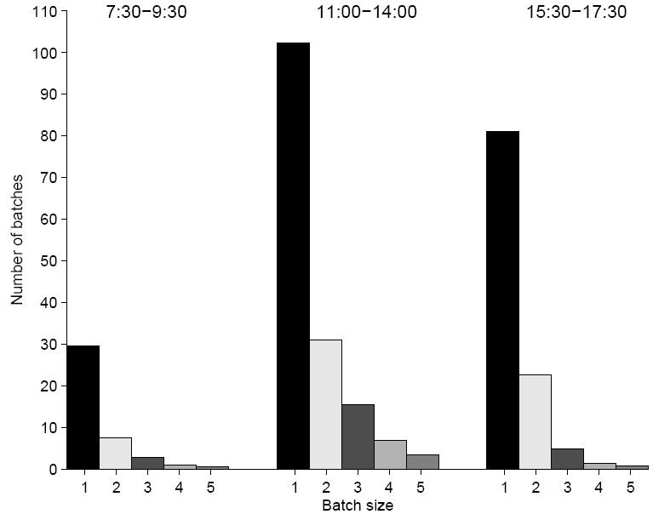
Batch Size in Outgoing Traffic
Many batches bigger than one passenger
Resemble the geometric distribution

Slide 16
Batch Arrival Test
Null hypothesis:
  Batch arrivals form a Poisson-process within five minutes intervals
Uniform conditional test for Poisson-process (Cox and Lewis 1966)
  Under the null hypothesis the transformed arrival times are independently and uniformly distributed over [0,1]

Slide 17
Test Results
In total 16 tests, 9 accepted null hypotheses:
  Six tests rejected independence
  One test rejected uniformity
Inter-arrival times close to exponential:
  Independence test give only a rough guide
Fit of batch arrivals to Poisson-process:
  Outgoing: good
  Incoming and interfloor: reasonable

Slide 18
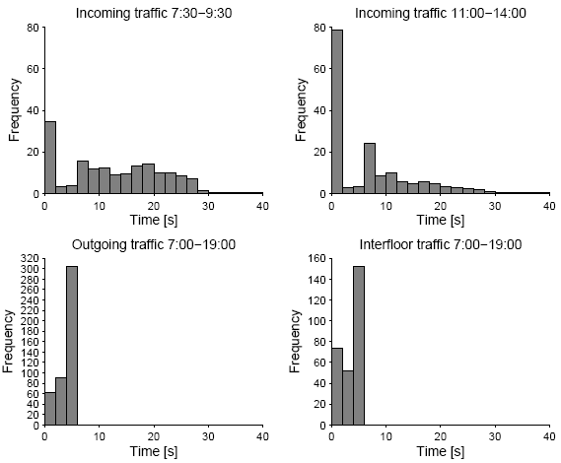
Call Response Time

Slide 19
Conclusion and Future Research
Passenger journeys enable detailed description of passenger traffic in elevators
For example, in outgoing traffic:
  Batch arrivals form a Poisson-process
  Batch size is often bigger than one passenger
Future research:
  Automatic recognition of building specific traffic patterns
  Forecasting in elevator group controls
  Measurements from other buildings

Slide 20
References
Alexandris, N.A. 1977. Statistical models in lift systems. Ph.D. thesis, Institute of Science and Technology, University of Manchester, England
Barney, G.C. 2003. Elevator Traffic Handbook. Spon Press
Cox, D.R., P.A.W. Lewis. 1966. The Statistical Analysis of Series of Events. Methuen & Co Ltd.
Siikonen, M-L. 1997. Planning and control models for elevators in high-rise buildings. Ph.D thesis, Systems Analysis Laboratory, Helsinki University of Technology, Finland
Siikonen, M-L., T. Susi, H. Hakonen. 2001. Passenger traffic simulation in tall buildings. Elevator World 49(8) 117-123
Sorsa, J., M-L. Siikonen, H. Ehtamo. 2003. Optimal control of double-deck elevator group using genetic algorithm. International Transactions in Operational Research 10(2) 103-114

