Slide 1

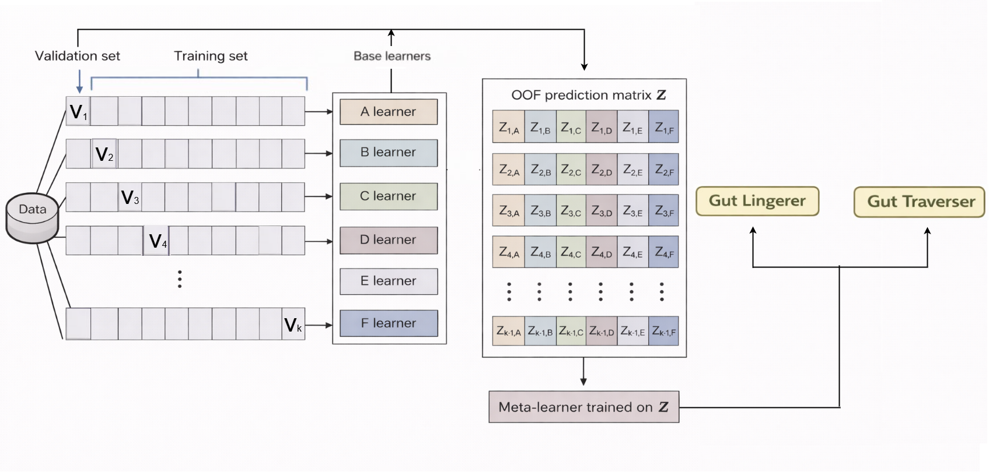
Super Learner model to predict gut permanence
Paper 1

