Slide 1
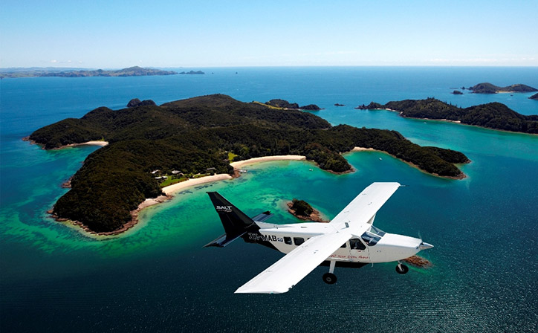
FLIGHTSHARER
Make the fun more intense,
Make it cost less.
Share your flight !
Group #1
Hiba ALAMI
Djagou DONKO
Raid GUDOUDJ
André KENY
Lydia KHEMSINE
Sonia KORAICHI
Jean-Yves LONDONIO
Remzi VUKOVIC

Slide 2
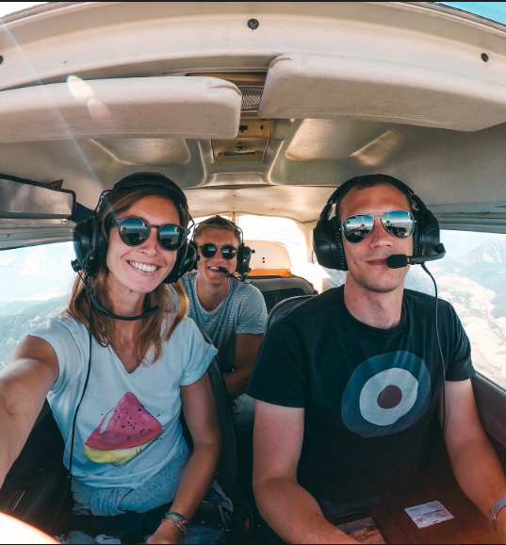
SYSTEM DEFINITION
Plane renting is out of your budget line, yet you can’t fight that plane trip craving you have? FlightSharer is here for you.
FlightSharer is a website that connects individuals, having pilot licenses or not, in order to share the cost of flight trips.
The platform allows pilots to planify flights and advise all the necessary information. While non-pilot individuals can look for flights to join by searching accordingly to their geolocalisation preferences and the number of seats they would like to book.

Slide 3
USERS
Users
Either logged in as pilots or passsengers, our main users are individuals participating in the flights planified on our platform.
Adminstratrors
A group of members responsible for verifying profiles and flights before confirming inscriptions, reservations and posts on the platform.

Slide 4
BUSINESS OBJECTS
User
-id
-firstname
-lastname
-email
-gsm
-address
-role
-LicenseValidityDate
Plane
-ATC_number
-number_of_seats
-status
Flight
-departure_aerodrome
-destination_aerodrome
-date
-departure_hour
-plane
-pilot
-passenger_list

Slide 5



TECHNICAL DIAGRAM
Database
Server
Alert System
Website
Mobile App

Slide 6

WEBSITE OUTLINE
The website version of FlightSharer platform allows you to navigate through its simply designed interfaces and well-thought-of ergonomy.

Slide 7
WEBSITE NAVIGATION PLAN

