Slide 1

ChuChuFly
Make the fun more intense,
Make it cost less.
Share your flight !
Group #1
Hiba ALAMI
Djagou DONKO
Raid GUDOUDJ
André KENY
Lydia KHEMSINE
Sonia KORAICHI
Jean-Yves LONDONIO
Remzi VUKOVIC

Slide 2

SYSTEM DEFINITION
Plane renting is out of your budget line, yet you can’t fight that plane trip craving you have? ChuChuFly is here for you.
ChuChuFly is a website that connects individuals, having pilot licenses or not, in order to share the cost of flight trips.
The platform allows pilots to planify flights and advise all the necessary information. While non-pilot individuals can look for flights to join by searching accordingly to their geolocalisation preferences and the number of seats they would like to book.

Slide 3
USERS
Users
Either logged in as pilots or passsengers, our main users are individuals participating in the flights planified on our platform.
Adminstratrors
A group of members responsible for verifying profiles and flights before confirming inscriptions, reservations and posts on the platform.

Slide 4
BUSINESS OBJECTS
User
-id
-firstname
-lastname
-email
-gsm
-address
-role
-LicenseValidityDate
Plane
-ATC_number
-number_of_seats
-status
Flight
-departure_aerodrome
-destination_aerodrome
-date
-departure_hour
-plane
-pilot
-passenger_list

Slide 5



TECHNICAL DIAGRAM
Database
Server
Alert System
Website
Mobile App

Slide 6

WEBSITE OUTLINE
The website version of ChuChuFly platform allows you to navigate through its simply designed interfaces and well-thought-of ergonomy.

Slide 7
WEBSITE NAVIGATION PLAN
ChuChuFly has three different navigation plans accordingly to weither the user is logged in as a passenger, a pilot, or not logged in at all.
Pilot
Passenger
Unregistered

Slide 8
WEBSITE NAVIGATION PLAN
>Not logged-in user
Search
Suggestions
list
Book Flight
Home
Become Pilot Form
Sign In
Form
Unrecognized Identifier
Sign Up
Form

Slide 9
WEBSITE NAVIGATION PLAN
>Passenger Schema
View
Profile
Become Pilot Form
Sign Out
Verify
Identity
List of
flights
Delete
Profile
Home
Messages
Search
Profile Edit
Form
Profile Dashboard
Suggestions
List
Profile
Settings

Slide 10
WEBSITE NAVIGATION PLAN
>Pilot Schema
View
Profile
Plan New Flight
Flight
Details
Sign Out
Verify
Identity
Reservations
List
List of
flights
Delete
Profile
Home
Reservation Details
Messages
Profile Edit
Form
Profile Dashboard
Profile
Settings

Slide 11
MOCKUPS
The following slides will show an approximative disposition of
the website interfaces in the most mainstream order.

Slide 12
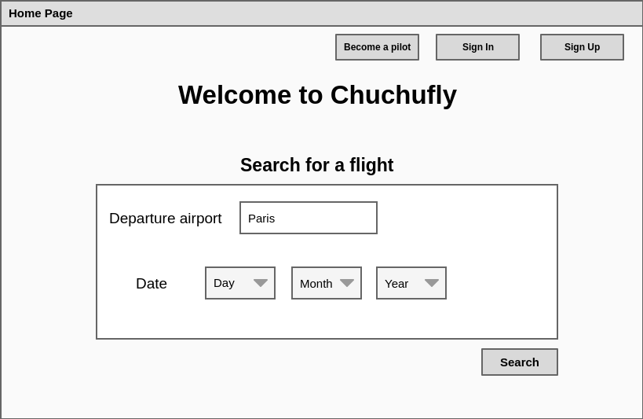
WEBSITE MOCKUPS
>Standard Home Page

Slide 13
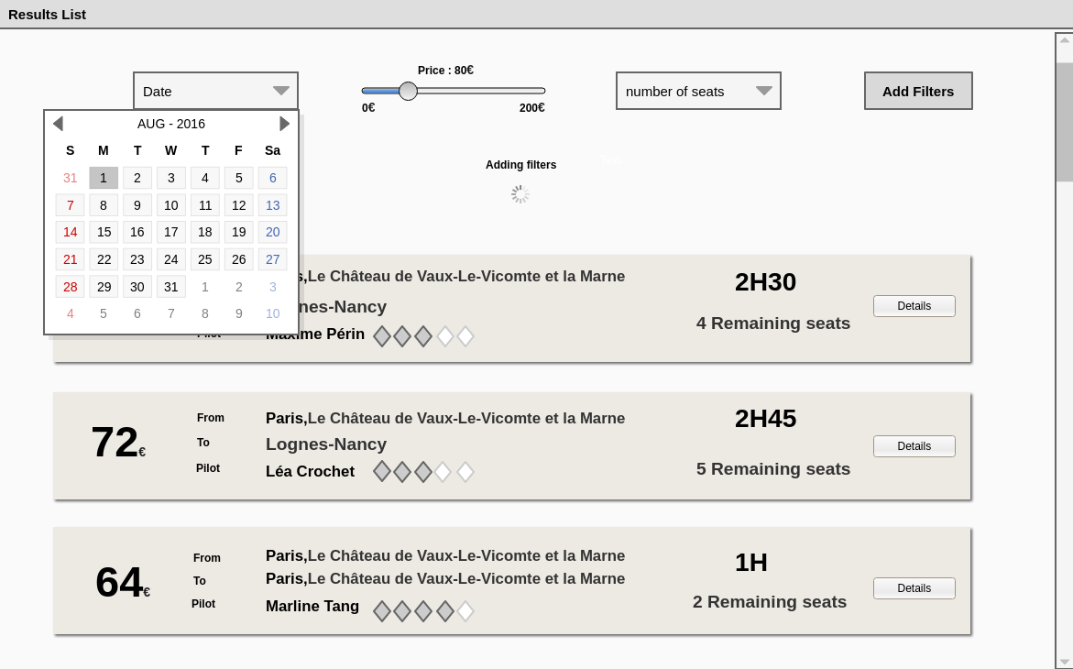
WEBSITE MOCKUPS
> Search Results

Slide 14
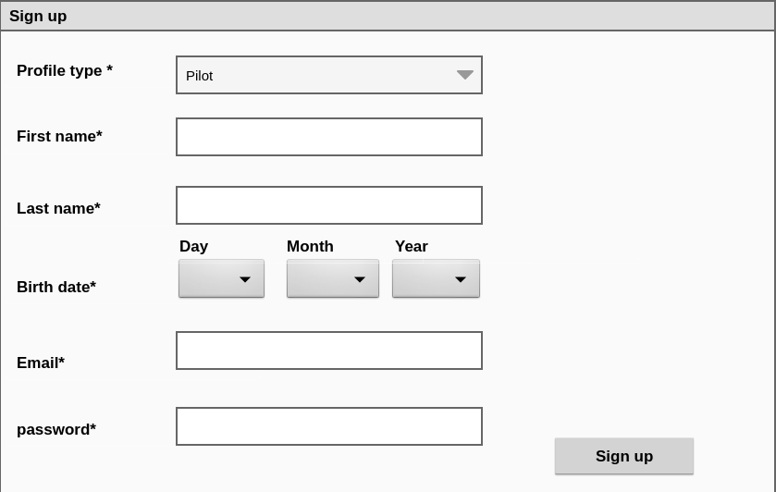
WEBSITE MOCKUPS
> Sign Up Form

Slide 15
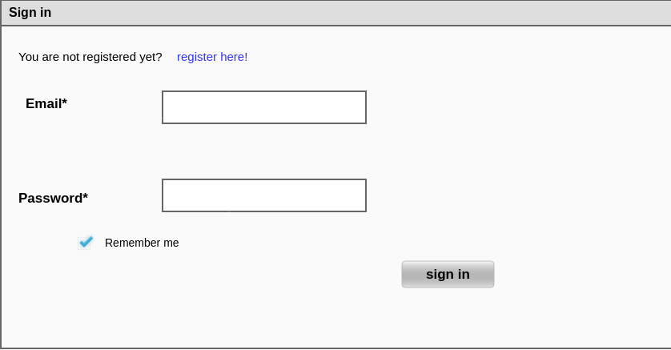
WEBSITE MOCKUPS
> Sign In Form

Slide 16
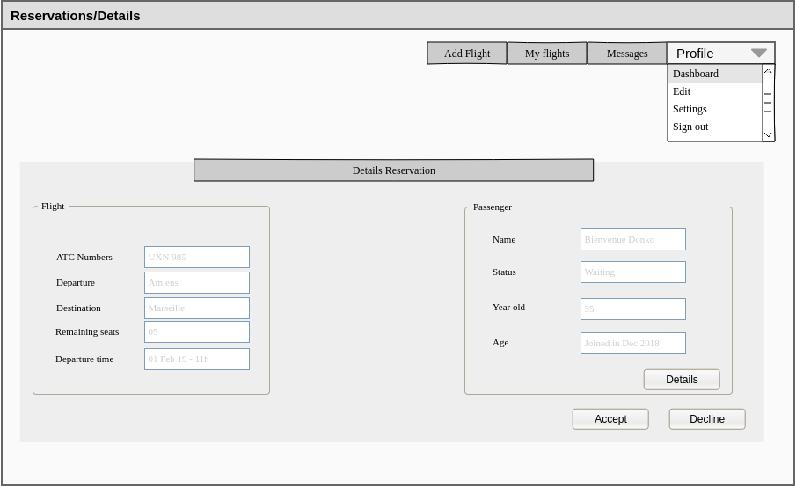
WEBSITE MOCKUPS
> Reservation Details

Slide 17
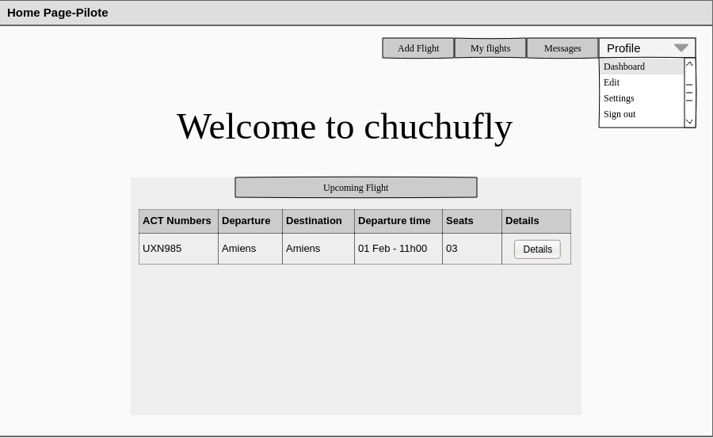
WEBSITE MOCKUPS
>Pilot Home Page

Slide 18
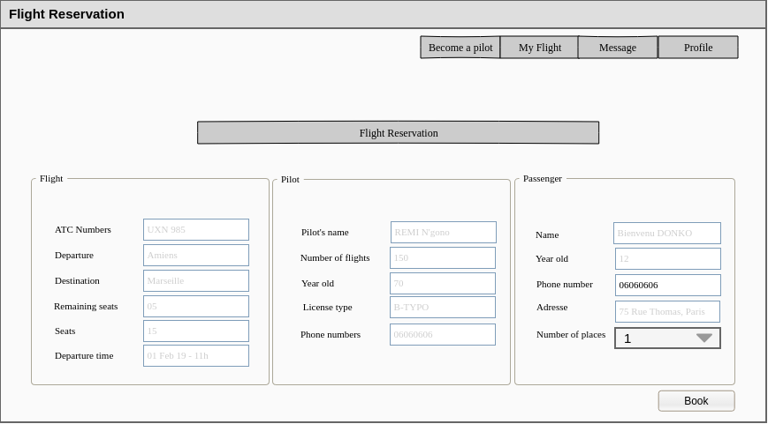
WEBSITE MOCKUPS
> Booking Form

Slide 19
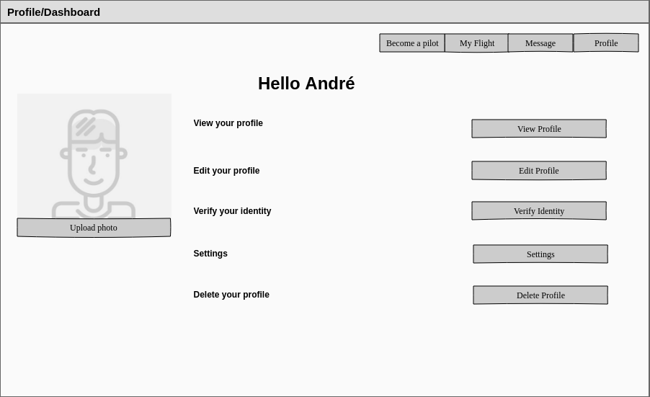
WEBSITE MOCKUPS
> Passenger Profile Page

Slide 20
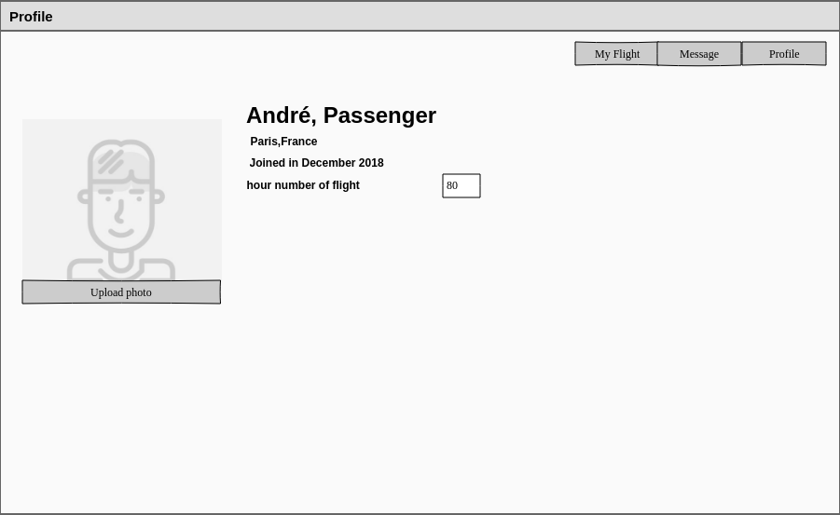
WEBSITE MOCKUPS
> Passenger Profile View

Slide 21
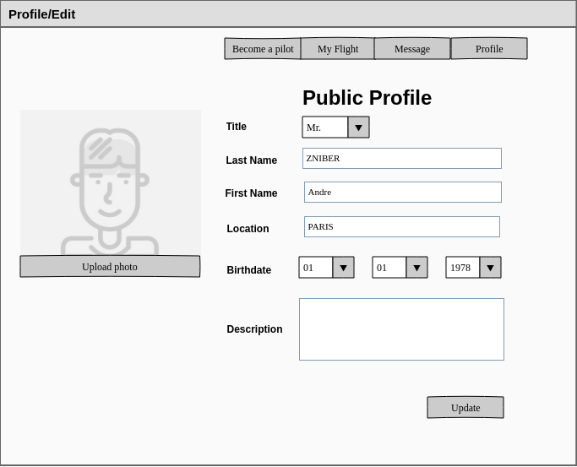
WEBSITE MOCKUPS
> Passenger Profile-edition Form

Slide 22
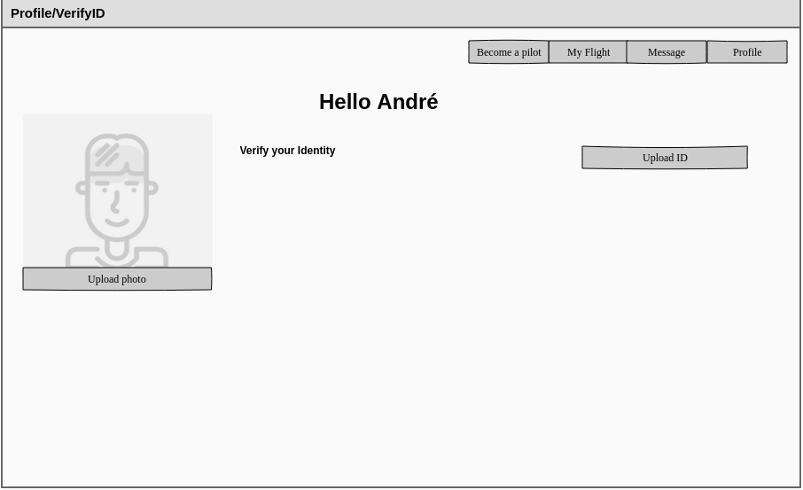
WEBSITE MOCKUPS
> Passenger Profile Verification

Slide 23
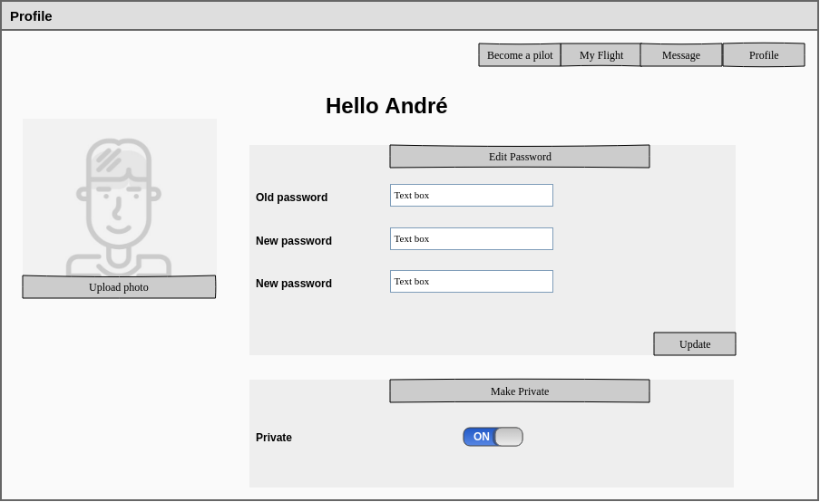
WEBSITE MOCKUPS
> Passenger Profile Settings

Slide 24
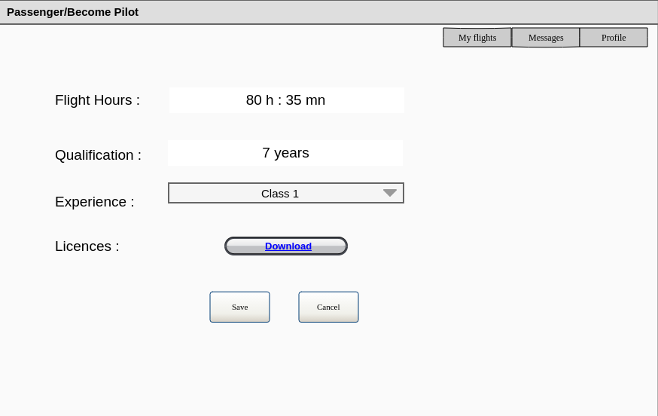
WEBSITE MOCKUPS
> Become Pilot Form

Slide 25
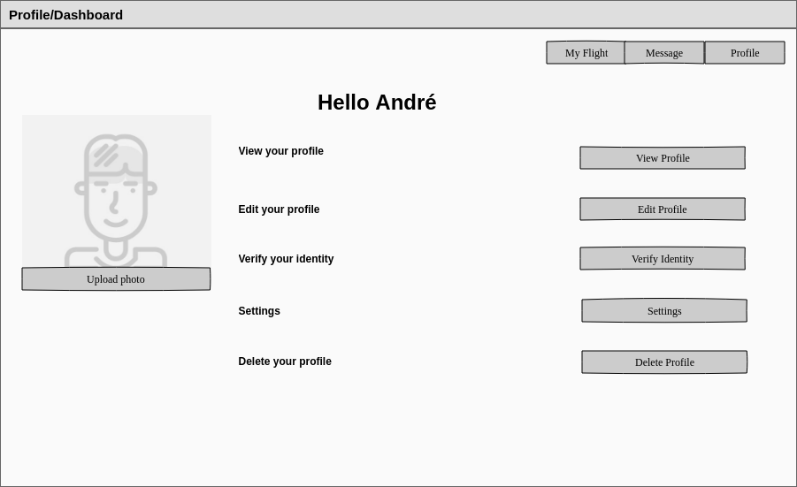
WEBSITE MOCKUPS
> Pilot Profile Dashboard

Slide 26
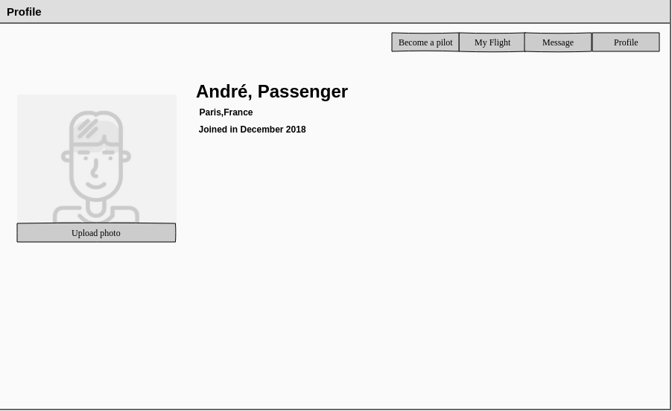
WEBSITE MOCKUPS
> Pilot Profile View

Slide 27
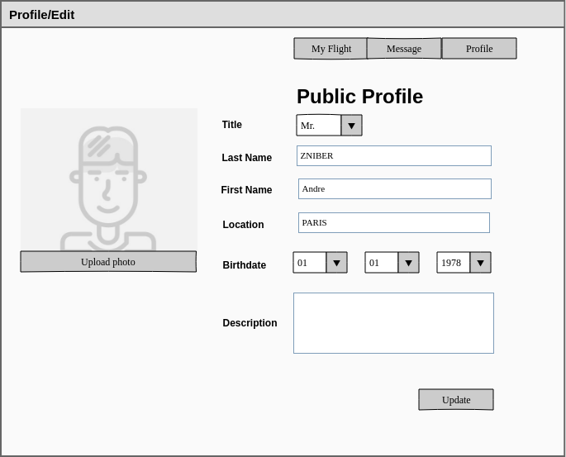
WEBSITE MOCKUPS
> Pilot Profile Edition Form

Slide 28
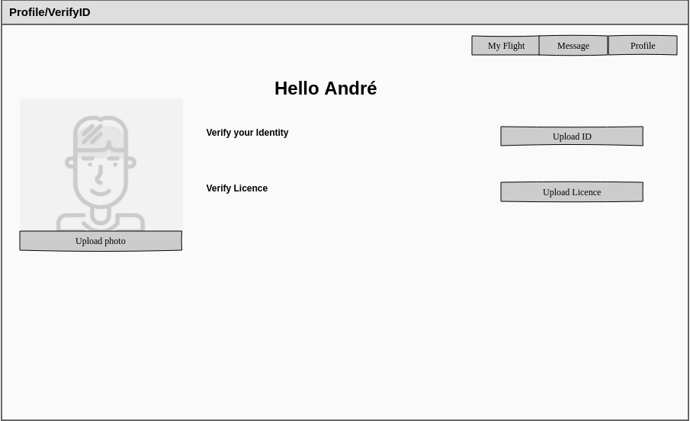
WEBSITE MOCKUPS
> Pilot Profile Verification

Slide 29
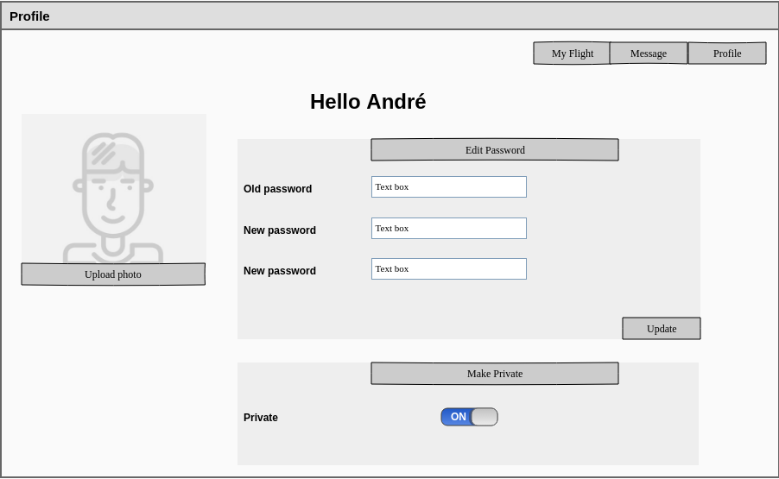
WEBSITE MOCKUPS
> Pilot Profile Settings

Slide 30
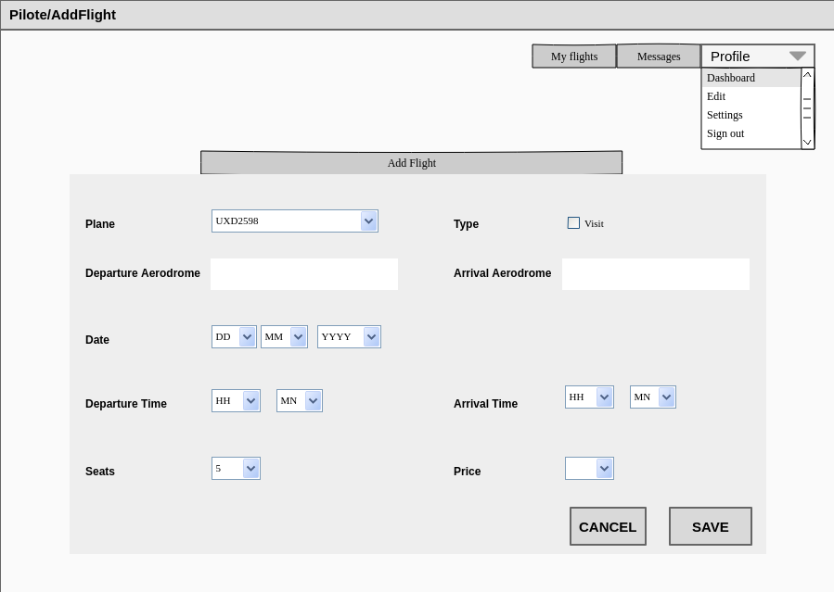
WEBSITE MOCKUPS
> Add Flight Form

Slide 31
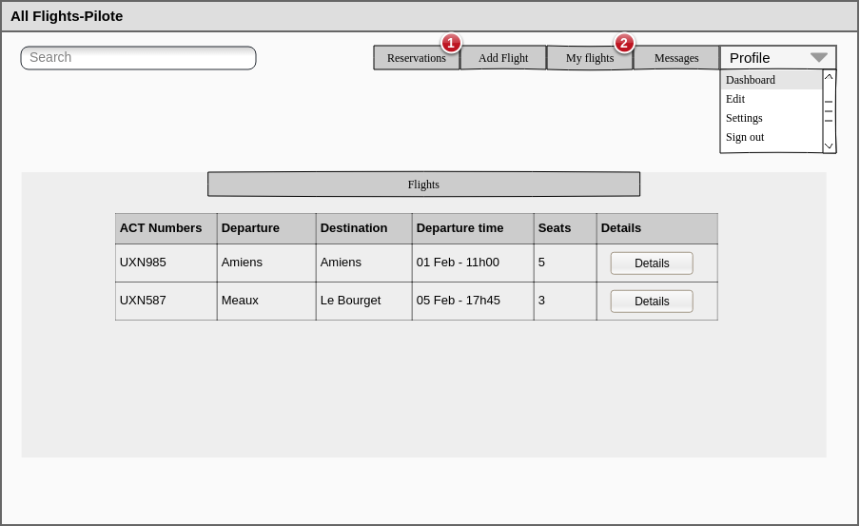
WEBSITE MOCKUPS
> Pilot Flights List

Slide 32
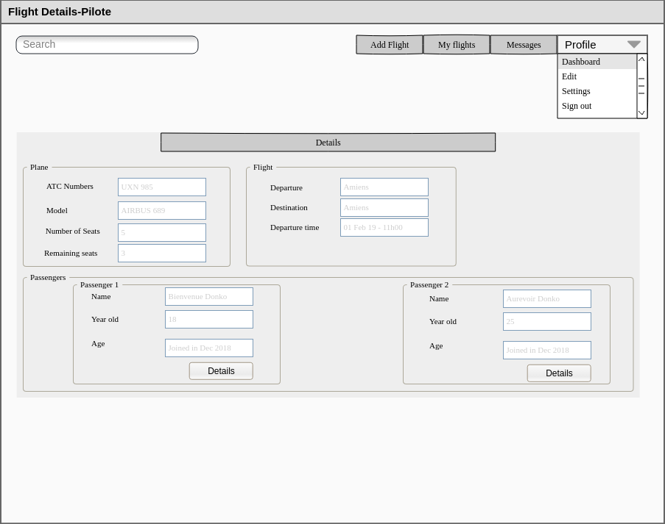
WEBSITE MOCKUPS
> Pilot Flight Details

Slide 33
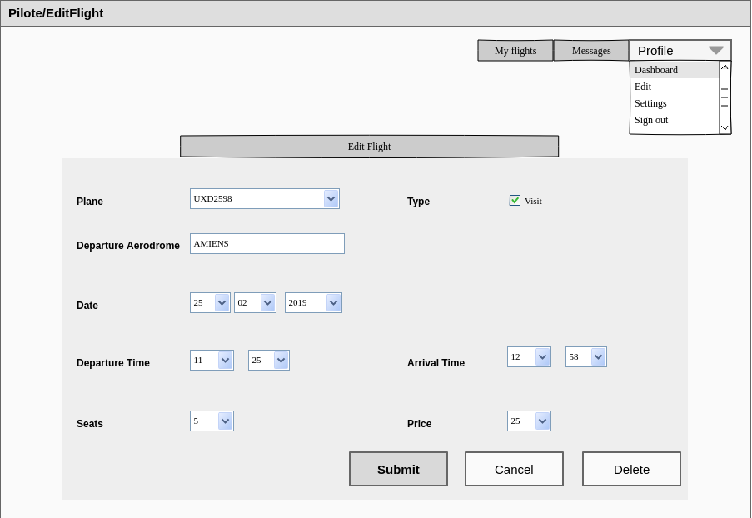
WEBSITE MOCKUPS
> Flight-edition Form

Slide 34
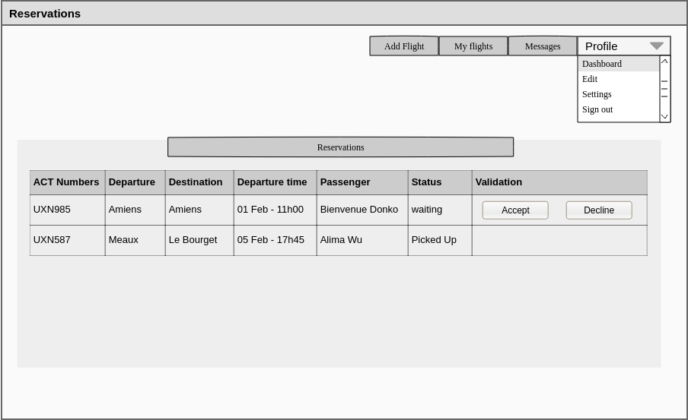
WEBSITE MOCKUPS
> Pilot’s Reservations List

Slide 35
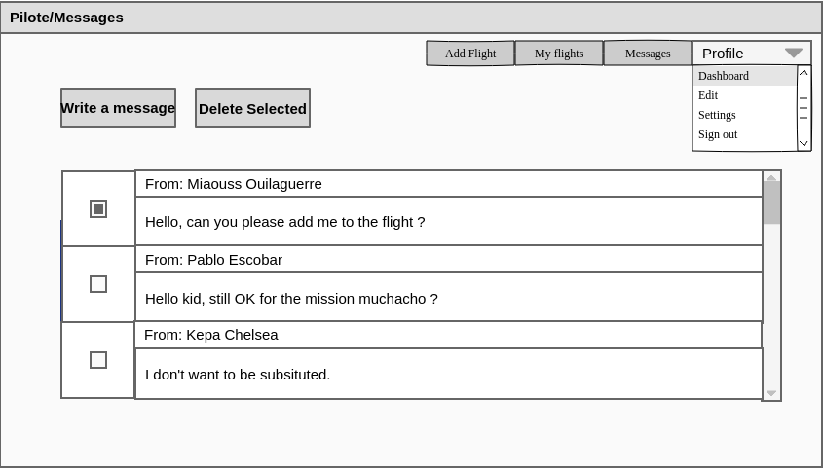
WEBSITE MOCKUPS
> Messages Page

Slide 36
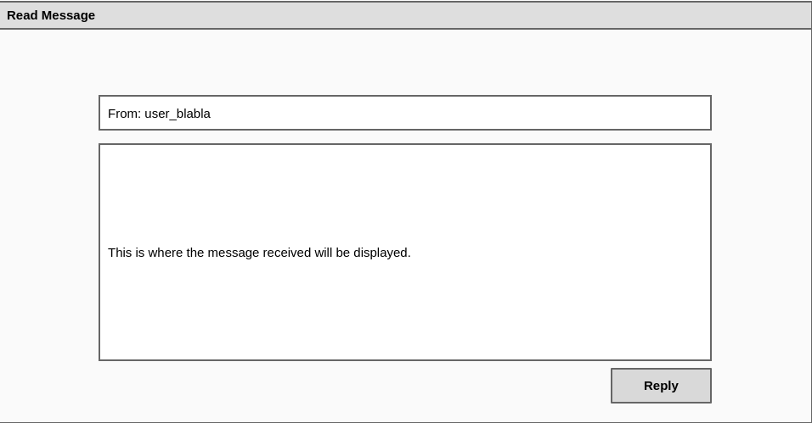
WEBSITE MOCKUPS
> Message details

Slide 37
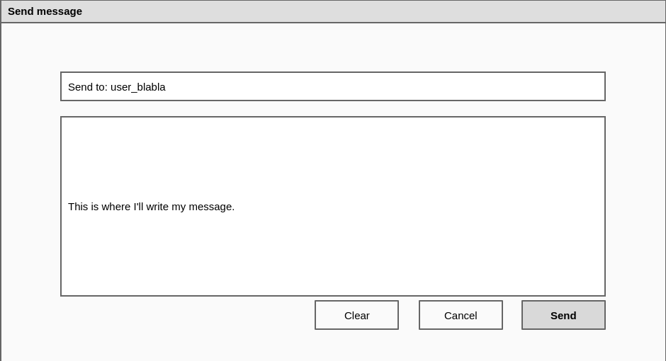
WEBSITE MOCKUPS
> Write a new message

Slide 38
Developpement base
Before getting to code interfaces and implement the application, we strated by making a backlog in order to split the work in term of functions. We also made a list of webservices that will eventually be translated to a stub.

Slide 39
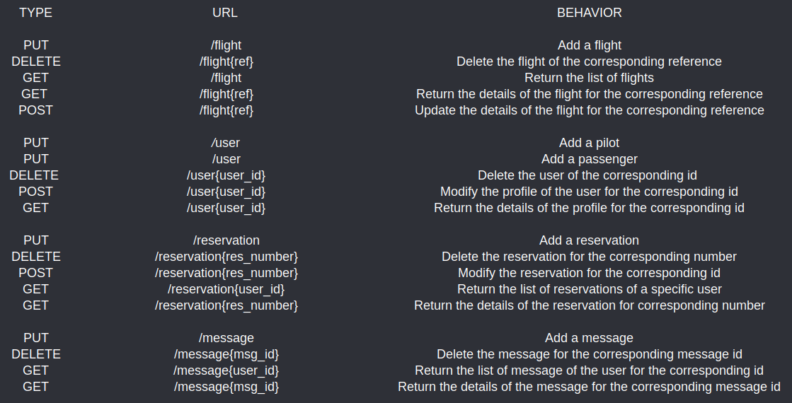
WEBSERVICES

Slide 40
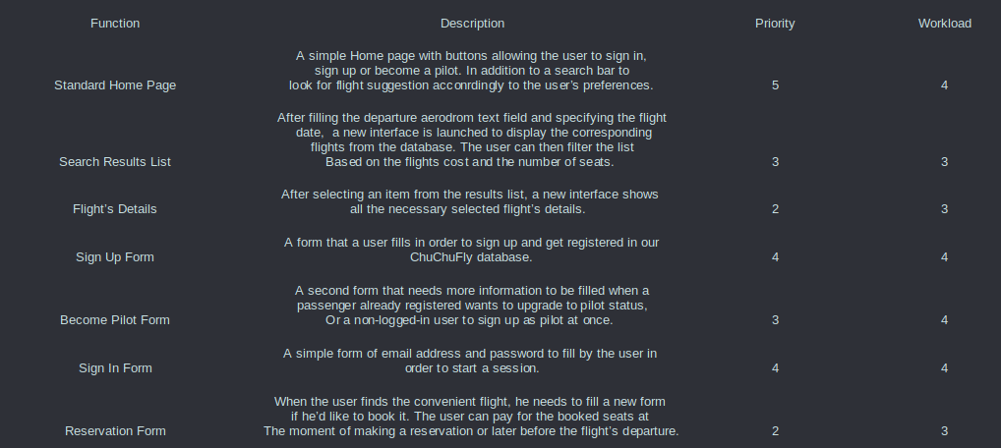
BACKLOG

Slide 41
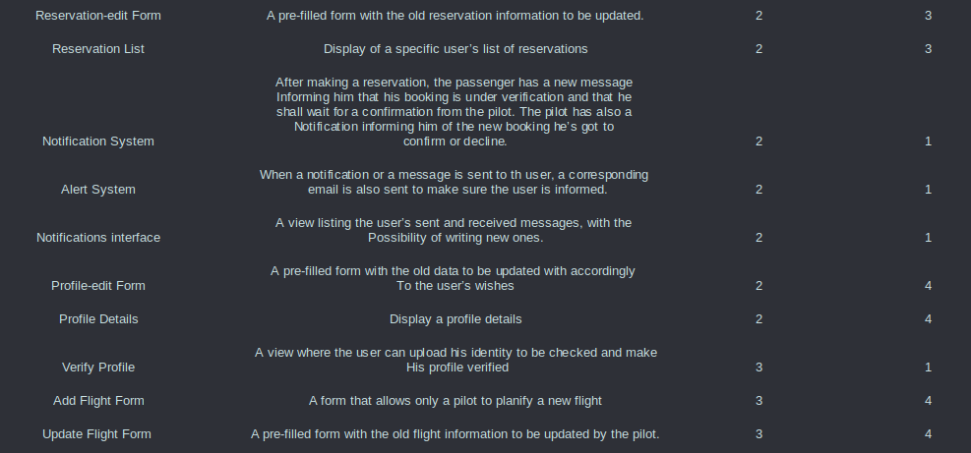
BACKLOG

Slide 42
FIRST CODING STEPS
After making a detailed analysis of the given spec and translating it to a developped list of function, we started coding our main DAO classes and stubs.

Slide 43
GITHUB LINK
https://github.com/andressito/ProjetGLA2019

Slide 44
List of implemented classes
Flight
Plane
FlightDAO
PlaneDAO
Reservation
Reservation
DAO
Message
User
MessageDAO
UserDAO

